Slide 1
Public Key Infrastructure
Slides by Prof. Jonathan Katz.
Lightly edited by me.

Slide 2
Public-key distribution
Alice, pk*
pk
X
Alice, pk
Alice, pk*
Alice, pk
pk, sk

Slide 3
Public-key distribution
pk
Alice, pk
Alice, pk
X
Alice, pk*
pk, sk

Slide 4
Use signatures for secure key distribution!
Assume a trusted party with a public key known to everyone
  CA = certificate authority
  Public key pk_{CA}
  Private key sk_{CA}

Slide 5
Use signatures for secure key distribution!
Alice asks the CA to sign the binding (Alice, pk)
  cert_{CA→Alice} = Sign_{skCA}(Alice, pk)
(CA must verify Alice’s identity out of band)

Slide 6
Use signatures for secure key distribution!
Bob obtains Alice, pk, and the certificate cert_{CA→Alice} …
  … check that Vrfy_{pKCA}((Alice, pk), cert_{CA→Alice}) = 1
Bob is then assured that pk is Alice’s public key
  As long as the CA is trustworthy…
    Honest, and properly verifies Alice’s identity
  …and the CA’s private key has not been compromised

Slide 7
Chicken-and-egg problem?
How does Bob get pk_{CA} in the first place?
Several possibilities…

Slide 8
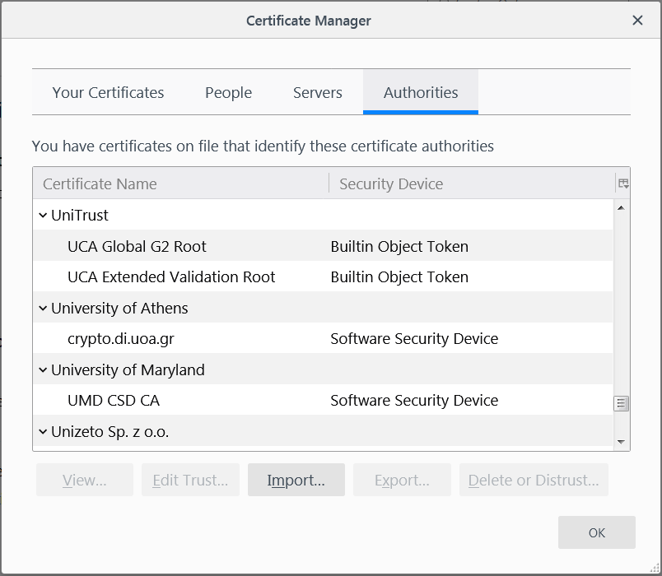
“Roots of trust”
Bob only needs to securely obtain a small number of CA’s public keys
  Need to ensure secure distribution only for these few, initial public keys
E.g., distribute as part of an operating system, or web browser
  Firefox:
  Tools->Options->Privacy & Security->View Certificates->Authorities

Slide 9
“Web of trust”
Obtain public keys in person
  “Key-signing parties”
Obtain “certificates” on your public key from people who know you
If A knows pk_{B}, and B issued a certificate for C, then C can send that certificate to A
  What trust assumptions are being made here?

Slide 10
Public repository
Store certificates in a central repository
  E.g., MIT PGP keyserver
To find Alice’s public key
  Get all public keys for “Alice,” along with certificates on those keys
  Look for a certificate signed by someone you trust whose public key you already have

Slide 11
PKI in practice…
Does not work quite as well as in theory…
  Proliferation of root CAs
    Compromises of CAs
  Revocation
  Users/browsers may not verify certificates

