Slide 1
SSL / TLS
Slides by Prof. Jonathan Katz. Lightly edited by me.

Slide 2
SSL/TLS
How can you securely send your credit card number to Amazon?
SSL/TLS
Secure Socket Layer (Netscape, mid-’90s)
Transport Layer Security
TLS 1.0 (1999)
TLS 1.2 (2008)
TLS 1.3 (2018)
Used by every web browser for https connections

Slide 3
SSL/TLS
Goals
Understand (at a high level) a real-world crypto protocol
Pull together everything learned in this course
Not goals
Understanding low-level details/implementation
Defining or proving security

Slide 4
SSL/TLS
Two phases
Handshake protocol
Establish a shared key between two entities
Record-layer protocol
Use the shared key for secure communication

Slide 5
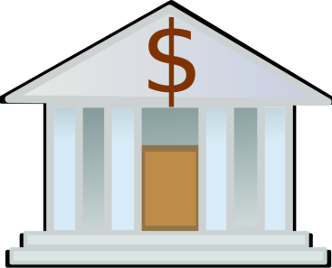
Handshake protocol
https://bank.com, N_{C}
pk, cert, N_{B}
Verify!
c =Enc_{pk}(pmk)
pk_{CA}
sk, pk, cert_{CA→Bank}
mk = H(pmk, N_{C}, N_{B})
k_{C}, k’_{C}, k_{S}, k’_{S} = G(mk)
Mac_{mk}(transcript)
pmk = Dec_{sk}(c)
mk = H(pmk, N_{C}, N_{B})
k_{C}, k’_{C}, k_{S}, k’_{S} = G(mk)
Verify!
Mac_{mk}(transcript’)
Verify!

Slide 6
Record-layer protocol
Parties now share k_{C}, k’_{C}, k_{S}, k’_{S}
Client uses k_{C}, k’_{C} to encrypt/authenticate all messages it sends
Server uses k_{S}, k’_{S} to encrypt/authenticate all messages it sends
Prevents reflection attacks
Sequence numbers prevent replay attacks

