Slide 1
ISA 562
Information Security, Theory and Practice.
Lecture 10: Malware
Slides from Goodrich and Tamassia
(unless otherwise credited.)

Slide 2
Logic Bombs
A logic bomb is a program that performs a malicious action as a result of a certain logic condition.
In 1982, the CIA learned that Moscow was going to steal software for use in handling a new gas pipeline to Western Europe.
The CIA inserted code that would set pump speeds and valve pressures that were far too high.
Resulted in the largest non-nuclear explosion ever seen from space.

Slide 3
Viruses, Worms, Trojans, Rootkits
Malware can be classified into several categories, depending on propagation and concealment
Propagation
  Virus: human-assisted propagation (e.g., open email attachment)
    Injects code into existing program code.
  Worm: automatic propagation without human assistance.
    Standalone piece of code.
Concealment
  Rootkit: modifies operating system to hide its existence
  Trojan: provides desirable functionality but hides malicious operation
Various types of payloads, ranging from annoyance to crime
Notes:
Name derives from the wooden horse left by the Greeks at the gates of Troy during the siege of Troy
A Trojan horse program intentionally hides malicious activity while pretending to be something else
Usually described as innocuous looking, or software delivered through innocuous means which either allows to take control of systems
Trojan horse programs do not replicate themselves
Sometimes passed on using commonly passed executables, things like jokes forwarded by e-mail
Sometimes marketed/distributed as “remote administration tool”
Often combined with rootkits to disguise activity and remote access
Popularized to an extent by software like Cult of the Dead Cow’s Back Orifice, offered as a free download for running “remote administration” tasks or playing spooky jokes on friends
The line between user-launched worms and Trojans is highly blurred, with many user-launched worms behaving in a manner similar to worms.
Trojans are by definition malicious. The classic movie/television exploit of remotely opening disk drives is a definite symptom of being infected by a Trojan.
Have lately begun using much of the same defense mechanisms used by viruses, there are known Trojans which use WSH to run.
To detect infected computers, attackers often use so called sweep lists, list of IP addresses known to be online. One of the popular ways of doing this is to monitor IRC chat rooms and use the IP addresses of participants in these rooms.
Payload examples
perform amusing or annoying pranks
destroy/corrupt files and applications
monitor and transmit user activity (spyware, logger)
install backdoor (makes the infected computer a zombie)
email spam
launch denial-of-service attack
alter browser settings to display ads
dial out international or 900 numbers (dialer)

Slide 4
Computer Worms
A computer worm is a malware program that spreads copies of itself without the need to inject itself in other programs, and usually without human interaction.
Thus, computer worms are technically not computer viruses (since they don’t infect other programs), but some people nevertheless confuse the terms, since both spread by self-replication.
In most cases, a computer worm will carry a malicious payload, such as deleting files or installing a backdoor.

Slide 5
Early History
First worms built in the labs of John Shock and Jon Hepps at Xerox PARC in the early 80s
CHRISTMA EXEC written in REXX, released in December 1987, and targeting IBM VM/CMS systems was the first worm to use e-mail service
The first internet worm was the Morris Worm, written by Cornell student Robert Tappan Morris and released on November 2, 1988
Notes:
Much of the macro classification carries over from viruses, worms based on macro capabilities of programs are programmed in much the same way as viruses, with minor differences
Primary classification has often been based on a worm relying on e-mail or IRC, ICQ, AIM.
Through much of the mid-90s IRC was a popular target, and worms were often combined with Trojans to allow for remotely controlling systems
Examples include IRC.Worm.Ceyda and IRC.Worm.Whacked, the later of which is also a Trojan
Simultaneously with a growth in instant messaging, popular IM clients have been targeted by worms
There are known worms targeting AIM (W32.AimVen.Worm), MSN (W32.Kelvir and variants), ICQ (W32.Bizex), Yahoo Messenger (W32.Hawawi) and pretty much every other popular IM network
P2P networks have been targeted of late, with W32.Hawawi and others spreading through Kazza
E-mail, exploited indirectly by the Morris Worm continues to be a popular propagation method, with worms like W97M.Melissa, and W32.Navidad relying on MAPI to provide them with an easy way to e-mail themselves out.

Slide 6
Worm Development
Identify vulnerability still unpatched
Write code for
  Exploit of vulnerability
  Generation of target list
    Random hosts on the internet
    Hosts on LAN
    Divide-and-conquer
  Installation and execution of payload
  Querying/reporting if a host is infected
Initial deployment on botnet
Worm template
  Generate target list
  For each host on target list
    Check if infected
    Check if vulnerable
    Infect
    Recur
Distributed graph search algorithm
  Forward edges: infection
  Back edges: already infected or not vulnerable

Slide 7


Worm Propagation
Worms propagate by finding and infecting vulnerable hosts.
  They need a way to tell if a host is vulnerable
  They need a way to tell if a host is already infected.
initial infection

Slide 8
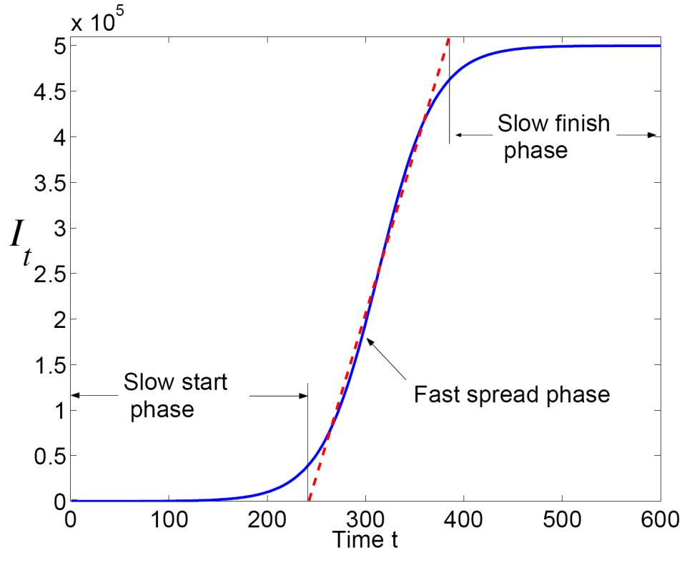
Propagation: Theory
Classic epidemic model
  N: total number of vulnerable hosts
  I(t): number of infected hosts at time t
  S(t): number of susceptible hosts at time t
  I(t) + S(t) = N
  β: infection rate
Differential equation for I(t):
dI/dt = βI(t) S(t)
More accurate models adjust propagation rate over time
Source:
Cliff C. Zou, Weibo Gong, Don Towsley, and Lixin Gao. The Monitoring and Early Detection of Internet Worms, IEEE/ACM Transactions on Networking, 2005.

Slide 9
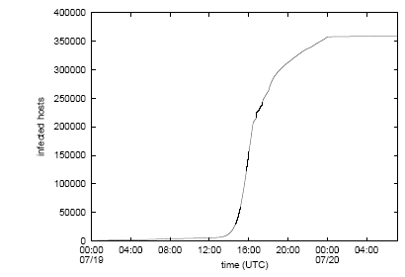
Propagation: Practice
Cumulative total of unique IP addresses infected by the first outbreak of Code-RedI v2 on July 19-20, 2001
Source:
David Moore, Colleen Shannon, and Jeffery Brown. Code-Red: a case study on the spread and victims of an Internet worm, CAIDA, 2002

Slide 10
Rootkits
A rootkit modifies the operating system to hide its existence
  E.g., modifies file system exploration utilities
  Hard to detect using software that relies on the OS itself
RootkitRevealer
  By Bryce Cogswell and Mark Russinovich (Sysinternals)
  Two scans of file system
  High-level scan using the Windows API
  Raw scan using disk access methods
  Discrepancy reveals presence of rootkit
  Could be defeated by rootkit that intercepts and modifies results of raw scan operations

Slide 11
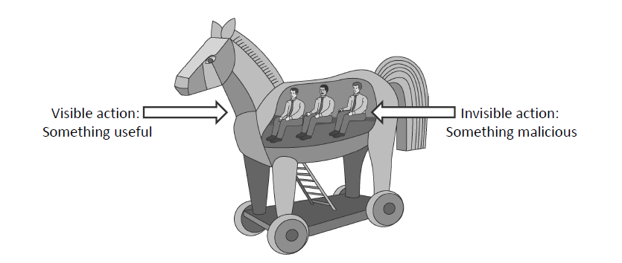
Trojan Horses
A Trojan horse (or Trojan) is a malware program that appears to perform some useful task, but which also does something with negative consequences (e.g., launches a keylogger).
Trojan horses can be installed as part of the payload of other malware but are often installed by a user or administrator, either deliberately or accidentally.

Slide 12
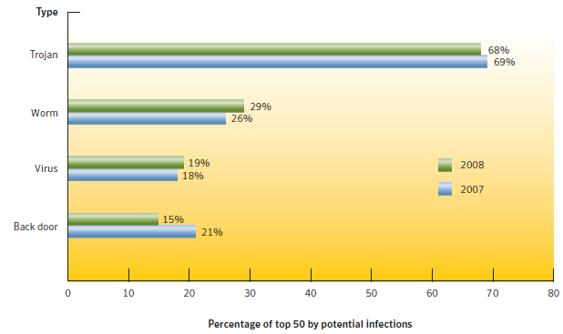
Current Trends
Trojans currently have largest infection potential
  Often exploit browser vulnerabilities
  Typically used to download other malware in multi-stage attacks
Source:
Symantec Internet Security Threat Report, April 2009

Slide 13
Spyware
Spyware software payload
Computer user
1. Spyware engine infects
a user’s computer.
2. Spyware process collects
keystrokes, passwords,
and screen captures.
3. Spyware process
periodically sends
collected data to
spyware data collection
agent.
Spyware data collection agent

Slide 14
Stuxnet
Worm that manipulated Siemens systems for controlling and monitoring centrifuge speeds.
Iran’s centrifuge system was air gapped.
  Had to infect USB drives that would be carried in.
  Then spread locally using other vulnerabilities.
Once in the network, it continues spreading, but searches for Siemens Step7 software.
Infected 200,000 machines. Ruined 1000 centrifuges.

Slide 15
Stuxnet
Exploited 4 “zero-day” vulnerabilities.
  LNK windows shortcuts, to spread via USB sticks.
  Windows print-spooler vulnerability.
  2 others for escalating privileges.
It had a P2P component for updating itself.
  2 infected hosts would compare their versions with each other, and the older would update.

Slide 16
Stuxnet
Once Siemens Step7 is found, the virus installs a rootkit.
  Sends unexpected commands to the logic controller, frequently changing motor speed.
  Sends normal operations system values to the user, and hides the behavior from monitoring.
  First publically known rootkit for a PLC.
The code was signed using 2 stolen keys from well known companies in Taiwan.
  Verisign has since revoked those keys.

Slide 17
Wannacry
Spread using the “eternalblue” vulnerability in Windows’ Server Message Block protocol.
  SMB is used to allow shared access to files, printers, serial ports, and inter-process comm.
  0-day discovered by the NSA and kept.
After it lands, it tries to connect to 3 URLs that look like this:
  www[.]iuqerfsodp9ifjaposdfjhgosurijfaewrwergwea[.]com
  If it succeeds, it halts!
  Not “proxy aware”, so even a local DNS server can reply with an A record. If the IP establishes a TCP 80 connection, the attack halts.
  Why did they do this? Possibly to detect sandboxing: virus hunters often fake the replies. This would detect “foul play” and stop the virus.
Creates a Windows service that looks for other SMB vulnerabilities so it can spread.

Slide 18
Wannacry
It encrypts anything with the following extensions.
.123, .jpeg , .rb , .602 , .jpg , .rtf , .doc , .js , .sch , .3dm , .jsp , .sh , .3ds , .key , .sldm , .3g2 , .lay , .sldm , .3gp , .lay6 , .sldx , .7z , .ldf , .slk , .accdb , .m3u , .sln , .aes , .m4u , .snt , .ai , .max , .sql , .ARC , .mdb , .sqlite3 , .asc , .mdf , .sqlitedb , .asf , .mid , .stc , .asm , .mkv , .std , .asp , .mml , .sti , .avi , .mov , .stw , .backup , .mp3 , .suo , .bak , .mp4 , .svg , .bat , .mpeg , .swf , .bmp , .mpg , .sxc , .brd , .msg , .sxd , .bz2 , .myd , .sxi , .c , .myi , .sxm , .cgm , .nef , .sxw , .class , .odb , .tar , .cmd , .odg , .tbk , .cpp , .odp , .tgz , .crt , .ods , .tif , .cs , .odt , .tiff , .csr , .onetoc2 , .txt , .csv , .ost , .uop , .db , .otg , .uot , .dbf , .otp , .vb , .dch , .ots , .vbs , .der" , .ott , .vcd , .dif , .p12 , .vdi , .dip , .PAQ , .vmdk , .djvu , .pas , .vmx , .docb , .pdf , .vob , .docm , .pem , .vsd , .docx , .pfx , .vsdx , .dot , .php , .wav , .dotm , .pl , .wb2 , .dotx , .png , .wk1 , .dwg , .pot , .wks , .edb , .potm , .wma , .eml , .potx , .wmv , .fla , .ppam , .xlc , .flv , .pps , .xlm , .frm , .ppsm , .xls , .gif , .ppsx , .xlsb , .gpg , .ppt , .xlsm , .gz , .pptm , .xlsx , .h , .pptx , .xlt , .hwp , .ps1 , .xltm , .ibd , .psd , .xltx , .iso , .pst , .xlw , .jar , .rar , .zip , .java , .raw.

Slide 19
Wannacry
Spread to 230,000 machines.
Earned $150,000, all money is withdrawn.
  Tried to use a unique bitcoin wallet for each victim, but a bug caused them to default to 1 of 4.
    Easy to track, and, hard for them to know who paid!
    No automation in checking for payment / sending key.
  Later released a new version with a fix. Too late.
  In contrast, Angler exploit kit is credited with $60Mil. from ransomware.

Slide 20
Wannacry
FedEx halted deliveries with a European subsidiary, claiming $300M in losses.
Hospitals in 3 countries had to turn patients away.
Some auto-manufacturers halted production.

Slide 21
Wannacry: crypto
Can’t use attacker’s public key to encrypt everything. Reveal the secret key only once!
Instead: Victim generates a new public key pair.
Because Public key encryption is slow:
Generates a new AES key for every file.
Encrypts the AES key using the local public key.
Encrypts the local private key using the attacker’s public key.
  Later, when attempting to recover, can send the encrypted private key to the attacker for decryption.

Slide 22
Wannacry: crypto
Can’t use attacker’s public key to encrypt everything. Reveal the secret key only once!
Instead: Victim generates a new public key pair.
A bug in MSFT key generation algorithm gave some people a way to recover the secret key:
Although MSFT provides an API for wiping the secret key after keygen, they fail to wipe the prime numbers used to generate the key!
Wannakey and wannawiki allowed some victims to recover the secret key and decrypt their files.

Slide 23
Shadow Brokers
Tailored Access Operations: NSA hacking group that found the SMB vulnerability, and likely the 4 vulnerabilities in Stuxnet.
  “They had operational insight that even most of my fellow operators at T.A.O. did not have,” said Mr. Williams, now with Rendition Infosec, a cybersecurity firm he founded. “I felt like I’d been kicked in the gut. Whoever wrote this either was a well-placed insider or had stolen a lot of operational data.” Nytimes, 11/12/17.

Slide 24
Shadow Brokers
Shadow Brokers leaked a lot of these NSA tools, providing code online for re-use.
  Wannacry was the first to use them.
  EternalRocks was recently found in a honeypot. Uses 7 of the NSA tools, compared with Wannacry’s 2.
They seem to have connections with Russia, but it also seems they might have insiders at the NSA.
Opens obvious ethical questions…

Slide 25
Malware Zombies
Malware can turn a computer in to a zombie, which is a machine that is controlled externally to perform malicious attacks, usually as a part of a botnet.
Botnet Controller (Attacker)
Attack Commands
Botnet:
Attack Actions
Victim

Slide 26
Slide credit:
Tom Ristenpart

Slide 27
Slide credit:
Tom Ristenpart

Slide 28
Slide credit:
Tom Ristenpart

Slide 29
Slide credit:
Tom Ristenpart

Slide 30
Slide credit:
Tom Ristenpart

Slide 31
Slide credit:
Tom Ristenpart

Slide 32
Slide credit:
Tom Ristenpart

Slide 33
Slide credit:
Tom Ristenpart

Slide 34
Mirai Botnet (2016)
First major one to go after Internet of Things.
  100Ks devices that are poorly configured.
Malware simply used 60 common factory default logins, and scanned.
A reboot of the device removes the malware.
Reports of DDOS reaching 620 Gb/s, or 1Tb/s.
10/21/16, attack on Dyn DNS provider impacted access to Netflix, Twitter, Github, Reddit, Airbnb, and others.

Slide 35
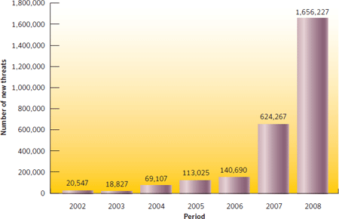
Economics of Malware
New malware threats have grown from 20K to 1.7M in the period 2002-2008
Most of the growth has been from 2006 to 2008
Number of new threats per year appears to be growing an exponential rate.
Source:
Symantec Internet Security Threat Report, April 2009

Slide 36

Professional Malware
Growth in professional cybercrime and online fraud has led to demand for professionally developed malware
New malware is often a custom-designed variations of known exploits, so the malware designer can sell different “products” to his/her customers.
Like every product, professional malware is subject to the laws of supply and demand.
  Recent studies put the price of a software keystroke logger at $23 and a botnet use at $225.
Image by User:SilverStar from http://commons.wikimedia.org/wiki/File:Supply-demand-equilibrium.svg
used by permission under the Creative Commons Attribution ShareAlike 3.0 License

Slide 37
Signatures: A Malware Countermeasure
Scan compare the analyzed object with a database of signatures
A signature is a virus fingerprint
  E.g.,a string with a sequence of instructions specific for each virus
  Different from a digital signature
A file is infected if there is a signature inside its code
  Fast pattern matching techniques to search for signatures
All the signatures together create the malware database that usually is proprietary

Slide 38
Signatures Database
Common Malware Enumeration (CME)
  aims to provide unique, common identifiers to new virus threats
  Hosted by MITRE
  http://cme.mitre.org/data/list.html
Digital Immune System (DIS)
  Create automatically new signatures
Notes:
While not completely standardized, virus naming follows a fairly standard convention
Viruses often have multiple names in standard usage, and names reported often depend on the detection software used.
Commonly used prefixes include:
@m: Worms or viruses propagating by e-mail
@mm: Mass mailer worms or viruses
Dr: Dropper programs
Family: A virus which shares characteristics with other viruses in a family
Gen: Similar to family
Int: An intended virus, a virus which failed
Worm: Sometimes used to indicate worms

Slide 39
Shield vs. On-demand
Shield
  Background process (service/daemon)
  Scans each time a file is touched (open, copy, execute, etc.)
On-demand
  Scan on explicit user request or according to regular schedule
  On a suspicious file, directory, drive, etc.
Performance test of scan techniques
  Comparative: check the number of already known viruses that are found and the time to perform the scan
    Retrospective: test the proactive detection of the scanner for unknown viruses, to verify which vendor uses better heuristics
  Anti-viruses are ranked using both parameters:
  http://www.av-comparatives.org/

Slide 40
Online vs Offline Anti Virus Software
Online
Free browser plug-in
Authentication through third party certificate (i.e. VeriSign)
No shielding
Software and signatures update at each scan
Poorly configurable
Scan needs internet connection
Report collected by the company that offers the service
Offline
Paid annual subscription
Installed on the OS
Software distributed securely by the vendor online or a retailer
System shielding
Scheduled software and signatures updates
Easily configurable
Scan without internet connection
Report collected locally and may be sent to vendor

Slide 41
Quarantine
A suspicious file can be isolated in a folder called quarantine:
  E.g,. if the result of the heuristic analysis is positive and you are waiting for db signatures update
The suspicious file is not deleted but made harmless: the user can decide when to remove it or eventually restore for a false positive
  Interacting with a file in quarantine it is possible only through the antivirus program
The file in quarantine is harmless because it is encrypted
Usually the quarantine technique is proprietary and the details are kept secret

Slide 42
White/Black Listing
Maintain database of cryptographic hashes for
  Operating system files
  Popular applications
  Known infected files
Compute hash of each file
Look up into database
Needs to protect the integrity of the database

Slide 43
Heuristic Analysis
Useful to identify new and “zero day” malware
Code analysis
  Based on the instructions, the antivirus can determine whether or not the program is malicious, i.e., program contains instruction to delete system files,
Execution emulation
  Run code in isolated emulation environment
  Monitor actions that target file takes
  If the actions are harmful, mark as virus
Heuristic methods can trigger false alarms

Slide 44
Static vs. Dynamic Analysis
Static Analysis
Checks the code without trying to execute it
Quick scan in white list
Filtering: scan with different antivirus and check if they return same result with different name
Weeding: remove the correct part of files as junk to better identify the virus
Code analysis: check binary code to understand if it is an executable, e.g., PE
Disassembling: check if the byte code shows something unusual
Dynamic Analysis
Check the execution of codes inside a virtual sandbox
Monitor
  File changes
  Registry changes
  Processes and threads
  Networks ports

