Slide 1
ISA 562
Information Security, Theory and Practice.
Lecture 11: Anonymity and Privacy
Slides by Tom Ristenpart.
(Some edits by Dov Gordon)

Slide 2
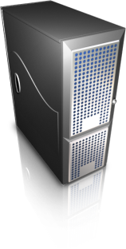
Internet communications
Bank customer
ISP1
ISP2
backbone
Bank
Internet is collection of networks run by organizations
Collection of protocols agreed upon so messages can be passed
from point A to point B
Originated out of ARPANet back in the 1960’s
World Wide Web (Web) is just one application running on top of
Internet (VOIP, regular telephony, email, bittorrent, etc.)

Slide 3
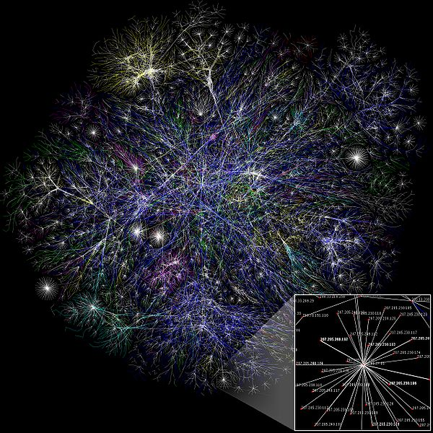
http://en.wikipedia.org/wiki
/File:Internet_map_1024.jpg

Slide 4
263 Internet cables

Slide 5
Surveillance and the Internet Backbone
Verizon
(formerly:
UUNet)
AT&T network
Other major backbone
MAE-West
(Metropolitan Area Exchange,
West)
Large amounts of Internet traffic cross (relatively) few
key points
2011: AT&T has 2365 peers (who it connects to)
Verizon has 1946 peers

Slide 6
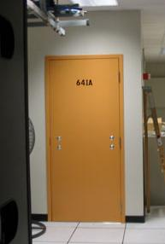
AT&T Wiretap case
Mark Klein discloses potential wiretapping activities by NSA at San Francisco AT&T office
2003 wiretap installed
2004 report by Klein
2006 EFF files lawsuit
Fiber optic splitter on major trunk line for Internet communications
Electronic voice and data communications copied to “secret room”
Narus STA 6400 device

Slide 7
AT&T Wiretap case
Done in 2003, ordered by the executive branch (Pres. G. W. Bush.).
Electronic Frontier Foundation sued AT&T.
Never heard, because in 2008, congress passed the FISA amendment act, which (among other things) granted retroactive immunity to AT&T.
Mining 100s of terabytes of data, including lists of websites visited and phones dialed.

Slide 8
PRISM
NSAs program to collect metadata on Internet communications from 9 Internet providers.
Began in 2007, under supervision of the FISA court.
Court had been ordering Verizon to hand over user’s metadata for phone calls.
Cannot be collected for domestic targets without a warrant.
A lot of foreign traffic comes through the U.S. because of low costs.
Require 51% confidence the target is foreign.
They often accidentally capture domestic traffic.

Slide 9
Surveillance and the Internet Backbone
Interception gear
Verizon
(formerly:
UUNet)
AT&T network
Other major backbone
MAE-West
(Metropolitan Area Exchange,
West)

Slide 10
Internet filtering / surveillance around the world
National Internet
International Internet
Src:
1.2.3.4
Dest:
5.6.7.8
Filtering equipment
Golden Shield Project most famous example
But many other nations perform filtering as well including
Iran, Syria, Pakistan (YouTube anecdote),
Singapore, Australia (proposed legislation)
Other countries?

Slide 11
Golden Shield (Great Firewall)
China’s firewall blocks many foreign companies and news sources, including Google and Facebook.
In addition to censorship, it is an economic tool.
All of these services have Chinese counterparts.
They employee: IP blocking, DNS filtering, URL filtering, packet filtering (DPI)

Slide 12
Islamic Republic of Iran
Every ISP must run “content-control software”
SmartFilter (up until 2009)
Nokia Siemens DPI systems
According to wikipedia: Facebook, Myspace, Twitter, Youtube, Rapidshare, Wordpress, BBC, CNN, all have been filtered
Big Web 2.0 security officer by way of Roger Dingledine (Tor project):
10% (~10k) of traffic via Tor
90% (~90k) of traffic via Amazon-hosted proxies
U.S. Voice of America runs a proxy server for helping Iranians access the Internet.
Contracted to Anonymizer Inc.

Slide 13
2011 BlueCoat in Syria
Blue Coat (now owned by Symantec) makes a secure web gateway.
Device used to scan Internet traffic for threats, data leakage, etc.
Hacktivists found these SWGs being used in Syria.
Against U.S. law!
Press release: “Blue Coat’s review of the data received from the channel partner indicated that certain appliances were transferred illegally to Syria after being lawfully sold to that channel distribution partner for a seemingly appropriate designated end user.”

Slide 14
Understanding the technology
How much data on these lines?
How is it inspected?
Can it be stored and analyzed?

Slide 15
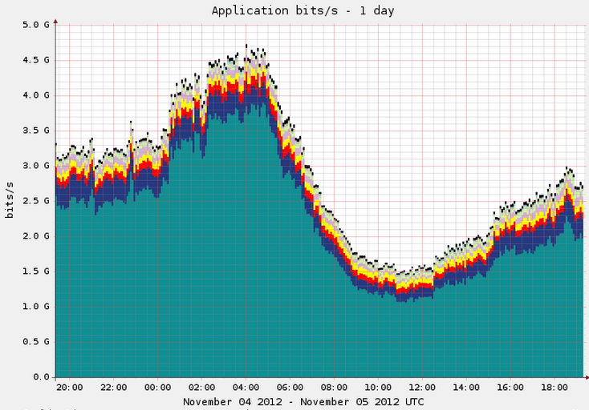
If avg is 3 Gbps
~259,200 Terabits / day
http://www.caida.org/data/realtime/passive/?monitor=equinix-sanjose-dirB

Slide 16
Dragnet versus filtered
Dragnet
Suck down and store everything you see
Challenges: storage and processing
Filtered
Only pull out and store items of interest
Challenges: keeping up with traffic as it flows by, ensuring filters are correct a priori

Slide 17
Processing of stored data
(2008) AT&T
19 petabytes of data every day
1 petabyte = 10¹⁵ bytes
Internet Archive Petabox 4 (2010)
5.8 petabytes storage
Facebook stores 300PB of data, 600PB come in per day. (2014)
2.5 exabytes are produced every day. (Couldn’t verify.)

Slide 18
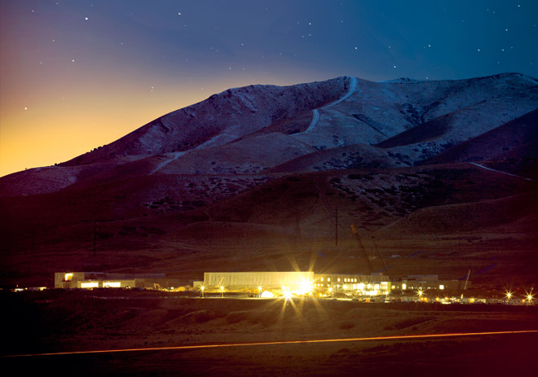
http://www.wired.com/threatlevel/2012/03/ff_nsadatacenter/all/1

Slide 19
Data mining
Once data is collected, real challenge is sorting through it
NSA Total Information Awareness
Data in practice is very noisy
No fly lists example.
Huge, complex topic, lots of active research

Slide 20
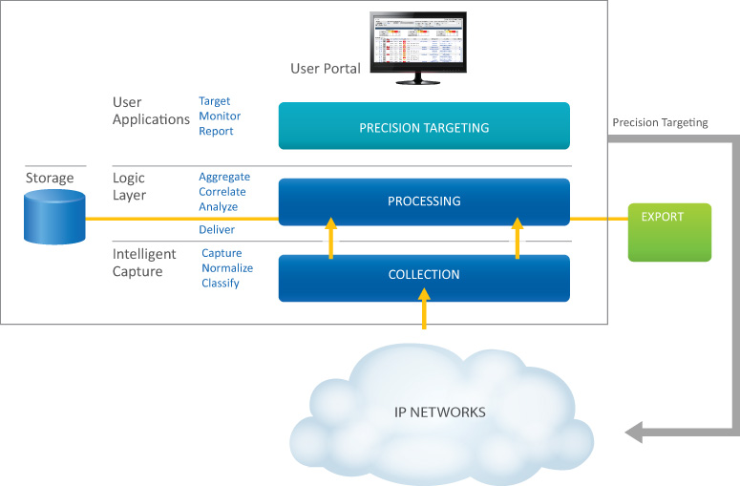
Narus Marketing Materials
http://narus.com/index.php/product/narusinsight-intercept

Slide 21
Internet protocol stack
Application
TCP
IP
Ethernet
A webpage
user data
Application protocol
(e.g., Hyper Text Transport Protocol)
Appl hdr
user data
TCP hdr
Appl hdr
user data
TCP segment
Transmission control
protocol
IP hdr
TCP hdr
Appl hdr
user data
IP datagram
Internet Protocol
46 to 1500 bytes
IP addresses: 128.105.183.25
This identifies to Internet routers where to send traffic

Slide 22
Types of packet inspection
IP datagram
IP header
TCP header
Appl header
user data
Internet service providers
need only look at IP headers
to perform routing
Deep packet inspection (DPI)
analyzes application
headers and data
Shallow packet involves
investigating lower
level headers such as
TCP/UDP

Slide 23
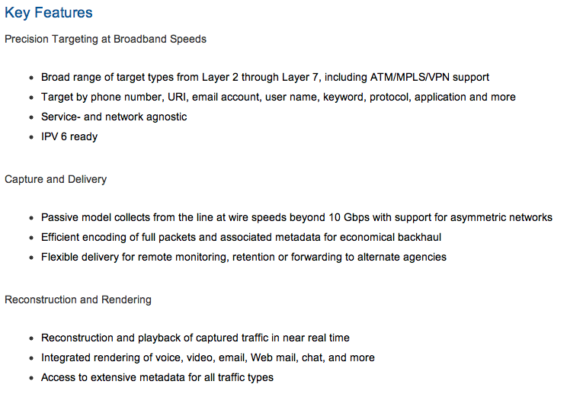
From http://narus.com/index.php/product/narusinsight-intercept

Slide 24
Lawful intercept
CALEA
Communications Assistance for Law Enforcement Act (1995)
FISA
Foreign Intelligence Surveillance Act (1978)
Demark boundaries of domestic vs. foreign intelligence gathering
Foreign Intelligence Surveillance Court (FISC) provides warrant oversite
Executive order by President Bush suspend need for NSA to get warrants from FISC
Almost all national governments mandate some kind of lawful intercept capabilities

Slide 25
Lots of companies
Narus (originally Israeli company), now owned by Boeing
Pen-Link (http://www.penlink.com/)
Nokia, Nokia Siemens
Cisco
…

Slide 26
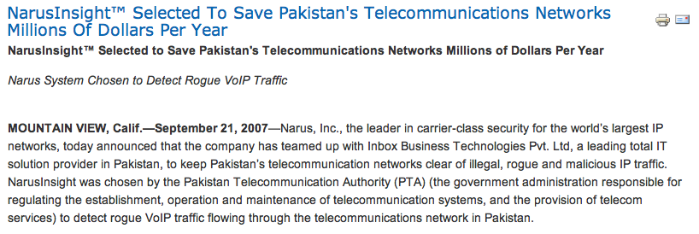
http://www.narus.com/index.php/news/
279-narusinsight-selected-to-save-pakistans-
telecommunications-networks-millions-of-dollars-per-year

Slide 27
Countermeasures?
Interception gear
Other major backbone
AT&T network
Other major backbone
MAE-West
(Metropolitan Area Exchange,
West)

Slide 28


Cryptography: “Hidden writing”
Study and practice of building security protocols that resist adversarial behavior
Blend of mathematics, computer science
Encryption:
Encrypt
Decrypt
Interception gear

Slide 29
Preventing intercept
End-to-end encryption (HTTPS, SSH)
What does this protect?
What does it leak?
Interception gear
Other major backbone
IP:
1.2.3.4
AT&T network
IP:
5.6.7.8

Slide 30
Hiding connectivity is harder
IP addresses are required to route communication, yet not encrypted by normal end-to-end encryption
1.2.3.4 talked to 5.6.7.8 over HTTPs
Anonymity tools can help

Slide 31
Anonymization systems
Single-hop proxy services
JonDonym, anoymous remailers (MixMaster, MixMinion), many more…
Anonymizer.com

Slide 32
Tor (The Onion Router)
Interception gear
Other major backbone
IP:
1.2.3.4
AT&T network
IP:
5.6.7.8
Other major backbone
Tor Node
Tor Node
Tor Node
7.8.9.1
9.1.1.2
8.9.1.1

Slide 33

IP:
1.2.3.4
7.8.9.1
8.9.1.1
9.1.1.2
IP:
5.6.7.8
Onion routing: the basic idea
Src:
9.1.1.2
Dest:
5.6.7.8
HTTP packet
Src:
8.9.1.1
Dest:
9.1.1.2
Encrypted to 9.1.1.2
Src:
7.8.9.1
Dest:
8.9.1.1
Encrypted to 8.9.1.1
Src:
1.2.3.4
Dest:
7.8.9.1
Encrypted to 7.8.9.1
Tor implements more complex version of this basic idea

Slide 34
Tor Guards
Tor keeps a centralized list of available relays that can be used for forming these “circuits”.
The list is public. Circuit choice is automated by default, but users may specify their relays.
They can choose circuits with key properties, such as the exit node should not be in my country.
The first hop on your circuit is called a guard.
If a repressive government knows the list, they can block connections to all guards!
Tor bridges are a special set of guards that are not publicized. Users can manually specify the IP of a bridge to avoid censorship.

Slide 35
Tor hidden services
Tor allows users to browse to public sites.
What if a user wants to browse to a site that itself remains anonymous?
Example: suppose I want to hand you a file, and we both are worried about surveillance?

Slide 36
Slide credit: Roger Dingledine

Slide 37
Slide credit: Roger Dingledine

Slide 38
Slide credit: Roger Dingledine

Slide 39
Slide credit: Roger Dingledine

Slide 40
Slide credit: Roger Dingledine

Slide 41
Slide credit: Roger Dingledine

Slide 42
Tor hidden services
2 examples of popular services:
SecureDrop: leave tips for journalists.
Facebook!
Aside from providing anonymity, there are practical reasons to run these as services.
Protect your users: make sure they run Tor.
Differentiate anonymous traffic from bad traffic with different procedures.
No need for an exit relay!
Exits are always getting blocked and harassed for bad traffic.
As a result, even with 6 relays instead of 3, this is faster.

Slide 43
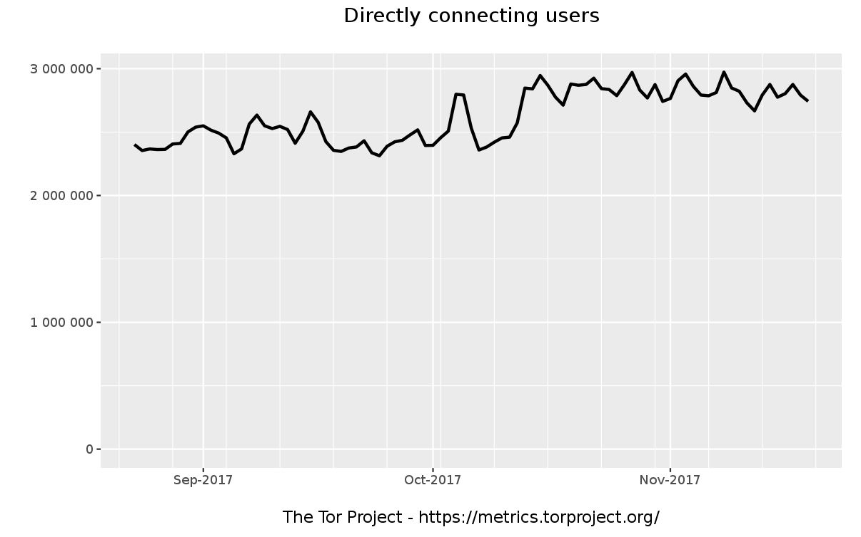

Slide 45
Arab Spring

Slide 47
Data Privacy

Slide 48


Live connections aren’t only place surveillance is possible on Internet

Slide 49
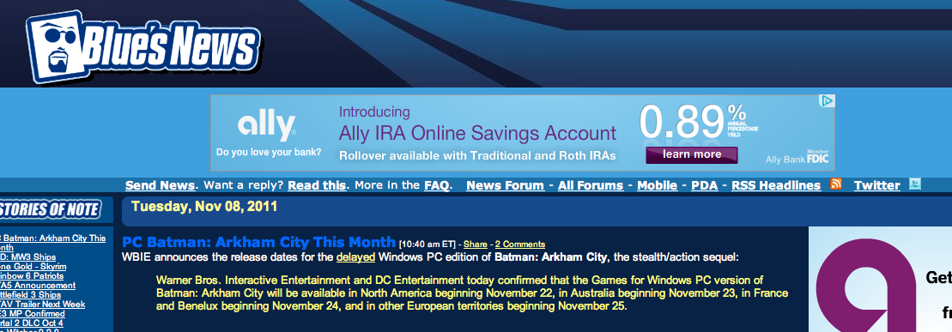
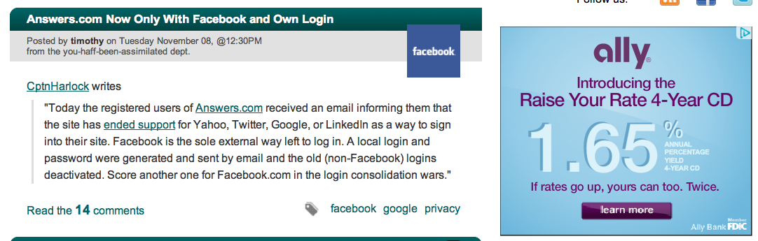

Slide 50

Data collection takes on many forms
In addition to ads based on interest categories, Google allows advertisers (including Google) to show you ads based on your previous interactions online, such as visits to advertisers’ websites. For example, someone who visited the website of an online sporting goods store can receive ads about special offers from that store.
--- http://www.google.com/privacy/ads/
Tor alone will not prevent such tracking …

Slide 51
Surveillance via third-party
“Some Supreme Court cases have held that you have no reasonable expectation of privacy in information you have "knowingly exposed" to a third party — for example, bank records or records of telephone numbers you have dialed — even if you intended for that third party to keep the information secret. In other words, by engaging in transactions with your bank or communicating phone numbers to your phone company for the purpose of connecting a call, you’ve "assumed the risk" that they will share that information with the government.”
From the EFF website
https://ssd.eff.org/your-computer/govt/privacy

Slide 52
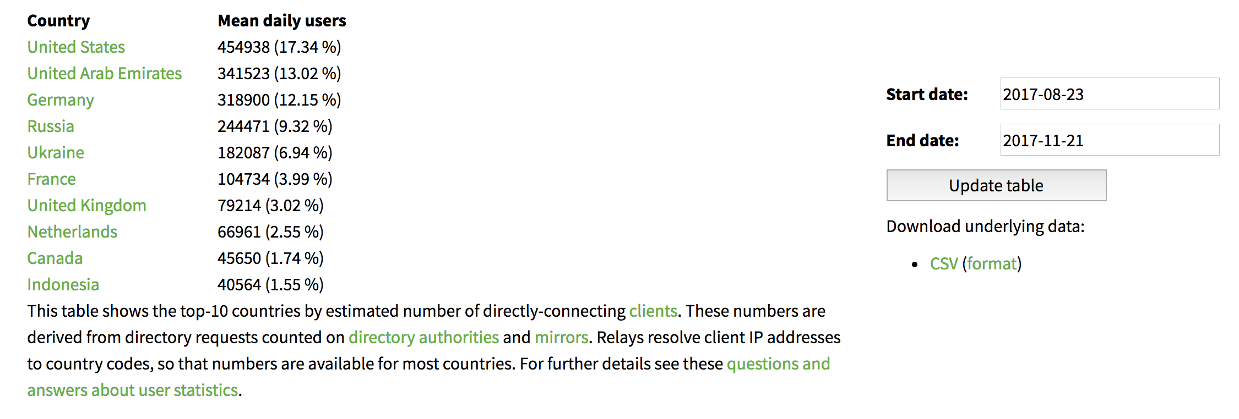
It’s not only about censorship!

Slide 53
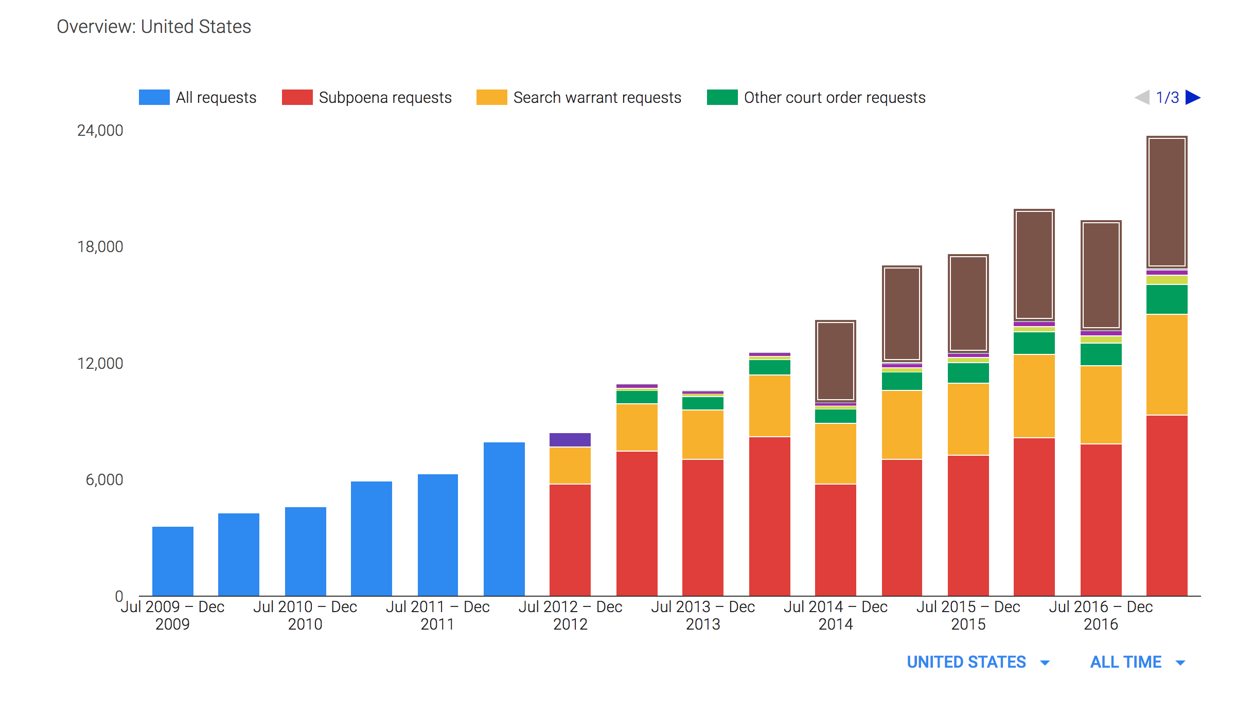
Google’s data requests

Slide 54
A changing alliance?
After PRISM was made public, Apple decided to user stronger security that could make it impossible to help federal agencies.
Users have the option of setting a PIN, and forcing a clean wipe after 10 attempts.
This is built into the OS!
What about bypassing the OS?
After entering Device Firmware Upgrade mode, the phone checks that it’s state is signed by Apple.

Slide 55
A changing alliance?
FBI ordered Apple to design and sign new software that would allow them to bypass the 10 attempt limit.
They wanted access to the phone of the shooter in the San Bernardino mass-killing.
Apple refused, and they went to court.
Before the case was heard, the FBI announced that a 3rd party helped them gain access.
It wasn’t the NSA! They said they couldn’t do it.

Slide 56
ISA 562
Information Security, Theory and Practice.
Lecture 11: Anonymity and Privacy
Slides borrow material from:
The Algorithmic Foundations of Differential Privacy by Dwork and Roth.

Slide 57
Data Privacy: is it a concern?
We have a lot of good reasons to share data.
We share it in exchange for personal services:
Tell google your location, they’ll find you a gas station.
Tell amazon what you’re shopping for, they’ll find you recommendations.
We benefit from allowing it to be aggregated:
Let medical researchers study your records.
Let the census understand changing needs in infrastructure.
We “sell it” so we can connect with friends and family.

Slide 58
Data Privacy: a growing concern?
The notion of a “right to privacy” is fairly new!
Louis Brandeis coined the phrase in a law review article. He was concerned about new cameras.
Even then, people loved postcards and “party lines”.
Should we worry about our data?
Should we worry about what companies will do with our data?
Should we worry about what governments will do with our data?

Slide 59
Data Sanitization: the wrong way
People often assume that if names and IDs are removed, the data remains private.
Many counterexamples show this to be false!
1997 the governor of Massachusetts had his medical record “re-identified”.
Used voter registration information, together withGender, DOB and zipcode.
Netflix challenge
Correlate with IMDB, and identify all movies ever rented by a user. (Even if user ranked few movies there!)

Slide 60
Data Sanitization: the wrong way
What if we only allow “reasonable” queries to the data? E.g. count queries that return large numbers?
Suppose we know that I’m in some dataset.
How many people in the dataset have gene mutation X?
How many people not named “Dov” have gene mutation X?
Summary statistics are not safe!

Slide 61
Data Privacy: add noise
It doesn’t suffice to remove sensitive fields.
It is hard to know what queries are safe.
What about adding some noise to the remaining fields?
This works!
Introduces a tradeoff between privacy and utility.

Slide 62
Data Privacy: an example
Everyone flip a coin, write down the result.
We will call this coin your “vote”. If it is heads, we will say for the purpose of this exercise that you voted for President Trump.
Everyone flip 2 more coins. Write them down.
Let’s name these, r1 and r2.
I will now take a “noisy” poll to estimate how many people voted for Trump.
If r1 == 1, give me your true vote.
Else if r1 == 0, use r2 as your vote.
Let’s compare with a true poll. Report your true vote.

Slide 63
Google Chrome statistics
Chrome wants to know where you’ve been.
Not to market to you, but to detect which sites have been acting maliciously.
Correlating across users will allow them to discover bad sites.
They do exactly the randomized response, bitwise! [Ref]
You send a random string of bits. They learn nothing about you.
In aggregate, they can figure out where people have been going and which sites lead to bad events.

Slide 64
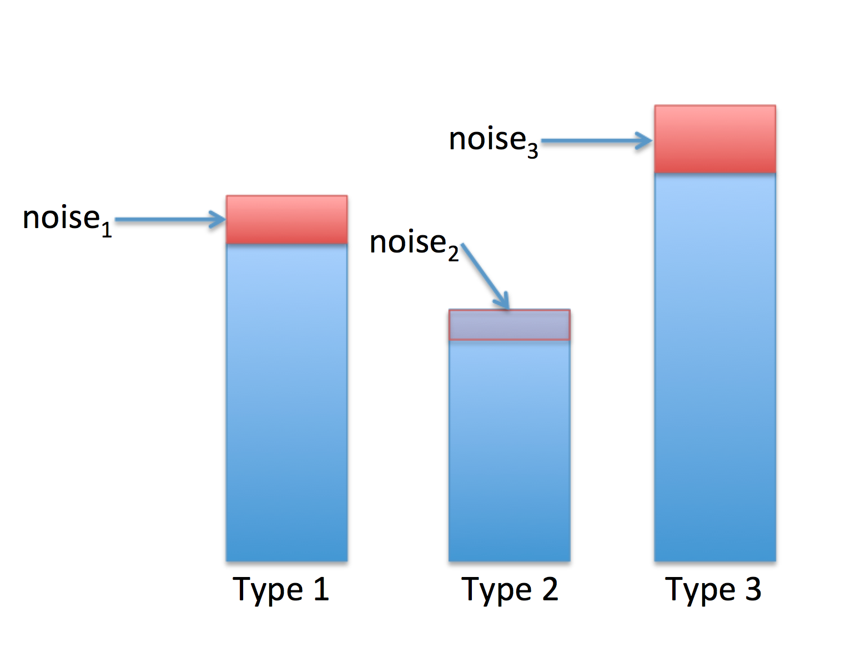
Centralized noise
Computing noisy histograms

Slide 65
Data Privacy: differential privacy
“Differential privacy” describes a promise, made by a data holder, or curator, to a data subject: “You will not be affected, adversely or otherwise, by allowing your data to be used in any study or analysis, no matter what other studies, data sets, or information sources, are available.”

Slide 66
Differential Privacy
Release statistics about a dataset.
Preserve the privacy of any single contributor.
Definition: We say a function f preserves (ε,δ)-differential privacy if for any 2 neighboring databases, D₁ and D₂, and any D in the range of f,
Pr[f(D₁) = D] = e^{ε}Pr[f(D₂) = D] + δ

Slide 67
Differential privacy
Consider the histogram example.
Suppose the adversary knows everything about the dataset, except for my input.
He still learns very little about my input!
Sure, I might have been type 1, but that additional value might have been noise.
Any of the values is still possible! The statistical likelihood that I contributed some particular value is mostly unchanged by the adversary’s view.

Slide 68
Data privacy: smoking example
Say I volunteer some medical information to a study on the impacts of smoking.
The study reveals that smokers are high risk.
My insurance rate goes up.
Was I negatively (or positively) impacted?
The view according to differential privacy is no!
The outcome of the study impacts me, but the outcome would be the same with or without my single data point.

Slide 69
Differential privacy in practice
We saw that Google chrome is using it.
Apple is using it for iPhones.
Opt-in. Helps with keyboard predictions, emoji suggestions, detecting bad sites…
The united states census is going to use it in 2020 in place of their prior mechanism.

Slide 70
Secure computation
Secure computation is a related, but separate tool for providing data privacy.
Differential privacy gives a mechanism for releasing data that others can compute upon.
Secure computation gives a mechanism for jointly computing on data, without ever releasing it at all!

Slide 71
What is Secure Computation
Two or more parties want to perform a computation.
None wants to entrust their data to anybody else.
Nobody learns anything other than the output.
X
Y
F(X,Y)
F
F(X,Y)

Slide 72
Secure Computation
What is Secure Computation
Send inputs to SC
x
y

Slide 73
What is Secure Computation
Secure Computation
F(x, y)
Compute the result
Send back the result
F(x, y)
F(x, y)
y ??
x ??

Slide 74
Applications
Satellite Collision Avoidance
Private Machine Learning
Location Based Services
Set Intersection
Encrypted Database Search
Secure Auctions
Tor statistics

