Slide 1
ISA 562
Information Security, Theory and Practice.
Lecture 9: Buffer Overflows
Slides from Goodrich and Tamassia

Slide 2
Buffer Overflow Attacks

Slide 3
What is an Exploit?
An exploit is any input (i.e., a piece of software, an argument string, or sequence of commands) that takes advantage of a bug, glitch or vulnerability in order to cause an attack
An attack is an unintended or unanticipated behavior that occurs on computer software, hardware, or something electronic and that brings an advantage to the attacker
Notes:
not necessarily a program... while it can be a program that communicates bad input to a vulnerable piece of software, it can also be just the bad input itself... any bad input (or even valid input that the developer just failed to anticipate) can cause the vulnerable application to behave improperly...

Slide 4
Buffer Overflow Attack
One of the most common OS bugs is a buffer overflow
  The developer fails to include code that checks whether an input string fits into its buffer array
  An input to the running process exceeds the length of the buffer
  The input string overwrites a portion of the memory of the process
  Causes the application to behave improperly and unexpectedly
Effect of a buffer overflow
  The process can operate on malicious data or execute malicious code passed in by the attacker
  If the process is executed as root, the malicious code will be executing with root privileges
Notes:
Because of the nature of the address space, locally declared buffers are allocated on the stack
Since the stack grows downward, if you write past the end of the buffer, you can corrupt the content of the rest of the stack, thus, if enough information is known about the program, one could write over known register information and the return address

Slide 5
Address Space
Every program needs to access memory in order to run
For simplicity sake, it would be nice to allow each process (i.e., each executing program) to act as if it owns all of memory
The address space model is used to accomplish this
Each process can allocate space anywhere it wants in memory
Most kernels manage each process’ allocation of memory through the virtual memory model
How the memory is managed is irrelevant to the process
Notes:
This would also be consistent with the process model proposed earlier where each process feels like it “owns” the machine. The size of the address space is machine dependent, until the Intel 386 came around, most address spaces were 16 bit, for most of the past 15 years, we have been sing 32 bit machines, though increasingly larger number of processors with 64 bit modes are making their way into people’s computers.

Slide 6
Virtual Memory
Program Sees
Actual Memory
Another
Program
Hard Drive
Mapping virtual addresses to real addresses

Slide 7
Unix Address Space
High Addresses
0xFFFF FFFF
Text: machine code of the program, compiled from the source code
Data: static program variables initialized in the source code prior to execution
BSS (block started by symbol): static variables that are uninitialized
Heap : data dynamically generated during the execution of a process
Stack: structure that grows downwards and keeps track of the activated method calls, their arguments and local variables
Stack
Heap
BSS
Data
Text
Low Addresses
0x0000 0000

Slide 8
Unix Address Space
Separate processes have separate addr. space
If a parent process forks a child, the child shares the addr. space, until a write occurs. “Copy-on-write.”
Programmers can specify that processes should share certain pages of memory.
  E.g. in Chrome, every tab is its own process, but likely share the same read-only program code.
Within a process, threads share all the same memory space.

Slide 9
Compiled code
Code is compiled from a high-level language into machine instructions.
Statically linked code: all needed libraries (including OS system calls) are copied into the compiled program on disk
  Could be safer.
  Duplicates code.
  Harder to debug.

Slide 10
Compiled code
Code is compiled from a high-level language into machine instructions.
Dynamically linked code:
  The loader determines what is needed at runtime, finds it on disk, imports it into prog. addr. space.
  MSFT: dynamically linking libraries (DLL).
  Unix: shared objects.
  Fix one DLL, no need to recompile everything that uses it.

Slide 11
Arithmetic Overflow
On 32-bit architectures, signed integers are represented using two’s compliment,
  Postive numbers: 0x00000000 through 0x7fffffff
  Negative numbers: 0x80000000 through 0xffffffff
0x7fffffff + 1 = (2³¹-1)+1 = 0x80000000 = -2³¹
Using unsigned integers, (2³²-1) + 1 = 0.

Slide 12
Arithmetic Overflow
Creates bugs! According to Wikipedia:
  Caused Ariane 5 rocket to crash ($370M)
  In 2015, FAA ordered Boeing 787 operators to periodically restart their electrical systems to avoid overflow.
  In August 2016, a casino issued a winning ticket for nearly $43M. (Court ruled with casino.)
  In Donkey Kong, can’t advance past level 22.
  Y2K.

Slide 13
Vulnerabilities and Attack Method
Vulnerability scenarios
  The program has root privileges (setuid) and is launched from a shell
  The program is part of a web application
Typical attack method
  Find vulnerability
  Reverse engineer the program
  Build the exploit

Slide 14
Buffer Overflow Attack in a Nutshell
First described in
  Aleph One. Smashing The Stack For Fun And Profit. e-zine www.Phrack.org #49, 1996
The attacker exploits an unchecked buffer to perform a buffer overflow attack
The ultimate goal for the attacker is getting a shell that allows to execute arbitrary commands with high privileges
Kinds of buffer overflow attacks:
  Heap smashing
  Stack smashing

Slide 15
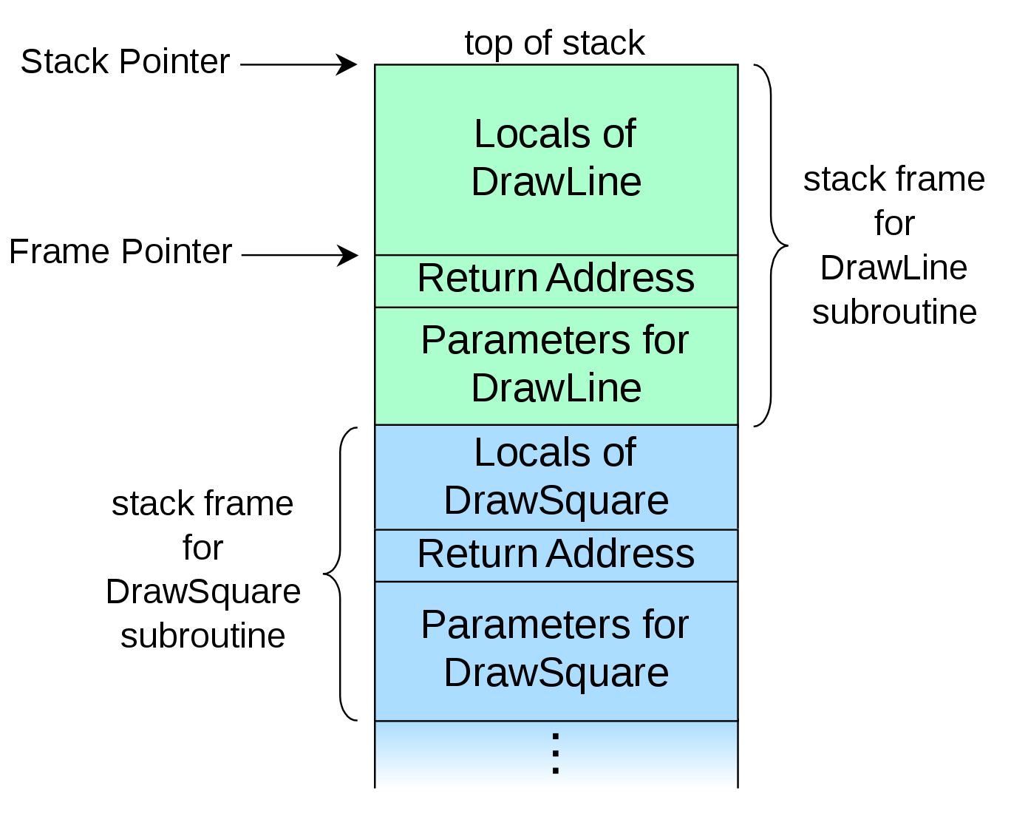
Some Stack Details

Slide 16
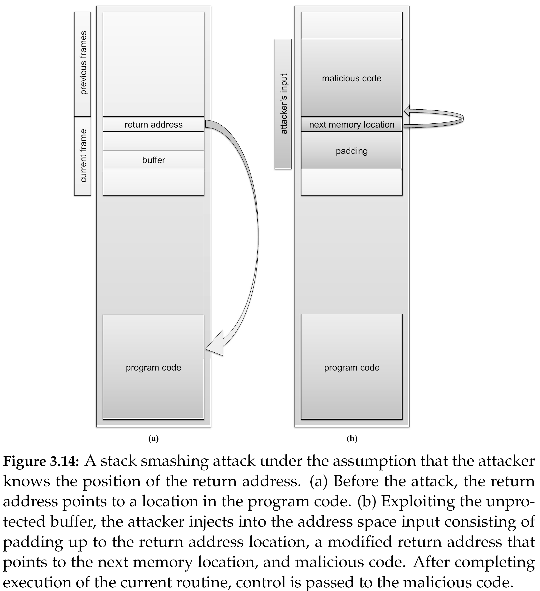

Slide 17
strcpy() vs. strncpy()
Function strcpy() copies the string in the second argument into the first argument
  e.g., strcpy(dest, src)
  If source string > destination string, the overflow characters may occupy the memory space used by other variables
  The null character is appended at the end automatically
Function strncpy() copies the string by specifying the number n of characters to copy
  e.g., strncpy(dest, src, n); dest[n] = ‘\0’
  If source string is longer than the destination string, the overflow characters are discarded automatically
  You have to place the null character manually

Slide 18
Shellcode Injection
An exploit takes control of attacked computer so injects code to “spawn a shell” or “shellcode”
A shellcode is:
  Code assembled in the CPU’s native instruction set (e.g. x86 , x86-64, arm, sparc, risc, etc.)
  Injected as a part of the buffer that is overflowed.
We inject the code directly into the buffer that we send for the attack
A buffer containing shellcode is a “payload”
Notes:
Now comes the question of injecting our own code to be executed. We inject the code directly into the buffer that we send for the attack.

Slide 19
NOP Sledding
What if you don’t know the location of the return address?
  Can just repeat the value: only need to overwrite it once.
What if you don’t know the address of buffer?
  Don’t know the location of the malicious code!
  Even if you knew where the return address resides, you wouldn’t know how to populate it.

Slide 21
Return-to-libc
Until now, we crammed our executable into the buffer and ran our code from the stack.
  Limited space, and stack might not be executable.
Instead,
  find address of dynamically linked system call. E.g. system().
  Overwrite RA with address of system call.
  Overwrite parameters to that call with “/bin/sh”

Slide 22
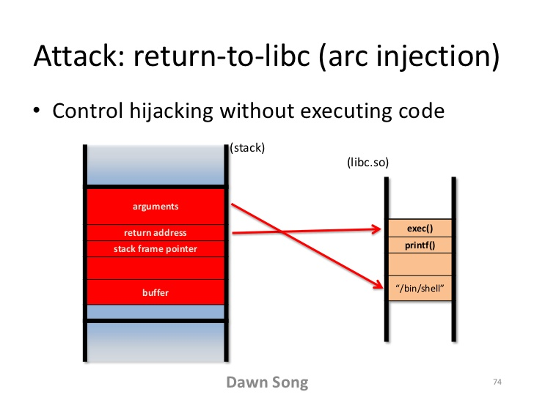
Return-to-libc

Slide 23
Buffer Overflow Mitigation
We know how a buffer overflow happens, but why does it happen?
This problem could not occur in Java; it is a C problem
  In Java, objects are allocated dynamically on the heap (except ints, etc.)
  Also cannot do pointer arithmetic in Java
  In C, however, you can declare things directly on the stack
One solution is to make the buffer dynamically allocated
Another (OS) problem is that fingerd had to run as root
  Just get rid of fingerd’s need for root access (solution eventually used)
  The program needed access to a file that had sensitive information in it
  A new world-readable file was created with the information required by fingerd
Notes:
Why doesn’t get do a bounds check and why does the operating system allow writing beyond the array bounds?
In Java can’t just overwrite the stack because you don’t know where the stack is!
In Java, cannot access memory without direct access, since we lack pointer arithmetic

Slide 24
Buffer Overflow Mitigation
Set the stack space to be non-executable.
  Implemented in most modern OSes.
  Protects against code injection, but not return-to-libc.
Address space layout randomization (ASLR)
  Shared libraries in random spot in addr. space.
  Shift heap up and stack down randomly.
  Isn’t a lot of randomness used. Still guessable.
Notes:
Why doesn’t get do a bounds check and why does the operating system allow writing beyond the array bounds?
In Java can’t just overwrite the stack because you don’t know where the stack is!
In Java, cannot access memory without direct access, since we lack pointer arithmetic

Slide 25
Stack-based buffer overflow detection using a random canary
Normal (safe) stack configuration:
Buffer
Other local variables
Canary (random)
Return address
Other data
Buffer overflow attack attempt:
Buffer
Overflow data
Corrupt return address
Attack code
x
The canary is placed in the stack prior to the return address, so that any attempt to over-write the return address also over-writes the canary.

Slide 26
Heap Overflows
Similar: exploit a failure to verify buffer size.
However, heap isn’t executable, and doesn’t handle control flow.
Instead, exploit the memory management mechanisms.
Malloc

Slide 27
Heap Overflows
Similar: exploit a failure to verify buffer size.
However, heap isn’t executable, and doesn’t handle control flow.
Instead, exploit the memory management mechanisms.
Unlink

Slide 28
Heap Overflows
Similar: exploit a failure to verify buffer size.
However, heap isn’t executable, and doesn’t handle control flow.
Instead, exploit the memory management mechanisms.
Overflow the
Unlink
address

Slide 29
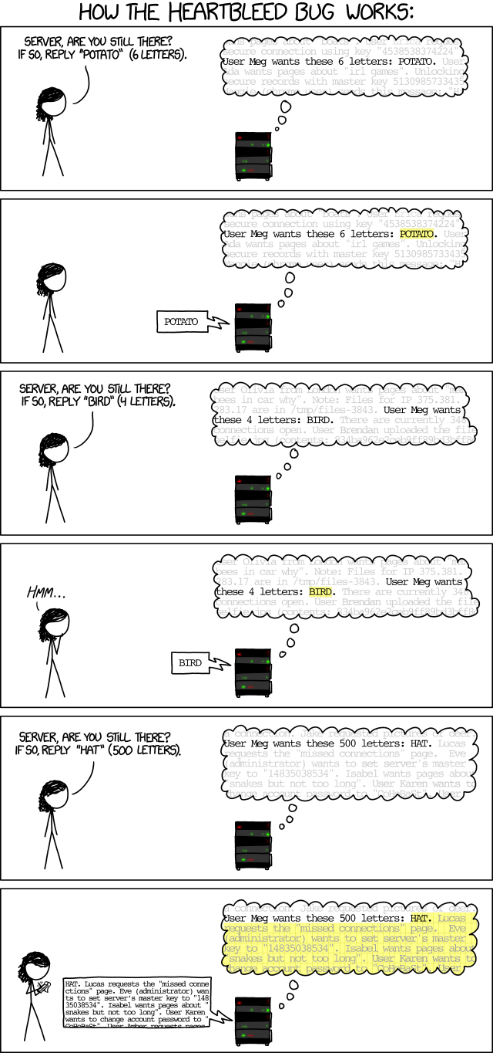

Slide 31
Heartbleed
Estimated 18% of web servers were vulnerable.
There’s evidence it was exploited by a botnet in late 2013.
  Same IPs had been attempting to record conversations on Freenode IRC network.
3 weeks after announcement:
  73% of certificates were not renewed.
  60% of those that were, did not revoke old ones.

