Slide 1
Asking and Answering Questions during a Programming Change Task
Jonathan Sillito, Gail C. Murphy, and Kris De Volder. 2008

Slide 2
Overarching Research Goals
  Discover and record Questions
  Analyze said questions and the process of answers
  Develop Model from findings
A “Grounded Theory” Approach
  Inductively create models from findings
  Do not constrain results from existing cognitive models
Not all questions were recorded
  Not task planning
  Not tool usage
  Questions were code focused

Slide 3
Experimental Lab Study
  Participant pair programming
  Difficult industry-worthy tasks
  Variety of Experience
  More questions/data
Observational Industry Study
  Individual programming
  Fewer questions/data
  Regular work tasks

Slide 4
Results
  44 Different Questions (When details excluded)
  Further Abstracted in terms of Graphs
    “Finding a Focus Point”
    “Expanding Focus Points”
    “Understanding a Subgraph”
    “Questions over groups of subgraphs”
  Examples On Next Slide

Slide 5
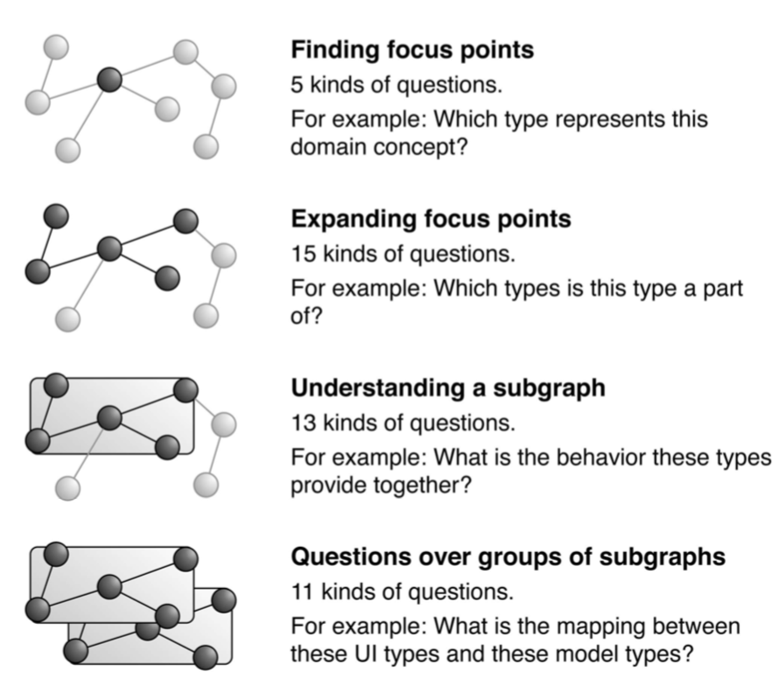
What class controls/contains this feature behavior?
What class does this object extend? What interfaces does it implement?
How is this package supposed to be used and what does it do?
How does functionality in package A get used in package B?

Slide 6
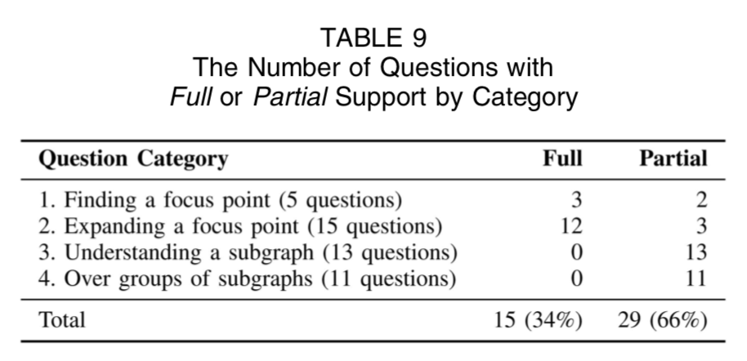
Evaluation of Existing Tools

Slide 7
Evaluation of Existing Tools
Fin

