Slide 1
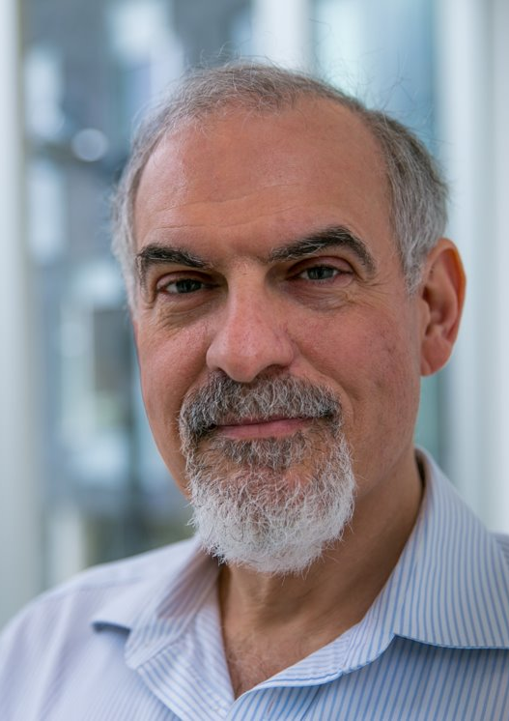
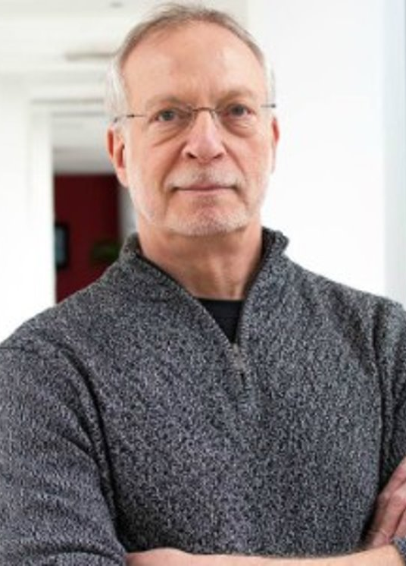
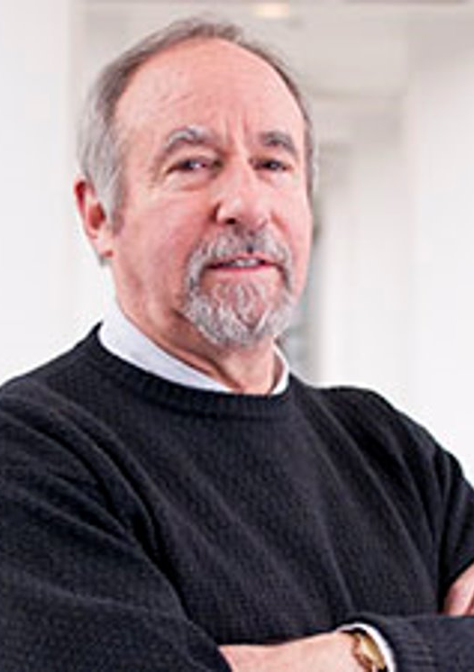
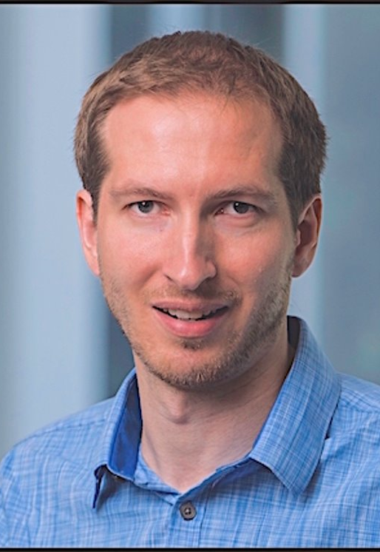
Program Comprehension as Fact Finding.
ESEC/FSE 2007
Brad A. Myers
JAMES D. HERBSLEB
DAVID GARLAN
SUMMARY BY ABDULAZIZ ALABOUDI
SWE 795 FALL 2019
THOMAS D. LATOZA

Slide 2
Problem statement
ESEC/FSE 2007
"Software engineering suggests that developers have a wide variety of knowledge about good design in the form of abstractions such as design patterns [6] and architectural styles [18]. But little is known about this knowledge or how it helps developers work more effectively"
"We conducted a study to understand how developers perform challenging code modification tasks and the effects of experience on this process."
Notes:
Experts possess knowledge about the program they are comprehending, but little is knowing about how this knowledge helped developers to work more effectivly.

Slide 3
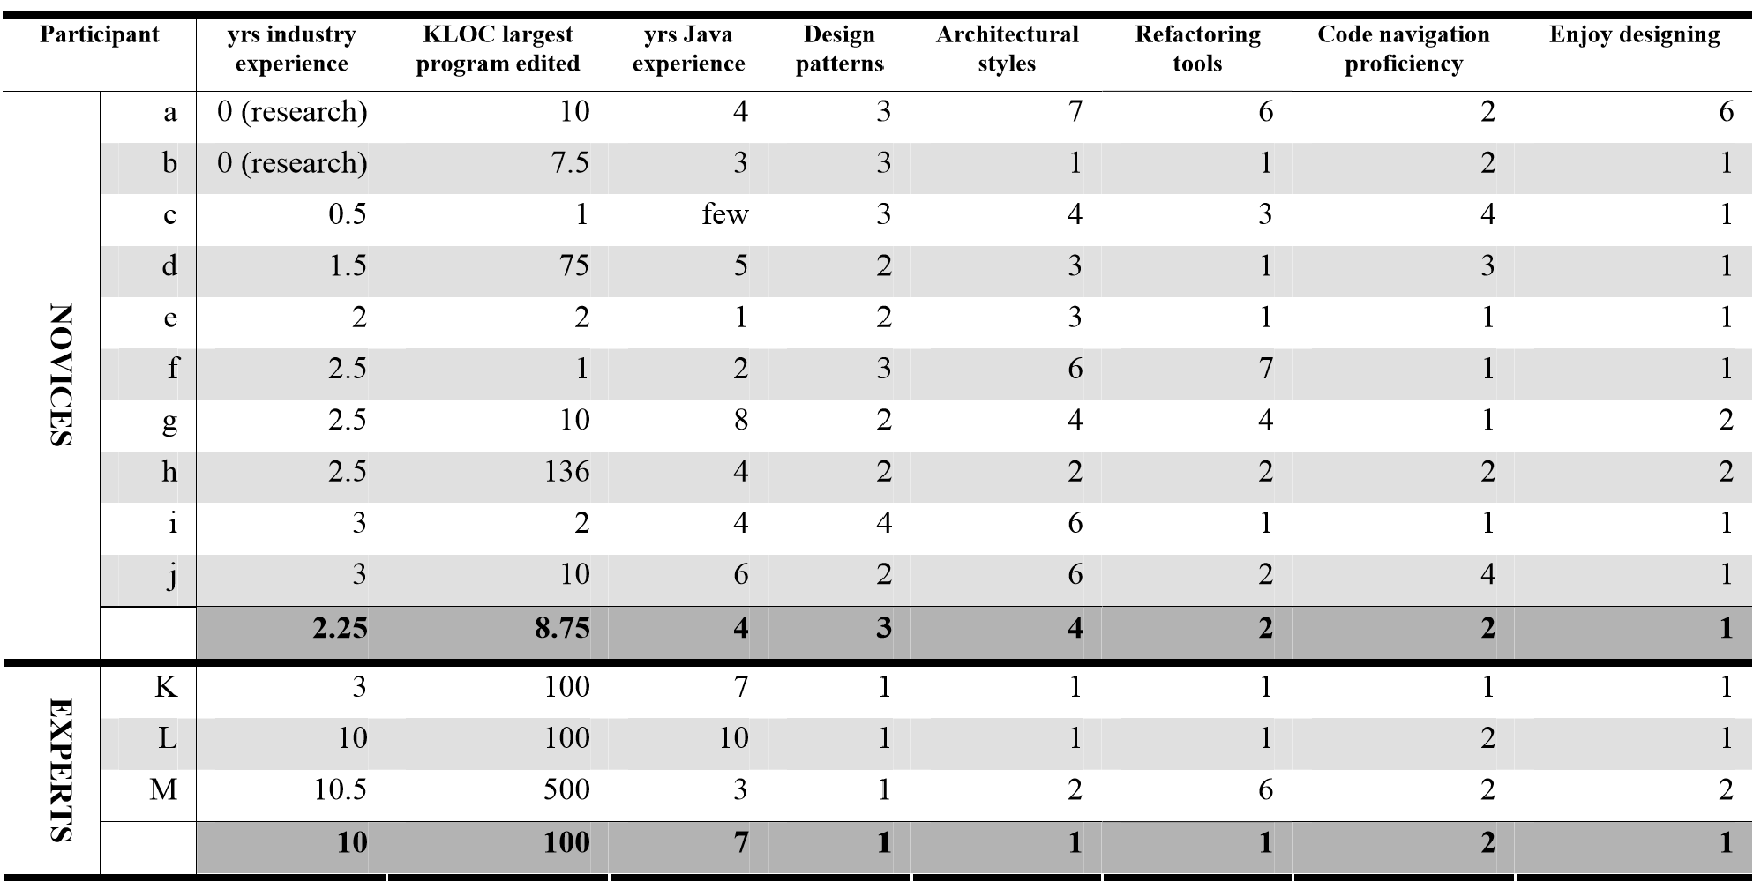

Methods: 13 participants
ESEC/FSE 2007
All participants:
(1) had at least two programming internships or fulltime development experience.
(2) comfortable programming in Java.
Notes:
Thirteen participants were recruited from undergraduate students, masters students, doctoral students, and staff at Carnegie Mellon University

Slide 4
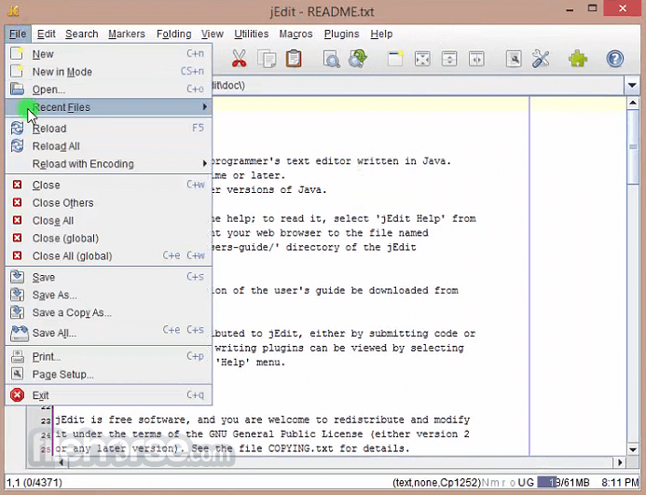
Methods: Two tasks, 3 hours, 54.7KLOC
ESEC/FSE 2007
Tasks were about nonfunctional improvements such as better architectural design that lead to performance and reusability gain.
Notes:
After poor experiences with functional change tasks, we picked nonfunctional tasks focused on improving the design rather than implementing features or fixing bugs

Slide 5
Methods: Procedure
Getting familiar with first task
First task
exploratory interview
Second task
Getting familiar with second task
ESEC/FSE 2007
Tutorial on Eclipse
Get familiar with task relevant classes
JEdit tutorial
30 minutes
90 minutes
90 minutes
Notes:
After poor experiences with functional change tasks, we picked nonfunctional tasks focused on improving the design rather than implementing features or fixing bugs

Slide 6
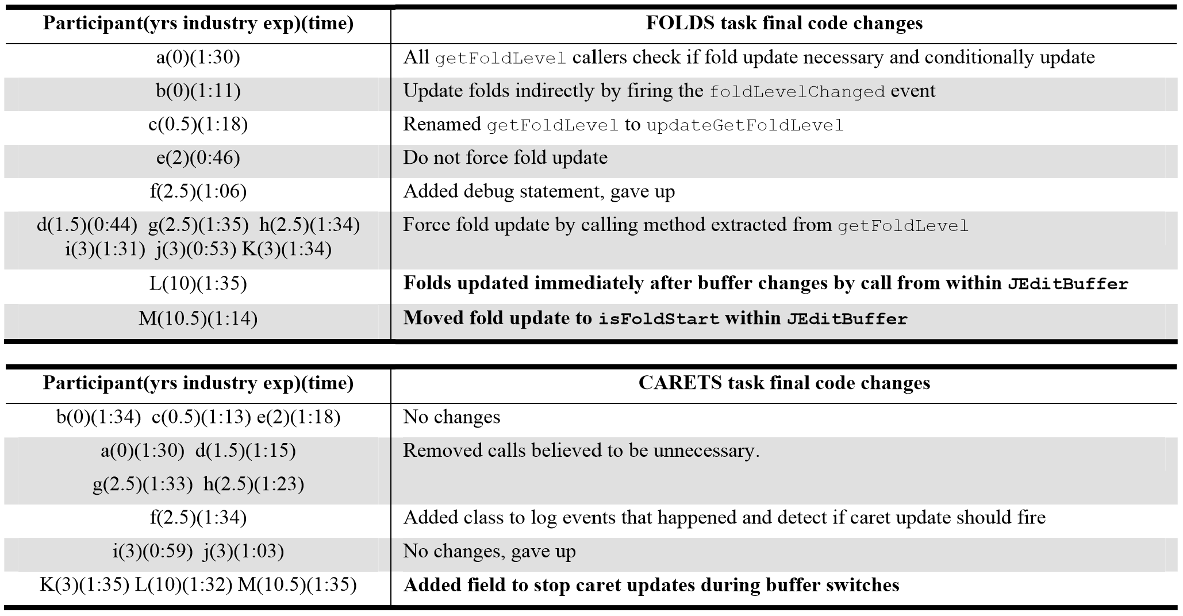
Results: Code Changes
ESEC/FSE 2007
Experts’ changes addressed the cause of the problems while novices’ changes addressed the symptoms.
Notes:
After poor experiences with functional change tasks, we picked nonfunctional tasks focused on improving the design raChanges made by two of the experts addressed the cause of the design problem by removing the need for doDelayedUpdate to force fold update. One (L) moved the fold update to two methods in JEditBuffer which are called after the buffer changes. Another (M) moved the fold update to isFoldStart within JEditBuffer. Both experts addressed the hidden design problems by removing the getFoldLevel call in BufferHandler that added questionable dependencies.ther than implementing features or fixing bugs

Slide 7
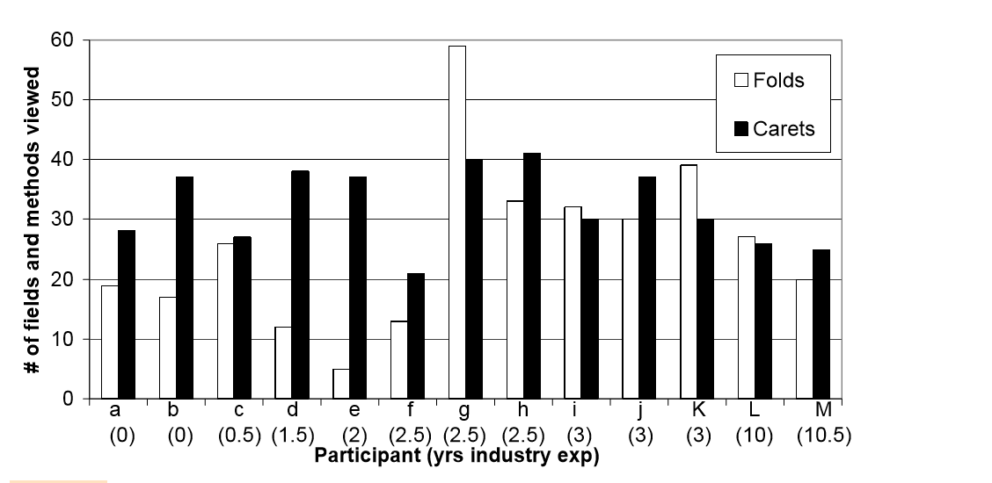
Results: Seeking Facts
ESEC/FSE 2007
Experts made better decisions about which methods were relevant, mostly because of their knowledge.
Notes:
There was no effect of experience on how many members participants visited, and participants visited similar numbers on both tasks. Thus, experts’ superior changes were not due to reading more members but from selecting better members to read and learning more from reading them.

Slide 8
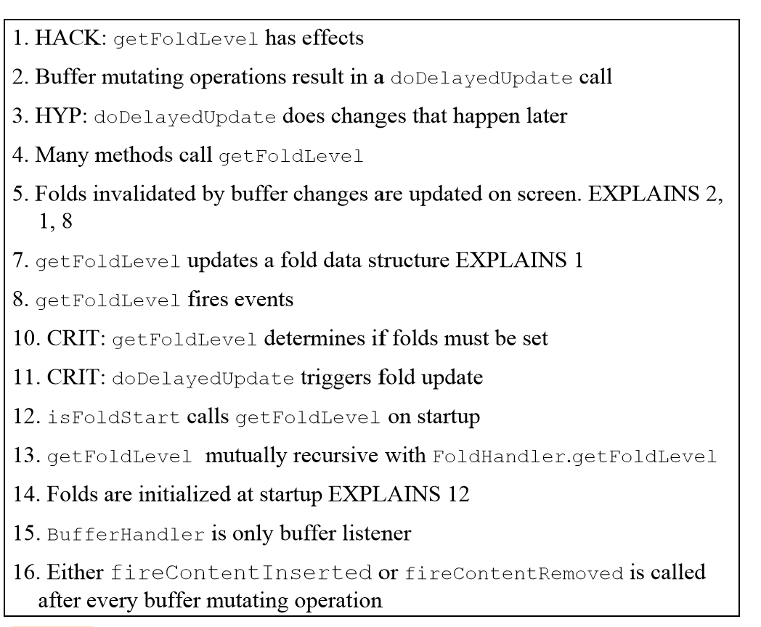
Results: Learning Facts
ESEC/FSE 2007
Experts talked about the code using abstractions rather than statement-by-statement descriptions
Notes:
Some facts found by expert participant L in the first 41 minutes of the FOLDS task in the order they were discovered. Facts are labeled with hack, hypothesis, and critique roles and the explanation of the relationships.

Slide 9
Results: Critiquing Facts
ESEC/FSE 2007
Novice criticisms resulted from missing design knowledge.
"It just seems really confusing for me to have this exact same method with the exact same parameters, they both have the handleMessage. I should investigate that. Hold on. – c 0:40(C) "
A single expert criticism justified Facts as design choice.
"And the second thing that I don’t like is that it is firing these updates. It seems like when you’re making the edit, that in order to keep the responsibilities of these guys very simple, when you’re making the edit, the people that care about that would be notified. – L 0:26(F) "
Notes:
And the second thing that I don’t like is that it is firing these updates. It seems like when you’re making the edit, that in order to keep the responsibilities of these guys very simple, when you’re making the edit, the people that care about that would be notified. – L 0:26(F)

Slide 10
Results: Explaining Facts
ESEC/FSE 2007
Experts explained facts novices were unable to explain, believing the decision could not possibly be overlooked but must be intended.
False requirements led to missed constraints, and thus failing to explain facts.
Notes:
The expert believed the decision could not possibly be overlooked but must be intended, suggesting the search for a hidden constraint must continue
A novice forgot that the instructions stated that the status bar displays caret and scroll position: This is, I think this is completely unnecessary because why would a scrolling event cause a caret update. Like if I’m just scrolling, by ---, it doesn’t change the caret offset. So I think I should just get rid of this one actually. – d 0:33(C)

Slide 11
Results: Proposing Facts
ESEC/FSE 2007
Changes often began as vague goals, generating hypotheses, and were then refined by learned facts
Novice proposals often did not solve the problem and worked out implementation details rather than considering general patterns.
Notes:
Proposing facts is iterative process of generating hypotheses and refinement by learning new facts.

Slide 12
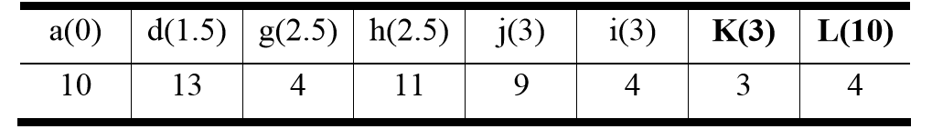
Results: Implementing Facts
ESEC/FSE 2007
Experts implemented a change more quickly than novices
Notes:
We observed one situation where many participants made the same change – 8 participants extracted a fold update method from getFoldLevel. more experienced participants did this more quickly. An expert extracted it merely to better understand it. Other participants intended it as their final change.

Slide 13
Tools implications
ESEC/FSE 2007
There are simple facts that developers discover. Tools may help developer discover these fact faster. (e.g., getFoldLevel has effects).
A tool externalizing these facts might help make it easier for developers to remember them and return to the code associated with them.
Notes:
We observed one situation where many participants made the same change – 8 participants extracted a fold update method from getFoldLevel. more experienced participants did this more quickly. An expert extracted it merely to better understand it. Other participants intended it as their final change.

Slide 14
Questions for discussion
ESEC/FSE 2007
There were some interesting decisions in design the experiment (e.g. exploratory instead of control, nonfunctional changes tasks instead of functional changes tasks and small number of participants instead of large number of participants). If you were to replicate this study, what design decisions you would like to change? And why?
Describe how existing tools (e.g., Eclipse debugger or any debugger) may use some the findings of this paper in their tool design?

