Slide 1
CodeExchange
Supporting Reformulation of Internet-Scale Code Queries in Context
Lee Martie, Thomas D. LaToza, and André van der Hoek
University of California, Irvine Department of Informatics
Summary By-Fardina Fathmiul Alam
SWE 795,Spring 2017

Slide 2
CodeExchange
Motivation
Programming today regularly involves searching for source code online, whether through a general search engine such as Google or a specialized code search engine such as SearchCode, Ohloh, or GitHub.
Searching typically is an iterative process, with developers adjusting the keywords they use based on the results of the previous query.
However, searching in this manner is not ideal, because just using keywords places limits on what developers can express as well as the overall interaction that is required.
Key Idea
Based on the observation that the results from one query create a context in which a next is formulated (query reformulation ), This paper proposed a new code search engine named CodeExchange,.
CodeExchange is developed to explicitly leverage this context to support fluid, expressive reformulation of queries.
Query Reformulation is the main driver of it’s features.
This paper has highlighted its key design decisions and overall architecture, and evaluated its use in both a field deployment and a laboratory study.

Slide 3
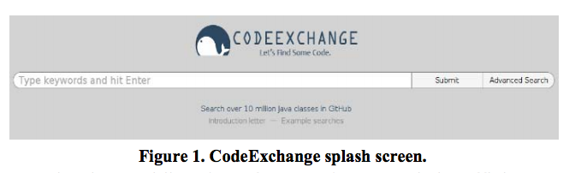
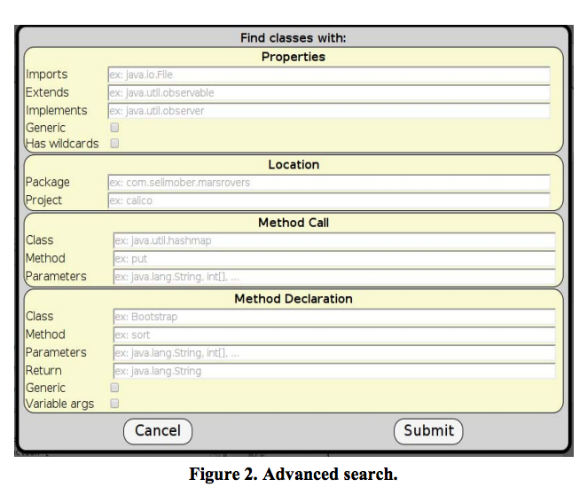
CodeExchange Approach (1/2)
Keyboard input box
Click
Figures(1-2): Interface before submission of initial query

Slide 4
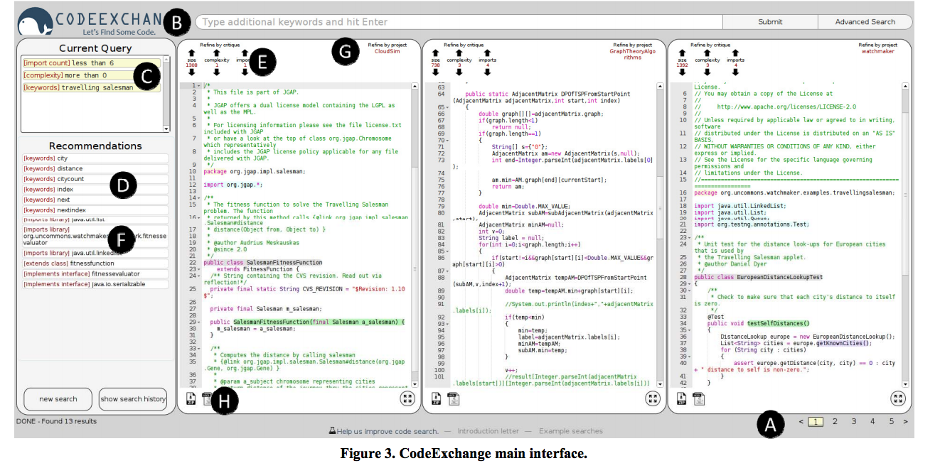
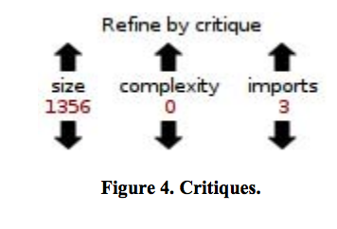
CodeExchange Approach (2/2)
LEGENDS
A: Query formulation
B: Query parts (Keyboard input box)
C: Query parts (Current Query)
D: Recommendations
E: Critiques At the top
F: Language concepts
G,H : Additional functionality
Figure: Interface after submission of initial query

Slide 5
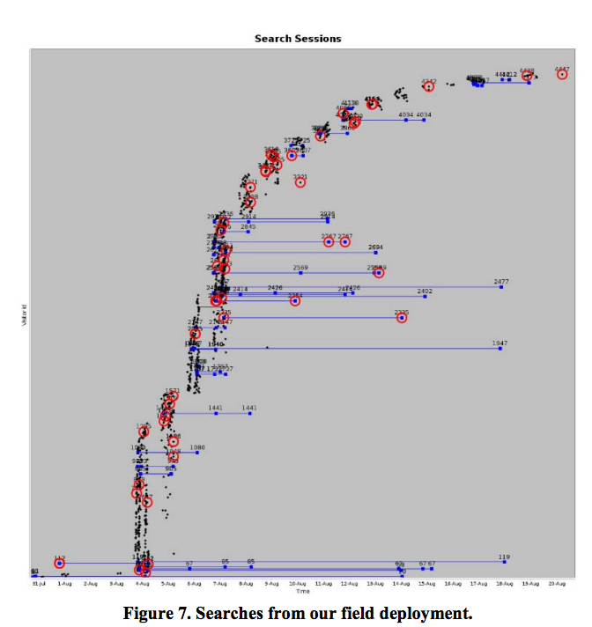
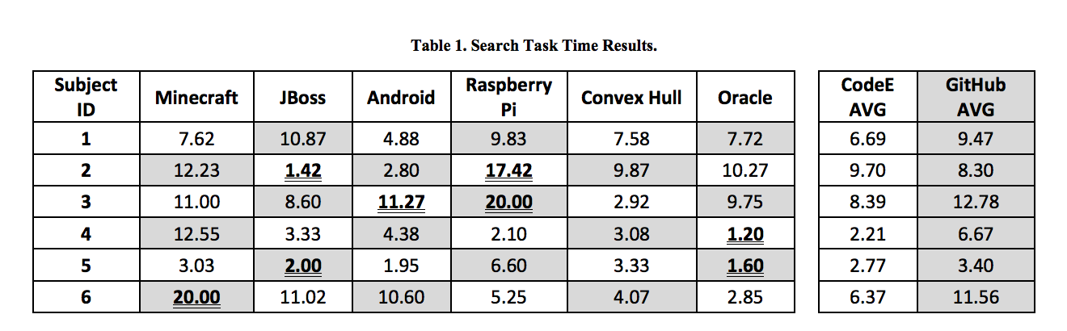
Experiment Result
In the field deployment, 78% of the successful searches (those involving, copying or downloading of code) used advanced features of CodeExchange.
In the laboratory experiment, successful searches from field deployment used as as input and compared task performance of six participants in issuing queries on CodeExchange or GitHub and found that participants with CodeExchange on average were about 2 1/2minutes faster in finding results.
Experiment Type: Laboratory experiment: comparative use
Experiment Type: Field deployment

Slide 6
QUESTIONS FOR DISCUSSION
Overall reactions
Would you like to use this technique?
What limitations does this have?

