Slide 1
Codepourri: Creating Visual Coding Tutorials Using A Volunteer Crowd Of Learners
Mitchell Gordon and Philip J. Guo Department of Computer Science University of Rochester Rochester
mgordI2@u.rochester.edu, pg@cs.rochester.edu
Presented by David Gonzalez

Slide 2
Key Insights
“A novel crowdsourcing workflow where volunteer learners use Codepourri to collectively create tutorials”.
“Experimental results showing that crowd-created tutorials are comparable to or better than expert-created ones, for code taken from an introductory textbook.”
Annotations let you select lines and ask what they do.
Execution visualizations expose what the program does, oriented to data structures and their relationships.
Collaborative approach to improve the tutorials based on crowd-voting.

Slide 3
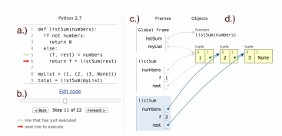
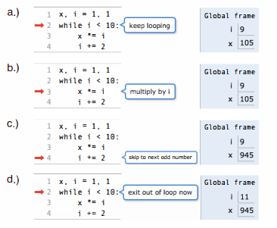
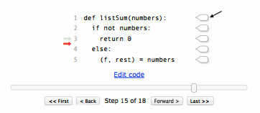
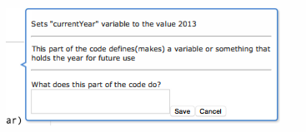
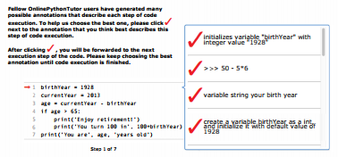
CodePourri

Slide 4
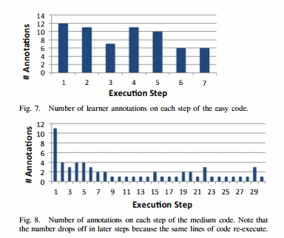
Experiment and results
Create tutorials for both the easy and medium code using Codepourri.

Slide 5
Questions
What about complexity of the visualizations?
What about same line of code on multiple calls?
What about crowd-voting?
Thanks =]

