Slide 1
Developers Ask Reachability Questions
Tomas D. Latoza
Brad A.Myers
Summery By
Maryam Arab, Feb2017

Slide 2
Reachability Questions
As developers build their mental model of the code
Ask questions, read code, use design knowledge, talk to teammates
Many of questions related to control flow.
A search across all feasible paths through a program for statements matching search criteria.
Related to reasoning about causality among behaviors in a program.
Result: Reachability questions are a significant portion of developer’s questions.
2 part:
The Path to search
The Search Criteria
Feasible Paths: set of concrete traces TR: list of <s, env>
Traces(p, O, D, C): set of all concerete traces in Program
Upstream R-Q: Questions without an origin
Downstream R-Q: Questions with an origin

Slide 3
Compare(TRa, TRb)
Compare(TR_{a}, TR_{b}) : TR_{common}, TR₁, TR₂ compares sets of traces.
Attempts to match each tr_{a} in TR_{a} to a corresponding trace tr_{b} in TR_{b}.
If found, then attempts to match tuples <s_{a}, env_{a}> in tr_{a} to corresponding tuples <s_{b}, env_{b}> in tr_{b}
This generates three new lists:
  tr_{common} which contains an ordered list of tuples that matched
  tr₁ and tr₂ which contain an ordered list of tuples in tr_{a} and tr_{b} that did not match.

Slide 4
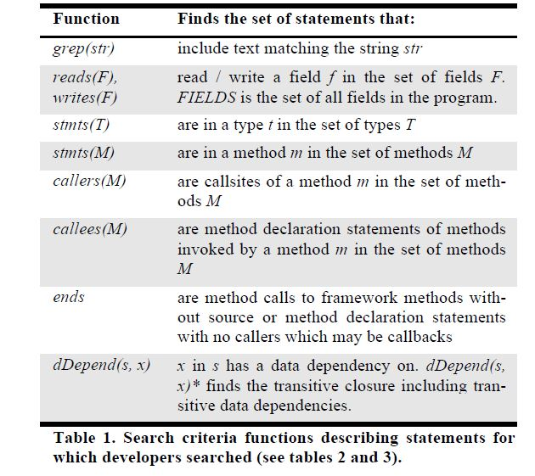
Find
Find SC in TR
Finds the portion of each tr in the set of traces TR that match search criteria SC.
A search criteria function, given attributes describing a set of statements, generates a set of statements SC.
R-Q then matches SC against each
<s, env> tuple in a trace tr to generate new traces containing only tuples where s is in SC.

Slide 5
3 studies to analyze
Reachability Questions

Slide 6
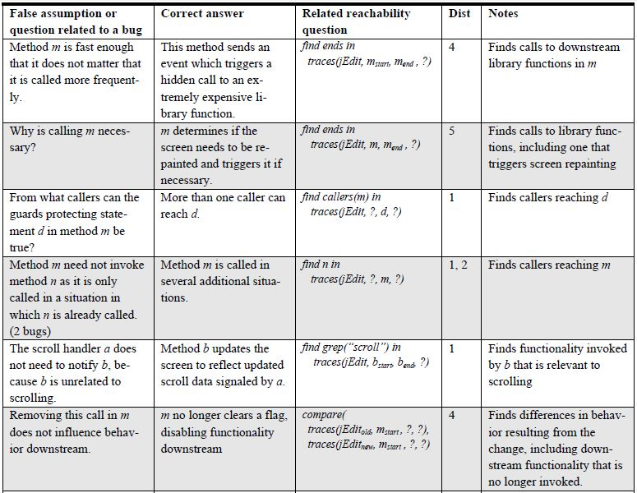
STUDY 1 – LAB OBSERVATIONS
A lab study of modification to complex, unfamiliar code
Reanalyze 13 developers
Changes to unfamiliar codebase
Allowed to use Eclipse feature & take notes with Windows Notepad or on paper.
Worked on two code-change tasks for 1.5 hours per task(changes to jEdit.)
Analysis1:
Identify edits and cluster into changes implemented:
Changes later abandoned
Changes contained a bug -> if developer ask questions or made assumption(r-q)
Analysis2:
Look for time-consuming questions (>10 minutes answering)

Slide 7
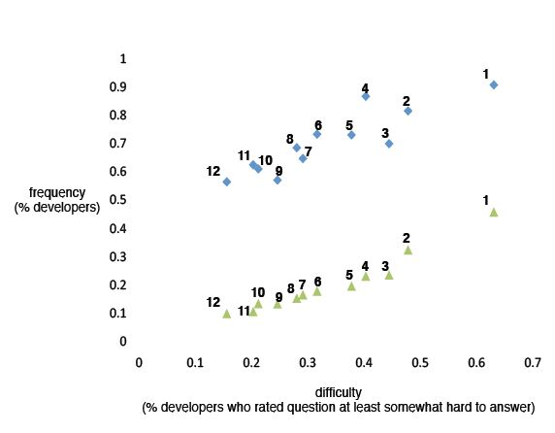

STUDY 2 –Reachability Survey
1. What are the implications of this change?
2. How does application behavior vary in these different situations that might occur?
3. Could this method call potentially be slow in some situation I need to consider?
4. To move this functionality (e.g., lines of code, methods, files) to here, what else needs to be moved?
5. Is this method call now redundant or unnecessary in this situation?
6. Across this path of calls or set of classes, where should functionality for this case be inserted?
7. When investigating some application feature or functionality, how is it implemented?
8. In what situations is this method called?
9. What is the correct way to use or access this data structure?
10. How is control getting (from that method) to this method?
11. What parts of this data structure are accessed in this code?
12. How are instances of these classes or data structures created and assembled?
A survey of 12 R-Q
Developers asked to rate 12 questions for frequency and difficulty
Invite 2000 employee at Microsoft Redmond campus(460) :
  They rate 9 of questions are asked everyday
  4.1 somewhat hard
  1.9 hard or very hard

Slide 8
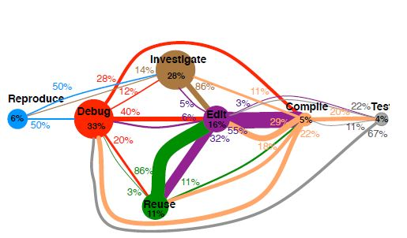
STUDY 3 – FIELD OBSERVATIONS
Observing 17 developers at work on their everyday coding tasks
20 developer from previous study
Single observer& single developer
Developers are free to use any programming languages, editor, and debuggers
Work on their coding task for 90 minutes
Encourage to select an unfamiliar code
Developers are asked to think aloud
Code reviews and interruption exclude form the analysis of time use
Sequence of activities and time spent for it

Slide 9
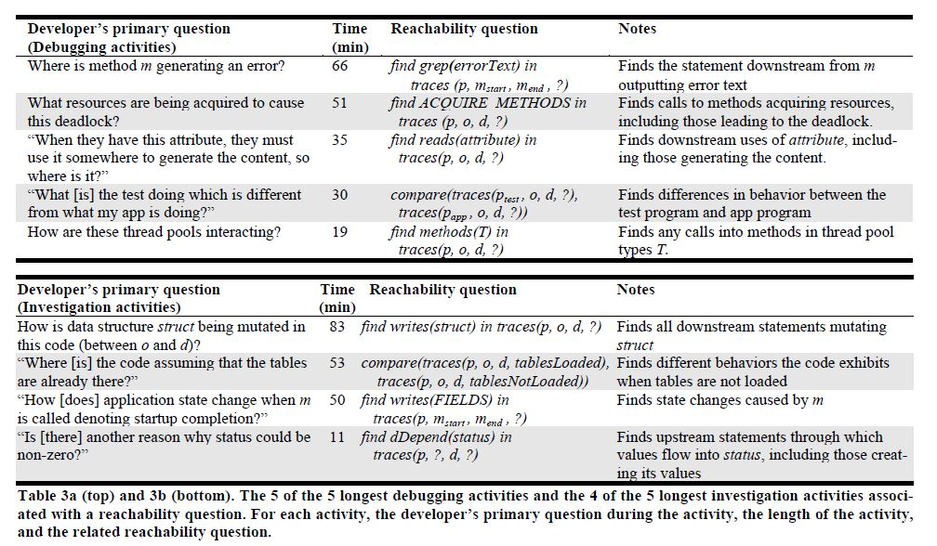
Time-consuming Activities

Slide 10
Conclusion
Better educating developers about reachability questions:
Help developers learn, share, and choose more effective strategies for answering
Coding more quickly and accurately with tools that support reachability questions.

Slide 11
What is your idea?
Do you think answering reachability questions help developers?

