Slide 1
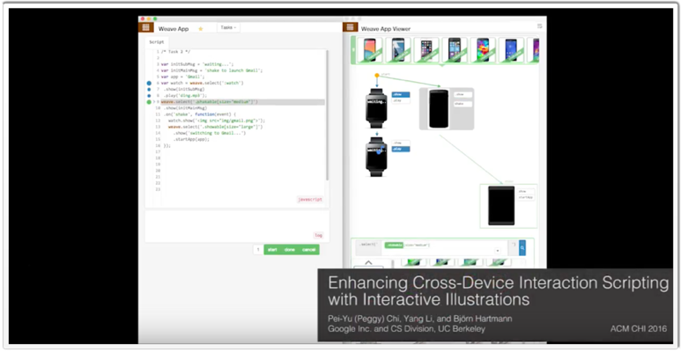
Enhancing Cross-Device Interaction Scripting with Interactive Illustrations
Pei-Yu (Peggy) Chi,, Yang Li1, Björn Hartmann
Summary By-Fardina Fathmiul Alam
SWE 795, Spring 2017

Slide 2
Enhancing Cross-Device Interaction Scripting with Interactive Illustrations
Motivation
Programming cross-device interactions can be challenging to programmers as it involve input and output on multiple computing devices.
It can be complex to express interaction flows that span multiple devices.
Testing cross-device interactions is also difficult.
Key Idea
DemoScript is a novel technique that assists developers in programming cross-device interactions.
Based on a fundamental understanding of a cross-device UI framework, DemoScript automatically analyzes and visualizes the scripted behavior by rendering a cross-device storyboard in real-time as the developers program in the editor.
Via the storyboard, a developer can revise various aspects of a program by direct manipulation.

Slide 3
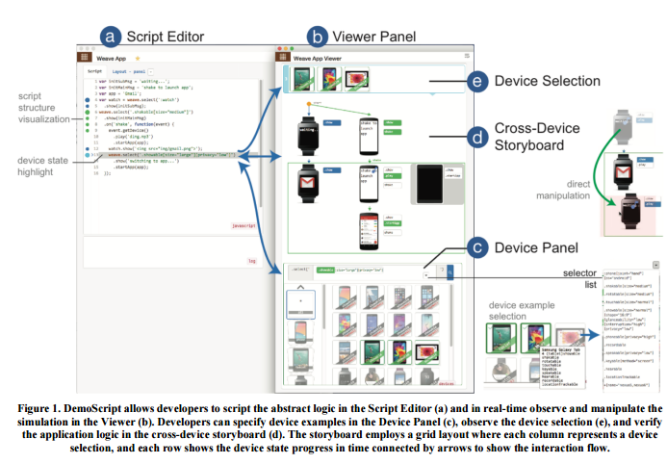
DemoScript Approach

Slide 4
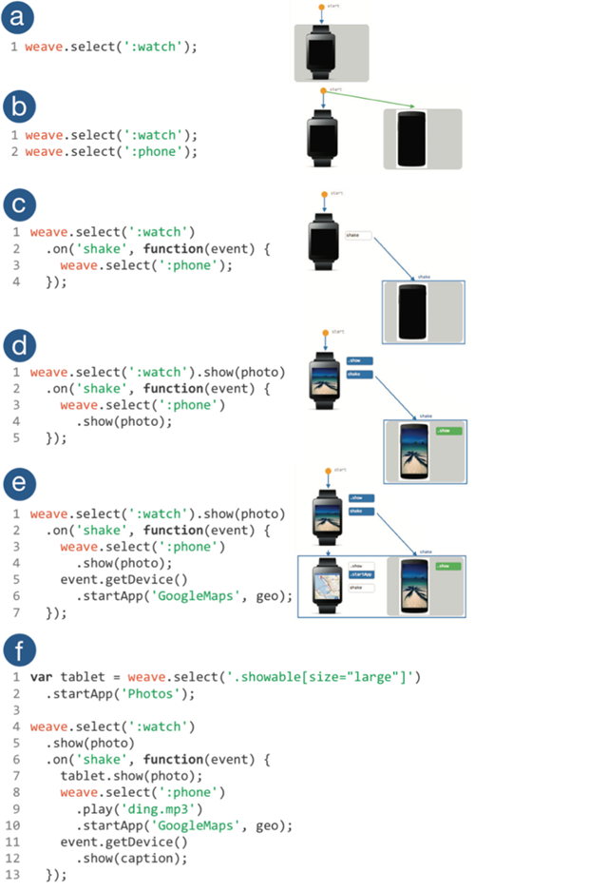
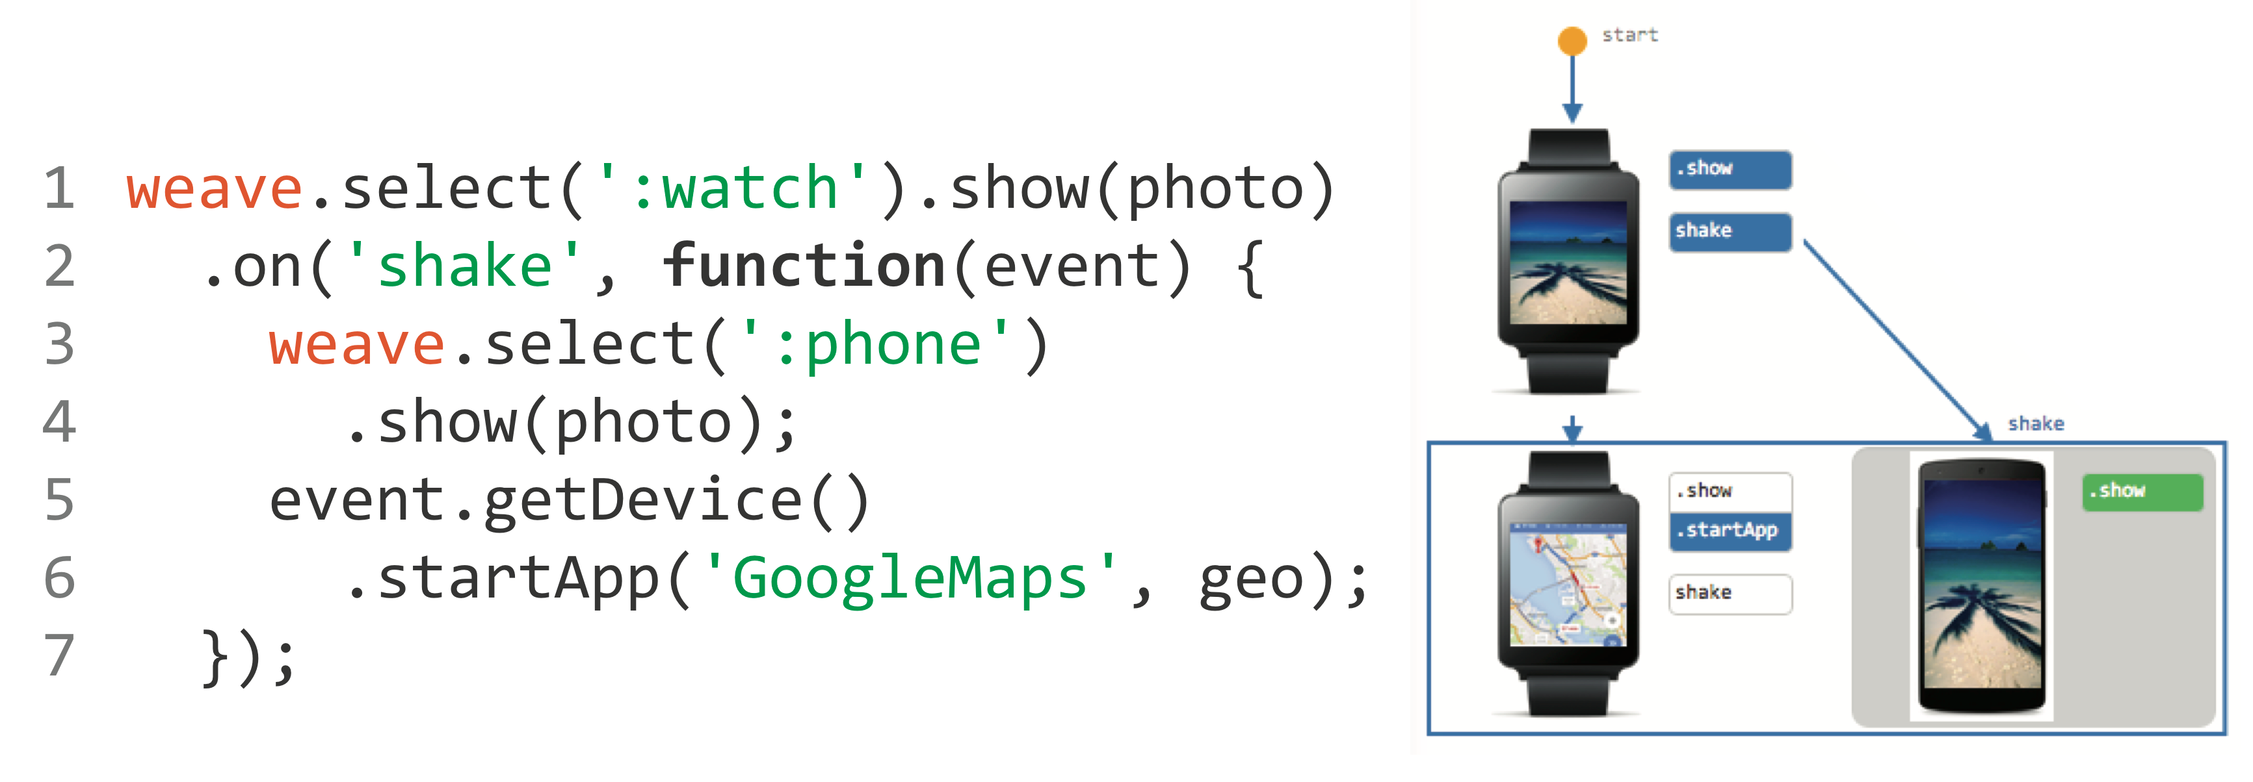
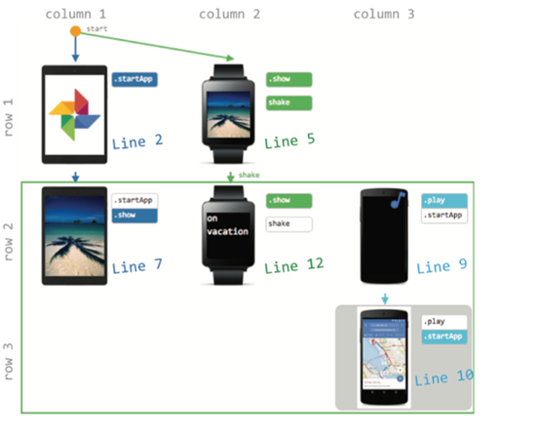
DemoScript Approach
(e)
Transitions
Fig: ScriptEditor
Fig: Storyboard

Slide 5
Contributions compared to existing works
Cross-Device storyboards : Show how scripted interactions behave in multiple devices simultaneously.
Cross-device interaction: Provided with code and visual editors working together.
Define target devices and their transitions, decide device selection criteria, and reuse interaction behavior using drop-drag in scripts.

Slide 6
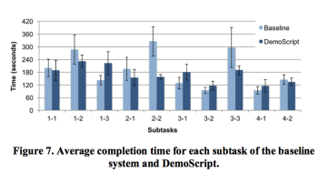
Evaluation Result
DemoScript has been evaluated by 8 professional programmers and they found it helpful as it significantly improved development efficiency by interpreting and managing cross-device interaction;
DemoScript also encourages testing to think through the script in a development process.

Slide 7
Questions for Discussion
Overall reactions
Would you like to use this technique?
What limitations does this have?

