Slide 1
Program comprehension during Software maintenance and evolution Armeliese von Mayrhauser , A. Marie Vans Colorado State University
Summary By- Fardina Fathmiul Alam
G#01031111

Slide 2
General Idea
Programming Understanding is a key factor in Software maintenance and evolution. Code cognition models examine how programmers understand program code. This paper has survey the current knowledge in this area by comparing six program comprehension models: the Letovsky (1986) model; the Shneiderman and Mayer (1979) model; the Brooks (1983) model; Soloway, Adelson and Ehrlich's (1988) top-down model; Pennington's (1987) bottom-up model; and the integrated metamodel of von Mayrhauser and Vans (1994) based on their scope and experimental support. All models use existing knowledge to build new knowledge about the mental model of the software that is under consideration.
This paper identifies open questions, particularly considering maintenance and evolution of large-scale code.
These questions relate to scalability of
existing experimental results with small programs
validity and credibility of results based on experimental procedure and challenges of data availability
2

Slide 3
Table 1
Maintenance Tasks Activities
Adaptive Understand system Define adaptation requirements Develop preliminary and detailed adaptation design Code changes Debug Regression tests
Perfective Understand system Diagnosis and requirements definition for improvements Develop preliminary and detailed perfective design Code changes/additions Debug Regression tests
Corrective Understand system Generate/evaluate hypotheses concerning problem Repair code Regression tests
Reuse Understand problem Find solution based on close fit with reusable components Locate components Integrate components
Code leverage Understand problem Find solution based on predefined components Reconfigure solution to increase likelihood of using predefined components Obtain and modify predefined components Integrate modified components
Table 1: Tasks and activities requiring code understanding.
3

Slide 4
To analyze the cognitive processes behind these tasks, researchers have developed several models
Model | Maintenance activity | Authors
Control-flow | Understand | Pennington
Functional | Understand | Pennington
Top-down | Understand | Soloway, Adelson, and Ehrlich
Integrated | Understand, Corrective, Adaptive, And Perfective | Von Mayrhauser and Vans
Other | Enhancement Understand | Letovsky Brooks Shneiderman and Mayer
Table 2: Code cognition models.
4

Slide 5
Cognition Models for Program Understanding
Letovsky model
Shneiderman and Mayer model
Brooks model
Soloway, Adelson, and Ehrlich model (top-down model)
Pennington model (bottom-up model)
Integrated metamodel
5

Slide 6
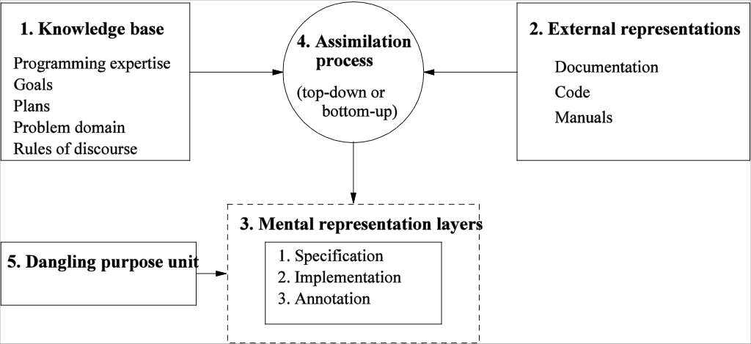
Letovsky model
Letovsky’s high-level comprehension model has three main components.
The knowledge base contains programming expertise, problem-domain knowledge, rules of discourse, plans, and goals.
The mental model has three layers:
The specification layer: characterizes the program goals.
The implementation layer contains the lowest level abstraction. with data structures and functions as entities.
The annotation layer : links each goal in the specification layer to its realization in the implementation layer.
The dangling-purpose unit : links such unresolved ,incomplete links.
The assimilation process : combine their knowledge base and the external representations to create their mental models. Produce the highest return in knowledge gain
Figure: Letovsky’s program comprehension model.
6

Slide 7
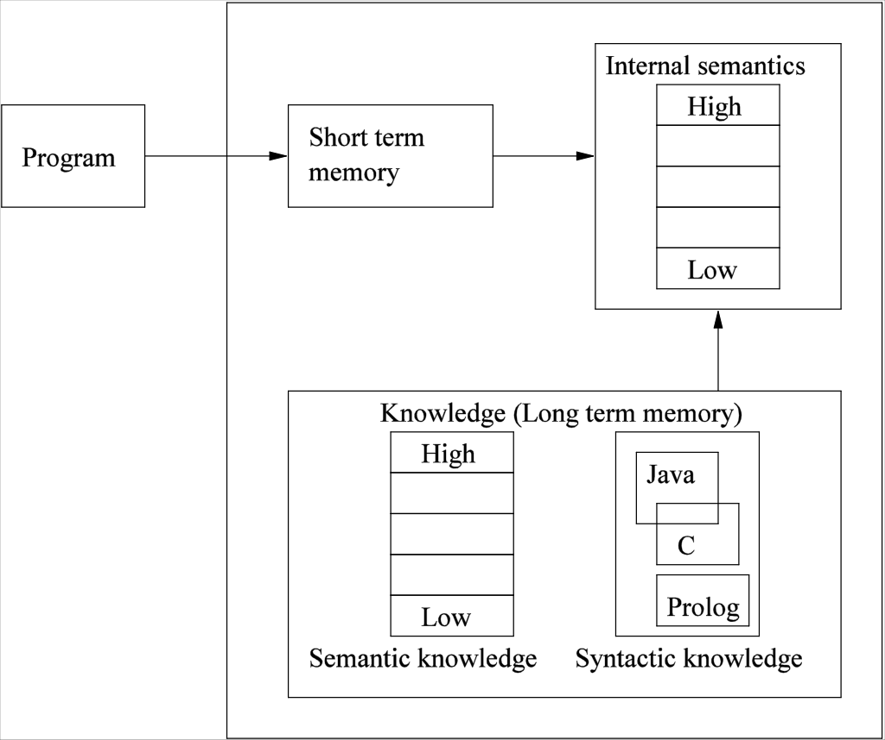
Shneiderman and Mayer model
Recodes the program in short-term memory into an internal semantic representation via a chunking process.
In internal semantics the top are high-level concepts are such as program goals, The lowest levels contain details algorithms used to achieve program goals.
Long-term memory, a knowledge base with semantic and syntactic knowledge, assists during internal semantics construction.
Program understanding is directional: It starts with the program code and continues until the problem statement is reconstructed.
Figure: Shneiderman and Mayer program
comprehension model.
7

Slide 8
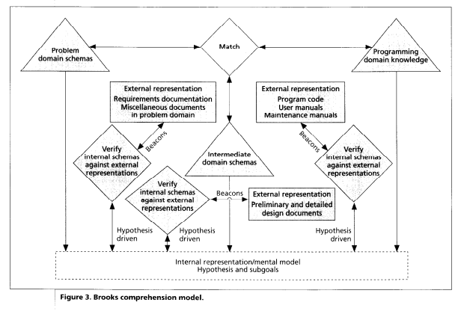
Brooks comprehension model
The three key elements of the model are-
Mappings from a problem (application) domain to the programming domain through several intermediate domains.
Understanding the mappings in terms of hypotheses. Programmers read all available documentations and try to reconstruct the mappings as much as they can.
Internal representations reflect knowledge contained in external representations such as code, design documents, or requirements specifications.
Figure : An overview of Brooks comprehension model.
8

Slide 9
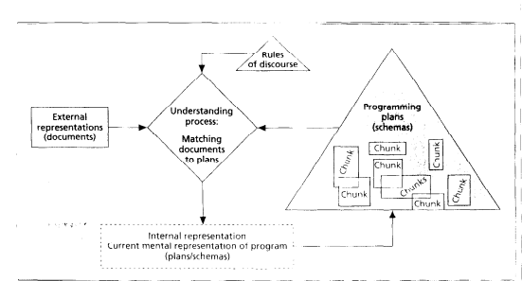
Soloway, Adelson, and Ehrlich model (top-down manner)
This model works in a top-down manner:
The understanding process matches external representations to programming plans using rules of discourse to select plans, by setting expectations.
Once a match is complete, the internal representation is updated to reflect the newly acquired knowledge. These updated mental representations are subsequently stored as new plans.
The process is said to complete when the programmer has associated all the programming plans with the goal hierarchy
Knowledge
Internal/ External Representation
Understanding process
Figure : Soloway, Adelson, and Ehrlich comprehension model.
9

Slide 10
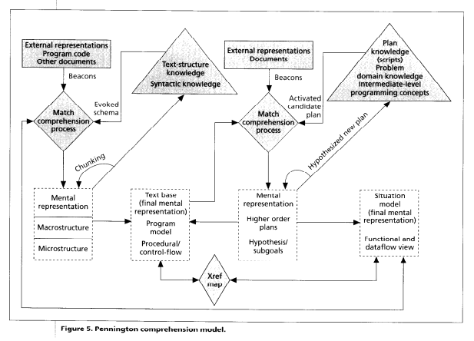
Pennington Model (Bottom-up Comprehension)
The model applies two concepts:
1.Program model: (high Right of the figure) textbase (A textbase represents information that the reader of a text can recall from memory after reading the text)and
2. situation model: (high Left of the figure) (represents what the text is about)
They are important to Pay attention to the loop:
{Match – Mental representation – Text structure knowledge} followed by the Text base.
Finally, when the programmer stops iterating through the loop, the final mental representation is known as the textbase.
The programmer assimilates their understanding of the code, knowledge of the text structure, and the situation model to create a mental model in the form of a textbase.
The programmer assimilates the documentations, plan knowledge, and the textbase to create the situation model.
The textbase and the situation model are cross-referenced to refine and update the two models.
Figure : Pennington model.
10

Slide 11
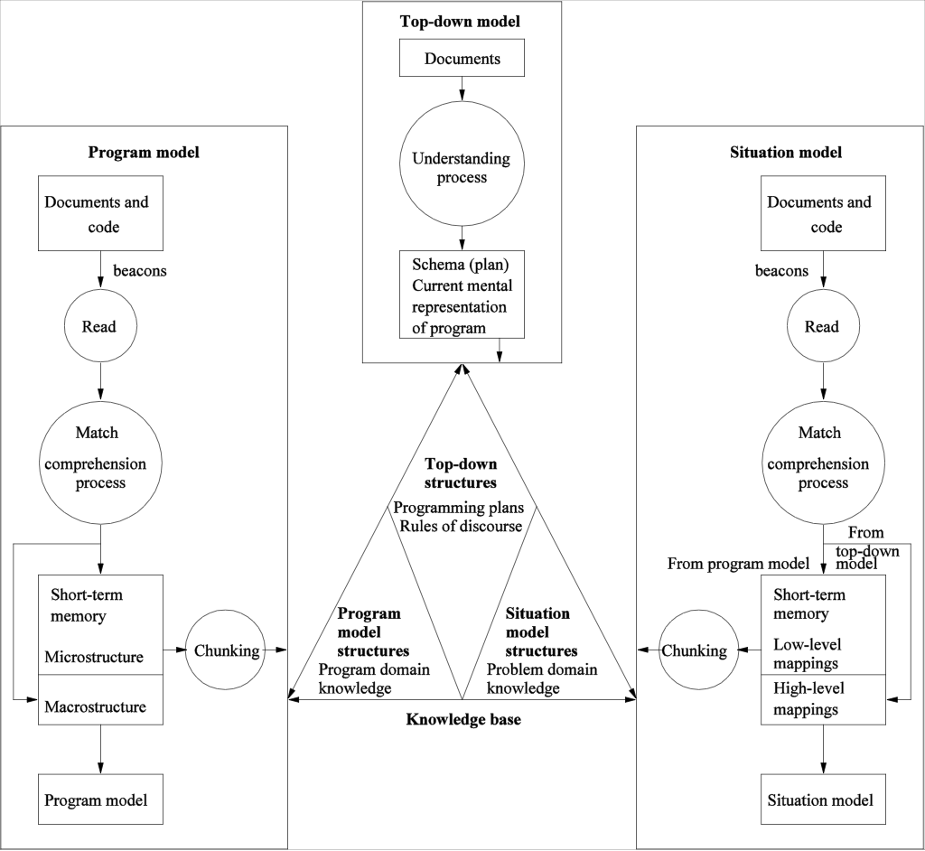
Integrated Metamodel
The four major components of the model are explained in the following:
Top-down model
It represents domain knowledge about the program. These include programming plans and rules of discourse.
Program model
If the programmer understands what the program is doing from the control flow aspect, then he has a program model of the code. These include two kinds of knowledge: text-structure knowledge and plan knowledge.
Situation model (See the Pennington’s model)
After building a program model, a programmer builds a situation model by using control flow and data flow information in a bottom-up manner.
Knowledge base
The knowledge base provides a medium for interactions among the above three models.
The programmer takes an opportunistic approach and simultaneously builds all the three models by updating the knowledge base with the understanding of one model and applying the knowledge to further build another model.
Figure : Integrated Metamodel
11

Slide 12
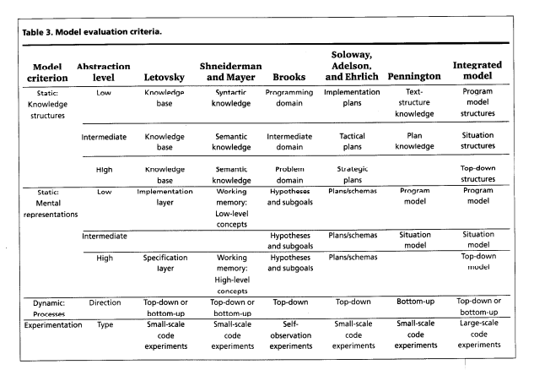
Model Evaluation Criteria

Slide 13
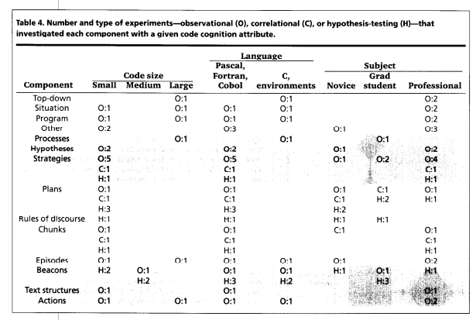
Program Comprehension Experiments

Slide 14
Some observation from the analysis of model evaluation criteria
Many characteristics are shared among different models. For example,
Brooks, Letovsky, and Shneiderman and Mayer all focus on hierarchical layers in the mental representations.
Brooks and Soloway, Adelson, and Ehrlich use a form of top-down program comprehension, while Pennington uses a bottom-up approach to code understanding.
Letovsky and Shneiderman and Mayer use both top-down and bottomup comprehension.
All five models use a matching process between knowledge structures and the artifact under study.
No one model accounts for all behavior as programmers understand unfamiliar code.
The Integrated Metamodel responds to the cognition needs for large software systems.

Slide 15
Conclusion
Based on all of these evaluations and analyses, this paper has drawn some conclusion that-
Existing experimental results of program understanding work is based of small scale programs and some of the model may or may not scale up successfully .So existing results from related areas need further investigation.
Some results generalize or appear as components of to larger results (Ex: Pennington’s and Soloway, Adelson, and Ehrlich’s models in the Integrated Metamodel ).
Accurate documentation and Data availability is a challenge. Because of it program comprehension is difficult .Because of these challenges, it become hard even for experts to work on project maintenance and evolution.

Slide 16
Questions
Overall reaction of this paper?.
Do you think that comparing this six program comprehension models is giving a whole scenario of understand programming code?
Some Limitations of these comprehension models.

