Slide 1
Program Slicing
Mark Weiser
University of Maryland, College Park
IEEE CHI, 1981
Presented by David Gonzalez

Slide 2
Key Insights
“Slicing is new way of decomposing programs automatically” circa 1981
Automates the generation of program slices under sound restrictions based on static analysis.
A program slice is reduced version of an original program where only the expressions necessary for executing a subset of it are kept and such execution must reproduce the original behavior.
Generating a slice follows criteria to delete non-related statements that include control and data flow analysis.
It provides convincing arguments and alternatives to overcome challenges in approach.

Slide 3
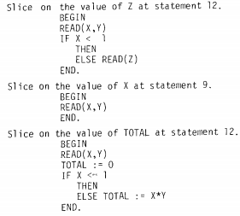
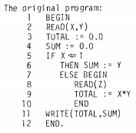
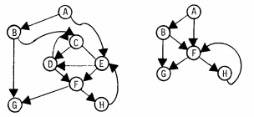
Approach
Statement deletions based on criteria*
Flow graphs
Criterion

Slide 4
Approach
Takes source code as input and uses an abstract representation –flowgraph – to enable statement deletion.
To allow a minimal set of slices, the definition of window for observing behavior is weakened from “all possible inputs” to “program terminates” due to the unsolvability of the former.
Under this definition, applies interprocedural dataflow analysis to determine “smallest” slice by using def-uses as criterion.
Also, includes branch statements that control execution of statements within the slice.

Slide 5
Additional contributions
Slicing study results:
Shows that in half of 63 cases, slices were remembered as relevant to the bug.
Slicing Real Programs*:
Generalizes program slicing, in contrast to DAVE’s slicing approach.
Interprocuderal Slicing*:
Provides how to handle multiple procedures at once, in contrast to SIMPL.
Separate Compilation*:
Provides how to slice when there are interprocedural complications, in contrast to SIMPL-D.
Slicing Based Metrics:
Introduces Coverage, Overlap, Clustering, Parallelism, Tightness for progr.
* Goes beyond prior work

Slide 6
Questions?
67% of time spent in maintenance, how about now?
Where have you seen program slicing being used?
What about the program slicing study?
What about feasible paths?
What research do you know about program slicing usefulness?
What topics do you find related to software testing(SWE637)?
Is OO programming an obstacle for inter-procedural techniques?

