Slide 1
Understanding Asynchronous Interactions In Full-Stack JavaScript
Saba Alimadadi, Ali Mesbah and Karthik Pattabiraman
University of British Columbia
ICSE 2016
Presented by David I. Samudio
*All images are taken or adapted from paper’s content or presentation (http://www.ece.ubc.ca/~saba/dl/sahand-slides.pdf)

Slide 2
Key Insights
Provides a visualization tool for program comprehension based on timelines of call executions between client and server, Sahand.
Sahand visualizes client-server communication live with time series charts, and attempts to minimize the information needed to understand such process with the help of visual aids.
The aids represent client-server transactions at method level; temporal primitives such as time points and intervals, and time structures for linear and branched flow of time among methods.
Authors claim these visualizations made Sahand's users perform tasks 3 times more accurately than the ones in the control group(using Chrome's developer tools[network chart, perhaps?], WebStorm).

Slide 3
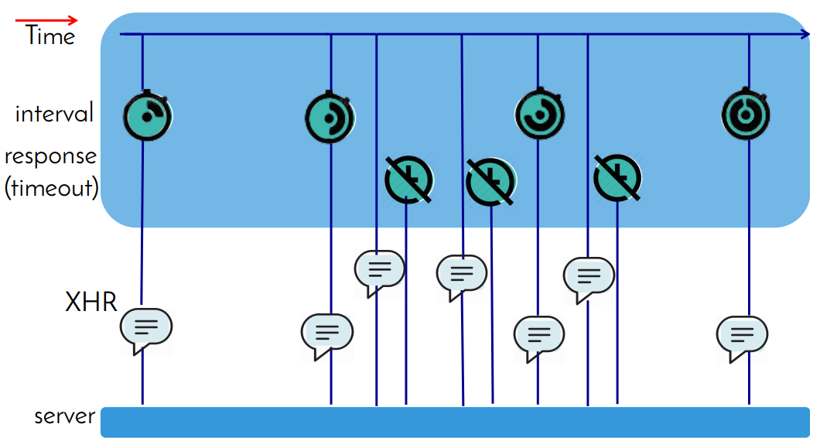
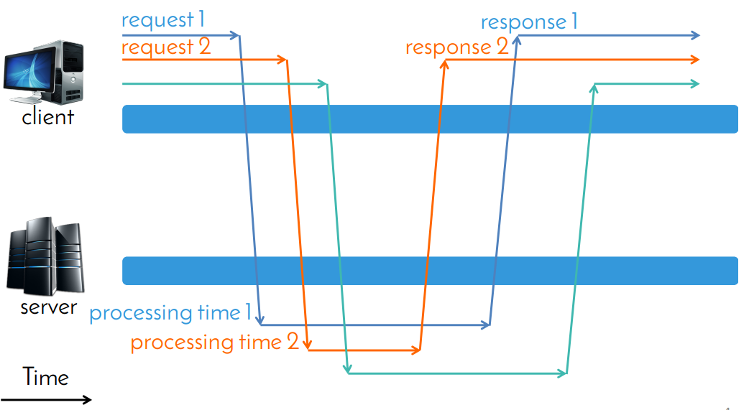
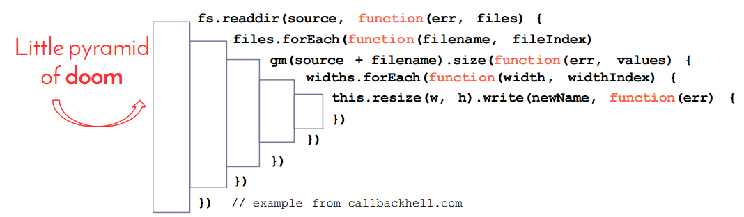
Problem
Challenges when developing JavaScript apps:
1. Server-Side callbacks
where nested callbacks create a “callback hell” and are executed asynchronously.
2. Network Communications
where distributed nature of client-server architecture makes race conditions common.
3. Asynchronous Client Side
where following requests to the server and responses from it make them hard to keep track of.

Slide 4
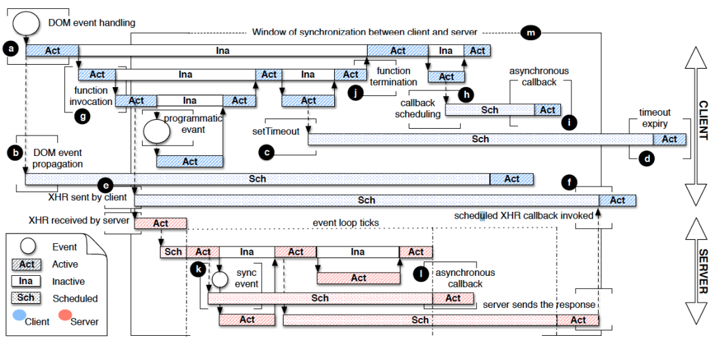
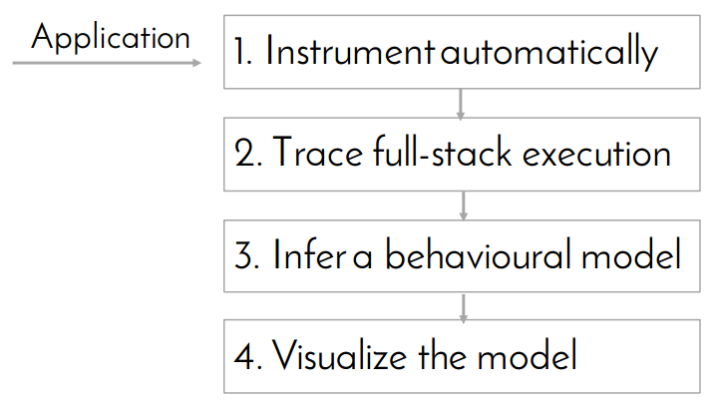
Approach(1/4)
Complete
“Real Behavioral Models Are Complex” – Alimadadi et al.

Slide 5
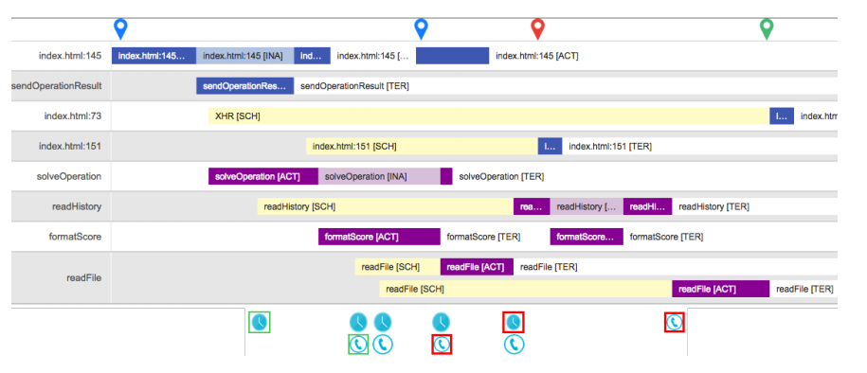
Approach(2/4)
Complete
VS
minimal

Slide 6
Approach(3/4)
minimal
Visualization Criteria [Aigner et al.]
Time
Data
Representation

Slide 7
Approach(4/4)
It defines a temporal model based on an abstract interpretation of client-server communication and context in full-stack JavaScript, and given an application's source code, Sahand automatically infers a behavioral graph as the application is executed.
Such inference is based on collecting traces of executed calls, thanks to the instrumentation of client and server code.
Collected traces include:
Client: timeouts, event and DOM interactions, XHRs and function executions.
Server: event loop, callback invocations and Node.js events.
Overall transactions.

Slide 8
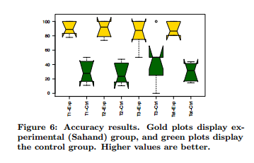
Results
For the controlled experiment, they recruited of 12 subjects within authors' university and assigned evenly to the two groups, keeping in mind that expertise was balanced in both.

Slide 9
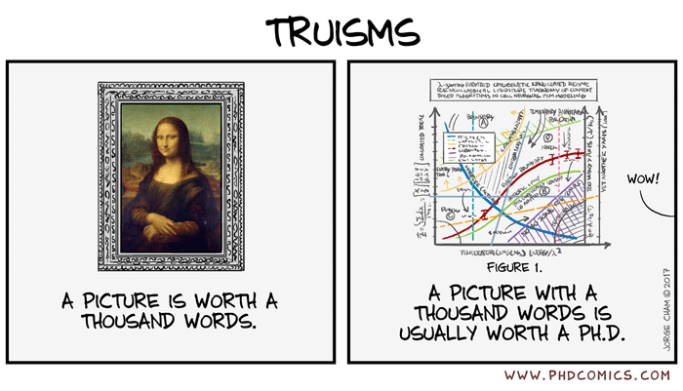
Questions
What about the “callback hell” on the client side?
Color code transactions rather than client-and-server?
What about the tasks in the experiment?

Slide 10
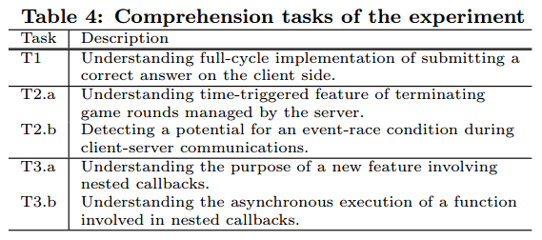
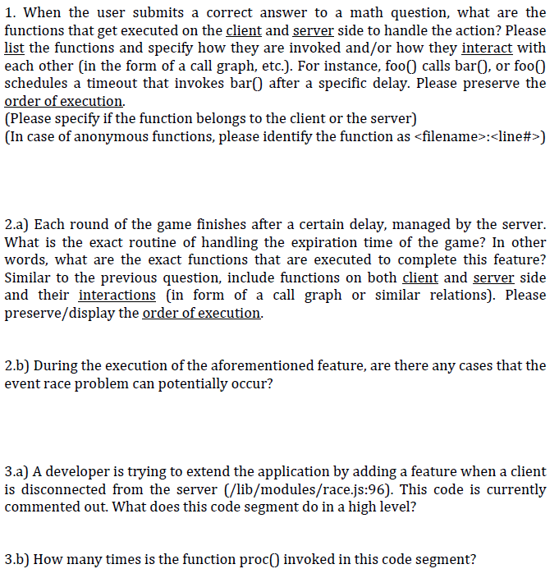
Appendix: Tasks and rubrics(?)

