Slide 1
Software Visualization for Debugging
Representing programs through algorithm animation,
typographic source-code presentation, and interactive auralization
transforms the hunt for bugs into a cognitively accessible multimedia experience.
Ron Baecker Chris DiGiano Aaron Marcus
Presented by Maryam Arab

Slide 2
Idea
Claim: Graphical and auditory representations of programs are useful in debugging
Visualization approaches:
Algorithm animation
30-minute film to demonstrate the power of algorithm animation
Source code présentation
design of computer program source text can enhance the program’s readability
Interactive auralization for debugging
LogoMedia— interactive construction of visualizations during program creation and
debugging
Auralization is the process of rendering audio data by digital means to achieve a virtual three-dimensional sound space.

Slide 3
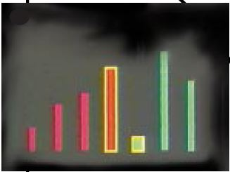
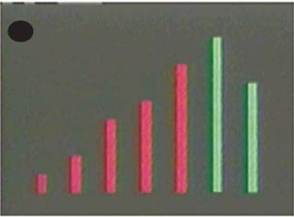
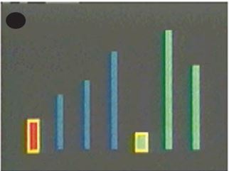
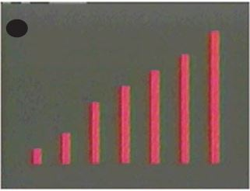

Slide 4
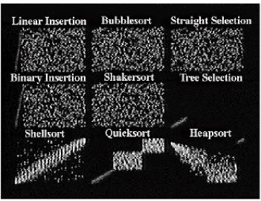
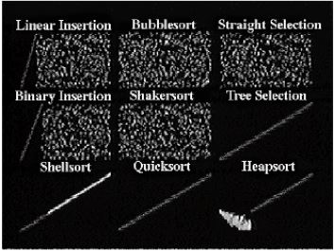
Algorithm animation

Slide 5
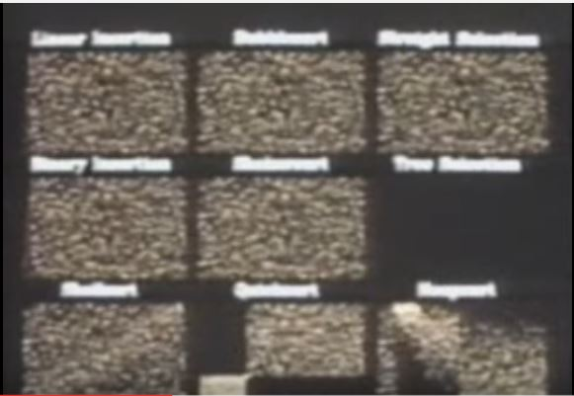
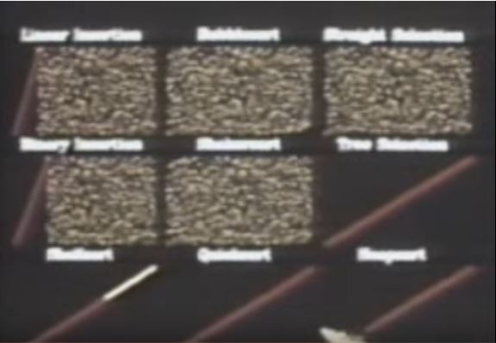
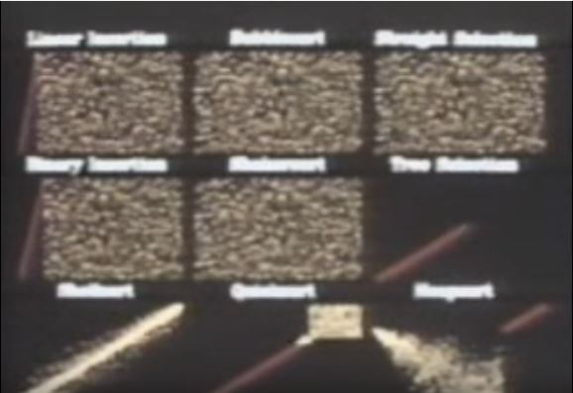
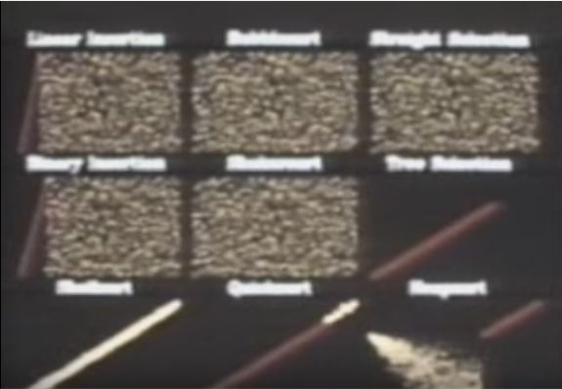
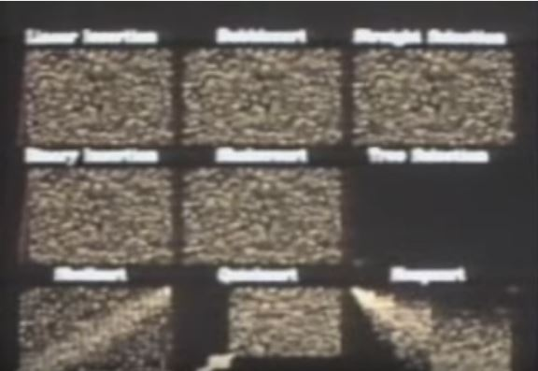
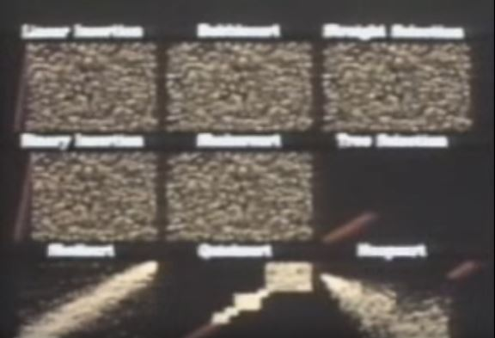
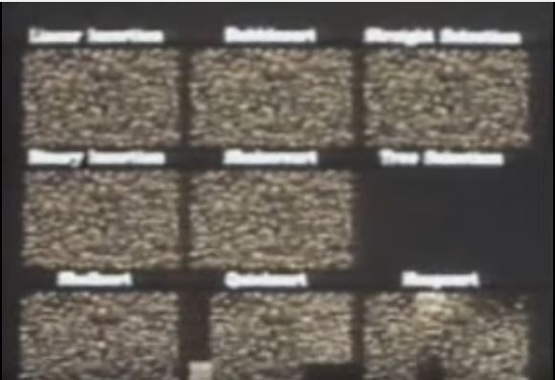
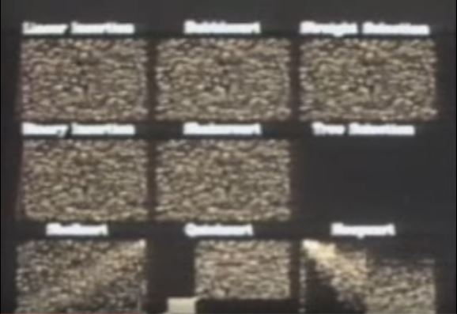
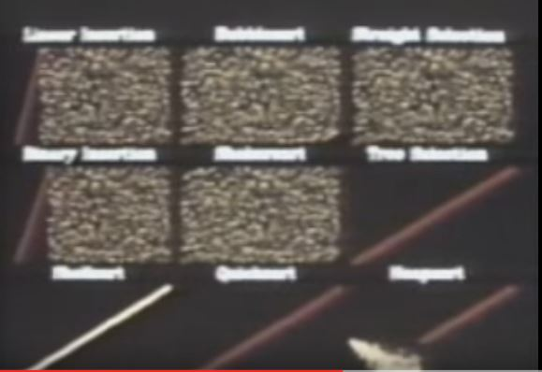
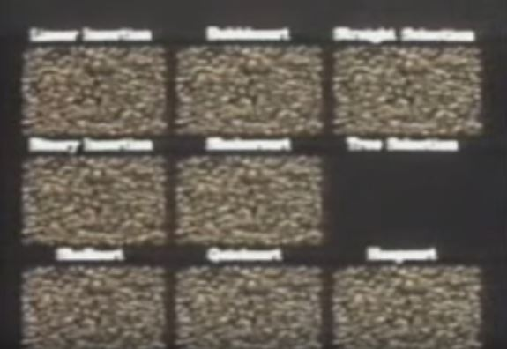
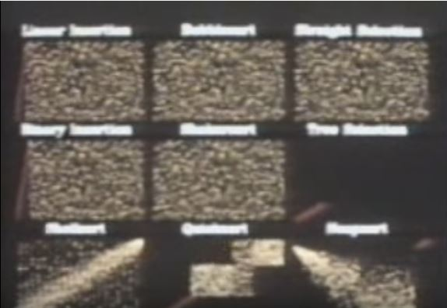
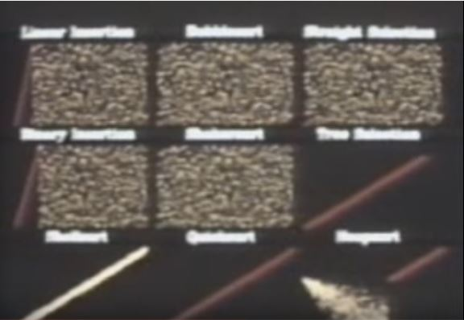
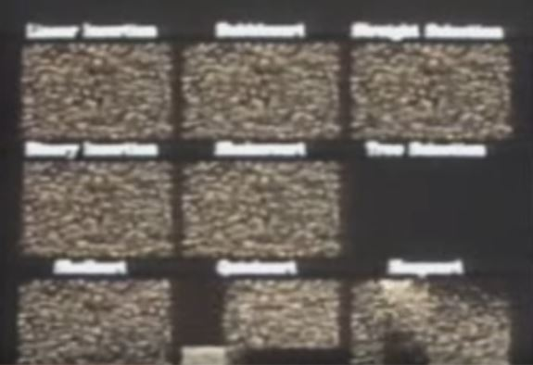
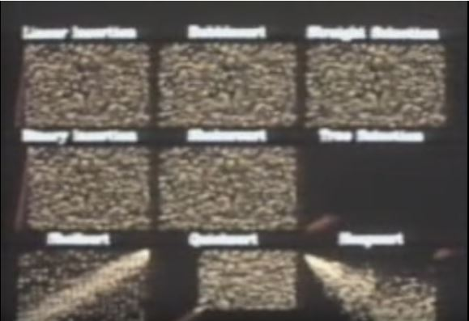
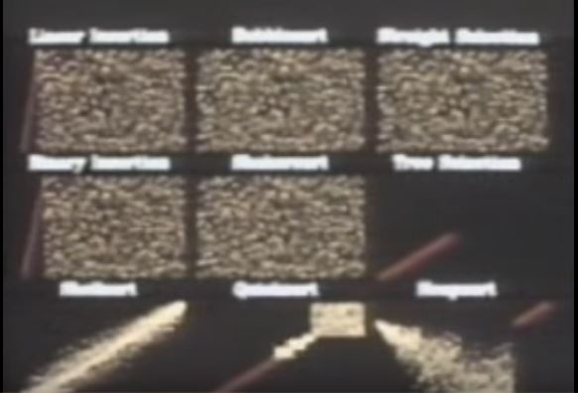
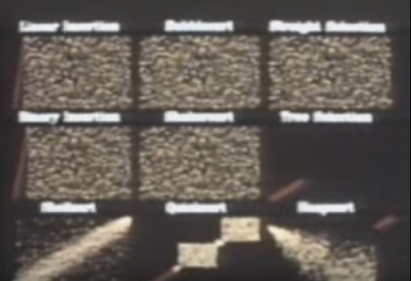
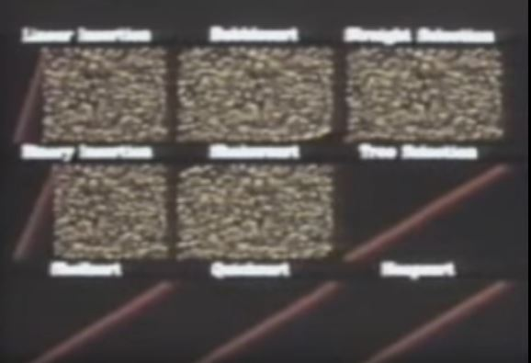
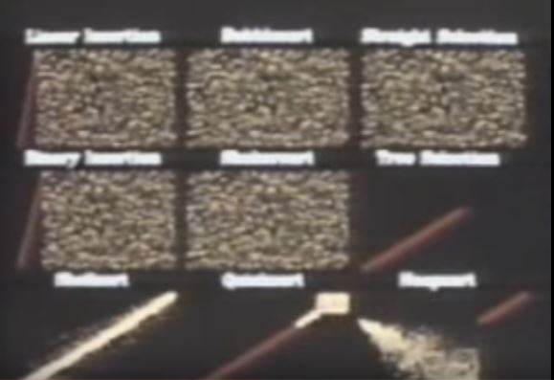

Slide 6
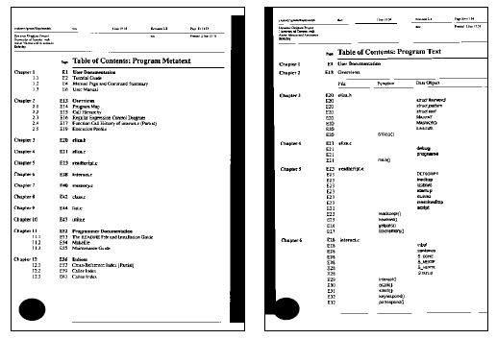
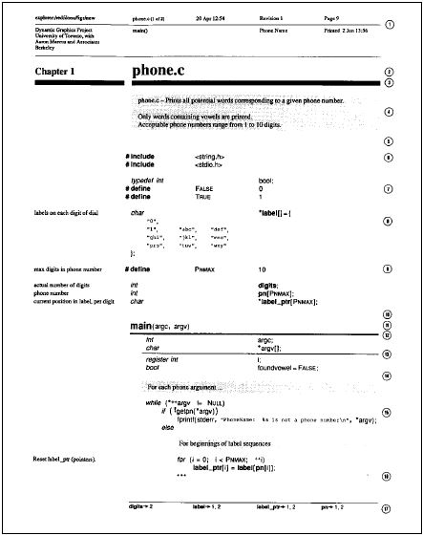
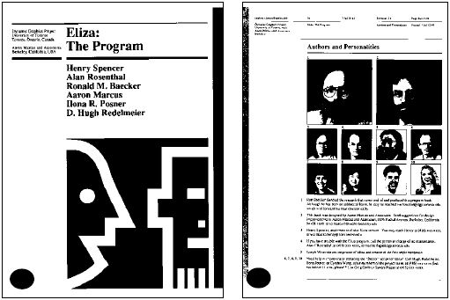
Source Code

Slide 7
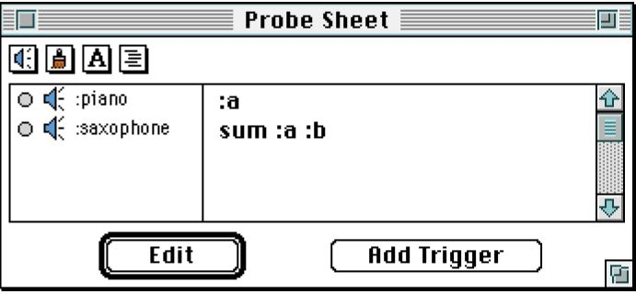
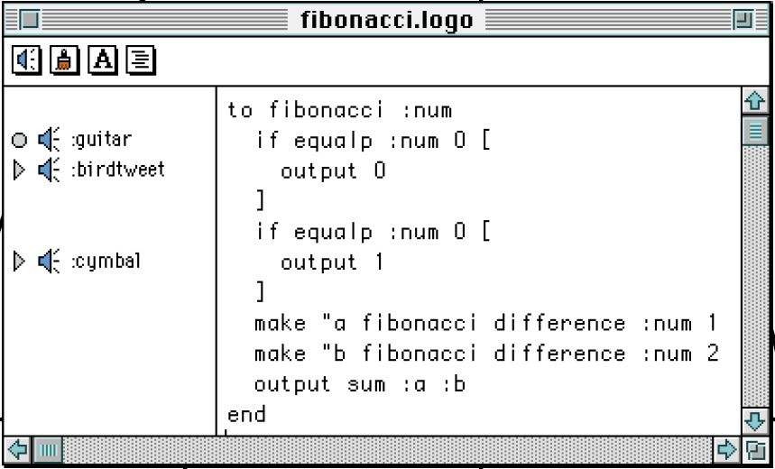
Visualization for debugging

Slide 8
Evaluation
Users tends to use LogoMedia to:
assess the values of variables at particular points in programs
monitor arbitrary changes to variables by mapping their values to sound
monitor acoustical variables:
loop indices
Lists
Counters
Problems with LogoMedia:
Simultaneous sound
Lack of tracking a dataflow for non-defined variables

Slide 9
Open Questions
Is either of the proposed ideas helpful?
Do programmers have the patient to go through the visual or acoustic interfaces?
Is it for only novices? Or experts can take advantage of it?

