Slide 1
The Emergent Structure of Development Tasks
University of British Columbia
Gail C.Murphy
Mik Kersten
Martin P. Robillard
Davor Cubranic
Present by Maryam Arab
Spring 2017

Slide 2
Introduction to task structure
Development tasks require changes that are scattered across system artifacts
spending more time looking for relevant information
may not always be finding relevant information
support for task structure can
improve the effectiveness of existing tools
enable support for new operations
improve a developer’s individual and group work.

Slide 3
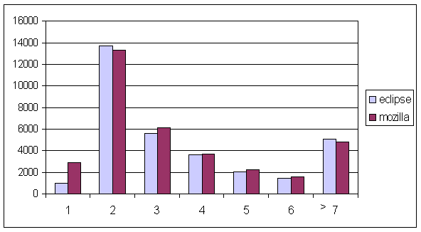
Claim
Current tools are not sufficiently supporting a developer
to find and manipulate the pieces of a project’s information space on which they are working
to manage the multiple problems on which they work at the same time
90% of changes
touch more
than one file
Notes:
Our claim is that current tools are falling short in helping a developer in two areas: finding and manipulating the parts of artifacts they need to work on, and managing the multiple problems they must constantly deal with.
One thing you could be thinking is that the kind of programming work I am talking about are few and far between. After all, we’ve spent a lot of time and energy designing and implementing programming languages that are intended to minimize the number of modules you must typically change as a software system evolves. To give you some sense that changes still require visiting and modifying multiple places in a code base, here is a graph showing modifications made to two open-source systems: Eclipse and Mozilla over a number of months. 90% of the changed touched more than one file and for 20 transactions randomly sampled from Eclipse, 25% represented non-local changes (non-package, non-plug-in).

Slide 4
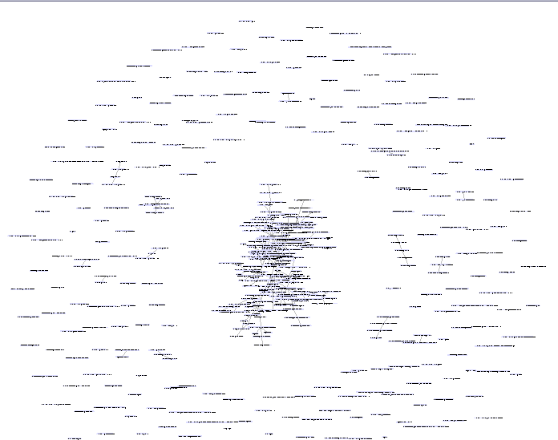
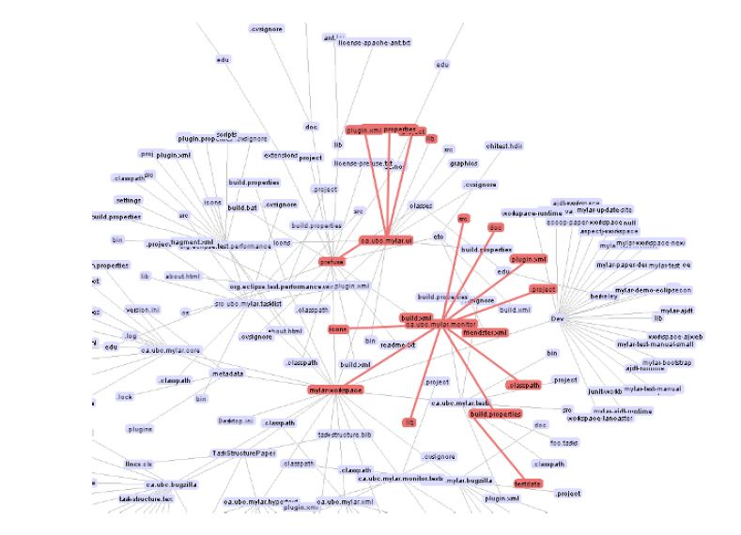
The Challenge
Notes:
The challenge is that the information space the developer is working with is huge. Here is just part of the information space for the bug we were trying to solve. Taking a bit of a closer look, we can see the kinds of nodes in this graph. The nodes are parts of artifacts (source code, the bugs, test cases, documentation, etc.) and the edges are different relationships that might appear such as a method in StackLayout calling a method that is declared in IFigure, and the bug referring to the start method.

Slide 5
Task Context
Parts and relationships of artifacts relevant to a developer as they work on the task
Can be approximated as a developer works:
algorithmically over the structure of the graph
by monitoring a developer’s activity and heuristics on the graph
Notes:
We use a different term, task context, for the structure that emerges as a developer works. In general, task context is a superset of task structure as it includes parts of artifacts that are accessed, not only those parts that are ultimately changed.
We can approximate task context in different ways as a developer works. For instance, we could run algorithms over the areas of the information space the developer is working on to extract the probable context. Or we can monitor how the developer is working with the graph and use heuristics. Let’s look at each of these in a bit more detail.

Slide 6
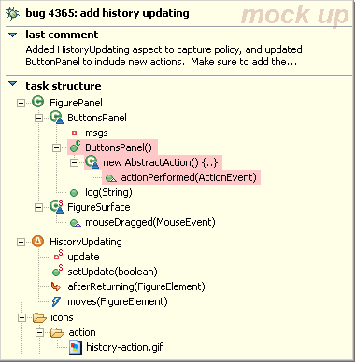
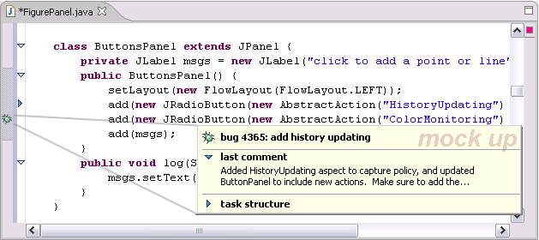
Asynchronous & Task Structure
E.g., Imagine a Hipikat^{TS}
group memory would include structures of completed tasks
search group memory with structure of current task
Notes:
How can task structure help these tools? Well, its simple. The task structure provides a richer search context. Imagine a Hipikat with task structure. The group memory would include task structures for completed tasks and you could use this information to provide better searchs – since a problem with Hipikat is that not everything returned is relevant. Imagine here you are working on some AspectJ code involving some kind of updating of figures (sound familiar ☺ ). As you are accessing and forming a task structure, Hipikat could in the background be searching for similar past tasks and recommending them as little bugs in the gutter. If you open up that bug, you see the task structure of the recommended completed bug with the overlap highlighted.

Slide 7
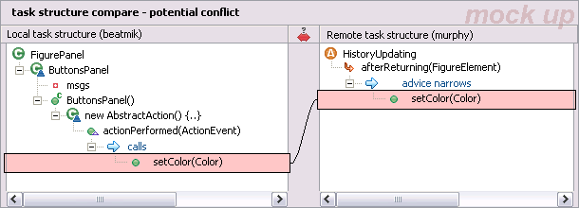
Synchronous & Task Structure
E.g., Imagine comparing task structures on check-in
compare committer’s task structure to current task structures of other group members
perform focused source analyses on those task structures
Committer’s Task Structure
Other Developer’s Task Structure
Notes:
How can task structure help here? JAZZ and Palantir both already support some comparison of workspace activity. As with the IDE level, task structure can help in focusing the information (and perhaps in speeding the analysis). For instance, imagine a developer reaches the point they want to check-in some code. Right before the actual check-in, a tool could run to compare the developer’s task structure with the task structure’s of their team members. This comparison could involve analyses that run from the task structure, maybe searching out x levels for similarity or interaction. In the example, we have played around with conceptually, the committing developer checks-in code that causes a new call to a method and a team member has code that changes an aspect that narrows some advice affecting that call which might change semantics. We could perform a focused analysis and then present the results using the task structure for context.

Slide 8
Improve IDE Platform
Capture and recommend workflow
E.g., mine completed task structures for patterns to form best practices or inform UI
Simplify tool development
E.g., arbitrate competition for limited screen real estate like gutters based on task being performed
Notes:
Task structure could also help us improve the IDE platform. For instance, one problem faced in tools like Rational is that they are now composed of many many many plug-ins. Its hard for developers to even find relevant functionality. We could mine collected task structures to determine which parts of tools were being used and use that to improve the UI (perhaps in a dynamic adaptive way or perhaps not). Embedding some explicit recognition of task structure in the IDE might also simplify tool development so that tools could compete for limited screen real estate depending upon the active task.

Slide 9
Open Questions
How should task structure be defined?
should it include rationale?
should it include how the task was worked on?
should it include confidence levels?
Can we determine task structure accurately without the developer’s involvement?
Can we make more program analyses feasible by using the focus of task structure?
Which is better to pursue: tool support for task structure or improve the languages developers use to express their systems?
And many more…

Slide 10
Summary
There is a mismatch between
how developers work with software artifacts
how tools attempt to support that work
This mismatch can be reduced by
capturing, retaining and using the structure of tasks to focus tool support
Plugin.xml
niftyIconFile

