Slide 1
WebRB:
Evaluating a Visual Domain-Specific Language For
Building Relational Web-Applications
Avraham Leff James T. Rayfield
IBM T.J. Watson Research Center
{avraham,jtray}@us.ibm.com
OOPSLA’07
Presented by David Gonzalez

Slide 2
Key Insights:
“WebRB is a visual domain-specific language for writing applications”, which provides:
An API (and dataflow) for CRUD operations:
  server-side relational model to the client-side view,
  and client-side event-handling for reflecting changes back to the other-side.
Relational algebra for expressing business logic.
A visual programming language for building client-side views and their logic.

Slide 3
Problem(1/2)
From Imperative-Embedding:
Web applications are written with imperative languages (Java, PHP).
To Relational:
“… since an all visual technique for designing web-pages would seem to be more natural.”
Context:
Front-end development was not what it is now.
Ajax was starting. Circa 2006 had its first draft proposed by the W3C.

Slide 4
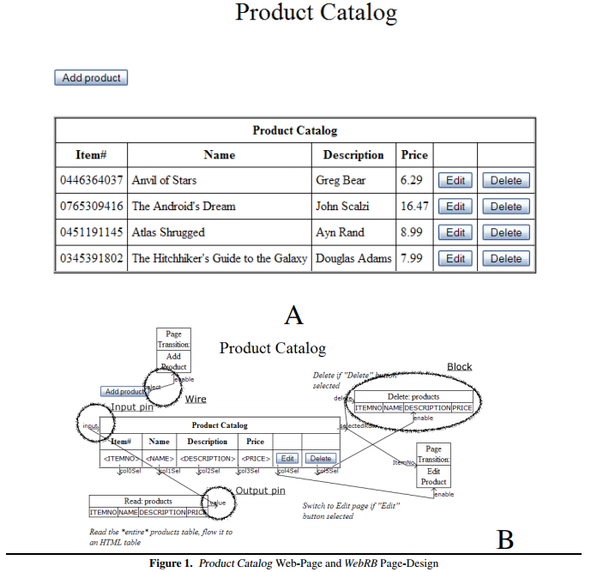
Problem(2/2)
Specifically,
“relational web-applications”:
“Read relational databases and present the data in a GUI”
“Update relational databases based on a user’s interaction with the GUI”
“Perform transformations of the relational data which require only simple or moderately complex business logic”

Slide 5
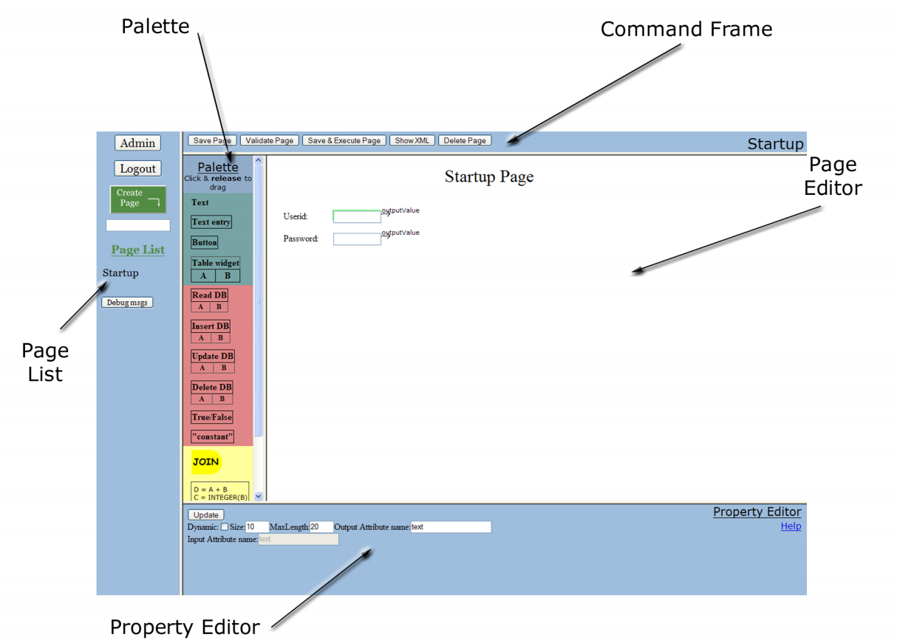
Approach(1/3)
Implementation:
Server-Side: PHP and DB2
Client-Side: JavaScript
Specification Format:
XML

Slide 6
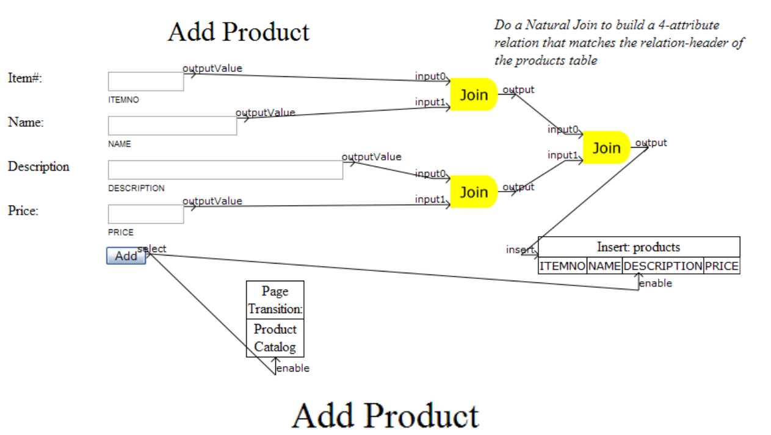
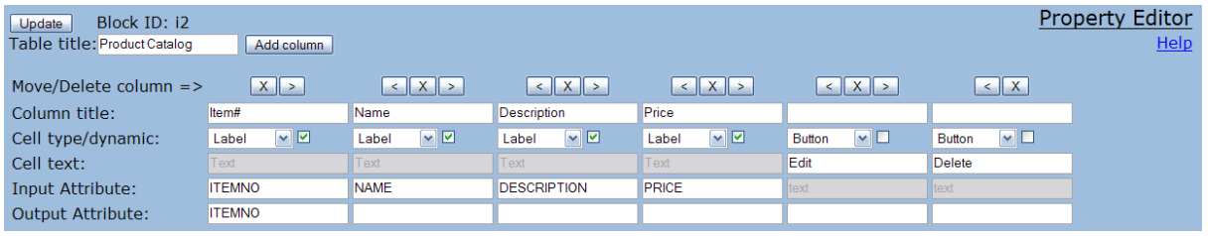
Approach(2/3)
Blocks: I/O Elements
Pins: I/O indicators
Wires: Dataflow

Slide 7
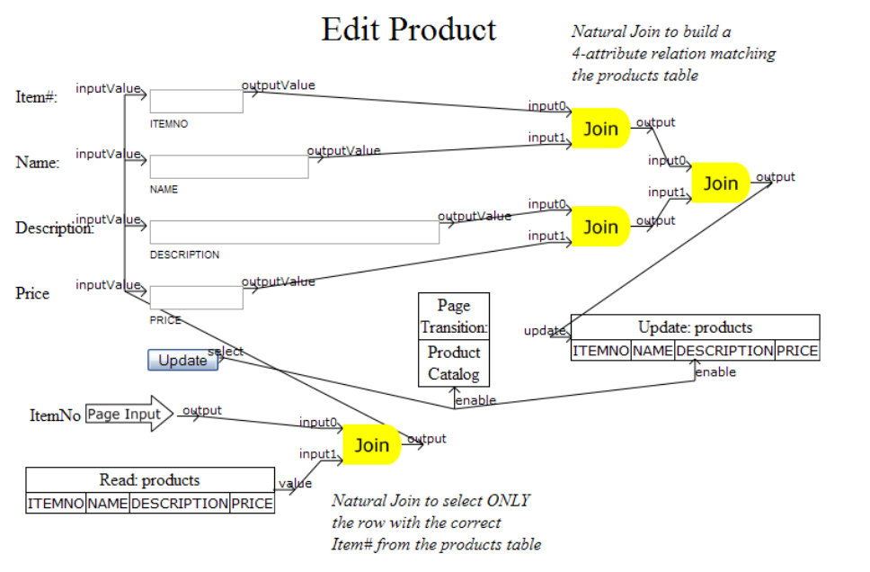
Approach(3/3)
Page Input!

Slide 8
Results Evaluation
Feature Analysis*:
The language uses a relatively small number of abstractions.
Provides excellent closeness-of-mapping for the application UI and less clear for database tables.
Attempts to be very consistent where most UI elements let any input may be connected to any output.
Visual components take more screen space than text-based equivalents.
Provides good visibility for blocks and dataflow at the page level.
* T. R. G. Green and M. Petre.
Usability analysis of visual programming environments:
a ’cognitive dimensions’ framework.
J. Visual Languages and Computing, 7(2):131– 174, 1996.

Slide 9

Questions?
Thanks!
What about the page editor?
What about the property editor?
What about the dataflow?
What about using the best of the two worlds?

