Slide 1

Root Causing Flaky Tests in a
Large-Scale Industrial Setting
Wing Lam
University of Illinois, USA
winglam2@illinois.edu
Patrice Godefroid Suman Nath
Anirudh Santhiar Suresh Thummalapenta
Microsoft Corporation, USA
pg,sumann,ansanthi,suthumma@microsoft.com
Experience paper
ISSTA 2019 | July 15th – 19th 2019 | Beijing, China

Slide 2
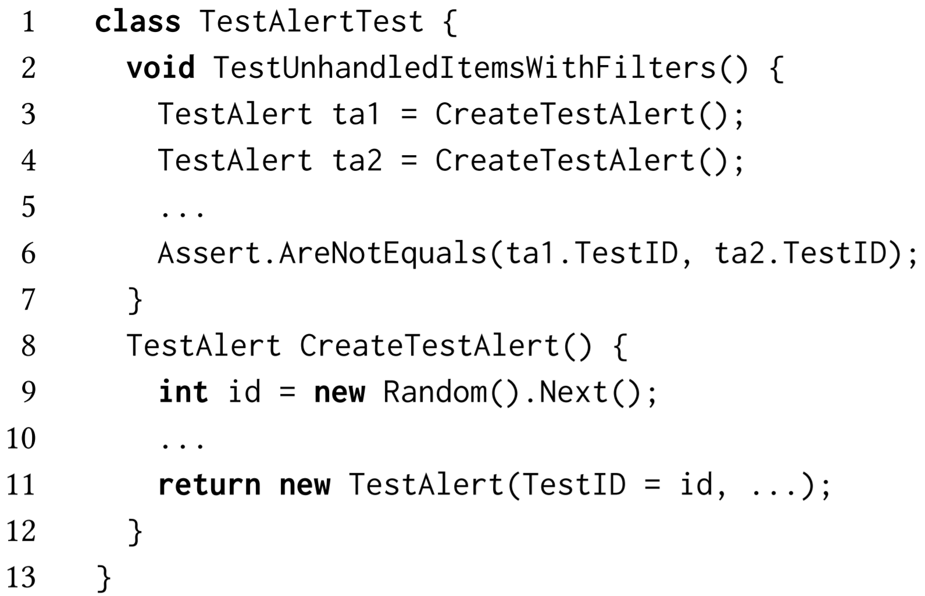
Flaky tests
Example of flaky test from a Microsoft product:
A test is considered flaky if it passes and fails when run in the same test scenario

Slide 3
Flaky tests
Example of flaky test from a Microsoft product:
A test is considered flaky if it passes and fails when run in the same test scenario
Question: How does new Random().Next() generate a random number when no seed is given?
Answer: It uses the system timestamp as seed

Slide 4
Flaky tests
Example of flaky test from a Microsoft product:
new Random().Next() uses the system timestamp as seed
When Line 9 is invoked close together (<15 ms), it will give the same id!
Line 6 checks that the two TestAlert do not have the same id ☹
Notes:
https://docs.microsoft.com/en-us/dotnet/api/system.random?view=netframework-4.8#Multiple

Slide 5
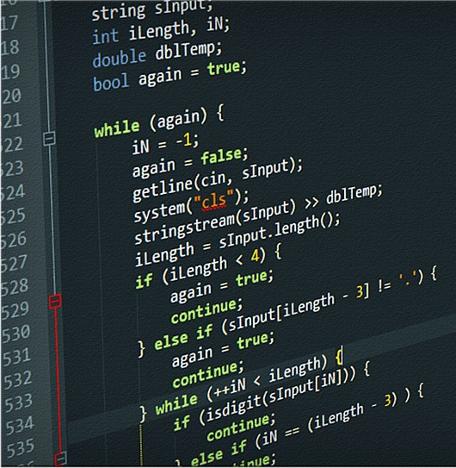





Issues with flaky tests
Source code
Test code
T1:
T2:
…
?
?
?
May not be real faults in current changes; reduce developers’ trust in results
Wastes developer’s and machine time—may manually debug a nonexistent fault in current changes and rerun tests

Slide 6
Contributions
Goal: Help research in the topic of flaky tests
Study – of flaky tests in an industrial setting, demonstrating their prevalence and effect on developers
Framework – to identify and root cause flaky tests within Microsoft
Tool (RootFinder) [1] – to root cause flaky tests by analyzing the logs of passing and failing executions of such tests
Dataset [1] – of anonymized execution logs of flaky tests
[1] https://github.com/winglam/RootFinder

Slide 7
Study - Background
CloudBuild [1]: Microsoft’s incremental and distributed system for compiling code and executing unit tests
CloudBuild
is used by 1200+ projects and executes 350+ million tests per day
executes all units tests in modules affected by changes
always executes a module’s tests in the same order [2]
provides developer an option to rerun failing tests
  if the rerun passes then the test is recorded as flaky
[1] H. Esfahani et al. CloudBuild: Microsoft’s Distributed and Caching Build Service. In ICSE’16.
[2] Lam et al. iDFlakies: A framework for identifying and partially classifying flaky tests. In ICST’19.

Slide 8
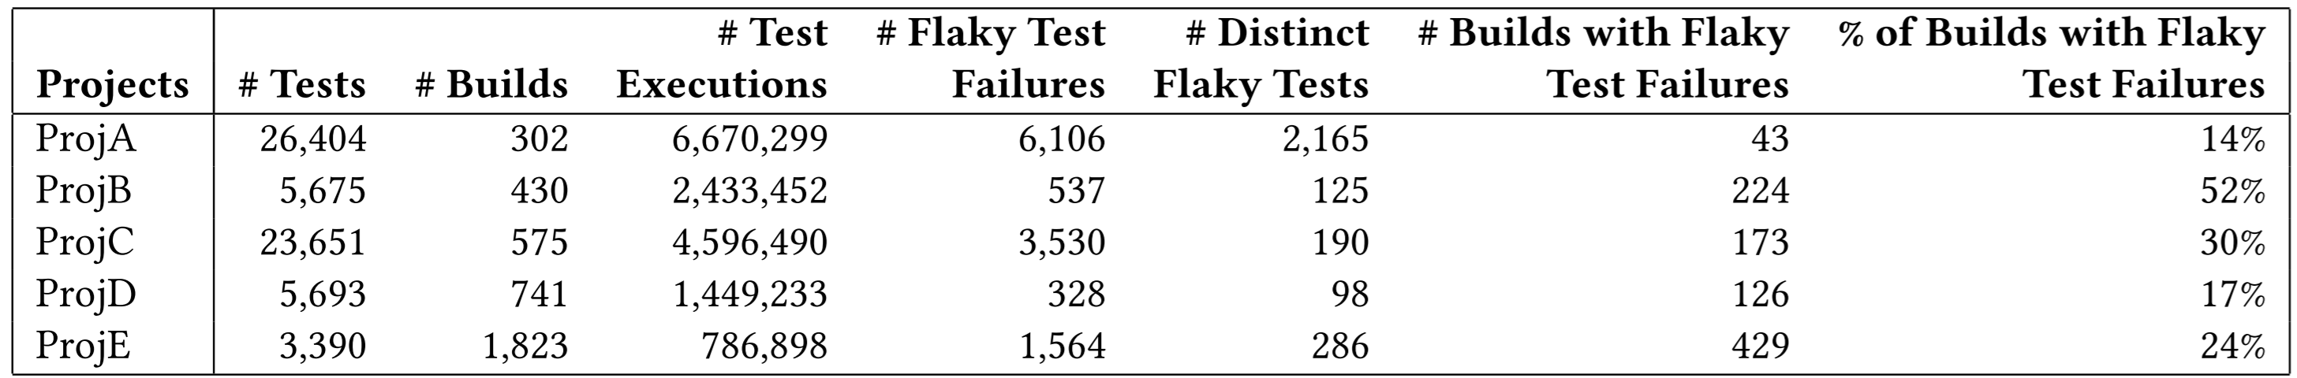
Study
Statistics of 5 projects that use CloudBuild across 30 days:
# of flaky test failures and flaky tests is lower bound; rerunning a failed flaky tests does not guarantee it will pass

Slide 9
Study
Statistics of 5 projects that use CloudBuild across 30 days:
# of flaky test failures and flaky tests is lower bound; rerunning a failed flaky tests does not guarantee it will pass
# of distinct flaky tests can be low but % of builds that fail due to flaky tests can be high

Slide 10
Complete framework - Overview
Input: developer’s changes in a repository
Output: result of tests, ranked list of possible root causes for flaky tests
Complete framework contains two parts;
Running tests relevant to developers’ changes (CloudBuild)
When flaky tests are identified from CloudBuild, output ranked list of possible root causes for them

Slide 11
Complete framework - Overview
Input: developer’s changes in a repository
Output: result of tests, ranked list of possible root causes for flaky tests
Complete framework contains two parts;
Running tests relevant to developers’ changes (CloudBuild)
When flaky tests are identified from CloudBuild, output ranked list of possible root causes for them

Slide 12
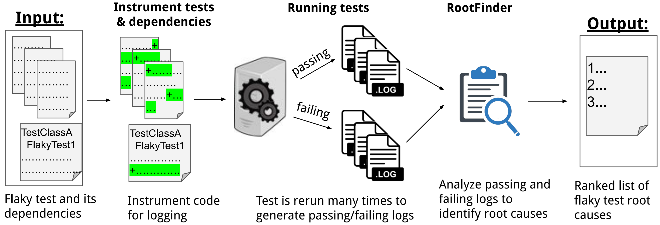
Root causing framework
Input: a flaky test and its dependencies

Slide 13
Root causing framework
Instruments the test and its dependencies to produce logs when run
Each log contains method call information, timestamp, return value of methods, thread IDs of method…

Slide 14
Root causing framework
Generate logs for passing and failing executions of the test by running it many times
Our experiments ran each test 100 times, about 14% of flaky tests were reproducible

Slide 15
Root causing framework
Analyze the logs with RootFinder to highlight likely reasons for why the test is flaky
More details to come…

Slide 16
Root causing framework
Input: a flaky test and its dependencies
Output: a ranked list of possible root causes for why the test is flaky

Slide 17
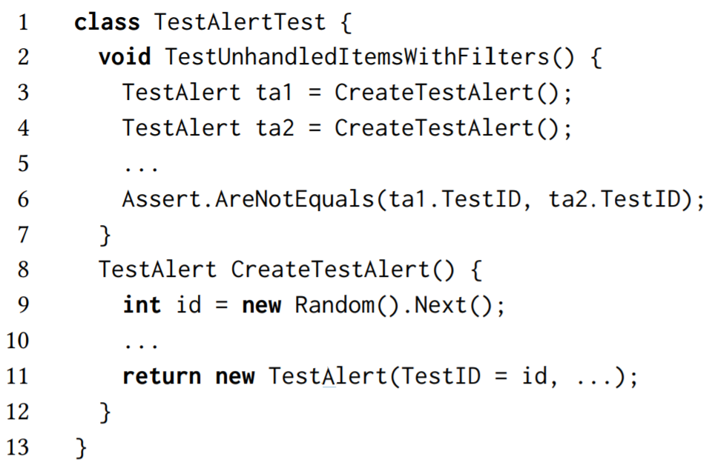
RootFinder - Example
Passing logs:
Line # | Source # | Seq # | Caller name | Callee name | Timestamp | Return Value
1 | 3 | 1 | TestAlertTest.TUIWF() | TestAlertTest.CreateTestAlert() | 1 | null
2 | 9 | 1 | TestAlertTest.CreateTestAlert() | Random.Next() | 2 | 14
3 | 11 | 1 | TestAlertTest.CreateTestAlert() | TestAlert.TestAlert(int) | 2 | null
4 | 4 | 1 | TestAlertTest. TUIWF() | TestAlertTest.CreateTestAlert() | 3 | null
5 | 9 | 2 | TestAlertTest.CreateTestAlert() | Random.Next() | 3 | 16
6 | 11 | 2 | TestAlertTest.CreateTestAlert() | TestAlert.TestAlert(int) | 3 | null
… | … | … | … | … | … | …
8 | 6 | 1 | TestAlertTest. TUIWF() | Assert.AreEquals(…) | 20 | null
Line # | Source # | Seq # | Caller name | Callee name | Timestamp | Return Value
1 | 3 | 1 | TestAlertTest.TUIWF() | TestAlertTest.CreateTestAlert() | 1 | null
2 | 9 | 1 | TestAlertTest.CreateTestAlert() | Random.Next() | 2 | 1
3 | 11 | 1 | TestAlertTest.CreateTestAlert() | TestAlert.TestAlert(int) | 2 | null
4 | 4 | 1 | TestAlertTest. TUIWF() | TestAlertTest.CreateTestAlert() | 3 | null
5 | 9 | 2 | TestAlertTest.CreateTestAlert() | Random.Next() | 3 | 5
6 | 11 | 2 | TestAlertTest.CreateTestAlert() | TestAlert.TestAlert(int) | 3 | null
… | … | … | … | … | … | …
8 | 6 | 1 | TestAlertTest. TUIWF() | Assert.AreEquals(…) | 17 | null
Line # | Source # | Seq # | Caller name | Callee name | Timestamp | Return Value
1 | 3 | 1 | TestAlertTest.TUIWF() | TestAlertTest.CreateTestAlert() | 1 | null
2 | 9 | 1 | TestAlertTest.CreateTestAlert() | Random.Next() | 2 | 19
3 | 11 | 1 | TestAlertTest.CreateTestAlert() | TestAlert.TestAlert(int) | 2 | null
4 | 4 | 1 | TestAlertTest. TUIWF() | TestAlertTest.CreateTestAlert() | 3 | null
5 | 9 | 2 | TestAlertTest.CreateTestAlert() | Random.Next() | 3 | 4
6 | 11 | 2 | TestAlertTest.CreateTestAlert() | TestAlert.TestAlert(int) | 3 | null
… | … | … | … | … | … | …
8 | 6 | 1 | TestAlertTest. TUIWF() | Assert.AreEquals(…) | 28 | null
Failing logs:
Line # | Source # | Seq # | Caller name | Callee name | Timestamp | Return Value
1 | 3 | 1 | TestAlertTest.TUIWF() | TestAlertTest.CreateTestAlert() | 1 | null
2 | 9 | 1 | TestAlertTest.CreateTestAlert() | Random.Next() | 2 | 21
3 | 11 | 1 | TestAlertTest.CreateTestAlert() | TestAlert.TestAlert(int) | 2 | null
4 | 4 | 1 | TestAlertTest. TUIWF() | TestAlertTest.CreateTestAlert() | 2 | null
5 | 9 | 2 | TestAlertTest.CreateTestAlert() | Random.Next() | 2 | 21
6 | 11 | 2 | TestAlertTest.CreateTestAlert() | TestAlert.TestAlert(int) | 2 | null
… | … | … | … | … | … | …
8 | 6 | 1 | TestAlertTest. TUIWF() | Assert.AreEquals(…) | 18 | null
Line # | Source # | Seq # | Caller name | Callee name | Timestamp | Return Value
1 | 3 | 1 | TestAlertTest.TUIWF() | TestAlertTest.CreateTestAlert() | 1 | null
2 | 9 | 1 | TestAlertTest.CreateTestAlert() | Random.Next() | 2 | 17
3 | 11 | 1 | TestAlertTest.CreateTestAlert() | TestAlert.TestAlert(int) | 2 | null
4 | 4 | 1 | TestAlertTest. TUIWF() | TestAlertTest.CreateTestAlert() | 2 | null
5 | 9 | 2 | TestAlertTest.CreateTestAlert() | Random.Next() | 2 | 17
6 | 11 | 2 | TestAlertTest.CreateTestAlert() | TestAlert.TestAlert(int) | 2 | null
… | … | … | … | … | … | …
8 | 6 | 1 | TestAlertTest. TUIWF() | Assert.AreEquals(…) | 24 | null
Line # | Source # | Seq # | Caller name | Callee name | Timestamp | Return Value
1 | 3 | 1 | TestAlertTest.TUIWF() | TestAlertTest.CreateTestAlert() | 1 | null
2 | 9 | 1 | TestAlertTest.CreateTestAlert() | Random.Next() | 2 | 5
3 | 11 | 1 | TestAlertTest.CreateTestAlert() | TestAlert.TestAlert(int) | 2 | null
4 | 4 | 1 | TestAlertTest. TUIWF() | TestAlertTest.CreateTestAlert() | 2 | null
5 | 9 | 2 | TestAlertTest.CreateTestAlert() | Random.Next() | 2 | 5
6 | 11 | 2 | TestAlertTest.CreateTestAlert() | TestAlert.TestAlert(int) | 2 | null
… | … | … | … | … | … | …
8 | 6 | 1 | TestAlertTest. TUIWF() | Assert.AreEquals(…) | 16 | null
All Passing logs’ Random.Next returned different values while Failing logs’ returned same ones!

Slide 18
RootFinder - Analysis
Log analysis steps:
Identify predicates within each individual log
  Example of predicate: whether the return value of a method call is the same as that of the same method call earlier in the log. Details are in paper…
Compare predicates of logs with one another
Output: predicates that are consistently the same within passing logs but are consistently different in failing logs
Ranking: predicates positioned earlier in logs are ranked higher

Slide 19
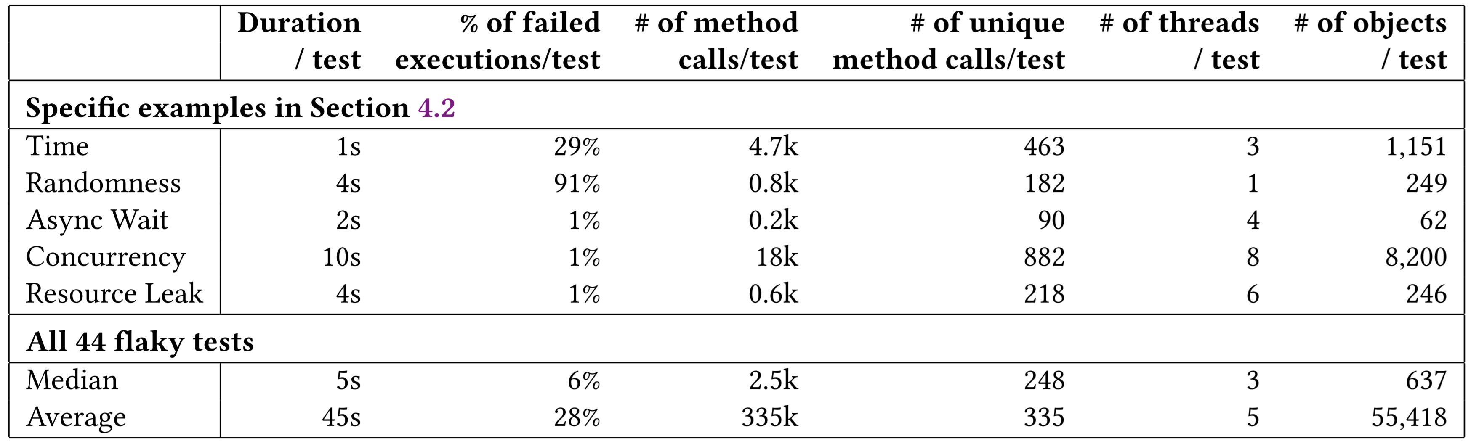
Dataset
Consists of 44 flaky tests belonging to 22 projects found in one day
100 anonymized logs for all 44 tests are publicly available [1]
Although these flaky tests are unit tests, on average they contain
  335k method calls, 5 threads, and 55k objects per test!
[1] https://github.com/winglam/RootFinder

Slide 20
RootFinder application
When analyzing 100 logs, RootFinder
consumes just 35 seconds on average
outputs a median of 1000 predicates
root cause to help developers is typically in top 3% of predicates!
RootFinder is available for use to Microsoft developers through CloudBuild and is publicly available online for others to use!

Slide 21
Lessons learned
Reproducing flakiness is challenging
  Only 14% of tests that were flaky on CloudBuild was reproducible locally in 100 executions
Runtime overhead from instrumentation can affect reproducibility of flaky tests
  When we run 59 flaky tests with and without instrumentation, 2 tests are flaky only with instrumentation, while 3 tests are flaky only without instrumentation
Finding differences in the runtime behavior of flaky tests can be an effective way to help developers root cause these tests
  RootFinder can already help developers in nine out of ten causes of flaky tests [1]
See paper for more lessons and open research challenges…
[1] Q. Luo et al. An Empirical Analysis of Flaky Tests. In FSE’14.

Slide 22
Conclusion
Lessons learned:
Reproducing flakiness is challenging
Runtime overhead from instrumentation can affect reproducibility of flaky tests
Finding differences in the runtime behavior of flaky tests can be an effective way to help developers root cause these tests
To help developers research in flaky tests, we present
  Study – of flaky tests in an industrial setting, demonstrating their prevalence and effect on developers
  Framework – to identify and root cause flaky tests within Microsoft
  RootFinder [1] – to root cause flaky tests by analyzing the logs of passing and failing executions of such tests
  Dataset [1] – of anonymized execution logs of flaky tests
[1] https://github.com/winglam/RootFinder
Email: winglam2@Illinois.edu

