Slide 1

iDFlakies: A Framework for Detecting and Partially Classifying Flaky Tests
Wing Lam Reed Oei August Shi
Darko Marinov Tao Xie
University of Illinois at Urbana-Champaign, USA
winglam2,reedoei2,awshi2,marinov,taoxie@illinois.edu
ICST 2019 | April 22nd – 27th 2019 | Xi’an, China

Slide 2
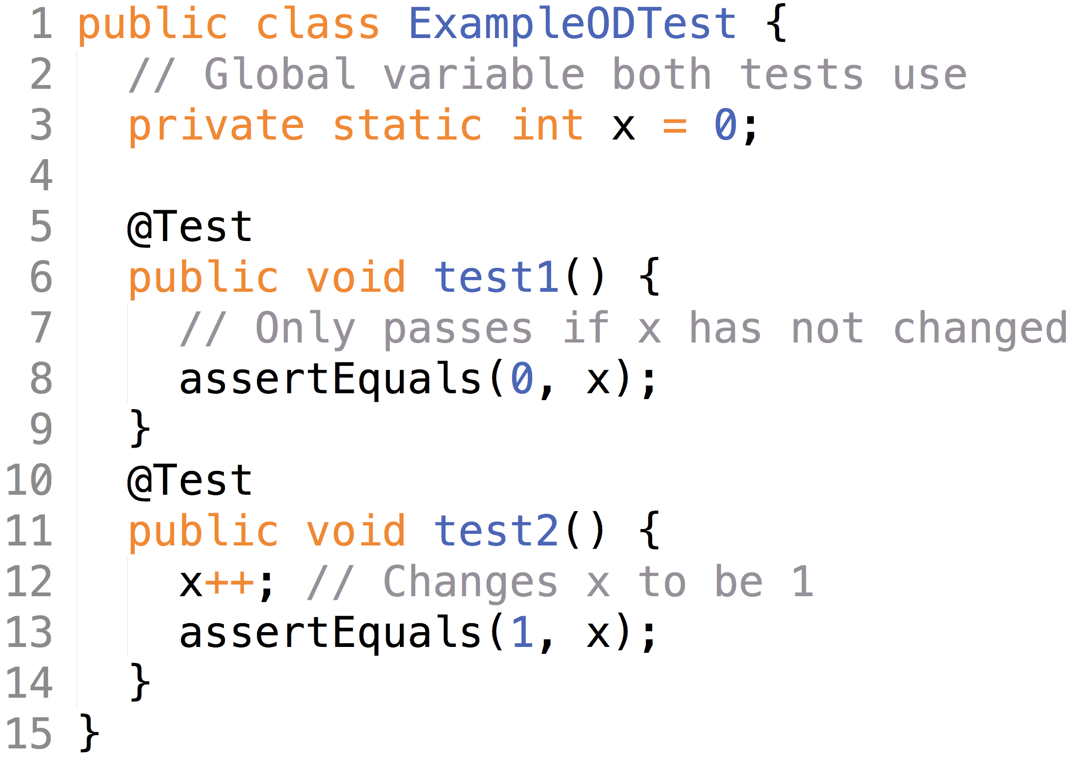
Flaky tests
A test is considered flaky if it passes and fails when run in the same test scenario
Types of flaky tests considered:
Order-dependent tests: flaky only due to the order in which tests run
Non-order-dependent tests: all other types of flaky tests

Slide 3






Issues with flaky tests
Source code
Test code
T1:
T2:
…
?
?
?
May not be real faults in current changes; reduce developers’ trust in results
Wastes developer’s and machine time—may manually debug a nonexistent fault in current changes and rerun tests

Slide 4
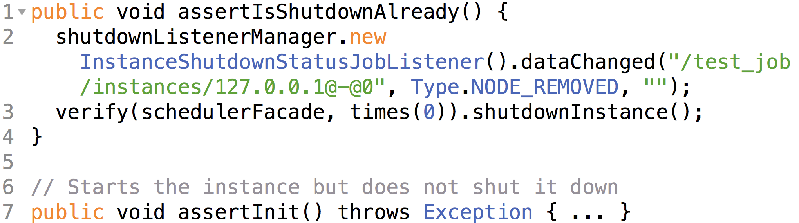
Order-dependent (OD) test
A test that is flaky only due to the order in which tests run
Example OD test from ElasticJob/Elastic-Job-Lite:

Slide 5
Order-dependent (OD) test
Line 3 checks that an instance of a class variable is shut down
But the instance can be started by other tests (Line 7)!

Slide 6
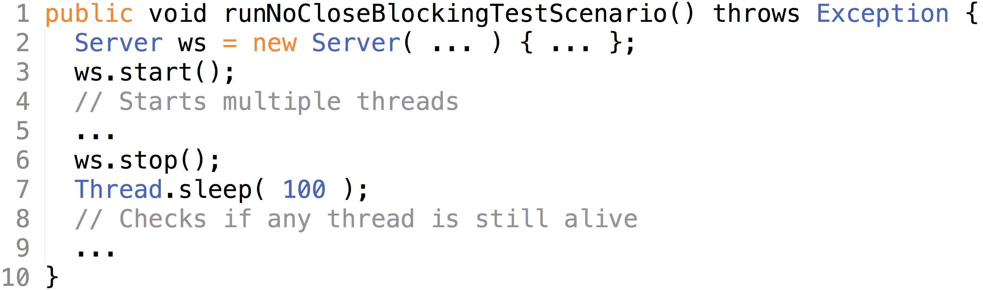
Non-order-dependent (NOD) test
All other types of flaky tests besides OD
Example NOD test from TooTallNate/Java-WebSocket:

Slide 7
Non-order-dependent (NOD) test
Line 5-7 starts multiple threads, stops the server, and waits 100 ms for the stopped server to kill the started threads
Line 9 checks whether any threads is still alive

Slide 8
Non-order-dependent (NOD) test
Depending on the load of the machine, the NOD test may take 100+ ms to close all threads!

Slide 9
Contributions
Goal: Help research in the topic of flaky tests
Tool – easy to integrate tool to detect flaky tests for Maven projects that use JUnit
iDFlakies framework – to easily extend and apply our tool to detect and classify flaky tests
Dataset [1] – a collection of artifacts, including Docker images and test-run logs, and list of flaky tests
Study – study of flaky tests including the prevalence of OD and NOD tests, and best way to automatically detect them
[1] https://sites.google.com/view/flakytestdataset

Slide 10
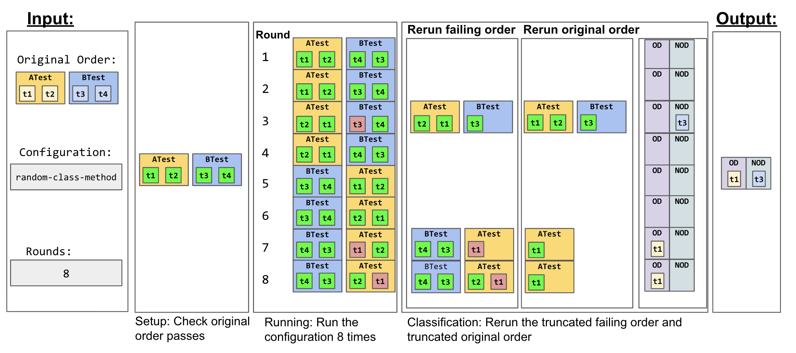
Tool inputs
configuration for ordering tests
Inputs: test suite, # of rounds to run,

Slide 11
Tool configurations
Tool configurations are different ways to order the execution of tests
These different ways generate different orderings based on the order of tests used by Maven
Tool comes with 5 configurations and can be easily extended with additional configurations

Slide 12
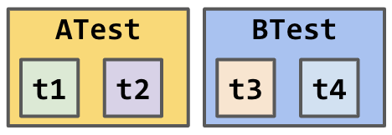
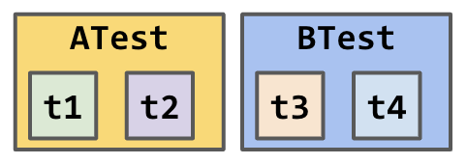
Tool configurations – Original-order
Maven-specified test order:
Original-order: runs tests in Maven-specified test order again and finds only NOD tests
Original-order test orders:

Slide 13
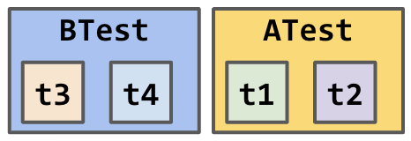
Tool configurations – Reverse-class
Maven-specified test order:
Reverse-class: reverses order of all test classes from original order but keeps test methods in the same order as original order
Reverse-class test orders:

Slide 14
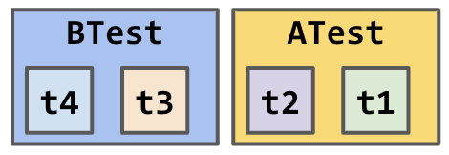
Tool configurations – Reverse-class-method
Maven-specified test order:
Reverse-class-method (ReCM): reverses order of all test classes and methods from original order
Reverse-class-method test orders:

Slide 15
Tool configurations – Random-class
Maven-specified test order:
Random-class: runs test classes in random order but keeps methods in each class in the same order as the original order
Random-class test orders:

Slide 16
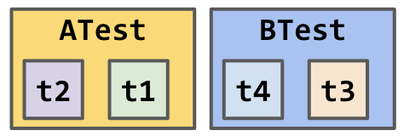
Tool configurations – Random-class-method
Maven-specified test order:
Examples of RaCM test orders:
Random-class-method (RaCM): runs test methods in random order; first, randomize order of the test classes then methods within test classes but not interleave methods between classes
…

Slide 17
Tool setup step
Setup step: Check original order passes

Slide 18
Tool running step
Running step: Run the Random-class-method configuration 8 times
Round 3
Round 7
Round 8

Slide 19
Tool classification step
Classification step: Rerun the truncated failing order and truncated original order for each failed test

Slide 20
Tool outputs
Inputs: test suite, configuration for ordering tests, # of times to run
Outputs: detected OD/NOD tests, exact order in which each OD test fails

Slide 21
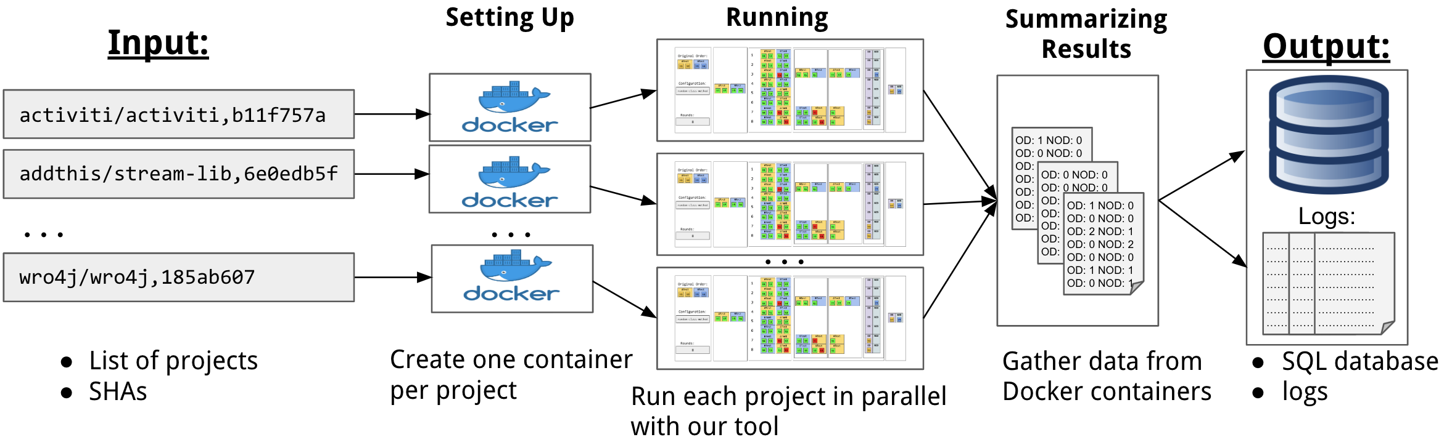
iDFlakies framework
Input: list of Java project URLs and commits

Slide 22
iDFlakies framework
Input: list of Java project URLs and commits

Slide 23
iDFlakies framework
Input: list of project URLs and commits
Output: database with various information, e.g., OD and NOD tests detected for each configuration, time a test suite takes to run, …

Slide 24
Study
To help understand two flaky test types’ prevalence, their impact on developers, and the effectiveness of different ordering configurations, we study
RQ1: What is the breakdown of OD and NOD tests in open-source projects?
RQ2: What is the probability of a round (test-suite run) containing at least one flaky-test failure?
RQ3: What ordering configurations detect the most flaky tests?

Slide 25
Study – Dataset & breakdown of OD/NOD tests
Contains a collection of artifacts, including Docker images and test-run logs used to create the dataset of flaky tests
Dataset contains
111 modules (from 82 projects) that have 1+ flaky tests
These 111 modules contain a total of 422 unknown flaky tests [1]
Of the 422 flaky tests, 213 (50.5%) are OD tests and 209 (49.5%) are NOD tests
[1] https://docs.google.com/spreadsheets/d/1aeQr9Rlb1ohGTABZsd5sZLdjh0hedxAWFJxHpsCnJ1w/

Slide 26
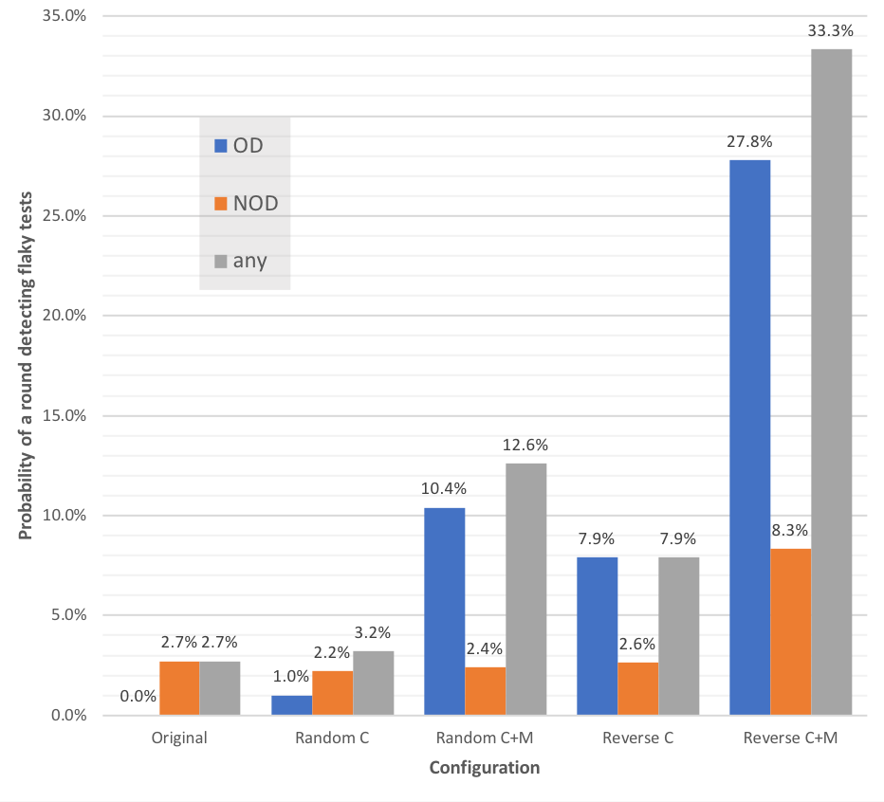
Study – Probability of flaky test failing round
Configurations have similar probability of failing round due to NOD tests. E.g., Original has 2.7%
Reverse-class-method (ReCM) is most efficient for detecting flaky tests. If flaky tests exist, ReCM has high probability of finding some from just 1 run!
Rounds | 10 | 50 | 100
OriginalO prob. to fail due to NOD tests | 24% | 75% | 94%
Probability = # of rounds in which a flaky test fails
/ # of rounds run

Slide 27
Study – Configurations detecting flaky tests
Chance to find NOD tests for Original-order is similar to Random-class-method (RaCM)
  There are no clear benefits to detecting flaky tests with Original-order
RaCM detects the most OD tests, 88.0% of all OD tests detected across all configurations
  RaCM is most effective for detecting OD tests
ReCM detects only 47 OD tests (25.5% of all OD tests), but detects 4 not detected by RaCM
  ReCM is not as effective, but can still be beneficial to run

Slide 28
Study – Findings
Found 422 flaky tests: 213 (50.5%) are OD tests and 209 (49.5%) are NOD tests
ReCM is most efficient for detecting flaky tests. If flaky tests exist, ReCM has very high probability of finding some from just one test-suite run!
RaCM is most effective for detecting OD tests. RaCM alone finds 88% of OD tests found from all configurations!
Developers should (1) run the ReCM once to quickly detect some flaky tests, then (2) run RaCM to detect more flaky tests!

Slide 29
Conclusion
Flaky tests waste developer’s and machine time
This work helps spur research in the topic of flaky tests. More specifically, we present
  Tool – easy to integrate tool to detect flaky tests for Maven projects that use JUnit
  iDFlakies framework – to easily extend and apply our tool to detect and classify flaky tests
  Dataset – a collection of artifacts, including Docker images and test-run logs, and list of flaky tests (https://sites.google.com/view/flakytestdataset)
  Study – study of flaky tests including the prevalence of OD and NOD tests, and best way to automatically detect them

Slide 30
Thank you! Questions?
Email: winglam2@Illinois.edu
Paper & Dataset: https://sites.google.com/view/FlakyTestDataset

Slide 31
Conclusion
Flaky tests waste developer’s and machine time
This work helps spur research in the topic of flaky tests. More specifically, we present
  Tool – easy to integrate tool to detect flaky tests for Maven projects that use JUnit
  iDFlakies framework – to easily extend and apply our tool to detect and classify flaky tests
  Dataset – a collection of artifacts, including Docker images and test-run logs, and list of flaky tests (https://sites.google.com/view/flakytestdataset)
  Study – study of flaky tests including the prevalence of OD and NOD tests, and best way to automatically detect them
This work was supported in part by National Science Foundation under grants no. CCF-1421503, CNS-1513939, CNS-1564274, CNS-1646305, CNS-1740916, CCF-1763788, CCF-1816615, OAC-1839010

