Slide 1

A Study on the Lifecycle of Flaky Tests
Wing Lam
University of Illinois at Urbana-Champaign
winglam2@illinois.edu
Kıvanç Muşlu, Hitesh Sajnani,
Suresh Thummalapenta
Microsoft
{kivanc.muslu,hitsaj,suthumma}@microsoft.com

Slide 2
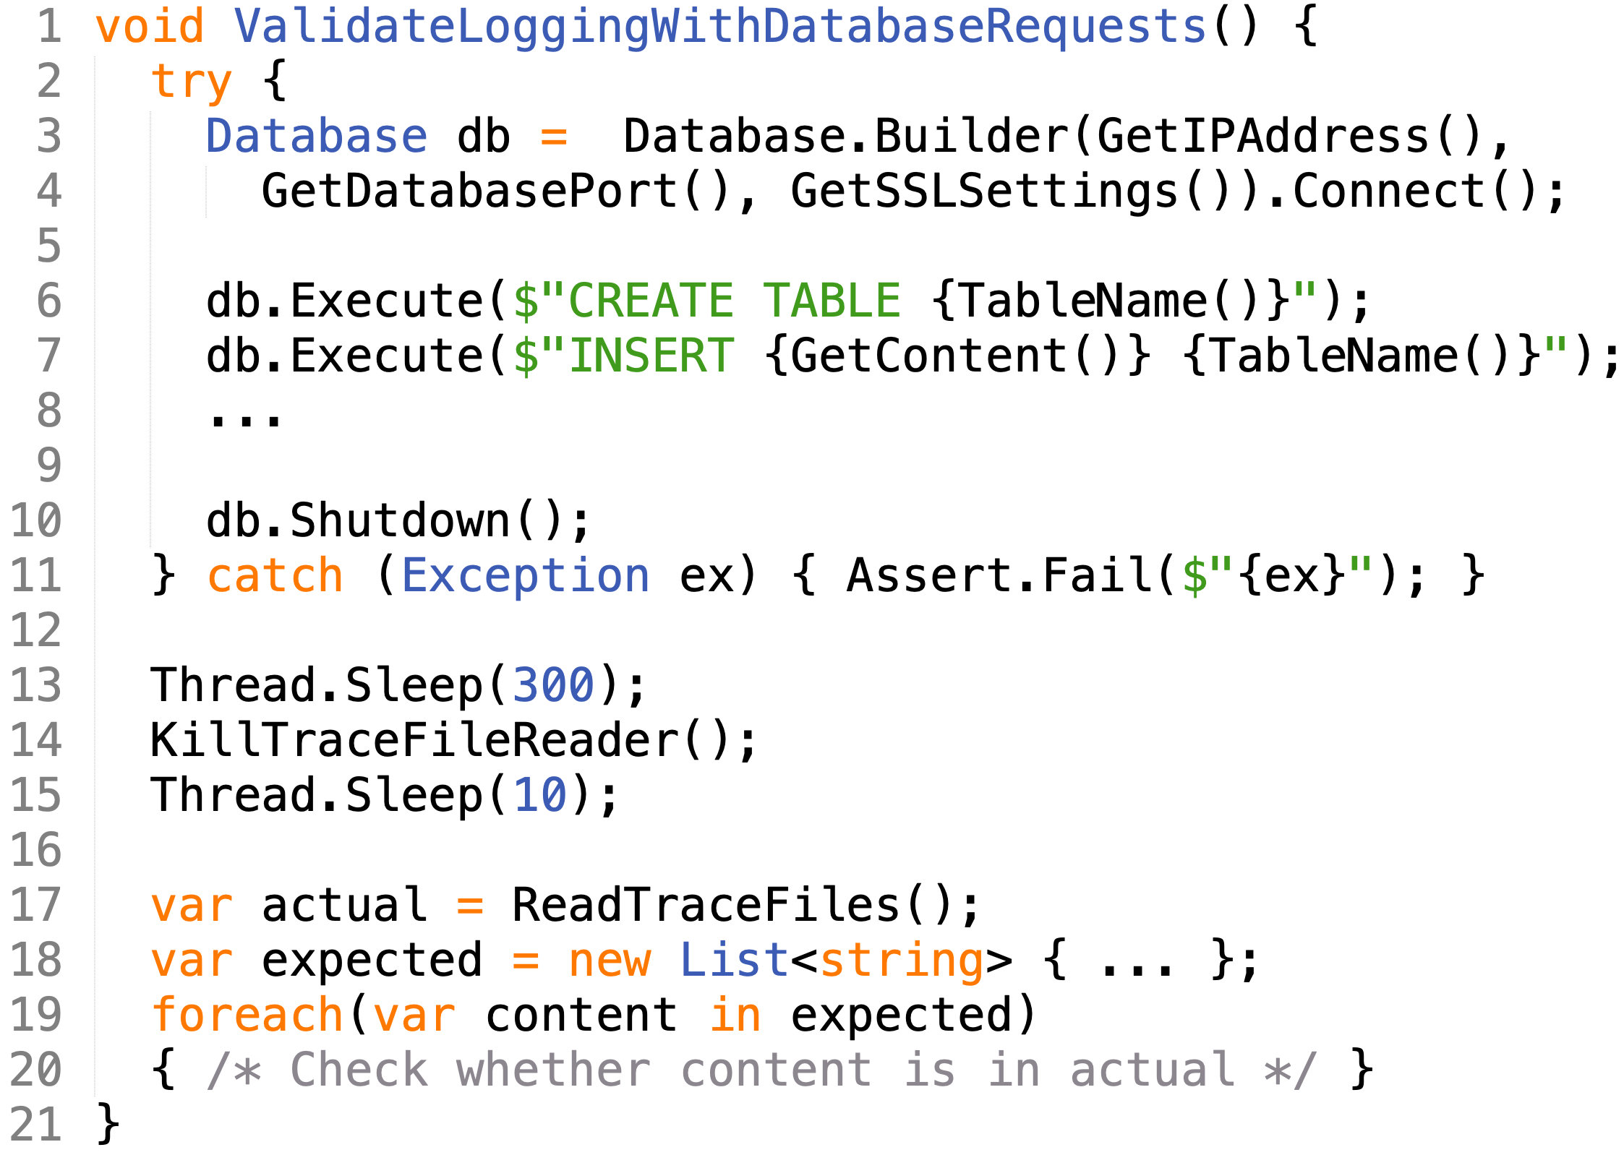

Flaky test – Example
Flaky test at Microsoft:
A test is considered flaky if it passes and fails when run in the same test scenario
Test in total contains 100+ lines just in this test class
Problem: Line 20 can pass and fail. How come??

Slide 3
Flaky test – Content
Flaky test at Microsoft:
Contents of test:
Lines 3-4: Setup database (db)
Lines 6-8: Add content to db
Line 10: Shutdown db
Line 13: ????????????????????
????????
Lines 14-15: Ensure file reader is killed before using it
Lines 17-20: Check whether expected content was logged
Why would expected content be missing sometimes?

Slide 4

Flaky test – Content
Flaky test at Microsoft:
Contents of test:
Lines 3-4: Setup database (db)
Lines 6-8: Add content to db
Line 10: Shutdown db
Line 13: Wait for added content to be logged to a trace file
Lines 14-15: Ensure file reader is killed before using it
Lines 17-20: Check whether expected content was logged

Slide 5
Flaky test – Fix
Flaky test at Microsoft:
Developer’s fix to reduce flakiness is to increase sleep time
Line 13 (300 -> 600)
“Fixed flakiness by increasing wait time before checking content” – Developer
Luo et al. [1] categorized such flaky tests as Async Wait
  Async Wait flaky tests make an asynchronous call and do not properly wait for the call to return
[1] Q. Luo et al. An Empirical Analysis of Flaky Tests. In FSE’14.

Slide 6
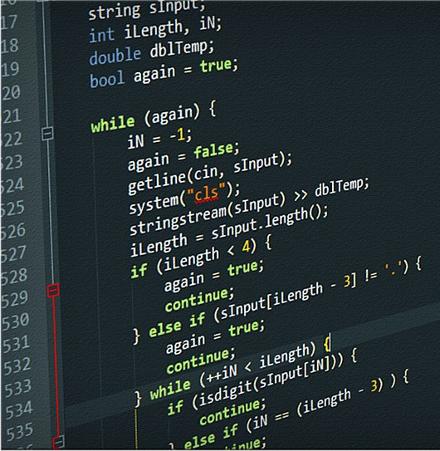





Issues with flaky tests
Source code
Test code
T1:
T2:
…
?
?
?
May not be real faults in current changes; reduce developers’ trust in results
Wastes developer’s and machine time—may manually debug a nonexistent fault in current changes and rerun tests

Slide 7
Contributions
Goal: Help proprietary software developers with flaky tests
Study – characterizing flaky tests in proprietary software, demonstrating their prevalence, detectability, characteristics, categories, and resolution
FaTB – approach to balance the runtime and frequency of flaky-test failures caused by asynchronous calls (the most prominent cause)

Slide 8
Study – Research questions
Prevalence – How prevalent are flaky tests and to what extent do they impact developers’ workflow?
Detectability – How many runs are needed to detect flaky tests?
Characteristics – Does test flakiness reoccur after fixes? How does the runtime of a flaky test differ between passing and failing runs?
Categories – What are the categories (e.g., root cause, location) of flaky-test fixes?
Resolution – How much time do developers take to fix flaky tests? How are developers fixing timing-related Async Wait issues in flaky tests?

Slide 9
Study – Research questions
Prevalence – How prevalent are flaky tests and to what extent do they impact developers’ workflow? See paper
Detectability – How many runs are needed to detect flaky tests? See paper
Characteristics – Does test flakiness reoccur after fixes? How does the runtime of a flaky test differ between passing and failing runs? See paper
Categories – What are the categories (e.g., root cause, location) of flaky-test fixes?
Resolution – How much time do developers take to fix flaky tests? See paper How are developers fixing timing-related Async Wait issues in flaky tests?
Paper: http://mir.cs.illinois.edu/winglam/publications/2020/LamETAL20FaTB.pdf

Slide 10
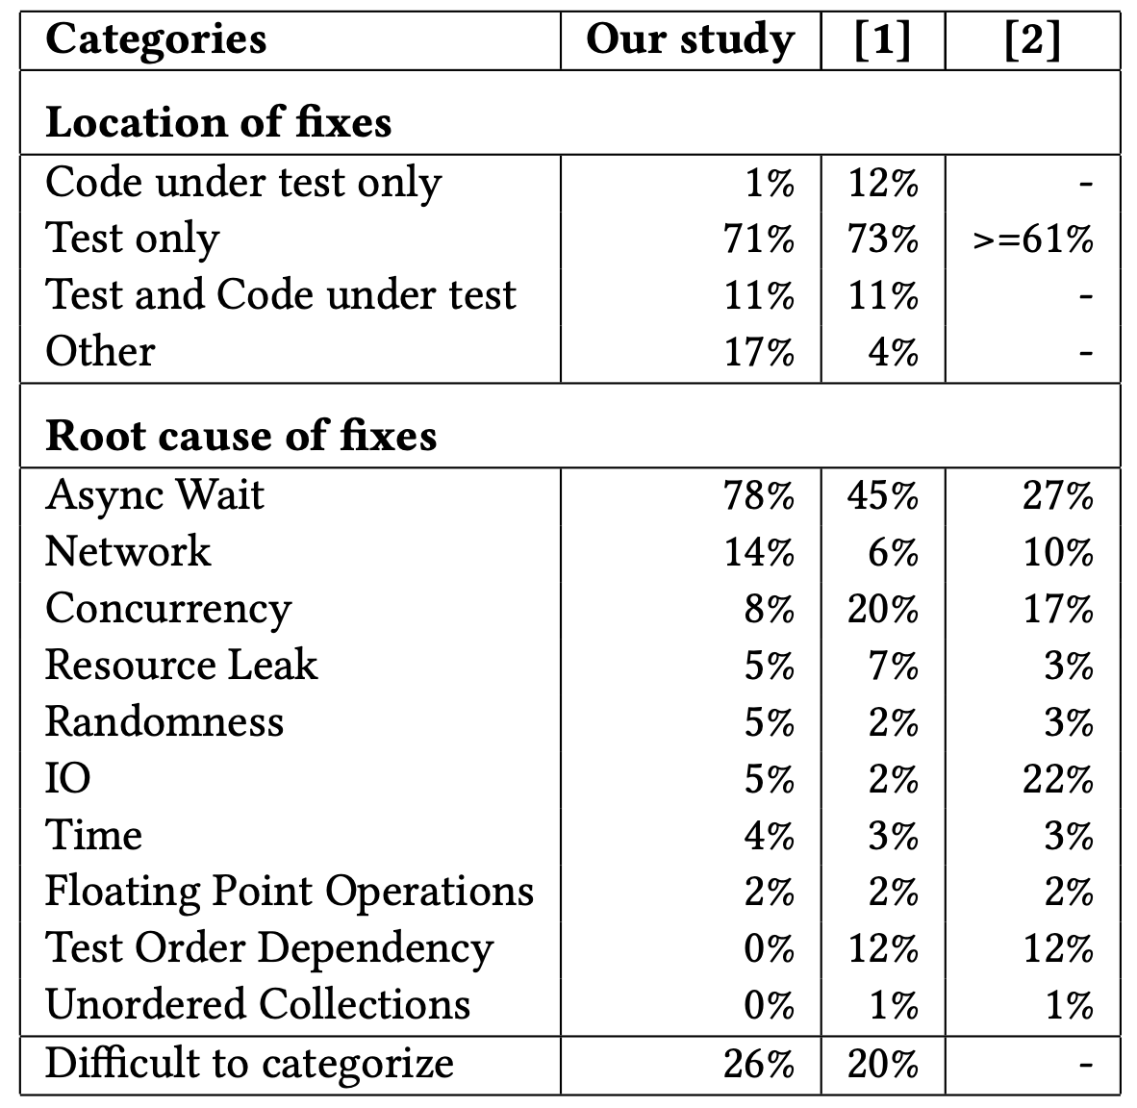
Categories of flaky-test fixes
For 6 projects, we find that
Majority of fixes (71%) are in the test code
Most common category of fixes is Async Wait (78%)
  Async Wait flaky tests make an asynchronous call and do not properly wait for the call to return
Our findings in proprietary software confirms what Luo et al. [1] found in open-source ones;
Test code is where fixes typically are made
Async Wait is the most common category
* Does not sum to 100% because
1 test can be in 1+ categories
[1] Q. Luo et al. An Empirical Analysis of Flaky Tests. In FSE’14.

Slide 11
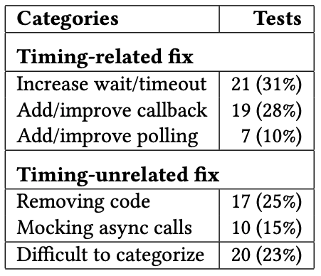
How developers fix Async Wait tests
Fowler [1] proposed three ways to fix Async Wait issues;
  Create “synchronous” interface (0%)
  Implement callback (28%)
  Implement polling (10%)
Besides what Fowler proposed, we find three other ways;
  Increasing wait/timeout (31%)
  Removing the code (25%)
  Mocking the async calls (15%)
* Does not sum to 100% because
1 test can be in 1+ categories
[1] M. Fowler. Eradicating non-determinism in tests. https://martinfowler.com/articles/nonDeterminism.html

Slide 12
Flakiness and Time Balancer (FaTB)
Majority of flaky tests are Async Wait category and majority of fixes performed by developers are increasing wait/timeout
Goal: suggest time values to wait for asynchronous calls while minimizing rate of flaky-test failures and test runtime
  E.g., values for Thread.sleep and timeout annotation
Contains two main steps:
  Obtain the flaky-test failure rate for the time set by the developer
  Generate different time values and for these values, obtain the flaky-test failure rate and runtime of the test

Slide 13
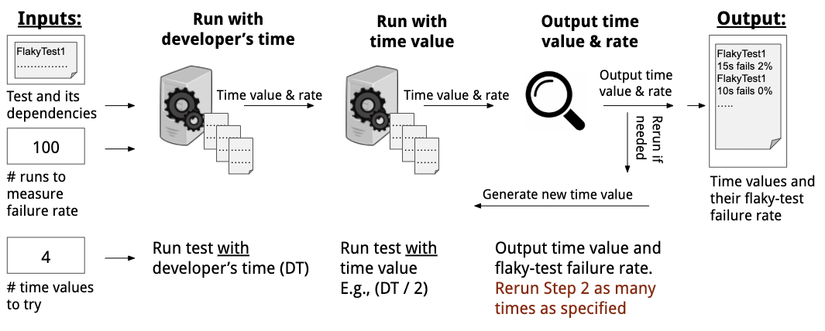
FaTB - Inputs
Input: a flaky test and its dependencies, number of runs to measure frequency of flaky-test failures, and number of time values to try

Slide 14
FaTB – Step 1
Run the test 100 times to to measure the flaky-test failure rate with the time value set by the developer

Slide 15
FaTB – Step 2
Generate a new time value (NTV) based on the previous time value (PTV) and that value’s flaky-test failure rate (PFR)
  E.g., if PTV = 300ms and PFR = 0, then NTV = 150ms

Slide 16
FaTB – Output
Input: a flaky test and its dependencies, number of runs to measure frequency of flaky-test failures, and number of time values to try
Output: for each time value FaTB tried, the runtime of the test and flaky-test failure rate

Slide 17
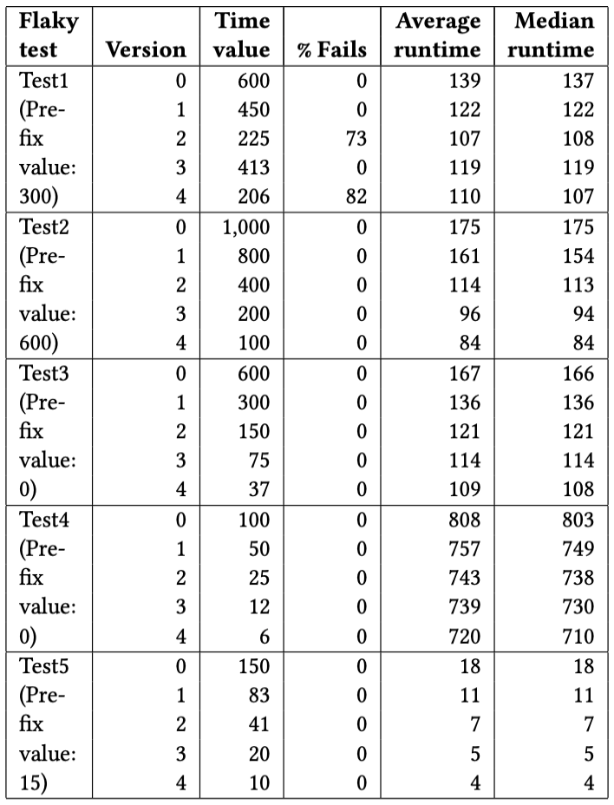
FaTB - Results
5 Async Wait fixes that increase wait/timeout
  Version 0 is time value fix from developers
On average, FaTB reduced running times of tests by 38% while keeping rate of failures at 0
  Test5’s running time was reduced by 78%!
4 out of 5 tests does not appear to be affected by the time value change!
Manual investigation of fix information finds that developers really thought that increasing the time would reduce failures!

Slide 18
Conclusion
Takeaways:
Detecting flakiness is still very challenging
What developers claim as “fixes” for flaky tests are often unreliable
Async Wait is one of the most common category of flaky tests in both open-source and proprietary software
To help proprietary software developers with flaky tests, I present
  Study – characterizing flaky tests in proprietary software, demonstrating their prevalence, detectability, characteristics, categories, and resolution
  FaTB – approach to balance the runtime and frequency of flaky-test failures caused by asynchronous calls
Email: winglam2@Illinois.edu

