Slide 1





A Large-Scale Longitudinal Study of Flaky Tests
Wing Lam Stefan Winter Anjiang Wei
Tao Xie Darko Marinov Jonathan Bell
winglam2@illinois.edu
CNS-1564274
CCF-1763788 CCF-1763822 CCF-1816615 CCF-1844880

Slide 2
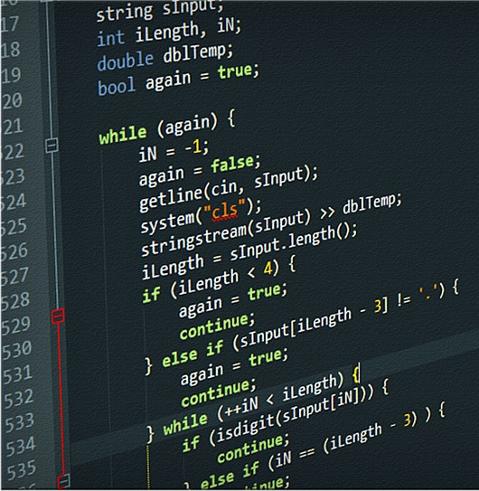





Flaky tests
A test is flaky if it can pass and fail when run in the same test scenario
Code under test
Test code
T1:
T2:
…
?
?
?
Reduces trust in testing—failures may not indicate faults in changes
Wastes time—developers may manually debug nonexistent fault in changes
Many organizations^{1,2,3,4} have reported on the problem of flaky tests
¹Lam et al., “A Study on the Lifecycle of Flaky Tests”. ICSE 2020. (Microsoft)
²Eck et al., “Understanding Flaky Tests: The Developer’s Perspective”. ESEC/FSE 2019. (Mozilla)
³Harman and O’Hearn, “From Start-ups to Scale-ups: Opportunities and Open Problems for Static and Dynamic Program Analysis”. SCAM 2018. (Facebook)
⁴Memon et al., “Taming Google-Scale Continuous Testing”. ICSE-SEIP 2017. (Google)

Slide 3
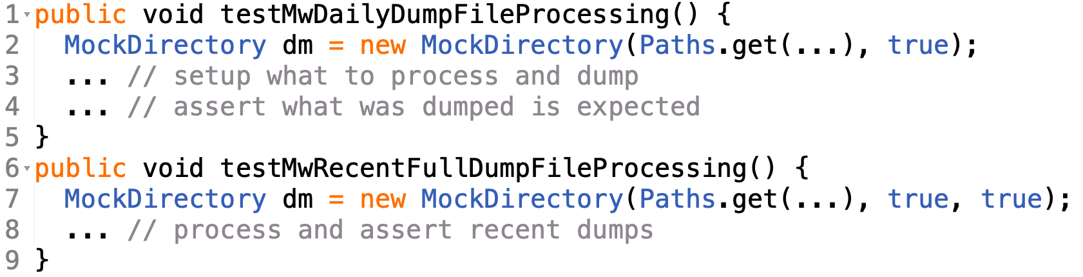

Flaky test – Example
Example flaky test from https://github.com/wikidata/wikidata-toolkit:
Contains 70+ lines just in its test method
Aims to setup a mock directory (dm), dump data into dm, and check its contents
Throws IOException on Line 2 depending on order tests are run

Slide 4

Flaky test – Example in different orders
Example flaky test from https://github.com/wikidata/wikidata-toolkit:
t1:
t2:
Run 1:
Run 2:
Line 7 creates MockDirectory in same path as Line 2
and Line 7’s extra true argument sets up a mock directory so t1 can pass
TestOrder1
TestOrder2
t1
t2
t2
t1

Slide 5
Detecting flaky tests
Some software organizations, e.g., Mozilla and Netflix, run some tools—detectors—to detect flaky tests as soon as possible
Detected tests can then be fixed or accommodated as soon as possible
Recent detectors fall into 3 types. They rerun tests while
isolating tests from one another
changing the order tests run
changing the underlying implementation of an underdetermined specification (e.g., iteration order of HashSet)
Detectors are shown to be effective at detecting flaky tests
But are costly to apply all the time
Many have expressed desire to decrease testing time already¹, reruns are costly!
¹Yoo and Harman, “Regression testing minimization, selection and prioritization: A survey”. STVR 2012.

Slide 6


Decreasing detector cost
To minimize high cost of detectors, while maximizing likelihood to detect flaky tests as soon as possible (ASAP):
What if detectors were applied only on certain changes?
E.g., Mozilla and Netflix apply detectors only when tests are newly added or modified
Runs detectors much less than on all changes
But how effective would that be at detecting flaky tests ASAP?
How often are flaky tests already flaky
when added or modified?

Slide 7
Our contributions
Goal: understand when flaky tests become flaky and its implications on when detectors should be run
We empirically study three main RQs:
RQ1: How effective are detectors if run only when tests are added?
RQ2: How do flaky-test categories affect the effectiveness of running detectors only when tests are added?
RQ3: When should one run detectors?

Slide 8
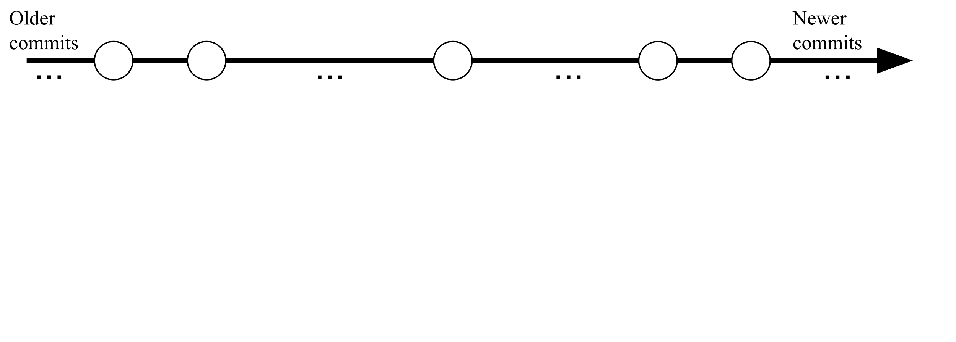
Study setup: Overview
Timeline for each flaky test:

Slide 9
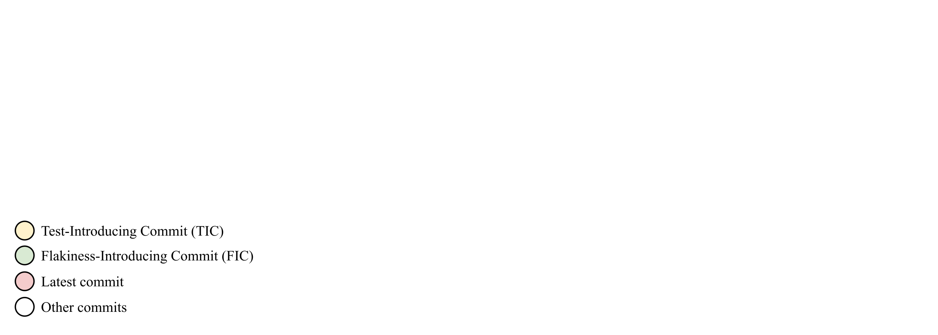
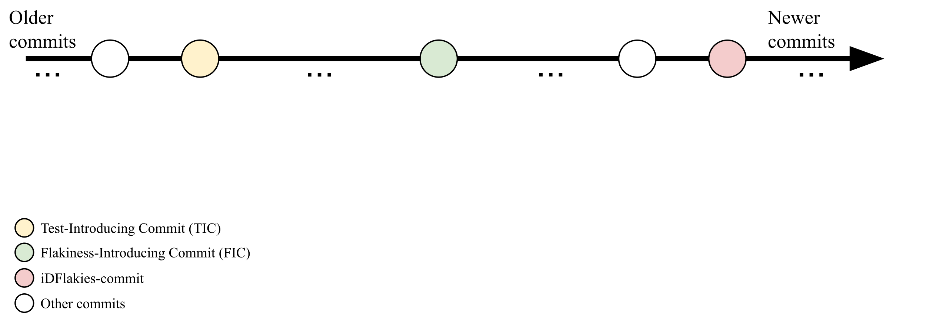
Study setup: Overview
Timeline for each flaky test:

Slide 10
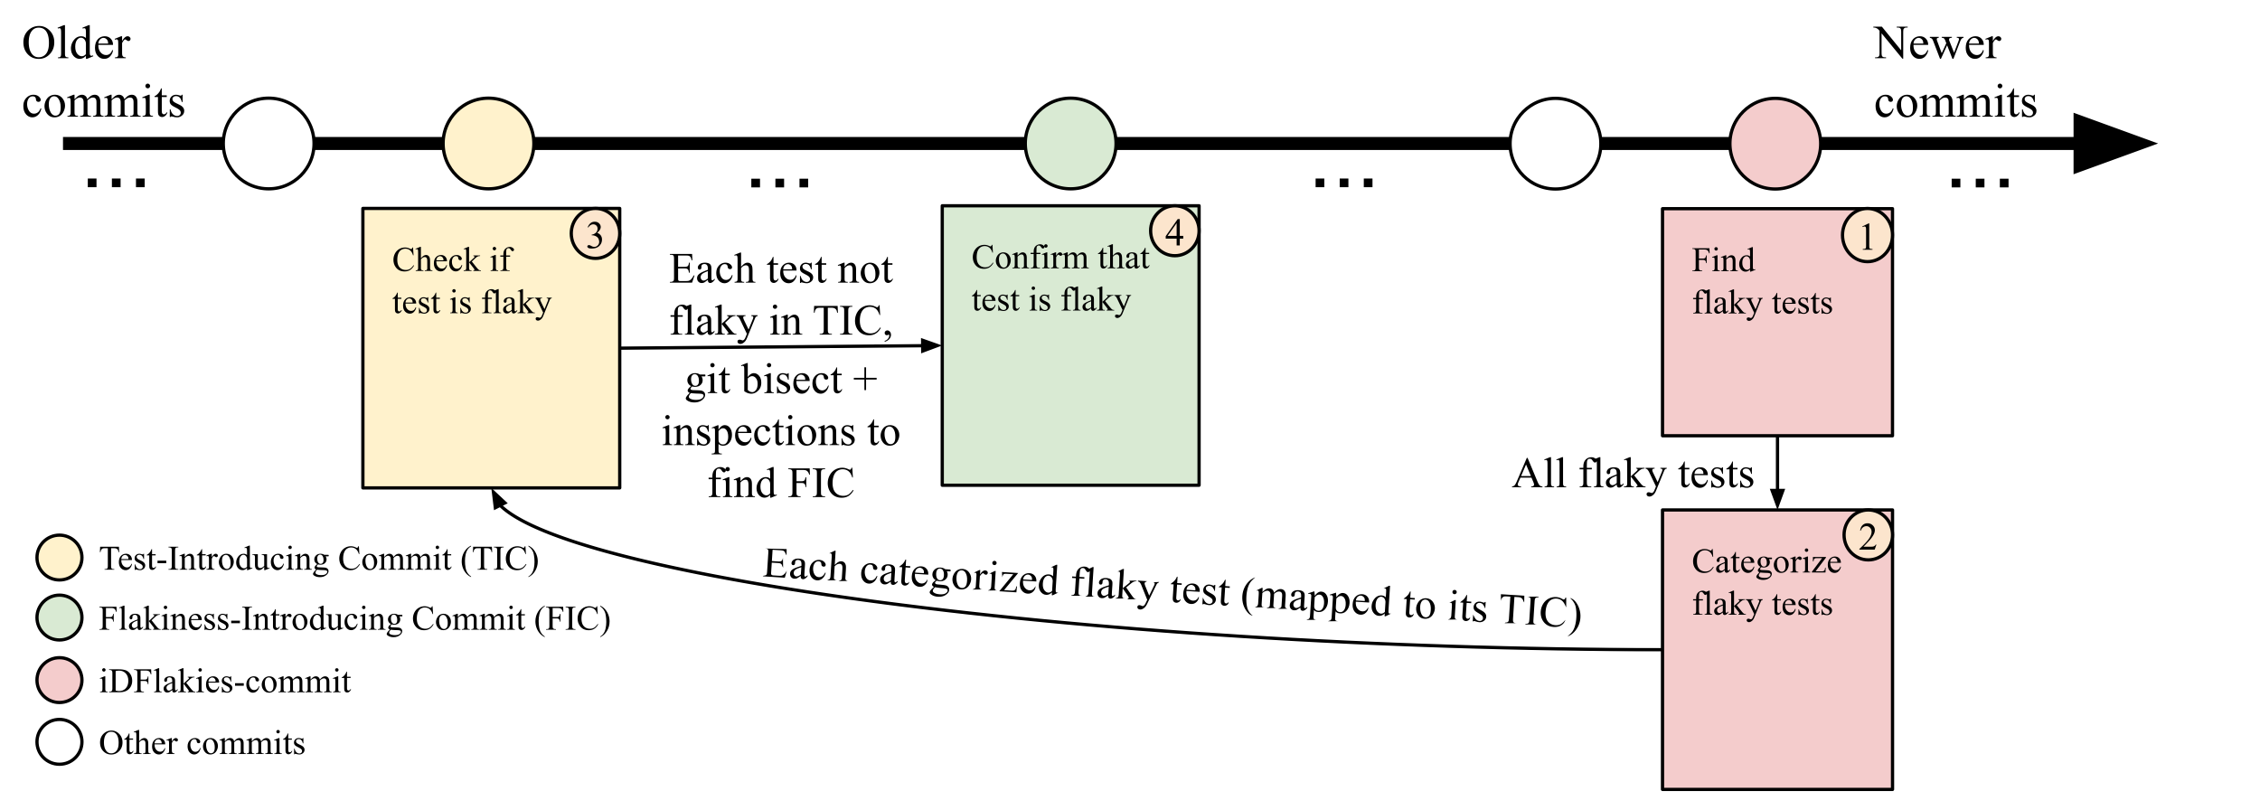
Study setup: Overview
Timeline for each flaky test:
4-step approach to accomplish goal:
find flaky tests in latest commit

Slide 11

Study setup: Overview
Timeline for each flaky test:
4-step approach to accomplish goal:
find flaky tests in latest commit
categorize flaky tests at latest commit

Slide 12
Study setup: Overview
Timeline for each flaky test:
4-step approach to accomplish goal:
find flaky tests in latest commit
categorize flaky tests at latest commit
check if tests are flaky when they are introduced (TIC)

Slide 13
Study setup: Overview
Timeline for each flaky test:
4-step approach to accomplish goal:
find flaky tests in latest commit
categorize flaky tests at latest commit
check if tests are flaky when they are introduced (TIC)
(optional) find commit when test becomes flaky (FIC)

Slide 14
Study setup: Step 1
Goal: find flaky tests in latest commit
2 tools selected to find flaky tests:
iDFlakies¹ – tool that randomizes test orders
NonDex² – tool that changes underlying implementation of an underdetermined specification
¹Lam et al., “iDFlakies: A Framework for Detecting and Partially Classifying Flaky Tests”. ICST 2019.
²Shi et al., “Detecting assumptions on deterministic implementations of non-deterministic specifications”. ICST 2016.

Slide 15
Study setup: Step 1
Goal: find flaky tests in latest commit
2 tools selected to find flaky tests:
iDFlakies can detect 3 categories of flaky tests:
Order-dependent brittle (OD Brit) – tests that fail when run in isolation but pass when run after some specific tests. E.g., testMwDailyDumpFileProcessing from example
Order-dependent victim (OD Vic) – tests that pass when run in isolation but fail when run after some specific tests
Non-deterministic (ND) – tests that non-deterministically pass or fail with no changes to test execution order

Slide 16
Study setup: Step 1
Goal: find flaky tests in latest commit
2 tools selected to find flaky tests:
NonDex – can detect 2 categories of flaky tests:
Implementation-dependent (ID) – tests that depend on specific implementation of API whose specification admits other implementations (e.g., iteration order of HashSet)
Non-deterministic (ND) – tests that non-deterministically pass or fail with no changes to test execution order or implementation of test dependencies

Slide 17
Study setup: Steps 2–4
Goal: categorize and confirm if test is flaky
To control machine cost to run and human cost to inspect, we do not use iDFlakies as random orders can miss confirmation of test as flaky
2 tools to replace iDFlakies for Steps 2–4:
Isolation – running every test by itself. Can detect:
OD Brits (tests that fail by themselves) and NDs
One-By-One (OBO) – running every test before flaky test. Can detect:
OD Vics (tests that fail when another test runs before it) and NDs

Slide 18
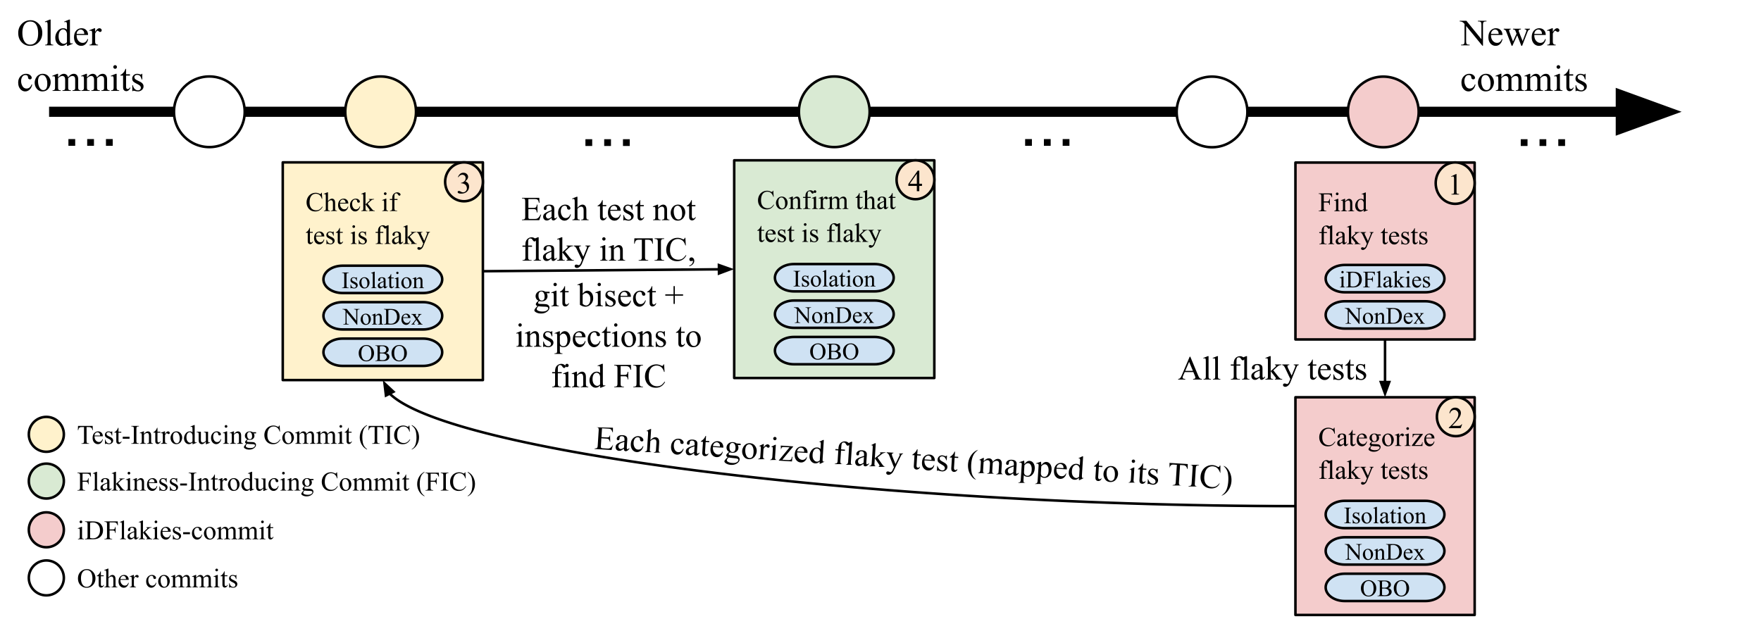
Study setup: Overview
Timeline for each flaky test:
4-step approach to accomplish goal:
find flaky tests in latest commit with iDFlakies and NonDex
categorize flaky tests at latest commit with 3 tools
check if tests are flaky when they are introduced (TIC) with 3 tools
(optional) find commit when test becomes flaky (FIC) with 3 tools

Slide 19
Study setup: Flaky tests
Goal: obtain flaky-test dataset and use 4-step approach to understand when flaky tests become flaky
68 popular Maven-based, Java projects available in public dataset collected in our prior work¹
Apply iDFlakies and NonDex, detected 684 flaky tests
Some flaky tests cannot be evaluated on Test-Introducing Commit (TIC)
E.g., Maven could not compile due to unavailable dependencies
In total, 245 flaky tests evaluated on their TIC
¹Lam et al., “iDFlakies: A Framework for Detecting and Partially Classifying Flaky Tests”. ICST 2019.

Slide 20
RQ1 & RQ2: Effectiveness of detectors on added tests and variation across categories
Breakdown of whether 245 tests are flaky on TIC:
OD Vic | OD Brit | ND | ID | Total
48/80 (60%) | 15/19 (79%) | 29/33 (88%) | 92/113 (81%) | 184/245 (75%)
Our results show that 75% of flaky tests are flaky when newly added
OD Vics are least likely (60%) to be flaky at TICs
OD Vics fail when run after some other test(s)
Our inspections find TICs of OD Vics are often missing test(s) to make OD Vics fail
Implication: running detectors on only newly added tests is effective
What about remaining 25% (61 / 245) of flaky tests?
Are they flaky at TIC? How could detectors detect them ASAP?

Slide 21
RQ3: When should one run detectors?
Flakiness-Introducing Commit (FIC) methodology:
Manually inspect all 61 flaky tests to find FIC. All 61 are not flaky at TIC
For each test, we record # of commits from TIC to FIC and files changed
Example flaky test from https://github.com/wikidata/wikidata-toolkit:
FIC is 522 commits after TIC, only 30 / 522 commits change flaky-test class
FIC changes: flaky-test class, other test classes, code under test
Running detectors when test class is modified would effectively detect this flaky test!

Slide 22
RQ3: When should one run detectors?
24 / 61 tests become flaky when their test class is modified --> 85% ((184 + 24) / 245) of tests are flaky when added or modified
Implication: running detectors on only newly added or modified tests can increase flaky tests detected to 85%!
Remaining 37 / 61 tests’ FICs change other test classes, code under test, or build config files
No clear cost-effective way to detect these tests
Running detectors infrequently based on developers’ budget can help
We find a median of 144 commits from TIC to FIC
Implication: Running detectors every ~150 commits could be beneficial

Slide 23
Conclusion
Some software organizations, e.g., Mozilla and Netflix, run detectors to detect flaky tests as soon as possible (ASAP)
Yet such detectors are often costly to run frequently
To minimize high cost of detectors, while maximizing likelihood to detect flaky tests ASAP, organizations run detectors on only added or modified tests
Our study provides the following implications:
Running detectors on only added tests can effectively detect 75% of flaky tests
Running detectors on added or modified tests can detect 85% of flaky tests
Remaining flaky tests can be detected by infrequent use of detectors based on developers’ budget (e.g., every ~150 commits)
Our dataset of when flaky tests become flaky is available: https://sites.google.com/view/first-commit-flaky-test
Email: winglam2@illinois.edu

