Slide 1


ChatGPT and Software Testing Education:
Promises & Perils
Sajed Jalil, Suzzana Rafi
Thomas D. LaToza, Kevin Moran, & Wing Lam

Slide 2
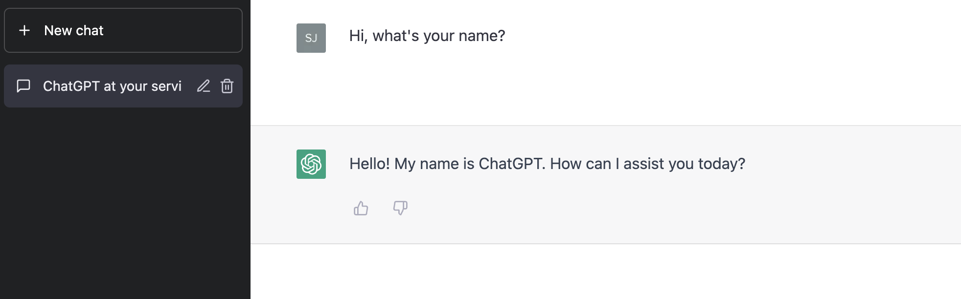
What is ChatGPT?
A generalized large language model (LLM) developed by OpenAI
A LLM consists of a neural network typically with billions of parameters, trained on large quantities of unlabeled text
ChatGPT is fine-tuned from a model in the GPT-3.5 series
It finished its training in early 2022

Slide 3
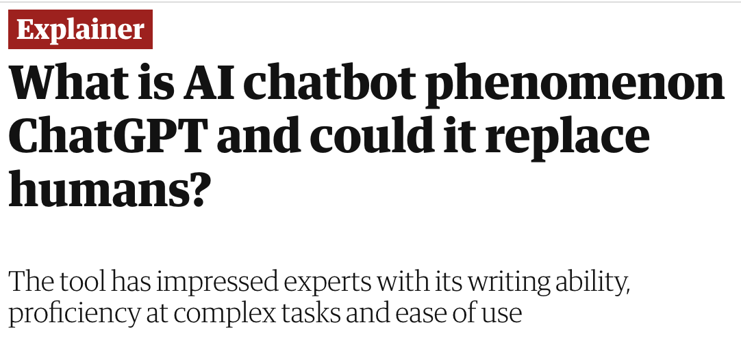


How Great is ChatGPT?
How does it impact Software Testing Education?

Slide 4
Our Work
To better understand how different ways of using ChatGPT affect its effectiveness in software testing, we study:
RQ1: How does shared & separate context affect ChatGPT’s answer and explanation correctness?
RQ2: How often will ChatGPT give non-identical answer-explanation pairs?
RQ3: How often will ChatGPT’s inconsistent responses affect the scores of answers and explanations?
RQ4: How does ChatGPT’s confidence in its response correlate to the correctness of the response?

Slide 5
Example Question
// Counts all numbers greater than 0
public int countPositive(int[] x){
int count = 0;
for (int i=0; i < x.length; i++) {
if (x[i] >= 0) count++;
}
return count;
}
// Test Case [-4, 2, 0, 2], Expected = 2
What is wrong with the given code?
Give a test case that does not result in a failure.

Slide 6
Using ChatGPT - Shared Context
public int countPositive(int[] x){
int count = 0;
for (int i=0; i < x.length; i++) {
if (x[i] >= 0) count++;
}
return count;
}// Test Case [-4, 2, 0, 2], Expected = 2
A. What is wrong with the given code?
Response by ChatGPT
B. Give a test case that does not result in a failure.
Response by ChatGPT

Slide 7
Using ChatGPT - Separate Context
public int countPositive(int[] x){
int count = 0;
for (int i=0; i < x.length; i++) {
if (x[i] >= 0) count++;
}
return count;
}
//Test Case [-4,2,0,2], Expected = 2
public int countPositive(int[] x){
int count = 0;
for (int i=0; i < x.length; i++) {
if (x[i] >= 0) count++;
}
return count;
}
//Test Case [-4,2,0,2], Expected = 2
A. What is wrong with the given code?
B. Give a test case that does not result in a failure.
Response by ChatGPT
Response by ChatGPT
Chat Thread #1
Chat Thread #2

Slide 8
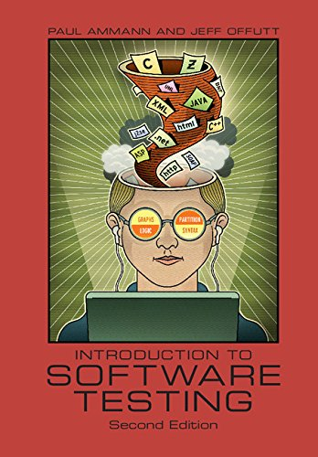
Our Study Dataset
Introduction to Software Testing, 2nd Edition, Ammann & Offutt
31 questions from the first 5 chapters
Selected questions only with student solution available
3 iterations of shared and separate contexts
Chapter | Muti-part | Independent | Code | Concept | Both
1 | 20 |  |  | 4 | 16
2 |  | 1 |  | 1
3 | 5 | 2 | 5 | 2
4 |  | 1 | 1
5 | 2 |  |  | 2
Total | 27 | 4 | 6 | 9 | 16

Slide 9



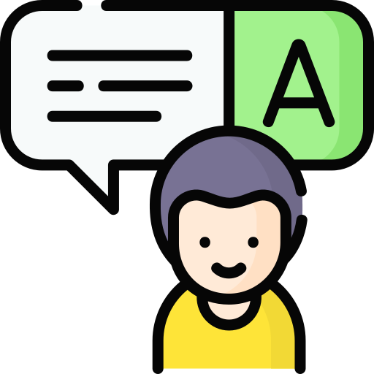
Methodology
Textbook Questions
Our Automated Tool
ChatGPT Server
Manual Response Annotation

Slide 10
Response Categorization
Our dataset labeling considered two perspectives:
whether the overall answer was correct or not
whether the explanation given was correct or not
Answer Correct (AC) | Answer Incorrect (AIC) | Answer Partially Correct (APC)
Explanation Correct (EC) | Explanation Incorrect (EIC) | Explanation Partially Correct (EPC)
Answers and explanations are deemed correct after manual comparison against textbook solutions

Slide 11
RQ1: Effect of Shared and Separate Context on ChatGPT
Correctness of ChatGPT answers for shared and separate contexts
Correctness of ChatGPT explanations for shared and separate contexts
Shared context is more likely than separate context to be correct. Using ChatGPT in a shared context can result in a correct answer 49.4% of the time and a correct explanation 40.2% of the time.

Slide 12
RQ2: Non-Identical Answer-Explanation Pairs (Example)
C1
e.g., edge coverage
C2
e.g., node coverage
T1
satisfies C1
T2
satisfies C2
Truncated Prompt to ChatGPT: Does T1 necessarily satisfies C2?
ChatGPT Response: T1 may or may not satisfy C2. C1 is a more comprehensive criterion that includes all the requirement of C2. However, it does not guarantee that T1 will satisfy C2.
Our Verdict: answer incorrect, explanation partially correct (AIC-EPC).

Slide 13
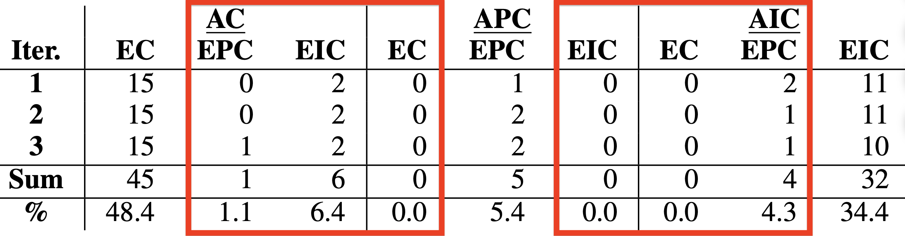
RQ2: Non-Identical Answer-Explanation Pairs
11.8% of the time ChatGPT produces responses where the answer-explanation pairs are non-identical, e.g., the answer is correct, but the explanation is not.

Slide 14
RQ3: Inconsistent Responses from ChatGPT
 | Iteration 1 | Iteration 2 | Iteration 3 | Verdict
Question 1 | AC | AC | APC | Inconsistent
Question 2 | AIC | APC | AC | Inconsistent
Question 3 | AC | AC | AC | Consistent
We are interested to find out how deterministic ChatGPT is
ChatGPT can give inconsistent responses to the same question if run more than once
Inconsistent in 9.7% of answers and 6.5% of explanations

Slide 15
RQ4: Confidence Level of ChatGPT
ChatGPT’s reported confidence for correct, partially correct, and incorrect answers.
ChatGPT’s reported confidence for correct, partially correct, and incorrect explanations.
ChatGPT’s self-reported confidence does not appear to be particularly useful, as it has little bearing on question correctness. This finding seems to indicate, that, for software testing questions, ChatGPT is not well calibrated.

Slide 16
RQ4: Confidence Level of ChatGPT
Why are ChatGPT’s responses are incorrect?
Can we change the prompt do make them correct?
ChatGPT’s reported confidence for correct, partially correct, and incorrect answers.
ChatGPT’s reported confidence for correct, partially correct, and incorrect explanations.
ChatGPT’s self-reported confidence does not appear to be particularly useful, as it has little bearing on question correctness. This finding seems to indicate, that, for software testing questions, ChatGPT is not well calibrated.

Slide 17
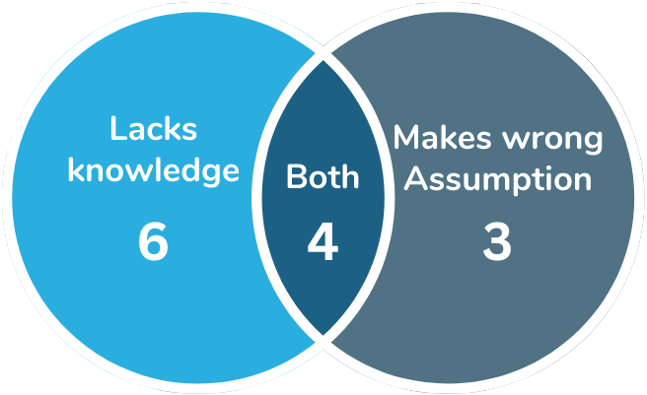
Case Study: Characteristics of Incorrect Answers
ChatGPT lacks knowledge
ChatGPT makes wrong assumption
Both

Slide 18
Case Study: Prompt Engineering Example
public static int oddOrPos (int[] x) { int count = 0; for (int i = 0; i < x.length; i++) { if (x[i]%2 == 1 || x[i] > 0) count++; } return count; } // test: x = [-3, -2, 0, 1, 4]; Expected = 3
ChatGPT says adding null check before for loop will solve the issue.
Actual issue is with finding negative odd integers.
Prompt: Implement your repair and verify that the given test now produces the expected output.

Slide 19
Case Study: Prompt Engineering Example
public static int oddOrPos (int[] x) { int count = 0; for (int i = 0; i < x.length; i++) { if (x[i]%2 == 1 || x[i] > 0) count++; } return count; } // test: x = [-3, -2, 0, 1, 4]; Expected = 3
Detects the fault correctly
Says if( x[i] % 2 != 0) or (x[i] > 0) will solve the issue.
Modified Prompt: The answer does not involve having a null check and zero is not a positive number. Implement your repair and verify that the given test now produces the expected output.

Slide 20
Conclusion
Shared context is better than separate context -- answers are correct 49.4% of the time and explanations are correct 40.2% of the time
11.8% of ChatGPT’s responses produces non-identical answer-explanation pairs
ChatGPT produces inconsistent answers for 9.7% of questions
ChatGPT’s self reported confidence level is not helpful
We are more likely to get correct responses with better prompt engineering

Slide 21

Suggestions to the Software Testing Educators
Creating study materials and practice questions that allow enhanced learning experience with ChatGPT usage
When ChatGPT is not welcomed, make the exercises involving both code and concepts
Raise awareness of the new honor code policy that might emerge from the use of ChatGPT

Slide 22
Conclusion
Sajed Jalil
sjalil@gmu.edu
Shared context is better than separate context -- answers are correct 49.4% of the time and explanations are correct 40.2% of the time
11.8% of ChatGPT’s responses produces non-identical answer-explanation pairs
ChatGPT produces inconsistent answers for 9.7% of questions
ChatGPT’s self reported confidence level is not helpful
We are more likely to get correct responses with better prompt engineering

