Slide 1




Systematically Producing Test Orders to Detect Order-Dependent Flaky Tests
July 20, 2023 ISSTA 2023
Chengpeng Li, M. Mahdi Khosravi, Wing Lam, August Shi
CCF-2145774
Jarmon Innovation Fund

Slide 2
Flaky test
t0
t0
Code Under Test
v1235
t1
t1
t2
t2
…
…
Flaky tests mislead developers
tn
tn

Slide 3
Order-dependent flaky test (OD test)
Order-dependent flaky tests among top 3 common types of flaky tests¹
t0
t0
Code Under Test
v1235
t1
t2
Test order not guaranteed!
t2
t1
…
…
tn
tn
¹Luo et al. “An empirical analysis of flaky tests”. FSE 2014

Slide 4
Reason for order-dependent flaky tests
static fields
file system
database
…
t0
t0
Polluter
Code Under Test
v1235
modify the state
t1
t2
shared state
t2
t1
depend on the state
…
…
Victim
tn
tn

Slide 5
Background
iDFlakies² reruns tests in different random test-orders, it does not provide guarantee towards detecting all OD tests
victim
polluter
…
victim
polluter
cleaner
victim
polluter
victim
We propose new techniques to systematically generate test-orders that guarantee to detect OD tests by covering test-pairs
²Lam et al. iDFlakies: A framework for detecting and partially classifying flaky tests. ICST 2019

Slide 6
Tuscan Squares³ Combinatorial Design
An n x n Tuscan square has n rows and n columns
each row is a permutation of the n different symbols
for any two distinct symbols a and b, there is a row in which b is directly to the right of a
all symbols can be placed at the beginning and at the end in some row
=> Tuscan squares can generate orders to cover all pairs
³Golomb et al. 1985. Tuscan squares – A new family of combinatorial designs. Ars Combinatoria 20, B (1985).

Slide 7
Tuscan Squares Example to Cover All Pairs
For a test suite with 4 tests:
All 4! orders
Tuscan Square orders
O1:
t₀
t₁
t₂
t₃
O1:
t₀
t₃
t₁
t₂
O2:
t₁
t₀
t₂
t₃
O2:
t₁
t₀
t₂
t₃
…
O3:
t₂
t₁
t₃
t₀
O24:
t₃
t₂
t₁
t₀
O4:
t₃
t₂
t₀
t₁

Slide 8
Tuscan Squares Example to Cover All Pairs
For a test suite with 4 tests:
All 4! orders
Tuscan Square orders
O1:
t₀
t₁
t₂
t₃
O1:
t₀
t₃
t₁
t₂
O2:
t₁
t₀
t₂
t₃
O2:
t₁
t₀
t₂
t₃
…
O3:
t₂
t₁
t₃
t₀
O24:
t₃
t₂
t₁
t₀
O4:
t₃
t₂
t₀
t₁

Slide 9
Tuscan Squares Example to Cover All Pairs
For a test suite with 4 tests:
All 4! orders
Tuscan Square orders
O1:
t₀
t₁
t₂
t₃
O1:
t₀
t₃
t₁
t₂
O2:
t₁
t₀
t₂
t₃
O2:
t₁
t₀
t₂
t₃
…
O3:
t₂
t₁
t₃
t₀
O24:
t₃
t₂
t₁
t₀
O4:
t₃
t₂
t₀
t₁

Slide 10
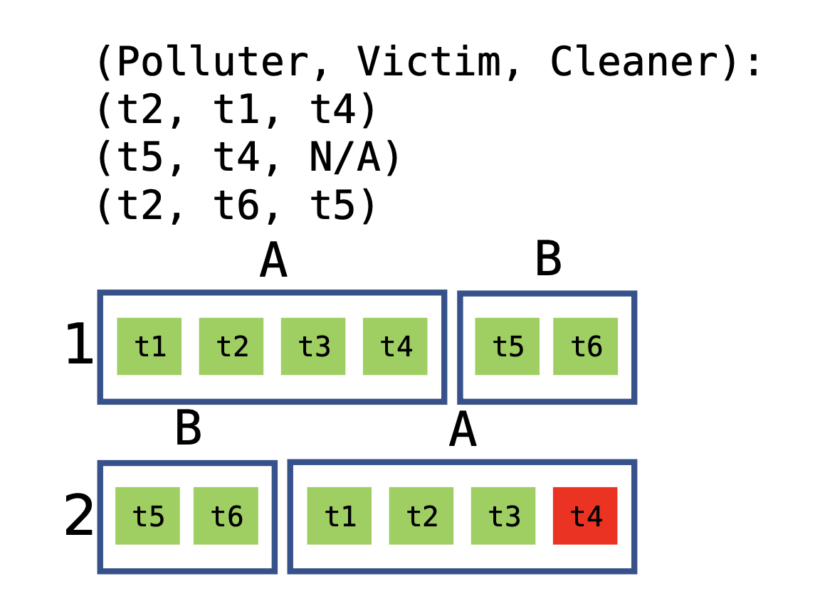
Technique 1: Tuscan Class-Only⁴
For 2 test classes:
Produce test orders that cover all test-class pairs, ignoring tests inside test classes
⁴Wei et al. “Probabilistic and systematic coverage of consecutive test-method pairs for detecting order-dependent flaky tests.” TACAS 2021.

Slide 11


Technique 1: Tuscan Class-Only
For 6 tests in 2 test classes:
Produce test orders that cover all test-class pairs, ignoring tests inside test classes
Runs 2 orders

Slide 12
Technique 2: Tuscan Intra-Class
For 6 tests in 2 test classes:
Produce test orders that cover all test-class pairs, and test pairs inside each test class
A
B
t1
t4
t2
t3
t5
t6
B
A
t6
t5
t2
t1
t3
t4
t1
t4
t2
t3
t5
t6
B
A
B
t2
t1
t3
t4
t6
t5
t3
t2
t4
t1
t5
t6
A
B
A
t3
t2
t4
t1
A
B
t6
t5
t4
t3
t1
t2
t4
t3
t1
t2
B
A

Slide 13
Technique 2: Tuscan Intra-Class
For 6 tests in 2 test classes:
Produce test orders that cover all test-class pairs, and test pairs inside each test class
A
B
t1
t4
t2
t3
t5
t6
B
A
t6
t5
t2
t1
t3
t4
A
B
Runs 4 orders
t3
t2
t4
t1
t5
t6
B
A
t6
t5
t4
t3
t1
t2

Slide 14
Technique 3: Tuscan Inter-Class
For 6 tests in 2 test classes:
A
B
Produce test orders that cover all test-class pairs, test pairs inside each test class, and test pairs across different test classes
1
t1
t4
t2
t3
t5
t6
A
B
2
t2
t1
t3
t4
t5
t6
t1
t4
t2
t3
t5
t6
...
B
A
B
t2
t1
t3
t4
t6
t5
5
t1
t4
t2
t3
t6
t5
A
...
t3
t2
t4
t1
A
B
B
A
t4
t3
t1
t2
B
A
9
t5
t6
t1
t4
t2
t3
...

Slide 15
Technique 3: Tuscan Inter-Class
For 6 tests in 2 test classes:
A
B
Produce test orders that cover all test-class pairs, test pairs inside each test class, and test pairs across different test classes
1
t1
t4
t2
t3
t5
t6
A
B
2
t2
t1
t3
t4
t5
t6
...
Runs 16 orders
B
A
5
t1
t4
t2
t3
t6
t5
...
B
A
9
t5
t6
t1
t4
t2
t3
...

Slide 16
Technique 4: Target Pairs
Target Pairs only covers pairs which share the same static fields⁵
contain
contain
class N
class X
contain
class Y
contain
class M
Target Pairs need to be covered:
(t1, t2) (t2, t1)
t1
test class A
t4
(t3, t5) (t4, t5) (t2, t6)
(t5, t3) (t5, t4) (t6, t2)
t5
t6
test
class B
t2
t3
⁵Zhang et al. “Empirically revisiting the test independence assumption”. ISSTA 2014

Slide 17
Technique 4: Target Pairs
Target Pairs only covers pairs which share the same static fields⁵
contain
contain
class N
class X
contain
class Y
contain
class M
Target Pairs need to be covered:
(t1, t2) (t2, t1)
t1
test class A
t4
(t3, t5) (t4, t5) (t2, t6)
(t5, t3) (t5, t4) (t6, t2)
t5
t6
test
class B
t2
t3
⁵Zhang et al. “Empirically revisiting the test independence assumption”. ISSTA 2014

Slide 18
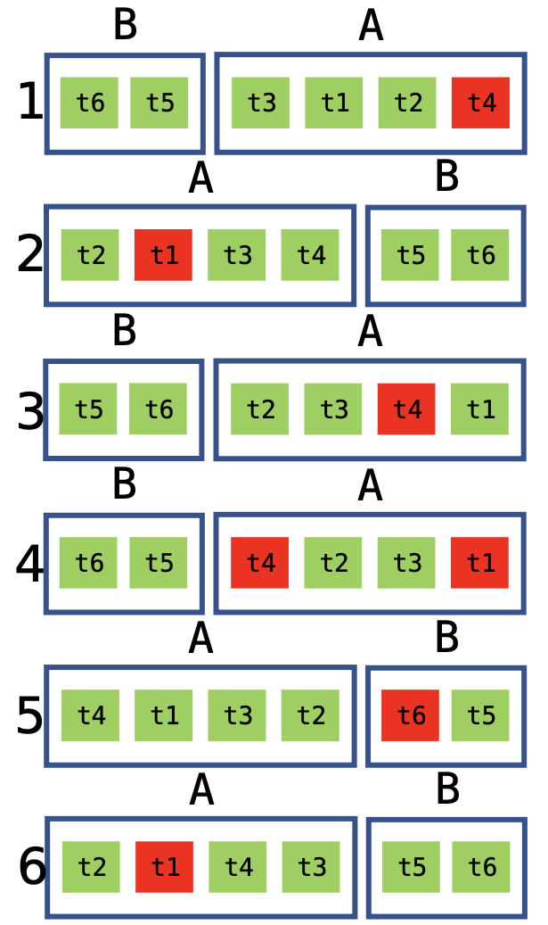
Technique 4: Target Pairs
For 6 tests in 2 test classes:
Greedily produce test-orders that cover all test-pairs that share static fields iteratively
See more details in paper …
Target Pairs need to be covered:
(t1, t2) (t2, t1)
Runs 6 orders
(t3, t5) (t4, t5) (t2, t6)
(t5, t3) (t5, t4) (t6, t2)

Slide 19
Evaluation
We use a dataset of known OD tests from prior work⁴
categorized OD tests into victims or not, and reported the corresponding polluters/cleaners for the tests
contains 289 OD tests from 47 projects
Subjects used in evaluation
 | # Test |  | # OD Tests
 | Class | Method
Avg. * 2 | Sum. * 1 | 93.9 | 394.3 | 289
⁴Wei et al. “Probabilistic and systematic coverage of consecutive test-method pairs for detecting order-dependent flaky tests.” TACAS 2021.

Slide 20
Research questions
RQ1: Number of test-orders
RQ2: Detected OD tests
RQ3: Cost-effectiveness
RQ4: Minimal test-orders needed

Slide 21
Research questions
RQ1: Number of test-orders
RQ2: Detected OD tests
RQ3: Cost-effectiveness
RQ4: Minimal test-orders needed
See more details in paper …

Slide 22
RQ1: Number of test-orders
 | Tuscan Class-Only | Tuscan Intra-Class | Tuscan Inter-Class | Target Pairs
Avg. | 94.0 | 104.7 | 769148.3 | 4167.3
Avg. num. of test orders per technique: Class-Only < Intra-Class < Target Pairs < Inter-Class
Class-Only and Intra-Class have similar number of test-orders => number of test-orders dominated by number of test classes
Inter-Class is expensive but still much less than all possible orders: >10 million for most subjects

Slide 23
RQ2: Detected OD tests
 | Tuscan Class-Only | Tuscan Intra-Class | Tuscan Inter-Class | Target Pairs
Avg. | 36.0 | 97.2 | 100.0 | 89.8
Perc. of OD tests detected per technique: Class-Only < Target Pairs < Intra-Class < Inter-Class
Target Pairs less effective because some OD tests are not OD due to static fields
But some OD tests detected using Target Pairs but not Intra-Class

Slide 24
RQ3: Cost-effectiveness
 | Tuscan Class-Only | Tuscan Intra-Class | Tuscan Inter-Class | Target Pairs
Median (seconds) | 138.8 | 201.7 | 167850.9 | 1962.7
% OD tests detected | 36.0 | 97.2 | 100.0 | 89.8
Median time of running each technique: Class-Only < Intra-Class < Target Pairs < Inter-Class
We recommend running Intra-Class as an effective way to detect OD tests

Slide 25
Conclusion
Systematic detection of OD tests by proposing three new techniques to generate test-orders
Our most practical technique, Tuscan Intra-Class, can detect 97.2% of known OD tests, while running only a few possible test-orders
Future work: prioritize the test-orders with higher chance to detect OD tests
https://sites.google.com/view/systematically-detecting-od
chengpengli@utexas.edu

