Slide 1



AURORA: Automated NeUral ScReen Understanding fOR Navigating UI TArpits
Safwat Ali Khan,
Wenyu Wang,
Yiran Ren,
Bin Zhu,
Jiangfan Shi,
Alyssa McGowan,
Wing Lam,
Kevin Moran
17th IEEE International Conference on Software Testing, Verification, and Validation (ICST’24)
Wednesday, May 29th, 2024

Slide 2





Mobile Testing Challenges
Highly Competitive App Marketplaces
Noisy Feedback from Users
Change / Fault Prone APIs
Pressure for Frequent Releases
2

Slide 3
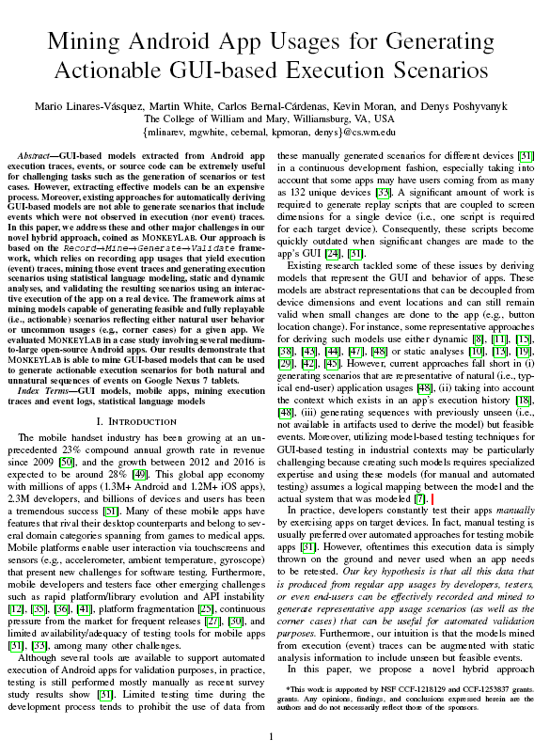
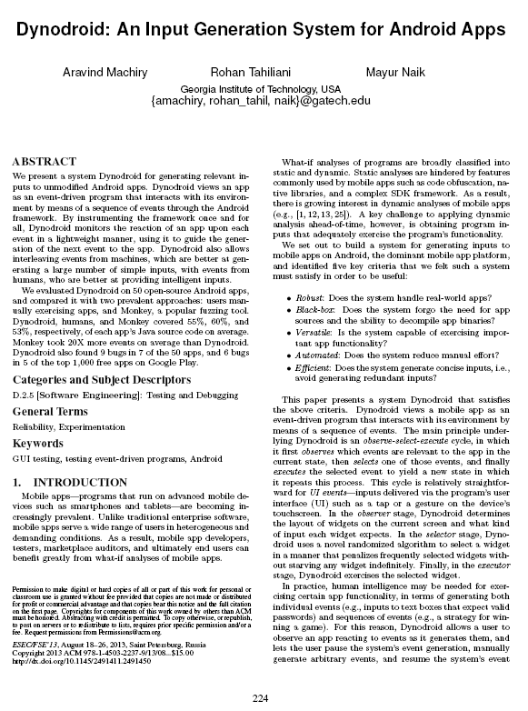
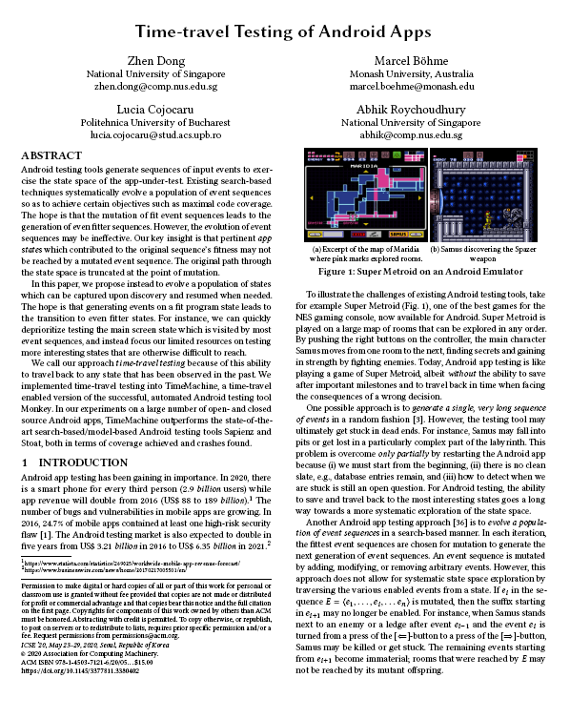
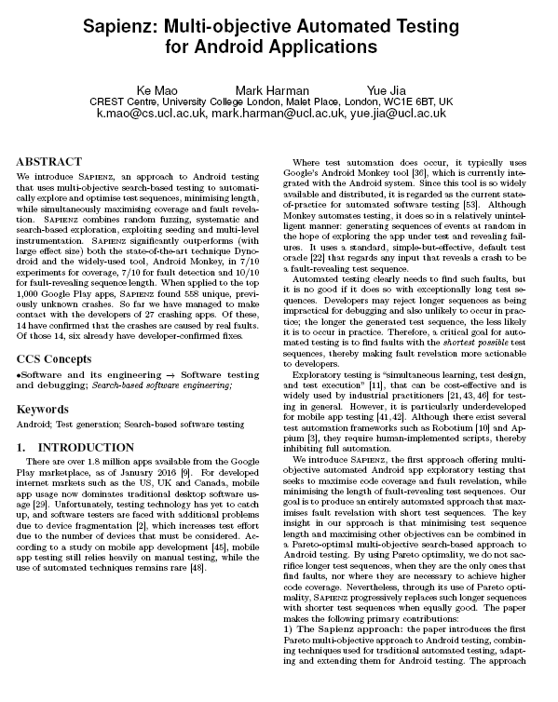
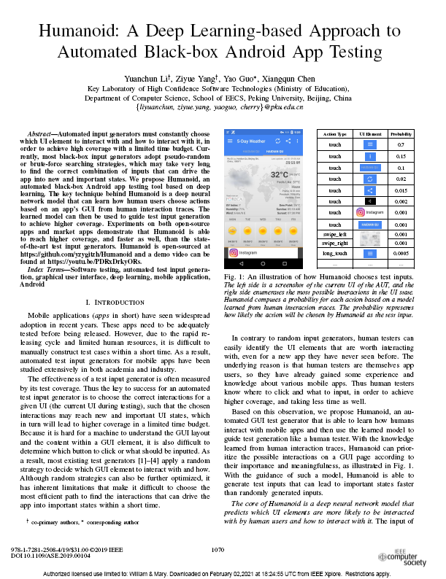
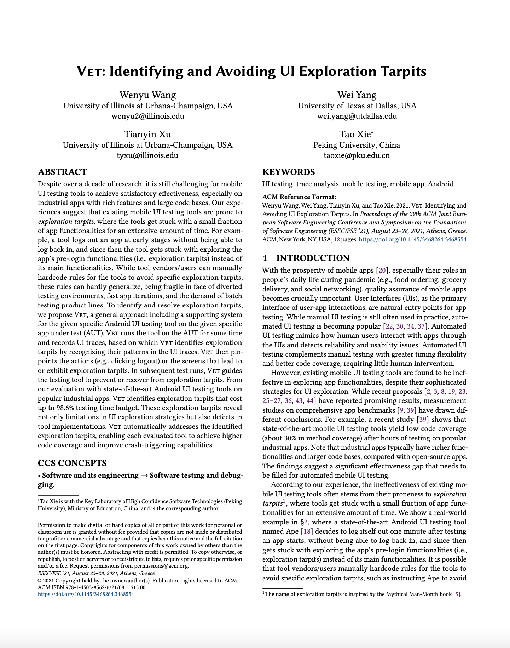
Automated Input Generation Tools (AIG Tools)
3

Slide 4
The Roadblock of UI Tarpits
Prior work has shown that AIG Tools tend to get “stuck” on certain screens
These screens are called UI Tarpits
The authors created a tool called VET to identify and avoid these tarpits
4

Slide 5
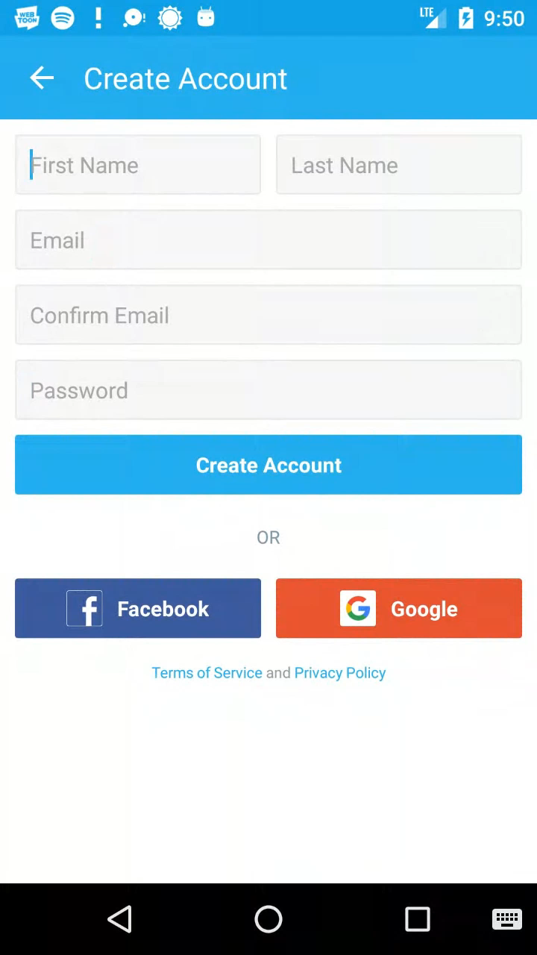

UI Tarpits¹
[1] W. Wang, W. Yang, T. Xu, and T. Xie, “VET: Identifying and Avoiding UI Exploration Tarpits,” in ESEC/FSE, 2021
5

Slide 6
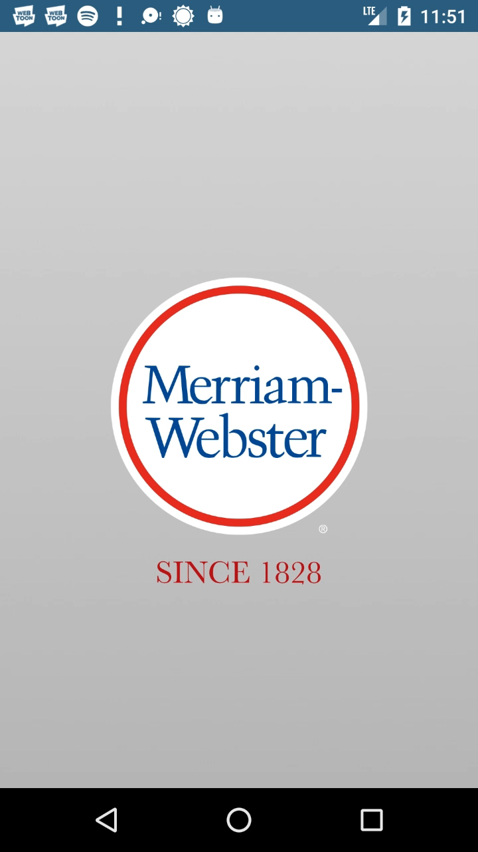

UI Tarpits¹
[1] W. Wang, W. Yang, T. Xu, and T. Xie, “VET: Identifying and Avoiding UI Exploration Tarpits,” in ESEC/FSE, 2021
6

Slide 7

Limitations of VET
VET
VET must run each app for an extended period of time to detect tarpits
VET only disables tarpits
Thus, it cannot explore certain areas of the app!
7

Slide 8

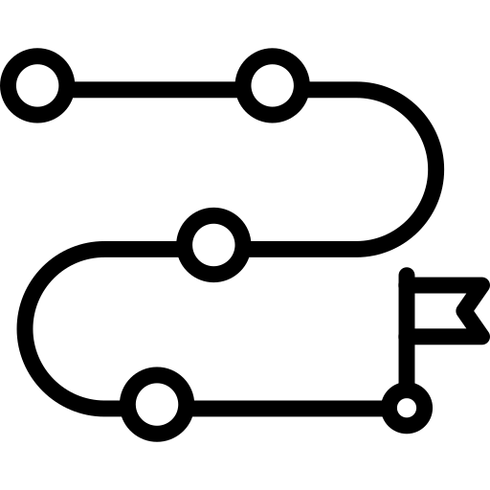

Key Intuition: Overview
Common UI design motifs
Design generalizable strategies
8

Slide 9
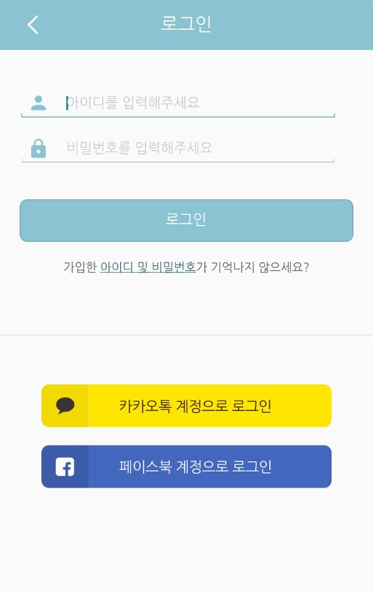
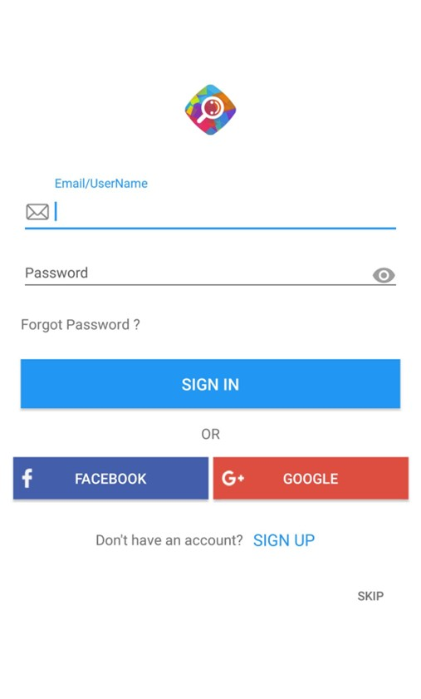
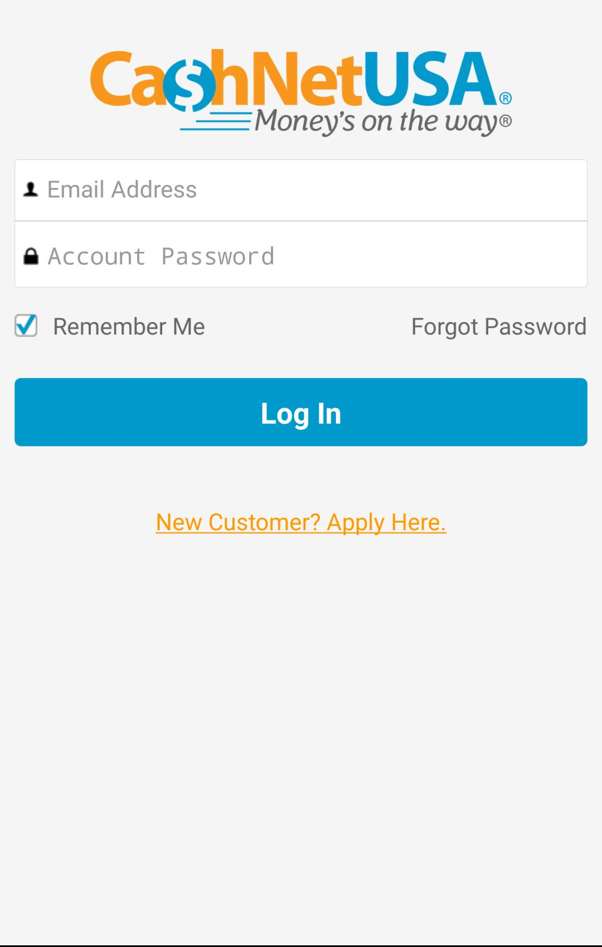
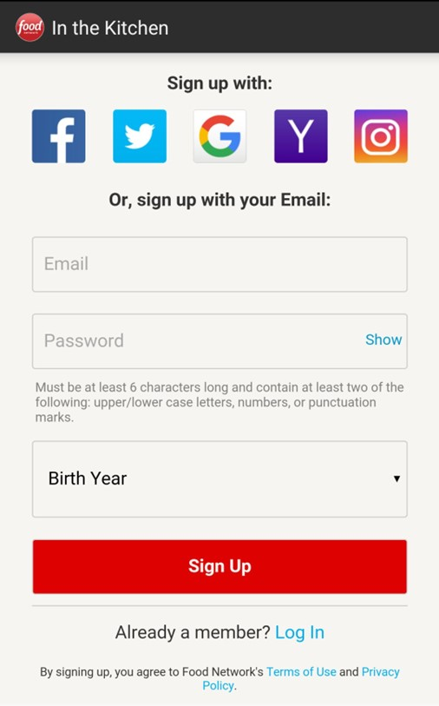
Key Intuition: Design Motifs
Common UI design motifs
9

Slide 10
Key Intuition: Design Motifs
Common UI design motifs
Login screens
10

Slide 11
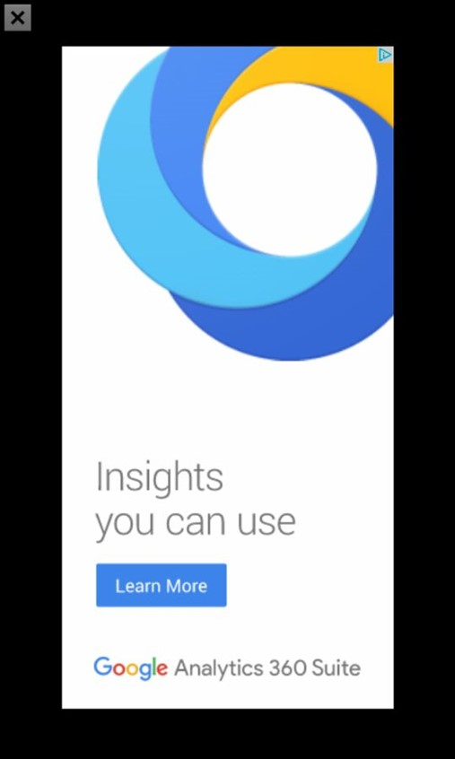
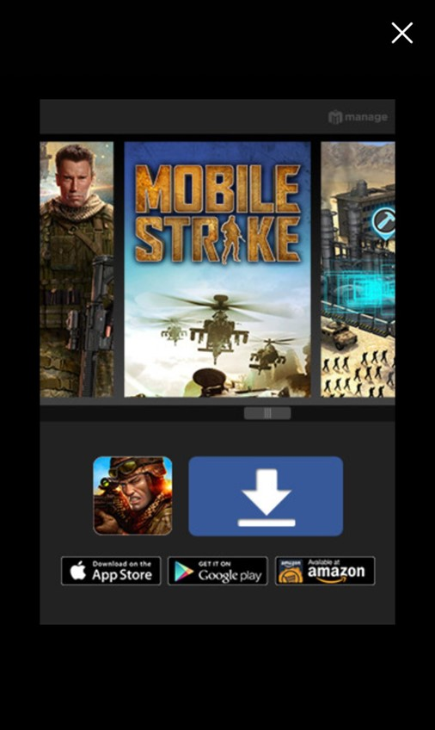
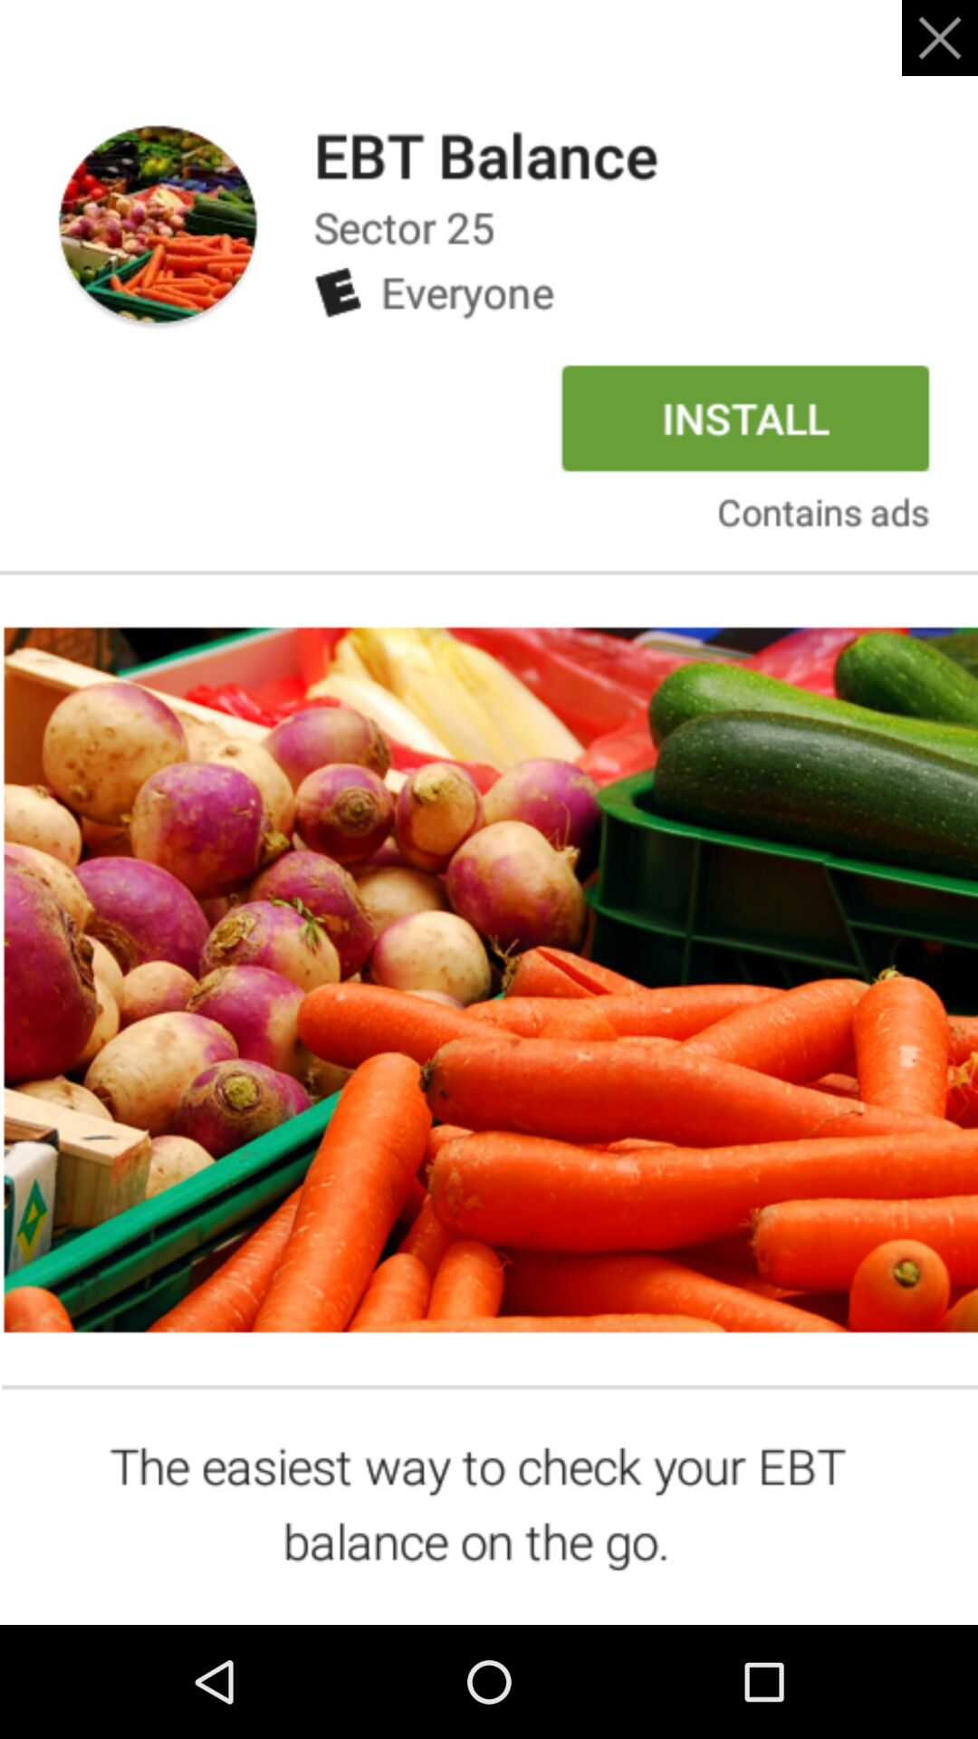
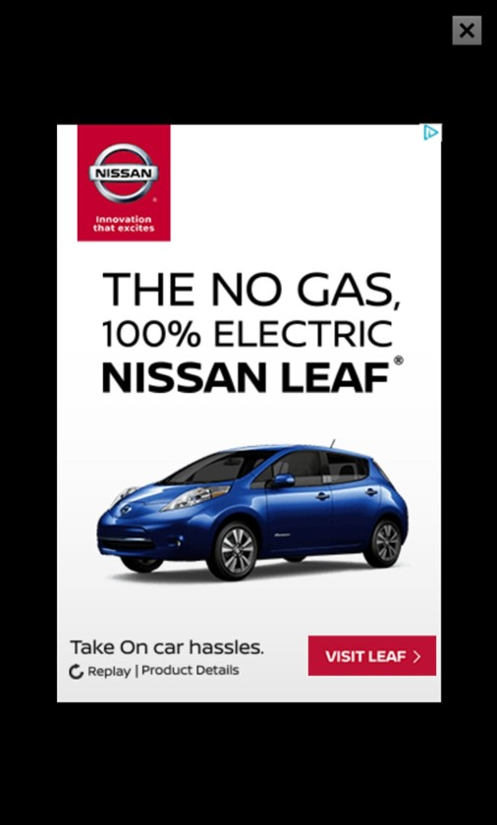
Key Intuition: Design Motifs
Common UI design motifs
11

Slide 12
Key Intuition: Design Motifs
Common UI design motifs
Advertisements
12

Slide 13
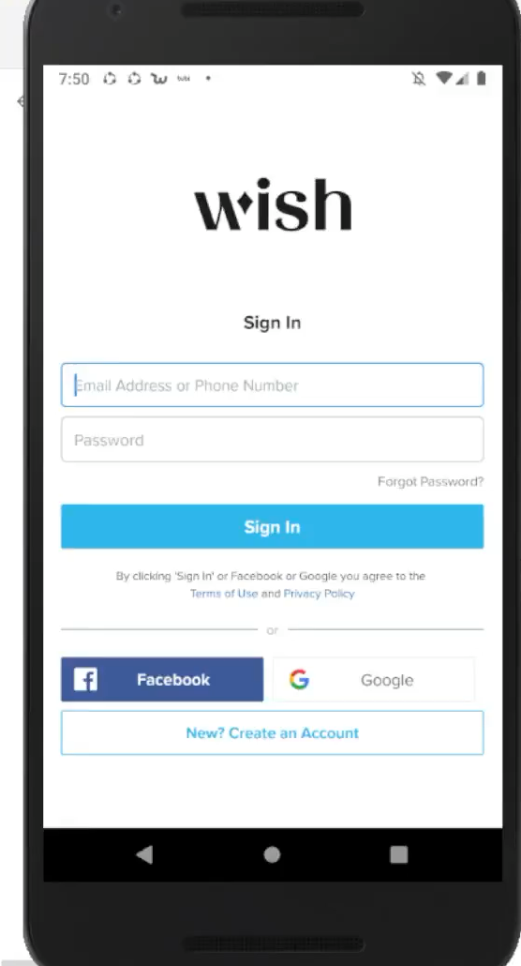
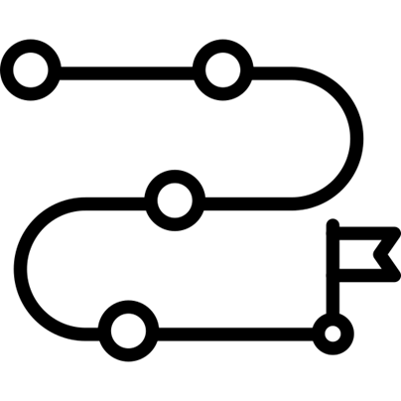
Key Intuition: Generalizable Strategy
Design generalizable strategies
13

Slide 14
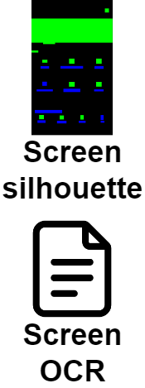
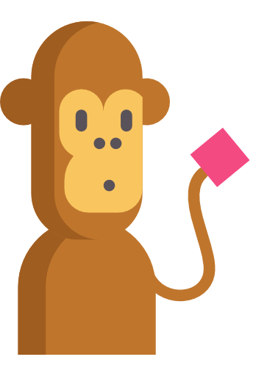
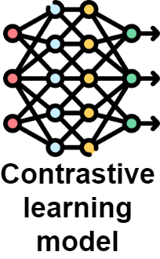
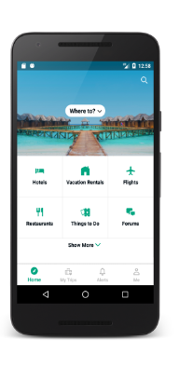

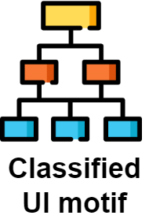

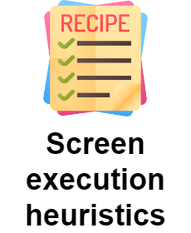
AURORA Approach Overview
14

Slide 15
AURORA Approach Overview
15

Slide 16
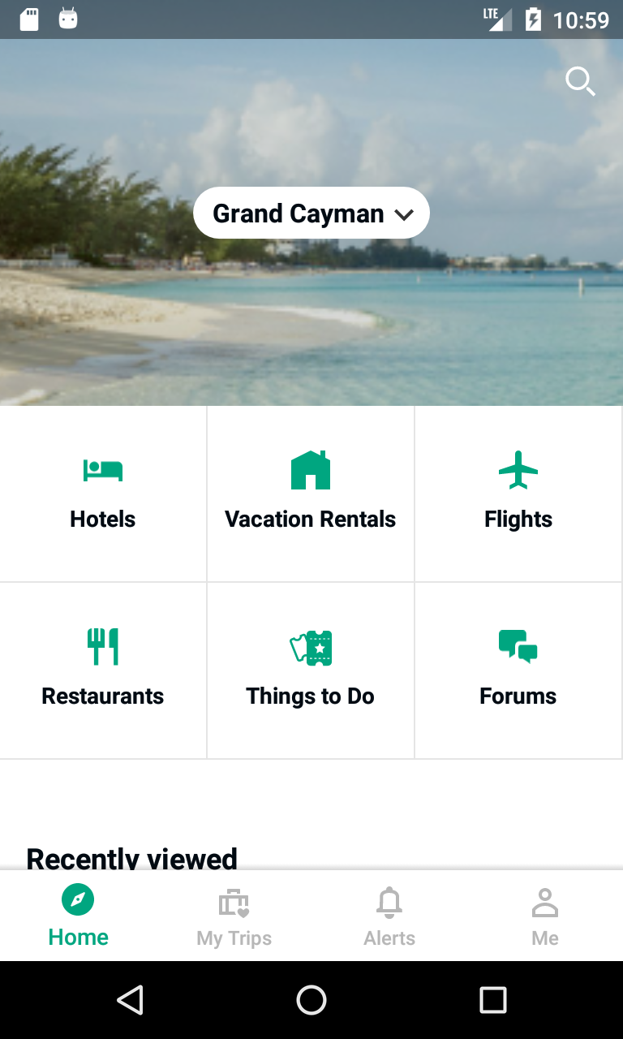
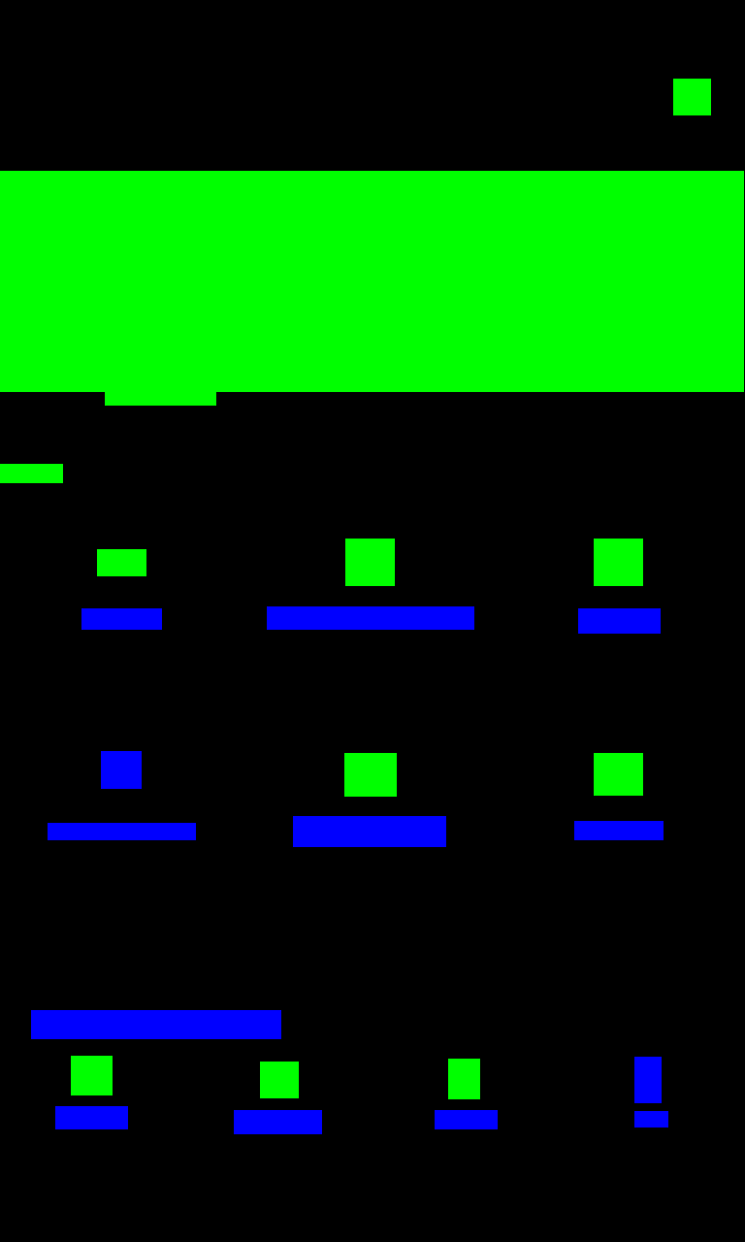
Screen Representation
Abstract UI images into Silhouettes
App screenshot
UI Silhouette
16

Slide 17
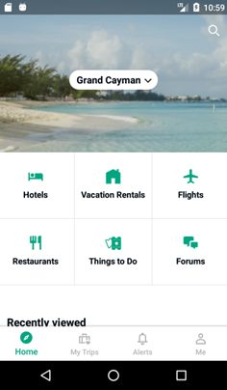
Screen Representation
Extracting OCR text
Hotels Restaurants Home Grand Cayman Vacation Rentals Recently viewed My Trips Things to Do Alerts Flights Forums Me
App screenshot
OCR text
17

Slide 18
AURORA Approach Overview
18

Slide 19
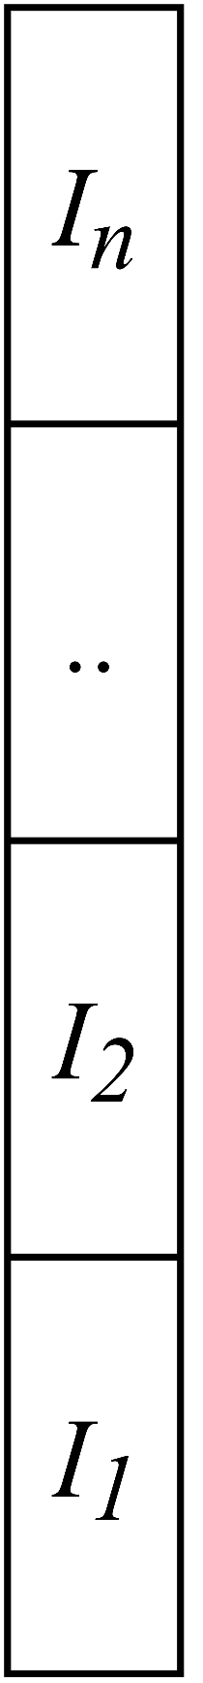

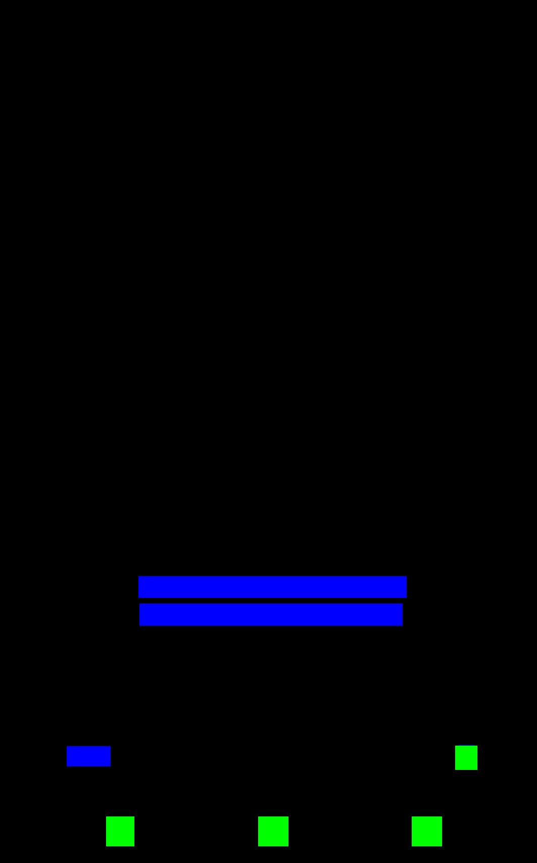
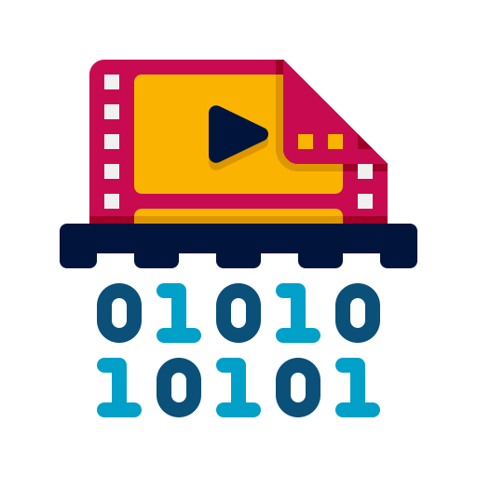


Pre-training Classifier (CLiP)
Image encoder
Screen silhouette
Screen OCR
Text encoder
19

Slide 20
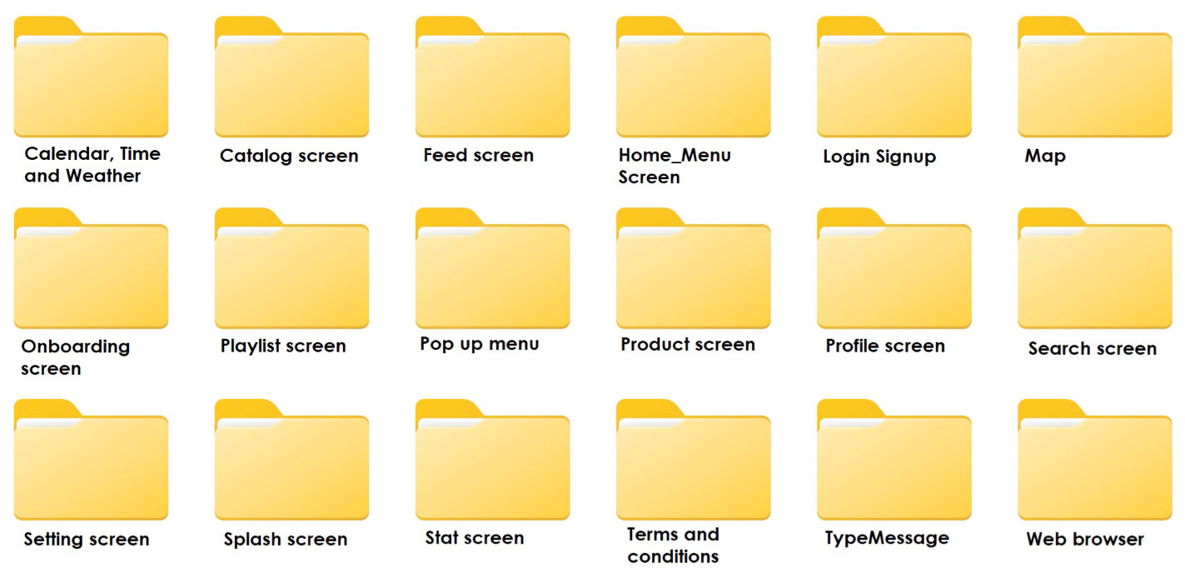


Predicting UI Motif Labels
…
Image encoder
Text encoder
20

Slide 21
AURORA Approach Overview
21

Slide 22

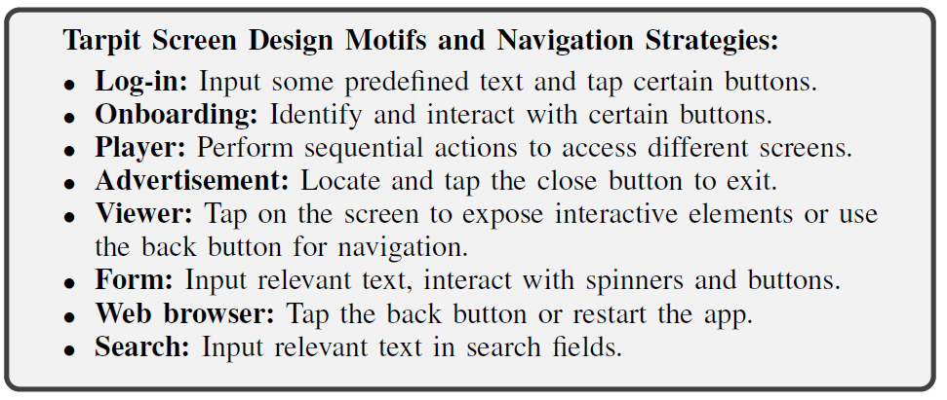
Crafting Heuristics
22

Slide 23
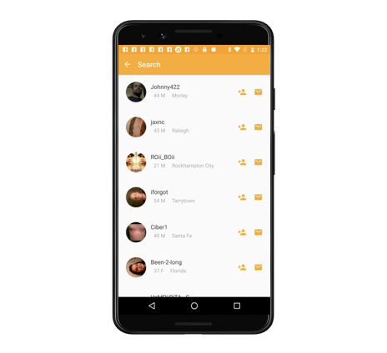



Heuristic Execution
Heuristic
Controller
Target Device
Heuristic
Information
(e.g., login credentials)
SentenceTransformer to match displayed UI Component Text
23

Slide 24
Research Questions
RQ₁: AURORA classification accuracy
RQ₂: AURORA coverage improvement
RQ₃: AURORA exclusive coverage
RQ₄: Heuristics effectiveness
24

Slide 25
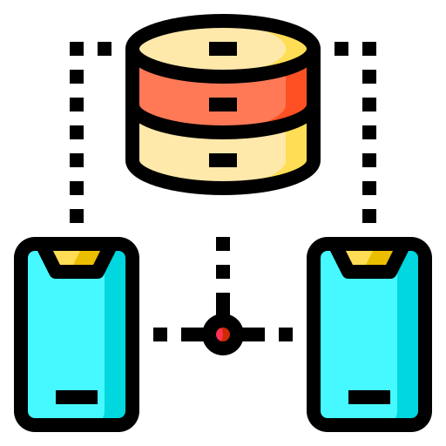





Design Motif Classifier Dataset
Phase I: Motif Definition
Phase II: Data Labeling
600 RICO
Dataset
Screens
Manual Inspection
60 images per motif
Screen Silhouettes
K-means
Clustering
1369 Total Screens Labeled with
21 Design Motifs
600 Screens Labeled with
21 Design Motifs
Manual Inspection
25

Slide 26
21 Design Motif Categories
Advertisement Pop up menu
Calendar, time and weather Product screen
Catalog screen Search screen
Feed screen Settings screen
Form screen Splash screen
Home menu screen Terms and conditions
List screen Travel booking
Log-in screen Type message
Map Viewer screen
Onboarding screen Web browser
Player screen
26

Slide 27
21 Design Motif Categories
We empirically derived Tarpit categories from execution traces from VET paper
Any screen that appeared for at least:
5 consecutive actions
Persisted for 10 seconds
Red Motifs Represent Tarpits
Advertisement Pop up menu
Calendar, time and weather Product screen
Catalog screen Search screen
Feed screen Settings screen
Form screen Splash screen
Home menu screen Terms and conditions
List screen Travel booking
Log-in screen Type message
Map Viewer screen
Onboarding screen Web browser
Player screen
27

Slide 28
AURORA Experimental Context
Dataset
Tool Settings
APE: Run APE for 3 hours
Monkey: Run Monkey for 3 hours
AURORA: Run AURORA for 3 hours
APE+AURORA: Run APE 1 hour & AURORA for 2 hours
AURORA vs. VET: 6 hour run
12 Apps from the VET paper
5 Additional popular apps from Google Play
A total of 17 apps
28

Slide 29
RQ₁: AURORA Classification Accuracy
29

Slide 30

RQ₁: AURORA Classification Accuracy
Accuracy: 81.3%
1369 UI Images 21 UI motifs
80/20 Training/Testing Split
30

Slide 31
RQ₂: AURORA Coverage Improvement
31

Slide 32
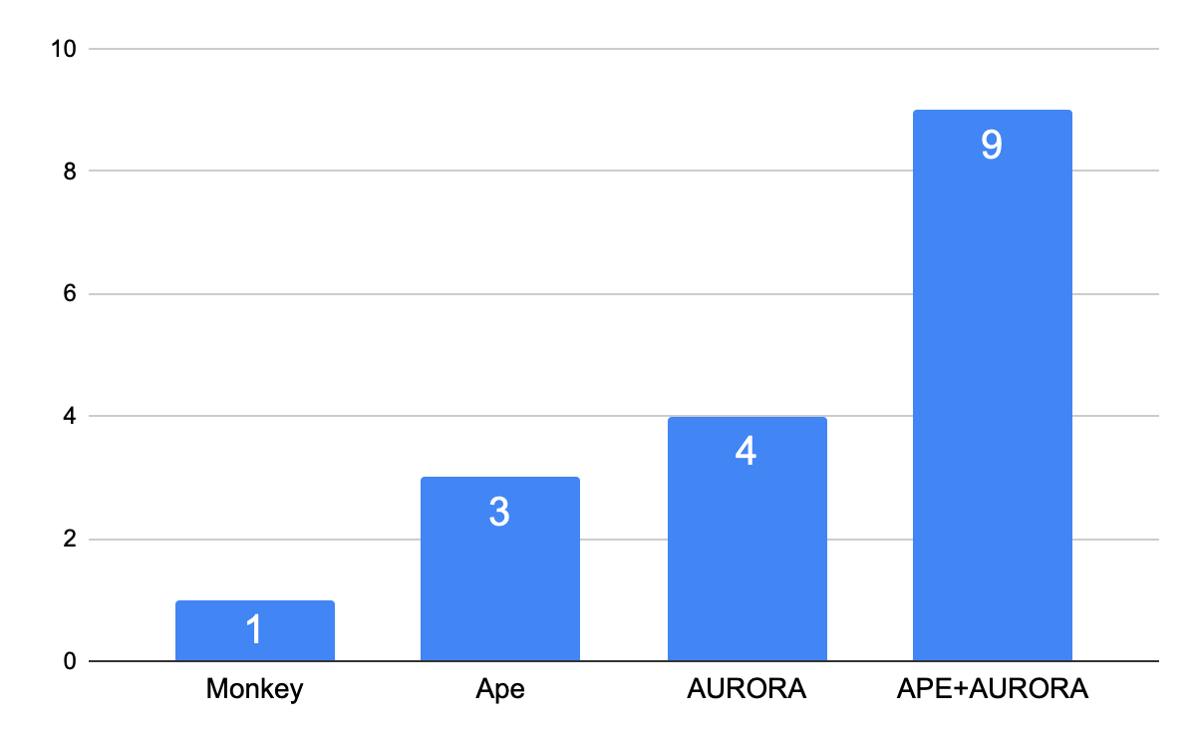
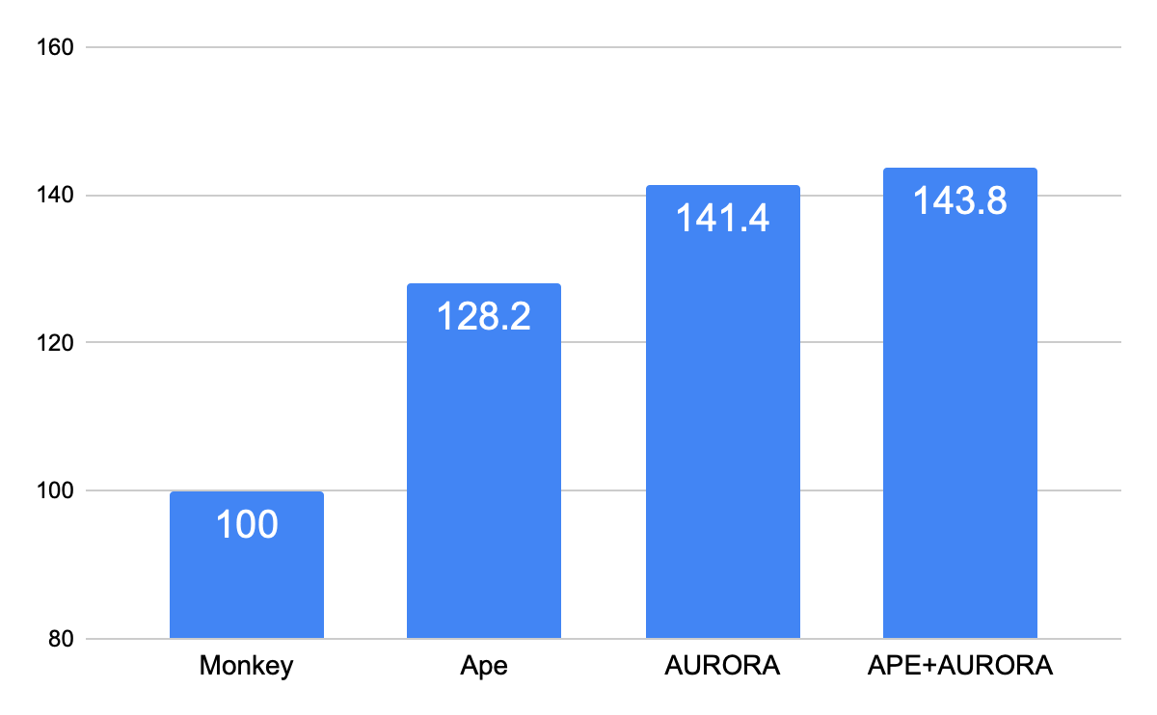
RQ₂: AURORA Coverage Improvement
# of Apps with Higher Coverage (Out of 17)
Total Method Coverage
32

Slide 33
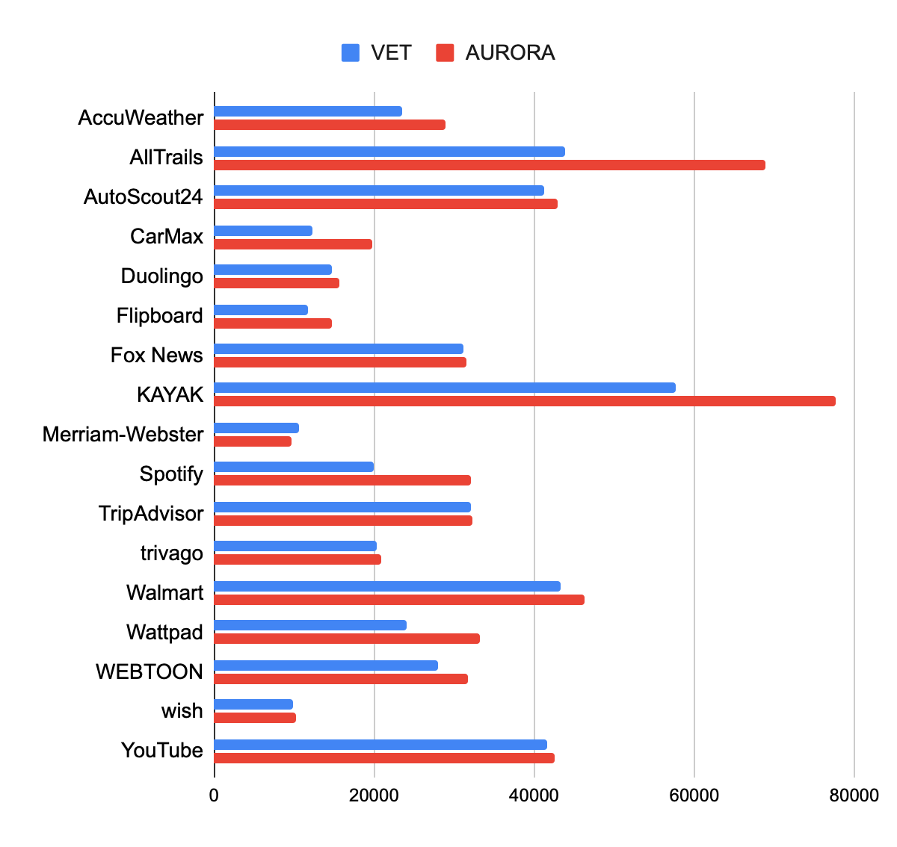
RQ₂: AURORA Coverage Improvement
AURORA achieves higher coverage in 16 out of 17 apps
Overall, 19.6% higher method coverage for AURORA
Method coverage
33

Slide 34
RQ₃: AURORA Exclusive Coverage
34

Slide 35
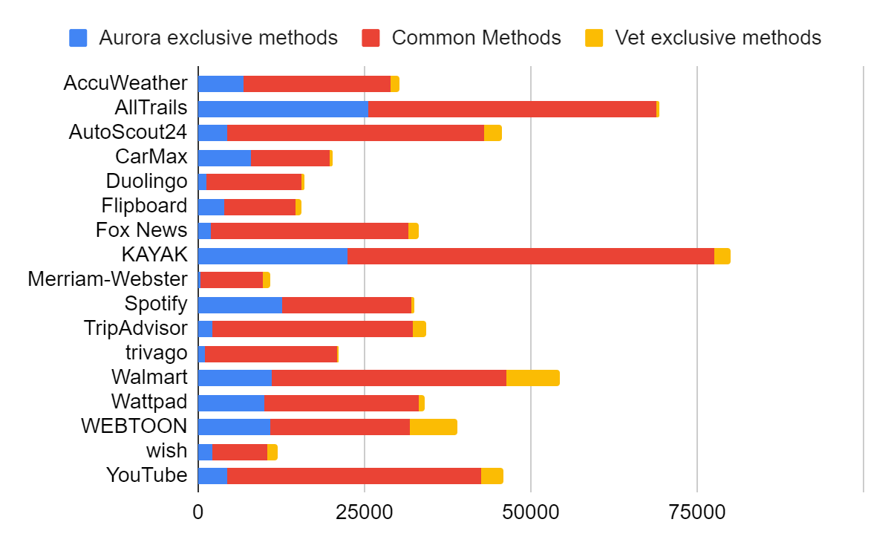
Exclusive Method Coverage Comparison
RQ₃: AURORA Exclusive Coverage
Overall, AURORA achieves 19.6% exclusive method coverage
VET achieves only 6.3% exclusive method coverage
35

Slide 36
RQ₄: Heuristics Effectiveness
36

Slide 37
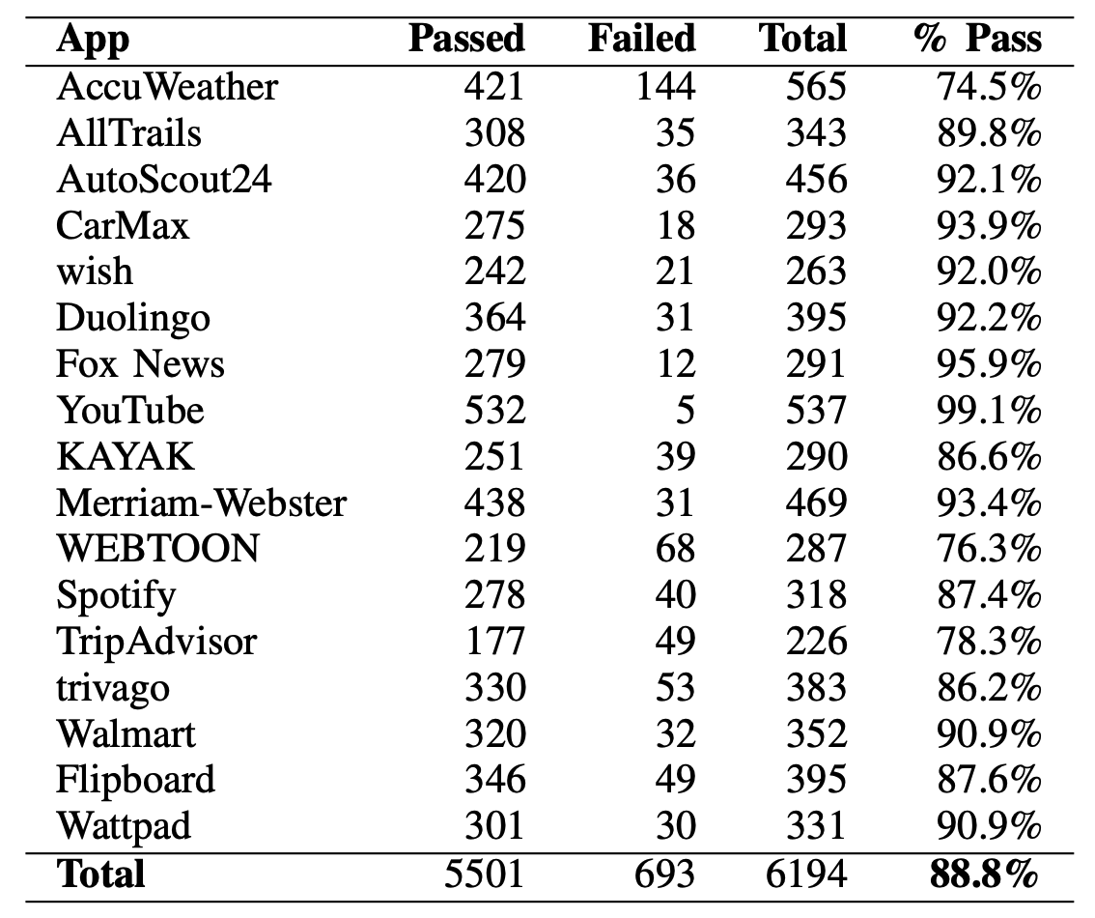
Heuristic Success Code
RQ₄: Heuristics Effectiveness
37

Slide 38
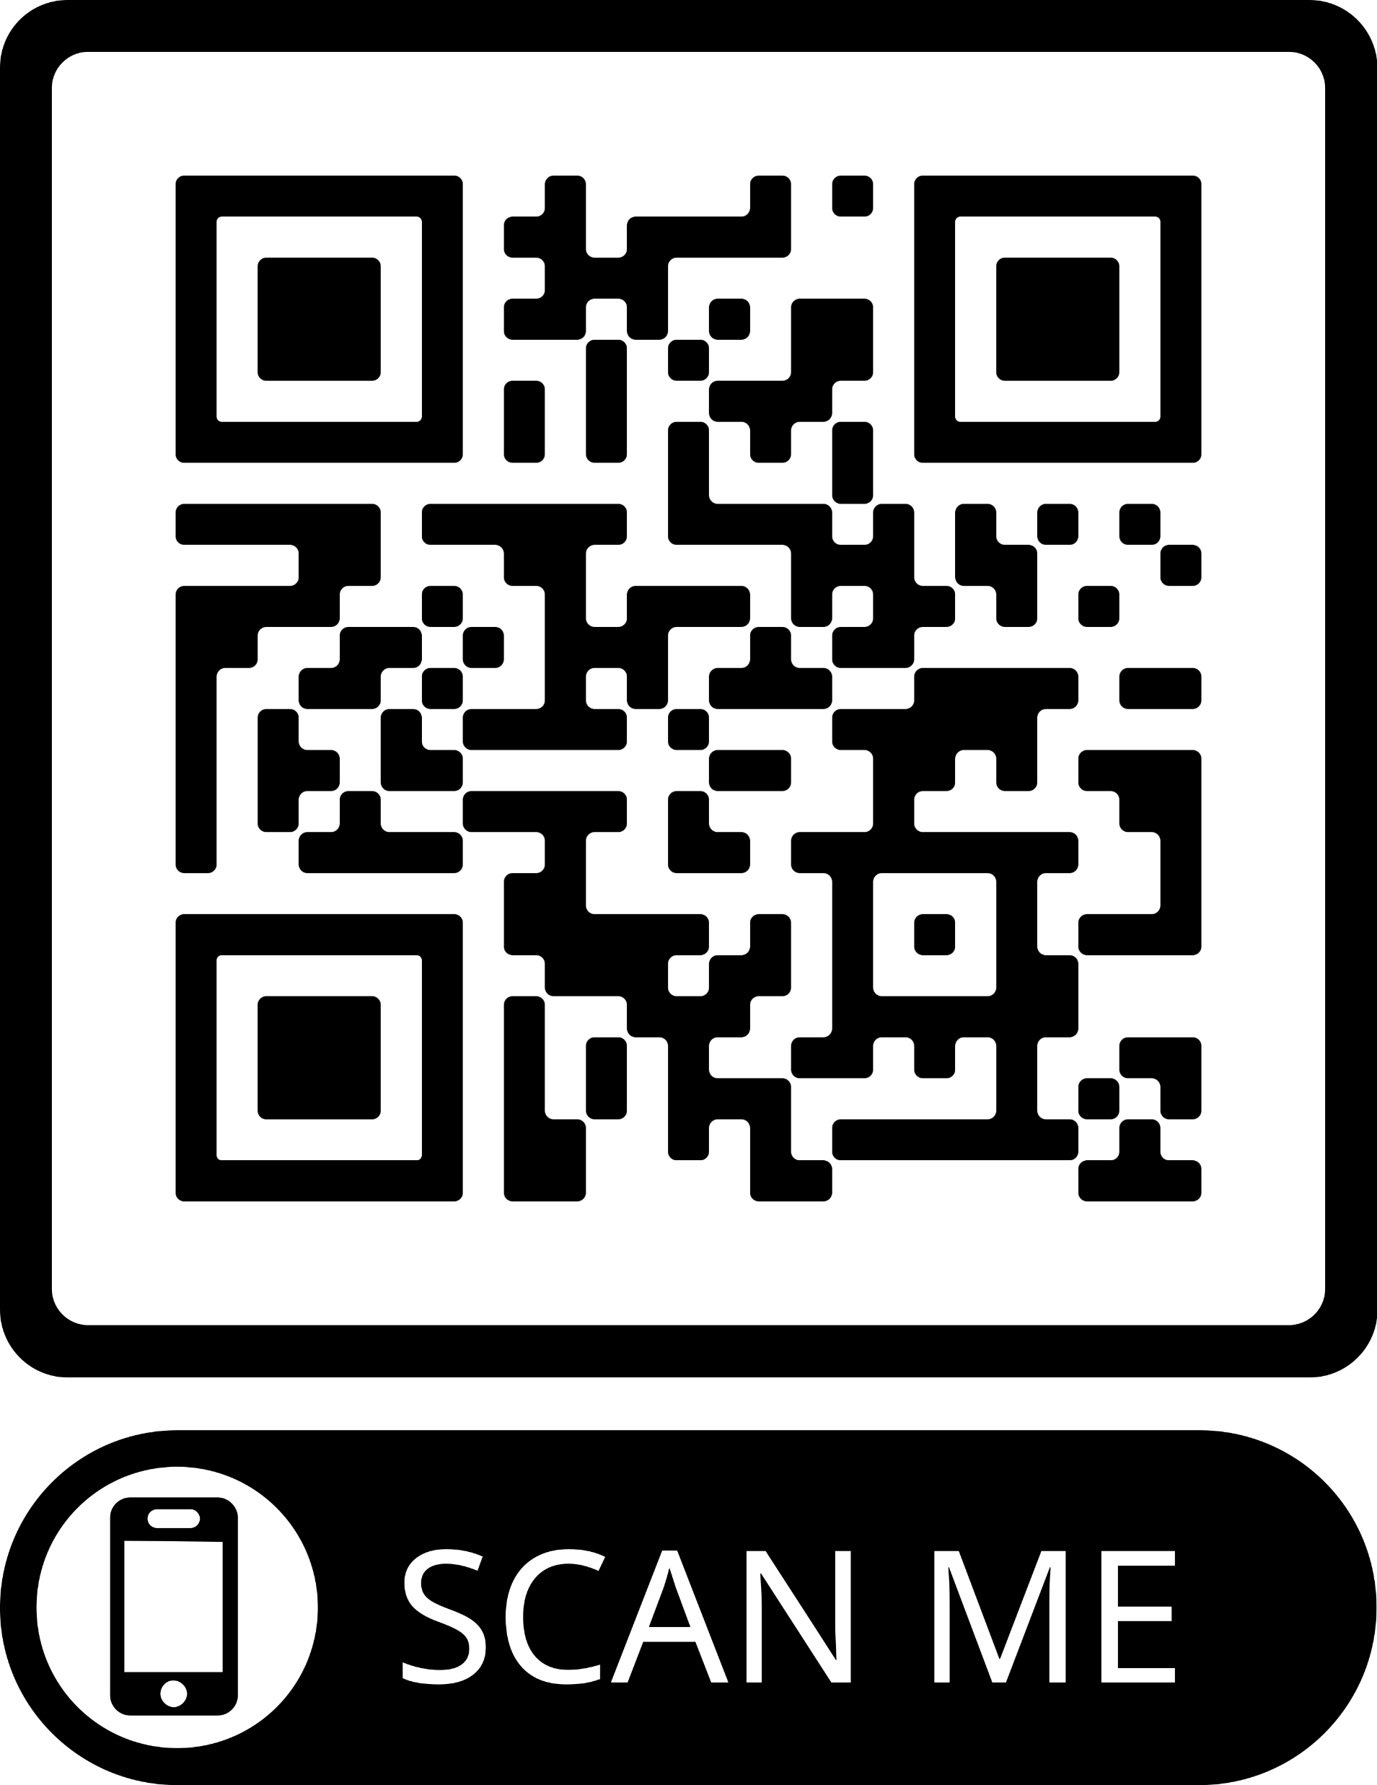



Contributions
A Study identifying prevalent UI design motifs
A multi-modal deep learning-based model for UI classification with 81.3% prediction accuracy
Generalizable heuristics
The AURORA framework
19.6% higher coverage on 17 proprietary apps
AURORA Repo
Safwat Ali Khan
PhD student in CS
skhan89@gmu.edu
https://www.linkedin.com/in/safwat-ali-khan/

Slide 39
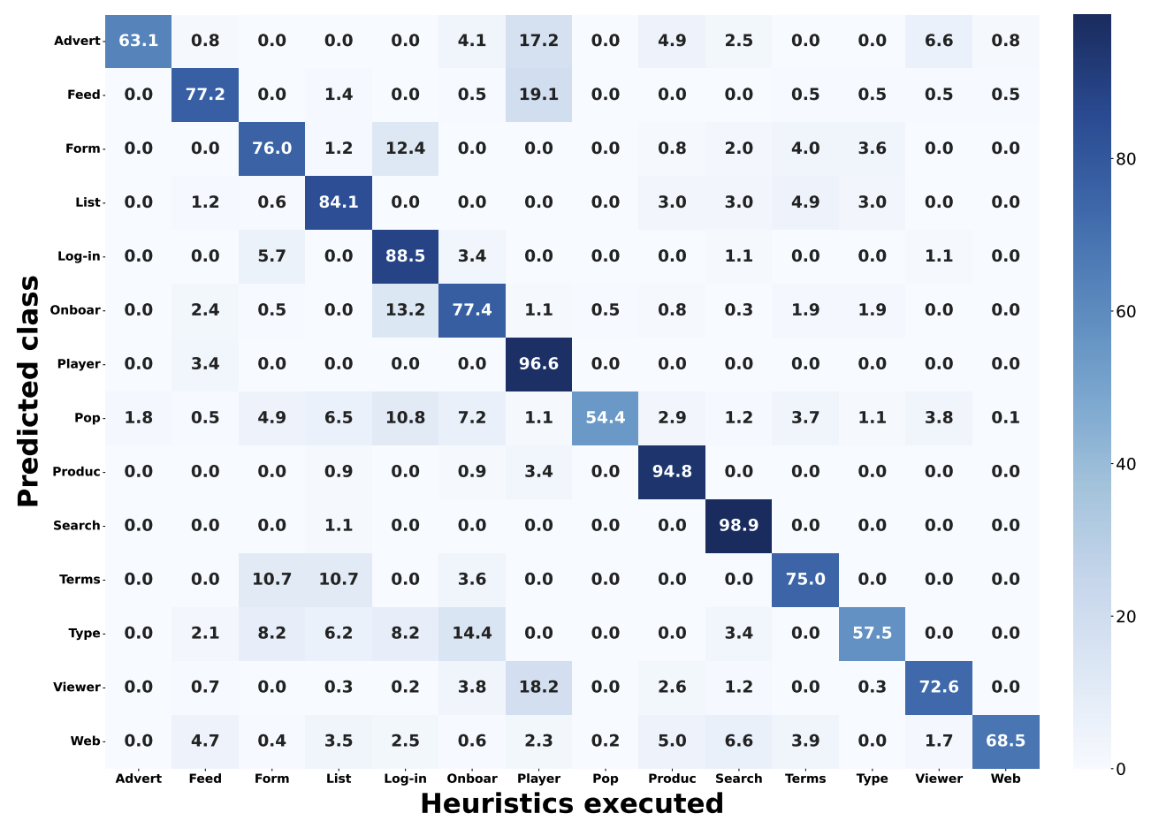
RQ₄: Heuristics Effectiveness
Predicted UI motif
Passed heuristics
39

