Slide 1




Automatically Reproducing Timing-Dependent Flaky-Test Failures
ICST 2024
CCF-2100037
CCF-2145774
Toronto, Canada
Shanto Rahman₁, Aaron Massey₂,
Wing Lam₂, August Shi₁, Jonathan Bell₃
1
2
3

Slide 2
Timing-Dependent Flaky Test
1 @Test
2 public void testCustomBufferSize() {
3 waitUntilEmailIsSent();
4 MimeMultipart mp = verifyMultipart ("..." + this.getClass().getName() + " - " + msg);
5 }
6 class SenderRunnable implements Runnable {
7 void run() {
8 sendBuffer(...);
9 } // sends e-mail
10 }
1 MimeMultipart verifyMultipart(...) {​
2 waitToReceiveEmails(1);​
3 assertEquals(1, server.getMessages().length);
4 }​
5 void waitToReceiveEmails(int emailCount) {​
6 greenMailServer.waitForIncomingEmail(5000, emailCount);​
8 }
FAIL
What if, it takes more than 5000 ms?
Example TD test from SMTPAppender_GreenTest class in the logback project [1]
[1] 2022. [Online]. Available: https://github.com/qos-ch/logback
Notes:
WaitUntilEmailIsSent() waits up to five seconds for this other thread to send the email.
The goal of the test is to check whether emails are properly sent when the framework logs an error. If Line sendBuffer() takes longer than five seconds to finish, then the assertion on fails. Based on the complexity of the operations that the test performs, it is possible for the test to take longer than five seconds to send the email.

Slide 3
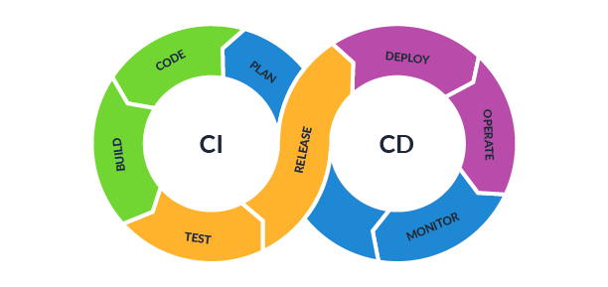

Difficulty in Debugging Flaky Tests
Passed Test
Developers
List of Tests
Failed Test
Run Test
Run Test
Run Test
Run Tests
Run Test
How to reproduce failure reliably?
Run Test
Run Test
Pass
Pass
Pass
Pass
Fail
Pass
Notes:
first, there is a human developer picture
they get a flaky test to fix
they first rerun the test to see the failure
but the test is flaky, so it does not fail immediately
so they rerun it
<imagine a loop image showing that they are continuously rerunning the test>
they get it to fail, so they can see something
but then they want to run again for better tracing
but it once again passes
so they have rerun again
so much time wasted on rerunning
we need more reliable way to reproduce flaky test failures

Slide 4
FlakeRake
We propose FlakeRake, an automated approach for finding failure-inducing configurations that reproduce TD-test failures
  Developers can use the configuration to more reliably reproduce the failure
  Configurations are code locations where to insert sleeps/waits
We implement our approach for Java and make our tool publicly available: https://github.com/gmu-swe/flakerake
Notes:
Configurations are locations where to insert sleeps/waits, changing execution timing as to more easily make the test fail

Slide 5
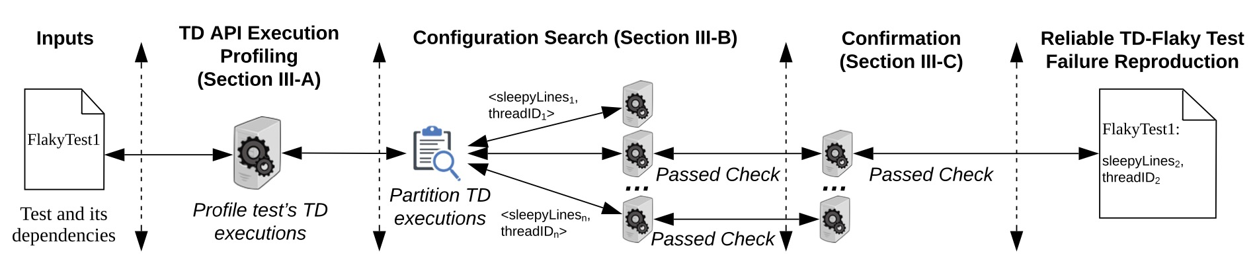
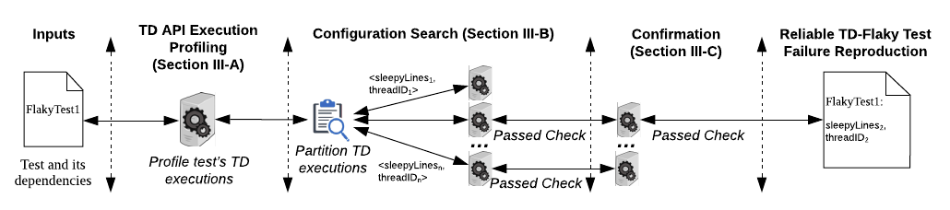
Overview of FlakeRake
FlakeRake
Notes:
Tell input is a flate, output is a configuration. Then open up the box, and describe the rest

Slide 6


Identify Timing Dependent API
2591 API(s)
  1955 APIs from java.util.concurrent, ​
  565 from java.nio, ​
  17 from java.net and javax.net, and ​
  54 from other packages in the JDK
Keyword filtering from JDK documentations
Java JDK
Authors
Example JDK:
Java.util.concurrent,
java.nio packages
Example Keywords: thread, lock, socket
Example APIs:
java/lang/System.currentTimeMillis()J
java/util/concurrent/CountDownLatch.await()V
Notes:
Why do we care about the TD API calls. Why I am doing this (Ans: to inject delay before that APIs)? Why these TD APIs not other APIs?
Draw pictures- documents picture (labeled with Java SDK); -> filter ("thread", "lock", "socket"); -> human picture; -> 2591 APIs
e.g.,
Why this one is needed:
To reproduce TD flaky-test failures, FlakeRake inserts delays around calls to APIs that are timing-dependent.

Slide 7

TD API Profiling
Run Test
Sleep lines, threadID
Track calls to TD APIs
Dynamic instrumentation
Notes:
Give example in the output, Line3, threadID

Slide 8
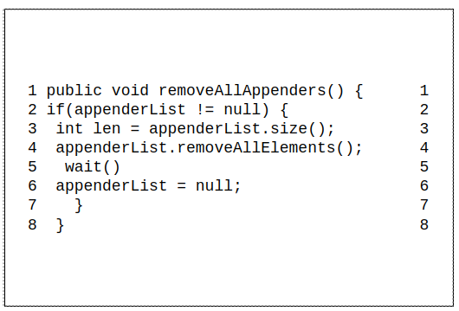
Configuration Search (OBO)
Thread2 (t2)
Thread1 (t1)
Sleep
Sleep
Sleep
Notes:
The aim is to We need a minimal set to inject dela.
Motivation: While there are many possible TD API lines to sleep at to reproduce a TD failure (sleepyLines), only a few of them may be needed. FlakeRake explores these lines by repeatedly running the test under different configurations involving subsets of the sleepyLines. Although FlakeRake’s process to repeatedly run the test can have a high cost, this cost is per test and not per failure
Can look for TD APIs instead of these APIs.

Slide 9
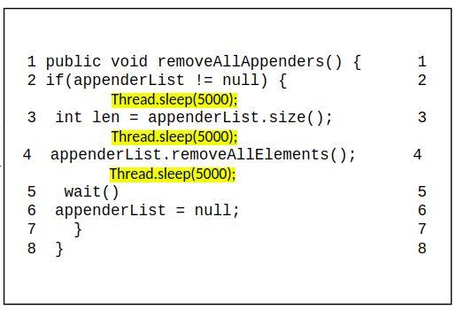
Configuration Search (One-By-One)
Thread2 (t2)
Thread1 (t1)
Sleep
Sleep
Sleep
OBO produces three configurations: < (s3, t1) >
< (s4, t1) >
< (s5, t2) >​
Notes:
The aim is to We need a minimal set to inject delay
Can look for TD APIs instead of these APIs.

Slide 10
Confirmation
#Same failure >=3
Run each Test 5 times
< (s3, t1) >
< (s4, t1) >
< (s5, t2) >
Yes
< (s3, t1) >
< (s5, t2) >
Config.
Configs.
Candidate
configurations
No
Discard
Notes:
To avoid deadlock, FlakeRake considers a timeout to run the test.

Slide 11
Experiment Setup
FlakeFlagger dataset [1]: 1,167 flaky failures from 811 tests in 23 projects
Conducted our experiments using machines, each running Ubuntu 20 and Java 1.8, with 16GB RAM and 4 virtual CPU cores
Compared with two state-of-practice baselines
  Rerun-Repl: repeatedly rerunning a test suite
  Isolated Rerun: repeatedly rerunning a test method (in isolation)
[1] Alshammari, Abdulrahman, et al. "Flakeflagger: Predicting flakiness without rerunning tests." ICSE 2021.

Slide 12
Research Questions
RQ1: Effectiveness of FlakeRake, Rerun-Repl, and Isolated Rerun?
RQ2: Reliability of FlakeRake, Rerun-Repl, and Isolated Rerun?
RQ3: Efficiency of FlakeRake, Rerun-Repl, and Isolated Rerun?
RQ4: Characteristics of FlakeRake failure-inducing configurations?
Notes:
RQ1: How effective are FlakeRake, Rerun-Repl, and Isolated Rerun at reproducing flaky-test failures at least three times?
RQ2: How reliably can FlakeRake, Rerun-Repl, and Isolated Rerun reproduce flaky-test failures?
RQ3: How efficient are FlakeRake, Rerun-Repl, and Isolated Rerun at reproducing flaky-test failures multiple times?
RQ4: What are the characteristics of the failure-inducing configurations outputted by FlakeRake?

Slide 13
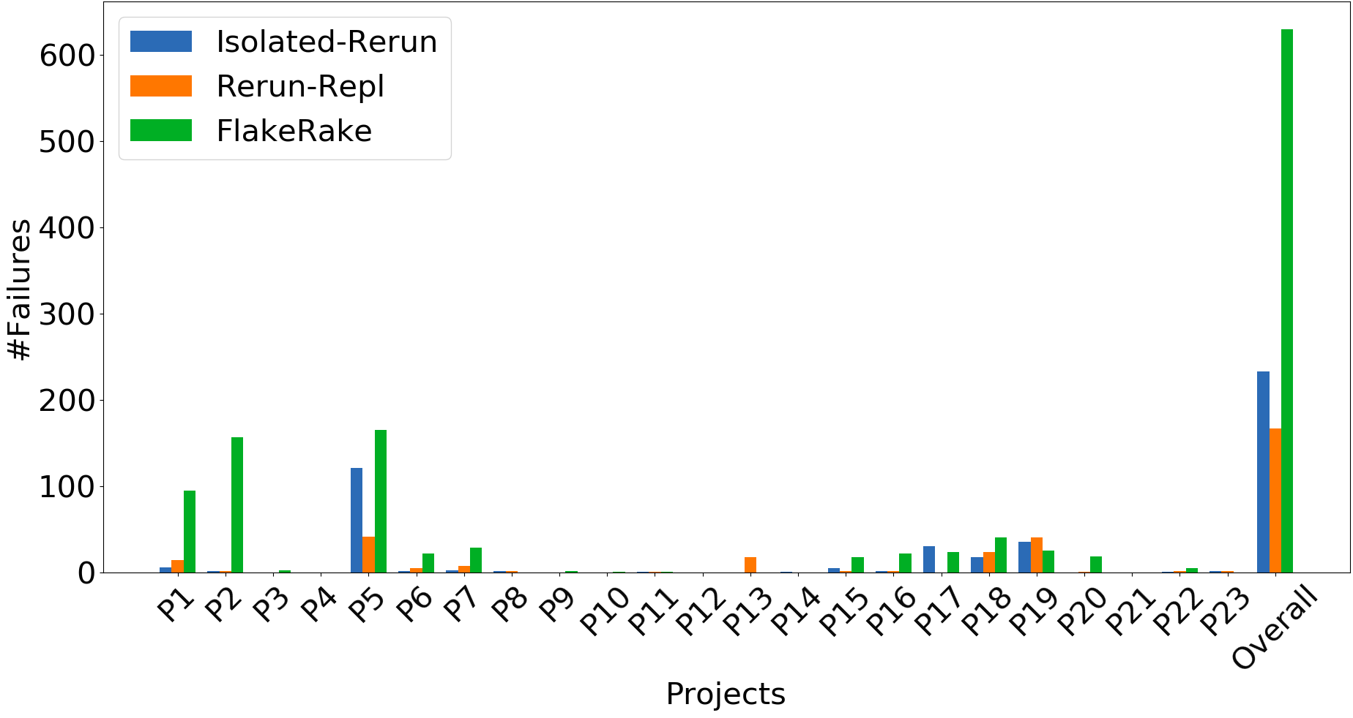
RQ1: Detected failures
RQ1 setting:
Rerun-Repl has 10,000 runs
Isolated-Rerun has 10,000 runs
FlakeRake searched configurations and reproduced each failure 3+ times
Each failure was observed 3+ times
Notes:
Highlights what we want to focus
What happens with these 500 around tests that are uniq here?

Slide 14
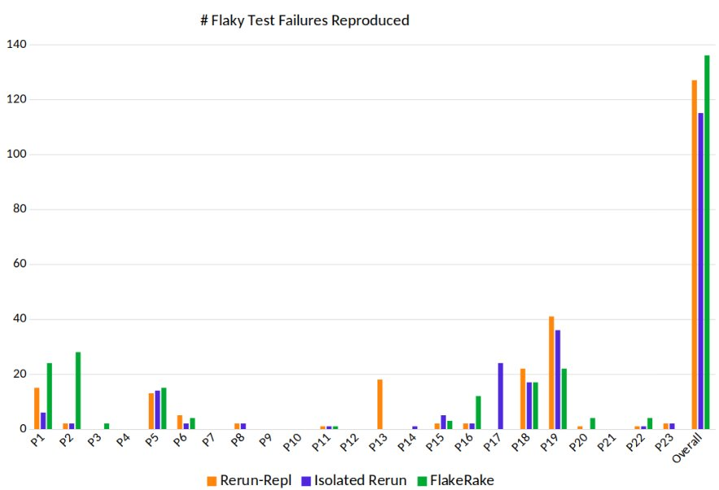
RQ1: Reproduced failures from FlakeFlagger
127, 115, 136 – Total of 247 uniq.
Notes:
Highlights what we want to focus
Ren-Repl and Isolated Reruns happened for 10,000 times. Need to confirm with Jon how many times Flakerake runs- it is 5 times by design
Why don’t we get the 900 failures to reproduce?

Slide 15
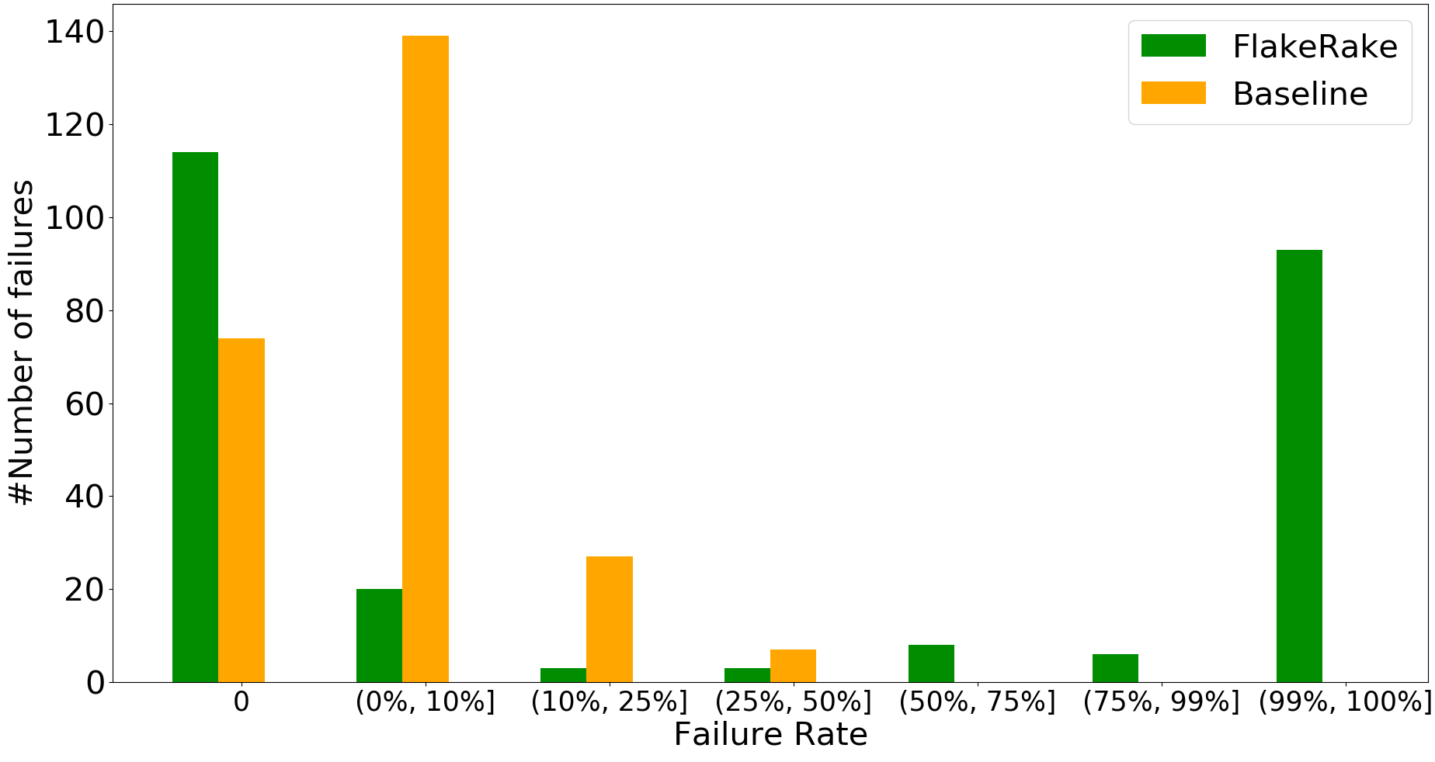
RQ2: Reliability of failure reproduction
RQ2 setting:
Uses 247 uniq. failure from RQ1
Baseline combines Rerun-Repl and Isolated-Rerun. Both are run 100 times
FlakeRake ran configurations from RQ1 100 times
107 failures at rate >50%!
Notes:
We take the tests that fail from before (corresponds this 247 failures, from RQ1) and, we rerun each test for 100 times. For example, 114 tests failure have 0% failure rate when run through Flakerake. There are more failures with the very high flailure rate when run trough FlakeRake's configuration.
What is failure rate?
For each failure, for each technique, we ran it 100 times.

Slide 16
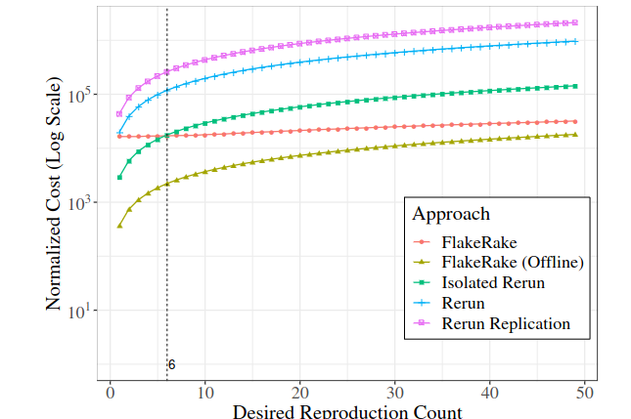
RQ3: Efficiency of reproducing failures multiple times
If reproducing failures < 6 times?
FlakeRake may not be the most efficient.
When reproducing failures more than 6 times,
FlakeRake is more efficient.
A recent study [1] found that developers run tests an average of 6 times and a maximum of 32 times when debugging normal test failures that fail deterministically
[1] A. Alaboudi and T. D. LaToza, “An exploratory study of debugging episodes,” arXiv, 2021.​
Notes:
Mention WHY??
Once we reproduce a failure, FlakeRake can reliably fails. Flakerake can reproduce many more failures than other techniques as per RQ1. FlakeRake is effective to use if we need at least 6 times failures.
Explain X-axis and Y-axis.
Y-axis represent how long all technique take to reproduce the failures that many times (i.e., X-axis count). Need to check the unit of y-axis
A recent study [46, Table 4] also found that developers run tests an average of six times and a maximum of 32 times when debugging normal test failures that fail deterministically.
Reproducing a flaky-test failure multiple times is an integral step to debugging the failure [31-32].
Figure 5 shows the relation between the number of desired reproduced failures and the normalized runtime cost to achieve that many failures for each approach. We see that FlakeRake (offline) is the fastest approach, regardless of the number of reproductions needed, by excluding the one-time cost of generating a reproduction script while still reliably reproducing a failure for each run.
If we disregard FlakeRake (offline), we see that using Isolated Rerun would be the fastest approach if the developer only needs to reproduce the failure fewer than six times. However, if a developer needs more than six failure reproductions, FlakeRake quickly surpasses Isolated Rerun in terms of performance

Slide 17
RQ4: Characteristics of configurations
The most frequently occurring API is ExitSyncBlock
  represents the exit of a synchronized block, appearing in 2,706 or 18% of failure-inducing configurations.
Timing-Dependent API | Timing-Dependent API | Pearson correlation coefficient (R)
ByteBuffer.allocate | ByteBuffer.array | 1.00
EnterSyncBlock | ExitSyncBlock | 0.99
EnterSyncMethod | ExitSyncMethod | 0.99
Selector.wakeup | Thread.currentThread | 0.96
System.currentTimeMillis | Thread.currentThread | 0.93
Top five Timing-Dependent APIs that are part of failure-inducing configurations
Notes:
MENTION WHY THIS RQ??
ANS:
How effectively we can use FlakeRake's configurations that developers can use without searching for the configurations.
To better understand why FlakeRake is effective, we study the characteristics of the failure-inducing configurations found by FlakeRake that reproduced failures from the FlakeFlagger dataset. Our results suggest that if developers are manually reproducing TD flaky-test failures, inserting sleeps around APIs such as ExitSyncBlock can help reproduce a failure in 85% of the tests for which FlakeRake can reproduce a failure.
Table IV shows the top five TD APIs that are part of failure-inducing configurations.
270 TD APIs are used in a mean of 201 and a median of 75 failure inducing configurations.

Slide 18
Conclusion
We propose FlakeRake to reliably reproduce timing-dependent flaky-test failures.
Compared to state-of-practice rerun baselines, FlakeRake can reproduce
  more failures (136 failures vs 115 and 127 failures by baselines)
  failures more reliably (107 failures at rate >50%, while baselines at rate <50%)
  failures more efficiently (FlakeRake is more cost efficient if need to reproduce the failure >= 6 times)
Artifact: https://github.com/gmu-swe/flakerake
Contact: Shanto Rahman <shanto.rahman@utexas.edu>
Notes:
FlakeRake reliably makes 136 flaky failure compared to 127 and 115 for Rerun-Repl and Isolated Rerun, respectively.
FlakeRake makes a total of 630 flaky failure compared to Rerun-Repl(167 ) and Isolated Rerun (233).
Reproduced 290 tests failures compared to Rerun-Repl and Isolated Rerun by 139 and 160 tests, respectively.

Slide 19
When and How to use FlakeRake
We suggest that developers attempting to reproduce flaky-test failures follow this workflow:
  Determine if the test is TD or OD:
    run FlakeRake (to detect TD failures) and OD detection tools (to detect OD failures).
  Both of these tools are fully automated, and if they succeed, will produce a script to deterministically reproduce that failure.
  If more failures are needed and the automated tools have produced a reproduction script, switch to the script to more reliably reproduce failures.
Notes:
FlakeRake produces a reproduction script using the failureinducing configurations outputted by the previous steps. This script includes (1) the failure, represented as the exception message and stack trace, and (2) the failure-inducing configuration, represented as a set of sleepyLines and their corresponding threadIDs for reproducing the specific failure. FlakeRake uses these scripts to dynamically apply the appropriate sleeps when re-running the test. Alternatively, developers can use the information to manually reproduce the failure.

Slide 20
TD API Identify
We construct a list of TD APIs for Java applications by collecting the API methods in the standard Java Development Kit (JDK), especially across multiple threads or concurrent operations on data.
  Examples – java.util.concurrent
  Java.nio
  We also inspected all APIs that have the keywords “thread”, “lock”, “socket”, or “time” in their API documentation from the following packages: java.io, java.lang, java.net, and javax.net.
Finally, we obtain 2591 APIs
  1955 APIs from java.util.concurrent,
  565 from java.nio,
  17 from java.net and javax.net, and
  54 from other packages in the JDK (e.g., System.currentTimeMillis)
We use only methods from the JDK as the TD APIs because any other methods from the tests, system-under-test, or third party library code that perform timing-related operations are likely to eventually use these APIs from the standard JDK.
Notes:
Draw pictures- documents picture (labeled with Java SDK); -> filter ("thread", "lock", "socket"); -> human picture; -> 2591 APIs
e.g.,
Why this one is needed:
To reproduce TD flaky-test failures, FlakeRake inserts delays around calls to APIs that are timing-dependent.

Slide 21
TD API Profiling
FlakeRake dynamically profiles the test’s execution to find where it makes calls to any of the TD APIs.
FlakeRake dynamically instruments the code to track calls to TD APIs.
This step executes the test multiple times to record which APIs get called.
The instrumented executions produce a list of sleepyLines – the list of candidate lines to sleep at.
As each TD API might be invoked in multiple threads, FlakeRake also records a threadID for each sleepyLine.
Notes:
There may not always be the same consistent TD APIs called during a test execution due to inherent non-determinism of the execution. To mitigate the issues of non-determinism, FlakeRake executes this profiling step multiple times and aggregates the set of TD API calls made across all executions. When we perform this profiling step 10 times on the flaky tests in the FlakeFlagger dataset [5], we find that the first profiling run already contributes 84% of the TD API calls that can be found in 10 runs. By the fifth run, no TD APIs found by our profiling were needed to reproduce the flaky-test failures in the FlakeFlagger dataset. Therefore, we set and recommend the default number of executions for this step to be five
We compute a stable identifier for the thread by
generating a hash of the stack trace at the location that spawned the thread,
the number of times that location has spawned a thread, and
the threadID that spawned the thread.
FlakeRake gives the initial, “main” thread the consistent identifier 0.

Slide 22
Configuration Search
While there are many possible TD API lines to sleep at to reproduce a TD failure (sleepyLines), only a few of them may be needed. FlakeRake explores these lines by repeatedly running the test under different configurations involving subsets of the sleepyLines.
We implement and evaluate two heuristic-based algorithms to partition the set of sleepyLines into smaller sets:
  One-by-one (OBO)
    Given sleepyLines and corresponding threadIDs (s1, t1),(s2, t1),(s3, t2), OBO produces three configurations: < (s1, t1) >, < (s2, t1) >, and < (s3, t2) >
  Bisection (similar to binary search)
    given sleepyLines (s1, t1),(s2, t1),(s3, t2) in order of appearance during execution,
    Bisection produces four configurations: < (s1, t1),(s2, t1) >, < (s1, t1) >, < (s2, t1) >, and < (s3, t2) >. FlakeRake’s bisection will not explore subsets of configurations if the union of the sub-sets does not reliably reproduce a failure.
We find that OBO finds slightly fewer failures than Bisection, while being only 2.4% faster than Bisection
Notes:
**Draw a few lines of code like flakysync. Then show how OBO and Bisection works.
We need to get some example or ilustration where do I add my sleeps?

Slide 23
Configuration Search (OBO)
Thread1
Thread2
1 public void removeAllAppenders() { 1
2 if(appenderList != null) { 2
Thread.sleep(5000);
3 int len = appenderList.size(); 3
Thread.sleep(5000);
4 appenderList.removeAllElements(); 4
Thread.sleep(5000);
5 wait() 5
6 appenderList = null; 6
7 } 7
8 } 8
OBO produces three configurations: < (s3, t1) >, < (s4, t1) >, and < (s5, t2) >​

Slide 24
Configuration Search (Bisection)
Thread1
Thread2
Bisection produces four configurations: < (s1, t1),(s2, t1) >, < (s1, t1) >, < (s2, t1) >, and < (s3, t2) >
Sleep
Sleep
Sleep

Slide 25
Configuration Search (OBO)
Thread1
Thread2
Sleep
Sleep
Sleep
OBO produces three configurations: < (s3, t1) >, < (s4, t1) >, and < (s5, t2) >​
Notes:
The aim is to We need a minimal set to inject delay
Can look for TD APIs instead of these APIs.

Slide 26
Confirmation
For each failure-inducing configuration, FlakeRake reruns the test five times
outputs the configuration only if it produced the same failure at least three times.
To avoid deadlock, FlakeRake considers a timeout to run the test.
Notes:
We rerun five times because prior work [41] found that rerunning a test five times is generally sufficient to observe both passing and failing results from a flaky test (Section IV-B shows our results rerunning 100 times)
To avoid deadlock situation, FlakeRake considers test execution time exceeding the expected time, then FlakeRake discards the configuration.

Slide 27
Output of the FlakeRake
FlakeRake produces a reproduction script using the failure inducing configurations outputted by the previous steps.
This script includes
  (1) the failure, represented as the exception message and stack trace, and
  (2) the failure-inducing configuration, represented as a set of sleepyLines and their corresponding threadIDs for reproducing the specific failure.
FlakeRake uses these scripts to dynamically apply the appropriate sleeps when re-running the test. Alternatively, developers can use the information to manually reproduce the failure.
Notes:
FlakeRake produces a reproduction script using the failureinducing configurations outputted by the previous steps. This script includes (1) the failure, represented as the exception message and stack trace, and (2) the failure-inducing configuration, represented as a set of sleepyLines and their corresponding threadIDs for reproducing the specific failure. FlakeRake uses these scripts to dynamically apply the appropriate sleeps when re-running the test. Alternatively, developers can use the information to manually reproduce the failure.

Slide 28
Experiment Setup
Data
Baselines

Slide 29
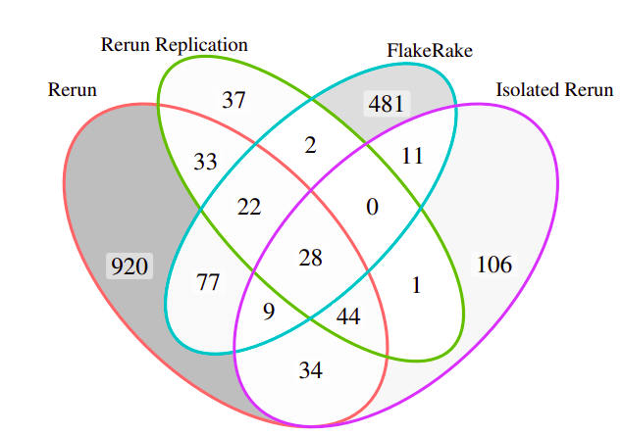


RQ1: Number of reproduced failures
Notes:
34+44+28+9
Of the techniques evaluated, FlakeRake was most successful at reproducing failures from the original Rerun dataset (136 failures), compared to Rerun-Repl (127 failures) and Isolated Rerun (115 failures). How these numbers come from?

Slide 30
RQ2: Reliability of failure reproduction
Make two plots for these FlakeRake and Baseline
 | Best of Rerun-Repl and Isolated Rerun
FlakeRake Repro | 0 | (0%, 10%] | (10%, 25%] | (25%, 50%] | Total
0 | 25 | 61 | 23 | 5 | 114
(0%, 10%] | 7 | 13 | 0 | 0 | 20
(10%, 25%] | 1 | 2 | 0 | 0 | 3
(25%, 50%] | 2 | 1 | 0 | 0 | 3
(50%, 75%] | 3 | 5 | 0 | 0 | 8
(75%, 99%] | 1 | 5 | 0 | 0 | 6
(99%, 100%] | 35 | 52 | 4 | 2 | 93
Total | 74 | 139 | 27 | 7 | 247
Notes:
What is happening? Why we do this?
Write
In contrast, of the 136 failures that FlakeRake reproduced (Table I), 107 (8+6+93) of these failures are reliably reproduced >50% of the time. In fact, many (93) of these failures are extremely reliably reproduced – in over 99% of the 100 runs. We conclude that FlakeRake can more reliably reproduce failures than state-ofpractice approaches, helping developers repeatedly reproduce TD failures for debugging and fixing.
FlakeRake have 0% failure rate for 61 tests, which tests have 10% failure rate for Rerun-Repl and Isolated Rerun.
Describe the cell what is means across columns and rows.

