Slide 1


CS 480/580: Introduction to Artificial Intelligence
Constraint Satisfaction Problems
Prof. Xuesu Xiao
George Mason University
[Based on slides created by Dan Klein and Pieter Abbeel for CS188 Intro to AI at UC Berkeley.
All original materials available at http://ai.berkeley.edu.]
Notes:
Please retain proper attribution, including the reference to ai.berkeley.edu. Thanks!

Slide 2


What is Search For?
Assumptions about the world: a single agent, deterministic actions, fully observed state, discrete state space
Planning: sequences of actions
The path to the goal is the important thing
Paths have various costs, depths
Heuristics give problem-specific guidance
Identification: assignments to variables
The goal itself is important, not the path
All paths at the same depth (for some formulations)
CSPs are specialized for identification problems

Slide 3

Constraint Satisfaction Problems

Slide 4


Constraint Satisfaction Problems
Standard search problems:
State is a “black box”: arbitrary data structure
Goal test can be any function over states
Successor function can also be anything
Constraint satisfaction problems (CSPs):
A special subset of search problems
State is defined by variables X_{i} with values from a domain D (sometimes D depends on i)
Goal test is a set of constraints specifying allowable combinations of values for subsets of variables
Allows useful general-purpose algorithms with more power than standard search algorithms
Notes:
Goal test has structure, it ‘s more like a manual describing a set of constraints that have to hold true

Slide 5
CSP Examples

Slide 6


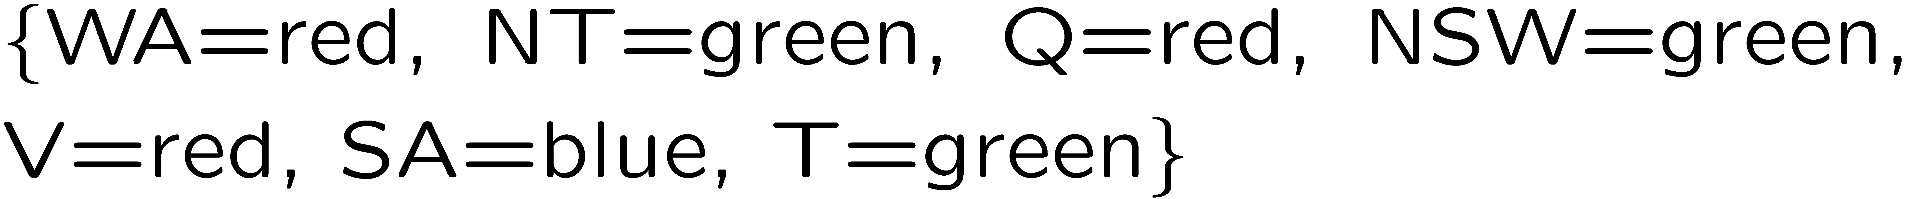
Example: Map Coloring
Variables:
Domains:
Constraints: adjacent regions must have different colors
Solutions are assignments satisfying all constraints, e.g.:
Implicit:
Explicit:

Slide 7
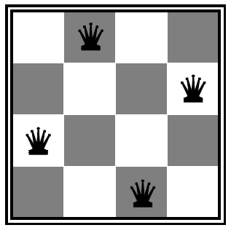

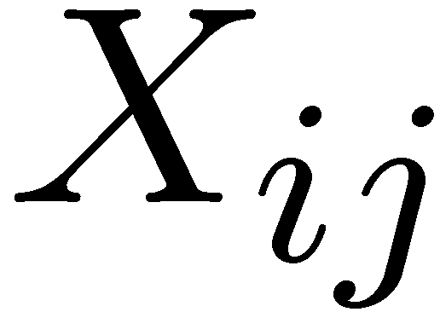

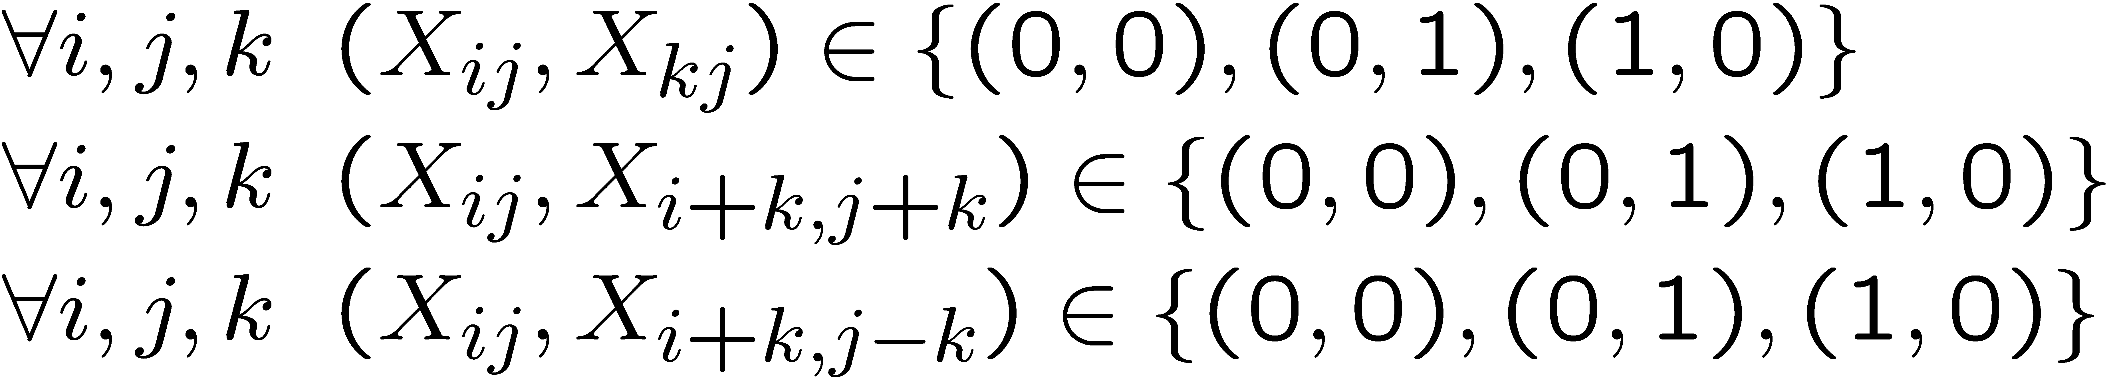
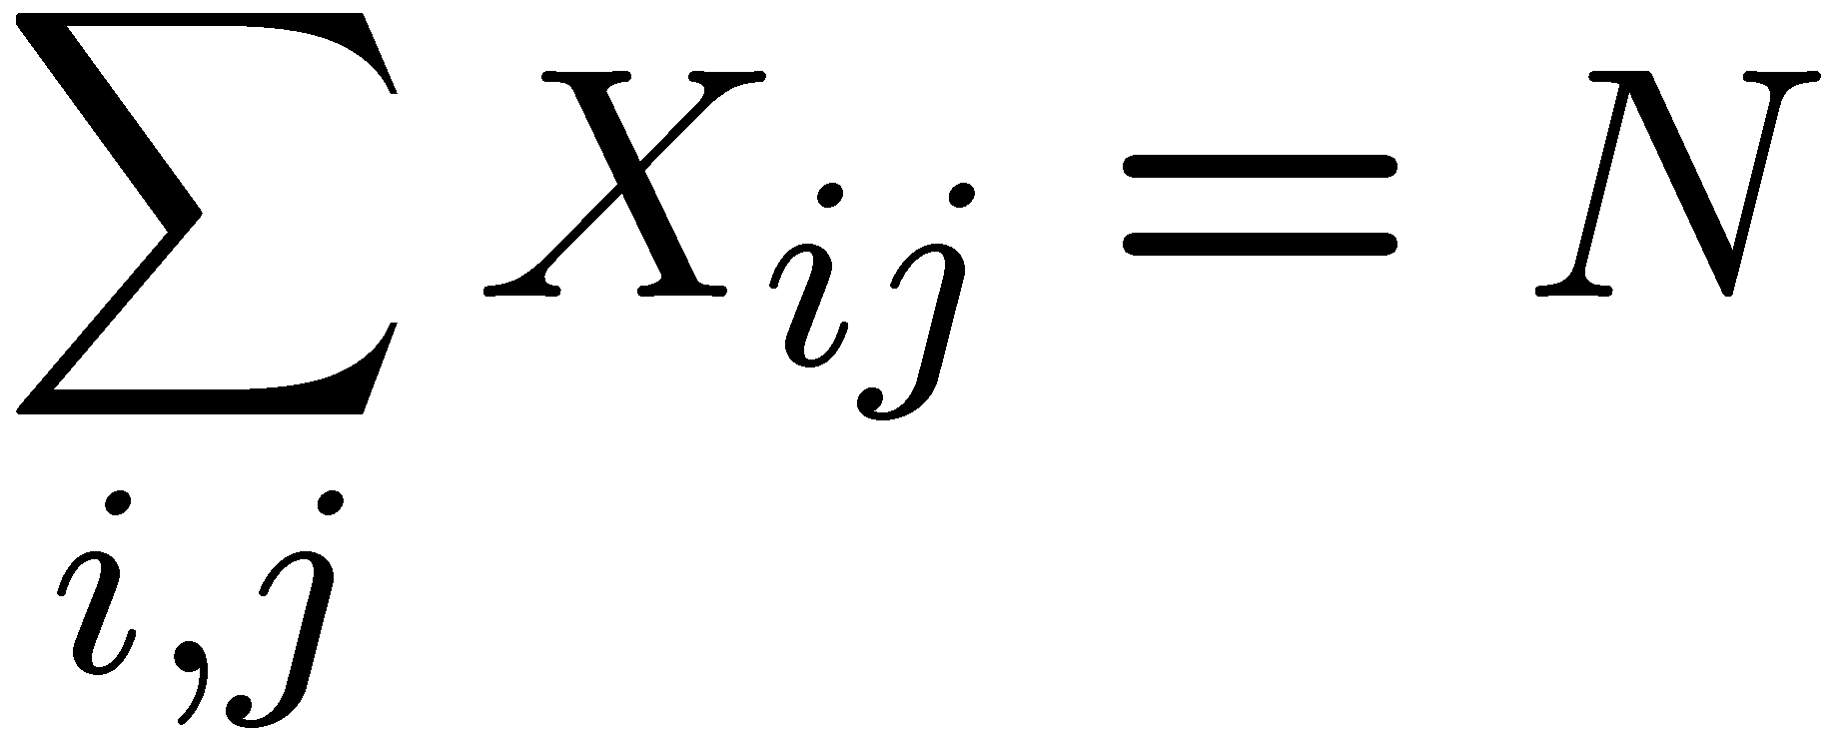
Example: N-Queens
Formulation 1:
Variables:
Domains:
Constraints

Slide 8







Example: N-Queens
Formulation 2:
Variables:
Domains:
Constraints:
Implicit:
Explicit:

Slide 9
Constraint Graphs

Slide 10
Constraint Graphs
Binary CSP: each constraint relates (at most) two variables
Binary constraint graph: nodes are variables, arcs show constraints
General-purpose CSP algorithms use the graph structure to speed up search. E.g., Tasmania is an independent subproblem!

Slide 11


Example: Cryptarithmetic
Variables:
Domains:
Constraints:
Notes:
0=7, R=4, W=6, U=2, T=8, F=1; 867 + 867 = 1734

Slide 12
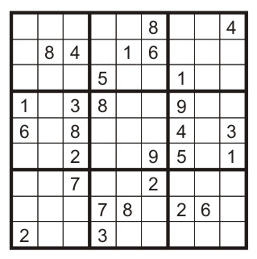
Example: Sudoku
Variables:
Each (open) square
Domains:
{1,2,…,9}
Constraints:
9-way alldiff for each column
9-way alldiff for each row
9-way alldiff for each region
(or can have a bunch of pairwise inequality constraints)

Slide 13

Varieties of CSPs and Constraints

Slide 14


Varieties of CSPs
Discrete Variables
Finite domains
Size d means O(d^{n}) complete assignments
E.g., Boolean CSPs, including Boolean satisfiability (NP-complete)
Infinite domains (integers, strings, etc.)
E.g., job scheduling, variables are start/end times for each job
Linear constraints solvable, nonlinear undecidable
Continuous variables
E.g., start/end times for Hubble Telescope observations
Linear constraints solvable in polynomial time by LP methods

Slide 15


Varieties of Constraints
Varieties of Constraints
Unary constraints involve a single variable (equivalent to reducing domains), e.g.:
Binary constraints involve pairs of variables, e.g.:
Higher-order constraints involve 3 or more variables:
e.g., cryptarithmetic column constraints
Preferences (soft constraints):
E.g., red is better than green
Often representable by a cost for each variable assignment
Gives constrained optimization problems
(We’ll ignore these until we get to Bayes’ nets)

Slide 16
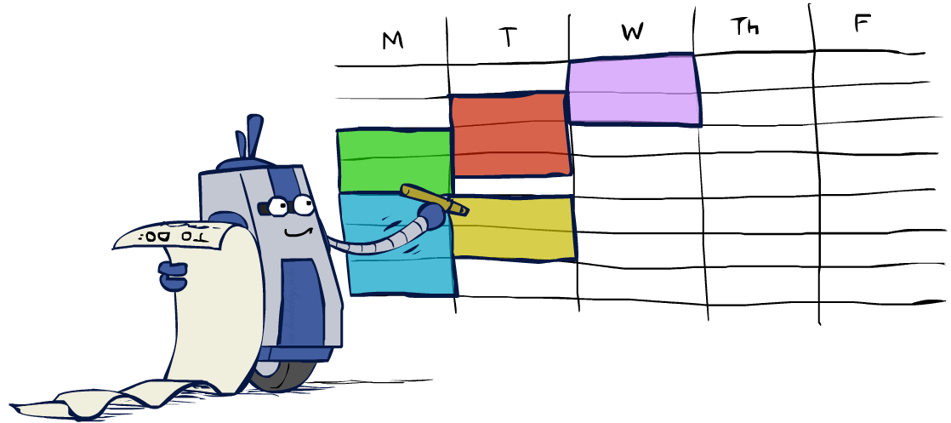
Real-World CSPs
Assignment problems: e.g., who teaches what class
Timetabling problems: e.g., which class is offered when and where?
Hardware configuration
Transportation scheduling
Factory scheduling
Circuit layout
Fault diagnosis
… lots more!
Many real-world problems involve real-valued variables…

Slide 17

Solving CSPs

Slide 18
Standard Search Formulation
Standard search formulation of CSPs
States defined by the values assigned so far (partial assignments)
Initial state: the empty assignment, {}
Successor function: assign a value to an unassigned variable
Goal test: the current assignment is complete and satisfies all constraints
We’ll start with the straightforward, naïve approach, then improve it

Slide 19
Search Methods
What would BFS do?
What would DFS do?
What problems does naïve search have?

Slide 20

Video of Demo Coloring -- DFS

Slide 21

Backtracking Search

Slide 22
Backtracking Search
Backtracking search is the basic uninformed algorithm for solving CSPs
Idea 1: One variable at a time
Variable assignments are commutative, so fix ordering
I.e., [WA = red then NT = green] same as [NT = green then WA = red]
Only need to consider assignments to a single variable at each step
Idea 2: Check constraints as you go
I.e. consider only values which do not conflict previous assignments
Might have to do some computation to check the constraints
“Incremental goal test”
Depth-first search with these two improvements
is called backtracking search (not the best name)
Can solve n-queens for n ≈ 25

Slide 23
Backtracking Example

Slide 24
Backtracking Search
Backtracking = DFS + variable-ordering + fail-on-violation

Slide 25
Video of Demo Coloring – Backtracking

Slide 26

Improving Backtracking
General-purpose ideas give huge gains in speed
Ordering:
Which variable should be assigned next?
In what order should its values be tried?
Filtering: Can we detect inevitable failure early?
Structure: Can we exploit the problem structure?

Slide 27

Filtering

Slide 28
Filtering: Forward Checking
Filtering: Keep track of domains for unassigned variables and cross off bad options
Forward checking: Cross off values that violate a constraint when added to the existing assignment
WA
NT
Q
SA
NSW
V

Slide 29
Video of Demo Coloring – Backtracking with Forward Checking

Slide 30
Filtering: Constraint Propagation
Forward checking propagates information from assigned to unassigned variables, but doesn't provide early detection for all failures:
NT and SA cannot both be blue!
Why didn’t we detect this yet?
Constraint propagation: reason from constraint to constraint
NT
Q
WA
SA
NSW
V
Notes:
We’ve already failed, but forward checking does not detect that.

Slide 31

Consistency of A Single Arc
An arc X → Y is consistent iff for every x in the tail there is some y in the head which could be assigned without violating a constraint
Forward checking?
Enforcing consistency of arcs pointing to each new assignment
NT
Q
WA
SA
NSW
V
Delete from the tail!
Notes:
Mnemonic – csp police checks my trunk

Slide 32
Arc Consistency of an Entire CSP
A simple form of propagation makes sure all arcs are consistent:
Important: If X loses a value, neighbors of X need to be rechecked!
Arc consistency detects failure earlier than forward checking
Can be run as a preprocessor or after each assignment
What’s the downside of enforcing arc consistency?
NT
Q
WA
SA
NSW
V
Remember: Delete from the tail!
Notes:
remids you of a* - heuristic takes time

Slide 33
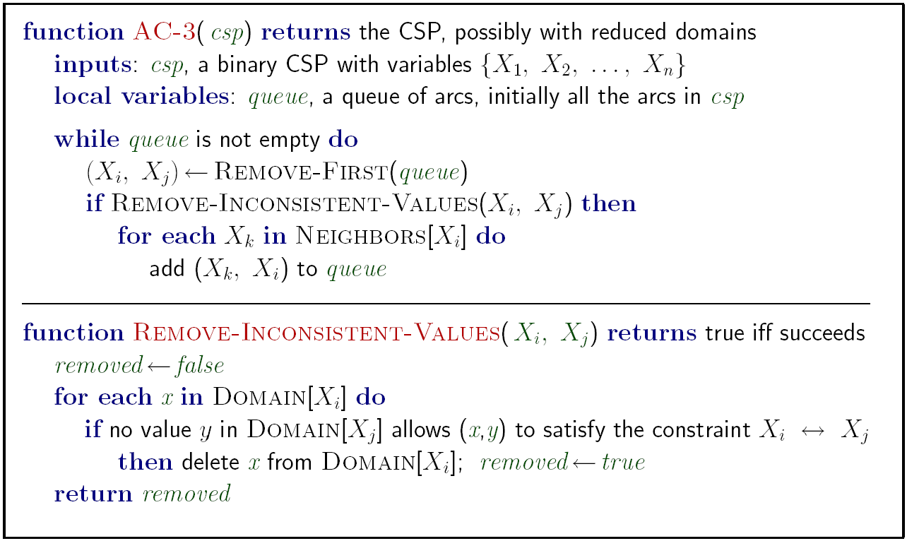
Enforcing Arc Consistency in a CSP
Runtime: O(n²d³), can be reduced to O(n²d²)
… but detecting all possible future problems is NP-hard – why?
Notes:
Auto-consistency (note initially nothing gets deleted/pruned since there are consistent options for all constraints for initial variable domains)
Flashes whenever something needs to be re-checked

Slide 34
Limitations of Arc Consistency
After enforcing arc consistency:
Can have one solution left
Can have multiple solutions left
Can have no solutions left (and not know it)
Arc consistency still runs inside a backtracking search!
What went wrong here?

Slide 35
Video of Demo Coloring – Backtracking with Forward Checking – Complex Graph

Slide 36
Video of Demo Coloring – Backtracking with Arc Consistency – Complex Graph

Slide 37

Ordering

Slide 38

Ordering: Minimum Remaining Values
Variable Ordering: Minimum remaining values (MRV):
Choose the variable with the fewest legal left values in its domain
Why min rather than max?
Also called “most constrained variable”
“Fail-fast” ordering

Slide 39

Ordering: Least Constraining Value
Value Ordering: Least Constraining Value
Given a choice of variable, choose the least constraining value
I.e., the one that rules out the fewest values in the remaining variables
Note that it may take some computation to determine this! (E.g., rerunning filtering)
Why least rather than most?
Combining these ordering ideas makes
1000 queens feasible

