Slide 1
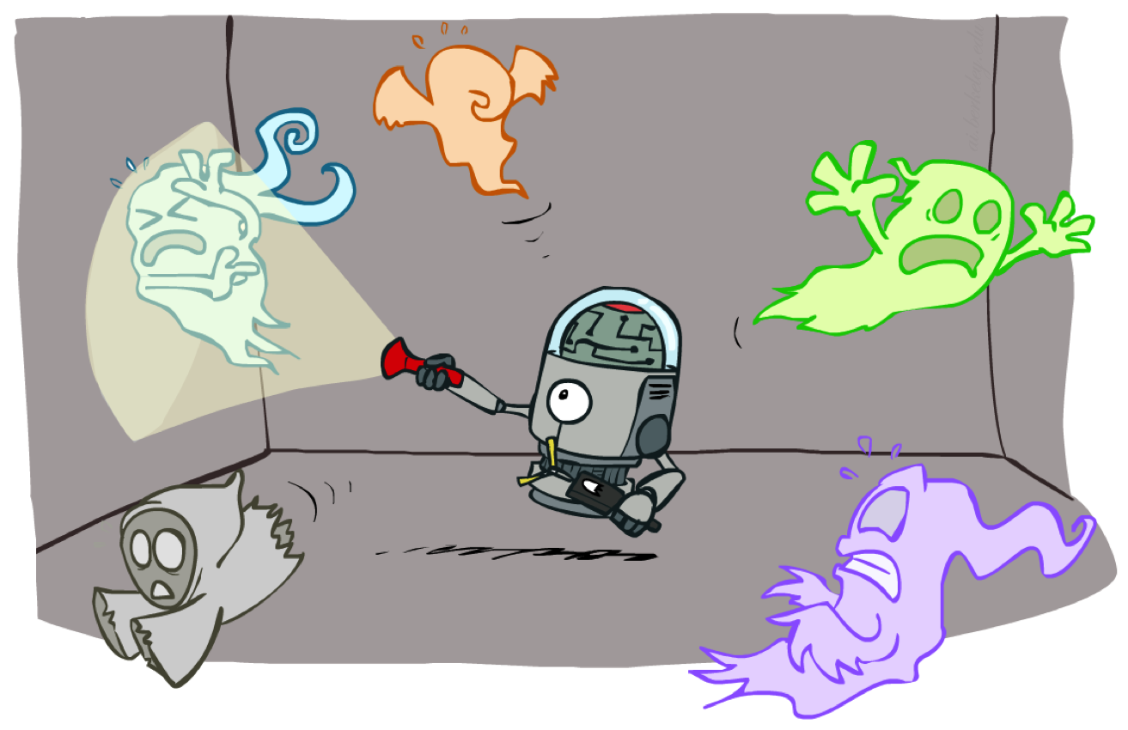
CS 480/580: Introduction to Artificial Intelligence
Particle Filters and Applications of HMMs
Prof. Xuesu Xiao
George Mason University
[Based on slides created by Dan Klein and Pieter Abbeel for CS188 Intro to AI at UC Berkeley. All original materials available at http://ai.berkeley.edu.]
Notes:
Please retain proper attribution, including the reference to ai.berkeley.edu. Thanks!

Slide 2


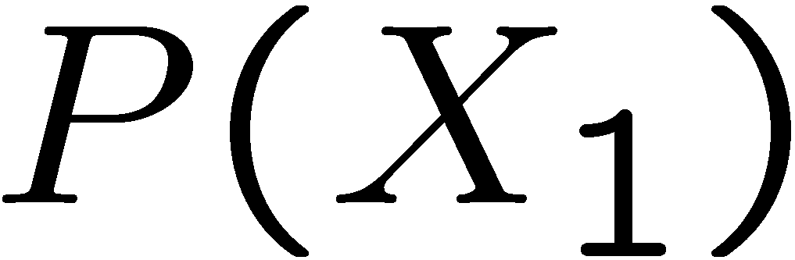
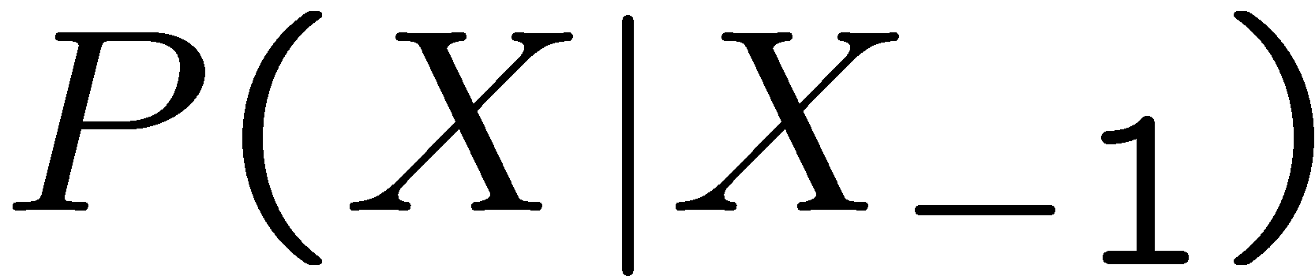
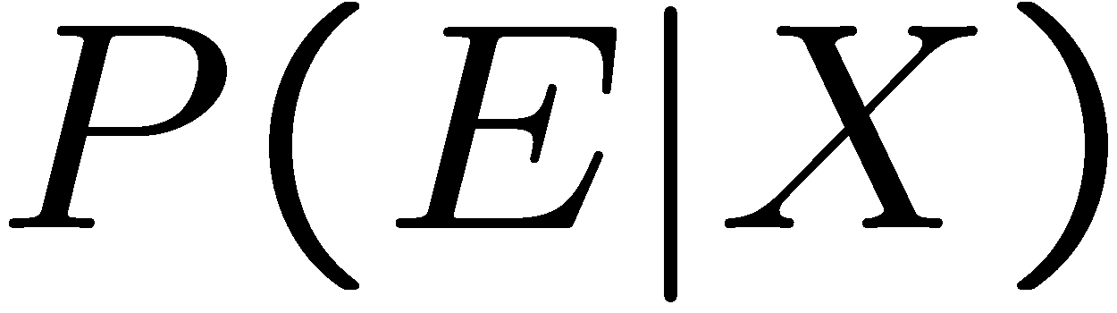
Recap: Reasoning Over Time
Markov models
Hidden Markov models
0.3
0.7
X₁
X₂
X₃
X₄
rain
sun
0.7
0.3
X₁
X₂
X₃
X₄
X₅
X | E | P
rain | umbrella | 0.9
rain | no umbrella | 0.1
sun | umbrella | 0.2
sun | no umbrella | 0.8
E₁
E₂
E₃
E₄
E₅

Slide 3

Video of Demo Ghostbusters Markov Model (Reminder)

Slide 4
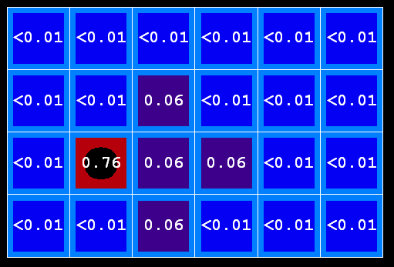
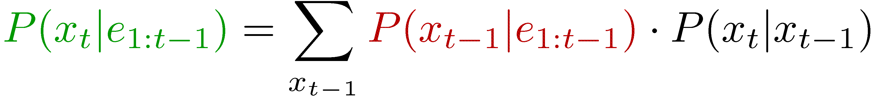

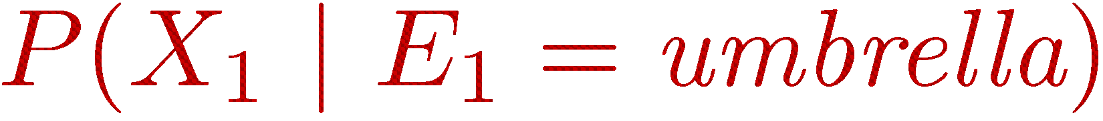
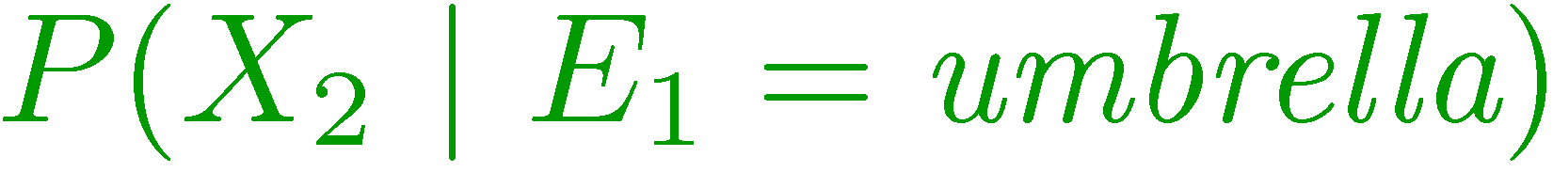
Recap: Filtering
Elapse time: compute P( X_{t} | e_{1:t-1} ) Observe: compute P( X_{t} | e_{1:t} )
Belief: <P(rain), P(sun)>
X₁
X₂
<0.5, 0.5>
Prior on X₁
<0.82, 0.18>
Observe
E₁
E₂
<0.63, 0.37>
Elapse time
<0.88, 0.12>
Observe

Slide 5
Video of Ghostbusters Exact Filtering (Reminder)

Slide 6
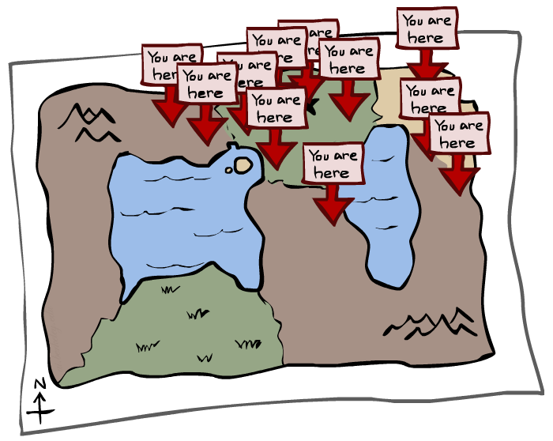
Particle Filtering

Slide 7
Particle Filtering
Filtering: approximate solution
Sometimes |X| is too big to use exact inference
|X| may be too big to even store B(X)
E.g. X is continuous
Solution: approximate inference
Track samples of X, not all values
Samples are called particles
Time per step is linear in the number of samples
But: number needed may be large
This is how robot localization works in practice
Particle is just new name for sample
0.0
0.1
0.0
0.0
0.0
0.2
0.0
0.2
0.5

Slide 8
Representation: Particles
Our representation of P(X) is now a list of N particles (samples)
Generally, N << |X|
P(x) approximated by number of particles with value x
So, many x may have P(x) = 0!
More particles, more accuracy
For now, all particles have a weight of 1
Particles:
(3,3)
(2,3)
(3,3)
(3,2)
(3,3)
(3,2)
(1,2)
(3,3)
(3,3)
(2,3)

Slide 9

Particle Filtering: Elapse Time
Each particle is moved by sampling its next position from the transition model
This is like prior sampling – samples’ frequencies reflect the transition probabilities
Here, most samples move clockwise, but some move in another direction or stay in place
This captures the passage of time
If enough samples, close to exact values before and after (consistent)
Particles:
(3,3)
(2,3)
(3,3)
(3,2)
(3,3)
(3,2)
(1,2)
(3,3)
(3,3)
(2,3)
Particles:
(3,2)
(2,3)
(3,2)
(3,1)
(3,3)
(3,2)
(1,3)
(2,3)
(3,2)
(2,2)

Slide 10


Particle Filtering: Observe
Particles:
(3,2)
(2,3)
(3,2)
(3,1)
(3,3)
(3,2)
(1,3)
(2,3)
(3,2)
(2,2)
Slightly trickier:
Don’t sample observation, fix it
Similar to likelihood weighting, downweight samples based on the evidence
As before, the probabilities don’t sum to one, since all have been downweighted (in fact they now sum to (N times) an approximation of P(e))
Particles:
(3,2) w=.9
(2,3) w=.2
(3,2) w=.9
(3,1) w=.4
(3,3) w=.4
(3,2) w=.9
(1,3) w=.1
(2,3) w=.2
(3,2) w=.9
(2,2) w=.4

Slide 11
Particle Filtering: Resample
Rather than tracking weighted samples, we resample
N times, we choose from our weighted sample distribution (i.e. draw with replacement)
This is equivalent to renormalizing the distribution
Now the update is complete for this time step, continue with the next one
Particles:
(3,2) w=.9
(2,3) w=.2
(3,2) w=.9
(3,1) w=.4
(3,3) w=.4
(3,2) w=.9
(1,3) w=.1
(2,3) w=.2
(3,2) w=.9
(2,2) w=.4
(New) Particles:
(3,2)
(2,2)
(3,2)
(2,3)
(3,3)
(3,2)
(1,3)
(2,3)
(3,2)
(3,2)

Slide 12
Recap: Particle Filtering
Particles: track samples of states rather than an explicit distribution
Elapse
Weight
Resample
Particles:
(3,3)
(2,3)
(3,3)
(3,2)
(3,3)
(3,2)
(1,2)
(3,3)
(3,3)
(2,3)
Particles:
(3,2)
(2,3)
(3,2)
(3,1)
(3,3)
(3,2)
(1,3)
(2,3)
(3,2)
(2,2)
Particles:
(3,2) w=.9
(2,3) w=.2
(3,2) w=.9
(3,1) w=.4
(3,3) w=.4
(3,2) w=.9
(1,3) w=.1
(2,3) w=.2
(3,2) w=.9
(2,2) w=.4
(New) Particles:
(3,2)
(2,2)
(3,2)
(2,3)
(3,3)
(3,2)
(1,3)
(2,3)
(3,2)
(3,2)

Slide 13
Video of Demo – Moderate Number of Particles

Slide 14
Video of Demo – One Particle

Slide 15
Video of Demo – Huge Number of Particles

Slide 16
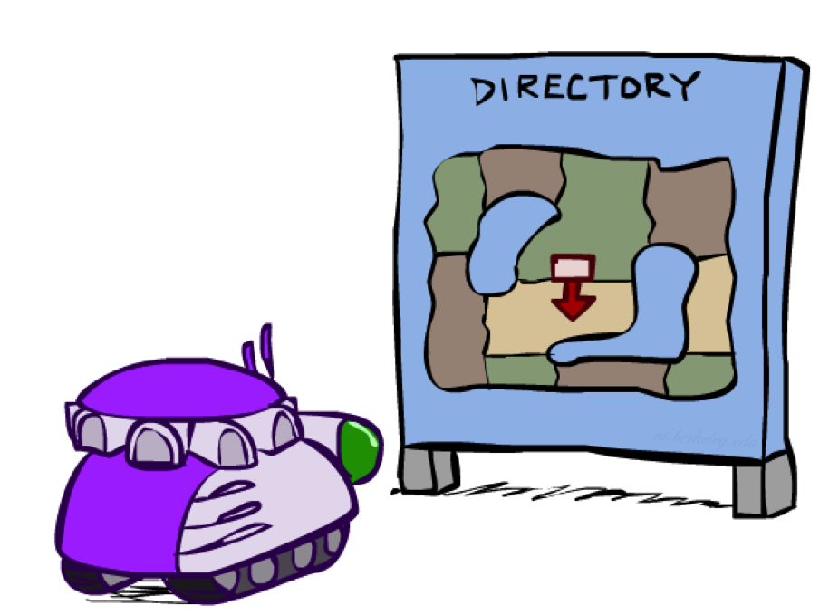
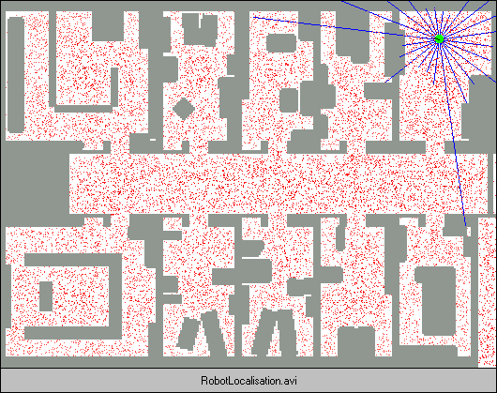
Robot Localization
In robot localization:
We know the map, but not the robot’s position
Observations may be vectors of range finder readings
State space and readings are typically continuous (works basically like a very fine grid) and so we cannot store B(X)
Particle filtering is a main technique

Slide 17

Particle Filter Localization (Sonar)

Slide 18
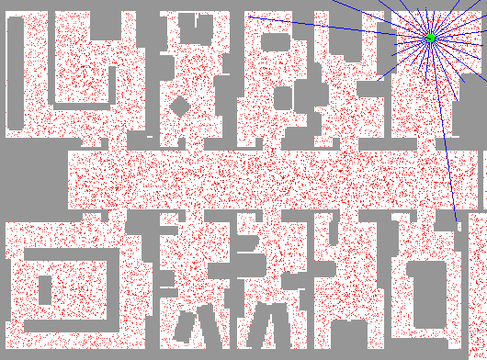
Particle Filter Localization (Laser)

Slide 19
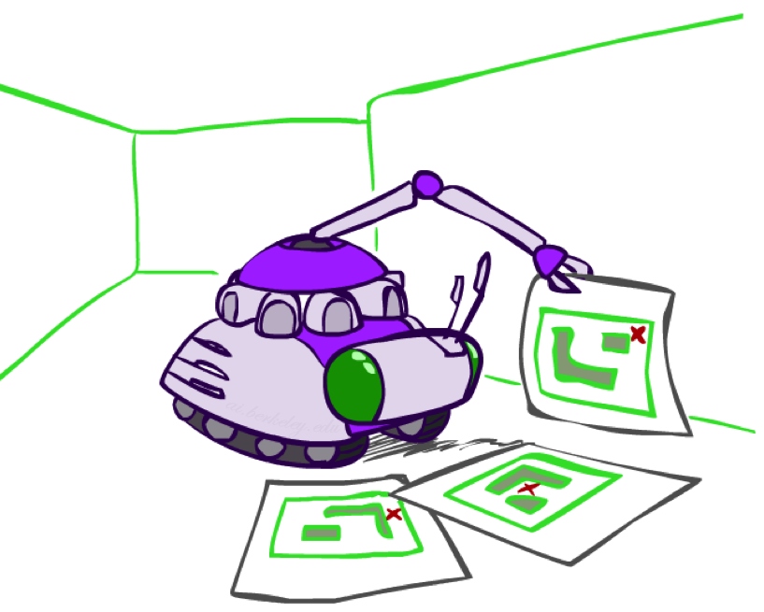
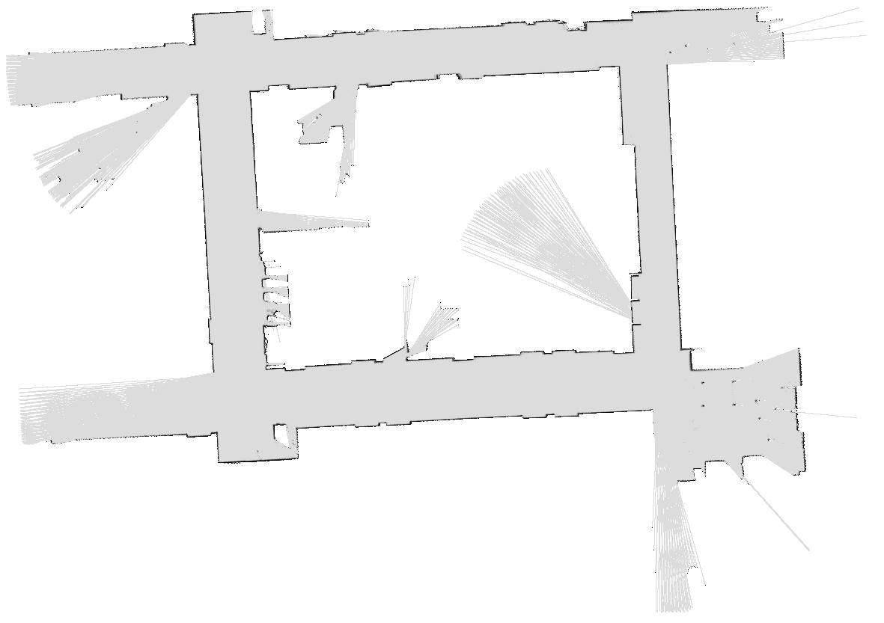
Robot Mapping
SLAM: Simultaneous Localization And Mapping
We do not know the map or our location
State consists of position AND map!
Main techniques: Kalman filtering (Gaussian HMMs) and particle methods
DP-SLAM, Ron Parr

Slide 20

Particle Filter SLAM

Slide 21
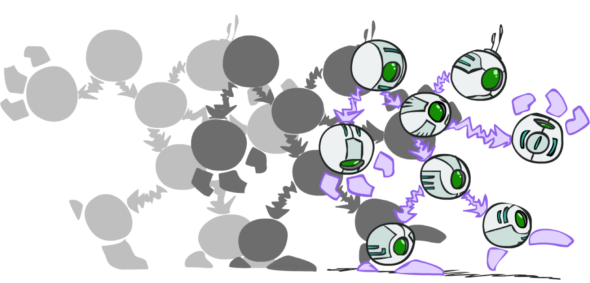
Dynamic Bayes Nets

Slide 22
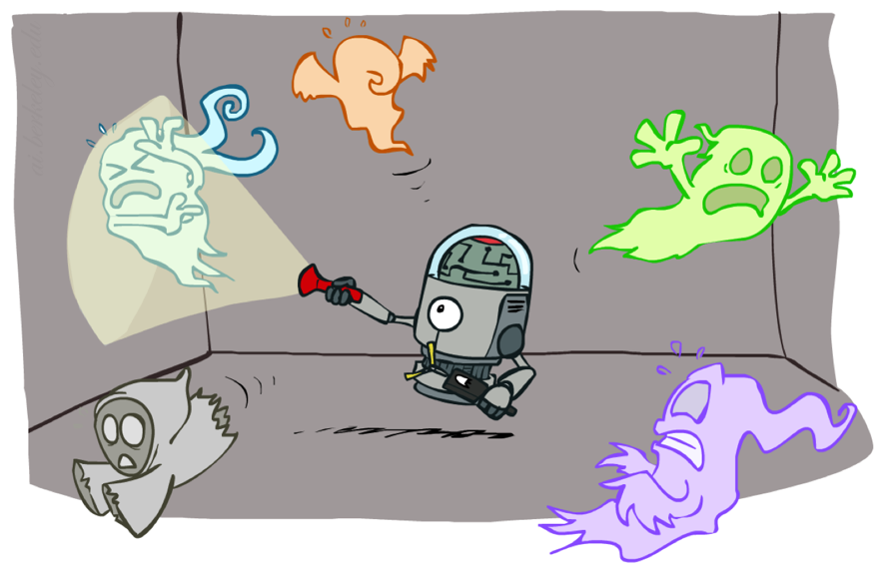
Dynamic Bayes Nets (DBNs)
We want to track multiple variables over time, using multiple sources of evidence
Idea: Repeat a fixed Bayes net structure at each time
Variables from time t can condition on those from t-1
Dynamic Bayes nets are a generalization of HMMs
t =1
t =2
t =3
G₁ª
G₂ª
G₃ª
G₁^{b}
G₂^{b}
G₃^{b}
E₁ª
E₁^{b}
E₂ª
E₂^{b}
E₃ª
E₃^{b}

Slide 23
Video of Demo Pacman Sonar Ghost DBN Model

Slide 24
Exact Inference in DBNs
Variable elimination applies to dynamic Bayes nets
Procedure: “unroll” the network for T time steps, then eliminate variables until P(X_{T}|e_{1:T}) is computed
Online belief updates: Eliminate all variables from the previous time step; store factors for current time only
t =1
t =2
t =3
G₁ª
G₂ª
G₃ª
G₃^{b}
G₁^{b}
G₂^{b}
G₃^{b}
E₁ª
E₁^{b}
E₂ª
E₂^{b}
E₃ª
E₃^{b}

Slide 25
DBN Particle Filters
A particle is a complete sample for a time step
Initialize: Generate prior samples for the t=1 Bayes net
Example particle: G₁ª = (3,3) G₁^{b} = (5,3)
Elapse time: Sample a successor for each particle
Example successor: G₂ª = (2,3) G₂^{b} = (6,3)
Observe: Weight each entire sample by the likelihood of the evidence conditioned on the sample
Likelihood: P(E₂ª |G₂ª ) * P(E₂^{b} |G₂^{b} )
Resample: Select prior samples (tuples of values) in proportion to their likelihood
Notes:
Dan has a demo here.

