Slide 1
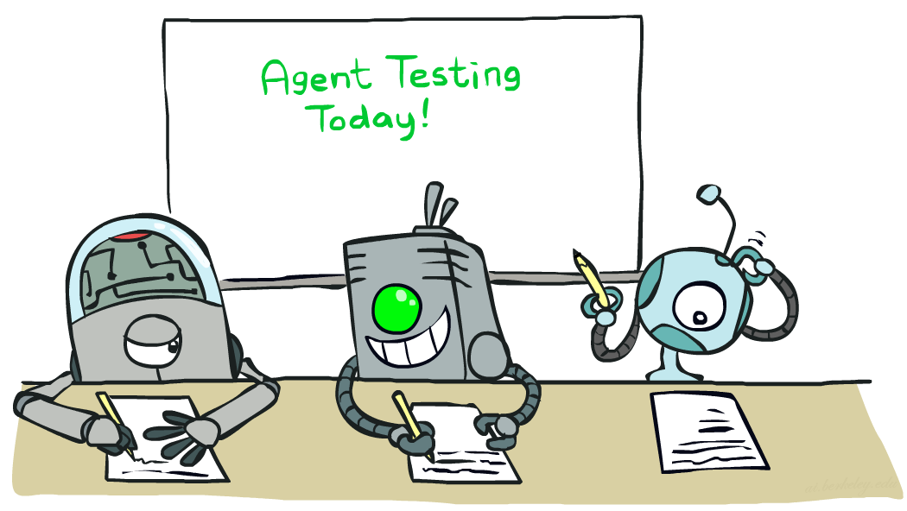

CS 480/580: Introduction to Artificial Intelligence
Naïve Bayes II
Prof. Xuesu Xiao
George Mason University
[Based on slides created by Dan Klein and Pieter Abbeel for CS188 Intro to AI at UC Berkeley. All original materials available at http://ai.berkeley.edu.]
Notes:
Please retain proper attribution, including the reference to ai.berkeley.edu. Thanks!

Slide 2

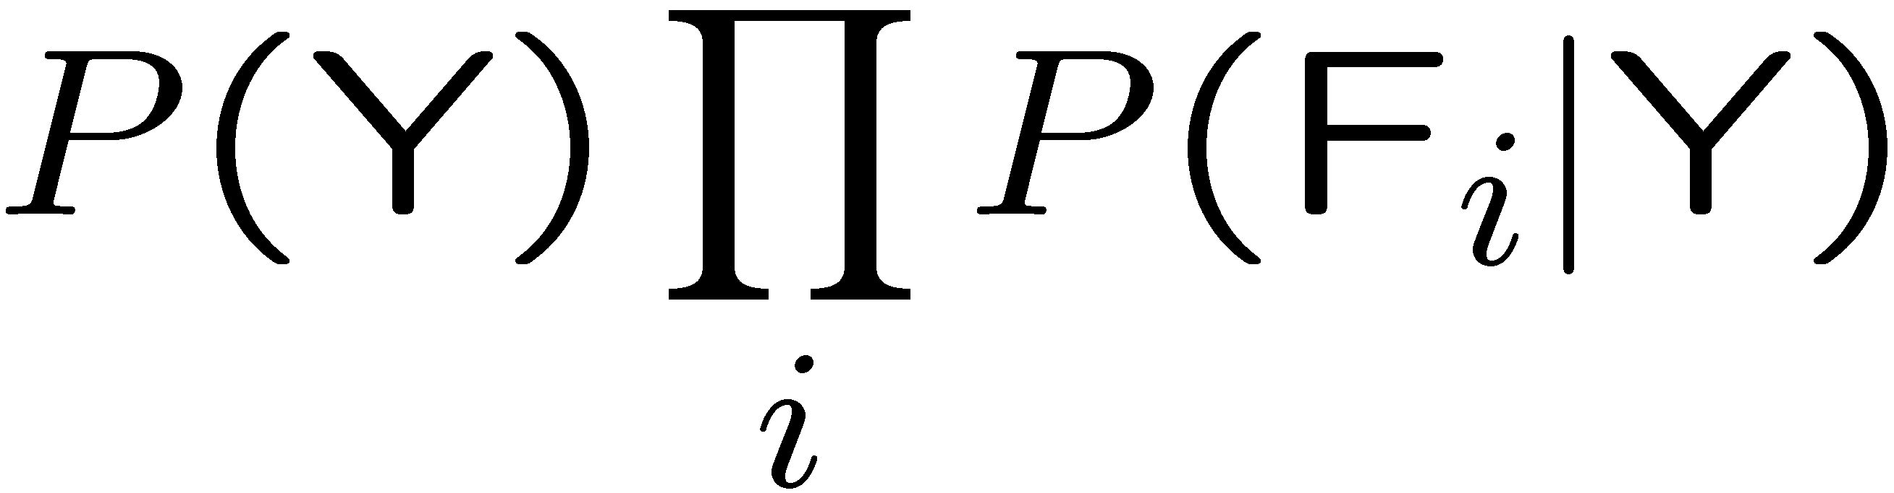

General Naïve Bayes
A general Naive Bayes model:
We only have to specify how each feature depends on the class
Total number of parameters is linear in n
Model is very simplistic, but often works anyway
Y
|Y| parameters
F₁
F₂
F_{n}
|Y| x |F|^{n} values
n x |F| x |Y| parameters

Slide 3

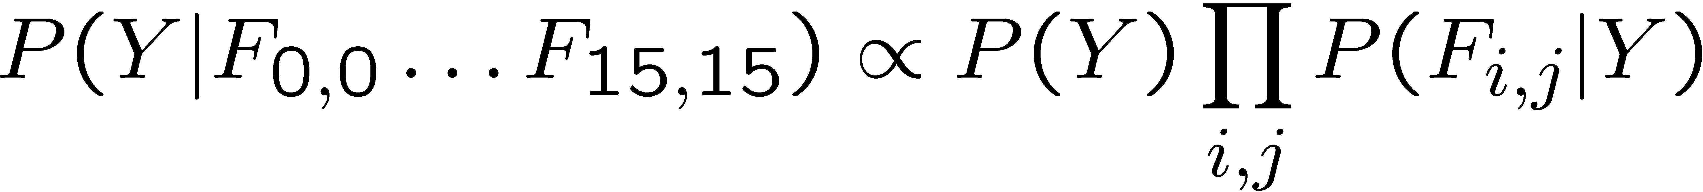
Naïve Bayes for Digits
Naïve Bayes: Assume all features are independent effects of the label
Simple digit recognition version:
  One feature (variable) F_{ij} for each grid position <i,j>
  Feature values are on / off, based on whether intensity
  is more or less than 0.5 in underlying image
  Each input maps to a feature vector, e.g.
  Here: lots of features, each is binary valued
Naïve Bayes model:
What do we need to learn?
Y
F₁
F₂
F_{n}

Slide 4
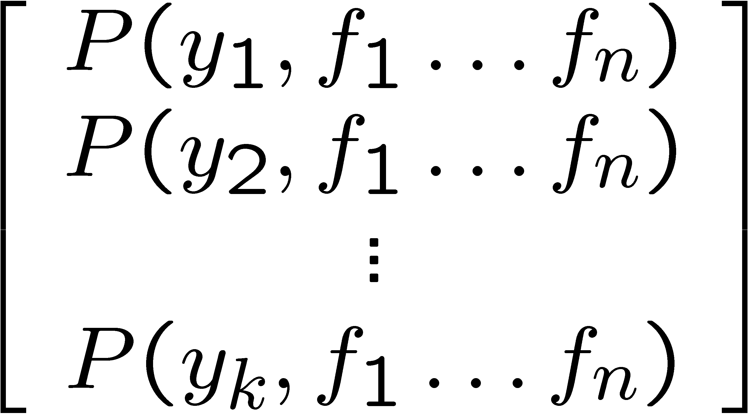
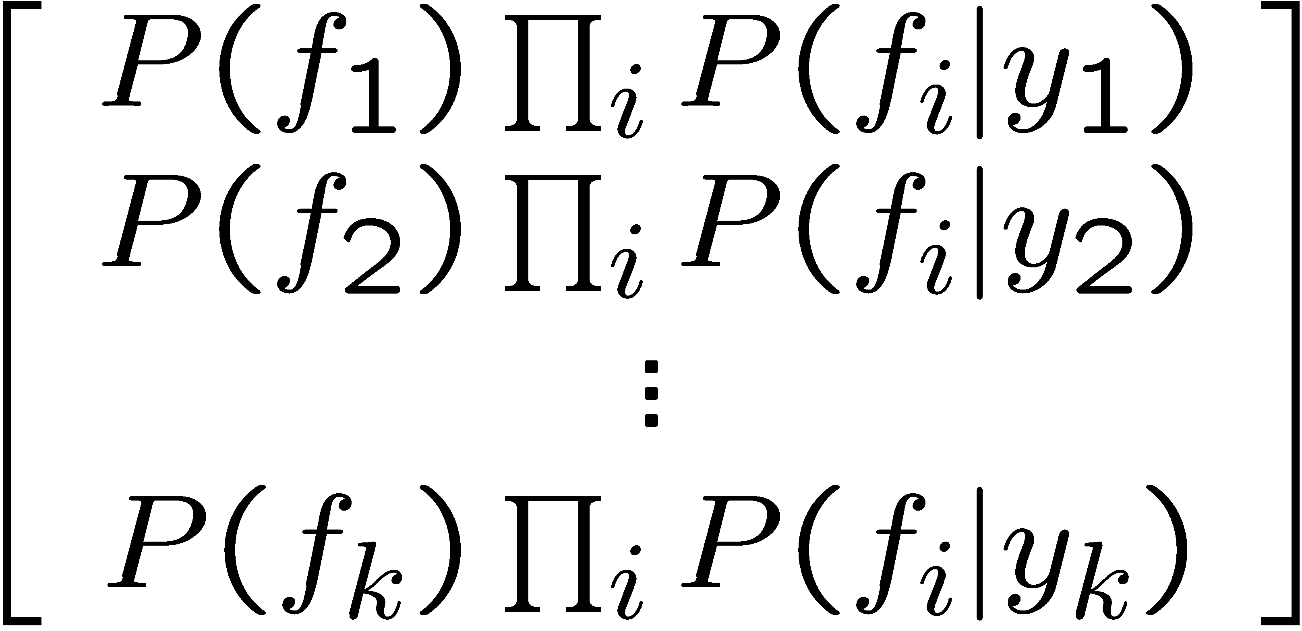

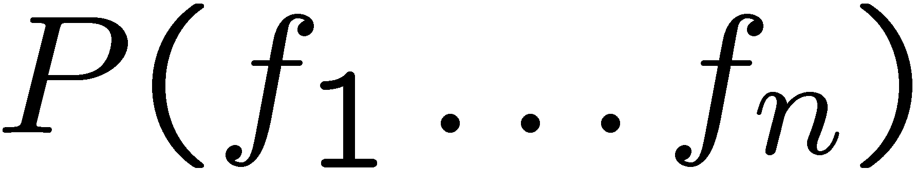
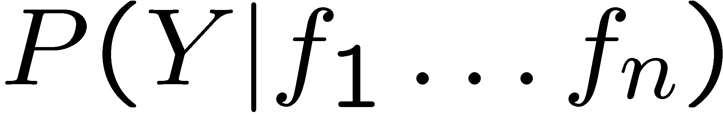
Inference for Naïve Bayes
Goal: compute posterior distribution over label variable Y
  Step 1: get joint probability of label and evidence for each label
  Step 2: sum to get probability of evidence
  Step 3: normalize by dividing Step 1 by Step 2
+

Slide 5
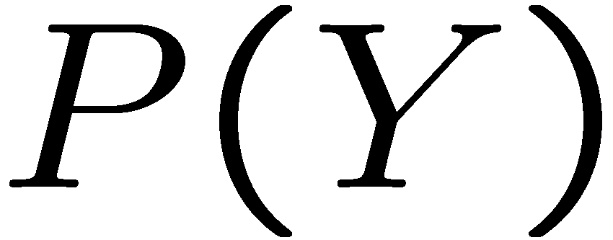


Example: Conditional Probabilities
1 | 0.1
2 | 0.1
3 | 0.1
4 | 0.1
5 | 0.1
6 | 0.1
7 | 0.1
8 | 0.1
9 | 0.1
0 | 0.1
1 | 0.01
2 | 0.05
3 | 0.05
4 | 0.30
5 | 0.80
6 | 0.90
7 | 0.05
8 | 0.60
9 | 0.50
0 | 0.80
1 | 0.05
2 | 0.01
3 | 0.90
4 | 0.80
5 | 0.90
6 | 0.90
7 | 0.25
8 | 0.85
9 | 0.60
0 | 0.80

Slide 6

Overfitting
30
25
20
Degree 15 polynomial
15
10
5
0
-5
-10
-15
0
2
4
6
8
10
12
14
16
18
20

Slide 7












Example: Overfitting
2 wins!!

Slide 8
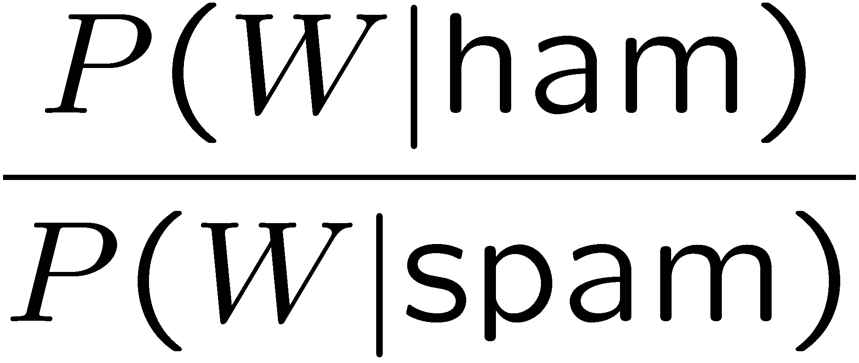
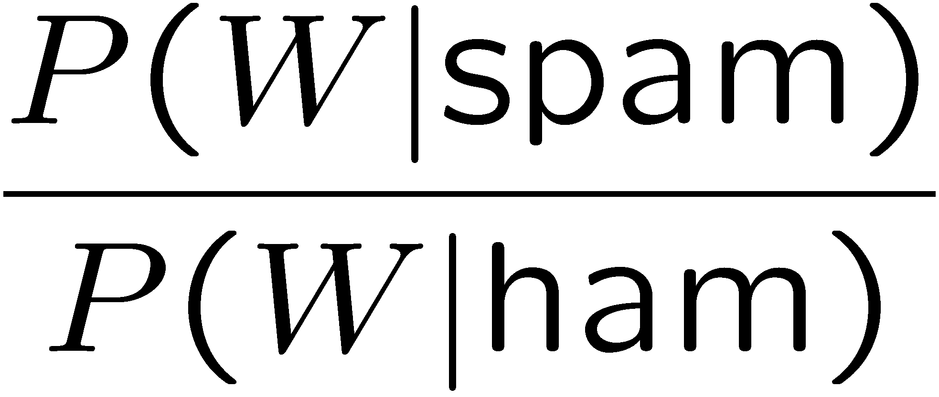
Example: Overfitting
relative probabilities (odds ratios):
south-west : inf
nation : inf
morally : inf
nicely : inf
extent : inf
seriously : inf
...
screens : inf
minute : inf
guaranteed : inf
$205.00 : inf
delivery : inf
signature : inf
...
What went wrong here?

Slide 9
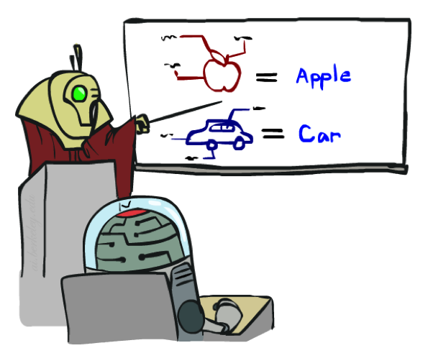
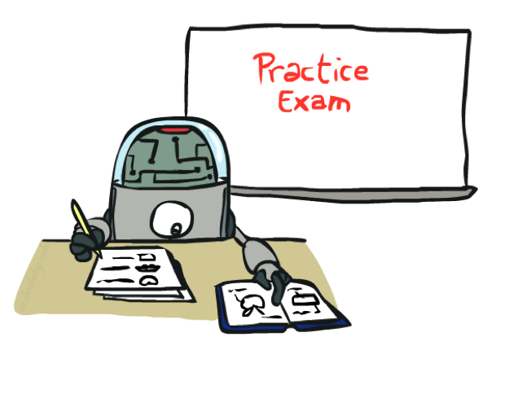
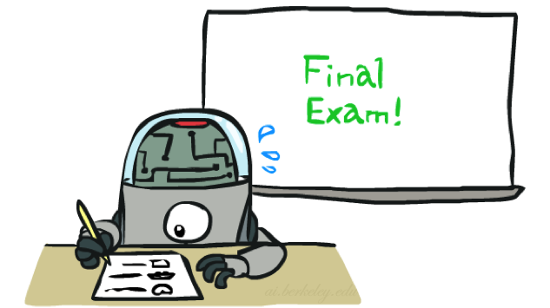
Training and Testing

Slide 10

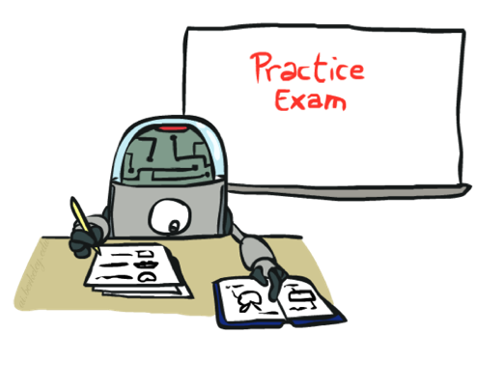
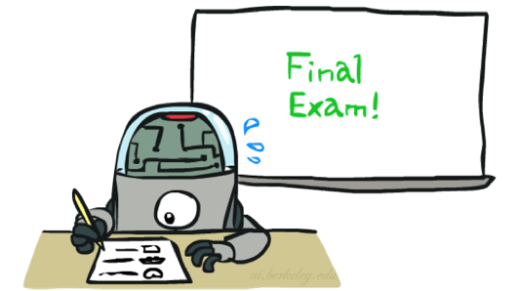
Important Concepts
Data: labeled instances, e.g. emails marked spam/ham
  Training set
  Held out set
  Test set
Features: attribute-value pairs which characterize each x
Experimentation cycle
  Learn parameters (e.g. model probabilities) on training set
  (Tune hyperparameters on held-out set)
  Compute accuracy of test set
  Very important: never “peek” at the test set!
Evaluation
  Accuracy: fraction of instances predicted correctly
Overfitting and generalization
  Want a classifier which does well on test data
  Overfitting: fitting the training data very closely, but not generalizing well
  We’ll investigate overfitting and generalization formally in a few lectures
Training
Data
Held-Out
Data
Test
Data

Slide 11
Generalization and Overfitting
Relative frequency parameters will overfit the training data!
  Just because we never saw a 3 with pixel (8, 8) on during training doesn’t mean we won’t see it at test time
  Unlikely that every occurrence of “minute” is 100% spam
  Unlikely that every occurrence of “seriously” is 100% ham
  What about all the words that don’t occur in the training set at all?
  In general, we can’t go around giving unseen events zero probability
As an extreme case, imagine using the entire email as the only feature
  Would get the training data perfect (if deterministic labeling)
  Wouldn’t generalize at all
  Just making the bag-of-words assumption gives us some generalization, but isn’t enough
To generalize better: we need to smooth or regularize the estimates

Slide 12
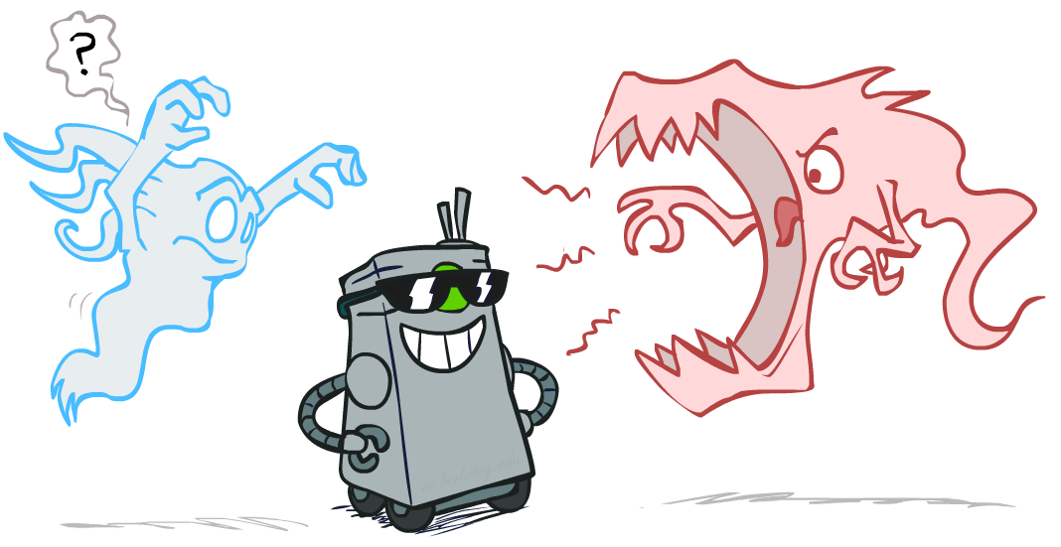
Smoothing

Slide 13

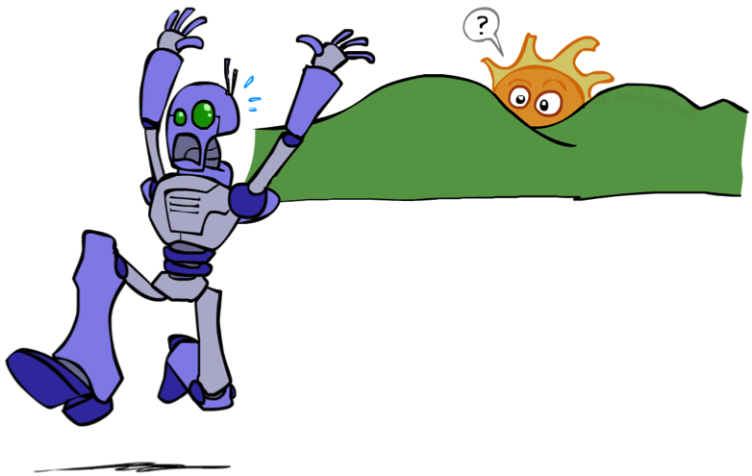
Unseen Events

Slide 14
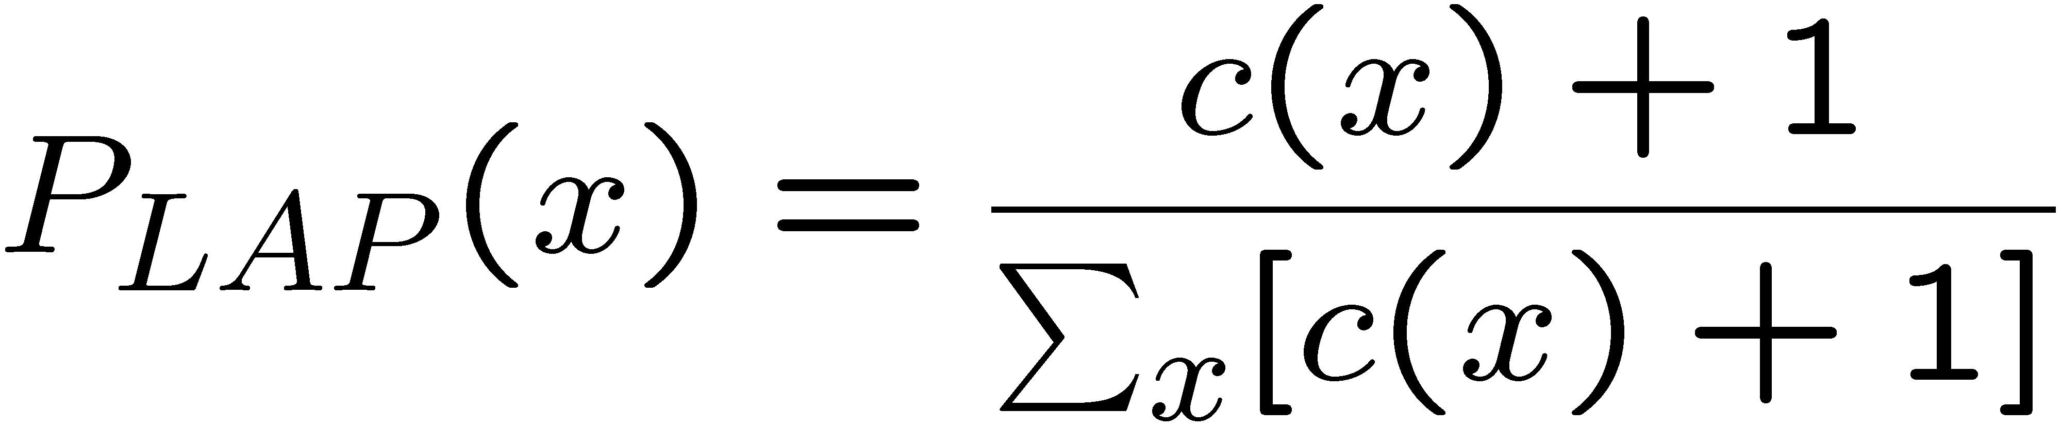
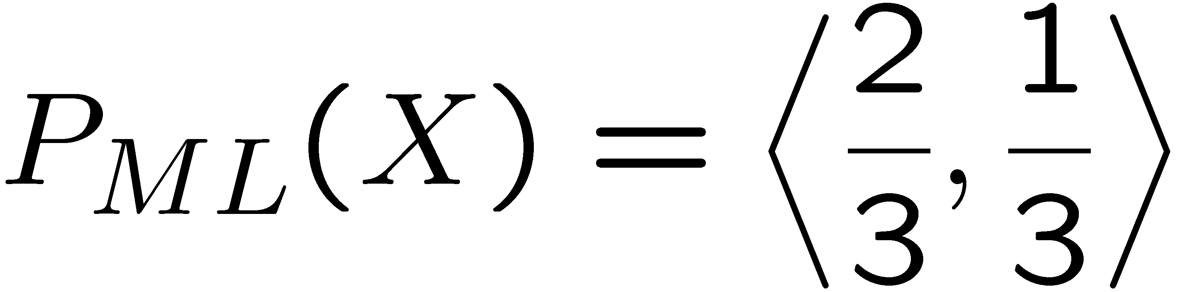
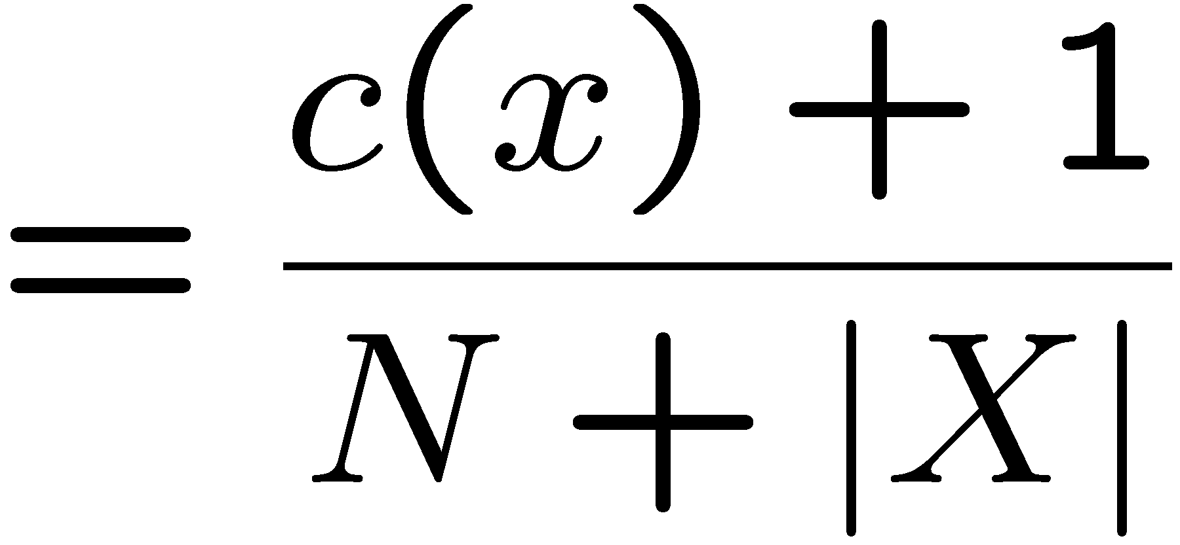
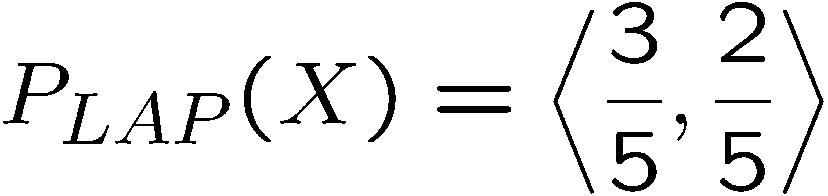
Laplace Smoothing
Laplace’s estimate:
  Pretend you saw every outcome once more than you actually did
r
r
b

Slide 15
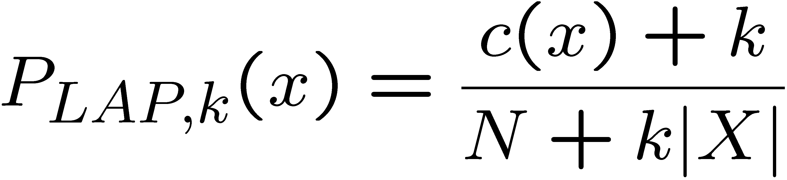
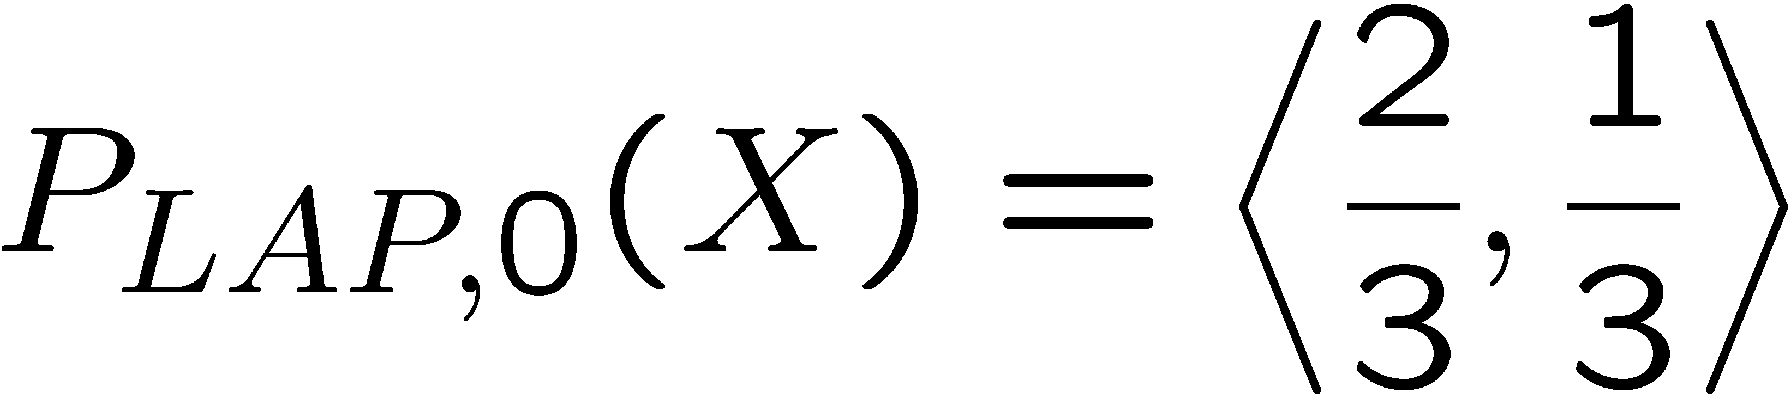
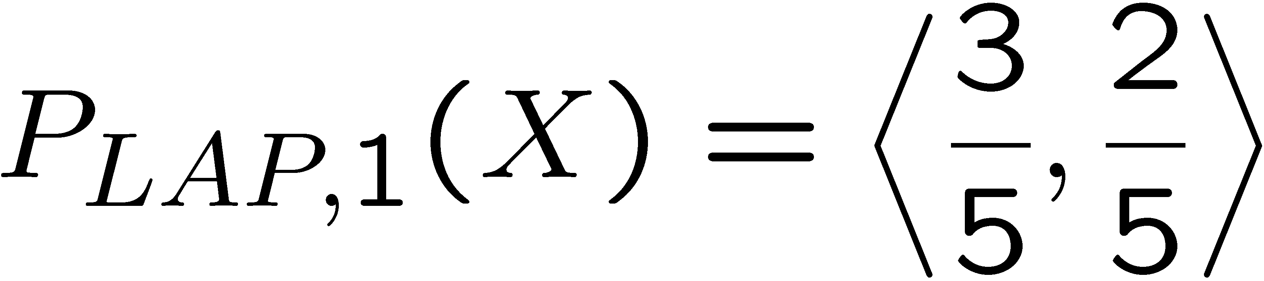
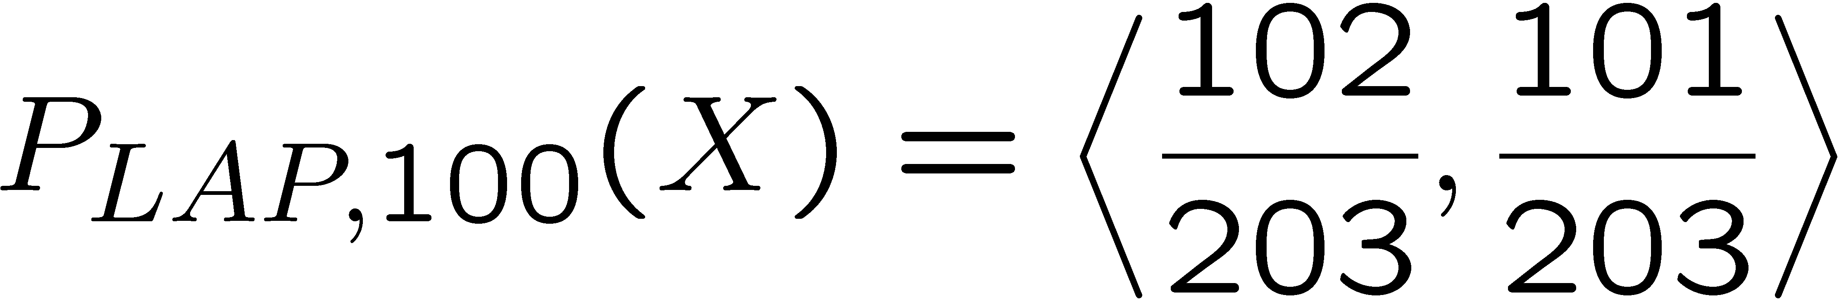
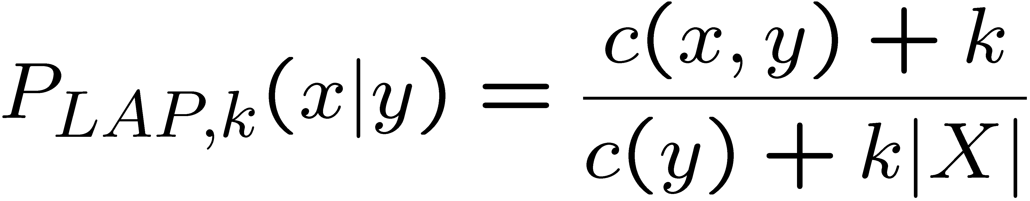
Laplace Smoothing
Laplace’s estimate (extended):
  Pretend you saw every outcome k extra times
  What’s Laplace with k = 0?
  k is the strength of the prior
Laplace for conditionals:
  Smooth each condition independently:
r
r
b

Slide 16
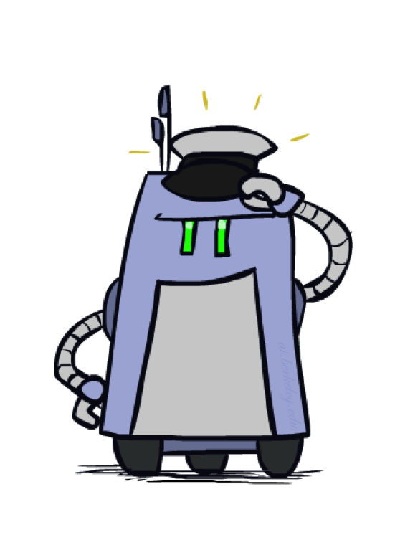
Real NB: Smoothing
For real classification problems, smoothing is critical
New odds ratios:
helvetica : 11.4
seems : 10.8
group : 10.2
ago : 8.4
areas : 8.3
...
verdana : 28.8
Credit : 28.4
ORDER : 27.2
<FONT> : 26.9
money : 26.5
...
Do these make more sense?

Slide 17
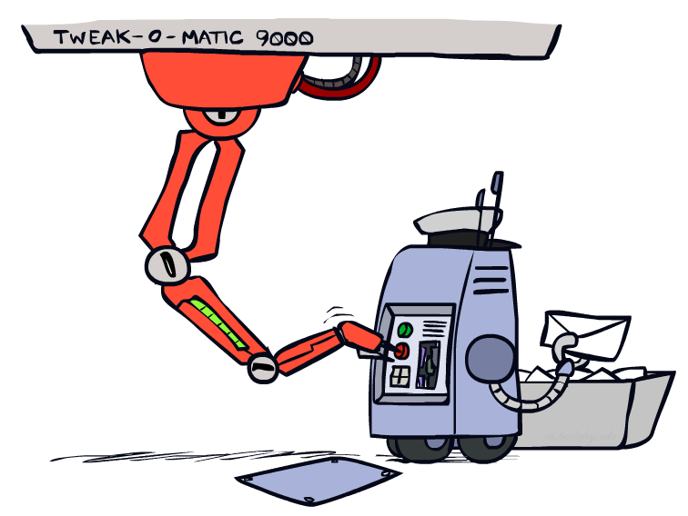
Tuning

Slide 18







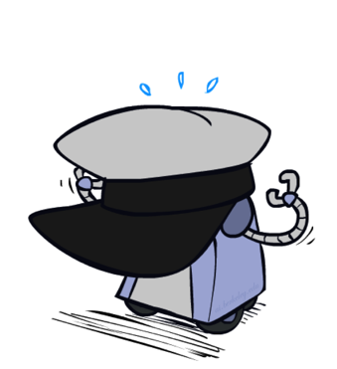
Tuning on Held-Out Data
Now we’ve got two kinds of unknowns
  Parameters: the probabilities P(X|Y), P(Y)
  Hyperparameters: e.g. the amount / type of smoothing to do, k
What should we learn where?
  Learn parameters from training data
  Tune hyperparameters on different data
    Why?
  For each value of the hyperparameters, train and test on the held-out data
  Choose the best value and do a final test on the test data

Slide 19
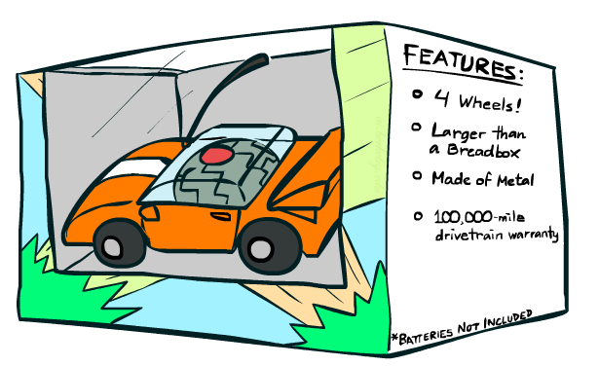
Features

Slide 20
Errors, and What to Do
Examples of errors
Dear GlobalSCAPE Customer,
GlobalSCAPE has partnered with ScanSoft to offer you the latest version of OmniPage Pro, for just $99.99* - the regular list price is $499! The most common question we've received about this offer is - Is this genuine? We would like to assure you that this offer is authorized by ScanSoft, is genuine and valid. You can get the . . .
. . . To receive your $30 Amazon.com promotional certificate, click through to
http://www.amazon.com/apparel
and see the prominent link for the $30 offer. All details are there. We hope you enjoyed receiving this message. However, if you'd rather not receive future e-mails announcing new store launches, please click . . .

Slide 21
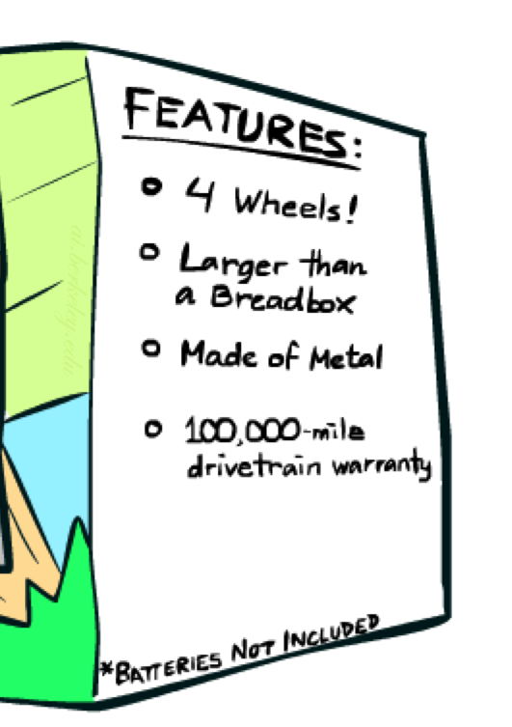
What to Do About Errors?
Need more features– words aren’t enough!
  Have you emailed the sender before?
  Have 1K other people just gotten the same email?
  Is the sending information consistent?
  Is the email in ALL CAPS?
  Do inline URLs point where they say they point?
  Does the email address you by (your) name?
Can add these information sources as new variables in the NB model
Next class we’ll talk about classifiers which let you easily add arbitrary features more easily

Slide 22
Baselines
First step: get a baseline
  Baselines are very simple “straw man” procedures
  Help determine how hard the task is
  Help know what a “good” accuracy is
Weak baseline: most frequent label classifier
  Gives all test instances whatever label was most common in the training set
  E.g. for spam filtering, might label everything as ham
  Accuracy might be very high if the problem is skewed
  E.g. calling everything “ham” gets 66%, so a classifier that gets 70% isn’t very good…
For real research, usually use previous work as a (strong) baseline

Slide 23
Summary
Bayes rule lets us do diagnostic queries with causal probabilities
The naïve Bayes assumption takes all features to be independent given the class label
We can build classifiers out of a naïve Bayes model using training data
Smoothing estimates is important in real systems

Slide 24
Next Time: Perceptron!

