Slide 1
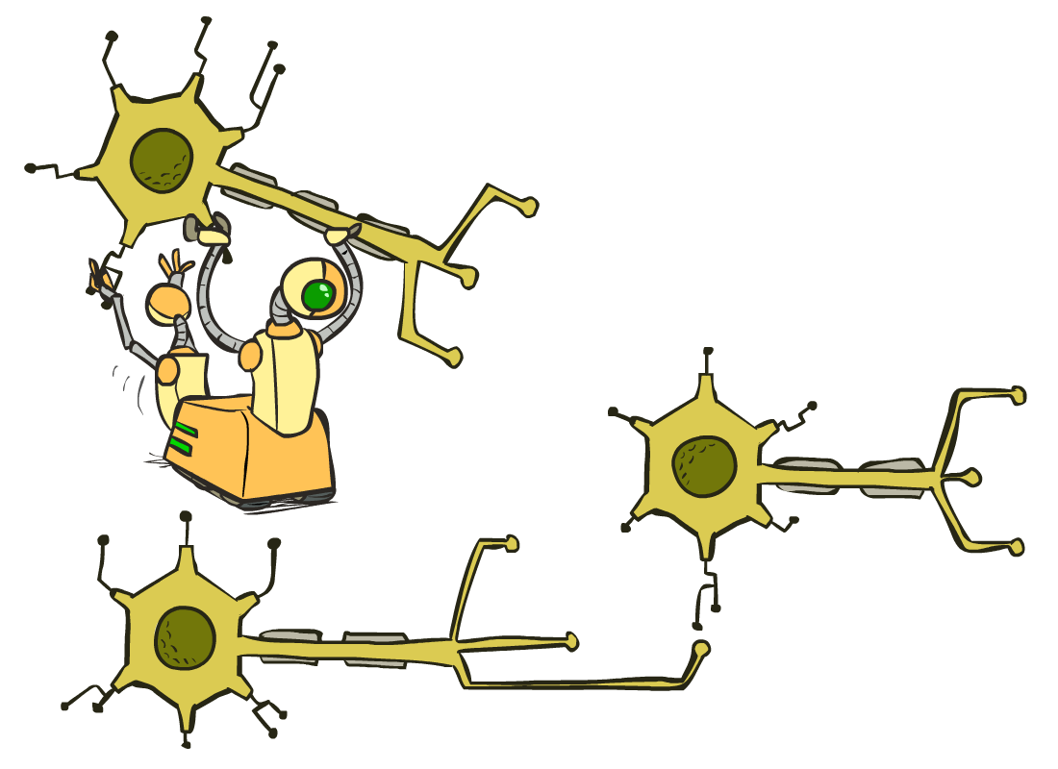
CS 480/580: Introduction to Artificial Intelligence
Neural Nets II
Prof. Xuesu Xiao
George Mason University
[Based on slides created by Dan Klein and Pieter Abbeel for CS188 Intro to AI at UC Berkeley. All original materials available at http://ai.berkeley.edu.]
Notes:
Please retain proper attribution, including the reference to ai.berkeley.edu. Thanks!

Slide 2
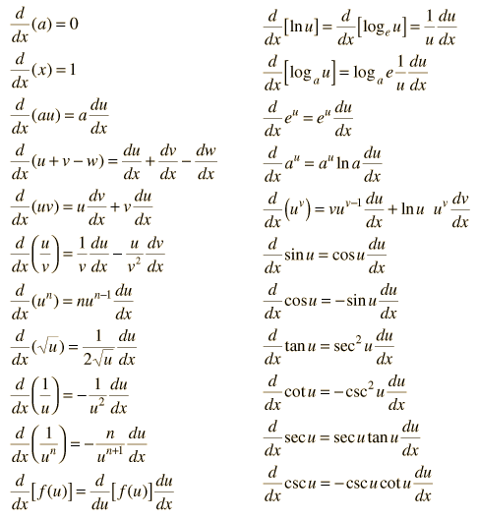
How about computing all the derivatives?
Derivatives tables:
[source: http://hyperphysics.phy-astr.gsu.edu/hbase/Math/derfunc.html

Slide 3
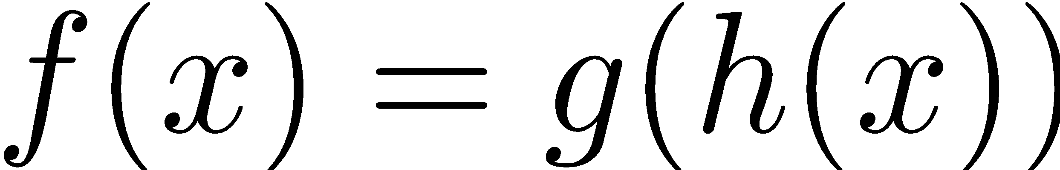
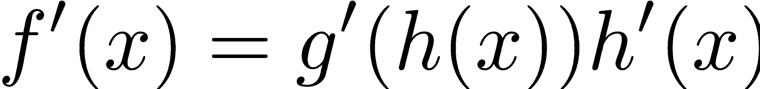
How about computing all the derivatives?
But neural net f is never one of those?
No problem: CHAIN RULE:
If
Then
Derivatives can be computed by following well-defined procedures

Slide 4
Automatic Differentiation
Automatic differentiation software
e.g. TensorFlow, PyTorch, Jax
Only need to program the function g(x,y,w)
Can automatically compute all derivatives w.r.t. all entries in w
This is typically done by caching info during forward computation pass of f, and then doing a backward pass = “backpropagation”
Autodiff / Backpropagation can often be done at computational cost comparable to the forward pass
Need to know this exists
How this is done? -- outside of scope of CS580

Slide 5
Training a Network (setting weights)
x₁
softmax
x₂
…
x₃
…
…
…
…
…
x_{L}
g = nonlinear activation function

Slide 6
Training a Network
softmax
Key words:
Forward
Backwards
Gradient
Backprop
…
…
g = nonlinear activation function

Slide 7
















Back Propagation: $g\left(w\right)=w_{1}^{3}w_{2}+3w_{1}$
Suppose we have $g\left(w\right)=w_{1}^{3}w_{2}+3w_{1}$ and want the gradient at $w=[2, 3]$
Think of the function as a composition of many functions.
Can use derivative chain rule to compute $\frac{∂g}{∂w_{1}}$ and $\frac{∂g}{∂w_{2}}$
$\frac{∂g}{∂w_{1}}$ = _____________________
$\frac{∂g}{∂w_{2}}$= _____________________
More complex to compute for more complicated functions
2
$∎^{3}$
$$a=8$$
$${{3w}_{1}^{2}w}_{2}+3$$
$$w_{1}$$
$×$
$$b=24$$
$$w_{2}$$
3
$+$
$$g=30$$
$$w_{1}^{3}$$
$$3$$
$×$
$$c=6$$
$$w_{1}$$
2
Computation Graph

Slide 8

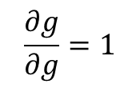
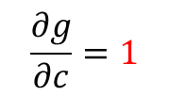

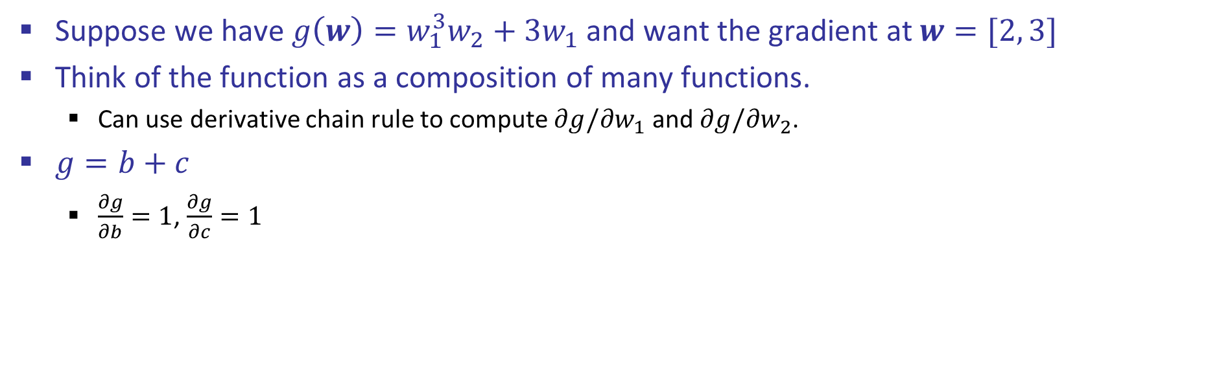
Back Propagation: $g\left(w\right)=w_{1}^{3}w_{2}+3w_{1}$
Suppose we have $g\left(w\right)=w_{1}^{3}w_{2}+3w_{1}$ and want the gradient at $w=[2, 3]$
Think of the function as a composition of many functions.
Can use derivative chain rule to compute $∂g/∂w_{1}$ and $∂g/∂w_{2}$.
$g=b+c$
$\frac{∂g}{∂b}=1$, $\frac{∂g}{∂c}=1$
2
$∎^{3}$
$$a=8$$
$$w_{1}$$
$×$
$$b=24$$
3
$$\frac{∂g}{∂b}=1$$
$$w_{2}$$
$$g=30$$
$+$
$$1$$
$$3$$
$×$
$$c=6$$
$$w_{1}$$
2
$$\frac{∂g}{∂c}=1$$
$$\frac{∂g}{∂g}=1$$
Computation Graph

Slide 9
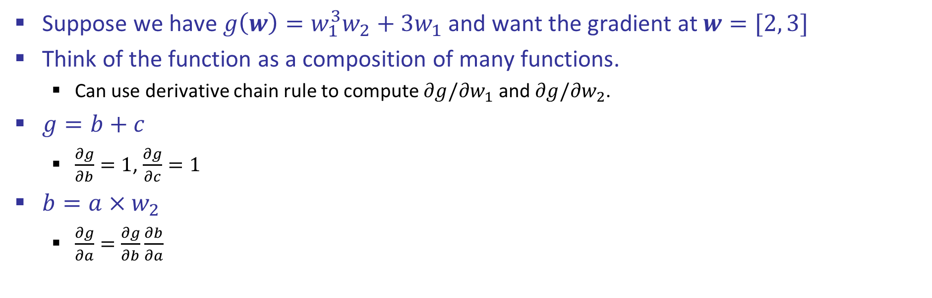
Back Propagation: $g\left(w\right)=w_{1}^{3}w_{2}+3w_{1}$
Suppose we have $g\left(w\right)=w_{1}^{3}w_{2}+3w_{1}$ and want the gradient at $w=[2, 3]$
Think of the function as a composition of many functions.
Can use derivative chain rule to compute $∂g/∂w_{1}$ and $∂g/∂w_{2}$.
$g=b+c$
$\frac{∂g}{∂b}=1$, $\frac{∂g}{∂c}=1$
$b=a×w_{2}$
$\frac{∂g}{∂a}=\frac{∂g}{∂b}\frac{∂b}{∂a}$
2
$∎^{3}$
$$a=8$$
$$w_{1}$$
$×$
$$b=24$$
3
$$\frac{∂g}{∂b}=1$$
$$w_{2}$$
$$g=30$$
$+$
$$1$$
$$3$$
$×$
$$c=6$$
$$w_{1}$$
2
$$\frac{∂g}{∂c}=1$$
$$\frac{∂g}{∂g}=1$$

Slide 10
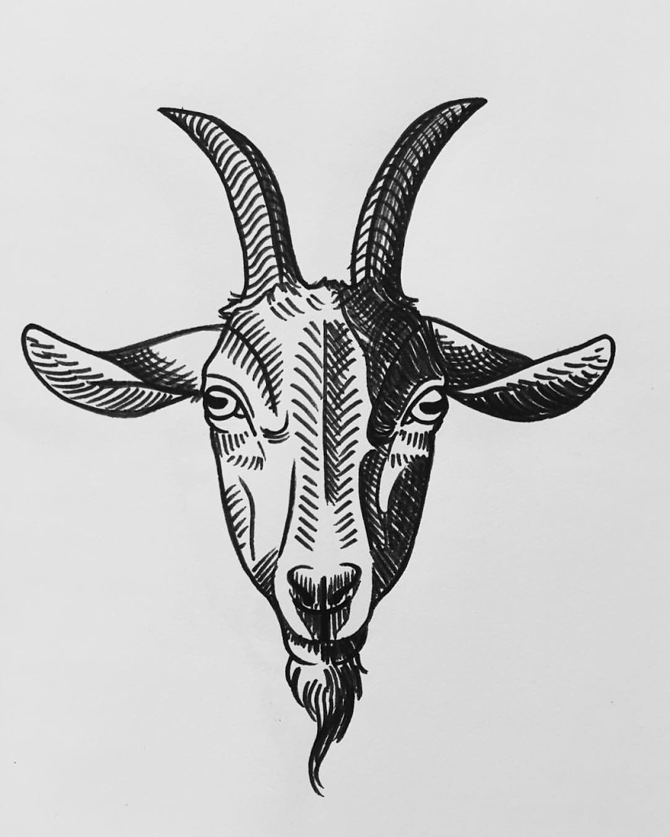

Back Propagation: $g\left(w\right)=w_{1}^{3}w_{2}+3w_{1}$
Suppose we have $g\left(w\right)=w_{1}^{3}w_{2}+3w_{1}$ and want the gradient at $w=[2, 3]$
Think of the function as a composition of many functions.
Can use derivative chain rule to compute $∂g/∂w_{1}$ and $∂g/∂w_{2}$.
$g=b+c$
$\frac{∂g}{∂b}=1$, $\frac{∂g}{∂c}=1$
$b=a×w_{2}$
$\frac{∂g}{∂a}=\frac{∂g}{∂b}\frac{∂b}{∂a}=?????$
2
$∎^{3}$
$$a=8$$
$$w_{1}$$
$×$
$$b=24$$
3
$$\frac{∂g}{∂b}=1$$
$$w_{2}$$
$$g=30$$
$+$
$$1$$
$$3$$
$×$
$$c=6$$
$$w_{1}$$
2
$$\frac{∂g}{∂c}=1$$
$$\frac{∂g}{∂g}=1$$

Slide 11

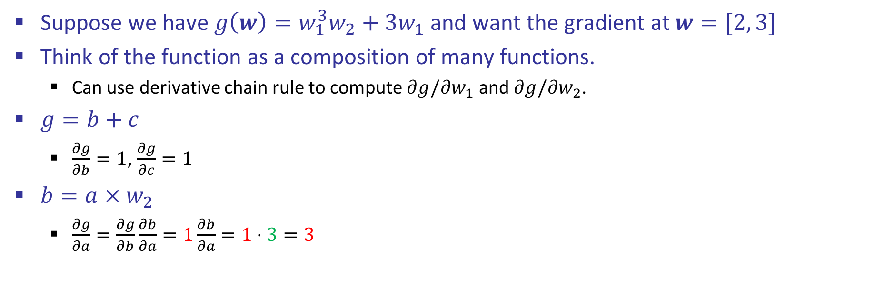
Back Propagation: $g\left(w\right)=w_{1}^{3}w_{2}+3w_{1}$
Suppose we have $g\left(w\right)=w_{1}^{3}w_{2}+3w_{1}$ and want the gradient at $w=[2, 3]$
Think of the function as a composition of many functions.
Can use derivative chain rule to compute $∂g/∂w_{1}$ and $∂g/∂w_{2}$.
$g=b+c$
$\frac{∂g}{∂b}=1$, $\frac{∂g}{∂c}=1$
$b=a×w_{2}$
$\frac{∂g}{∂a}=\frac{∂g}{∂b}\frac{∂b}{∂a}=1\frac{∂b}{∂a}=1⋅3=3$
2
$∎^{3}$
$$a=8$$
$$w_{1}$$
$$3$$
$×$
$$b=24$$
3
$$\frac{∂g}{∂b}=1$$
$$w_{2}$$
$$g=30$$
$+$
$$1$$
$$3$$
$×$
$$c=6$$
$$w_{1}$$
2
$$\frac{∂g}{∂c}=1$$
$$\frac{∂g}{∂g}=1$$

Slide 12
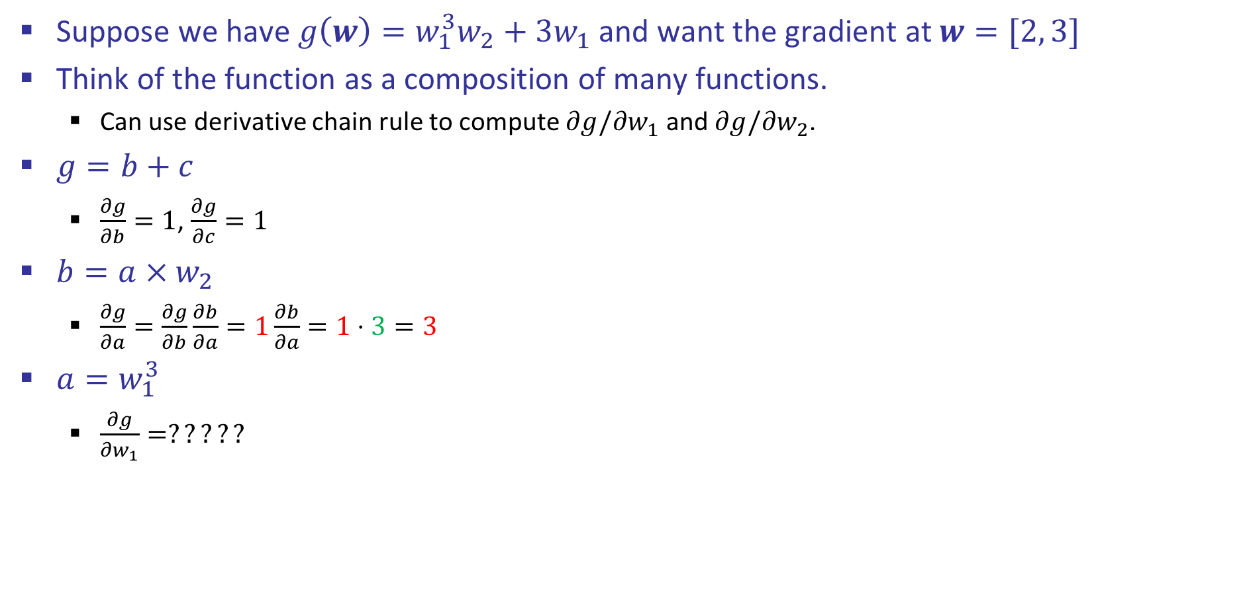
Back Propagation: $g\left(w\right)=w_{1}^{3}w_{2}+3w_{1}$
Suppose we have $g\left(w\right)=w_{1}^{3}w_{2}+3w_{1}$ and want the gradient at $w=[2, 3]$
Think of the function as a composition of many functions.
Can use derivative chain rule to compute $∂g/∂w_{1}$ and $∂g/∂w_{2}$.
$g=b+c$
$\frac{∂g}{∂b}=1$, $\frac{∂g}{∂c}=1$
$b=a×w_{2}$
$\frac{∂g}{∂a}=\frac{∂g}{∂b}\frac{∂b}{∂a}=1\frac{∂b}{∂a}=1⋅3=3$
$a=w_{1}^{3}$
$\frac{∂g}{∂w_{1}}=?????$
2
$∎^{3}$
$$a=8$$
$$w_{1}$$
$$3$$
$×$
$$b=24$$
3
$$\frac{∂g}{∂b}=1$$
$$w_{2}$$
$$g=30$$
$+$
$$1$$
$$3$$
$×$
$$c=6$$
$$w_{1}$$
2
$$\frac{∂g}{∂c}=1$$
$$\frac{∂g}{∂g}=1$$

Slide 13
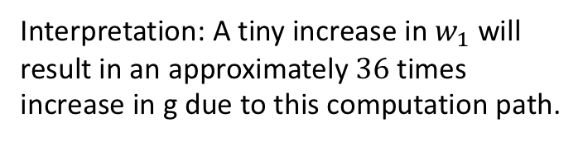
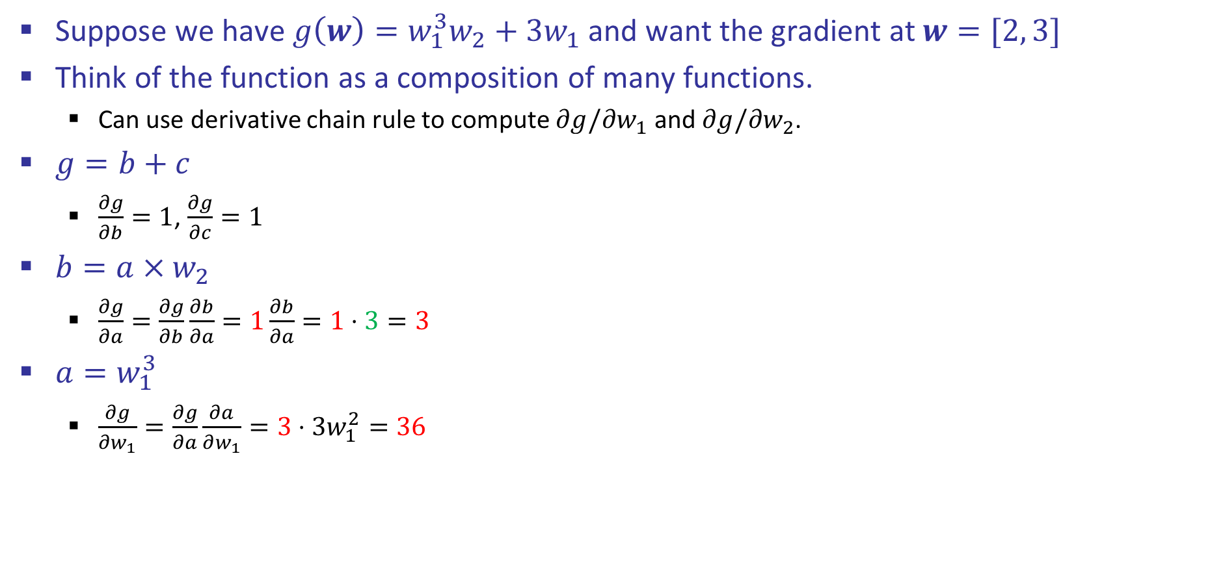

Back Propagation: $g\left(w\right)=w_{1}^{3}w_{2}+3w_{1}$
Suppose we have $g\left(w\right)=w_{1}^{3}w_{2}+3w_{1}$ and want the gradient at $w=[2, 3]$
Think of the function as a composition of many functions.
Can use derivative chain rule to compute $∂g/∂w_{1}$ and $∂g/∂w_{2}$.
$g=b+c$
$\frac{∂g}{∂b}=1$, $\frac{∂g}{∂c}=1$
$b=a×w_{2}$
$\frac{∂g}{∂a}=\frac{∂g}{∂b}\frac{∂b}{∂a}=1\frac{∂b}{∂a}=1⋅3=3$
$a=w_{1}^{3}$
$\frac{∂g}{∂w_{1}}=\frac{∂g}{∂a}\frac{∂a}{∂w_{1}}=3⋅3w_{1}^{2}=36$
2
$∎^{3}$
$$a=8$$
$$w_{1}$$
$$36$$
$$3$$
$×$
$$b=24$$
3
$$\frac{∂g}{∂b}=1$$
$$w_{2}$$
$$g=30$$
$+$
$$1$$
$$3$$
$×$
$$c=6$$
$$w_{1}$$
2
$$\frac{∂g}{∂c}=1$$
$$\frac{∂g}{∂g}=1$$
Interpretation: A tiny increase in $w_{1}$ will result in an approximately $36$ times increase in g due to this computation path.

Slide 14

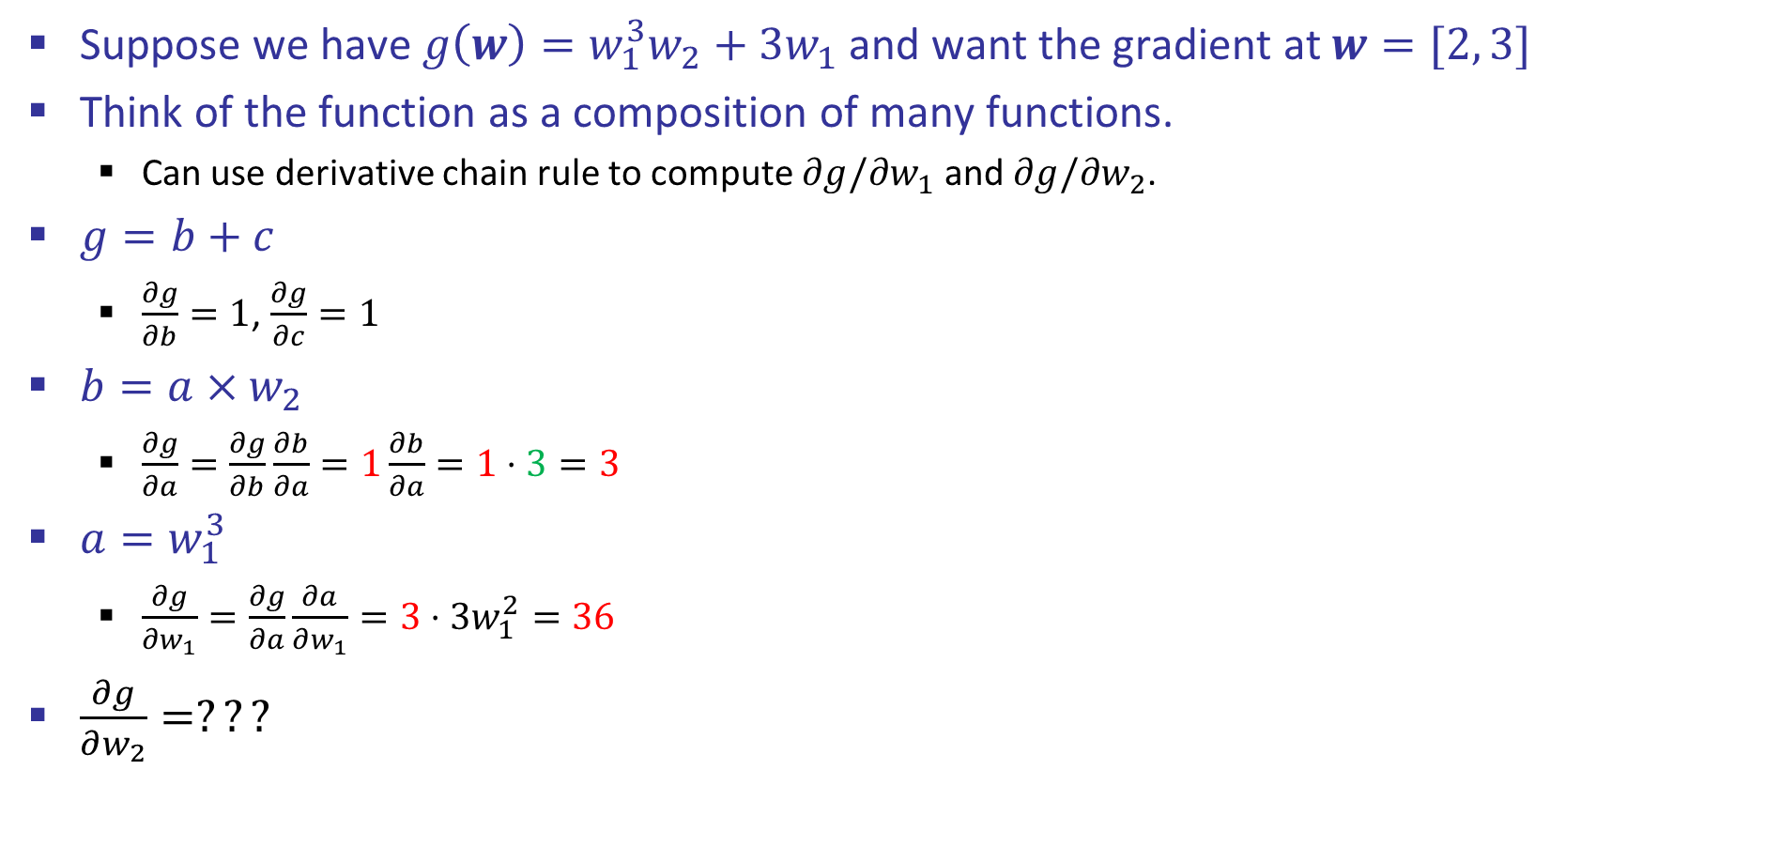
Back Propagation: $g\left(w\right)=w_{1}^{3}w_{2}+3w_{1}$
Suppose we have $g\left(w\right)=w_{1}^{3}w_{2}+3w_{1}$ and want the gradient at $w=[2, 3]$
Think of the function as a composition of many functions.
Can use derivative chain rule to compute $∂g/∂w_{1}$ and $∂g/∂w_{2}$.
$g=b+c$
$\frac{∂g}{∂b}=1$, $\frac{∂g}{∂c}=1$
$b=a×w_{2}$
$\frac{∂g}{∂a}=\frac{∂g}{∂b}\frac{∂b}{∂a}=1\frac{∂b}{∂a}=1⋅3=3$
$a=w_{1}^{3}$
$\frac{∂g}{∂w_{1}}=\frac{∂g}{∂a}\frac{∂a}{∂w_{1}}=3⋅3w_{1}^{2}=36$
$\frac{∂g}{∂w_{2}}=???$
2
$∎^{3}$
$$a=8$$
$$w_{1}$$
$$36$$
$$3$$
$×$
$$b=24$$
3
$$\frac{∂g}{∂b}=1$$
$$w_{2}$$
$$g=30$$
$+$
$$1$$
$$3$$
$×$
$$c=6$$
$$w_{1}$$
2
$$\frac{∂g}{∂c}=1$$
$$\frac{∂g}{∂g}=1$$
Hint: $b=a×3$ may be useful.

Slide 15

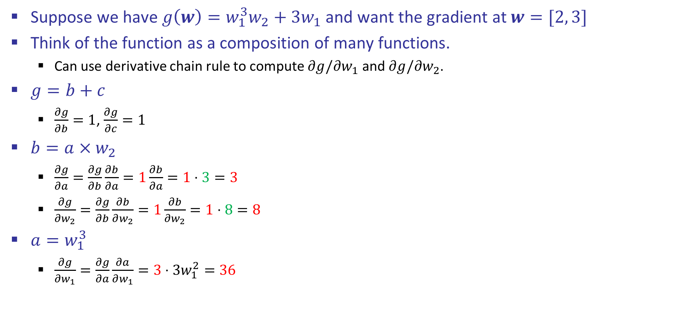
Back Propagation: $g\left(w\right)=w_{1}^{3}w_{2}+3w_{1}$
Suppose we have $g\left(w\right)=w_{1}^{3}w_{2}+3w_{1}$ and want the gradient at $w=[2, 3]$
Think of the function as a composition of many functions.
Can use derivative chain rule to compute $∂g/∂w_{1}$ and $∂g/∂w_{2}$.
$g=b+c$
$\frac{∂g}{∂b}=1$, $\frac{∂g}{∂c}=1$
$b=a×w_{2}$
$\frac{∂g}{∂a}=\frac{∂g}{∂b}\frac{∂b}{∂a}=1\frac{∂b}{∂a}=1⋅3=3$
$\frac{∂g}{∂w_{2}}=\frac{∂g}{∂b}\frac{∂b}{∂w_{2}}=1\frac{∂b}{∂w_{2}}=1⋅8=8$
$a=w_{1}^{3}$
$\frac{∂g}{∂w_{1}}=\frac{∂g}{∂a}\frac{∂a}{∂w_{1}}=3⋅3w_{1}^{2}=36$
2
$∎^{3}$
$$a=8$$
$$w_{1}$$
$$36$$
$$3$$
$×$
$$b=24$$
3
$$\frac{∂g}{∂b}=1$$
$$w_{2}$$
$$g=30$$
$$8$$
$+$
$$1$$
$$3$$
$×$
$$c=6$$
$$w_{1}$$
2
$$\frac{∂g}{∂c}=1$$
$$\frac{∂g}{∂g}=1$$

Slide 16

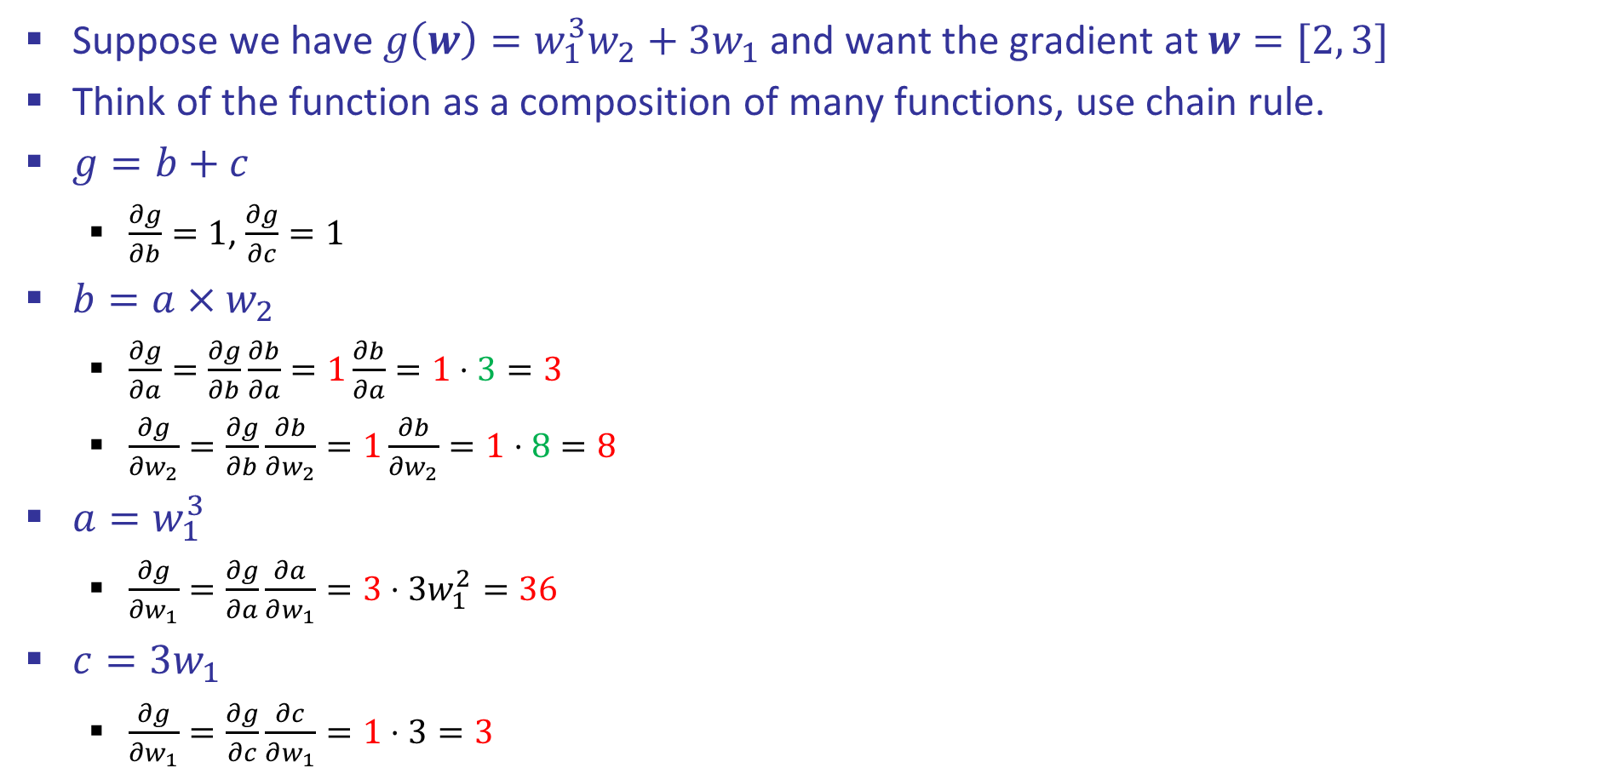
Back Propagation: $g\left(w\right)=w_{1}^{3}w_{2}+3w_{1}$
Suppose we have $g\left(w\right)=w_{1}^{3}w_{2}+3w_{1}$ and want the gradient at $w=[2, 3]$
Think of the function as a composition of many functions, use chain rule.
$g=b+c$
$\frac{∂g}{∂b}=1$, $\frac{∂g}{∂c}=1$
$b=a×w_{2}$
$\frac{∂g}{∂a}=\frac{∂g}{∂b}\frac{∂b}{∂a}=1\frac{∂b}{∂a}=1⋅3=3$
$\frac{∂g}{∂w_{2}}=\frac{∂g}{∂b}\frac{∂b}{∂w_{2}}=1\frac{∂b}{∂w_{2}}=1⋅8=8$
$a=w_{1}^{3}$
$\frac{∂g}{∂w_{1}}=\frac{∂g}{∂a}\frac{∂a}{∂w_{1}}=3⋅3w_{1}^{2}=36$
$c=3w_{1}$
$\frac{∂g}{∂w_{1}}=\frac{∂g}{∂c}\frac{∂c}{∂w_{1}}=1⋅3=3$
2
$∎^{3}$
$$a=8$$
$$w_{1}$$
$$36$$
$$3$$
$×$
$$b=24$$
3
$$\frac{∂g}{∂b}=1$$
$$w_{2}$$
$$g=30$$
$$8$$
$+$
$$1$$
$$3$$
$×$
$$c=6$$
$$w_{1}$$
2
$$3$$
$$\frac{∂g}{∂c}=1$$
$$\frac{∂g}{∂g}=1$$
Adding the changes to g contributed by
change in w₁ together

Slide 17
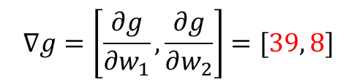
Back Propagation: $g\left(w\right)=w_{1}^{3}w_{2}+3w_{1}$
Suppose we have $g\left(w\right)=w_{1}^{3}w_{2}+3w_{1}$ and want the gradient at $w=[2, 3]$
Think of the function as a composition of many functions, use chain rule.
$g=b+c$
$\frac{∂g}{∂b}=1$, $\frac{∂g}{∂c}=1$
$b=a×w_{2}$
$\frac{∂g}{∂a}=\frac{∂g}{∂b}\frac{∂b}{∂a}=1\frac{∂b}{∂a}=1⋅3=3$
$\frac{∂g}{∂w_{2}}=\frac{∂g}{∂b}\frac{∂b}{∂w_{2}}=1\frac{∂b}{∂w_{2}}=1⋅8=8$
$a=w_{1}^{3}$
$\frac{∂g}{∂w_{1}}=\frac{∂g}{∂a}\frac{∂a}{∂w_{1}}=3⋅3w_{1}^{2}=36$
$c=3w_{1}$
$\frac{∂g}{∂w_{1}}=\frac{∂g}{∂c}\frac{∂c}{∂w_{1}}=1⋅3=3$
2
$∎^{3}$
$$a=8$$
$$w_{1}$$
$$36$$
$$3$$
$×$
$$b=24$$
3
$$\frac{∂g}{∂b}=1$$
$$w_{2}$$
$$g=30$$
$$8$$
$+$
$$1$$
$$3$$
$×$
$$c=6$$
$$w_{1}$$
2
$$3$$
$$\frac{∂g}{∂c}=1$$
$$\frac{∂g}{∂g}=1$$
$$∇g=\left[\frac{∂g}{∂w_{1}},\frac{∂g}{∂w_{2}}\right]=[39, 8]$$

Slide 18
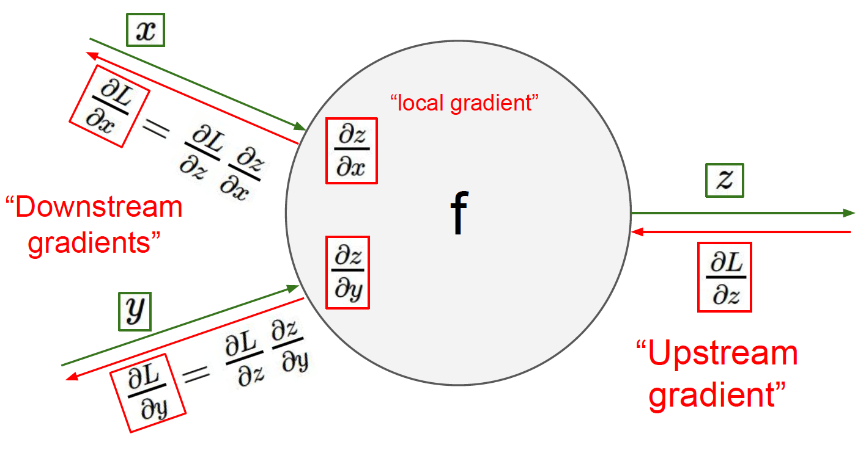

Slide 19
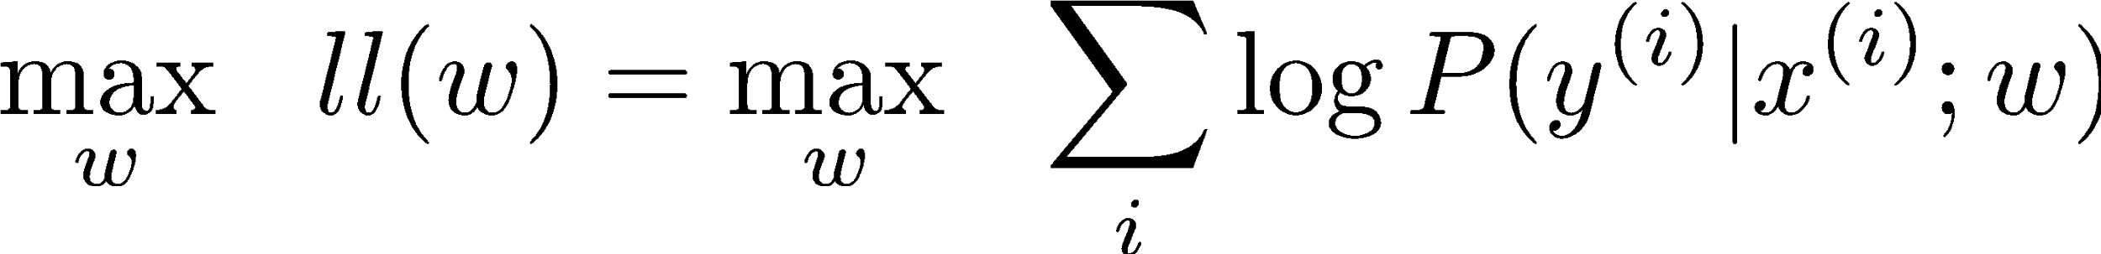
Summary of Key Ideas
Optimize probability of label given input
Continuous optimization
Gradient ascent:
Compute steepest uphill direction = gradient (= just vector of partial derivatives)
Take step in the gradient direction
Repeat (until held-out data accuracy starts to drop = “early stopping”)
Deep neural nets
Last layer = still logistic regression
Now also many more layers before this last layer
= computing the features
The features are learned rather than hand-designed
Universal function approximation theorem
If neural net is large enough
Then neural net can represent any continuous mapping from input to output with arbitrary accuracy
But remember: need to avoid overfitting / memorizing the training data -> early stopping!
Automatic differentiation gives the derivatives efficiently (how? = outside of scope of 588)

Slide 20
How well does it work?

Slide 21

Computer Vision
Notes:
21

Slide 22
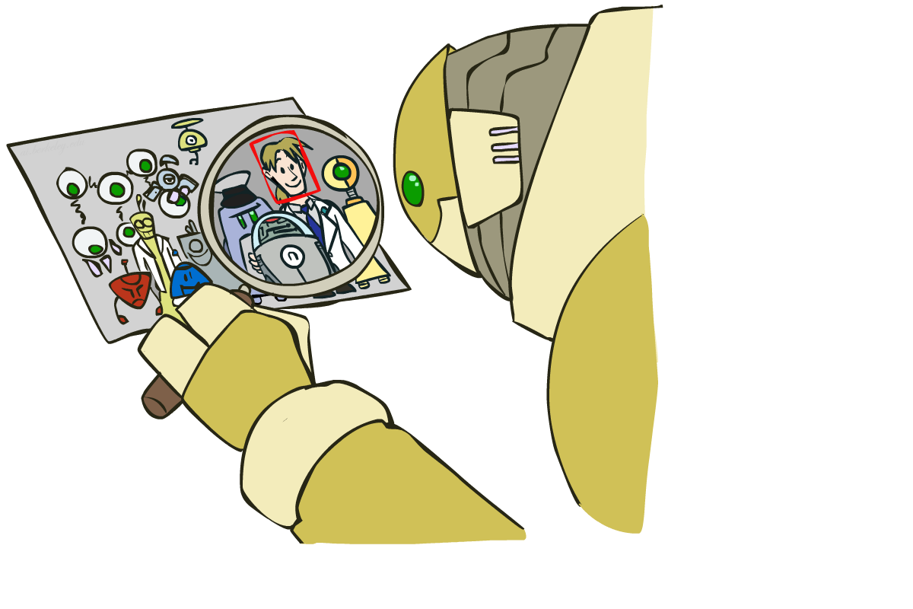
Object Detection
Notes:
22

Slide 23

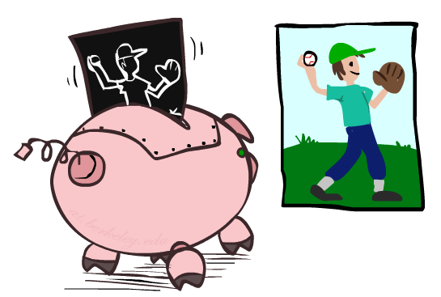

Manual Feature Design
Notes:
23

Slide 24
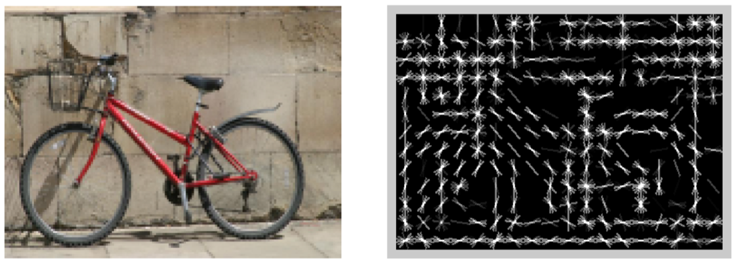
Features and Generalization
[HoG: Dalal and Triggs, 2005]
Notes:
24

Slide 25
Features and Generalization
Image
HoG
Notes:
HoG, SIFT, Daisy
Deformable part models
25

Slide 26
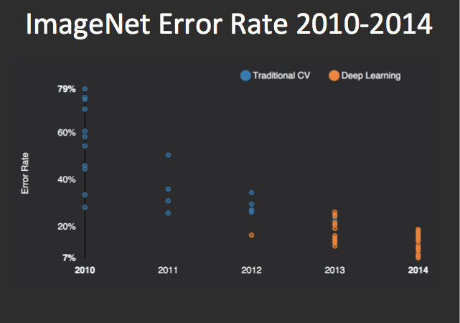
Performance
graph credit Matt Zeiler, Clarifai

Slide 27
Performance
graph credit Matt Zeiler, Clarifai

Slide 28
Performance
AlexNet
graph credit Matt Zeiler, Clarifai

Slide 29
Performance
AlexNet
graph credit Matt Zeiler, Clarifai

Slide 30
Performance
AlexNet
graph credit Matt Zeiler, Clarifai

Slide 31
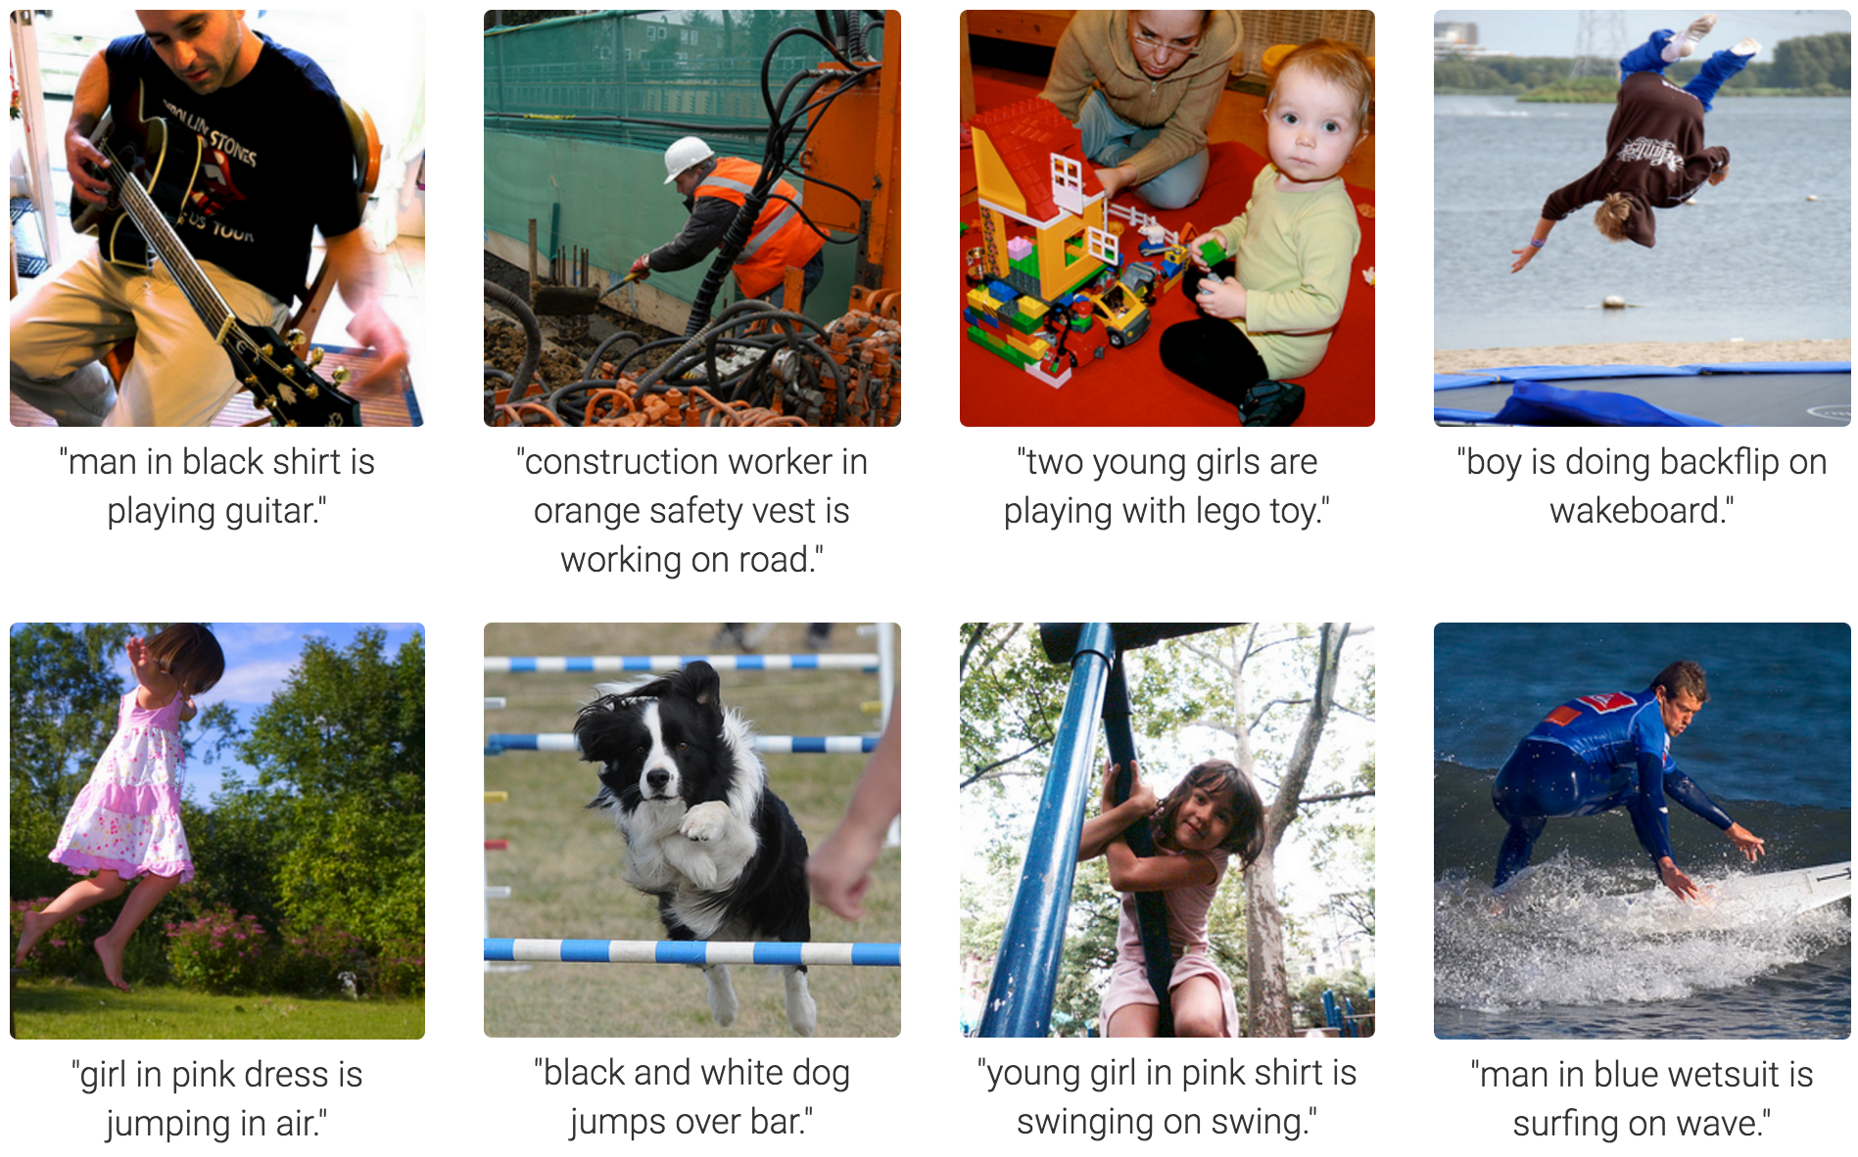
MS COCO Image Captioning Challenge
Karpathy & Fei-Fei, 2015; Donahue et al., 2015; Xu et al, 2015; many more

Slide 32
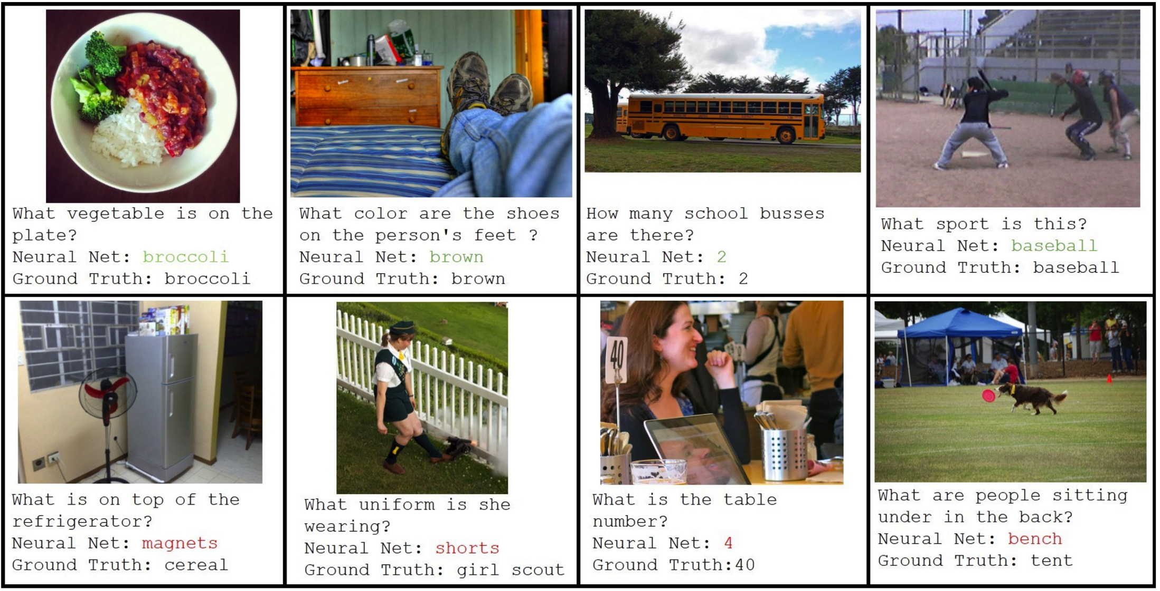
Visual QA Challenge
Stanislaw Antol, Aishwarya Agrawal, Jiasen Lu, Margaret Mitchell, Dhruv Batra, C. Lawrence Zitnick, Devi Parikh

Slide 33
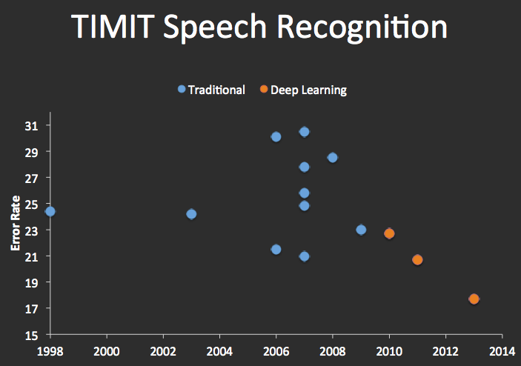


Speech Recognition
graph credit Matt Zeiler, Clarifai

Slide 34
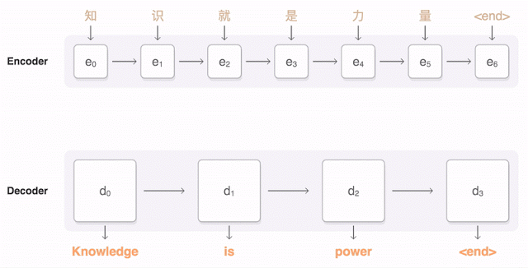
Machine Translation
Google Neural Machine Translation (in production)
Notes:
https://research.googleblog.com/2016/09/a-neural-network-for-machine.html

