Slide 1
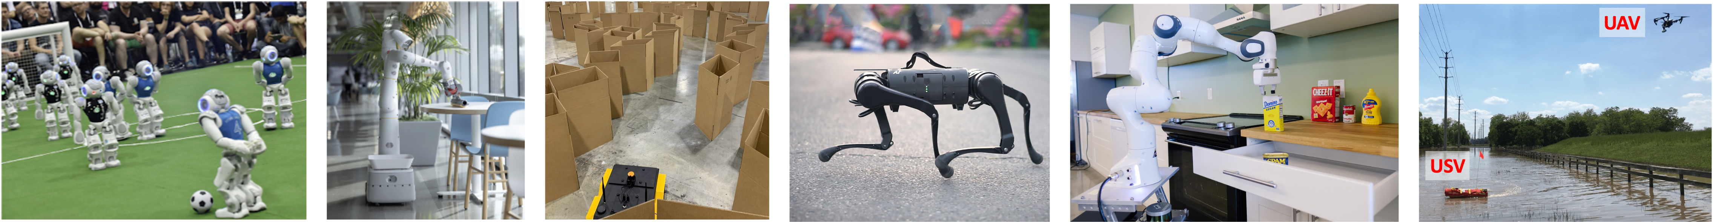
CS 485 Autonomous Robotics
Localization II
Prof. Xuesu Xiao
George Mason University
Slides Credits: Gregory Stein

Slide 2
Motion so far comes from odometry, but what if we don’t have it?
Rather than comparing laser scans against a known map, we can compare them to one another: “scan matching”

Slide 3
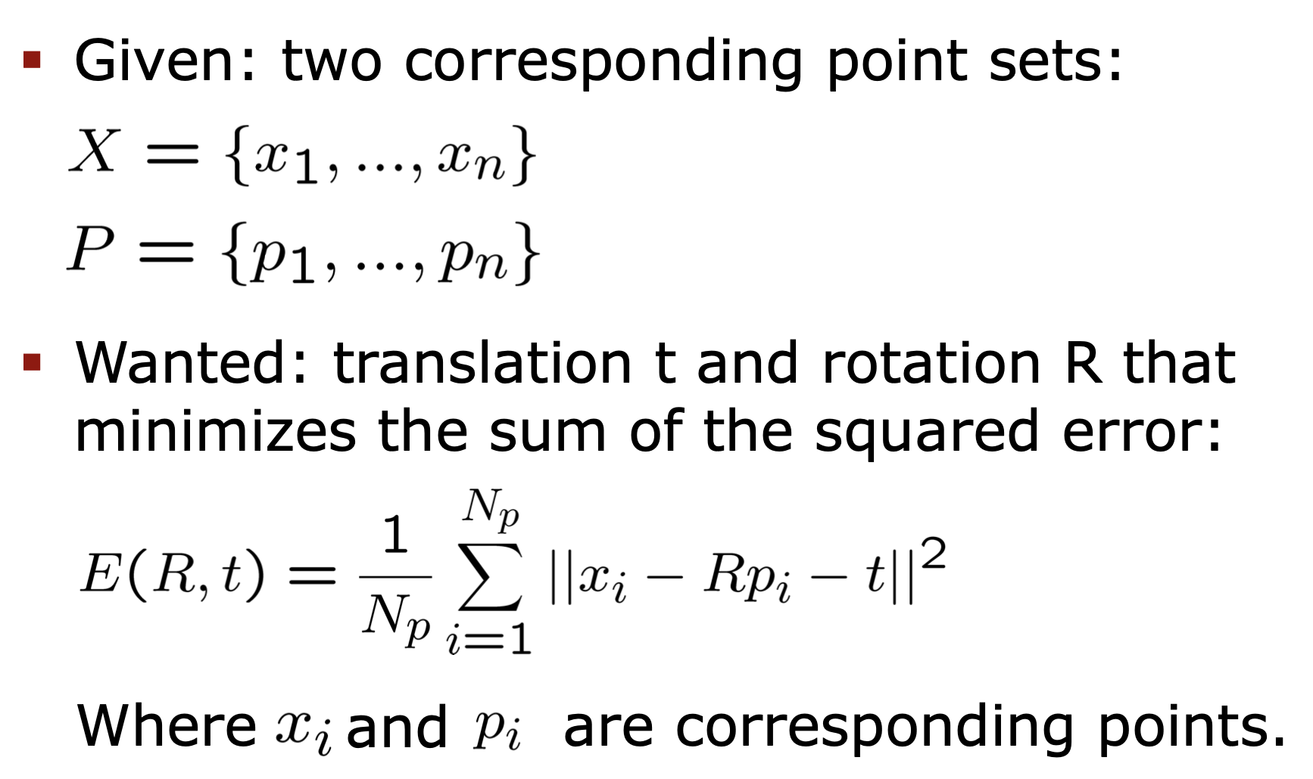
Scan Matching: comparing consecutive scans to figure out how far we’ve moved

Slide 4
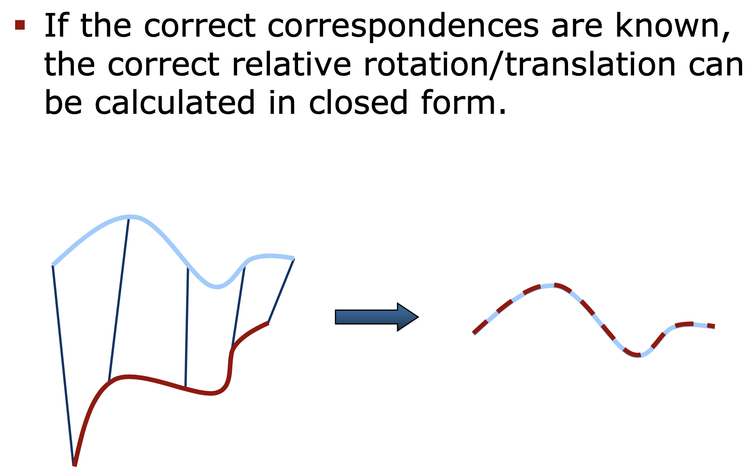
Scan Matching: comparing consecutive scans to figure out how far we’ve moved

Slide 5
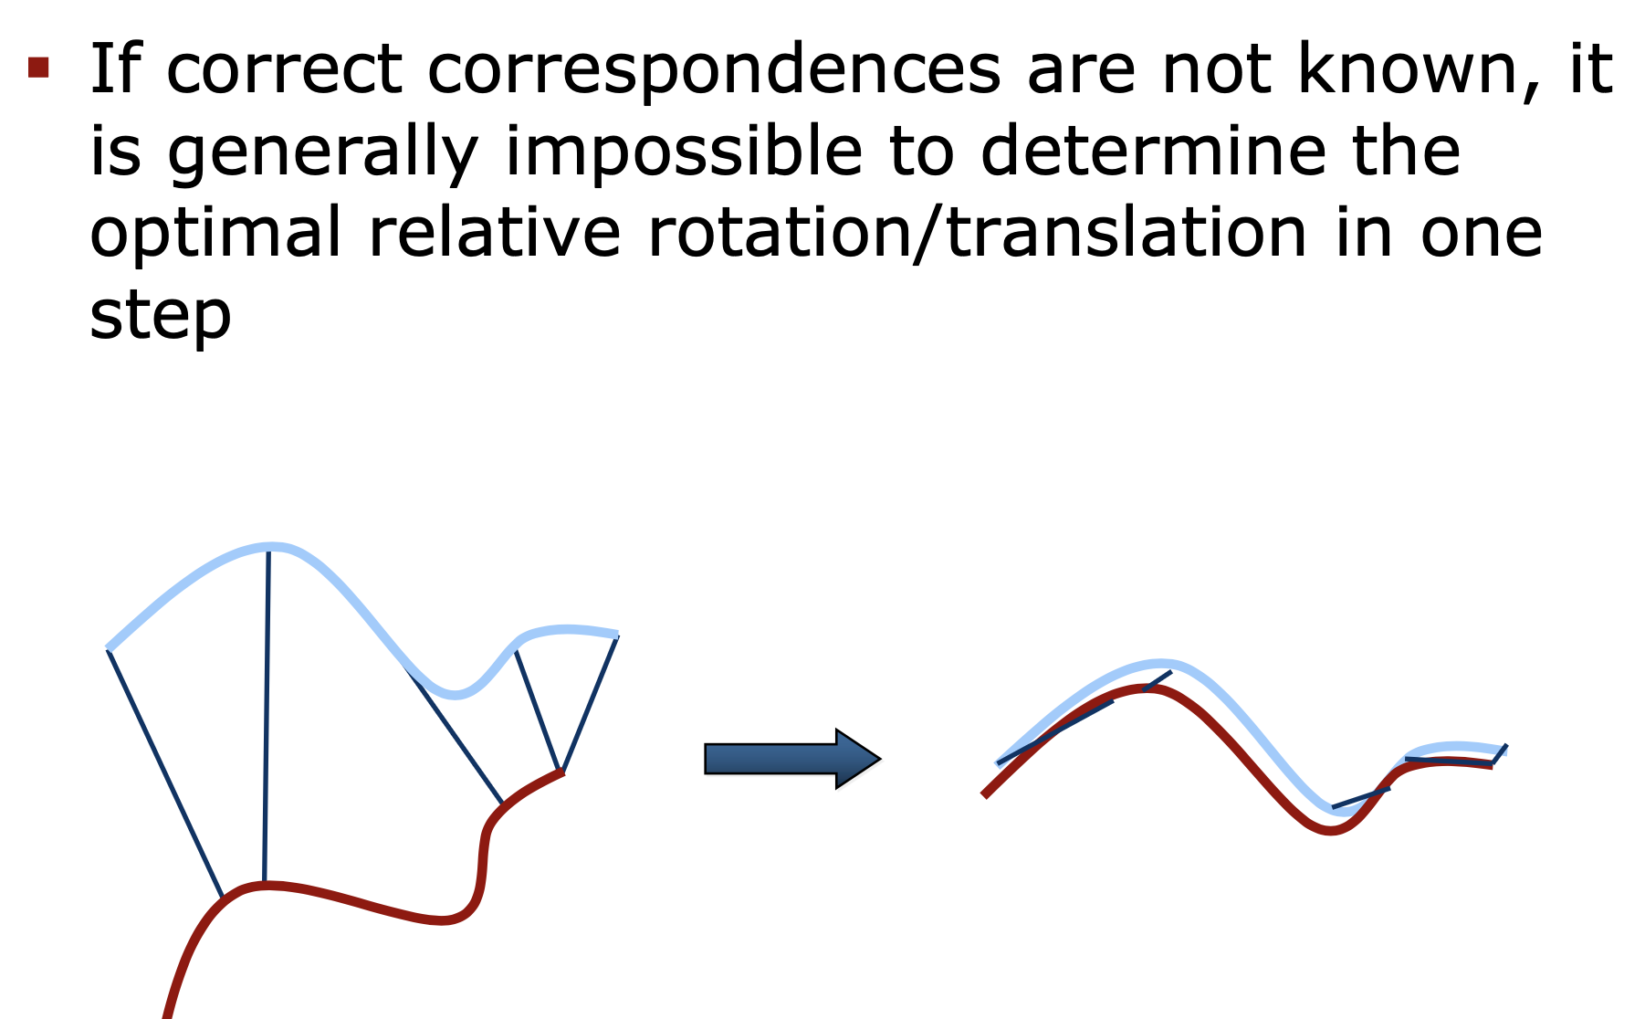
Scan Matching via “Iterative Closest Point”

Slide 6
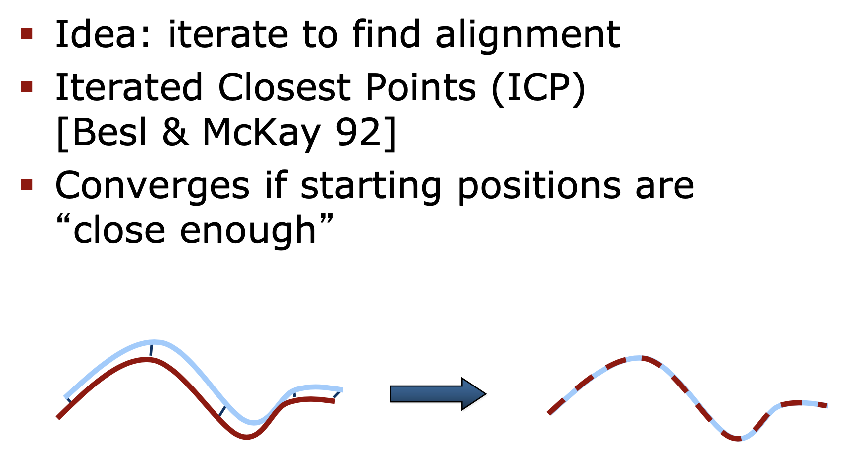
Iterative Closest Point

Slide 7
Iterative Closest Point
Issues? It’s a bit sensitive to outliers.
What if there are points in one set that don’t exist in the other?
This happens often in practice: noise, reflections, motion between the scans. We need an approach that is robust to outliers.

Slide 8
But First…
Linear Algebra
A Crash Course

Slide 9
Least Squares Solving

Slide 10
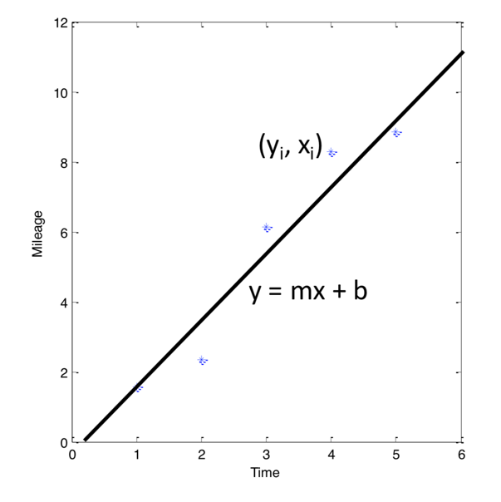
Least Squares is used to solve, for example, curve fitting problems
Linear regression:

Slide 11
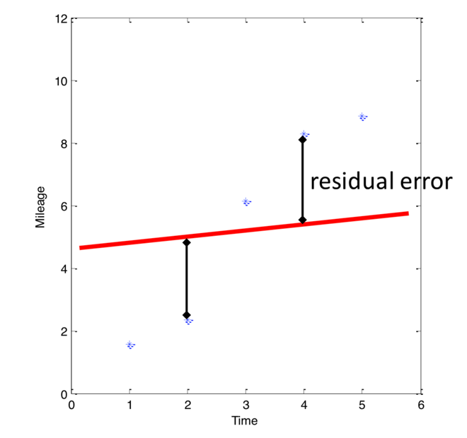
Least Squares is used to solve, for example, curve fitting problems
Linear regression:

Slide 12
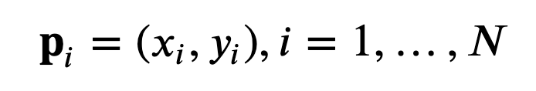
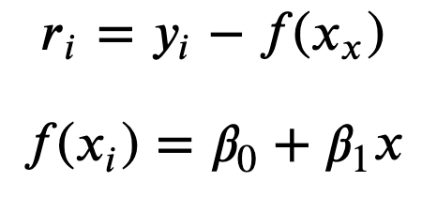
So how do we solve this problem?
Let’s look at this from a net cost perspective. I have
N points:
The residuals specify the “error”:
We want the beta’s that minimize
this error.

Slide 13
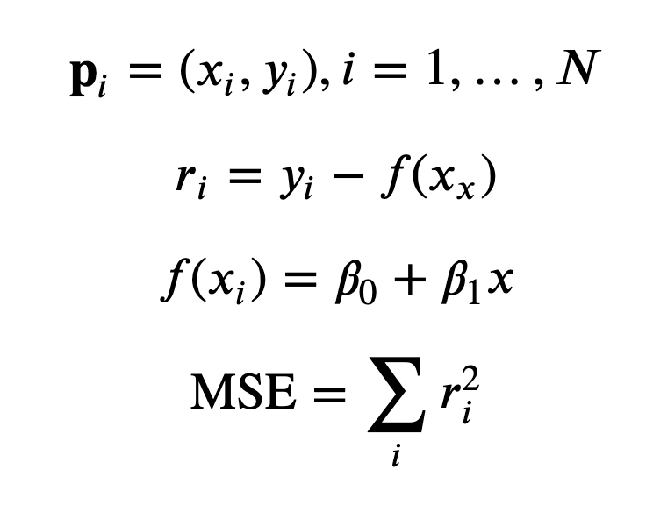
We want to minimize the Sum of Squared Error (or Mean Squared Error)

Slide 14
We want to minimize the Sum of Squared Error (or Mean Squared Error)
So how do we solve for this?

Slide 15
If we write this as a matrix equation, we can solve it using linear algebra.
From CMU Statistics Course

Slide 16
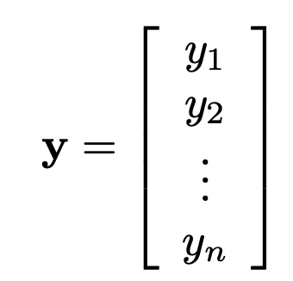
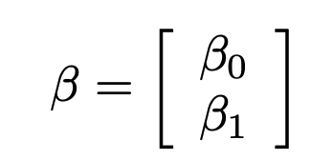
If we write this as a matrix equation, we can solve it using linear algebra.
From CMU Statistics Course

Slide 17
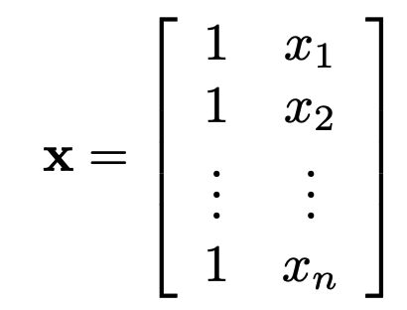
If we write this as a matrix equation, we can solve it using linear algebra.
From CMU Statistics Course

Slide 18
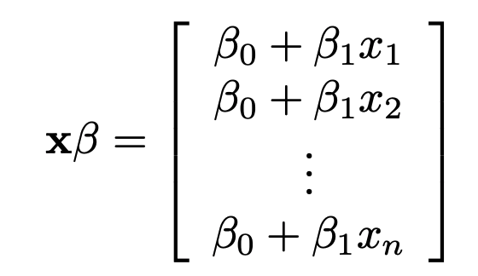
If we write this as a matrix equation, we can solve it using linear algebra.
From CMU Statistics Course

Slide 19
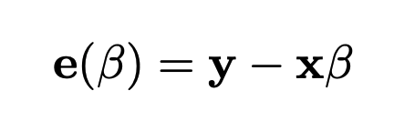
If we write this as a matrix equation, we can solve it using linear algebra.
From CMU Statistics Course

Slide 20
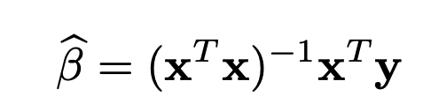
If we write this as a matrix equation, we can solve it using linear algebra.
From CMU Statistics Course

Slide 21
Many problems in robot state estimation are least-squares problems

Slide 22
Many problems in robot state estimation are least-squares problems
Also, this is the “Pseudo-inverse” of x:
It allows us to “invert” a matrix that isn’t square.
Note that if the matrix is square, this will allows us to solve for a line that exactly fits the parameters. No pseudo-inverse required.

Slide 23
Eigenvalues and Eigenvectors

Slide 24
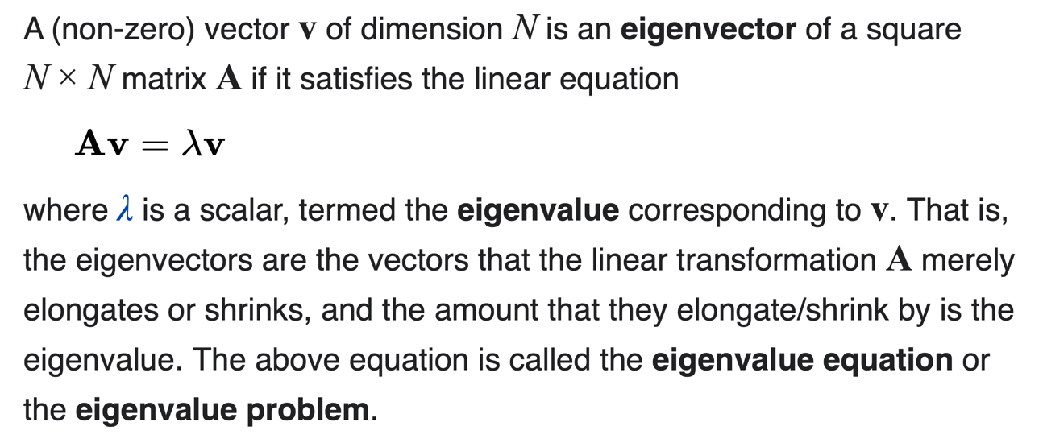
What are eigenvalues and eigenvectors?
Source: Wikipedia

Slide 25
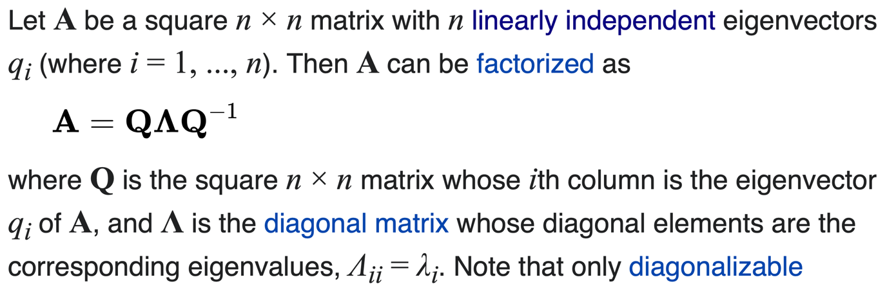
We can also rewrite a matrix using its eigenvalues and eigenvectors
Source: Wikipedia

Slide 26
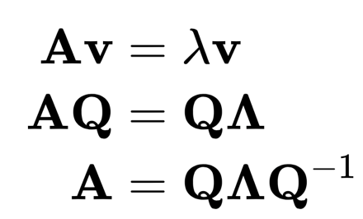
We can also rewrite a matrix using its eigenvalues and eigenvectors
Source: Wikipedia

Slide 27
Matrix Factorization

Slide 28
There are many different ways of “factorizing” matrices
Source: Wikipedia

Slide 29
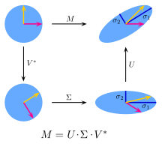
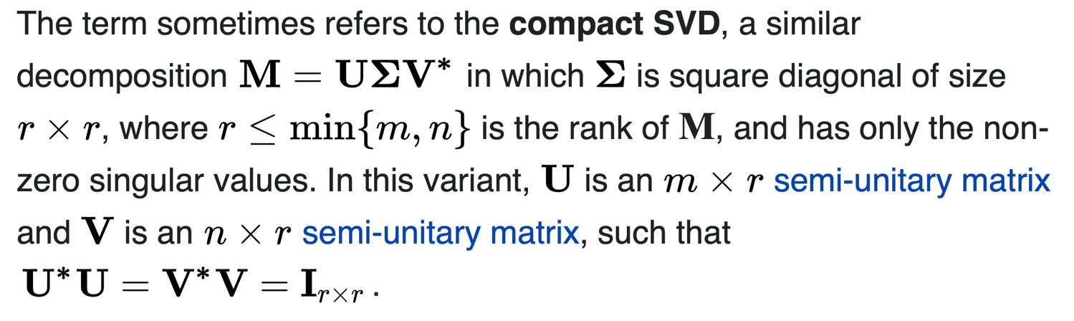
Singular Value Decomposition is similar but for non-square matrices

Slide 30
RANSAC
Handling outliers in data

Slide 31
Reading & Slide Credits
Slide Credits (from which many of these slides are either directly taken or adapted)
Cornell Tech Computer Vision Course (Noah Snavely)
CMU Computer Vision Course
Penn State Computer Vision Course
Stanford: Stats 203

Slide 32
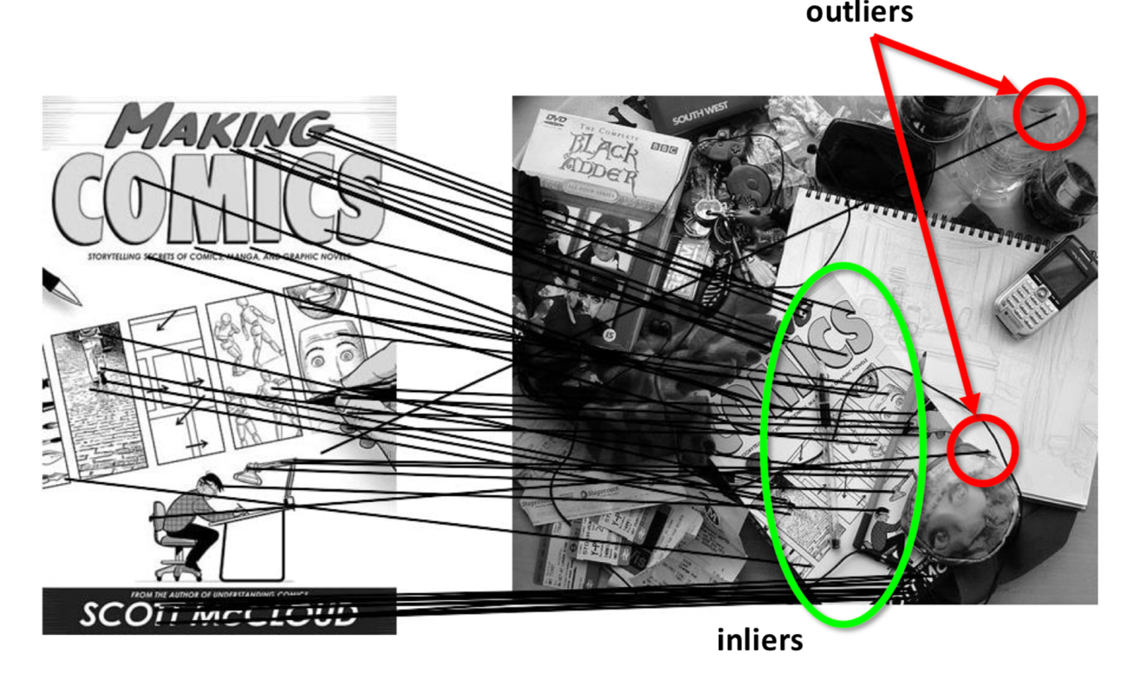
So how do we make what is obvious to us visible to the computer (via an algorithm)?

Slide 33
Outliers are (roughly) points that don’t agree with our model of the problem
Let’s fit a line to some data:

Slide 34
Outliers are (roughly) points that don’t agree with our model of the problem
Let’s fit a line to some data:
This is the line I want…

Slide 35
Outliers are (roughly) points that don’t agree with our model of the problem
Let’s fit a line to some data:
This is the line I want, but the residuals for those two outlying points are enormous.

Slide 36
Outliers are (roughly) points that don’t agree with our model of the problem
Let’s fit a line to some data:
The actual line I fit to all the data (roughly) looks like this, because it minimizes the sum of squared residuals.

Slide 37
Outliers are (roughly) points that don’t agree with our model of the problem
Let’s fit a line to some data:
If we split these points into inliers and outliers (somehow), we could fit the line we wanted to the inlying data and ignore the outliers.

Slide 38
Outliers are (roughly) points that don’t agree with our model of the problem
Let’s fit a line to some data:
Inliers
Outlier
If we split these points into inliers and outliers (somehow), we could fit the line we wanted to the inlying data and ignore the outliers.
Outlier

Slide 39
Outliers are (roughly) points that don’t agree with our model of the problem
Let’s fit a line to some data:
Inliers
Outlier
If we split these points into inliers and outliers (somehow), we could fit the line we wanted to the inlying data and ignore the outliers.
Outlier

Slide 40
Robust Estimation via
Random Sample Consensus
RANdom Sample Consensus (a.k.a RANSAC) is a very common and relatively simple procedure for detecting outliers.
The general procedure involves two steps (performed repeatedly):
Split the data into inliers and outliers
Fit the model parameters to the inliers (ignoring outliers)
Original Paper: M. A. Fischler and R. C. Bolles (June 1981). "Random Sample Consensus: A Paradigm for Model Fitting with Applications to Image Analysis and Automated Cartography". Comm. of the ACM 24: 381—395.

Slide 41
Robust Estimation via
Random Sample Consensus
In RANSAC: We pick a random set of points (”s” of them) to be inliers, and fit our model to those, and count the number of inliers: points that are below some distance/residual threshold.
We repeatedly conduct this procedure and pick the model parameters that maximize the number of inliers.
Why can’t we just pick the one with the lowest sum of squared residuals for the inlying points?

Slide 42
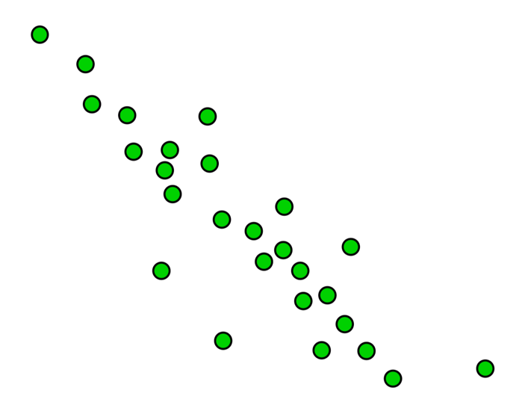
Robust Estimation via
Random Sample Consensus
In RANSAC: We pick a random set of points (”s” of them) to be inliers, and fit our model to those, and count the number of inliers: points that are below some distance/residual threshold.

Slide 43
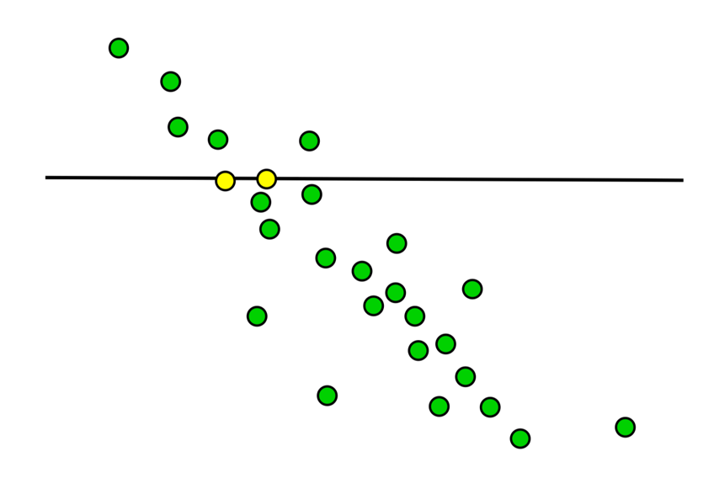
Robust Estimation via
Random Sample Consensus
In RANSAC: We pick a random set of points (”s” of them) to be inliers, and fit our model to those, and count the number of inliers: points that are below some distance/residual threshold.
Fit to 2 yellow points

Slide 44
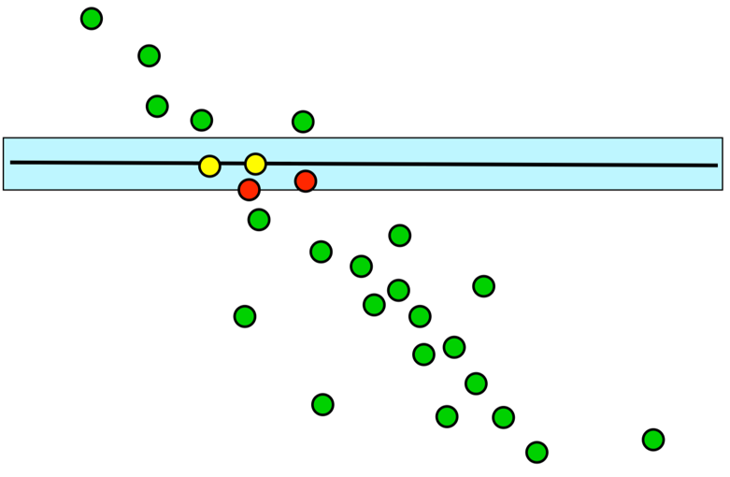
Robust Estimation via
Random Sample Consensus
In RANSAC: We pick a random set of points (”s” of them) to be inliers, and fit our model to those, and count the number of inliers: points that are below some distance/residual threshold.
Fit to 2 yellow points
Inliers: 4

Slide 45
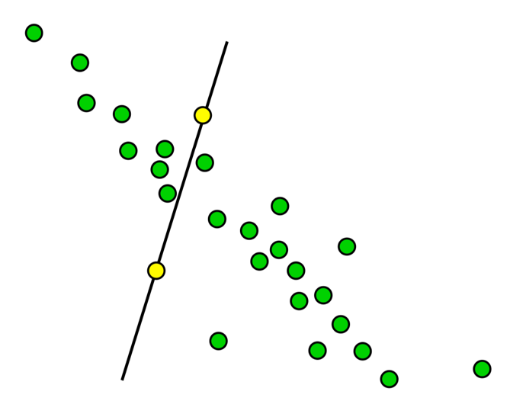
Robust Estimation via
Random Sample Consensus
In RANSAC: We pick a random set of points (”s” of them) to be inliers, and fit our model to those, and count the number of inliers: points that are below some distance/residual threshold.
Fit to 2 yellow points

Slide 46
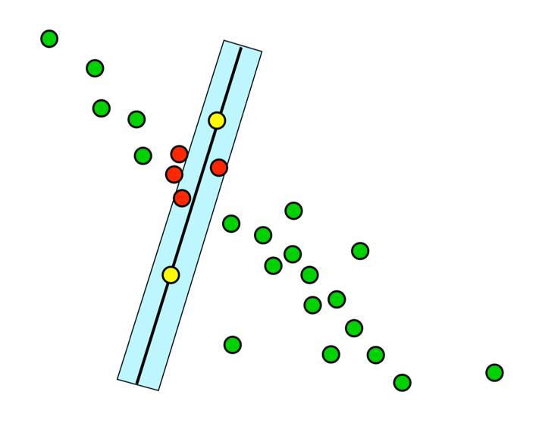
Robust Estimation via
Random Sample Consensus
In RANSAC: We pick a random set of points (”s” of them) to be inliers, and fit our model to those, and count the number of inliers: points that are below some distance/residual threshold.
Fit to 2 yellow points
Inliers: 6

Slide 47
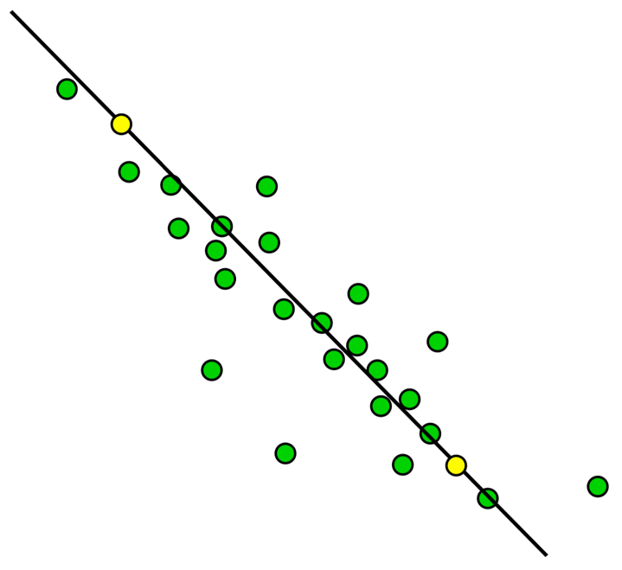
Robust Estimation via
Random Sample Consensus
In RANSAC: We pick a random set of points (”s” of them) to be inliers, and fit our model to those, and count the number of inliers: points that are below some distance/residual threshold.
Fit to 2 yellow points

Slide 48
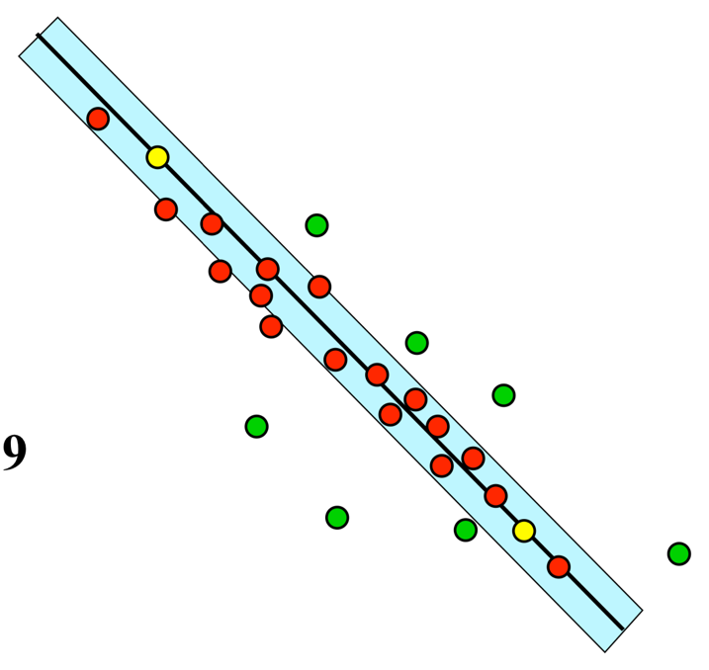
Robust Estimation via
Random Sample Consensus
In RANSAC: We pick a random set of points (”s” of them) to be inliers, and fit our model to those, and count the number of inliers: points that are below some distance/residual threshold.
Fit to 2 yellow points
Inliers: 19

Slide 49
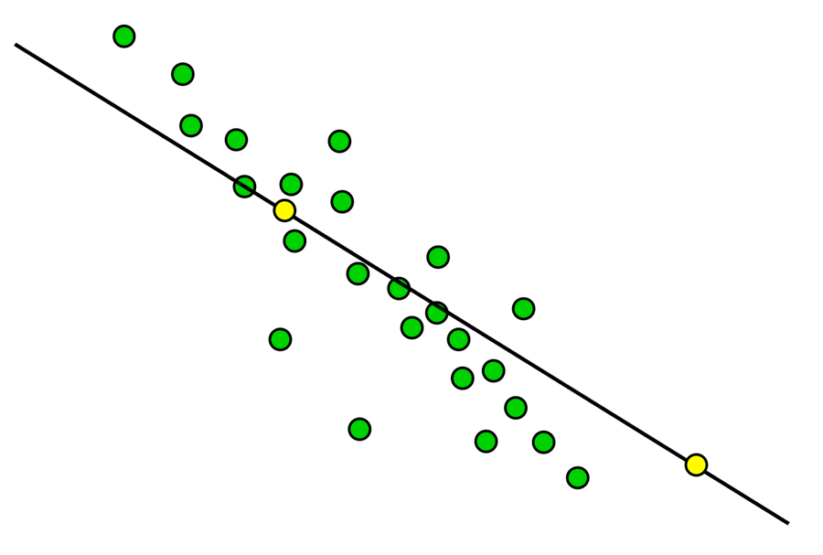
Robust Estimation via
Random Sample Consensus
In RANSAC: We pick a random set of points (”s” of them) to be inliers, and fit our model to those, and count the number of inliers: points that are below some distance/residual threshold.
Fit to 2 yellow points

Slide 50
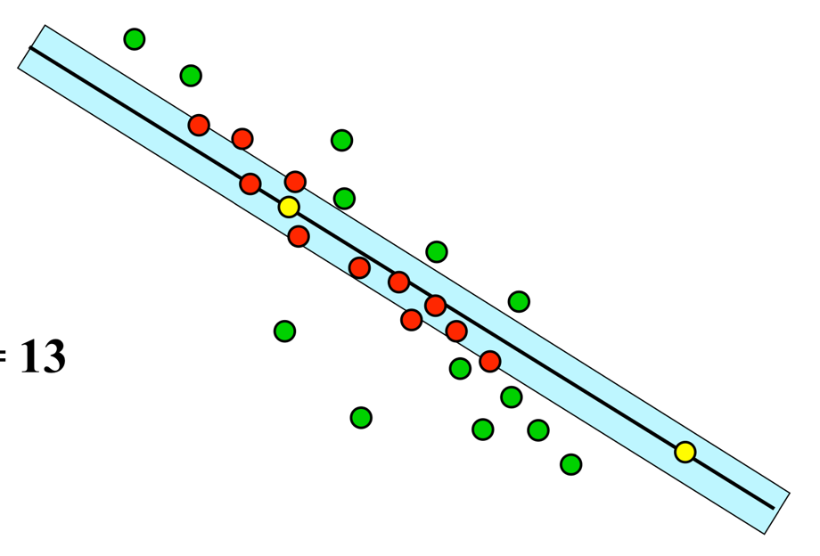
Robust Estimation via
Random Sample Consensus
In RANSAC: We pick a random set of points (”s” of them) to be inliers, and fit our model to those, and count the number of inliers: points that are below some distance/residual threshold.
Fit to 2 yellow points
Inliers: 13

Slide 51
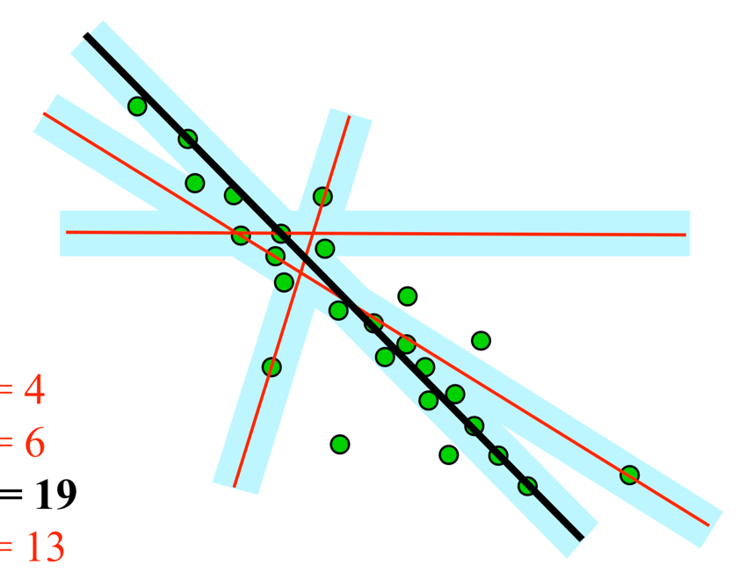
Robust Estimation via
Random Sample Consensus
In RANSAC: We pick a random set of points (”s” of them) to be inliers, and fit our model to those, and count the number of inliers: points that are below some distance/residual threshold.
We pick the line that has the most inliers.

Slide 52
Robust Estimation via
Random Sample Consensus
In RANSAC: We pick a random set of points (”s” of them) to be inliers, and fit our model to those, and count the number of inliers: points that are below some distance/residual threshold.
In practice, we usually re-fit the line to all the inliers once the best line is chosen.
We pick the line that has the most inliers.

Slide 53
Robust Estimation via
Random Sample Consensus
Why can’t we just pick the one with the lowest sum of squared residuals for the inlying points?

Slide 54
Robust Estimation via
Random Sample Consensus
Why can’t we just pick the one with the lowest sum of squared residuals for the inlying points?

Slide 55
Robust Estimation via
Random Sample Consensus
Why can’t we just pick the one with the lowest sum of squared residuals for the inlying points?
The residual of this line (which has only 2 inliers) is zero…

Slide 56
Lots of questions remain!
How do we decide what it means to be an inlier?
How many samples do we need to ensure good performance?
What does it even mean to have good performance?

Slide 57
We often assume that the noise follows some sort of Gaussian distribution
In order to decide what an inlier or an outlier looks like, we need to choose a noise model: usually, it’s Gaussian, with some standard deviation (e.g. 3 pixels).

Slide 58
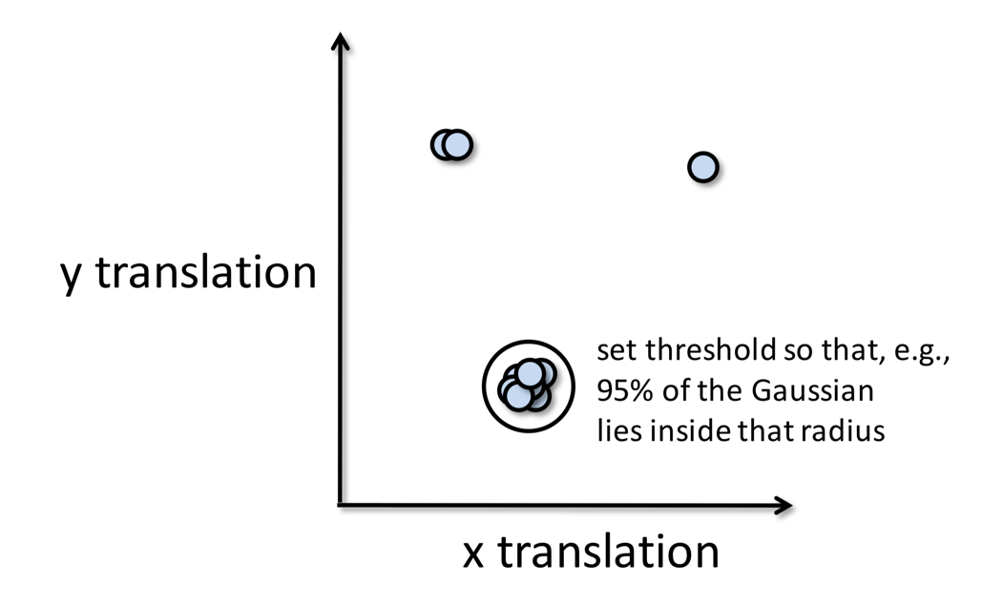
We often assume that the noise follows some sort of Gaussian distribution
In order to decide what an inlier or an outlier looks like, we need to choose a noise model: usually, it’s Gaussian, with some standard deviation (e.g. 3 pixels).

Slide 59

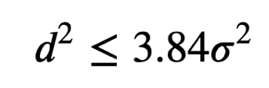
We can select inliers by thresholding via a Chi-Squared test
For a 1-dimensional system, like fitting a line, a threshold of
yields 95% inliers.
(5.99 for 2D)

Slide 60
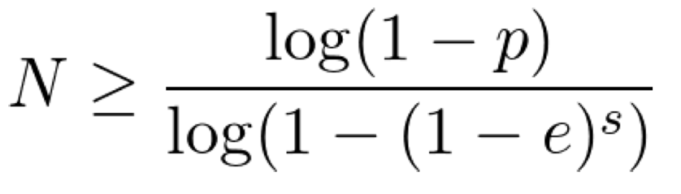
How many times (“rounds” N) should we run the system?
If we need to choose s samples per round, and we have an outlier ratio e, and we want to get the “right answer” with probability p:
Where did this come from?

Slide 61
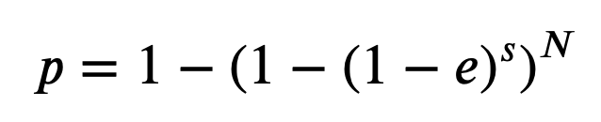
How many times (“rounds” N) should we run the system?
If we need to choose s samples per round, and we have an outlier ratio e, and we want to get the “right answer” with probability p:
The probability a single point is an inlier

Slide 62
How many times (“rounds” N) should we run the system?
If we need to choose s samples per round, and we have an outlier ratio e, and we want to get the “right answer” with probability p:
The probability that choosing s points yields only inliers

Slide 63
How many times (“rounds” N) should we run the system?
If we need to choose s samples per round, and we have an outlier ratio e, and we want to get the “right answer” with probability p:
The probability that at least one point was an outlier in one round

Slide 64
How many times (“rounds” N) should we run the system?
If we need to choose s samples per round, and we have an outlier ratio e, and we want to get the “right answer” with probability p:
The probability that all N rounds have at least one outlier

Slide 65
How many times (“rounds” N) should we run the system?
If we need to choose s samples per round, and we have an outlier ratio e, and we want to get the “right answer” with probability p:
The probability that after N rounds, we managed to find at least one round of s points that were all inliers.

Slide 66
How many times (“rounds” N) should we run the system?
If we need to choose s samples per round, and we have an outlier ratio e, and we want to get the “right answer” with probability p:
Solve for N to get the above formula.

Slide 67
How many times (“rounds”) should we run the system?
If we need to choose s samples per round, and we have an outlier ratio e, and we want to get the “right answer” with probability p:
Solve for N to get the above formula.
This means we need a pretty good idea of the inlier ratio, which means approximating the noise.

Slide 68
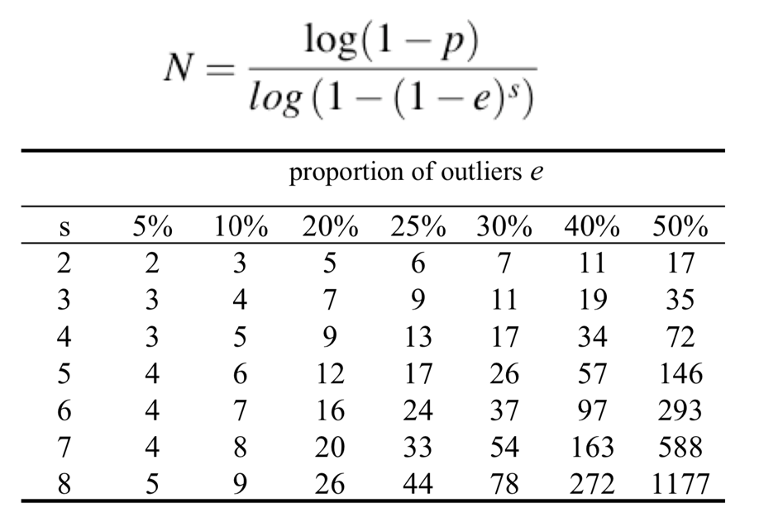
How many times (“rounds”) should we run the system?
If we need to choose s samples per round, and we have an outlier ratio e, and we want to get the “right answer” with probability p:

Slide 69
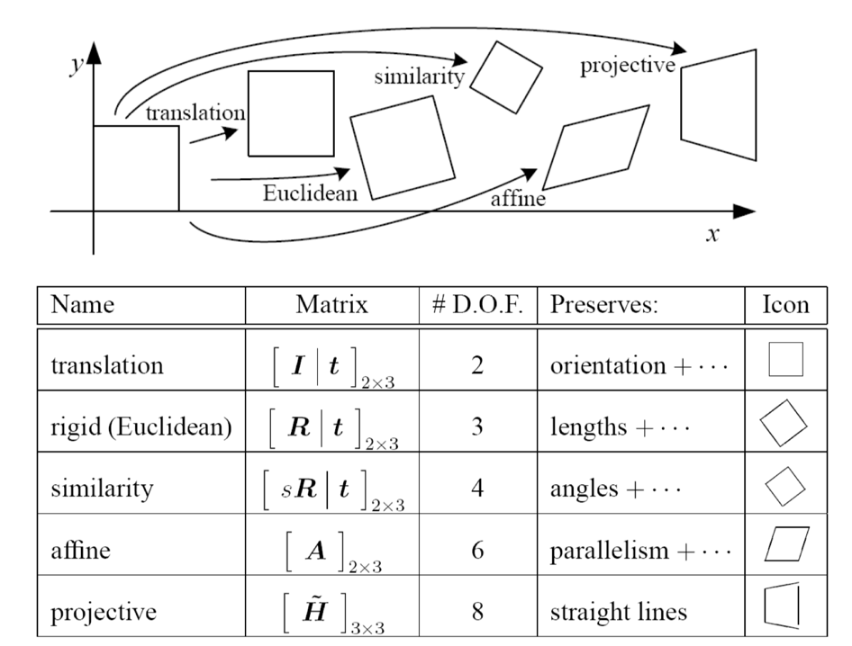
How do we pick s (the number of samples per round)?
This is really a matter of the type of problem we’re trying to solve:

Slide 70
RANSAC: Pros and Cons
Pros (the good):
Simple and general
Can (and and usually is) applicable to many different types of problem
Often works quite well in practice
Cons (the bad):
There are still some parameters to tune, like the inlier ratio or those of the error model
Sometimes it requires too many iterations
Can fail when there are too many outliers

Slide 71
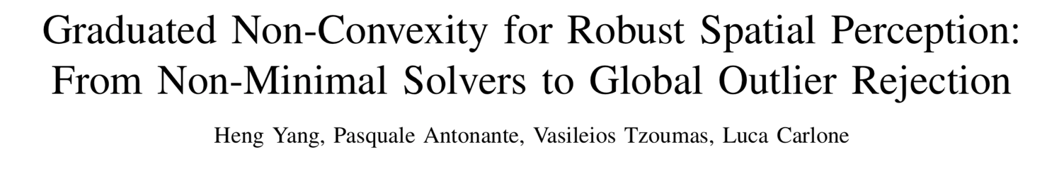
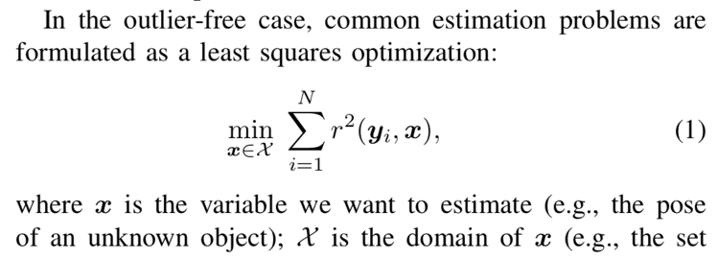
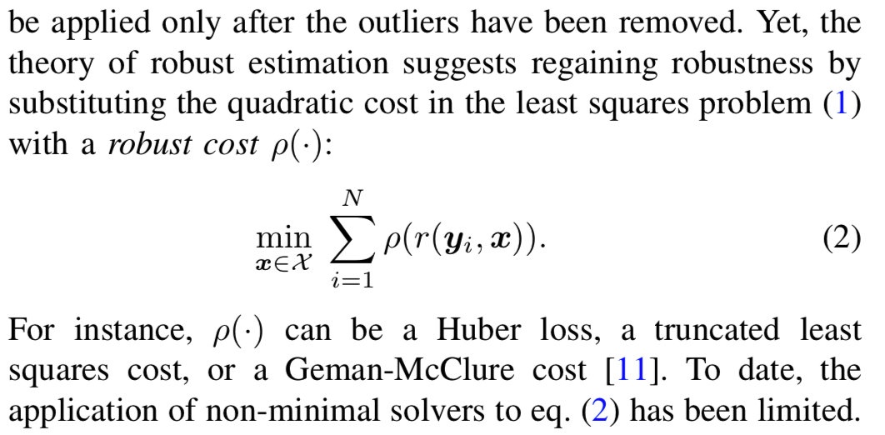
This is the backbone of many applications like SLAM
https://arxiv.org/pdf/1909.08605.pdf

Slide 72
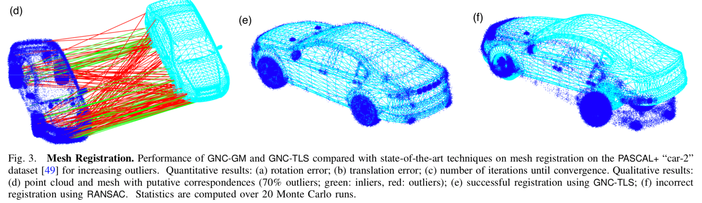
This is the backbone of many applications like SLAM
https://arxiv.org/pdf/1909.08605.pdf

Slide 73
Landmarks

Slide 74
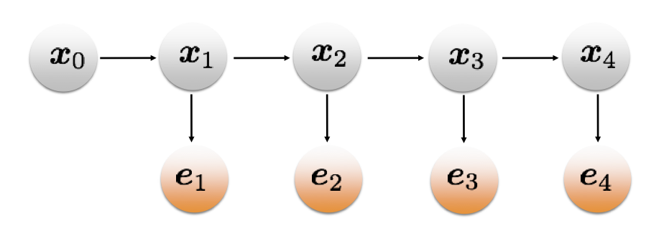
Let’s revisit the idea of probability distributions being represented as graphs
The graph is a convenient visual tool, but an incredibly powerful way to think about these problems more generally:
What if I removed an observation?
What if I added additional observations and sensors?

Slide 75
Let’s revisit the idea of probability distributions being represented as graphs
The graph is a convenient visual tool, but an incredibly powerful way to think about these problems more generally:
What if I removed an observation?
What if I added additional observations and sensors?
The probability distribution starts to get quite complicated, but the graph helps us manage that complexity.

Slide 76
Instead of GPS, the robot may instead need to figure out where it is from landmarks
The robot will detect “stuff” in the environment.
If we see the same thing from different viewpoints, we can triangulate its location and use that to constrain our movement.
Even when our measurements of the landmarks are noisy, each gives us more information about where we are likely to be.

Slide 77
Modern SLAM: everything is a graph
SLAM: Simultaneous Localization and Mapping
Square Root SAM paper

Slide 78
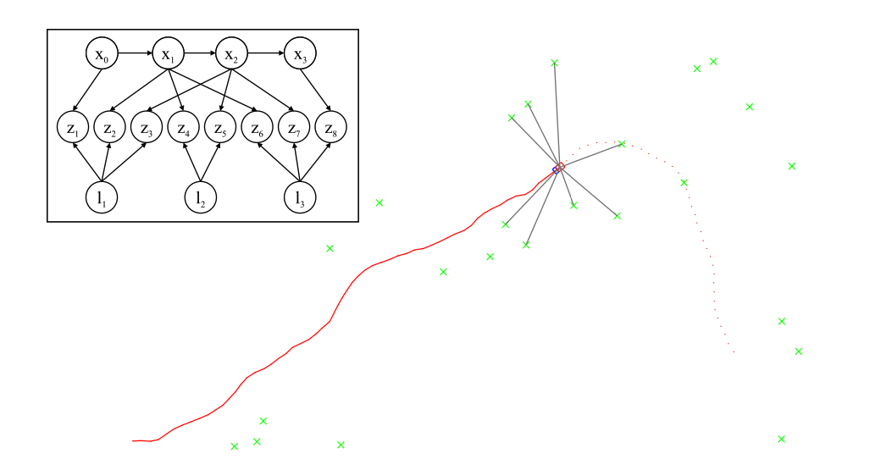
Modern SLAM: everything is a graph
Square Root SAM paper

Slide 79
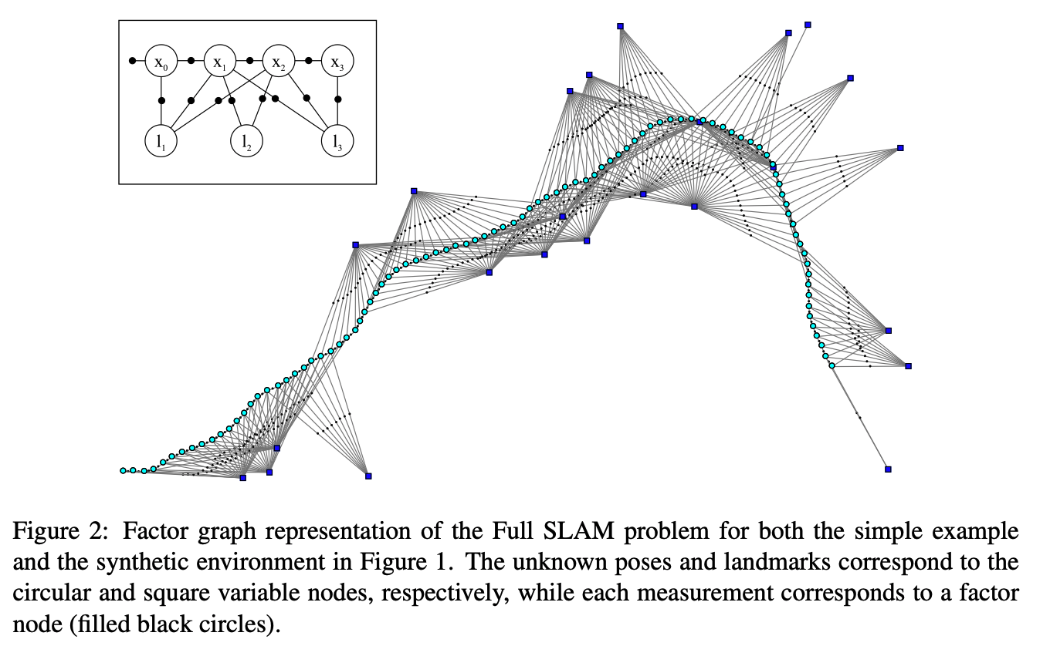
Modern SLAM: everything is a graph
Square Root SAM paper

Slide 80

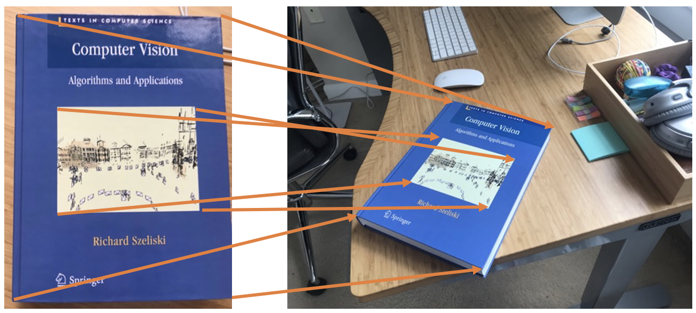
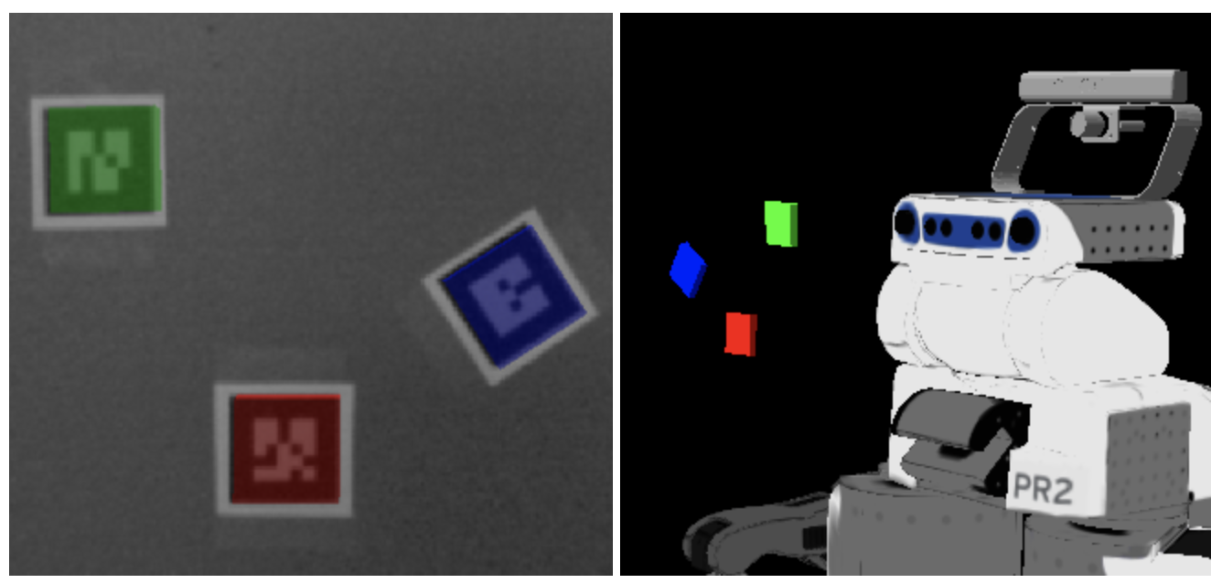
What’s a landmark?
Points of interest
Objects
AR Tags
Other ideas?
From the National Park Service

Slide 81
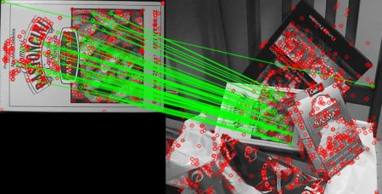
Sparse Features: distinguishable points detected and matched between images
From the OpenCV Feature Matching Tutorial

Slide 82
Landmarks don’t exactly solve all our problems
What if our landmarks move?
How will our graph need to change?

Slide 83
Landmarks don’t exactly solve all our problems
What if our landmarks move?
How will our graph need to change?
What if we have multiple of the same object
(e.g., multiple of the same textbook)
How can we tell which one we’re looking at?

Slide 84
Landmarks don’t exactly solve all our problems
What if our landmarks move?
How will our graph need to change?
What if we have multiple of the same object
(e.g., multiple of the same textbook)
How can we tell which one we’re looking at?
We’ll talk about tracking and data association.

