Slide 1
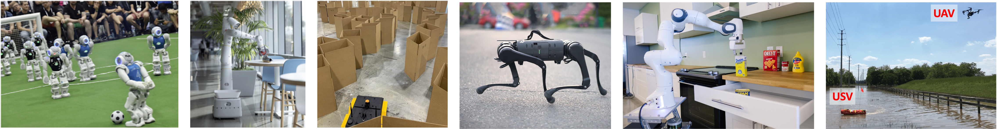
CS 485 Autonomous Robotics Motion Control I
Prof. Xuesu Xiao
George Mason University
Slides Credits: Gregory Stein

Slide 2
Logistics
Homework: Assignment 1 is out, due September 21 before class
Standardized Project: Team formation due before this Thursday’s class
Open-Ended Project: Start forming teams if you haven’t yet and brainstorm ideas and discuss with the Instructor and TA

Slide 3
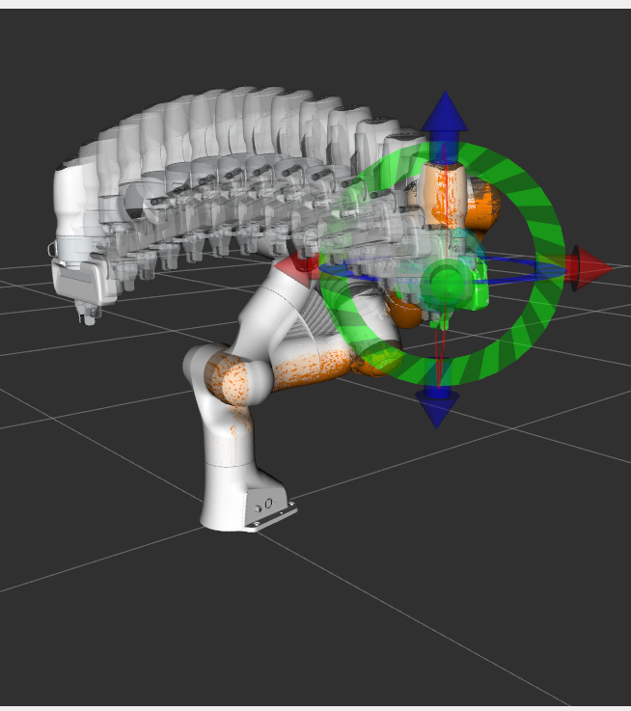
Motivation: how do we make a robot do what we tell it to?
Last week, we mostly talked about how to represent the robot.
Inverse kinematics gives us a configuration of our robot that we are targeting and last week, we could simply tell the robot to turn the joints until we get there.
So what’s the problem? Will this work?
From: MoveIt tutorial

Slide 4
Motivation: how do we make a robot do what we tell it to?
Last week, we mostly talked about how to represent the robot.
Inverse kinematics gives us a configuration of our robot that we are targeting and last week, we could simply tell the robot to turn the joints until we get there.
So what’s the problem? Will this work?
Maybe. In reality, though, it’s more likely that the motors will not respond exactly as we expect…

Slide 5
Motivation: real robots are imperfect, making it tricky to specify how they should move
Let’s say we have a robot arm joint at angle 0, but we want it to move to an angle 1.5.
We could command the motors to turn until it gets to 1.5… problem solved?

Slide 6
Motivation: real robots are imperfect, making it tricky to specify how they should move
Let’s say we have a robot arm joint at angle 0, but we want it to move to an angle 1.5.
We could command the motors to turn until it gets to 1.5… problem solved?
How much power should the motors exert?
Should we always be at the limit?
What if the robot is holding something heavy? A lower torque might not work, but a higher torque might be too much for an arm holding nothing.
Suddenly it’s not so simple…

Slide 7
Motivation: we need a process of turning goals into motor inputs (and more!)
Control is that process! It describes some function that relates a specification of the state in which we want our system to be to the low-level motor commands that will get it there.
Today we’ll talk about a few approaches.
Note: control is a big field, and we’ll only really be covering the basics.
From: MoveIt tutorial

Slide 8
Reading & Slide Credits
Slide Credits (from which many of the reference images have been taken or adapted):
Notes on control (“Controlling Physical Systems”) from Nathan Sprague
Brown’s CS148 lecture notes on control
University of South Carolina CSCE 574 (by Ioannis Rekleitis)
Notes on Differential Drive from Columbia CS W4733 (itself compiled from Dudek and Jenkin, Computational Principles of Mobile Robotics)
Introduction to Linear Quadratic Regulation by Rob Platt
Russ Tedrake’s Underactuated Robotics online textbook

Slide 9
What’s a controller?
A controller (at least an active controller) uses actuators to exert control on a physical system: e.g., a robot, a thermostat, etc.
Here’s a simple example:
The controller sends commands to one or more actuators (e.g., motors and such). Those actuators change the state of the physical system.
Time advances and the state of the world is updated.
Controller
Actuator
Physical System
Outputs/
World

Slide 10

Let’s start with an example!
Here’s an example (inspired by notes from Nathan Sprague):
We have a robot that can move in 1D.
It is at position “x”.
We want it to be at position “g”.
How do we get it there?
x
g

Slide 11
Let’s start with an example!
We could simply set the velocity, move for a specified amount of time and then stop. Will this work? Why might it not?
x
g

Slide 12
Let’s start with an example!
We could simply set the velocity, move for a specified amount of time and then stop. Will this work? Why might it not?
What if there is air resistance? What if we don’t know the weight of the robot very precisely and cannot tell what velocity we are at with enough precision? What if we cannot simply “set” the velocity?
x
g

Slide 13
Let’s start with an example!
We could simply set the velocity, move for a specified amount of time and then stop. Will this work? Why might it not?
What if there is air resistance? What if we don’t know the weight of the robot very precisely and cannot tell what velocity we are at with enough precision? What if we cannot simply “set” the velocity?
There are plenty of reasons this might not be good enough for us.
However, this is open loop control, and it’s a perfectly valid strategy in some situations.
x
g

Slide 14
Open Loop Control
An “open loop” controller is one that relies on a strong assumption that we understand our system pretty well.
Open Loop implies that measurements from our sensors are not used.
This was an open loop controller:
There is no mechanism by which the controller can directly observe or monitor the state of the system.

Slide 15
Open Loop Control
An “open loop” controller is one that relies on a strong assumption that we understand our system pretty well.
Open Loop implies that measurements from our sensors are not used.
This was an open loop controller:
There is no mechanism by which the controller can directly observe or monitor the state of the system.
Controller
Actuator
Physical System
Outputs/
World

Slide 16
Open Loop Control vs Closed Loop Control
An “open loop” controller is one that relies on a strong assumption that we understand our system pretty well.
A “closed loop” controller is one in which sensor information is fed back into the controller, which can subsequently correct for errors or deviations from our idealized model.

Slide 17
Open Loop Control
An “open loop” controller is one that relies on a strong assumption that we understand our system pretty well.
Open Loop implies that measurements from our sensors are not used.
This was an open loop controller:
There is no mechanism by which the controller can directly observe or monitor the state of the system.
Controller
Actuator
Physical System
Outputs/
World

Slide 18
Open Loop Control vs Closed Loop Control
An “open loop” controller is one that relies on a strong assumption that we understand our system pretty well.
A “closed loop” controller is one in which sensor information is fed back into the controller, which can subsequently correct for errors or deviations from our idealized model.
Controller
Actuator
Physical System
Sensors
Outputs/
World
“Closing the loop” between action and response

Slide 19
Let’s try for a “closed loop controller”
What might we need to know (about the robot, system, etc.)?
x
g

Slide 20
Let’s try for a “closed loop controller”
What might we need to know (about the robot, system, etc.)?
How does the robot move?
Is there air resistance?
How can we (the robot or user) change the state of the system?
What can we sense?
x
g

Slide 21
Let’s try for a “closed loop controller”
What might we need to know (about the robot, system, etc.)?
For now, let’s assume that we don’t know too much…
The robot has some thrusters that it can use to apply a force along the x-axis (both positive and negative).
The robot knows where it is at any given time.
x
g

Slide 22
Let’s define a few key terms
x(t) is the state of the system at time t. In this case, it’s just the position of the robot
g(t) is the goal state at time t. For now, we have only a single goal, but we’ll allow the goal to change over time later on.
e(t) is the error at time t. For us, this is just the difference between x(t) and g(t).
u(t) is the control signal at time t. What it is will depend on the system, but it’s the way in which the robot or system can change its own state. For us, it’s some (bounded) force that the robot can apply to change its velocity.

Slide 23
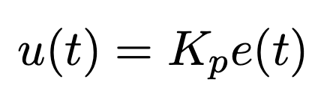
Proportional Control is a simple concept: apply control proportional to some error
Here’s a simple control strategy:
What does this mean?
The control signal we apply will be proportional to the difference between the position we have and the position we want.
When we’re near the goal, we apply little force.
When we’re far, we apply more.

Slide 24
Proportional Control is a simple concept: apply control proportional to some error
Here’s a simple control strategy:
K_{p} is the gain. It controls how much control/force is applied for a given error value.

Slide 25
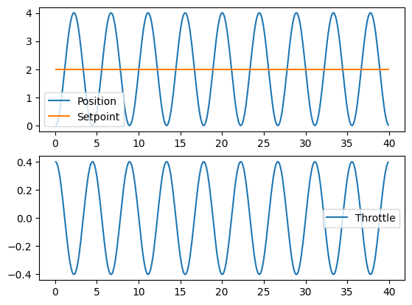
The results may not have been what you expected…
You may observe oscillatory behavior:

Slide 26
The results may not have been what you expected…
You may observe oscillatory behavior:
Why did we get this behavior?

Slide 27
The results may not have been what you expected…
You may observe oscillatory behavior:
Why did we get this behavior?
Who remembers Hooke’s law?

Slide 28
The results may not have been what you expected…
You may observe oscillatory behavior:
Why did we get this behavior?
Who remembers Hooke’s law?
For an ideal spring, the force is proportional to the “stretch”
Our system behaves like an ideal spring!
How can we address this issue?
What would we do if it were a spring?

Slide 29
The results may not have been what you expected…
You may observe oscillatory behavior:
Why did we get this behavior?
Who remembers Hooke’s law?
For an ideal spring, the force is proportional to the “stretch”
Our system behaves like an ideal spring!
How can we address this issue?
What would we do if it were a spring?
Let’s add some “friction”, a damping term that sheds momentum.

Slide 30
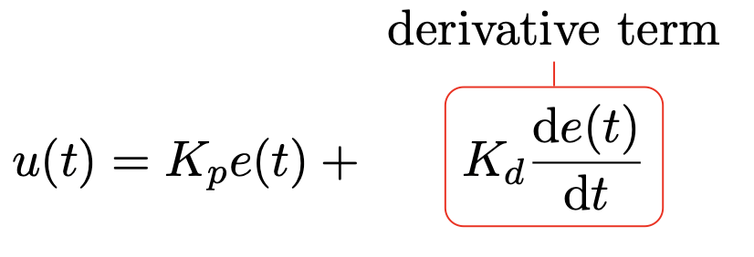
We will add a “derivative” term to our controller to damp the oscillations
We add a term proportional to the derivative of the error:
But we don’t have the derivative. How should we compute it?

Slide 31
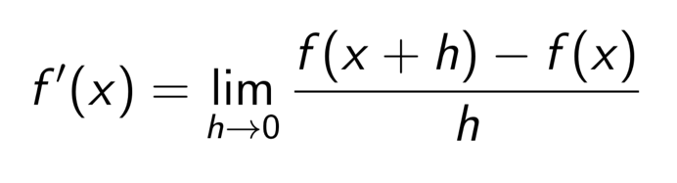
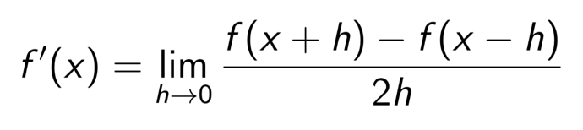
How might we take the derivative of a discrete function? Finite Differences.
How would we take the derivative/gradient of any function?
How we normally take a derivative:
We can also use the central derivative:

Slide 32
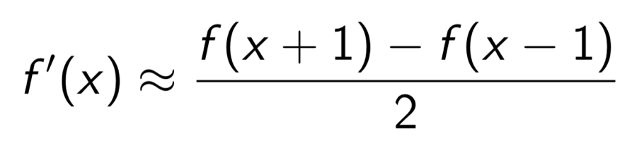
How might we take the derivative of a discrete function? Finite Differences.
For discrete signals, we approximate the derivative without the limit (finite difference approximation):

Slide 33
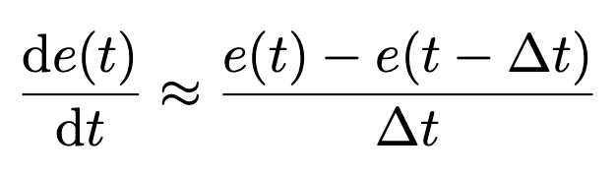
We will add a “derivative” term to our controller to damp the oscillations
We add a term proportional to the derivative of the error:
But we don’t have the derivative. How should we compute it?
Finite differences:

Slide 34
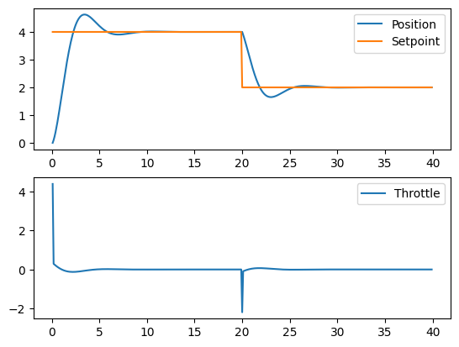
Adding the derivative term…

Slide 35
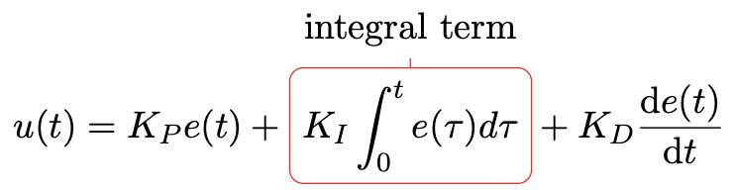
What if there is a constant force acting upon the robot?
The robot will apply some force to move it towards the goal, but it may get pushed by the force and come to rest before it reaches it, the force of the proportional controller matched by the systematic force (e.g., wind).
We can add an Integral Term:
If there is a systematic error, it will grow over time until the system compensates for it.

Slide 36
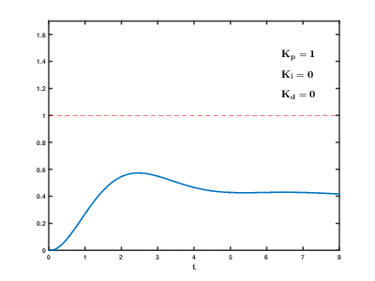
Here’s a great little animation showing parameter tuning on a toy system
From: https://lab.vanderbilt.edu/taha/teaching/ee-3413-analysis-and-design-of-control-systems/

Slide 37
PID Control: Proportional + Integral + Derivative
PID Controllers are popular because they are both simple and generally quite effective.
How do we pick the values? [Ziegler-Nichols Method]
Remove integral and derivative action.
Create a small disturbance in the loop by changing the set point.
Adjust the proportional, increasing and/or decreasing the gain until the oscillations have constant amplitude.
Record the gain value K_{u} and period of oscillation P_{u}

Slide 38
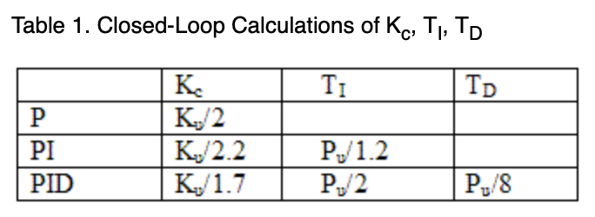
PID Control: Proportional + Integral + Derivative
PID Controllers are popular because they are both simple and generally quite effective.
How do we pick the values? [Ziegler-Nichols Method]
Record the gain value K_{u} and period of oscillation P_{u}

Slide 39
What if the system has noise?
So what? Do our equations change?
Not really!
We can handle such a system with relative ease and without modification to our equations: the acceleration we actually impart on the system may differ from the one we want a bit, but we have the derivative term to smooth it out and the integral term to compensate for systematic error.
Note: with discrete time systems especially, noise can lead to some issues in the derivative calculation term. Be careful not to make that effect too strong.

