Slide 1
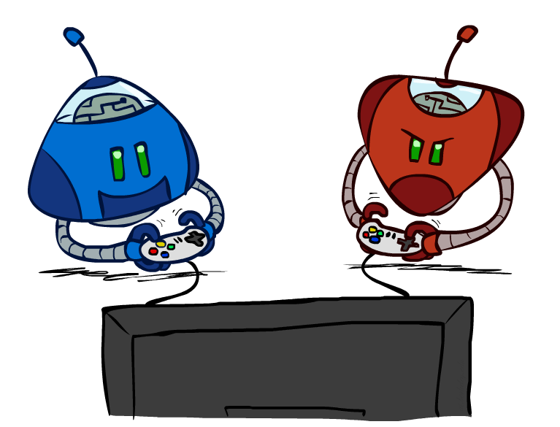
CS 580: Introduction to Artificial Intelligence
Adversarial Search
Prof. Xuesu Xiao
George Mason University
[Based on slides created by Dan Klein and Pieter Abbeel for CS188 Intro to AI at UC Berkeley. All original materials available at http://ai.berkeley.edu.]
Notes:
Please retain proper attribution, including the reference to ai.berkeley.edu. Thanks!

Slide 2
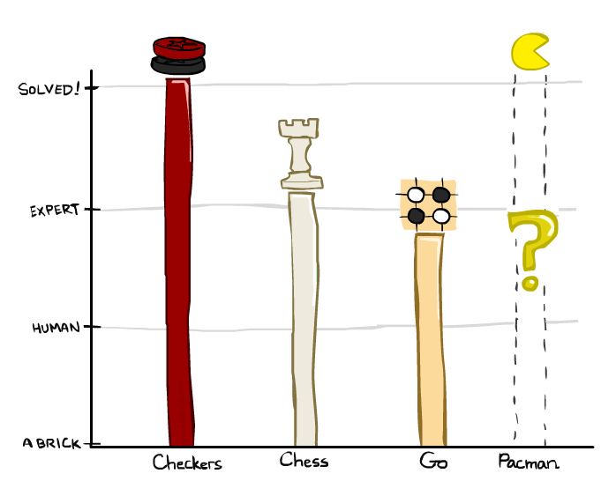
Game Playing State-of-the-Art
Checkers: 1950: First computer player. 1994: First computer champion: Chinook ended 40-year-reign of human champion Marion Tinsley using complete 8-piece endgame. 2007: Checkers solved!
Chess: 1997: Deep Blue defeats human champion Gary Kasparov in a six-game match. Deep Blue examined 200M positions per second, used very sophisticated evaluation and undisclosed methods for extending some lines of search up to 40 ply. Current programs are even better, if less historic.
Go: Human champions are now starting to be challenged by machines, though the best humans still beat the best machines. In go, b > 300! Classic programs use pattern knowledge bases, but big recent advances use Monte Carlo (randomized) expansion methods.

Slide 3

Game Playing State-of-the-Art
Checkers: 1950: First computer player. 1994: First computer champion: Chinook ended 40-year-reign of human champion Marion Tinsley using complete 8-piece endgame. 2007: Checkers solved!
Chess: 1997: Deep Blue defeats human champion Gary Kasparov in a six-game match. Deep Blue examined 200M positions per second, used very sophisticated evaluation and undisclosed methods for extending some lines of search up to 40 ply. Current programs are even better, if less historic.
Go: 2016: Alpha GO defeats human champion. Uses Monte Carlo Tree Search, learned evaluation function.
Pacman
Notes:
A solved game is a game whose outcome (win, lose or draw) can be correctly predicted from any position, assuming that both players play perfectly.

Slide 4
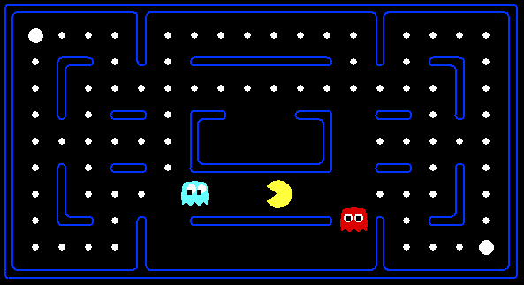
How to consider behavior of ghosts?

Slide 5

How to consider behavior of ghosts?

Slide 6
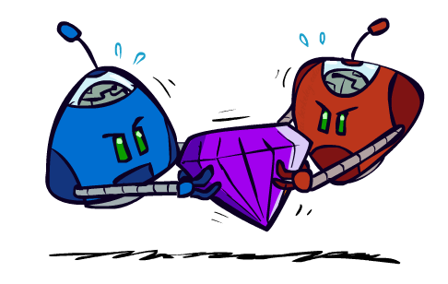
Adversarial Games

Slide 7
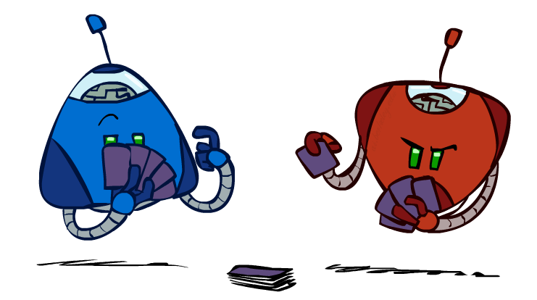
Types of Games
Many different kinds of games!
Axes:
  Deterministic or stochastic?
  One, two, or more players?
  Zero sum?
  Perfect information (can you see the state)?
Want algorithms for calculating a strategy (policy) which recommends a move from each state

Slide 8
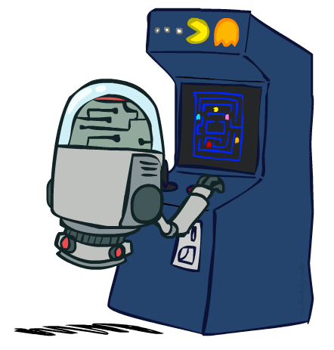
Deterministic Games
Many possible formalizations, one is:
  States: S (start at s₀)
  Players: P={1...N} (usually take turns)
  Actions: A (may depend on player / state)
  Transition Function: SxA → S
  Terminal Test: S → {t,f}
  Terminal Utilities: SxP → R
Solution for a player is a policy: S → A

Slide 9
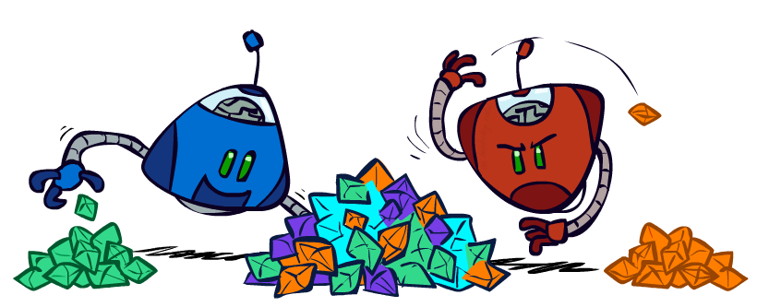
Zero-Sum Games
Zero-Sum Games
  Agents have opposite utilities (values on outcomes)
  Lets us think of a single value that one maximizes and the other minimizes
  Adversarial, pure competition
General Games
  Agents have independent utilities (values on outcomes)
  Cooperation, indifference, competition, and more are all possible
  More later on non-zero-sum games

Slide 10
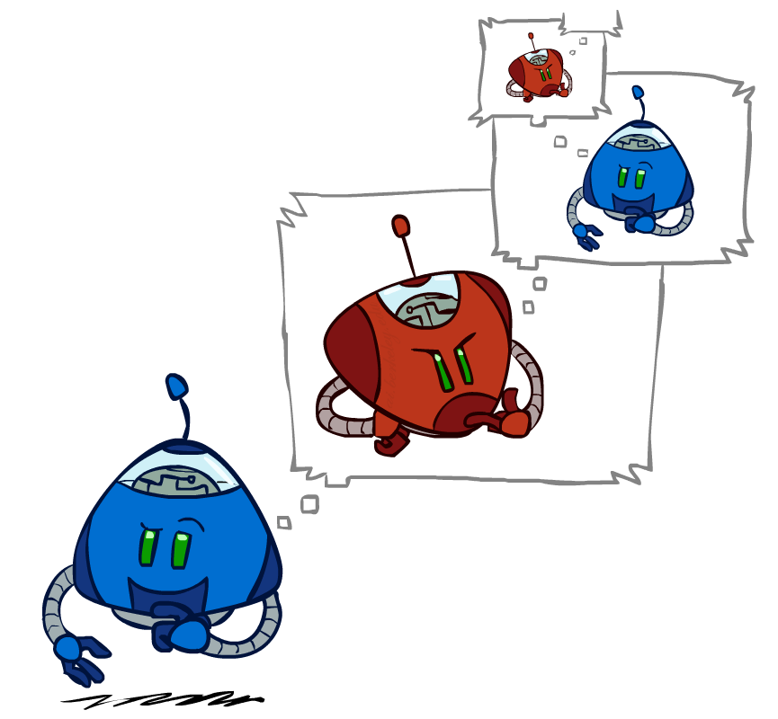
Adversarial Search

Slide 11
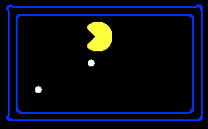
Single-Agent Trees
8
2
0
…
2
6
…
4
6

Slide 12
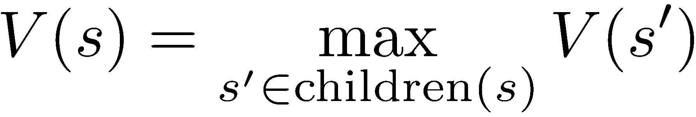
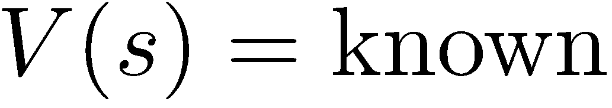
Value of a State
Value of a state: The best achievable outcome (utility) from that state
Non-Terminal States:
8
2
0
…
2
6
…
4
6
Terminal States:

Slide 13

Adversarial Game Trees
-20
-8
…
-18
-5
…
-10
+4
-20
+8

Slide 14
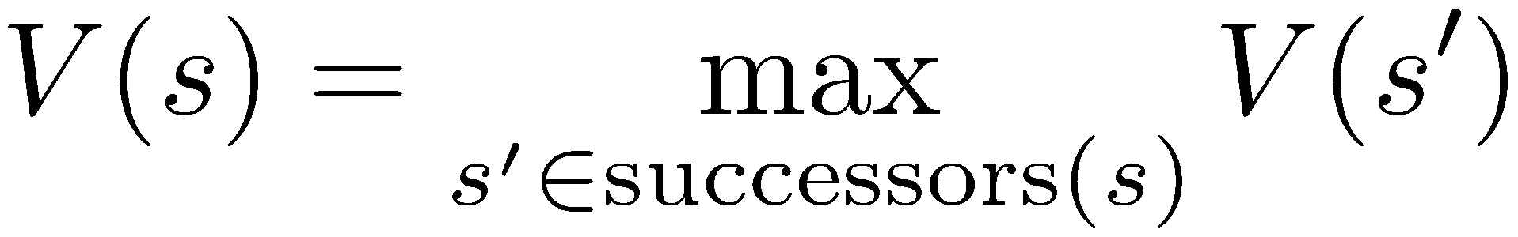
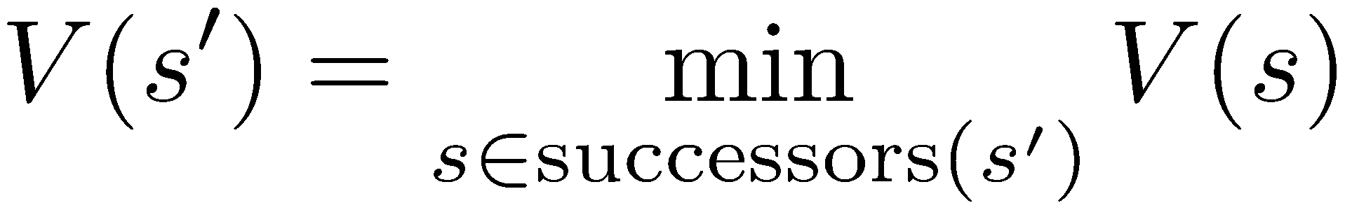
Minimax Values
States Under Agent’s Control:
States Under Opponent’s Control:
-8
-5
+4
+8
Terminal States:

Slide 15

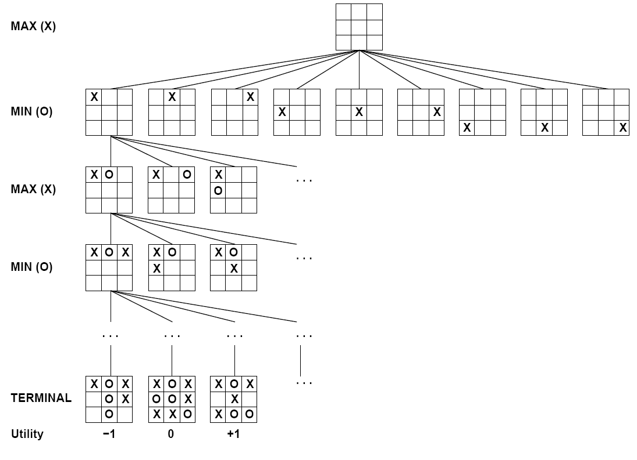

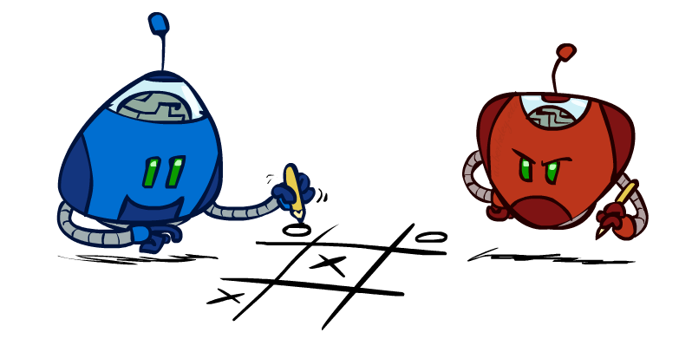
Tic-Tac-Toe Game Tree

Slide 16
Adversarial Search (Minimax)
Deterministic, zero-sum games:
  Tic-tac-toe, chess, checkers
  One player maximizes result
  The other minimizes result
Minimax search:
  A state-space search tree
  Players alternate turns
  Compute each node’s minimax value: the best achievable utility against a rational (optimal) adversary
Minimax values:
computed recursively
5
max
2
5
min
8
2
5
6
Terminal values:
part of the game

Slide 17
Minimax Implementation
def max-value(state):
  initialize v = -∞
  for each successor of state:
    v = max(v, min-value(successor))
  return v
def min-value(state):
  initialize v = +∞
  for each successor of state:
    v = min(v, max-value(successor))
  return v

Slide 18
Minimax Implementation (Dispatch)
def value(state):
  if the state is a terminal state: return the state’s utility
  if the next agent is MAX: return max-value(state)
  if the next agent is MIN: return min-value(state)
def max-value(state):
  initialize v = -∞
  for each successor of state:
    v = max(v, value(successor))
  return v
def min-value(state):
  initialize v = +∞
  for each successor of state:
    v = min(v, value(successor))
  return v
Notes:
Pick an order for two reasons: sequential processor and pruning

Slide 19
Minimax Example
3
3
2
2
3
12
8
2
4
6
14
5
2

Slide 20
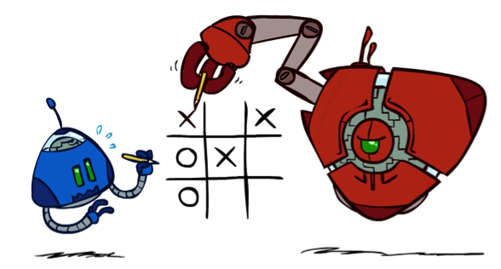
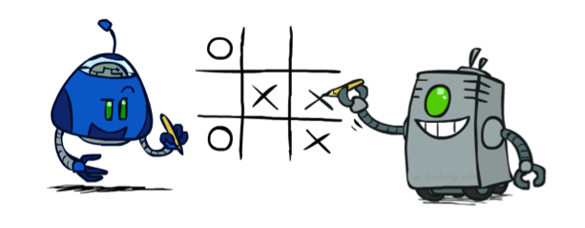
Minimax Properties
max
min
10
10
9
100
Optimal against a perfect player. Otherwise?

Slide 21
Video of Demo Min vs. Exp (Min)

Slide 22
Video of Demo Min vs. Exp (Exp)

Slide 23
Minimax Efficiency
How efficient is minimax?
  Just like (exhaustive) DFS
  Time: O(b^{m})
  Space: O(bm)
Example: For chess, b ≈ 35, m ≈ 100
  Exact solution is completely infeasible
  But, do we need to explore the whole tree?

Slide 24

Resource Limits

Slide 25
Resource Limits
Problem: In realistic games, cannot search to leaves!
Solution: Depth-limited search
  Instead, search only to a limited depth in the tree
  Replace terminal utilities with an evaluation function for non-terminal positions
Example:
  Suppose we have 100 seconds, can explore 10K nodes / sec
  So can check 1M nodes per move
  For chess, b=~35 so reaches about depth 4 – not so good
Guarantee of optimal play is gone
Use iterative deepening for an anytime algorithm
max
4
-2
4
min
-1
-2
4
9
?
?
?
?

Slide 26


Depth Matters
Evaluation functions are always imperfect
The deeper in the tree the evaluation function is buried, the less the quality of the evaluation function matters
An important example of the tradeoff between complexity of features and complexity of computation

Slide 27
Video of Demo Limited Depth (2)

Slide 28
Video of Demo Limited Depth (10)

Slide 29
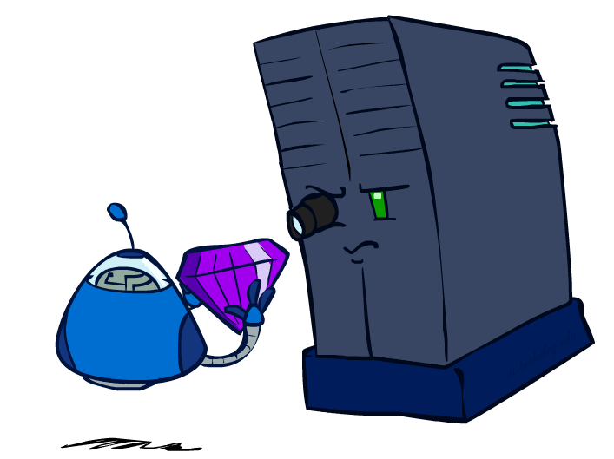
Evaluation Functions

Slide 30
Evaluation Functions
Evaluation functions score non-terminals in depth-limited search
Ideal function: returns the actual minimax value of the position
In practice: typically weighted linear sum of features:
e.g. f₁(s) = (num white queens – num black queens), etc.

Slide 31




Evaluation for Pacman

Slide 32
Video of Demo Thrashing (d=2)

Slide 33
Why Pacman Starves
A danger of replanning agents!
  He knows his score will go up by eating the dot now (left, right)
  He knows his score will go up just as much by eating the dot later (right, right)
  There are no point-scoring opportunities after eating the dot (within the horizon, two here)
  Therefore, waiting seems just as good as eating: he may go right, then back left in the next round of replanning!

Slide 34
Video of Demo Thrashing -- Fixed (d=2)

Slide 35
Video of Demo Smart Ghosts (Coordination)

Slide 36
Video of Demo Smart Ghosts (Coordination) – Zoomed In

Slide 37
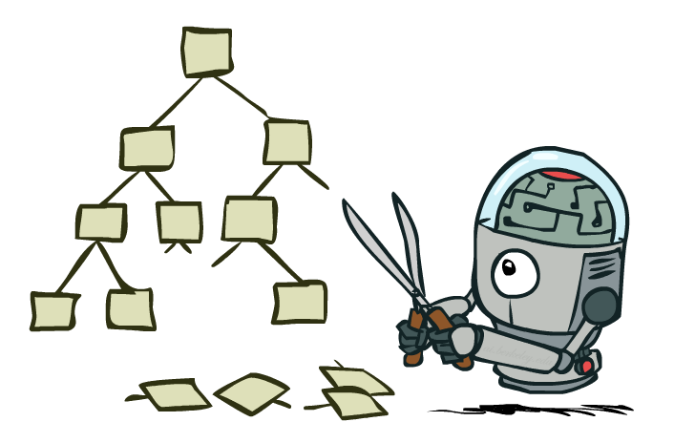
Game Tree Pruning

Slide 38
Minimax Example
3
3
2
2
3
12
8
2
4
6
14
5
2

Slide 39
Minimax Example
3
3
<=2
2
3
12
8
2
14
5
2

Slide 40
Alpha-Beta Pruning
General configuration (MIN version)
  We’re computing the MIN-VALUE at some node n
  We’re looping over n’s children
  n’s estimate of the childrens’ min is dropping
  Who cares about n’s value? MAX
  Let a be the best value that MAX can get at any choice point along the current path from the root
  If n becomes worse than a, MAX will avoid it, so we can stop considering n’s other children (it’s already bad enough that it won’t be played)
MAX version is symmetric
MAX
MIN
a
MAX
MIN
n

Slide 41
Alpha-Beta Implementation
  α: MAX’s best option on path to root
  β: MIN’s best option on path to root
def max-value(state, α, β):
  initialize v = -∞
  for each successor of state:
    v = max(v, value(successor, α, β))
    if v ≥ β return v
    α = max(α, v)
  return v
def min-value(state , α, β):
  initialize v = +∞
  for each successor of state:
    v = min(v, value(successor, α, β))
    if v ≤ α return v
    β = min(β, v)
  return v
Notes:
Pick an order for two reasons: sequential processor and pruning

Slide 42
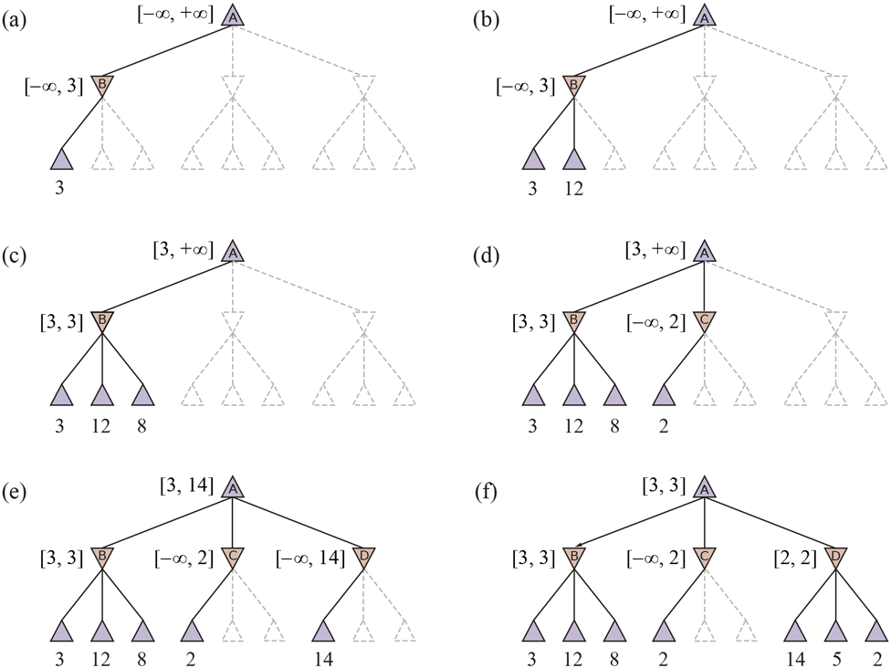
Alpha-Beta Pruning Example

Slide 43
Alpha-Beta Pruning Properties
This pruning has no effect on minimax value computed for the root!
Values of intermediate nodes might be wrong
  Important: children of the root may have the wrong value
Good child ordering improves effectiveness of pruning
With “perfect ordering”:
  Time complexity drops to O(b^{m/2})
  Doubles solvable depth!
  Full search of, e.g. chess, is still hopeless…
This is a simple example of metareasoning (computing about what to compute)
max
min
10
10
0

Slide 44
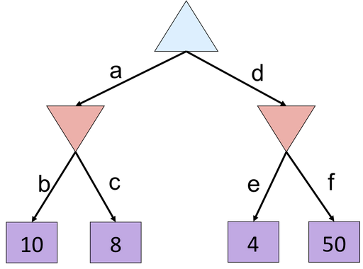
Alpha-Beta Quiz
8
8
<=4

Slide 45
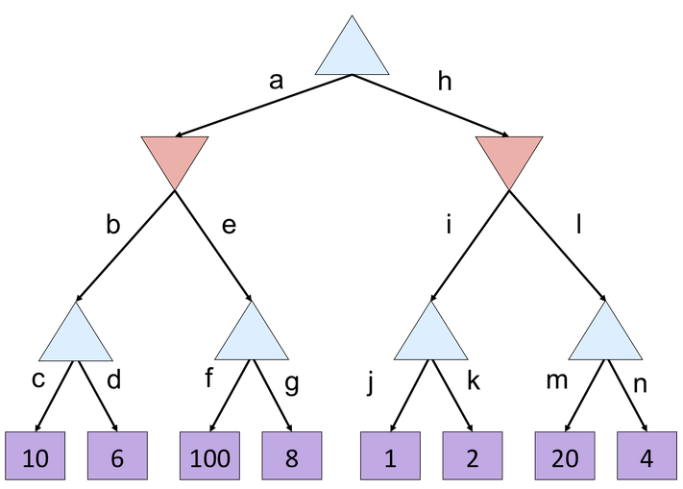
Alpha-Beta Quiz 2
10
10
<=2
10
>=100
2

Slide 46
Next Time: Uncertainty!

