Slide 1
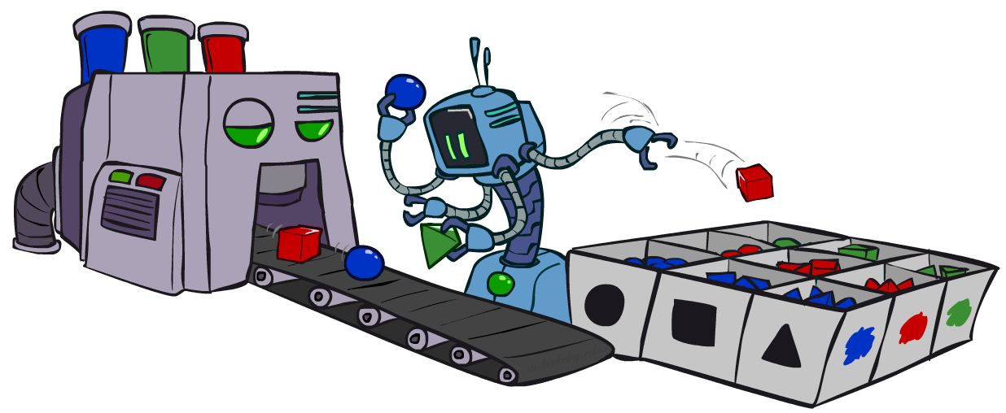
CS 580: Introduction to Artificial Intelligence
Bayes’ Nets: Sampling
Prof. Xuesu Xiao
George Mason University
[Based on slides created by Dan Klein and Pieter Abbeel for CS188 Intro to AI at UC Berkeley. All original materials available at http://ai.berkeley.edu.]
Notes:
Please retain proper attribution, including the reference to ai.berkeley.edu. Thanks!

Slide 2
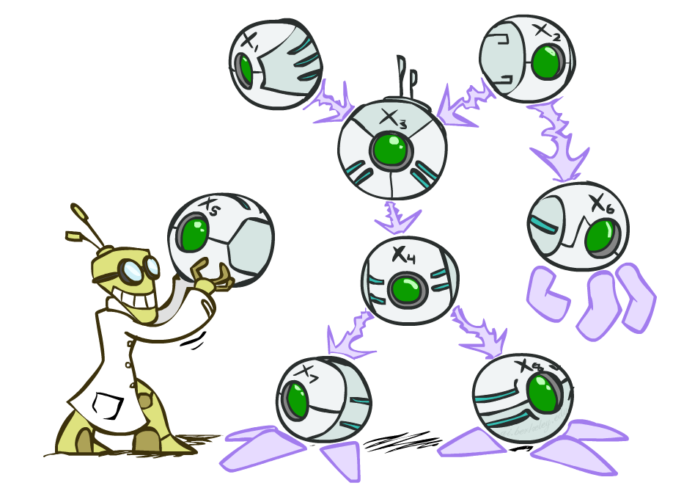

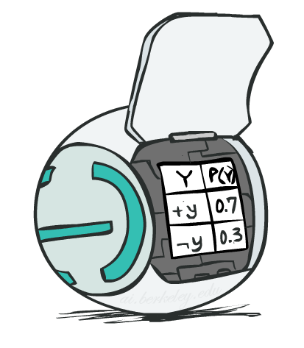
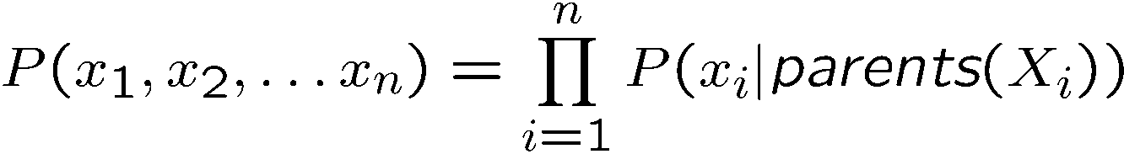
Bayes’ Net Representation
A directed, acyclic graph, one node per random variable
A conditional probability table (CPT) for each node
A collection of distributions over X, one for each combination of parents’ values
Bayes’ nets implicitly encode joint distributions
As a product of local conditional distributions
To see what probability a BN gives to a full assignment, multiply all the relevant conditionals together:

Slide 3
Bayes’ Nets Independence
Bayes nets compactly encode joint distributions
Guaranteed independencies of distributions can be deduced from BN graph structure
D-separation gives precise conditional independence guarantees from graph alone
Causal chain
Common cause
Common effect
Active/inactive paths

Slide 4
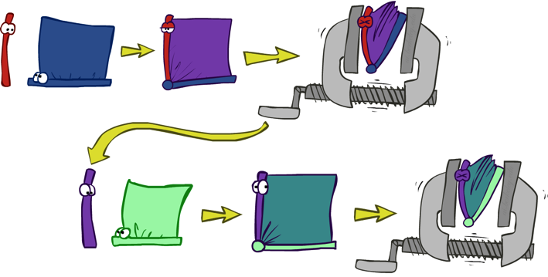


























Bayes’ Nets Inference
Inference by Enumeration
Multiple Join, Multiple Eliminate
Variable Elimination
Interleave joining and marginalizing
d^{k} entries computed for a factor over k variables with domain sizes d
Ordering of elimination of hidden variables can affect size of factors generated
Worst case: running time exponential in the size of the Bayes’ netß
…
…

Slide 5

Approximate Inference: Sampling

Slide 6

Sampling
Sampling is a lot like repeated simulation
Predicting the weather, basketball games, …
Basic idea
Draw N samples from a sampling distribution S
Compute an approximate posterior probability
Show this converges to the true probability P
Why sample?
Learning: get samples from a distribution you don’t know
Inference: getting a sample is faster than computing the right answer (e.g. with variable elimination)

Slide 7
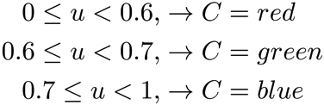

Sampling
Sampling from given distribution
Step 1: Get sample u from uniform distribution over [0, 1)
E.g. random() in python
Step 2: Convert this sample u into an outcome for the given distribution by having each outcome associated with a sub-interval of [0,1) with sub-interval size equal to probability of the outcome
Example
If random() returns u = 0.83, then our sample is C = blue
E.g, after sampling 8 times:
C | P(C)
red | 0.6
green | 0.1
blue | 0.3

Slide 8
Sampling in Bayes’ Nets
Prior Sampling
Rejection Sampling
Likelihood Weighting
Gibbs Sampling

Slide 9
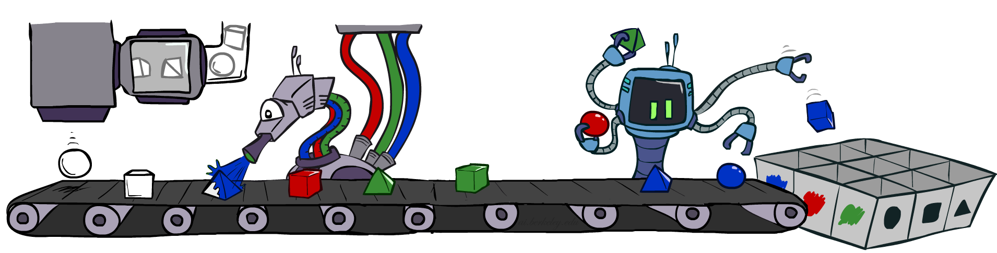
Prior Sampling

Slide 10




Prior Sampling
+c | 0.5
-c | 0.5
Cloudy
Cloudy
+c | +s | 0.1
 | -s | 0.9
-c | +s | 0.5
 | -s | 0.5
+c | +r | 0.8
 | -r | 0.2
-c | +r | 0.2
 | -r | 0.8
Sprinkler
Sprinkler
Rain
Rain
WetGrass
WetGrass
Samples:
+s | +r | +w | 0.99
 |  | -w | 0.01
 | -r | +w | 0.90
 |  | -w | 0.10
-s | +r | +w | 0.90
 |  | -w | 0.10
 | -r | +w | 0.01
 |  | -w | 0.99
+c, -s, +r, +w
-c, +s, -r, +w
…

Slide 11
Prior Sampling
For i=1, 2, …, n
Sample x_{i} from P(X_{i} | Parents(X_{i}))
Return (x₁, x₂, …, x_{n})

Slide 12
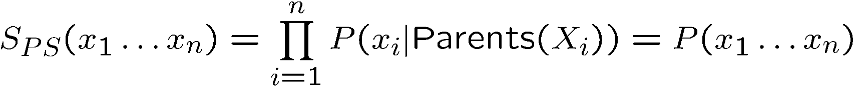

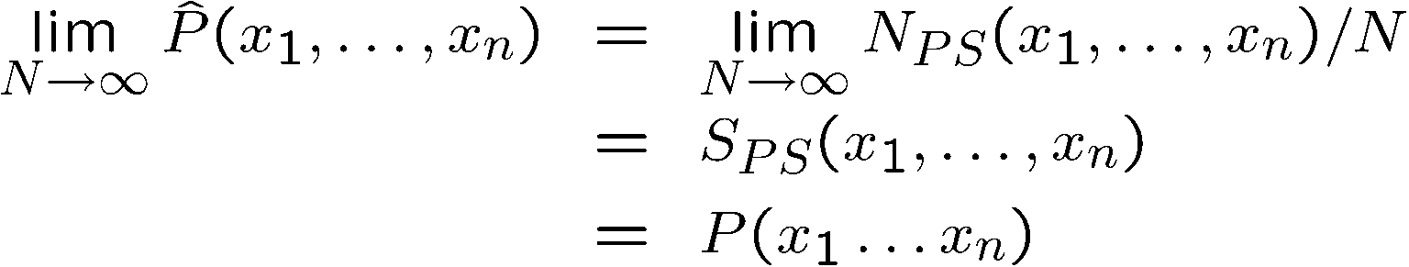
Prior Sampling
This process generates samples with probability:
…i.e. the BN’s joint probability
Let the number of samples of an event be
Then
I.e., the sampling procedure is consistent

Slide 13
Example
We’ll get a bunch of samples from the BN:
+c, -s, +r, +w
+c, +s, +r, +w
-c, +s, +r, -w
+c, -s, +r, +w
-c, -s, -r, +w
If we want to know P(W)
We have counts <+w:4, -w:1>
Normalize to get P(W) = <+w:0.8, -w:0.2>
This will get closer to the true distribution with more samples
Can estimate anything else, too
What about P(C| +w)? P(C| +r, +w)? P(C| -r, -w)?
Fast: can use fewer samples if less time (what’s the drawback?)
C
S
R
W

Slide 14
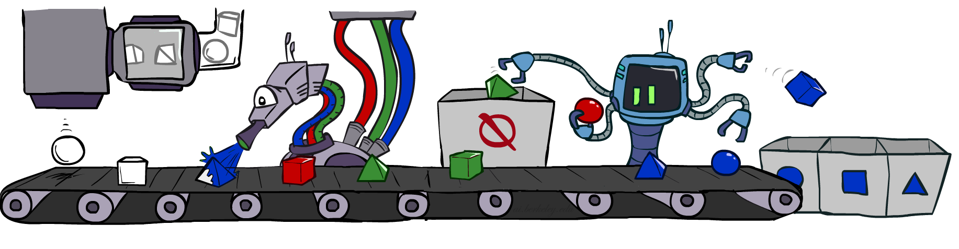
Rejection Sampling

Slide 15
Rejection Sampling
Let’s say we want P(C)
No point keeping all samples around
Just tally counts of C as we go
Let’s say we want P(C| +s)
Same thing: tally C outcomes, but ignore (reject) samples which don’t have S=+s
This is called rejection sampling
It is also consistent for conditional probabilities (i.e., correct in the limit)
C
S
R
W
+c, -s, +r, +w
+c, +s, +r, +w
-c, +s, +r, -w
+c, -s, +r, +w
-c, -s, -r, +w

Slide 16
Rejection Sampling
IN: evidence instantiation
For i=1, 2, …, n
Sample x_{i} from P(X_{i} | Parents(X_{i}))
If x_{i} not consistent with evidence
Reject: Return, and no sample is generated in this cycle
Return (x₁, x₂, …, x_{n})

Slide 17
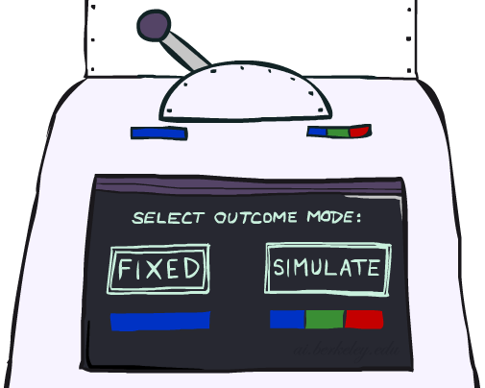
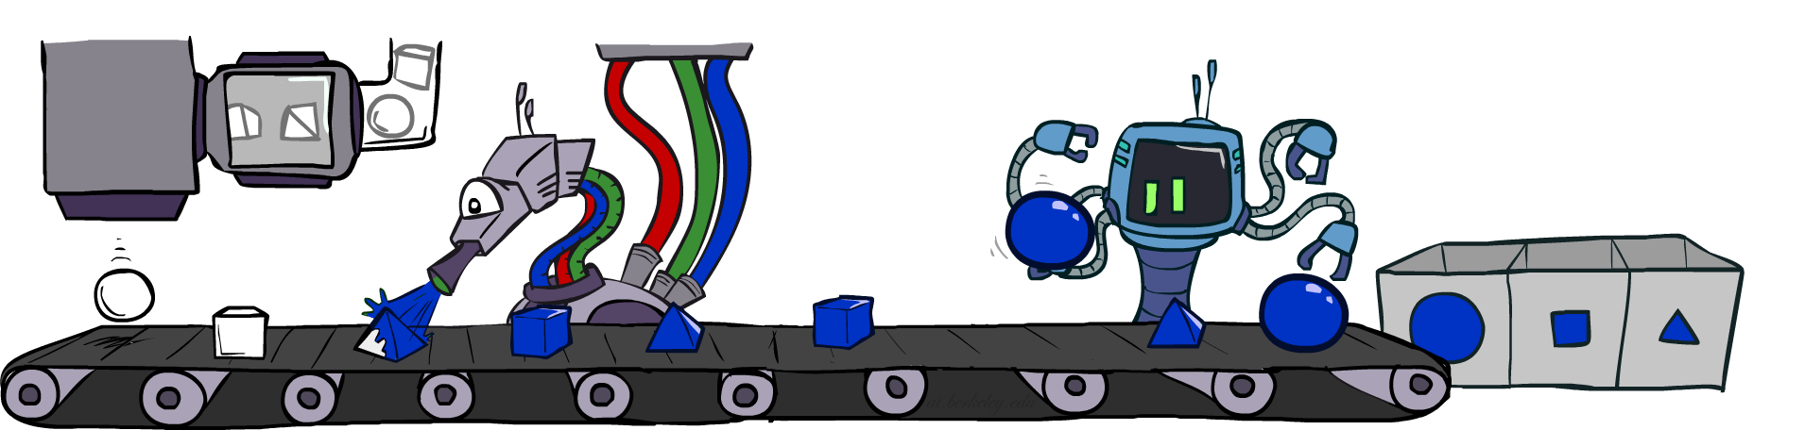
Likelihood Weighting

Slide 18
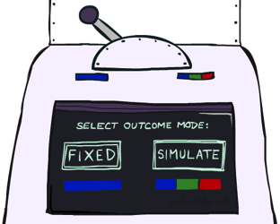


Likelihood Weighting
Problem with rejection sampling:
If evidence is unlikely, rejects lots of samples
Evidence not exploited as you sample
Consider P(Shape|blue)
Idea: fix evidence variables and sample the rest
Problem: sample distribution not consistent!
Solution: weight by probability of evidence given parents
pyramid, green
pyramid, red
sphere, blue
cube, red
sphere, green
pyramid, blue
pyramid, blue
sphere, blue
cube, blue
sphere, blue
Shape
Color
Shape
Color

Slide 19



Likelihood Weighting
+c | 0.5
-c | 0.5
Cloudy
Cloudy
+c | +s | 0.1
 | -s | 0.9
-c | +s | 0.5
 | -s | 0.5
+c | +r | 0.8
 | -r | 0.2
-c | +r | 0.2
 | -r | 0.8
Sprinkler
Sprinkler
Rain
Rain
WetGrass
Samples:
WetGrass
+s | +r | +w | 0.99
 |  | -w | 0.01
 | -r | +w | 0.90
 |  | -w | 0.10
-s | +r | +w | 0.90
 |  | -w | 0.10
 | -r | +w | 0.01
 |  | -w | 0.99
+c, +s, +r, +w
…

Slide 20
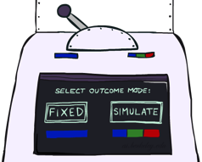
Likelihood Weighting
IN: evidence instantiation
w = 1.0
for i=1, 2, …, n
if X_{i} is an evidence variable
X_{i} = observation x_{i} for X_{i}
Set w = w * P(x_{i} | Parents(X_{i}))
else
Sample x_{i} from P(X_{i} | Parents(X_{i}))
return (x₁, x₂, …, x_{n}), w

Slide 21
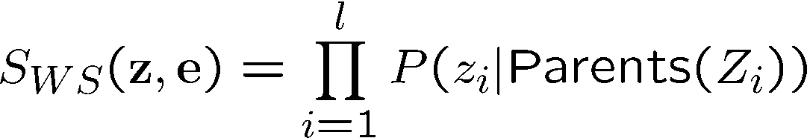
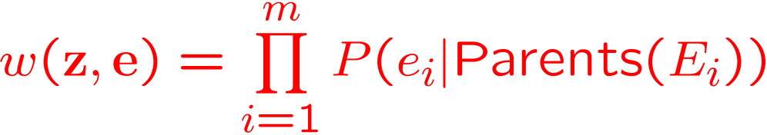
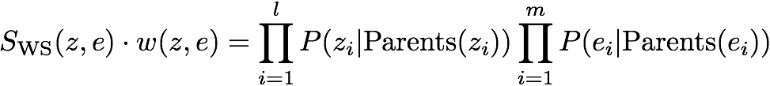

Likelihood Weighting
Sampling distribution if z sampled and e fixed evidence
Now, samples have weights
Together, weighted sampling distribution is consistent
Cloudy
C
S
R
W

Slide 22

Likelihood Weighting
Likelihood weighting is good
We have taken evidence into account as we generate the sample
E.g. here, W’s value will get picked based on the evidence values of S, R
More of our samples will reflect the state of the world suggested by the evidence
Likelihood weighting doesn’t solve all our problems
Evidence influences the choice of downstream variables, but not upstream ones (C isn’t more likely to get a value matching the evidence)
We would like to consider evidence when we sample every variable
→ Gibbs sampling

Slide 23

Gibbs Sampling

Slide 24
Gibbs Sampling
Procedure: keep track of a full instantiation x₁, x₂, …, x_{n}. Start with an arbitrary instantiation consistent with the evidence. Sample one variable at a time, conditioned on all the rest, but keep evidence fixed. Keep repeating this for a long time.
Property: in the limit of repeating this infinitely many times the resulting sample is coming from the correct distribution
Rationale: both upstream and downstream variables condition on evidence.
In contrast: likelihood weighting only conditions on upstream evidence, and hence weights obtained in likelihood weighting can sometimes be very small. Sum of weights over all samples is indicative of how many “effective” samples were obtained, so want high weight.
C
C
C
C
C
C
S
+r
S
+r
S
+r
S
+r
S
+r
S
+r
W
W
W
W
W
W

Slide 25
Gibbs Sampling Example: P( S | +r)
Step 1: Fix evidence
R = +r
Steps 3: Repeat
Choose a non-evidence variable X
Resample X from P( X | all other variables)
Step 2: Initialize other variables
Randomly
C
C
S
+r
S
+r
W
W
C
C
C
C
C
C
S
+r
S
+r
S
+r
S
+r
S
+r
S
+r
W
W
W
W
W
W

Slide 26
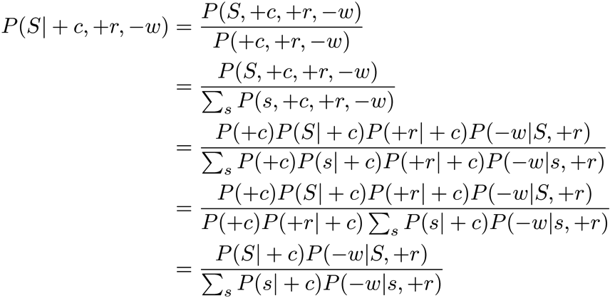
Efficient Resampling of One Variable
C
Sample from P(S | +c, +r, -w)
Many things cancel out – only CPTs with S remain!
More generally: only CPTs that have resampled variable need to be considered, and joined together
S
+r
W

Slide 27
Further Reading on Gibbs Sampling*
Gibbs sampling produces sample from the query distribution P( Q | e ) in limit of re-sampling infinitely often
Gibbs sampling is a special case of more general methods called Markov chain Monte Carlo (MCMC) methods
Metropolis-Hastings is one of the more famous MCMC methods (in fact, Gibbs sampling is a special case of Metropolis-Hastings)
You may read about Monte Carlo methods – they’re just sampling
https://ermongroup.github.io/cs228-notes/inference/sampling/

Slide 28


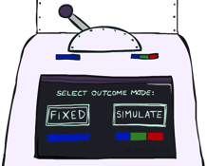
Bayes’ Net Sampling Summary
Prior Sampling P
Likelihood Weighting P( Q | e)
Rejection Sampling P( Q | e )
Gibbs Sampling P( Q | e )

