Slide 1
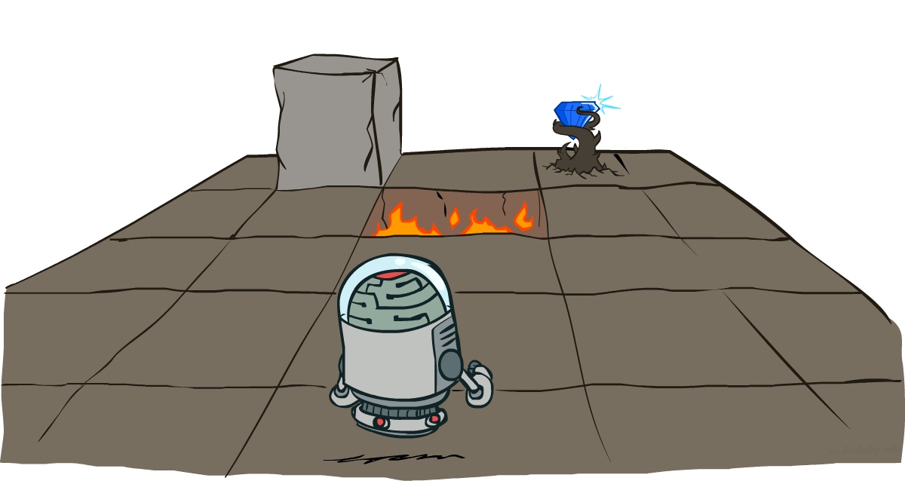
CS 580: Introduction to Artificial Intelligence
Markov Decision Processes
Prof. Xuesu Xiao
George Mason University
[Based on slides created by Dan Klein and Pieter Abbeel for CS188 Intro to AI at UC Berkeley. All original materials available at http://ai.berkeley.edu.]
Notes:
Please retain proper attribution, including the reference to ai.berkeley.edu. Thanks!

Slide 2
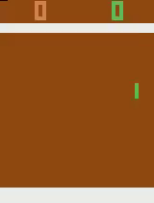
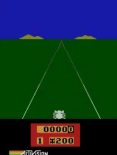
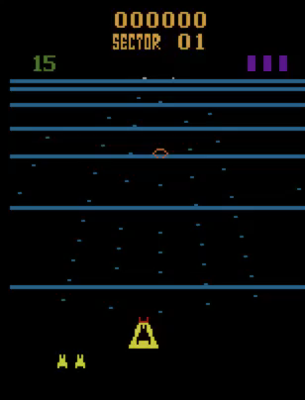
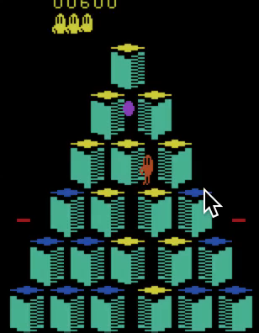
Deep Reinforcement Learning
2013
Atari (DQN) [Deepmind]
Pong
Enduro
Beamrider
Q*bert
Notes:
The modern AI era, slash deep learning, took off in 2012 with the ImageNet breakthrough from Geoff Hinton’s lab in Toronto.
Soon thereafter, in 2013, Deepmind showed it’s possible for neural nets to learn to play a wide range of Atari games, from their own trial and error.

Slide 3
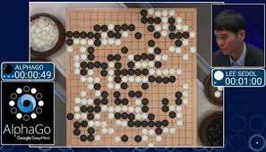
Deep Reinforcement Learning
2013
Atari (DQN) [Deepmind]
2015
AlphaGo [Deepmind]
Notes:
Then in 2015, Deepmind developed a neural net that beat the world champion in Go.

Slide 4
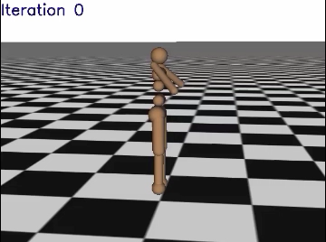
Deep Reinforcement Learning
2013
Atari (DQN) [Deepmind]
2015
AlphaGo [Deepmind]
2016
3D locomotion (TRPO+GAE) [Berkeley]
[Schulman, Moritz, Levine, Jordan, Abbeel, ICLR 2016]
Notes:
And in 2016, my lab at Berkeley showed it’s possible for a neural net to learn robotic locomotion in 3-d environments. In fact, in this video here, we get to watch the learning in action. Initially the neural net is randomly initialized, and the robot just falls over, but over time it figures out how to run. The beauty here is that the exact some code can be used for another robot to learn to run, in this case a 4 legged robot. Or for the twolegged robot to learn to get up.

Slide 5

Deep Reinforcement Learning
2013
Atari (DQN) [Deepmind]
2015
AlphaGo [Deepmind]
2016
3D locomotion (TRPO+GAE) [Berkeley]
2016
Real Robot Manipulation (GPS) [Berkeley]
[Levine*, Finn*, Darrell, Abbeel, JMLR 2016]
Notes:
Also in 2016, we showed it’s possible for a neural net to learn to control a real robot, here learning to put the block into the matching opening.
And Sergey Levine, the post-doc who led this project in my lab, then went onto Google to scale this up.

Slide 6
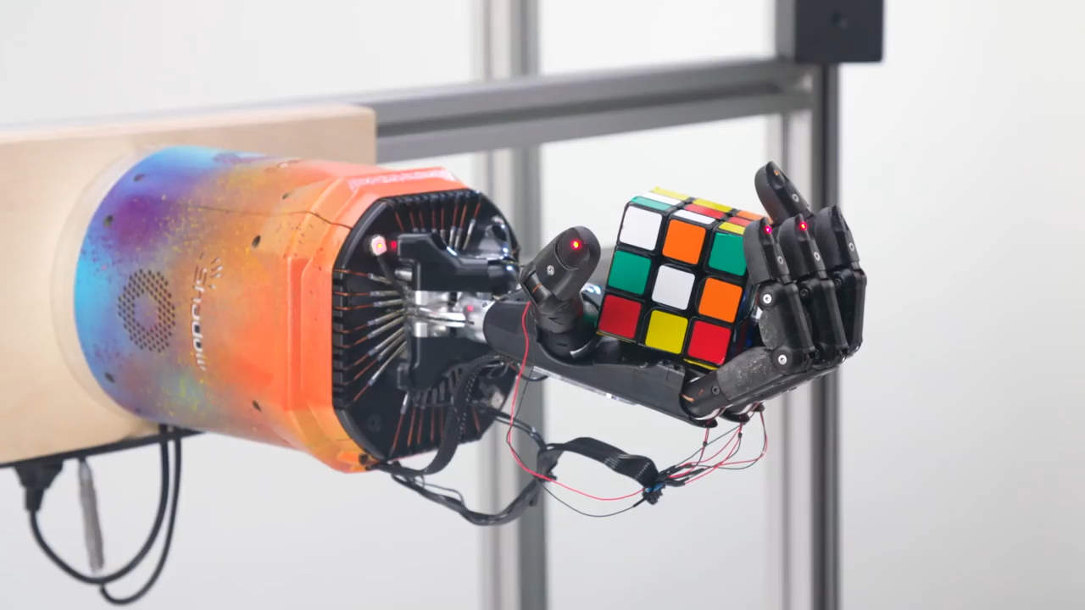
Deep Reinforcement Learning
2013
Atari (DQN) [Deepmind]
2015
AlphaGo [Deepmind]
2016
3D locomotion (TRPO+GAE) [Berkeley]
2016
Real Robot Manipulation (GPS) [Berkeley]
2019
Rubik’s Cube (PPO+DR) [OpenAI]
OpenAI
Notes:
And OpenAI showcased a robot that had learned to solve a rubik’s cube.

Slide 7
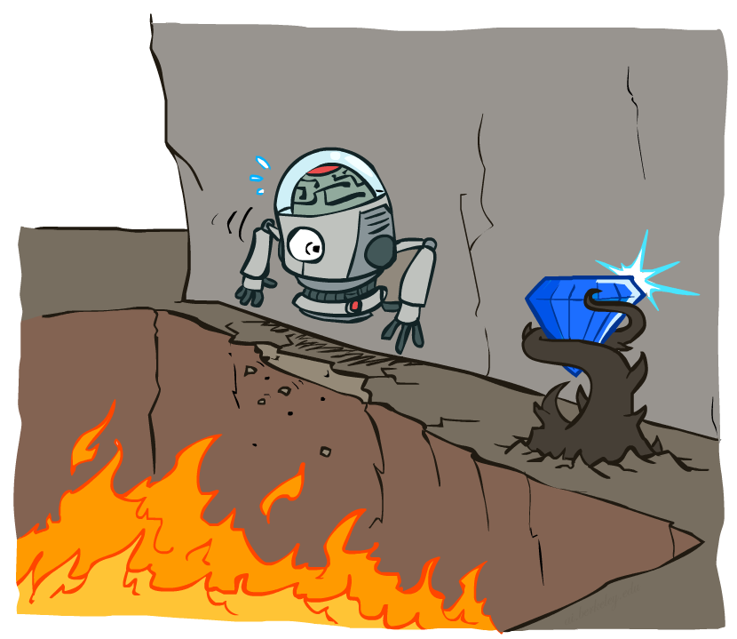
Non-Deterministic Search

Slide 8
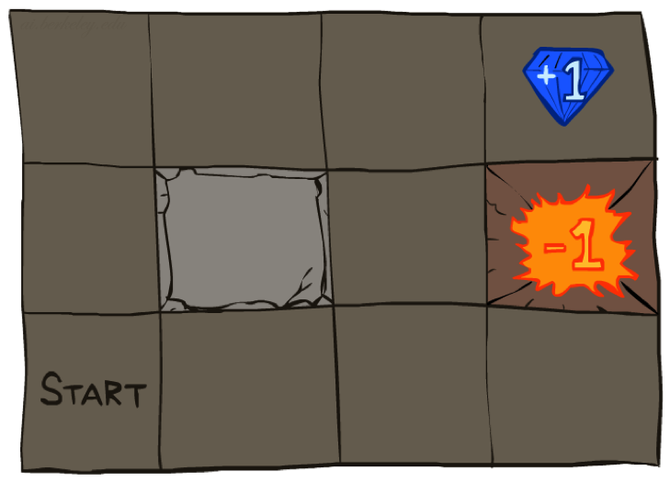




Example: Grid World
A maze-like problem
The agent lives in a grid
Walls block the agent’s path
Noisy movement: actions do not always go as planned
80% of the time, the action North takes the agent North (if there is no wall there)
10% of the time, North takes the agent West; 10% East
If there is a wall in the direction the agent would have been taken, the agent stays put
The agent receives rewards each time step
Small “living” reward each step (can be negative)
Big rewards come at the end (good or bad)
Goal: maximize sum of rewards
Notes:
[cut demo of moving around in grid world program]

Slide 9
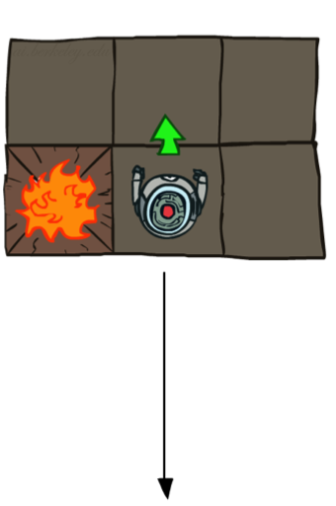
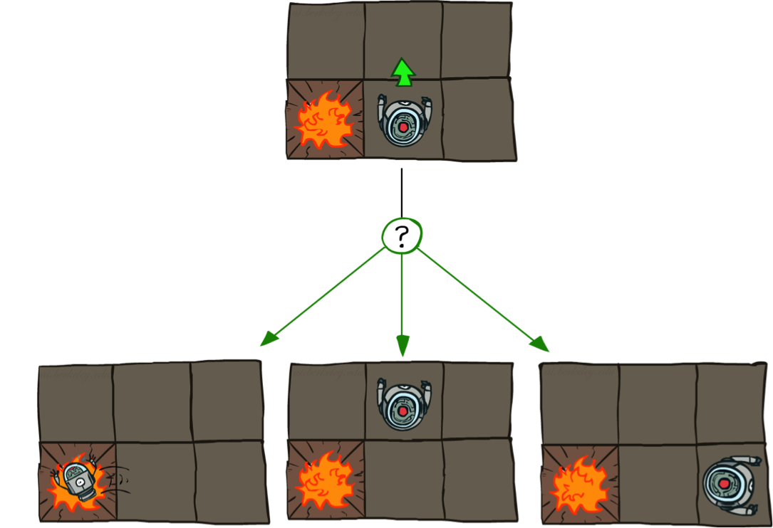
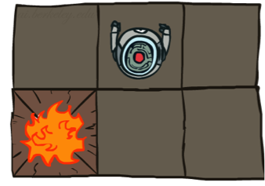
Grid World Actions
Deterministic Grid World
Stochastic Grid World

Slide 10
Markov Decision Processes
An MDP is defined by:
A set of states s ∈ S
A set of actions a ∈ A
A transition function T(s, a, s’)
Probability that a from s leads to s’, i.e., P(s’| s, a)
Also called the model or the dynamics
A reward function R(s, a, s’)
Sometimes just R(s) or R(s’)
A start state
Maybe a terminal state
MDPs are non-deterministic search problems
One way to solve them is with expectimax search
We’ll have a new tool soon
Notes:
In search problems: did not talk about actions, but about successor functions --- now the information inside the successor function is unpacked into actions, transitions and reward
Write out S, A, example entry in T, entry in R
Reward function different from the book : R(s,a,s’)
In book simpler for equations, but not useful for the projects.
Need to modify expectimax a tiny little bit to account for rewards along the way, but that’s something you should be able to do, and so you can already solve MDP’s (not in most efficient way)

Slide 11
Video of Demo Gridworld Manual Intro

Slide 12
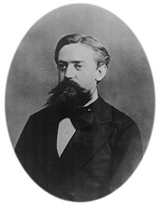

What is Markov about MDPs?
“Markov” generally means that given the present state, the future and the past are independent
For Markov decision processes, “Markov” means action outcomes depend only on the current state
This is just like search, where the successor function could only depend on the current state (not the history)
Andrey Markov (1856-1922)
Notes:
Like search: successor function only depended on current state
Can make this happen by stuffing more into the state;
Very similar to search problems: when solving a maze with food pellets, we stored which food pellets were eaten

Slide 13
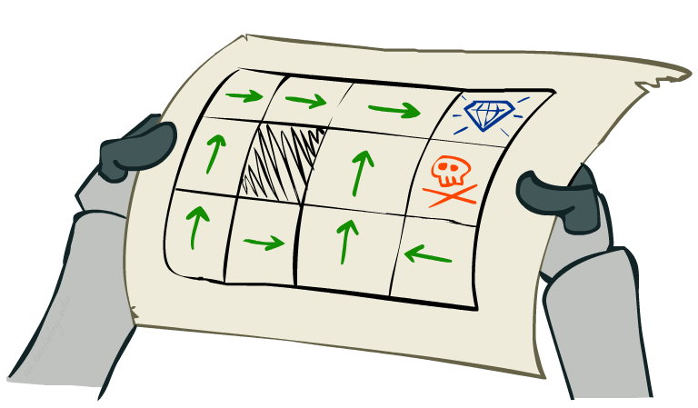
Policies
In deterministic single-agent search problems, we wanted an optimal plan, or sequence of actions, from start to a goal
For MDPs, we want an optimal policy π*: S → A
A policy π gives an action for each state
An optimal policy is one that maximizes expected utility if followed
An explicit policy defines a reflex agent
Optimal policy when R(s, a, s’) = -0.03 for all non-terminals s
Notes:
Dan has a DEMO for this.

Slide 14
Optimal Policies
R(s) = -0.01
R(s) = -0.03
R(s) = -0.4
R(s) = -2.0
Notes:
R(s) = the “living reward”
Note 2nd row 3rd column

Slide 15
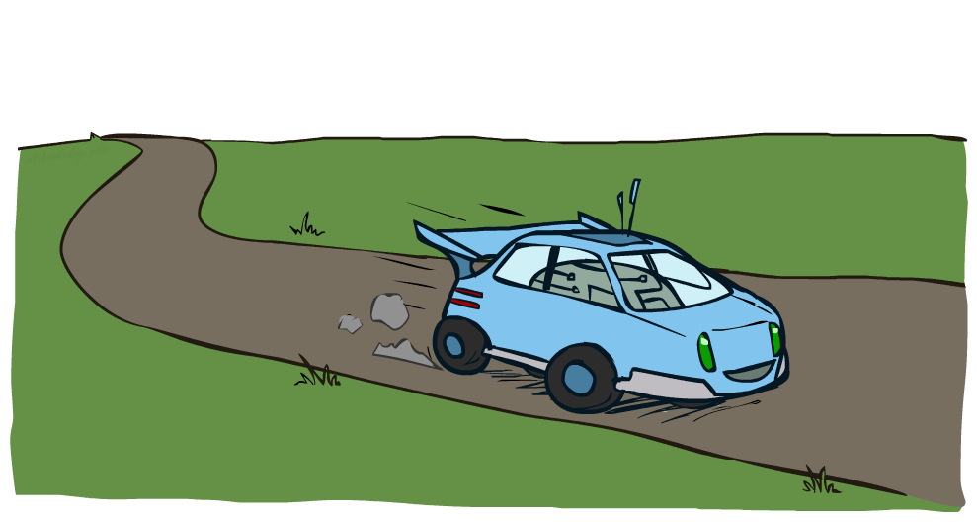
Example: Racing

Slide 16
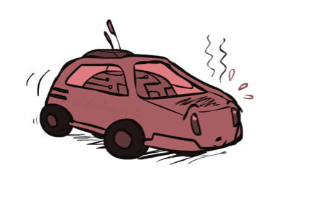
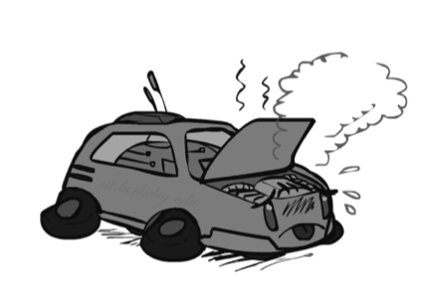
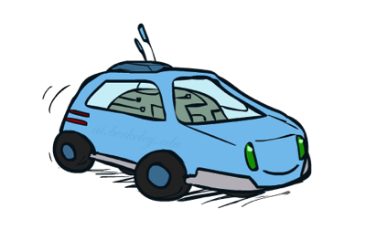
Example: Racing
A robot car wants to travel far, quickly
Three states: Cool, Warm, Overheated
Two actions: Slow, Fast
Going faster gets double reward
0.5
+1
1.0
Fast
Slow
-10
+1
0.5
Warm
Slow
Fast
0.5
+2
Cool
0.5
Overheated
+1
1.0
+2

Slide 17




Racing Search Tree

Slide 18
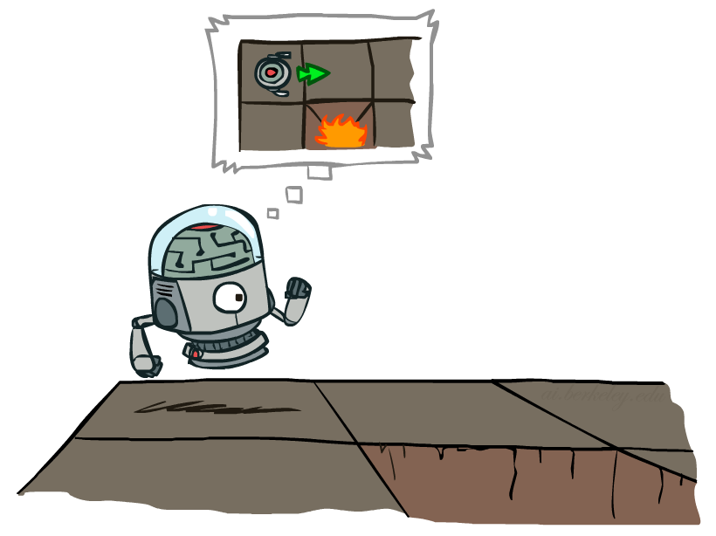

MDP Search Trees
Each MDP state projects an expectimax-like search tree
s
s is a state
a
(s, a) is a q-state
s, a
(s,a,s’) called a transition
T(s,a,s’) = P(s’|s,a)
R(s,a,s’)
s,a,s’
s’
Notes:
In MDP chance node represents uncertainty about what might happen based on (s,a) [as opposed to being a random adversary]
Q-state (s,a) is when you were in a state and took an action

Slide 19
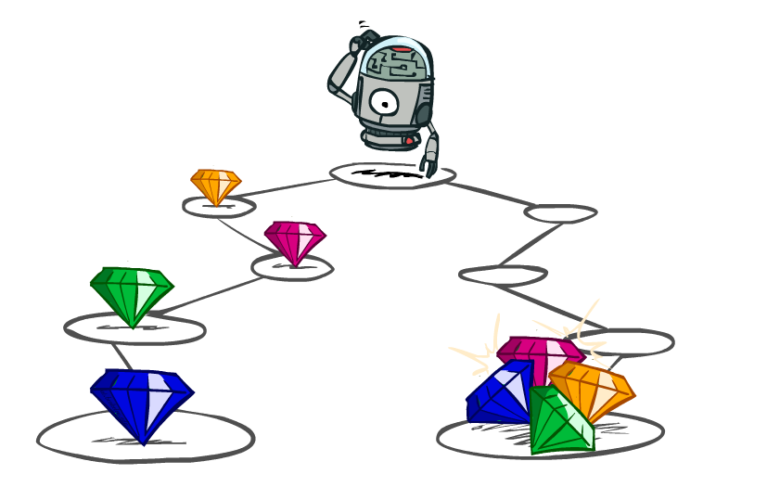
Utilities of Sequences

Slide 20
Utilities of Sequences
What preferences should an agent have over reward sequences?
More or less?
Now or later?
[1, 2, 2]
or
[2, 3, 4]
[0, 0, 1]
or
[1, 0, 0]

Slide 21
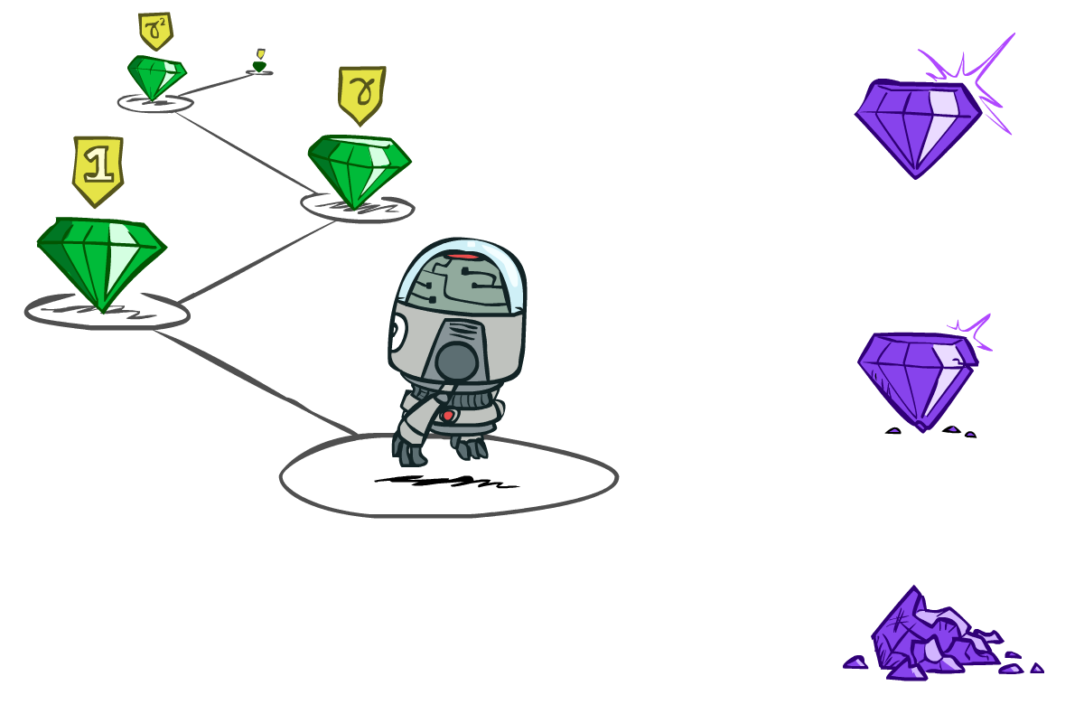

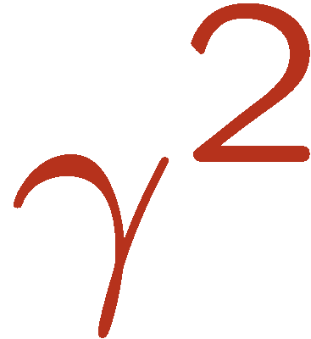

Discounting
It’s reasonable to maximize the sum of rewards
It’s also reasonable to prefer rewards now to rewards later
One solution: values of rewards decay exponentially
Worth Now
Worth Next Step
Worth In Two Steps

Slide 22

Discounting
How to discount?
Each time we descend a level, we multiply in the discount once
Why discount?
Sooner rewards probably do have higher utility than later rewards
Also helps our algorithms converge
Example: discount of 0.5
U([1,2,3]) = 1*1 + 0.5*2 + 0.25*3
U([1,2,3]) < U([3,2,1])
Notes:
Rewards in the future (deeper in the tree) matter less
Interesting: running expectimax, if having to truncate the search, then not losing much; e.g., less then \gamma^d / (1-\gamma)

Slide 23


Quiz: Discounting
Given:
Actions: East, West, and Exit (only available in exit states a, e)
Transitions: deterministic
Quiz 1: For γ = 1, what is the optimal policy?
Quiz 2: For γ = 0.1, what is the optimal policy?
Quiz 3: For which γ are West and East equally good when in state d?
<-
<-
<-
<-
<-
->
1γ=10 γ³
Notes:
eat also takes one step, one more discount

Slide 24
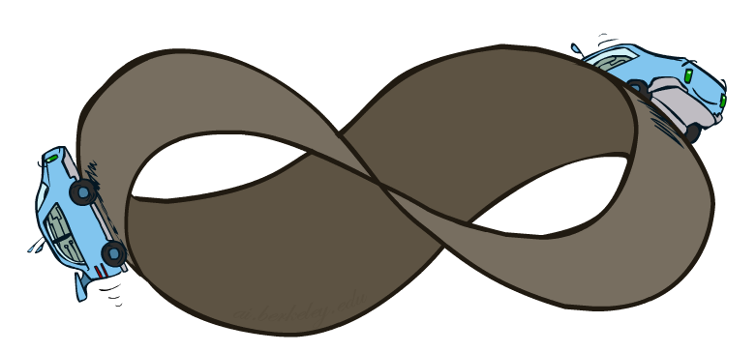
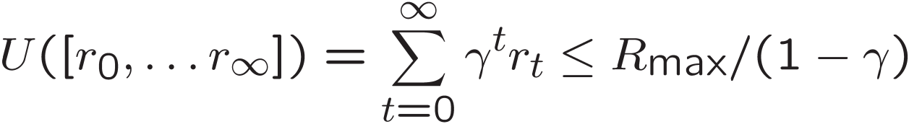
Infinite Utilities?!
Problem: What if the game lasts forever? Do we get infinite rewards?
Solutions:
Finite horizon: (similar to depth-limited search)
Terminate episodes after a fixed T steps (e.g. life)
Gives nonstationary policies (π depends on time left)
Discounting: use 0 < γ < 1
Smaller γ means smaller “horizon” – shorter term focus
Absorbing state: guarantee that for every policy, a terminal state will eventually be reached (like “overheated” for racing)

Slide 25
Recap: Defining MDPs
Markov decision processes:
Set of states S
Start state s₀
Set of actions A
Transitions P(s’|s,a) (or T(s,a,s’))
Rewards R(s,a,s’) (and discount γ)
MDP quantities so far:
Policy = Choice of action for each state
Utility = sum of (discounted) rewards
s
a
s, a
s,a,s’
s’

Slide 26
Solving MDPs

Slide 27
Recall: Racing MDP
A robot car wants to travel far, quickly
Three states: Cool, Warm, Overheated
Two actions: Slow, Fast
Going faster gets double reward
0.5
+1
1.0
Fast
Slow
-10
+1
0.5
Warm
Slow
Fast
0.5
+2
Cool
0.5
Overheated
+1
1.0
+2
Notes:
-10 and the game ends (important that the game ends because regardless you never want to do it)

Slide 28
Racing Search Tree

Slide 29


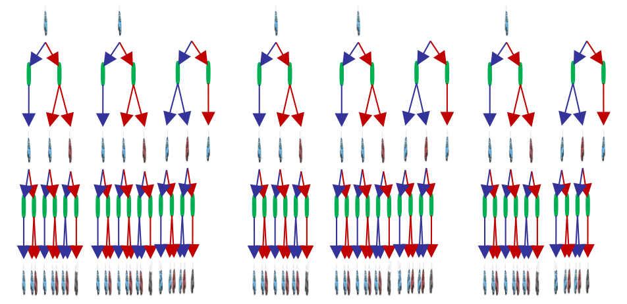

Racing Search Tree

Slide 30
Racing Search Tree
We’re doing way too much work with expectimax!
Problem: States are repeated
Idea: Only compute needed quantities once
Problem: Tree goes on forever
Idea: Do a depth-limited computation, but with increasing depths until change is small
Note: deep parts of the tree eventually don’t matter if γ < 1

Slide 31
Optimal Quantities
The value (utility) of a state s:
V*(s) = expected utility starting in s and acting optimally
The value (utility) of a q-state (s,a):
Q*(s,a) = expected utility starting out having taken action a from state s and (thereafter) acting optimally
The optimal policy:
π*(s) = optimal action from state s
s
s is a state
a
(s, a) is a q-state
s, a
s,a,s’
(s,a,s’) is a transition
s’
Notes:
[Note: this demo doesn’t show anything in action, just pops up V and Q values.]

Slide 32
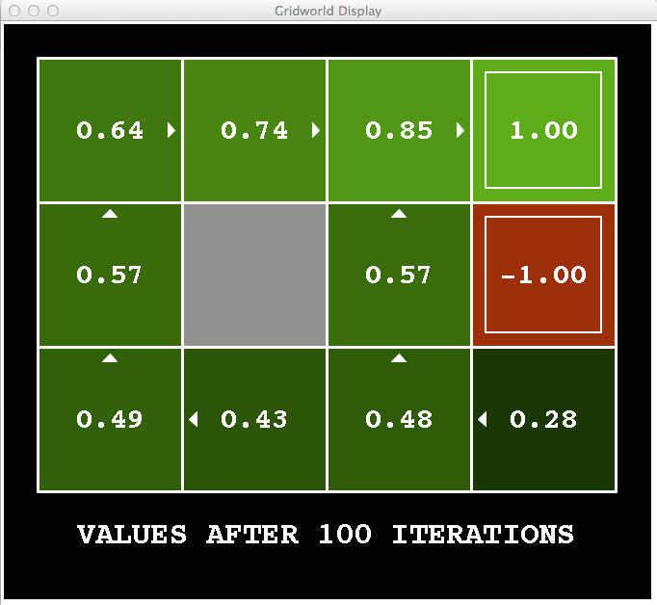
Snapshot of Demo – Gridworld V Values
Noise = 0.2
Discount = 0.9
Living reward = 0
Notes:
This demo doesn’t show anything in action, it just shows the V and Q values.

Slide 33
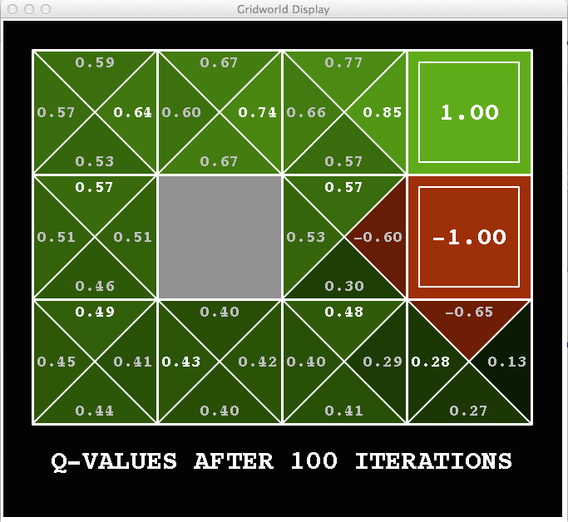
Snapshot of Demo – Gridworld Q Values
Noise = 0.2
Discount = 0.9
Living reward = 0
Notes:
This demo doesn’t show anything in action, it just shows the V and Q values.

Slide 34

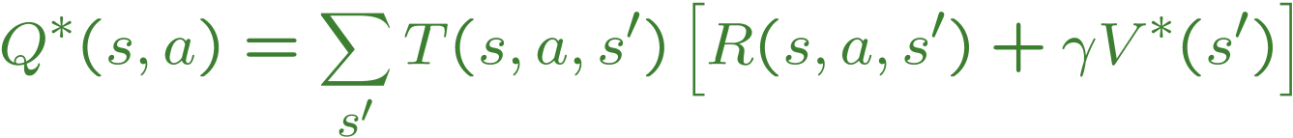
Values of States
Fundamental operation: compute the (expectimax) value of a state
Expected utility under optimal action
Average sum of (discounted) rewards
This is just what expectimax computed!
Recursive definition of value:
s
a
s, a
s,a,s’
s’

Slide 35


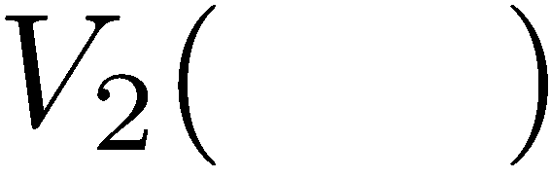


Time-Limited Values
Key idea: time-limited values
Define V_{k}(s) to be the optimal value of s if the game ends in k more time steps
Equivalently, it’s what a depth-k expectimax would give from s
Notes:
This demo generates the time-limited values for gridworld as snapshotted onto the next slides.

Slide 36
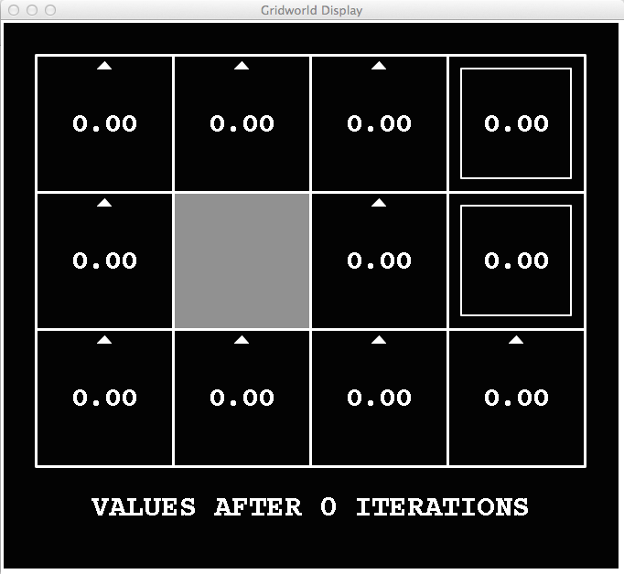
k=0
Noise = 0.2
Discount = 0.9
Living reward = 0
Notes:
Assuming zero living reward

Slide 37
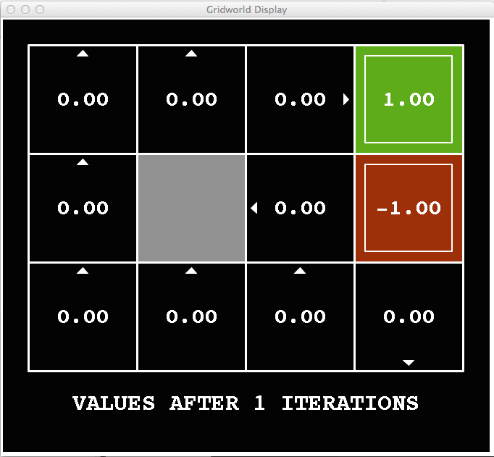
k=1
Noise = 0.2
Discount = 0.9
Living reward = 0
Notes:
Assuming zero living reward

Slide 38
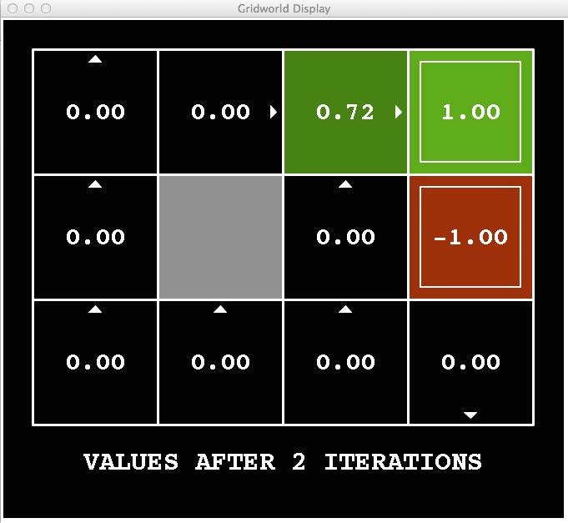
k=2
Noise = 0.2
Discount = 0.9
Living reward = 0
Notes:
Assuming zero living reward

Slide 39
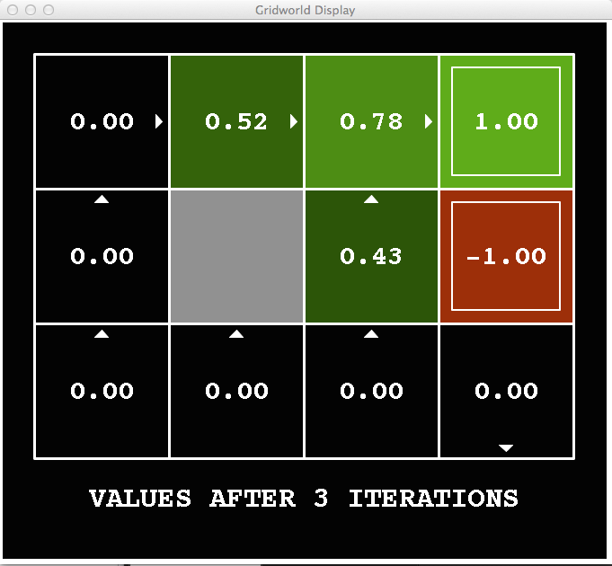
k=3
Noise = 0.2
Discount = 0.9
Living reward = 0
Notes:
Assuming zero living reward

Slide 40
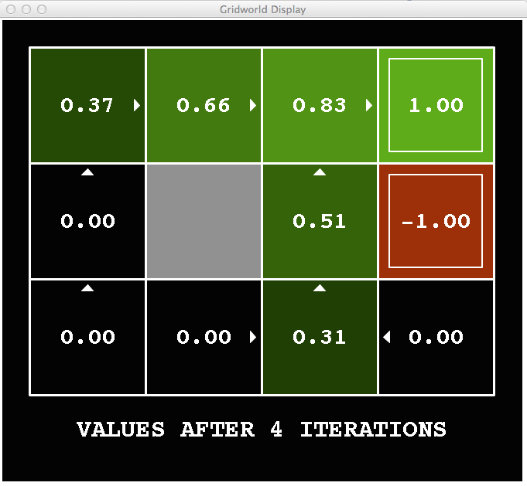
k=4
Noise = 0.2
Discount = 0.9
Living reward = 0
Notes:
Assuming zero living reward

Slide 41
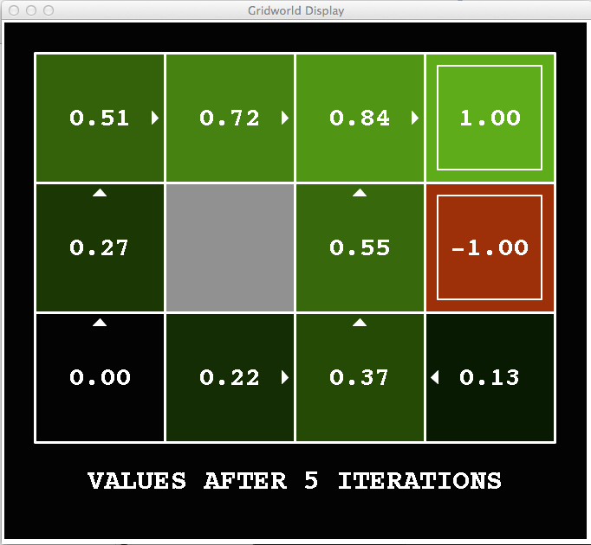
k=5
Noise = 0.2
Discount = 0.9
Living reward = 0
Notes:
Assuming zero living reward

Slide 42
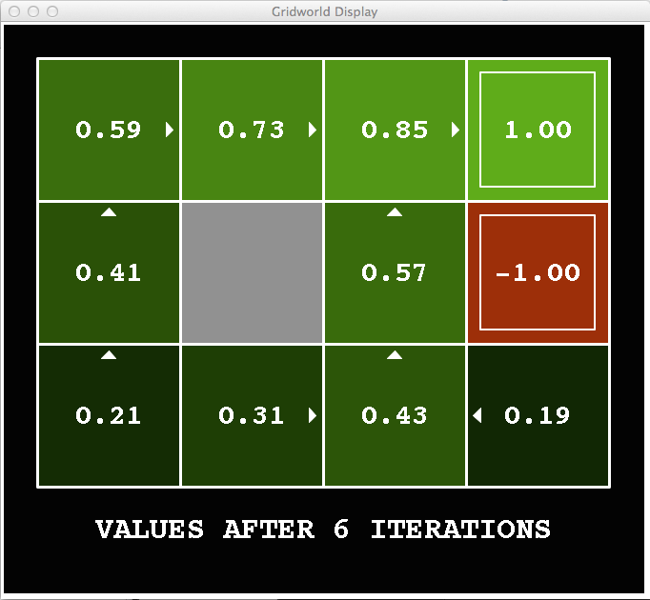
k=6
Noise = 0.2
Discount = 0.9
Living reward = 0
Notes:
Assuming zero living reward

Slide 43
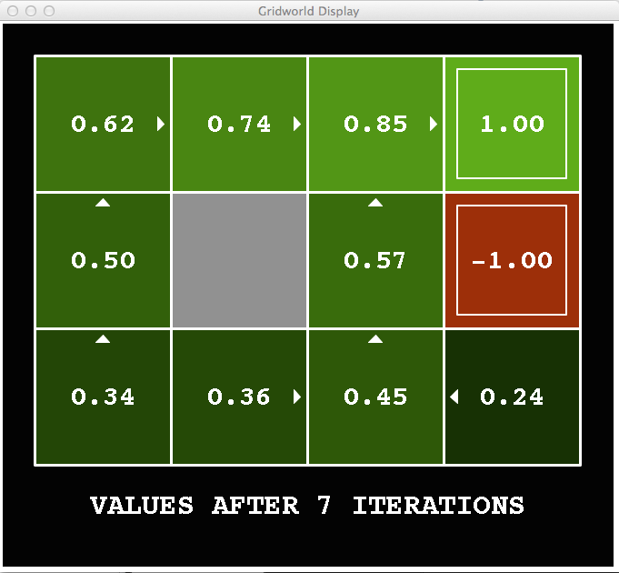
k=7
Noise = 0.2
Discount = 0.9
Living reward = 0
Notes:
Assuming zero living reward

Slide 44
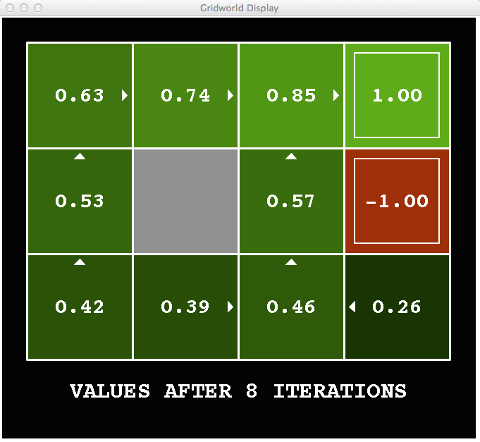
k=8
Noise = 0.2
Discount = 0.9
Living reward = 0
Notes:
Assuming zero living reward

Slide 45
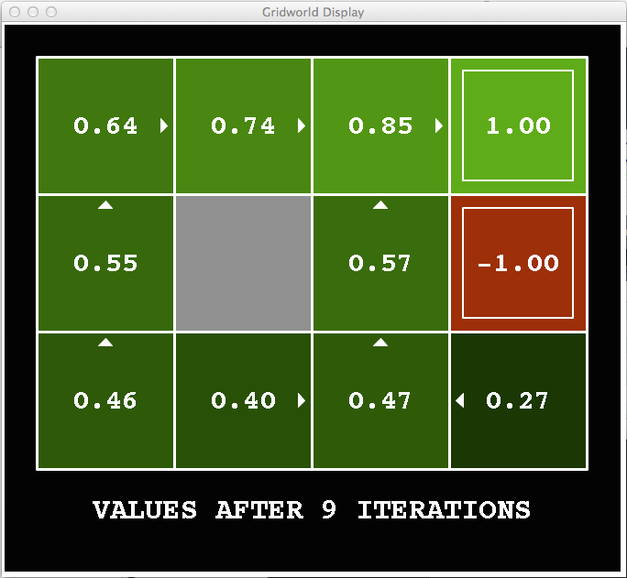
k=9
Noise = 0.2
Discount = 0.9
Living reward = 0
Notes:
Assuming zero living reward

Slide 46

k=10
Noise = 0.2
Discount = 0.9
Living reward = 0
Notes:
Assuming zero living reward

Slide 47

k=11
Noise = 0.2
Discount = 0.9
Living reward = 0
Notes:
Assuming zero living reward

Slide 48

k=12
Noise = 0.2
Discount = 0.9
Living reward = 0
Notes:
Assuming zero living reward

Slide 49

k=100
Noise = 0.2
Discount = 0.9
Living reward = 0
Notes:
Assuming zero living reward

Slide 50
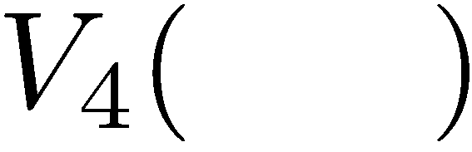

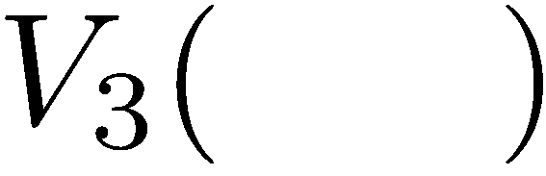
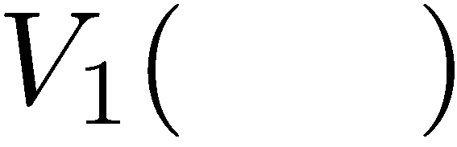
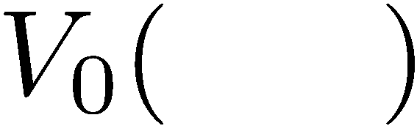
Computing Time-Limited Values

Slide 51
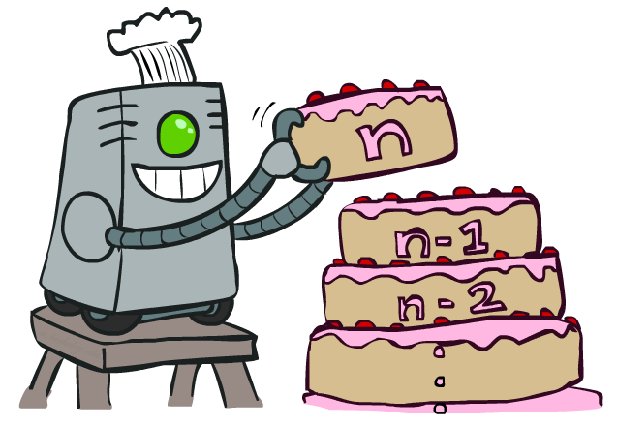
Value Iteration

Slide 52
Value Iteration
Start with V₀(s) = 0: no time steps left means an expected reward sum of zero
Given vector of V_{k}(s) values, do one ply of expectimax from each state:
Repeat until convergence
Complexity of each iteration: O(S²A)
Theorem: will converge to unique optimal values
Basic idea: approximations get refined towards optimal values
Policy may converge long before values do
V_{k+1}(s)
a
s, a
s,a,s’
V_{k}(s’)
Notes:
Discuss computational complexity: S * A * S times number of iterations
Note: updates not in place [if in place, it means something else and not even clear what it means]

Slide 53

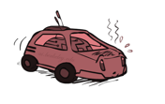
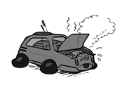
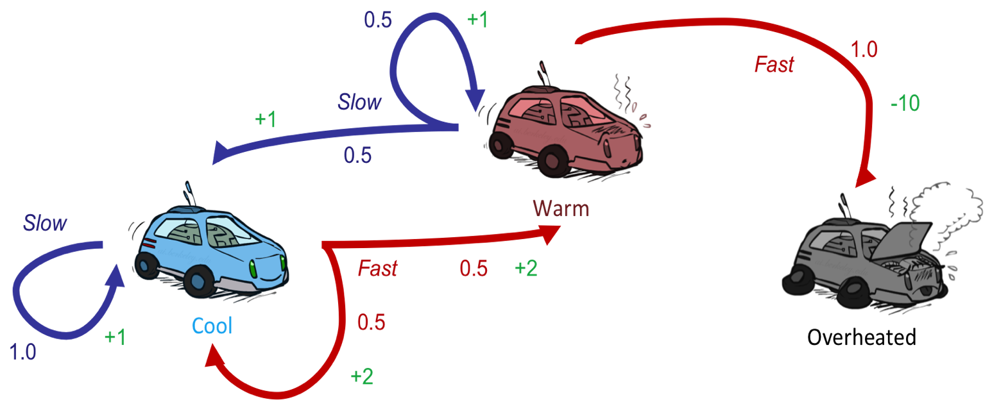
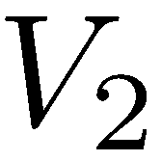
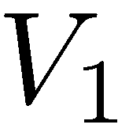

Example: Value Iteration
S: 1
F: .5*2+.5*2=2
Assume no discount!
0 0 0

Slide 54
Example: Value Iteration
2
S: .5*1+.5*1=1
F: -10
Assume no discount!
0 0 0

Slide 55
Example: Value Iteration
2
1
0
Assume no discount!
0 0 0

Slide 56
Example: Value Iteration
S: 1+2=3
F: .5*(2+2)+.5*(2+1)=3.5
2
1
0
Assume no discount!
0 0 0

Slide 57
Example: Value Iteration
3.5
2.5
0
2
1
0
Assume no discount!
0 0 0

Slide 58
Next Time: Policy-Based Methods

