Slide 1
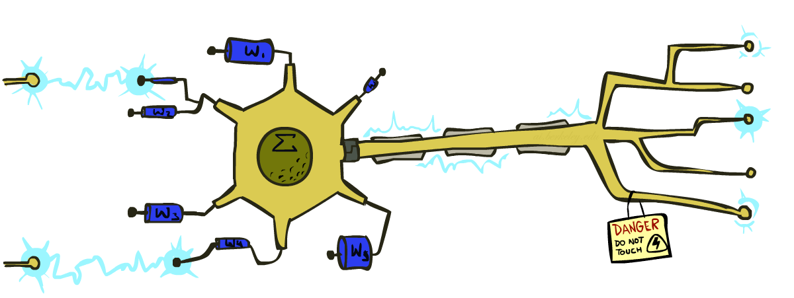
CS 580: Introduction to Artificial Intelligence
Perceptrons
Prof. Xuesu Xiao
George Mason University
[Based on slides created by Dan Klein and Pieter Abbeel for CS188 Intro to AI at UC Berkeley. All original materials available at http://ai.berkeley.edu.]

Slide 2
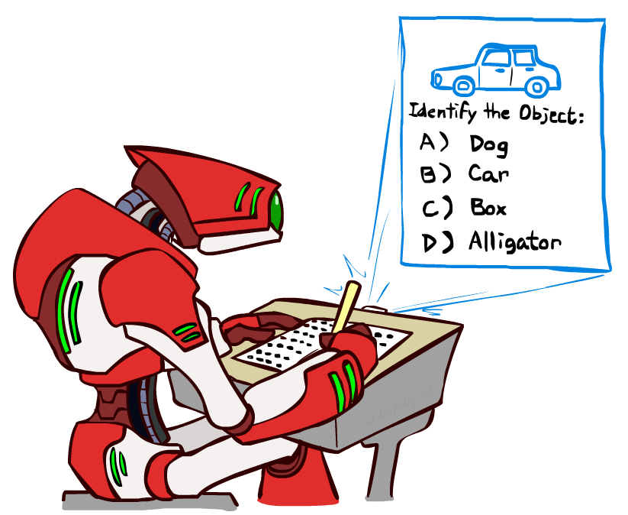

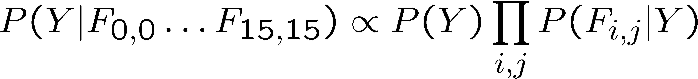
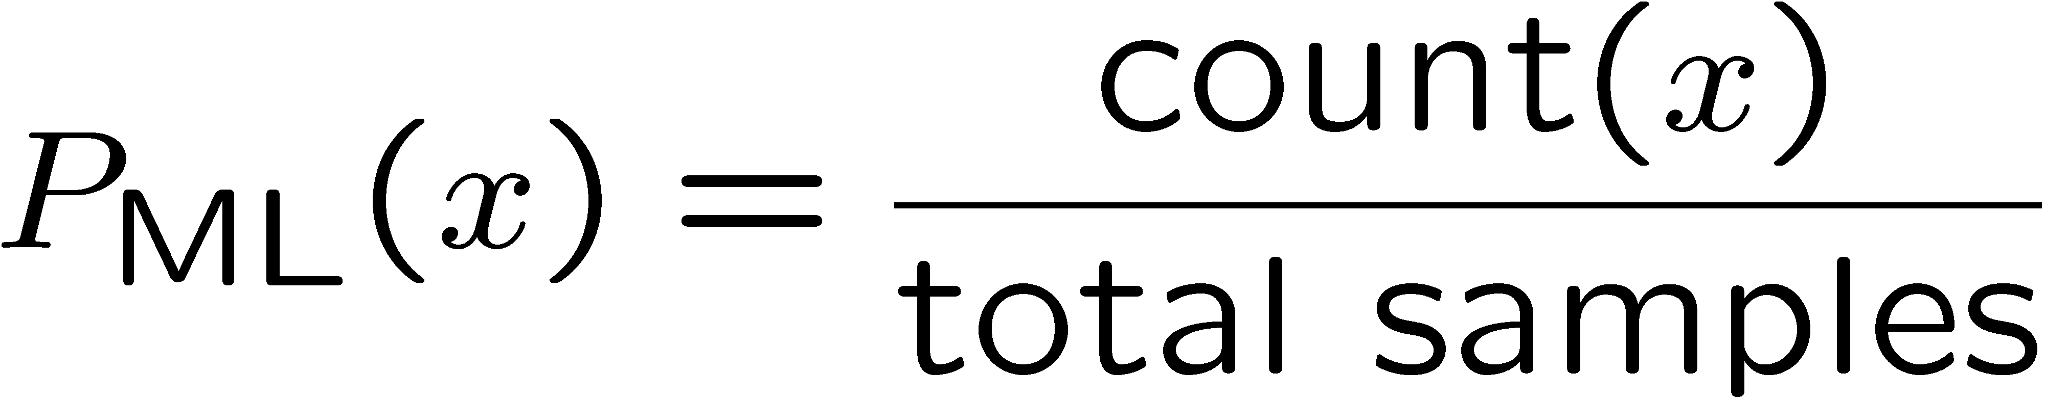
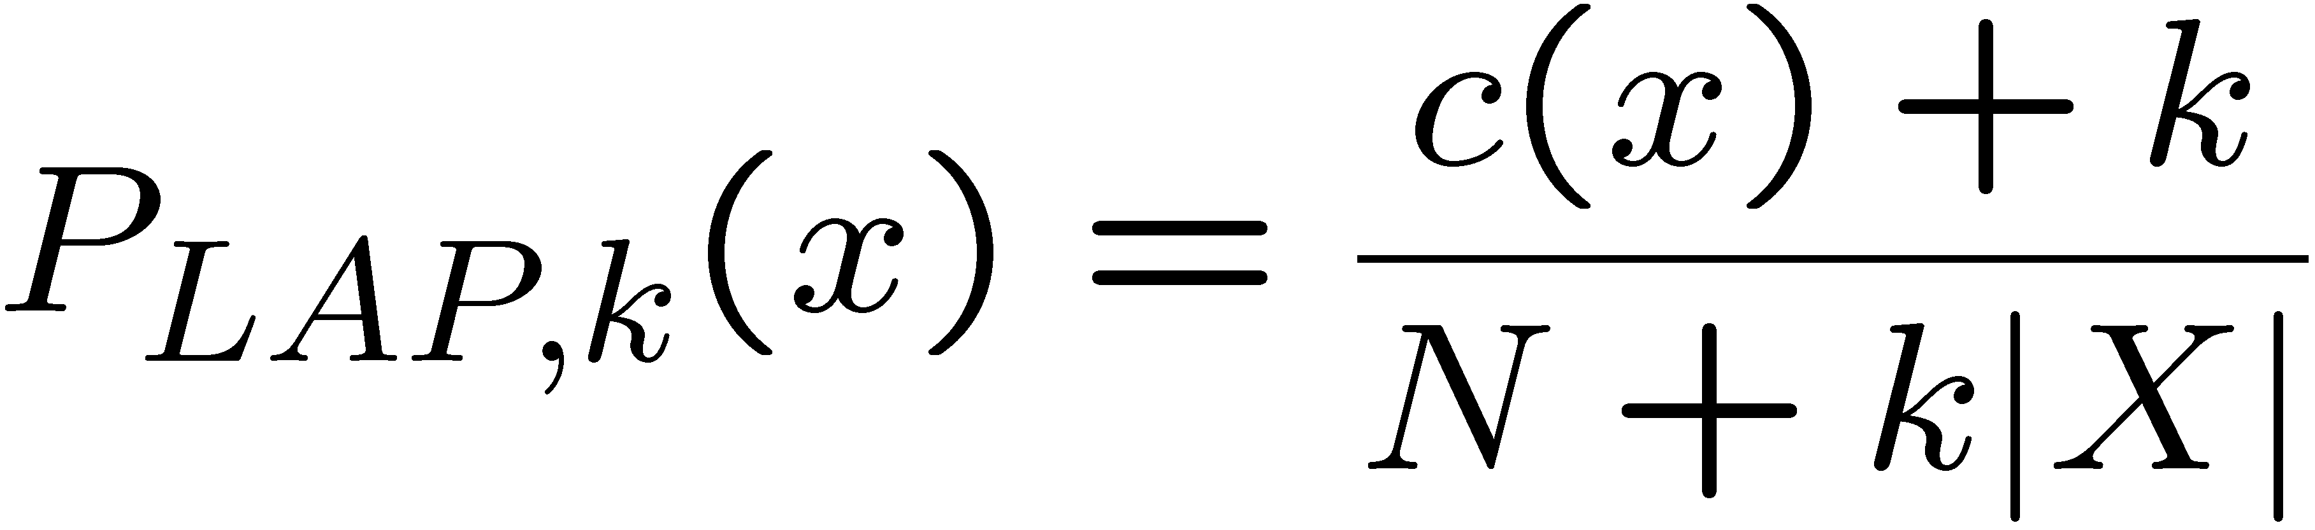
Last Time
Classification: given inputs x, predict labels (classes) y
Naïve Bayes
Parameter estimation:
  MLE, MAP, priors
Laplace smoothing
Training set, held-out set, test set
Y
F₁
F₂
F_{n}

Slide 3
Workflow
Training
Data
Phase 1: Train model on Training Data. Choice points for “tuning”
  Attributes / Features
  Model types: Naïve Bayes vs. Perceptron vs. Logistic Regression vs. Neural Net etc..
  Model hyperparameters
    E.g. Naïve Bayes – Laplace k
    E.g. Logistic Regression – weight regularization
    E.g. Neural Net – architecture, learning rate, …
  Make sure good performance on training data
Phase 2: Evaluate on Hold-Out Data
  If Hold-Out performance is close to Train performance
    We achieved good generalization, onto Phase 3! ☺
  If Hold-Out performance is much worse than Train performance
    We overfitted to the training data! ☹
    Take inspiration from the errors and:
      Either: go back to Phase 1 for tuning (typically: make the model less expressive)
      Or: if we are out of options for tuning while maintaining high train accuracy, collect more data (i.e., let the data drive generalization, rather than the tuning/regularization) and go to Phase 1
Phase 3: Report performance on Test Data
Possible outer-loop: Collect more data ☺
Held-Out
Data
Test
Data

Slide 4
Practical Tip: Baselines
First step: get a baseline
  Baselines are very simple “straw man” procedures
  Help determine how hard the task is
  Help know what a “good” accuracy is
Weak baseline: most frequent label classifier
  Gives all test instances whatever label was most common in the training set
  E.g. for spam filtering, might label everything as ham
  Accuracy might be very high if the problem is skewed
  E.g. calling everything “ham” gets 66%, so a classifier that gets 70% isn’t very good…
For real research, usually use previous work as a (strong) baseline

Slide 5
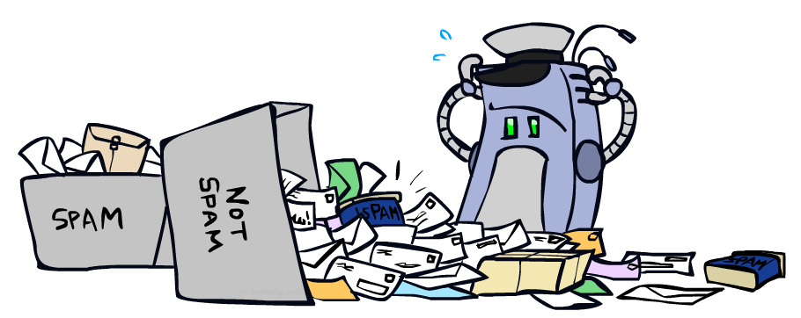
Error-Driven Classification

Slide 6
Errors, and What to Do
Examples of errors
Dear GlobalSCAPE Customer,
GlobalSCAPE has partnered with ScanSoft to offer you the latest version of OmniPage Pro, for just $99.99* - the regular list price is $499! The most common question we've received about this offer is - Is this genuine? We would like to assure you that this offer is authorized by ScanSoft, is genuine and valid. You can get the . . .
. . . To receive your $30 Amazon.com promotional certificate, click through to
http://www.amazon.com/apparel
and see the prominent link for the $30 offer. All details are there. We hope you enjoyed receiving this message. However, if you'd rather not receive future e-mails announcing new store launches, please click . . .

Slide 7
What to Do About Errors
Problem: there’s still spam in your inbox
Need more features – words aren’t enough!
  Have you emailed the sender before?
  Have 1M other people just gotten the same email?
  Is the sending information consistent?
  Is the email in ALL CAPS?
  Do inline URLs point where they say they point?
  Does the email address you by (your) name?
Naïve Bayes models can incorporate a variety of features, but tend to do best in homogeneous cases (e.g. all features are word occurrences)

Slide 8
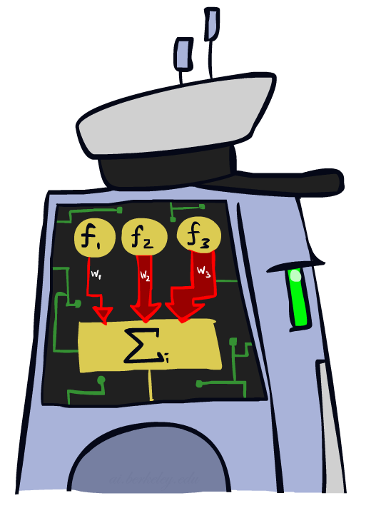
Linear Classifiers

Slide 9
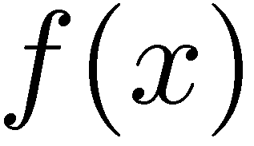



Feature Vectors
Hello,
Do you want free printr cartriges? Why pay more when you can get them ABSOLUTELY FREE! Just
# free : 2
YOUR_NAME : 0
MISSPELLED : 2
FROM_FRIEND : 0
...
SPAM
or
+
PIXEL-7,12 : 1
PIXEL-7,13 : 0
...
NUM_LOOPS : 1
...
“2”

Slide 10

Some (Simplified) Biology
Very loose inspiration: human neurons

Slide 11
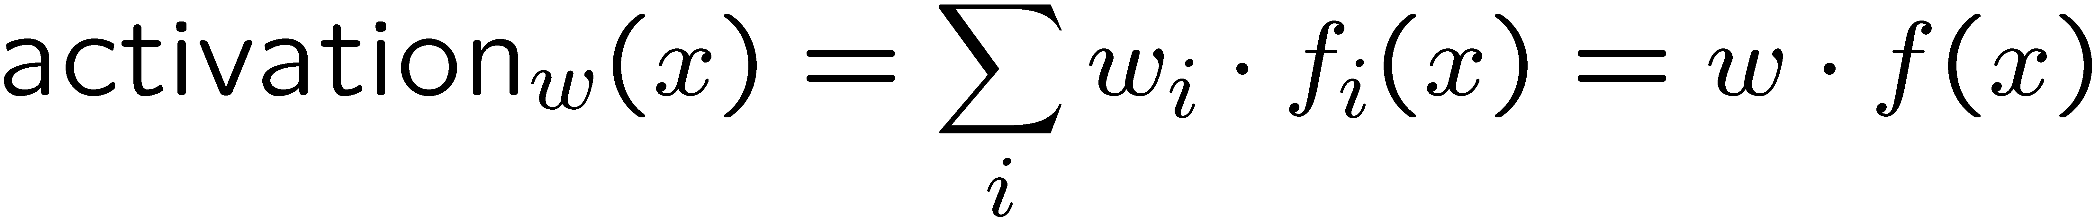
Linear Classifiers
Inputs are feature values
Each feature has a weight
Sum is the activation
If the activation is:
  Positive, output +1
  Negative, output -1
w₁
f₁
Σ
w₂
>0?
f₂
w₃
f₃

Slide 12


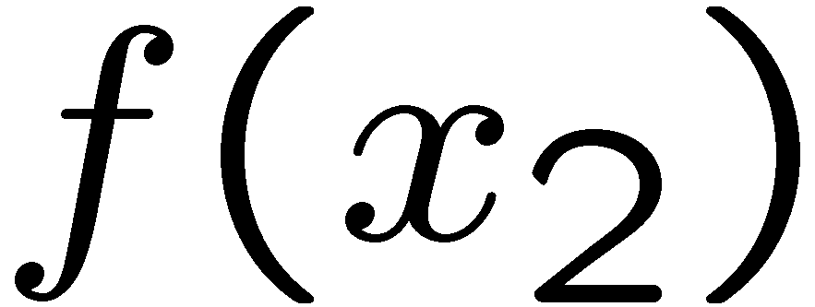
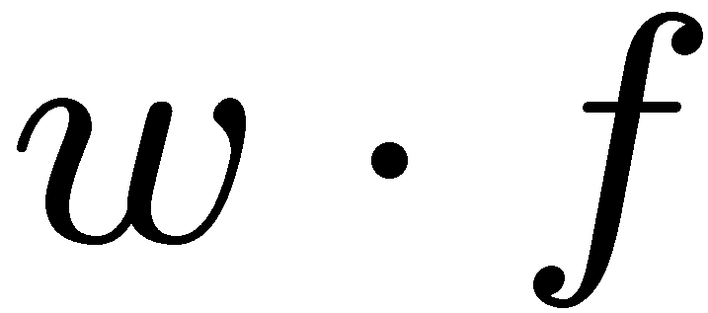
Weights
Binary case: compare features to a weight vector
Learning: figure out the weight vector from examples
# free : 4
YOUR_NAME :-1
MISSPELLED : 1
FROM_FRIEND :-3
...
# free : 2
YOUR_NAME : 0
MISSPELLED : 2
FROM_FRIEND : 0
...
# free : 0
YOUR_NAME : 1
MISSPELLED : 1
FROM_FRIEND : 1
...
Dot product positive means the positive class

Slide 13
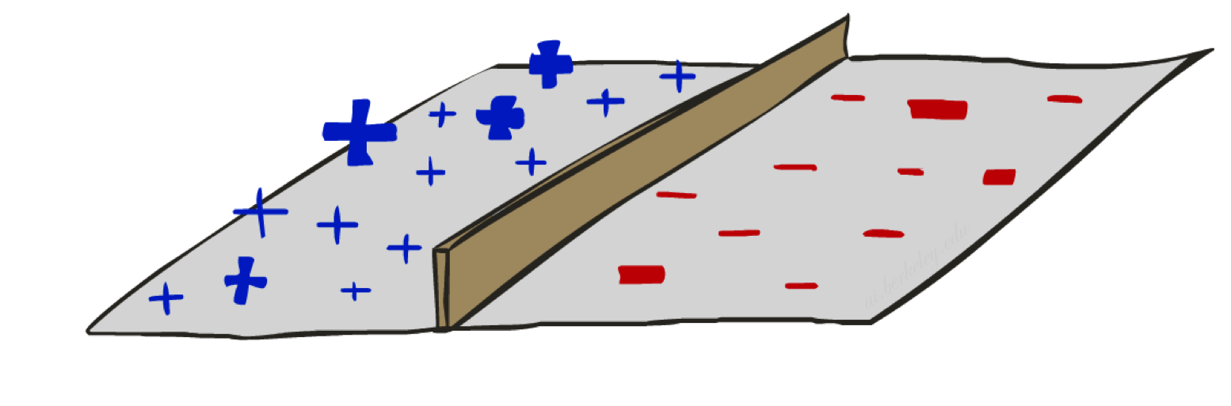
Decision Rules

Slide 14


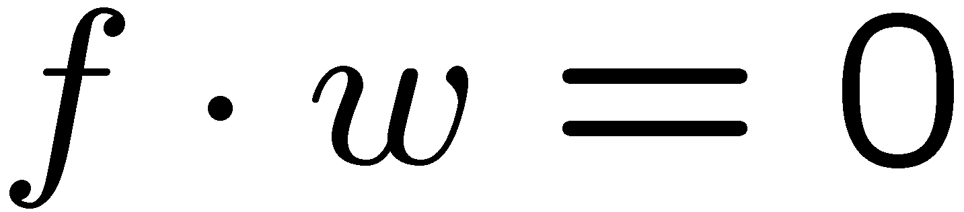
Binary Decision Rule
In the space of feature vectors
  Examples are points
  Any weight vector is a hyperplane
  One side corresponds to Y=+1
  Other corresponds to Y=-1
money
2
+1 = SPAM
1
BIAS : -3
free : 4
money : 2
...
0
-1 = HAM
0
1
free

Slide 15
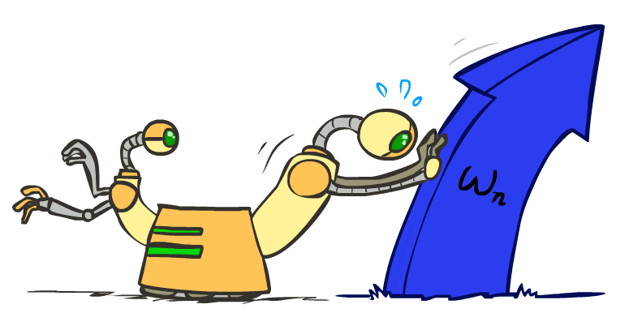
Weight Updates

Slide 16
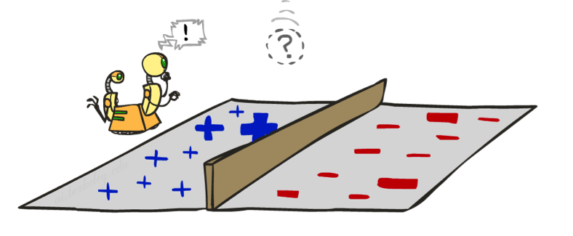
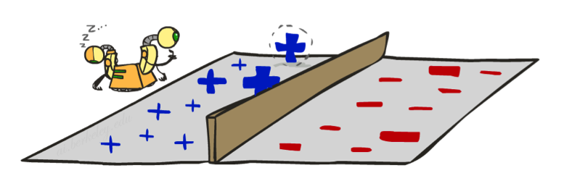
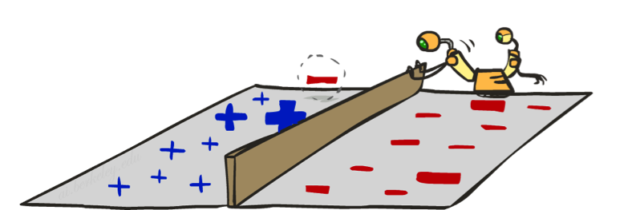
Learning: Binary Perceptron
Start with weights = 0
For each training instance:
  Classify with current weights
  If correct (i.e., y=y*), no change!
  If wrong: adjust the weight vector
Notes:
http://isl.ira.uka.de/neuralNetCourse/2004/VL_11_5/Perceptron.html

Slide 17
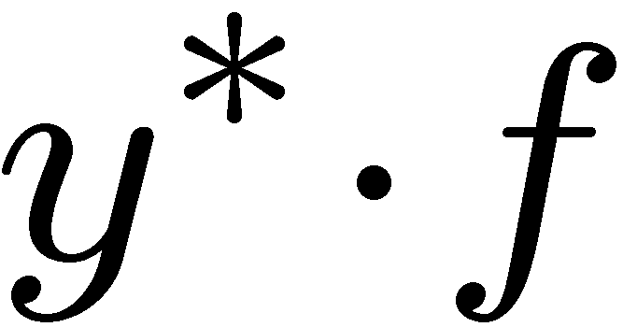
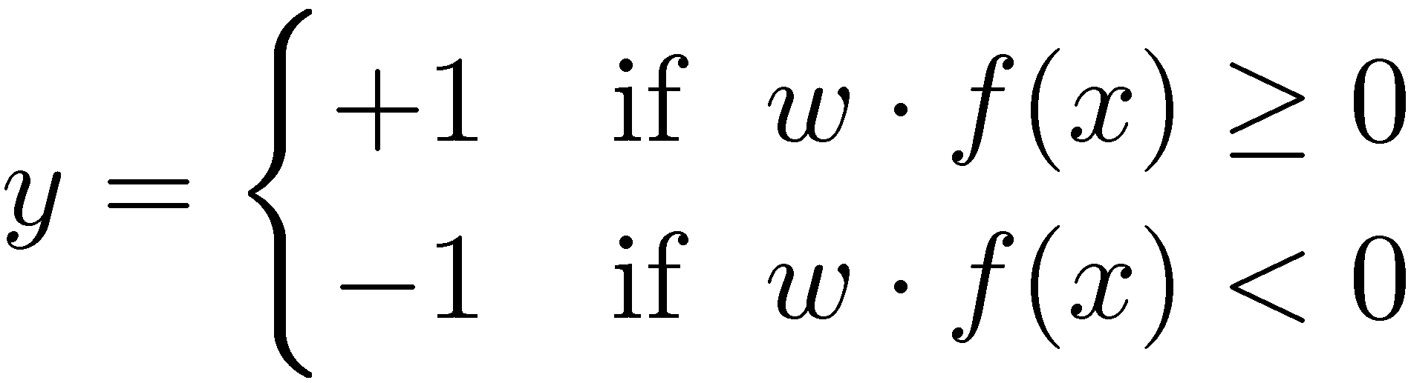

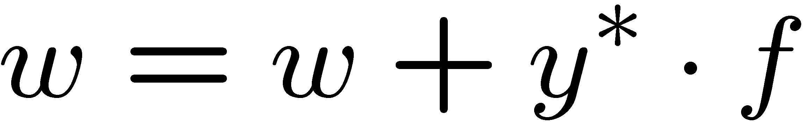
Learning: Binary Perceptron
Start with weights = 0
For each training instance:
  Classify with current weights
  If correct (i.e., y=y*), no change!
  If wrong: adjust the weight vector by adding or subtracting the feature vector. Subtract if y* is -1.
Notes:
http://isl.ira.uka.de/neuralNetCourse/2004/VL_11_5/Perceptron.html

Slide 18
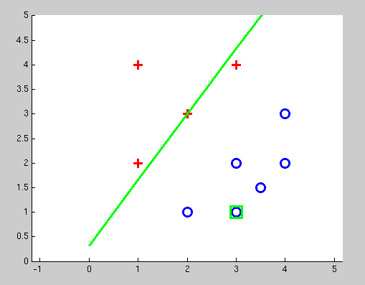
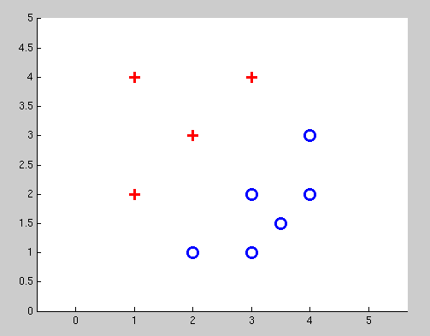
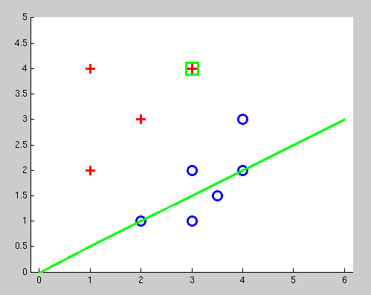
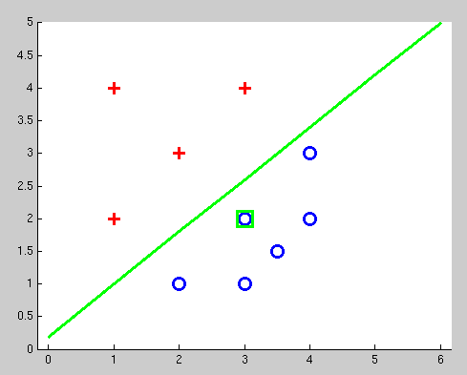
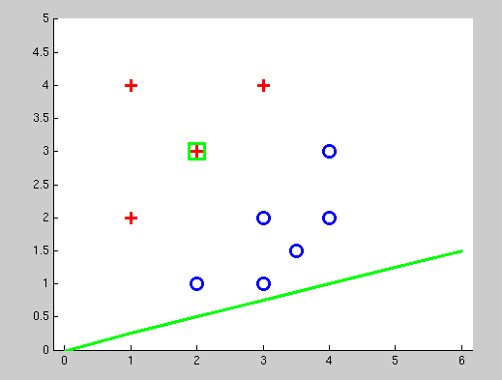
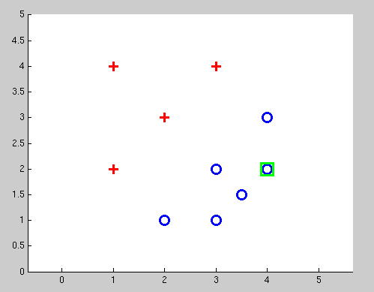
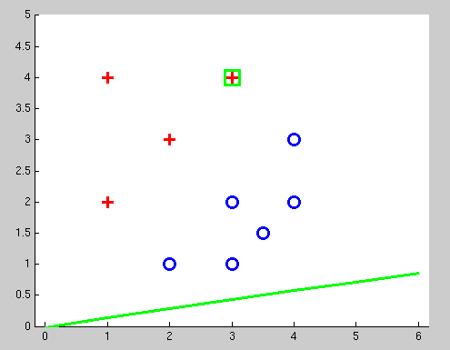
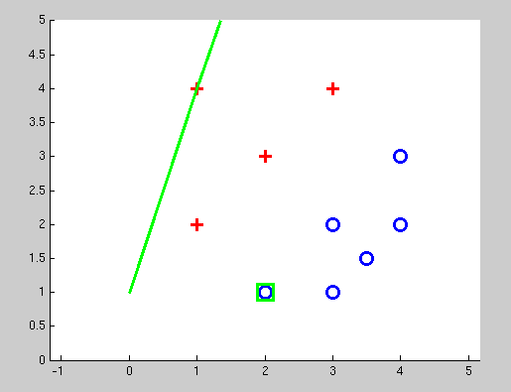
Examples: Perceptron
Separable Case

Slide 19
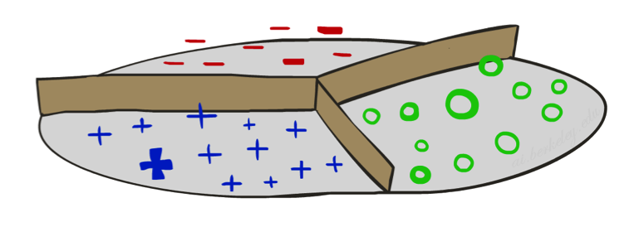


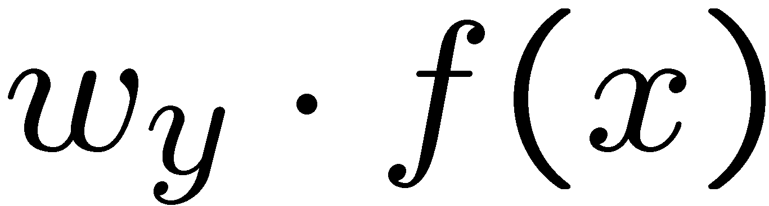



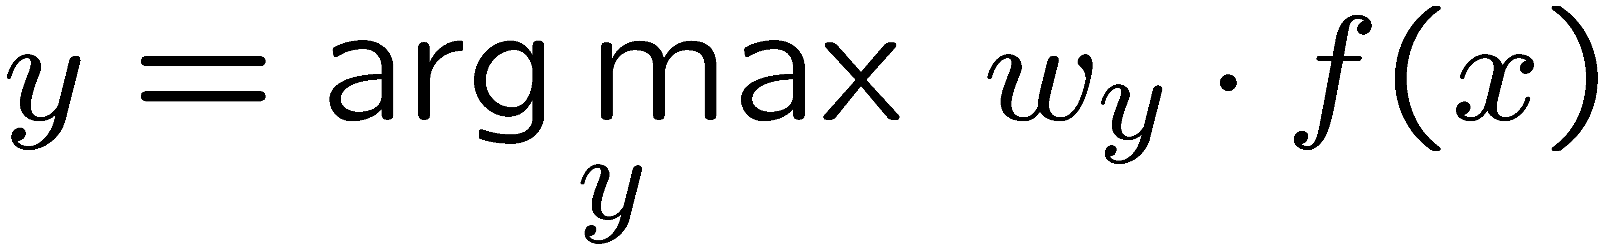
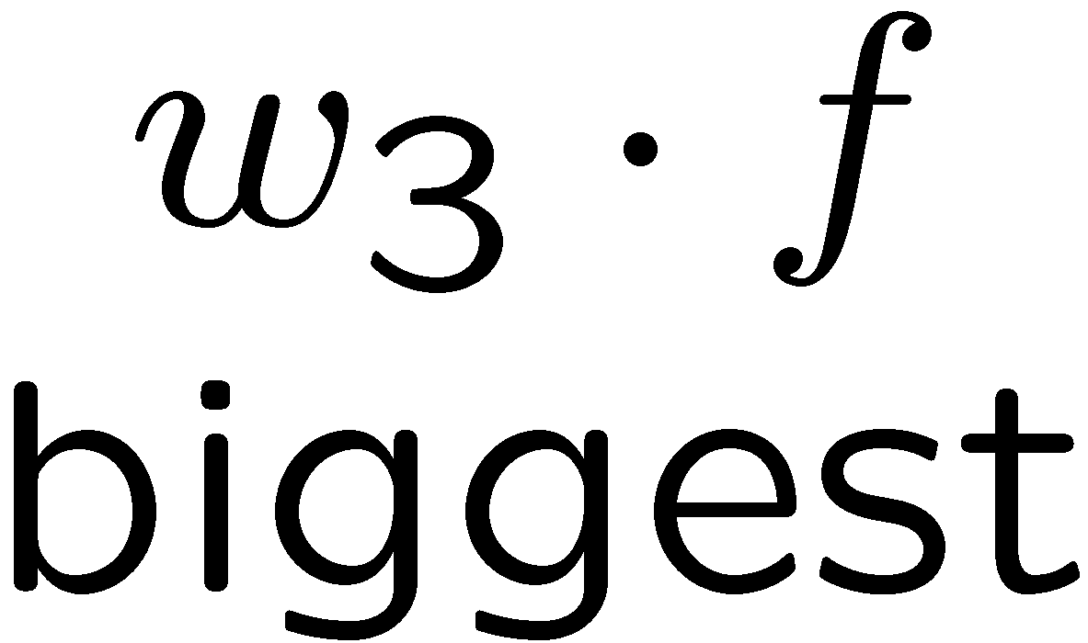
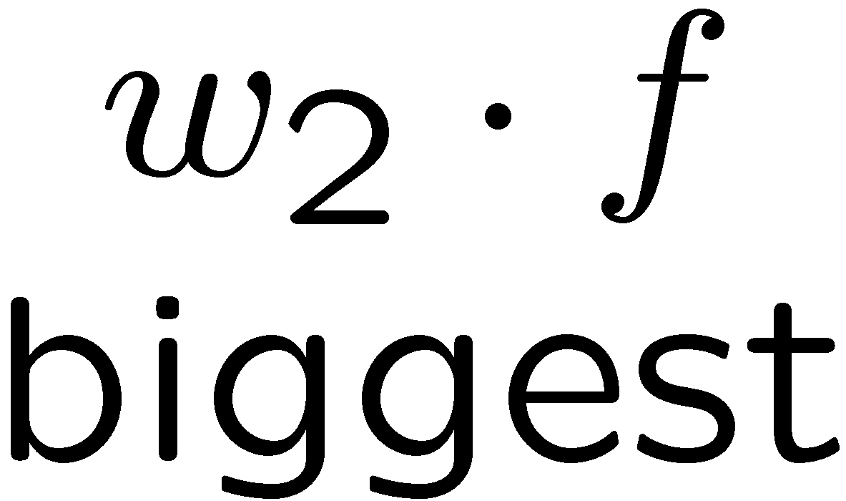
Multiclass Decision Rule
If we have multiple classes:
  A weight vector for each class:
  Score (activation) of a class y:
  Prediction highest score wins
Binary = multiclass where the negative class has weight zero

Slide 20



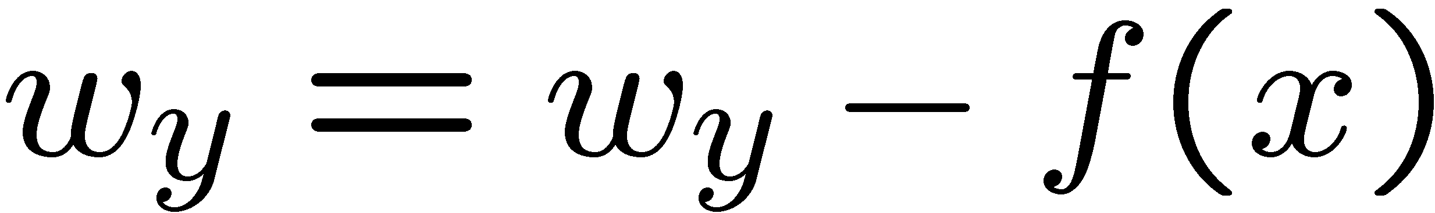
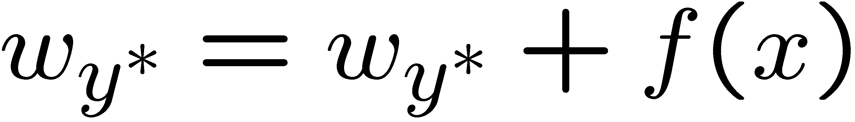
Learning: Multiclass Perceptron
Start with all weights = 0
Pick up training examples one by one
Predict with current weights
If correct, no change!
If wrong: lower score of wrong answer, raise score of right answer

Slide 21
Properties of Perceptrons
Separable
Separability: true if some parameters get the training set perfectly correct
Convergence: if the training is separable, perceptron will eventually converge (binary case)
Mistake Bound: the maximum number of mistakes (binary case) related to the margin or degree of separability
Non-Separable

Slide 22
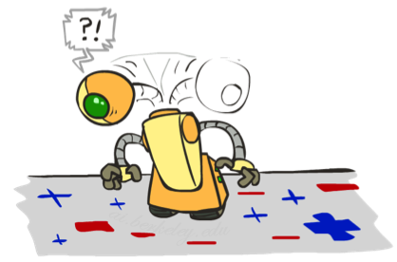
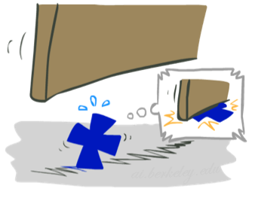

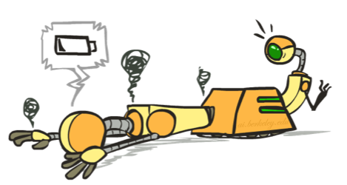




Problems with the Perceptron
Noise: if the data isn’t separable, weights might thrash
  Averaging weight vectors over time can help (averaged perceptron)
Mediocre generalization: finds a “barely” separating solution
Overtraining: test / held-out accuracy usually rises, then falls
  Overtraining is a kind of overfitting

Slide 23
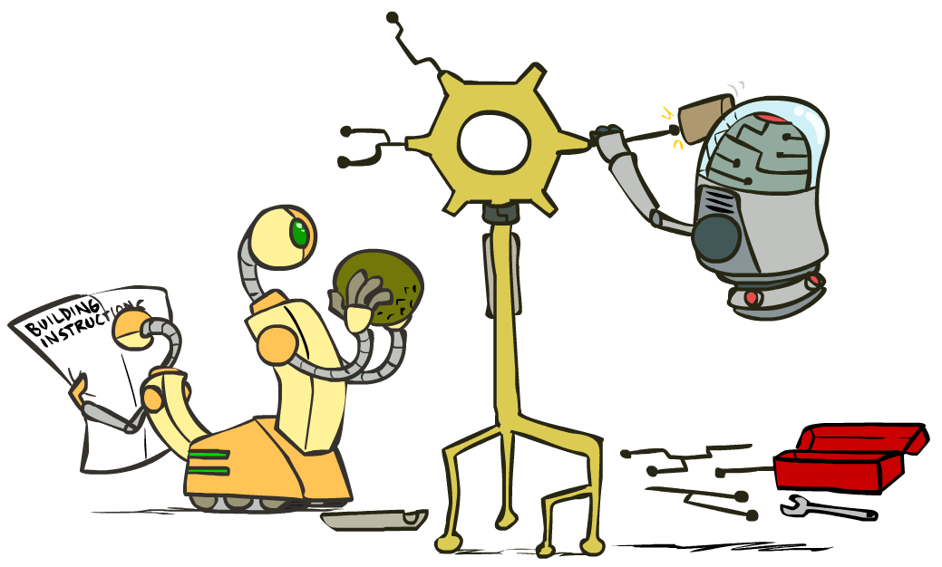
Improving the Perceptron

Slide 24
How to get probabilistic decisions?
Perceptron scoring:
If very positive → want probability going to 1
If very negative → want probability going to 0
Sigmoid function

Slide 25



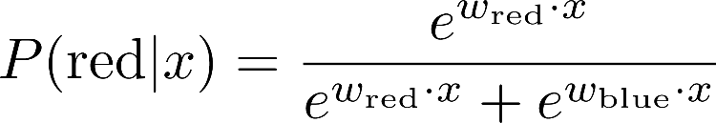
A 1D Example
definitely blue
not sure
definitely red
probability increases exponentially as we move away from boundary
normalizer

Slide 26
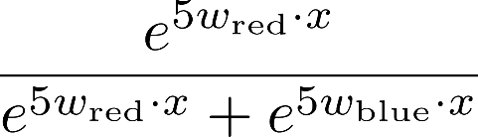
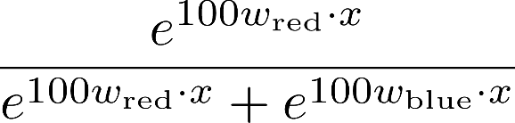

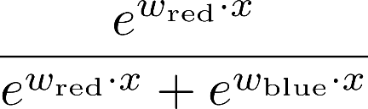
The Soft Max

Slide 27
Best w?
Maximum likelihood estimation:
with:
= Logistic Regression

Slide 28
Multiclass Logistic Regression
Recall Perceptron:
  A weight vector for each class:
  Score (activation) of a class y:
  Prediction highest score wins
How to make the scores into probabilities?
original activations
softmax activations

Slide 29
Best w?
Maximum likelihood estimation:
with:
= Multi-Class Logistic Regression

Slide 30
Classification: Comparison
Naïve Bayes
  Builds a model with training data
  Gives prediction probabilities
  Strong assumptions about feature independence
  One pass through data (counting)
Perceptrons:
  Makes less assumptions about data
  Mistake-driven learning
  Multiple passes through data (prediction)
  Often more accurate

Slide 31
Next: Kernels and Clustering

