Slide 1
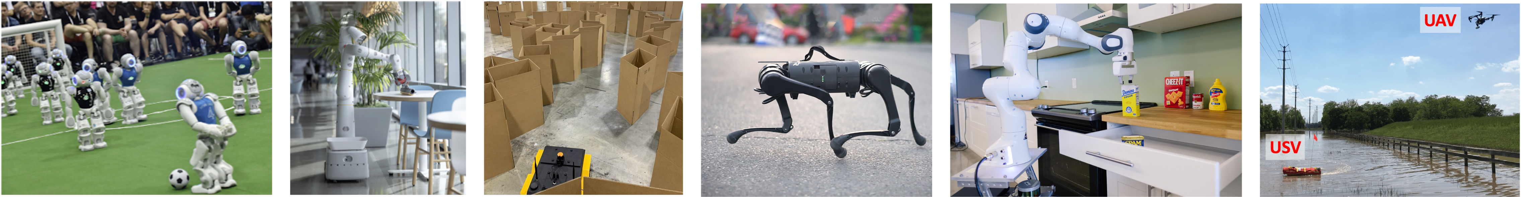
CS 685 Autonomous Robotics
Robot Learning 1
Prof. Xuesu Xiao
George Mason University
Slides Credits: Gregory Stein

Slide 2
There are many things we want robots to do
In just one semester, we won’t be able to talk about all of those.
We will learn about the fundamentals:
The core mathematical tools used to represent robots and the world
How robots move and interact
How robots sense the world
How robots understand the world
How robots …

Slide 3
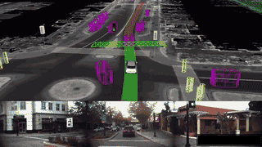
Waymo: let’s say you want to build a self-driving car… what might you need?

Slide 4
Motivation: the world is noisy and complicated
Let’s consider a self-driving vehicle:
How do I plan when there are other cars (or people or bikes) around?
How can I make good decisions when my sensors are noisy and I may not even be able to detect everyone or everything in my midst.

Slide 5
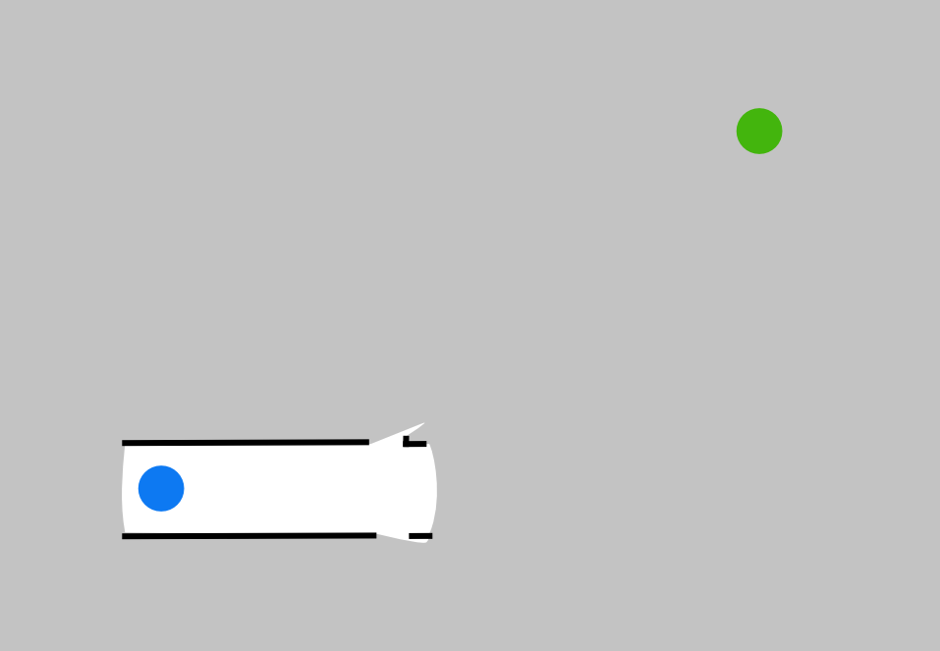
Motivation: we may not know the state of the world

Slide 6
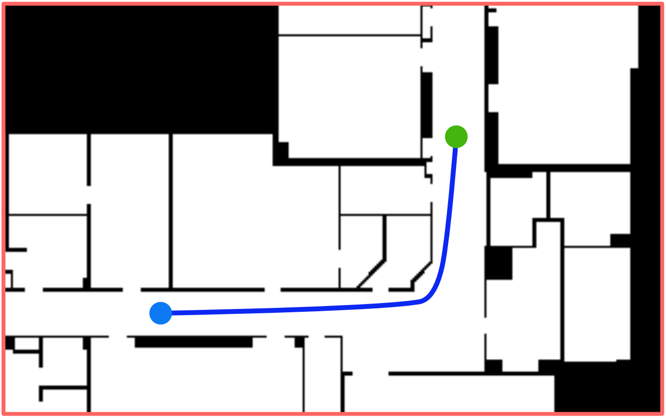
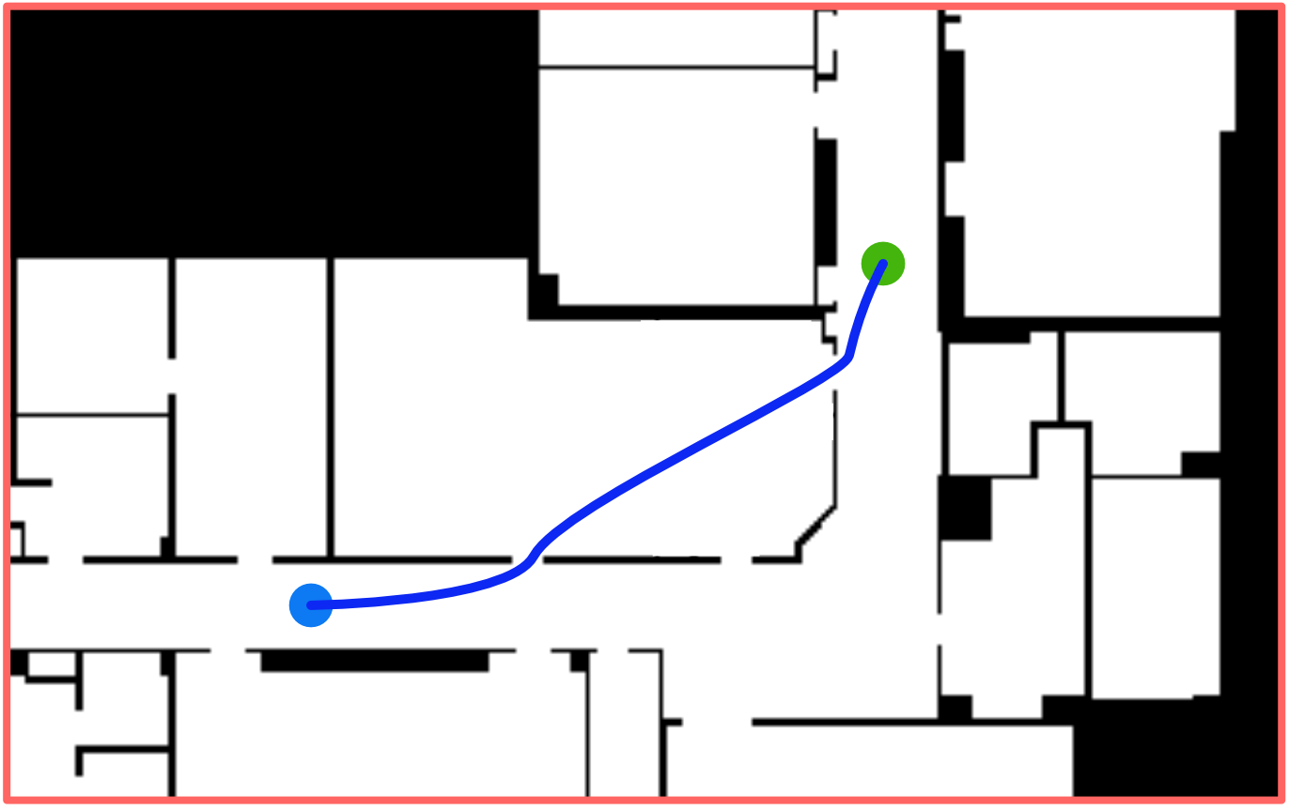
Motivation: we may not know the state of the world
Notes:
"...and this can be quite challenging, but making effective decisions requires considering what the unknown space will look like."

Slide 7
Motivation: we can use prior experience and data to inform what to do
Learning has become a key capability for robots
Today, we’ll discuss how machine learning—fueled by advancements in representation, data volume, and access to computation—has allowed for significant progress in robotics.

Slide 8
Plan for today and next week
Deep Learning “Crash Course”
Learning for Robot Perception
Learning for Robot Action
Learning for Robot …

Slide 9
Curve Fitting Crash Course
Perhaps a review for many of you.

Slide 10
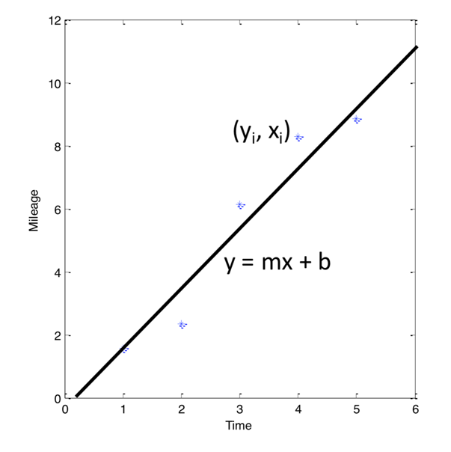
At it’s core, most of (supervised) machine learning is really just fitting lines to data.
We have a “bucket” of data with “labels”
Our aim is to find the parameters of the model (in this case ‘m’ and ‘b’)

Slide 11
At it’s core, most of (supervised) machine learning is really just fitting lines to data.
We have a “bucket” of data with “labels”
Our aim is to find the parameters of the model (in this case ‘m’ and ‘b’)
We are trying to solve a function approximation problem: we have a bunch of input/output pairs, and we want to estimate the parameters of a function that best relates the two.
This idea of function approximation will be very important for the rest of today. A question you should ask is what are we trying to approximate?

Slide 12
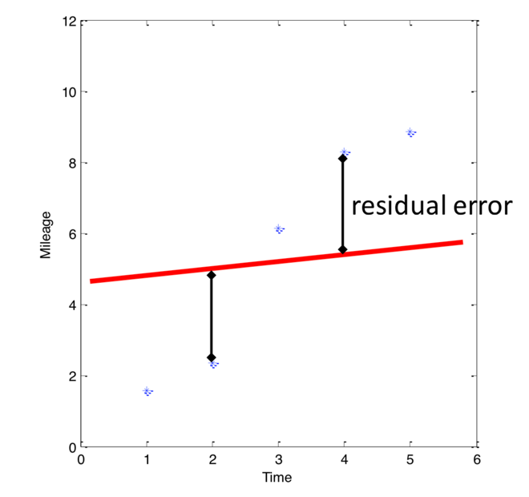
Least Squares is used to solve, for example, curve fitting problems
Linear regression:

Slide 13
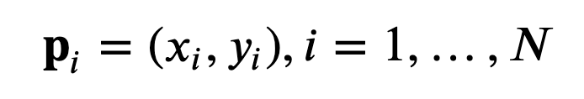
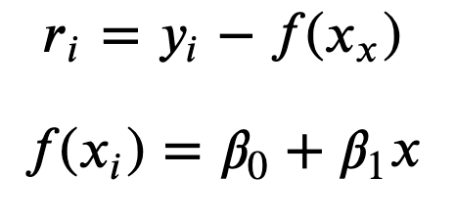
So how do we solve this problem?
Let’s look at this from a net cost perspective. I have
N points:
The residuals specify the “error”:
We want the beta’s that minimize
this error.

Slide 14
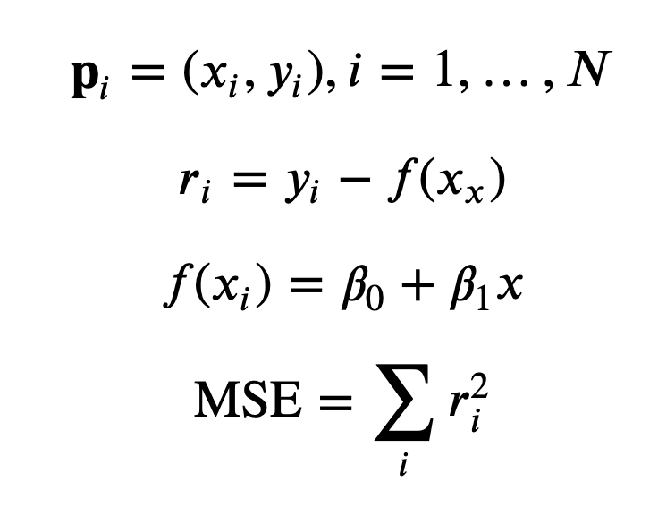
We want to minimize the Sum of Squared Error (or Mean Squared Error)

Slide 15
We want to minimize the Sum of Squared Error (or Mean Squared Error)
So how do we solve for this?

Slide 16
If we write this as a matrix equation, we can solve it using linear algebra.
From CMU Statistics Course

Slide 17
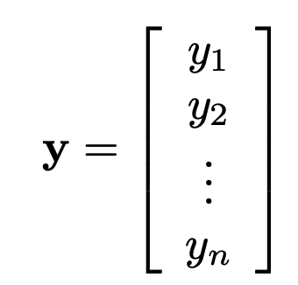
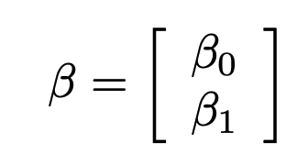
If we write this as a matrix equation, we can solve it using linear algebra.
From CMU Statistics Course

Slide 18
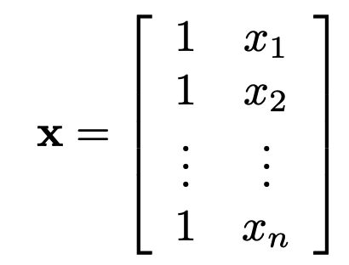
If we write this as a matrix equation, we can solve it using linear algebra.
From CMU Statistics Course

Slide 19
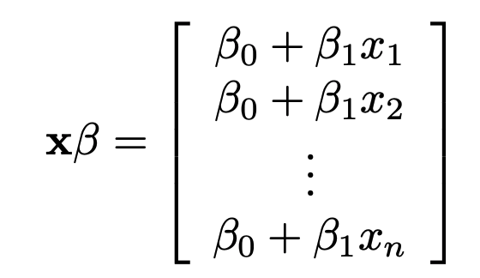
If we write this as a matrix equation, we can solve it using linear algebra.
From CMU Statistics Course

Slide 20
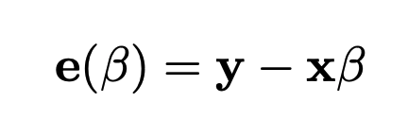
If we write this as a matrix equation, we can solve it using linear algebra.
From CMU Statistics Course

Slide 21
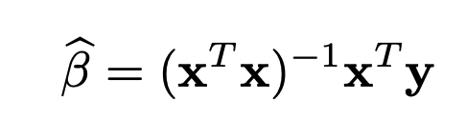
If we write this as a matrix equation, we can solve it using linear algebra.
From CMU Statistics Course

Slide 22
If we write this as a matrix equation, we can solve it using linear algebra.

Slide 23
If we write this as a matrix equation, we can solve it using linear algebra.
Also, this is the “Pseudo-inverse” of x:
It allows us to “invert” a matrix that isn’t square.
Note that if the matrix is square, this will allows us to solve for a line that exactly fits the parameters. No pseudo-inverse required.

Slide 24
However, most problems cannot be solved using linear algebra
Next, we’ll motivate gradient descent, a more generic (iterative) algorithm for learning from data.

Slide 25
So, what are these Neural Networks I’ve been hearing so much about lately?

Slide 26
So, what are these Neural Networks I’ve been hearing so much about lately?
First, some history…

Slide 27
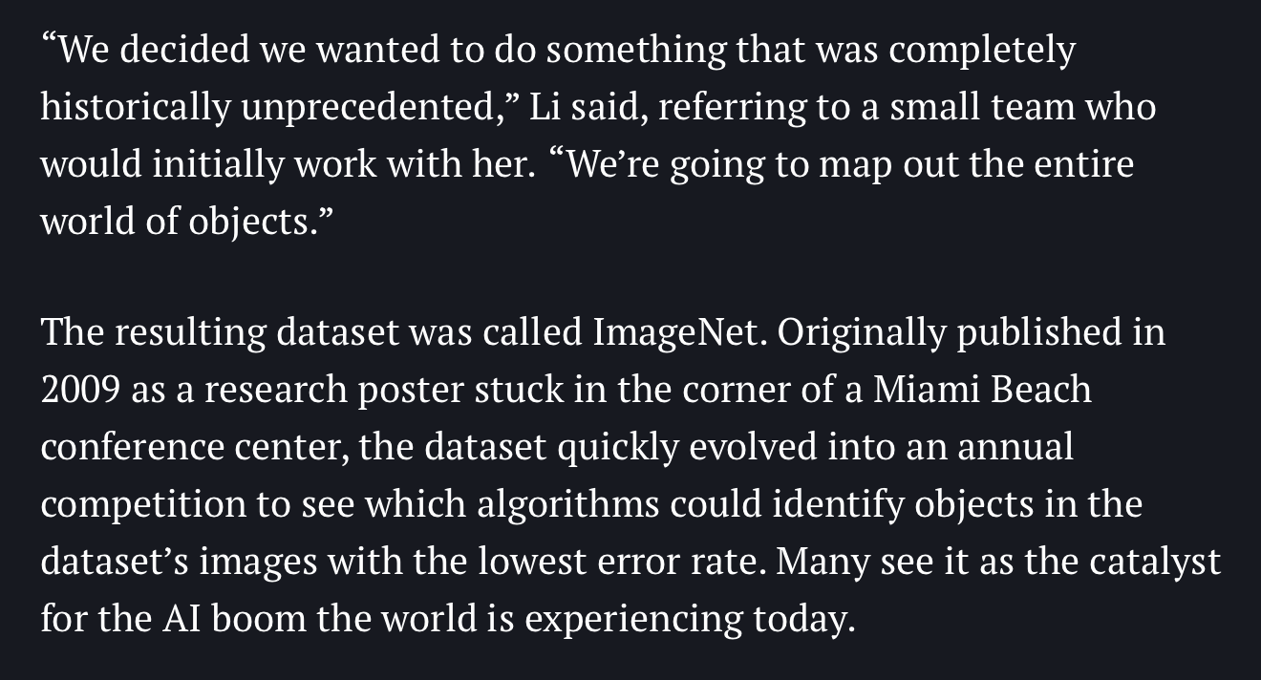

So, what are these Neural Networks I’ve been hearing so much about lately?
First, some history: 2010 marked the first year of the ImageNet image classification competition.
Fei-Fei Li
Sources: https://qz.com/1034972/the-data-that-changed-the-direction-of-ai-research-and-possibly-the-world/

Slide 28
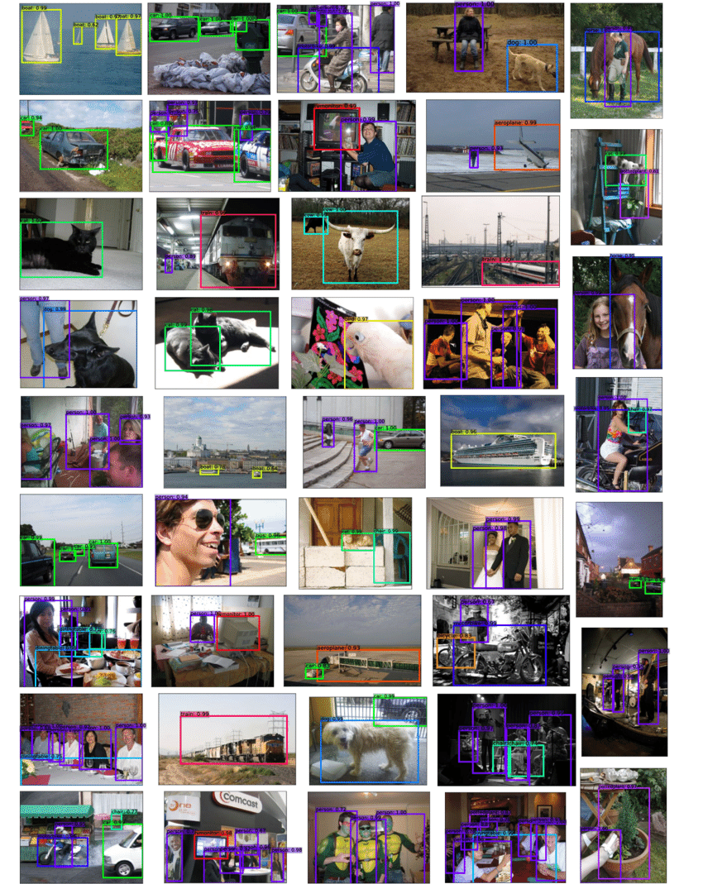
The ImageNet competition had more images/variety than other similar challenges
For context, PASCAL VOC 2012 had 10 object classes: bicycle, bus, car, cat, horse, motorbike, person, sheep.
Training set: 2618 images containing 4754 annotated objects

Slide 29
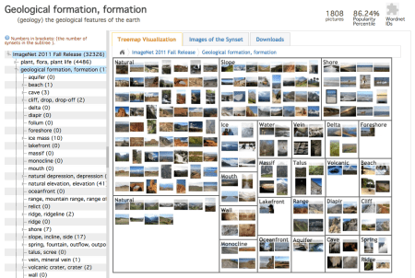
The ImageNet competition had more images/variety than other similar challenges
By contrast, ImageNet had 3.2 million images and 1,000 object classes (actually more like 5,000 grouped into 1,000 buckets)
Sources: https://qz.com/1034972/the-data-that-changed-the-direction-of-ai-research-and-possibly-the-world/

Slide 30
The ImageNet competition had more images/variety than other similar challenges
By contrast, ImageNet had 3.2 million images and 1,000 object classes (actually more like 5,000 grouped into 1,000 buckets)
This meant that the teams had an incredible amount of data to work with and performance on the challenge in its first year was 🤷‍♀️ … fine.
Sources: https://qz.com/1034972/the-data-that-changed-the-direction-of-ai-research-and-possibly-the-world/

Slide 31
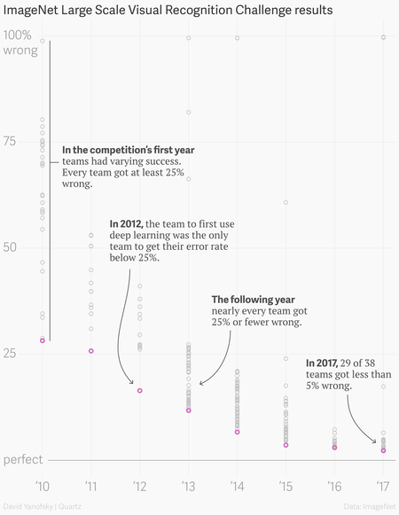
This graph shows Top-5 performance of the teams that entered the competition.
Performance was mediocre, although really impressive: teams were using techniques like bag-of-words on sparse features and training classifiers in descriptor space.
Sources: https://qz.com/1034972/the-data-that-changed-the-direction-of-ai-research-and-possibly-the-world/

Slide 32
This graph shows Top-5 performance of the teams that entered the competition.
Performance was mediocre, although really impressive: teams were using techniques like bag-of-words on sparse features and training classifiers in descriptor space.
Then 2012 happened…
Sources: https://qz.com/1034972/the-data-that-changed-the-direction-of-ai-research-and-possibly-the-world/

Slide 33
Other top performers are very close to each other
2012 is when AlexNet came on to the scene and, using a Convolutional Neural Network, outperformed all other teams by over 10% absolute accuracy.
Sources: https://qz.com/1034972/the-data-that-changed-the-direction-of-ai-research-and-possibly-the-world/

Slide 34
The Perceptron

Slide 35
Aside: inspiration from biological neurons

Slide 36
Here’s a simple “perceptron”
Many Inputs nonlinearly mapped to a single output

Slide 37
In code:

Slide 38
Neural Networks

Slide 39
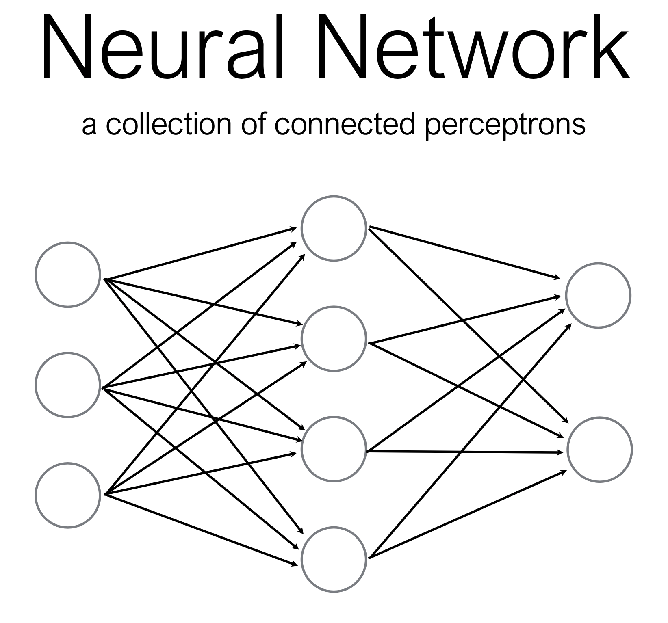
What if we just… connect a bunch of perceptrons together?

Slide 40
How many perceptrons are in this neural network?

Slide 41
How many perceptrons are in this neural network?

Slide 42
How many perceptrons are in this neural network?

Slide 43
How many perceptrons are in this neural network?

Slide 44
How many perceptrons are in this neural network?

Slide 45
How many perceptrons are in this neural network?

Slide 46
Some terminology

Slide 47
Some terminology

Slide 48
Some terminology

Slide 49
Some terminology

Slide 50
Some terminology

Slide 51
A Multi-Layer Perceptron is just a bunch of matrix multiplications + nonlinearity
MLP (multi-layer perceptron) is now more commonly known as a fully-connected neural network.
Each layer consists of:
a matrix multiplication (by a weight matrix W) to change the dimensionality of the data (input size => output size) and
An element-wise nonlinear function.
That’s the core idea!
Where does the weight matrix come from?

Slide 52
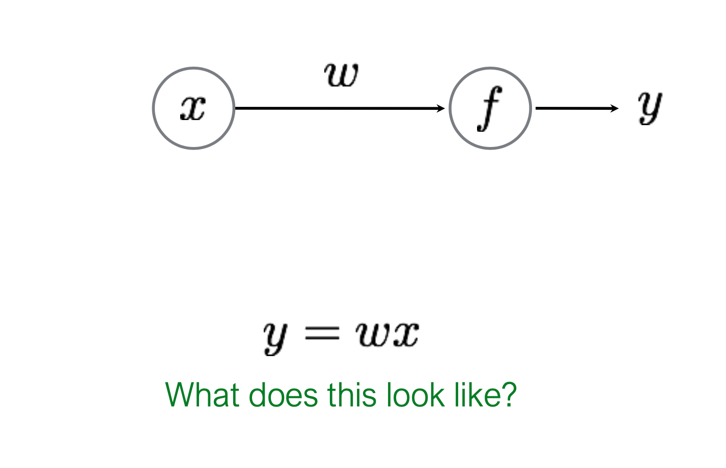
So how do we train these neural networks?
Let’s start easy!

Slide 53
So how do we train these neural networks?
Let’s start easy!
Linear Regression! We’ve seen this scenario before.

Slide 54
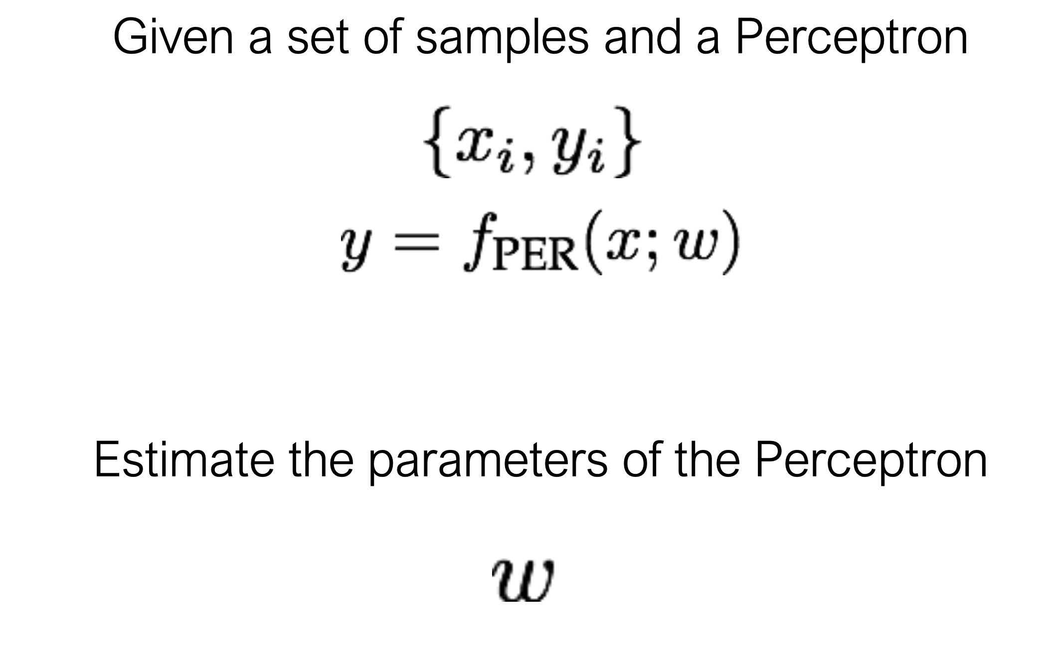
Learning (training) a perceptron

Slide 55
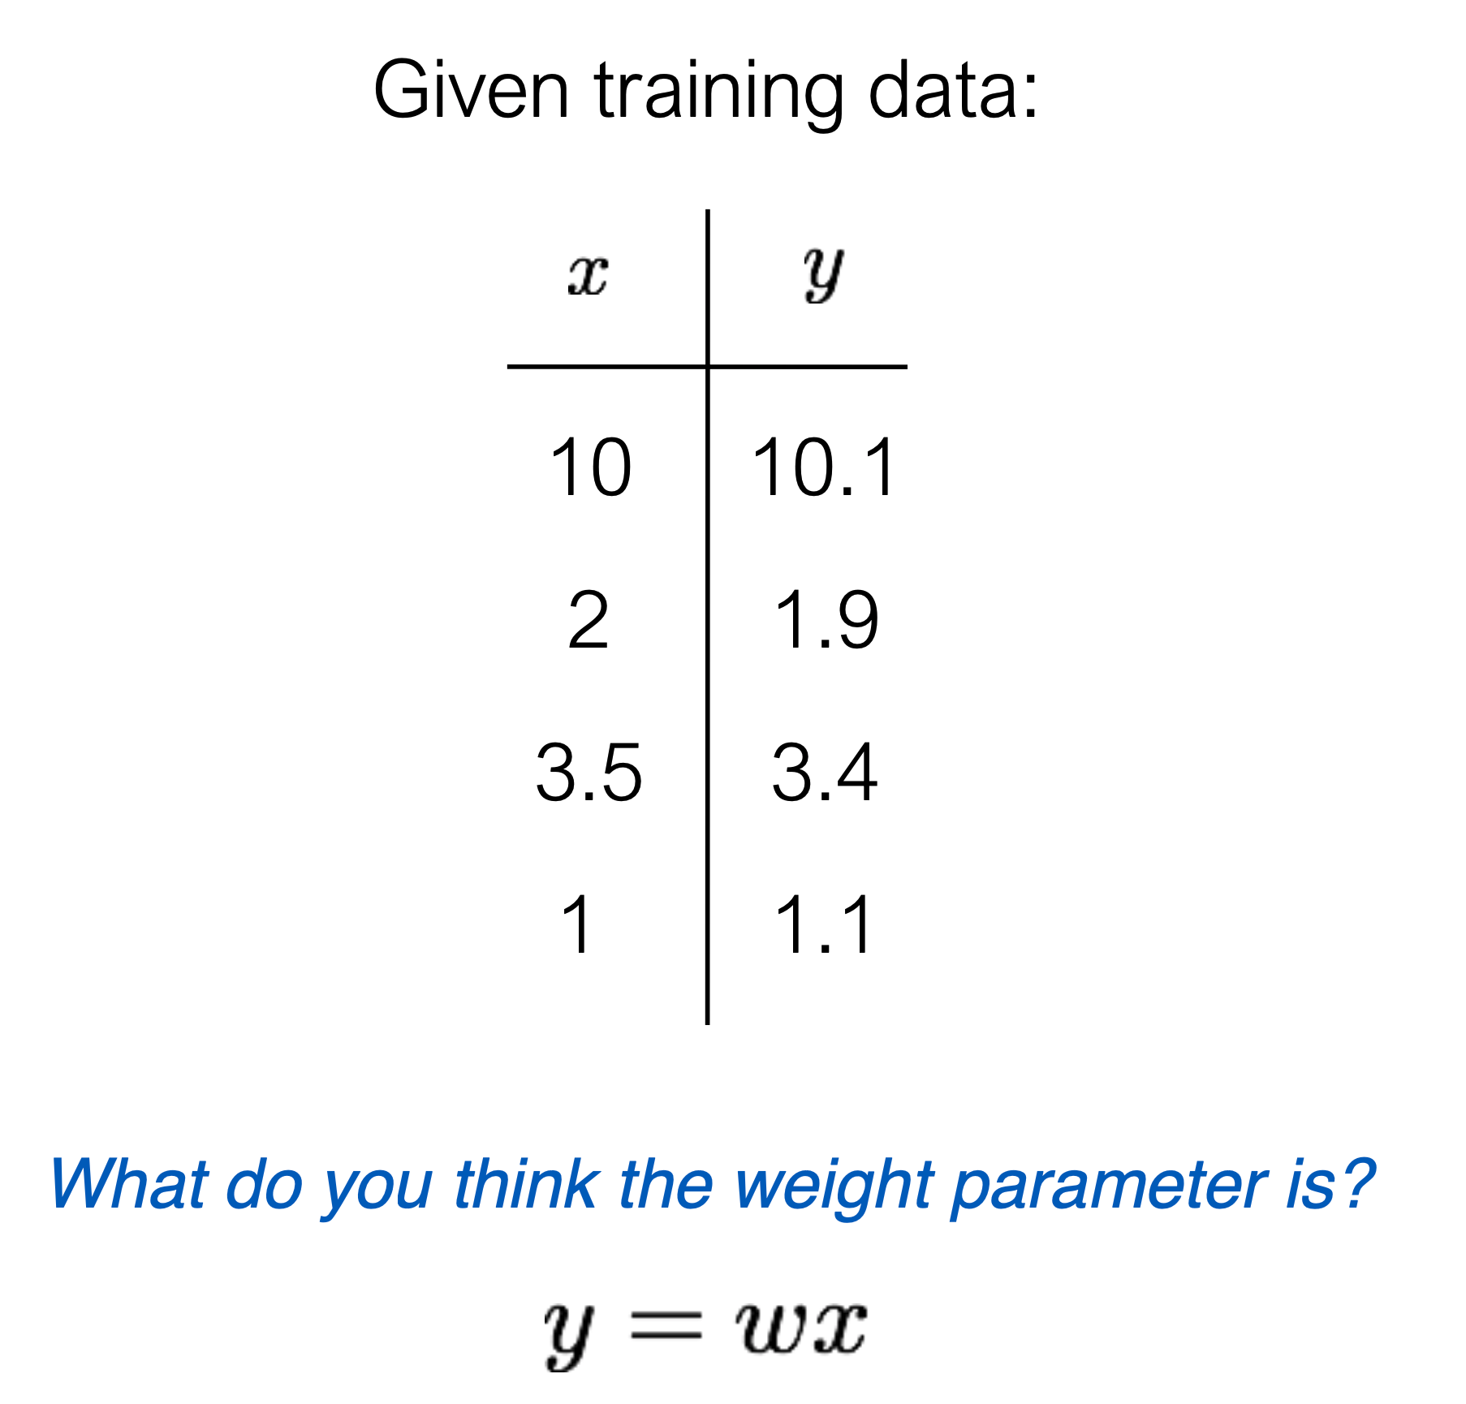
Learning (training) a perceptron

Slide 56
It is common to use an incremental learning strategy (often Gradient Descent)

Slide 57
It is common to use an incremental learning strategy (often Gradient Descent)

Slide 58
It is common to use an incremental learning strategy (often Gradient Descent)

Slide 59
It is common to use an incremental learning strategy (often Gradient Descent)

Slide 60
It is common to use an incremental learning strategy (often Gradient Descent)

Slide 61
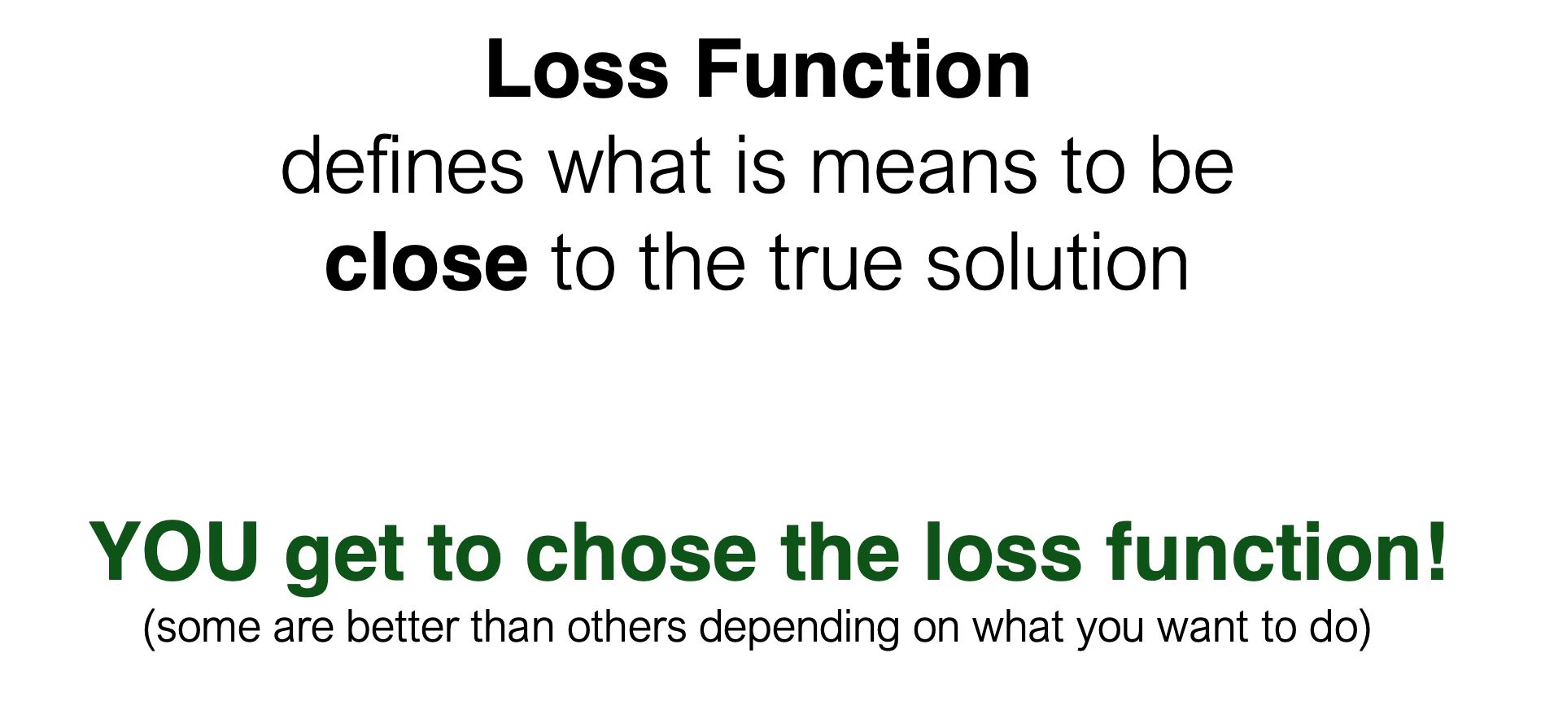
It is common to use an incremental learning strategy (often Gradient Descent)
Before diving deeper, we need to understand how we define “closeness”

Slide 62
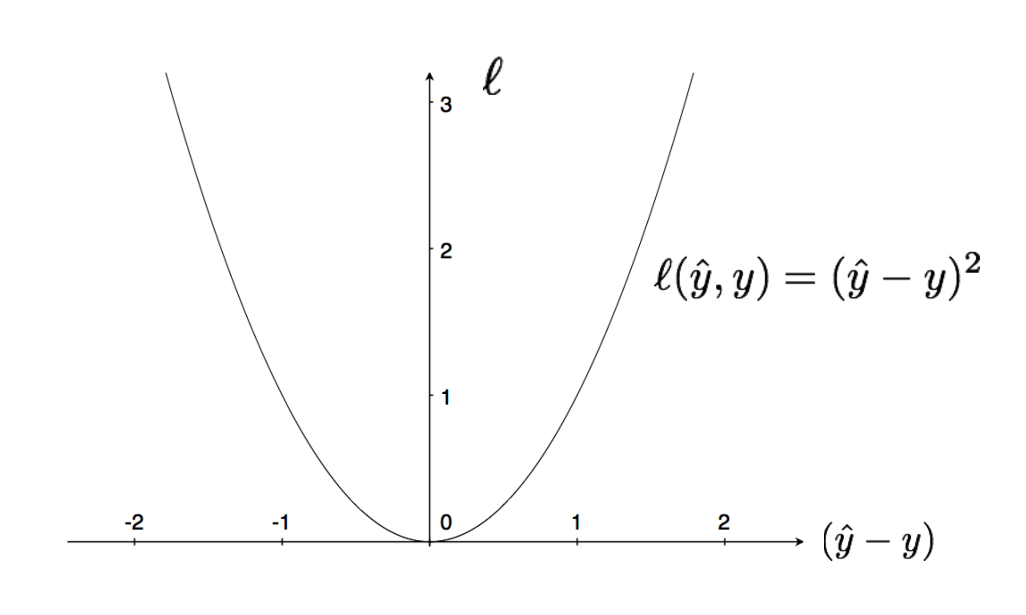
Squared Loss: very common loss function

Slide 63
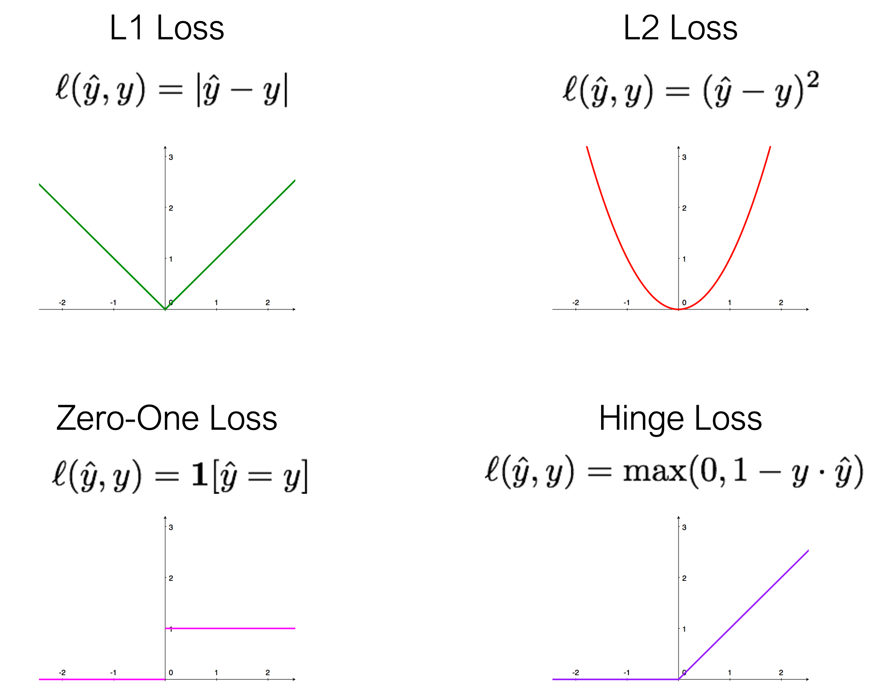
There are plenty of loss functions:

Slide 64
Back to our “world’s simplest perceptron” (which has only one parameter)
Linear Regression! We’ve seen this scenario before.

Slide 65
Back to our “world’s simplest perceptron” (which has only one parameter)

Slide 66
Back to our “world’s simplest perceptron” (which has only one parameter)

Slide 67
Back to our “world’s simplest perceptron” (which has only one parameter)

Slide 68
Gradient Descent
Training your model

Slide 69
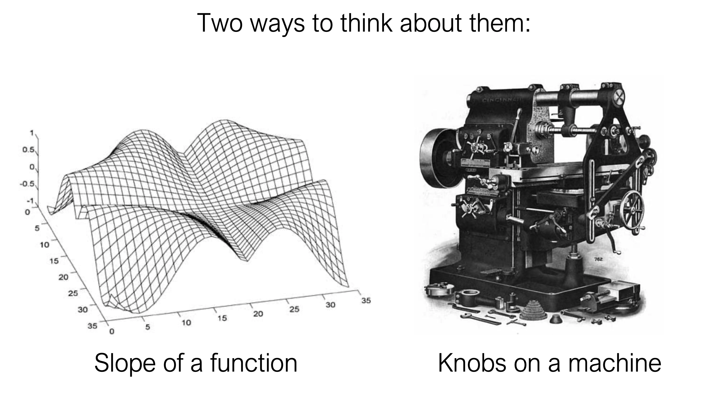
Partial derivatives tell us how much a change in one variable impacts another

Slide 70
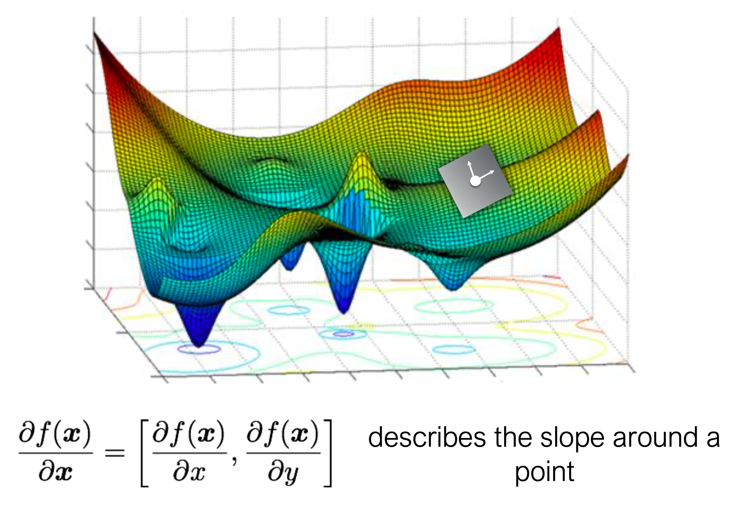
Slope of a function: the partial derivatives describe the slope around a point of interest

Slide 71
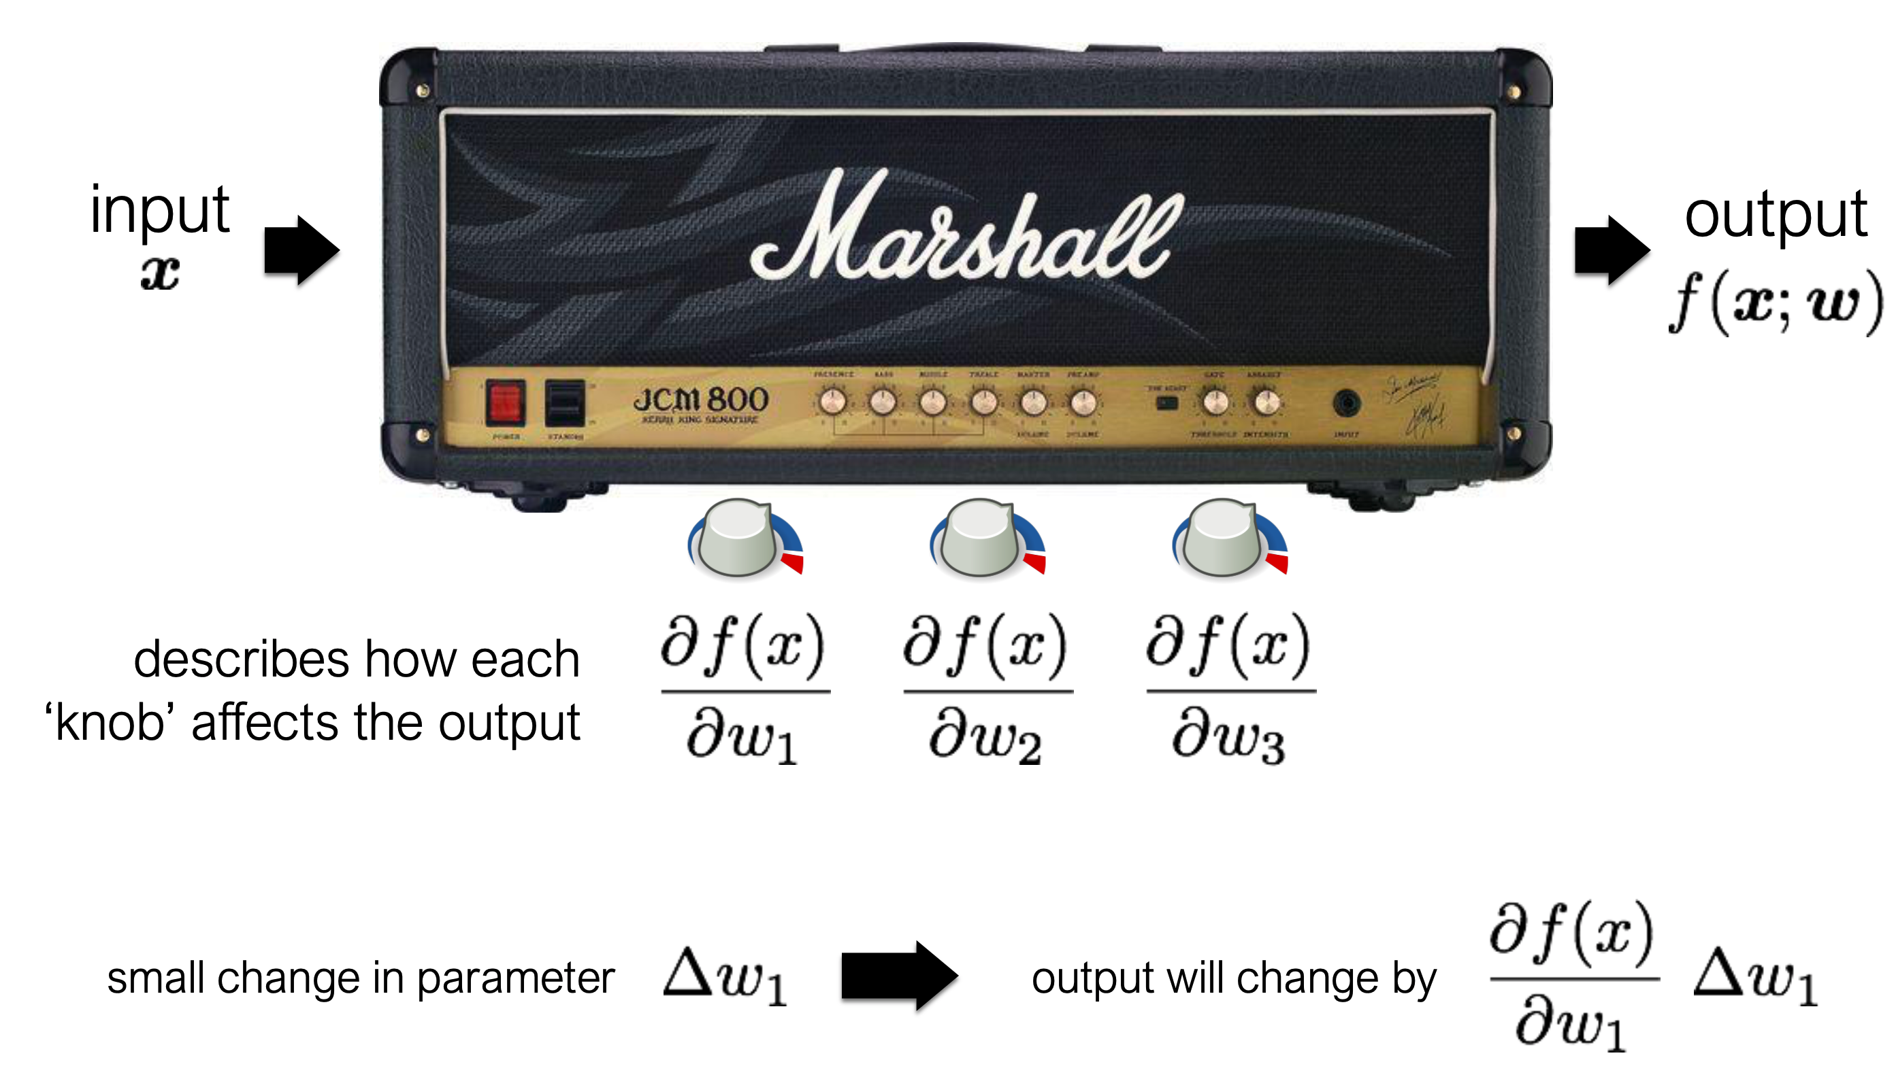
Knobs on a machine: tuning the knobs changing how the input becomes the output

Slide 72
Gradient Descent involves using the partial derivatives to tune the knobs:

Slide 73
Gradient Descent involves using the partial derivatives to tune the knobs:

Slide 74
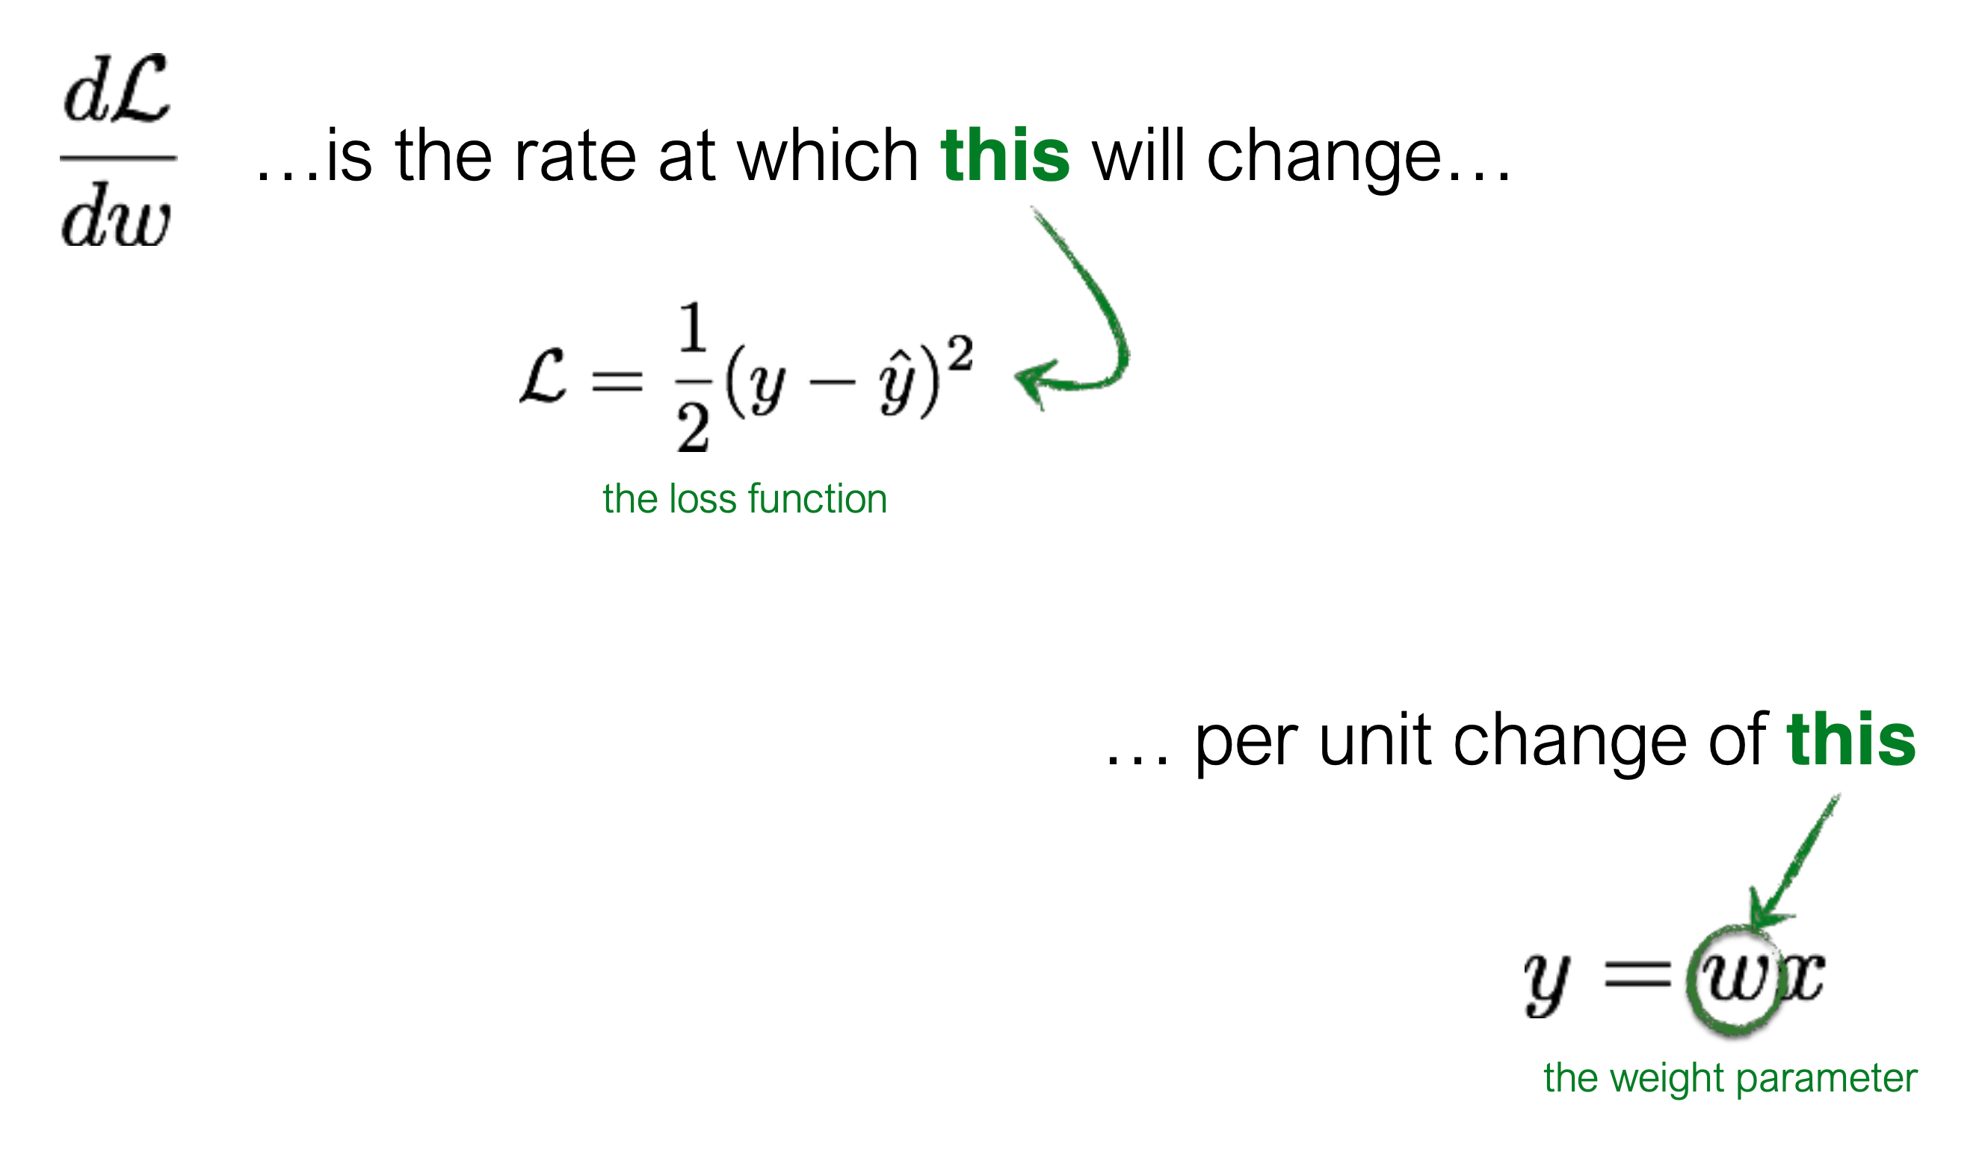
So what does gradient descent look like on our simple example?

Slide 75
So what does gradient descent look like on our simple example?

Slide 76
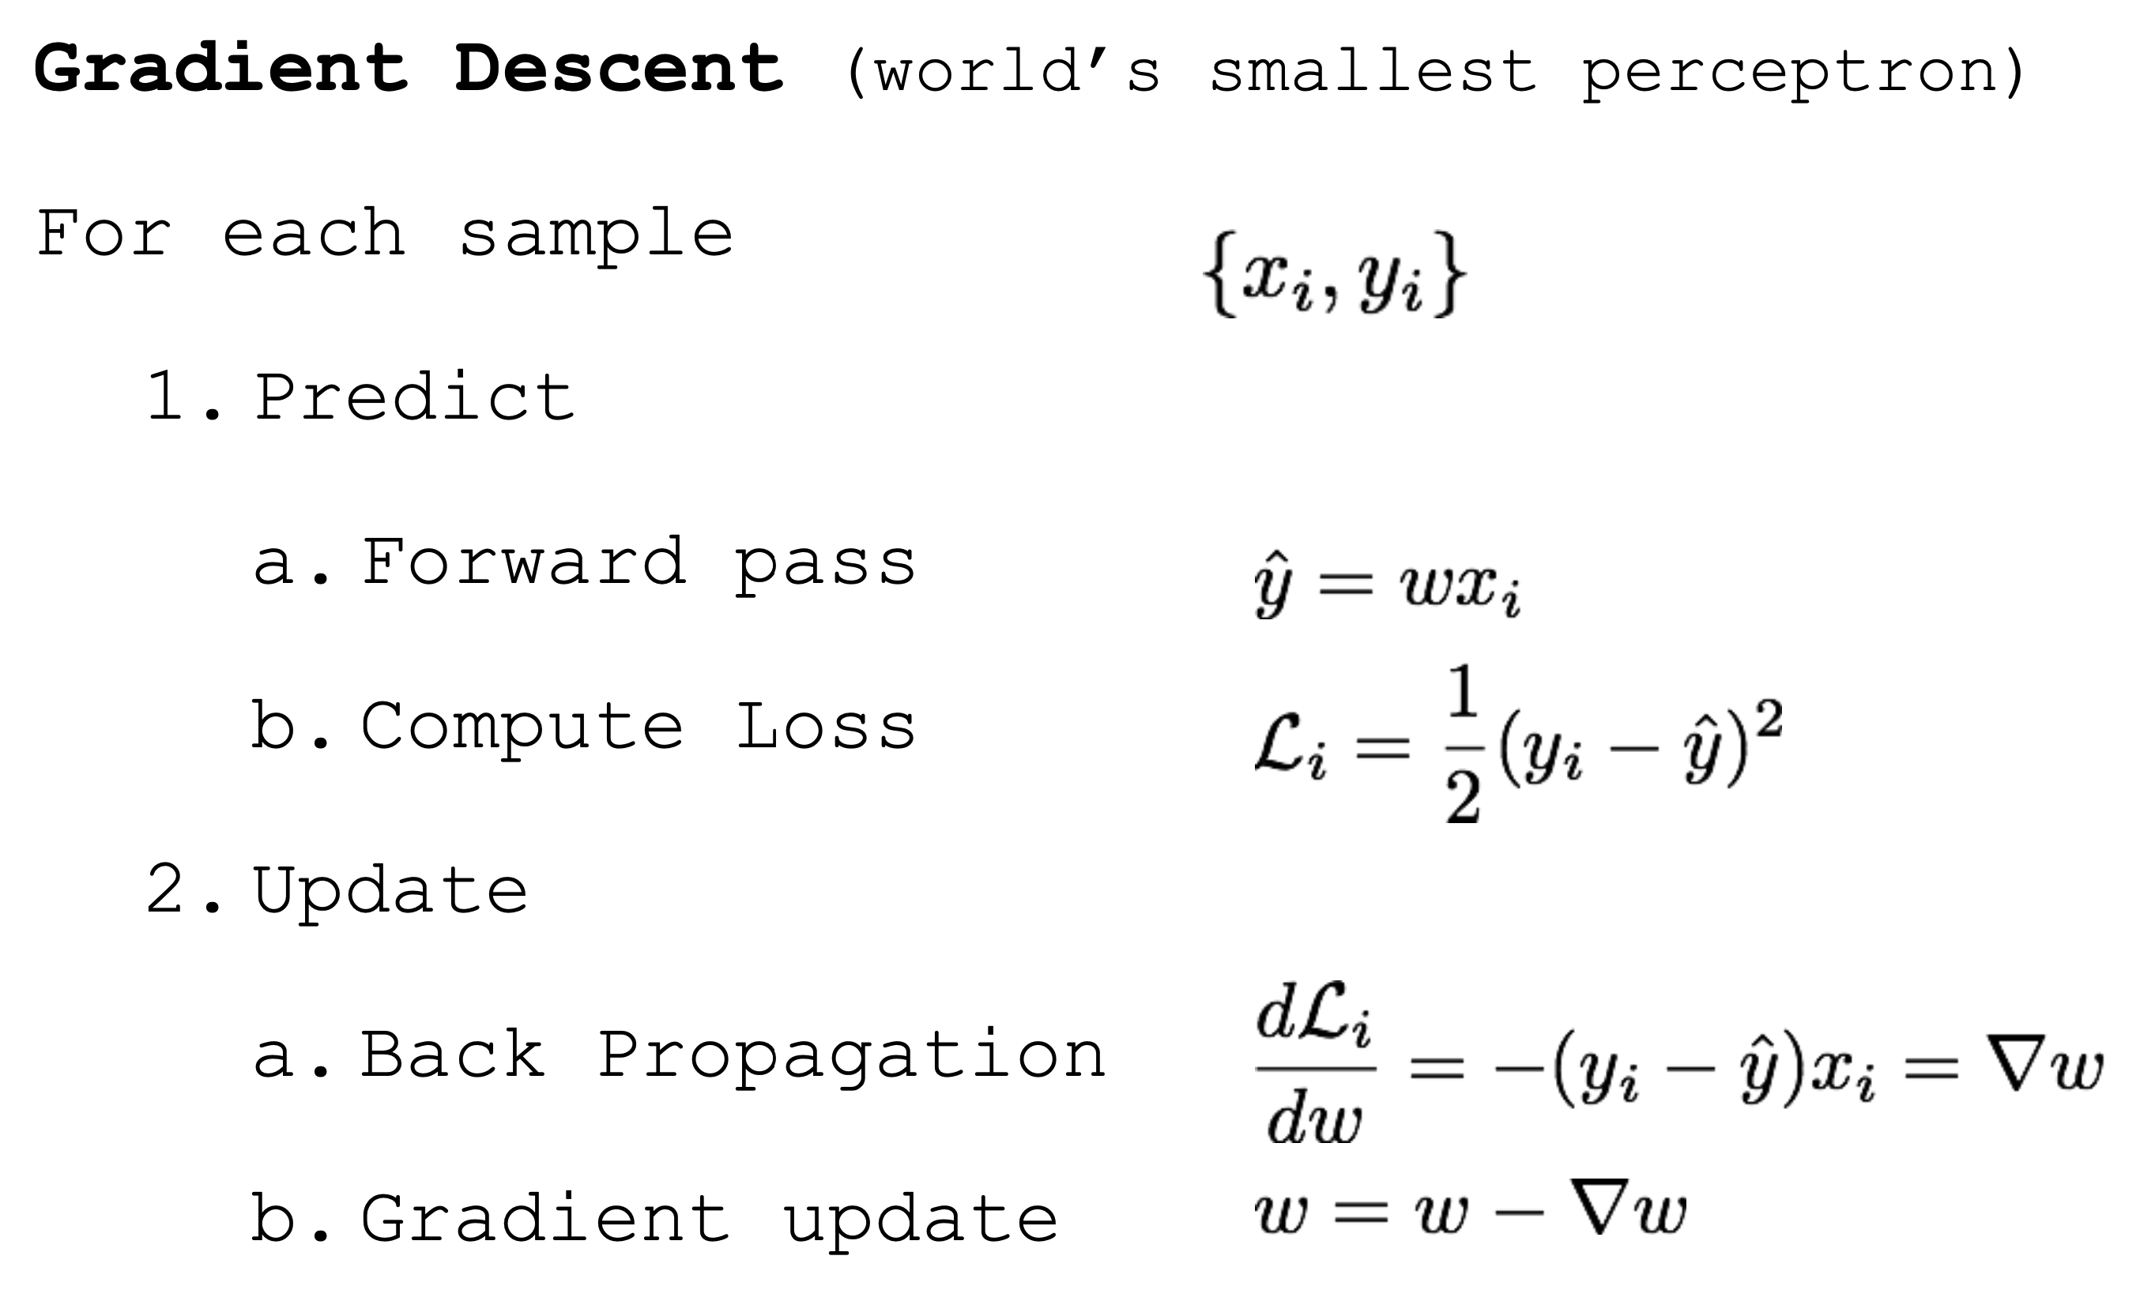
So what does gradient descent look like on our simple example?

Slide 77
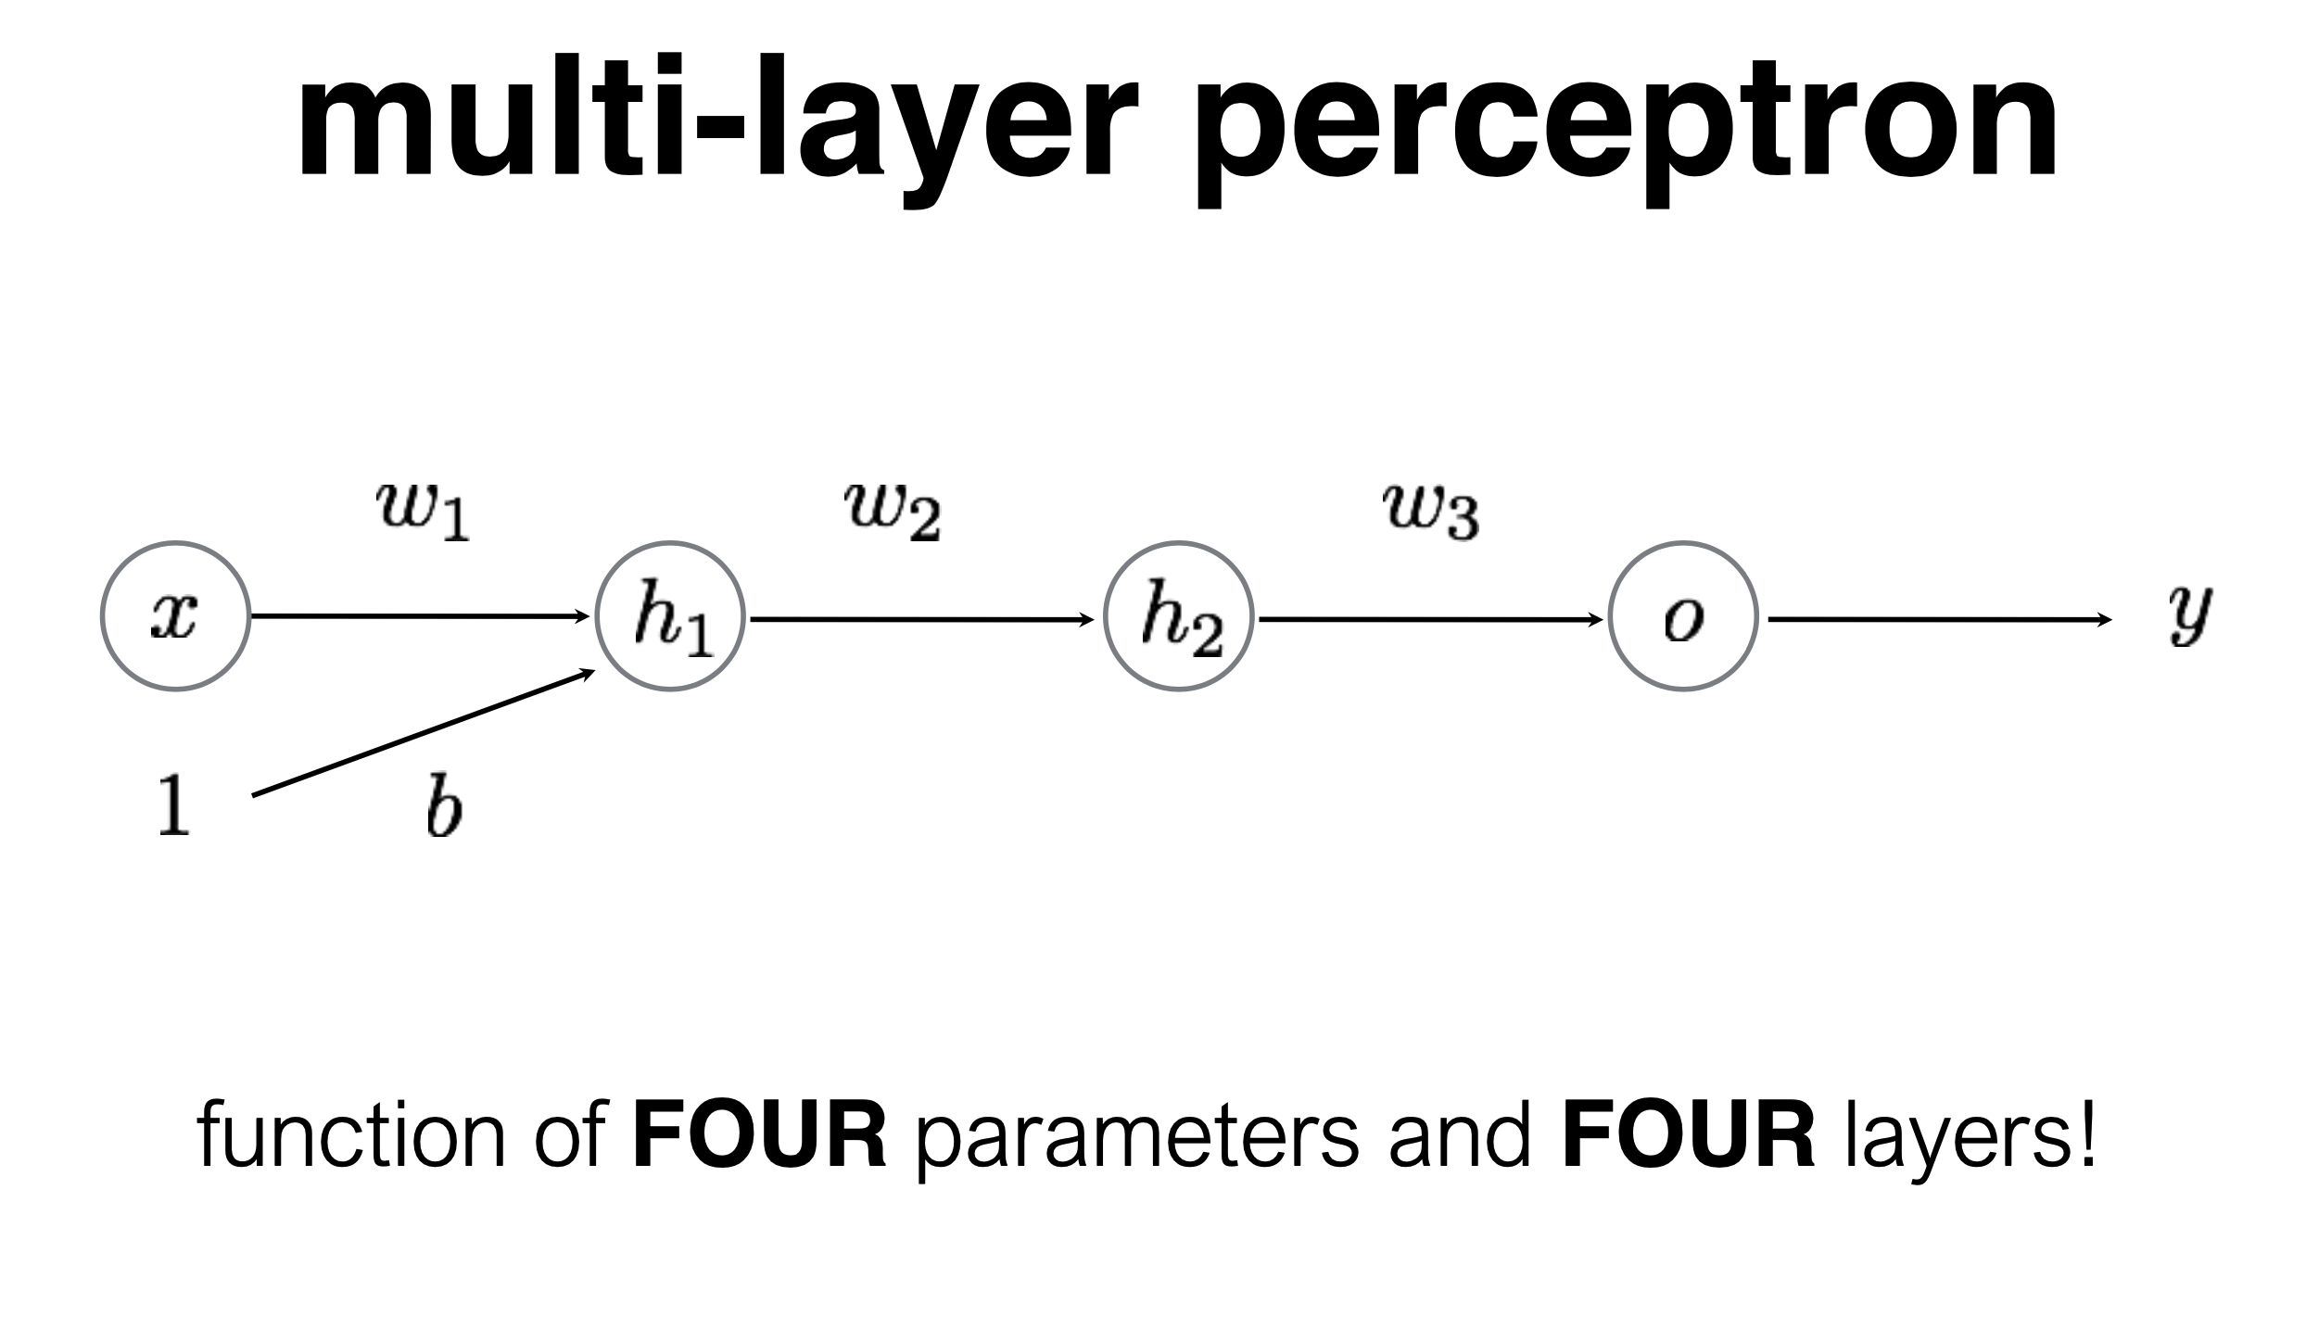
So far we’ve only had one layer.
Let’s add more!

Slide 87
We can write down the entire network as a single equation.

Slide 88
We can write down the entire network as a single equation.

Slide 89
We can write down the entire network as a single equation.

Slide 90
Using what we just learned, training an MLP isn’t terribly (theoretically) complicated

Slide 91
(Stochastic) Gradient Descent Procedure

Slide 92
Key Ideas: Deep Learning is about “hyperparametric function approximation”
We assume we have some model: y = f(x)
We have lots of examples of {y, x} and there are a TON of free parameters that define the function “f”
Given enough data and enough computation, we can approximate the function that represents that relationship knowing very little about that function in advance
That let’s us do a lot: think of object detection: we cannot write down the function that turns an image to a prediction about what object is in it, so we learn it instead.

Slide 93
When you see a learning problem, ask yourself…
What is the data? Where does it come from?
What is the loss function? How do we define error? (and is that the way we think we should actually measure error?)
What is the structure of the neural network? [Note: we’ll talk about this more later.]

