Slide 1
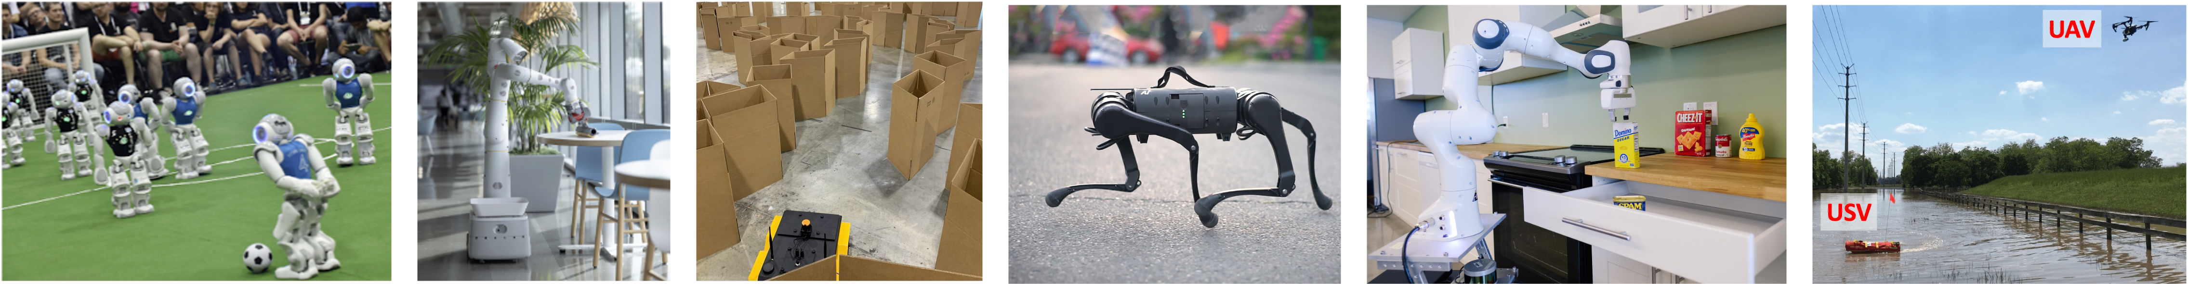
CS 685 Autonomous Robotics
Robot Learning II
Prof. Xuesu Xiao
George Mason University
Slides Credits: Gregory Stein

Slide 2
Final Project Presentation next week!
10-min presentation + 5-min Q&A (15-min per team)
  Reminder of what your project is about?
  What is your approach?
  What have you done?
  What are the results? Any thing learned?
  Project Demo! (Preferably live, at least recorded)
Remember the open-ended project is 40% of your final grade
  Devote 40% of the effort necessary for a 3-credit graduate-level course!
Final project report due in two weeks

Slide 3
Course Evaluation
Please help fill in the course evaluation form at https://gmu.bluera.com/gmu/
Your feedback will be very helpful in improving future offerings of the course
Send the instructor a screenshot of proof of completion to get 5 points extra credit ☺

Slide 4
Learning for Perception
Speaking of object detection…

Slide 5
But first…
Convolutional Neural Networks
A building block of deep learning for image data

Slide 6
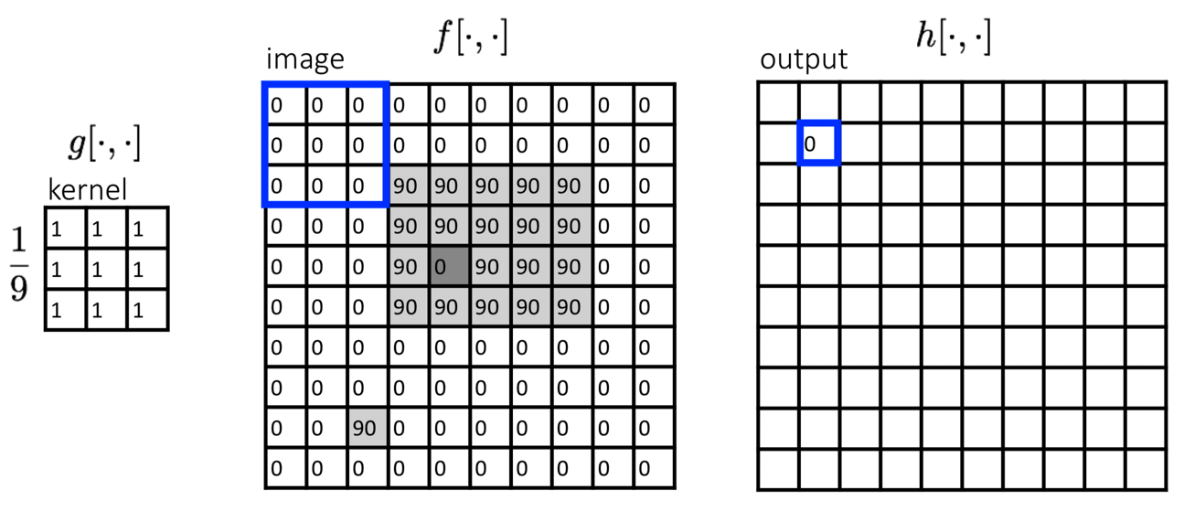
Convolution: “sweep” a “kernel” across a 2D grid of data and compute the dot product.

Slide 7
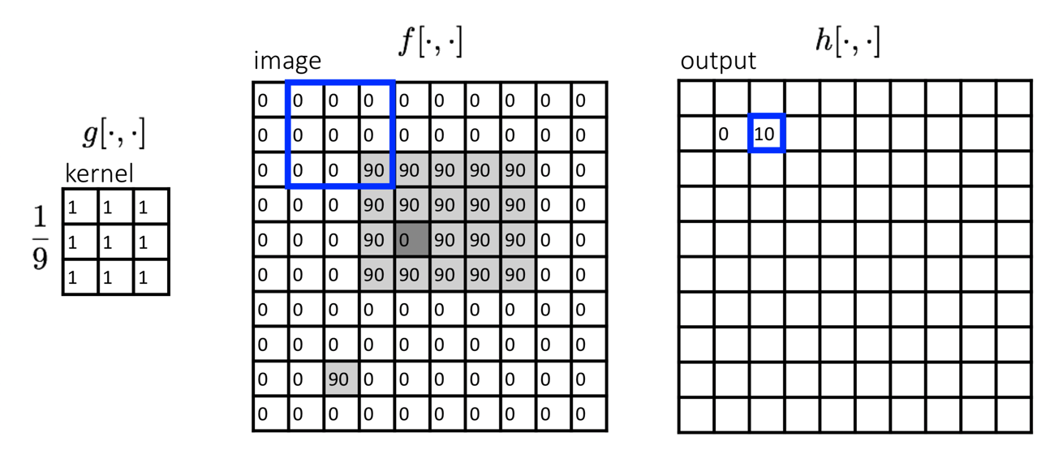
Convolution: “sweep” a “kernel” across a 2D grid of data and compute the dot product.

Slide 8
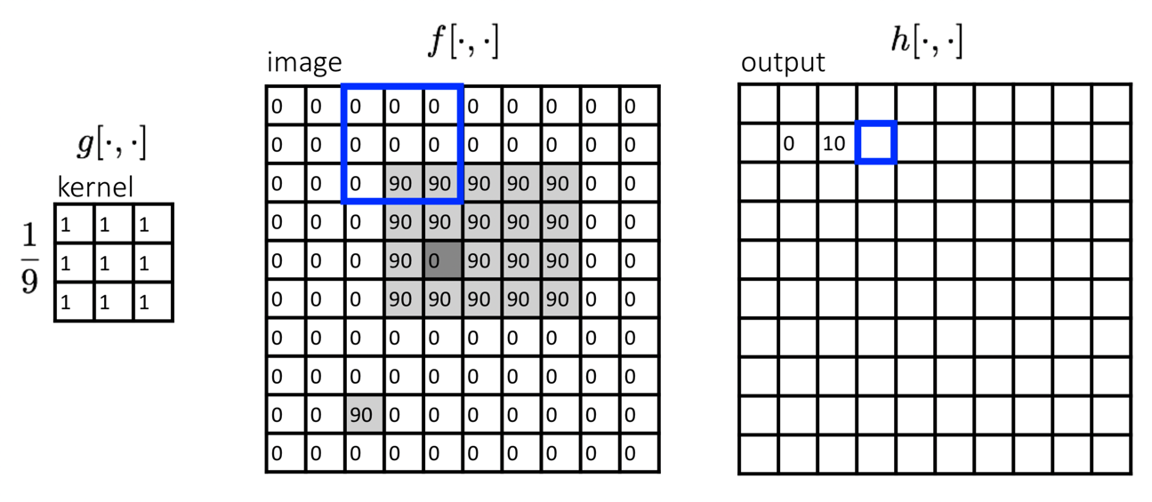
Convolution: “sweep” a “kernel” across a 2D grid of data and compute the dot product.

Slide 9
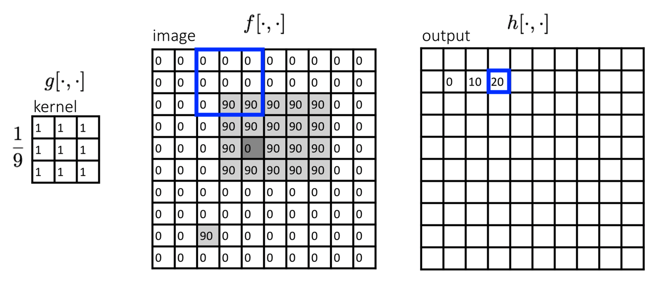
Convolution: “sweep” a “kernel” across a 2D grid of data and compute the dot product.

Slide 10
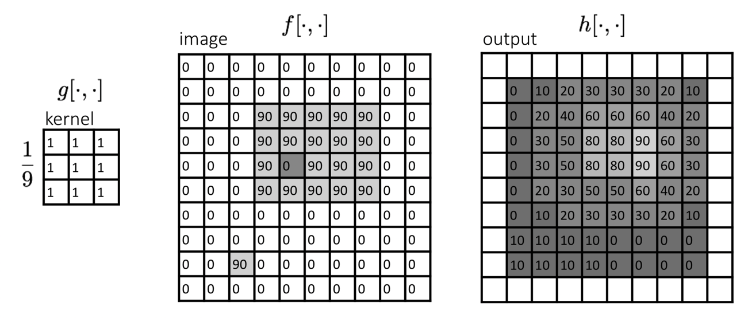
Convolution: “sweep” a “kernel” across a 2D grid of data and compute the dot product.

Slide 11
Instead of “fully-connected layers” (matrix multiplies), CNN’s use convolutions
CNN: Convolutional Neural Network
A CNN consists of stacks of convolution operations, each followed by a nonlinearity and a “downsampling operation”
Similar in spirit to Fully Connected Neural Networks, but only to local pixels

Slide 15
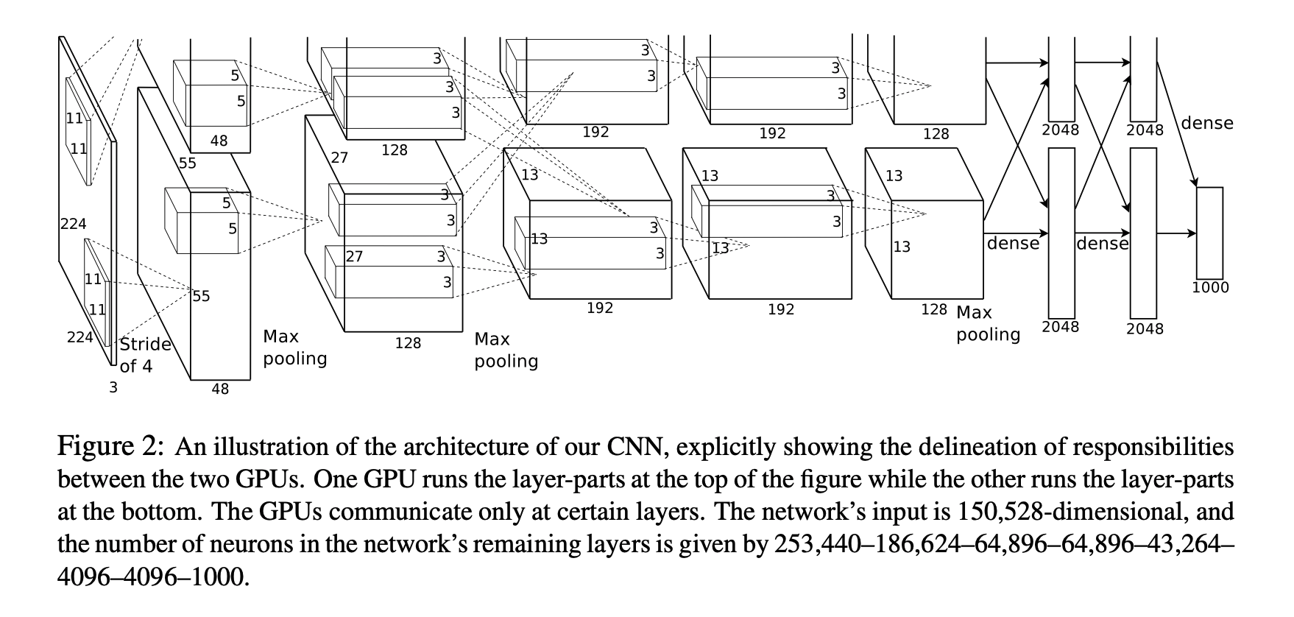
AlexNet
The CNN that started the revolution
https://papers.nips.cc/paper/2012/file/c399862d3b9d6b76c8436e924a68c45b-Paper.pdf

Slide 16
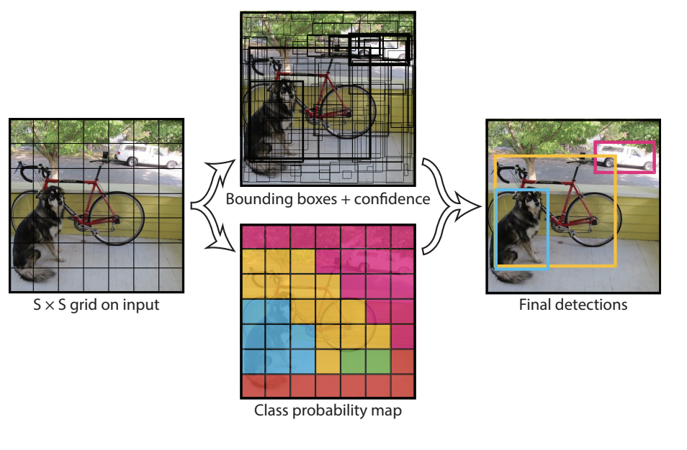
YOLO: You Only Look Once
An order of magnitude faster…

Slide 17
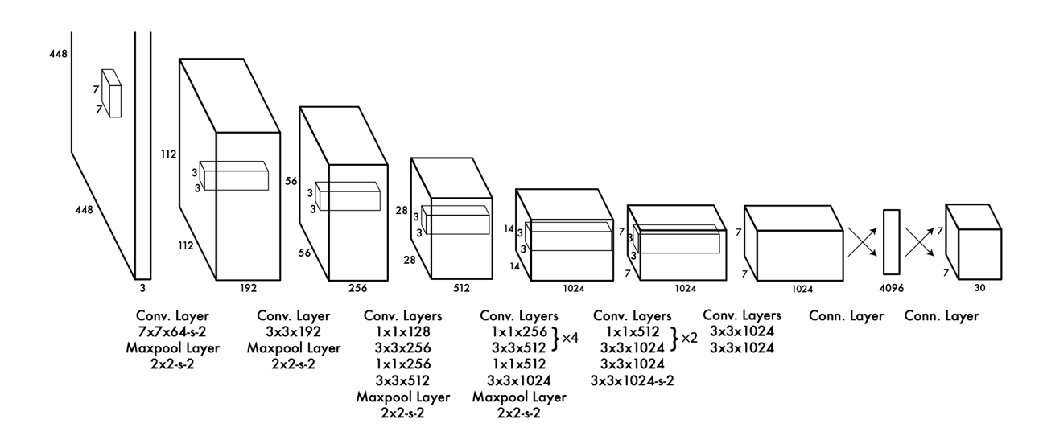
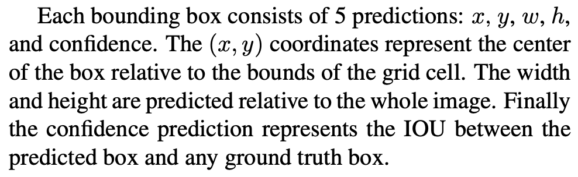
YOLO: You Only Look Once

Slide 18
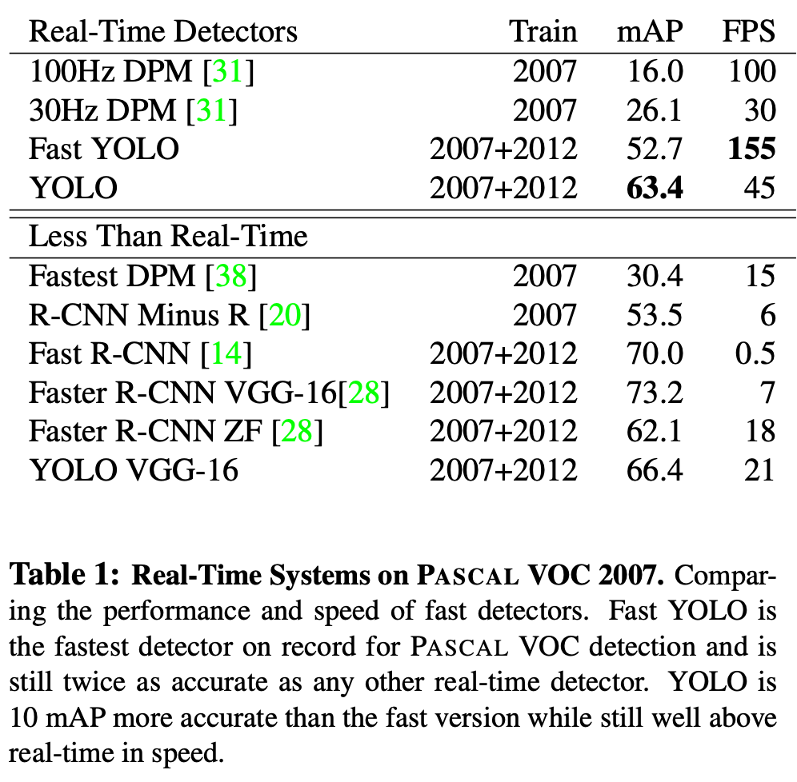
YOLO: You Only Look Once

Slide 19
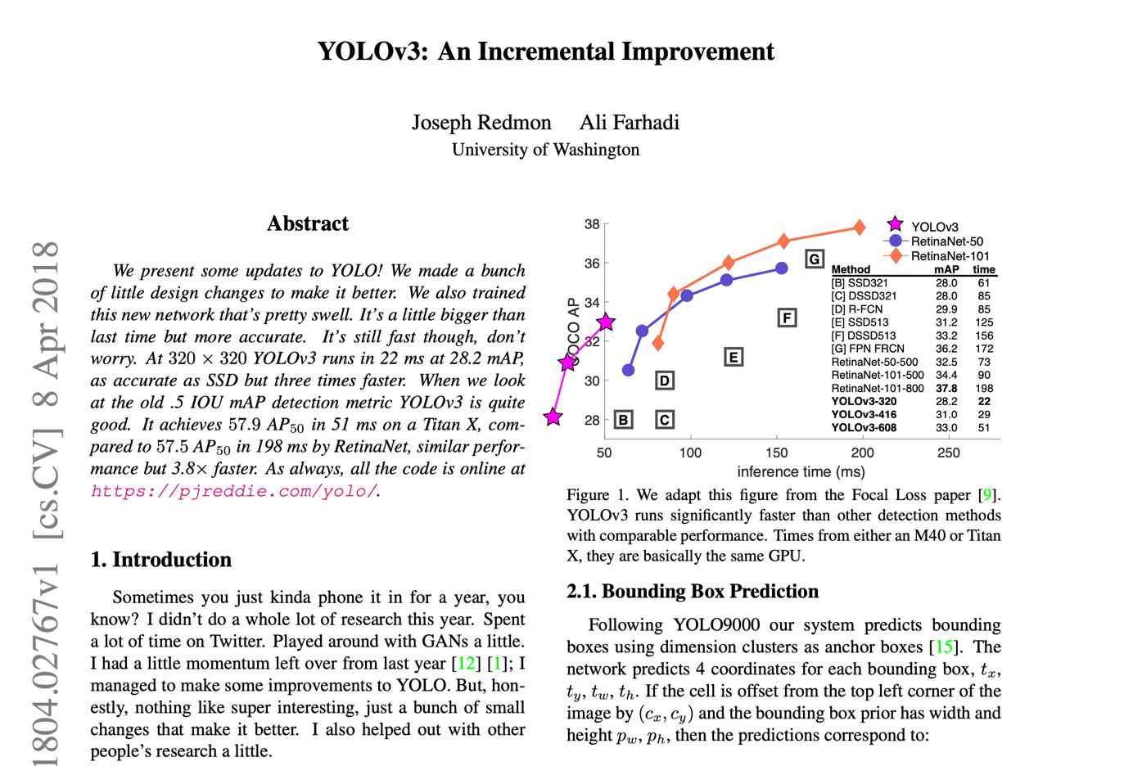
Aside: YOLO v3 is one of the most brutally honest papers…

Slide 20
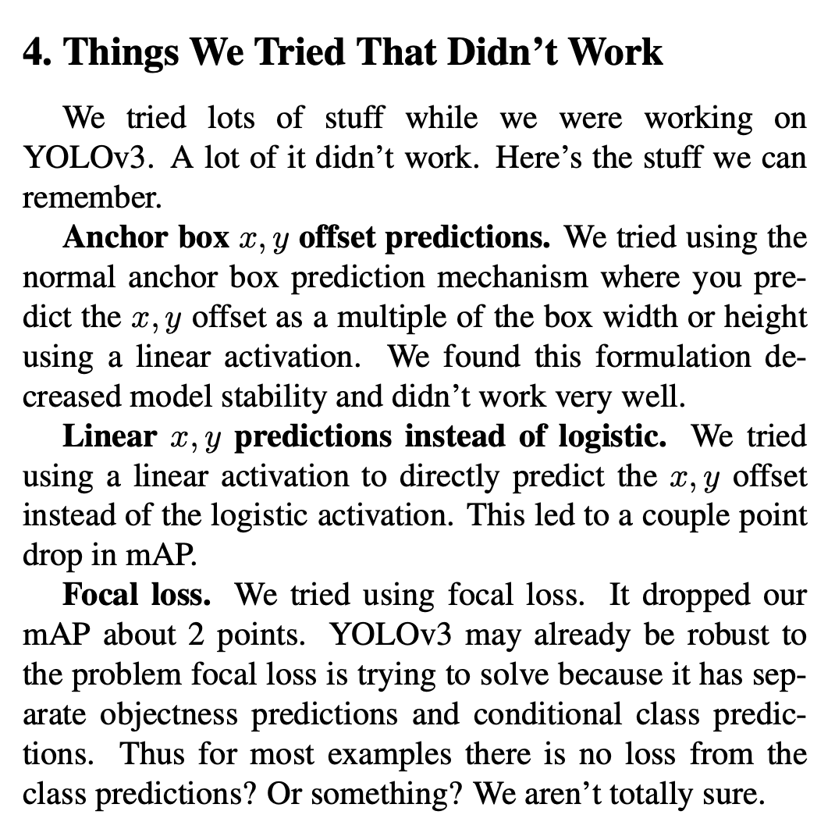
Aside: YOLO v3 is one of the most brutally honest papers…

Slide 21
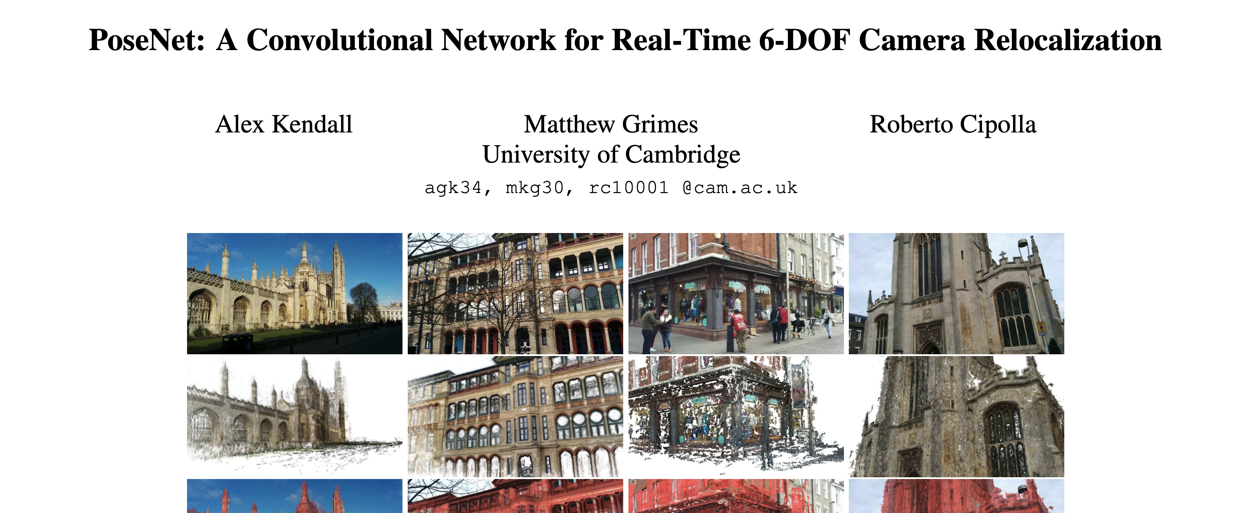
Also: “Pseudo-Sensors”
Some times, we wish we had a sensor for something, but we… don’t. But if images contain the knowledge we want, we might be able to estimate that quantity (and then use it for another process).
Example: pose estimation

Slide 22
Latent Representations of Data

Slide 23
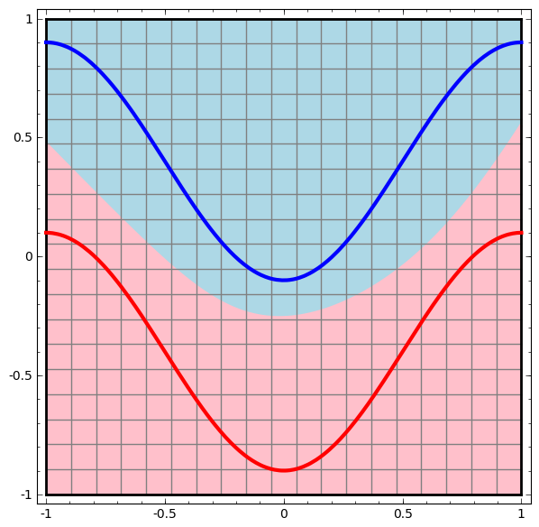
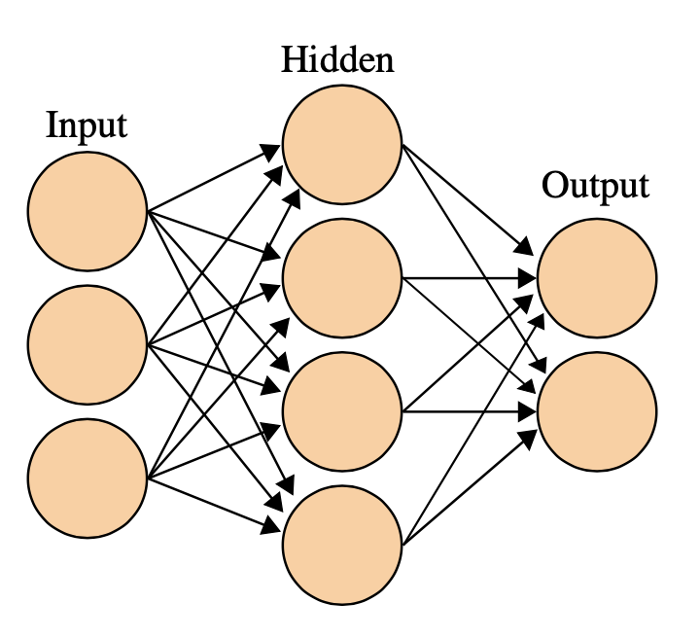
Visualizing Neural Networks
A neural network—a multi-layered set of perceptrons with other nonlinear activations—transforms the data into a new representation.
The classification over all inputs
http://colah.github.io/posts/2014-03-NN-Manifolds-Topology/

Slide 24
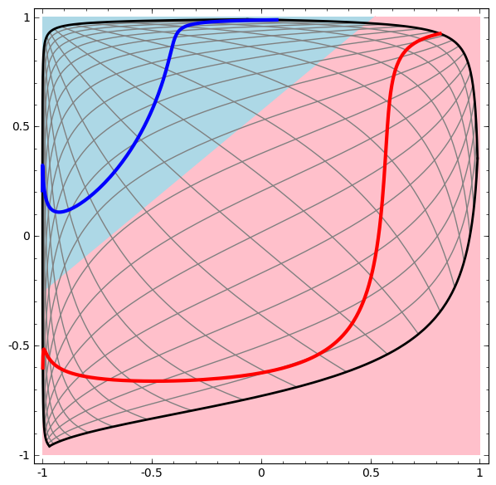
Visualizing Neural Networks
A neural network—a multi-layered set of perceptrons or other nonlinear —transforms the data into a new representation.
The classification over all inputs
Visualization of the hidden layer.
Notice that the data is linearly separable in the hidden-layer space.
http://colah.github.io/posts/2014-03-NN-Manifolds-Topology/

Slide 25
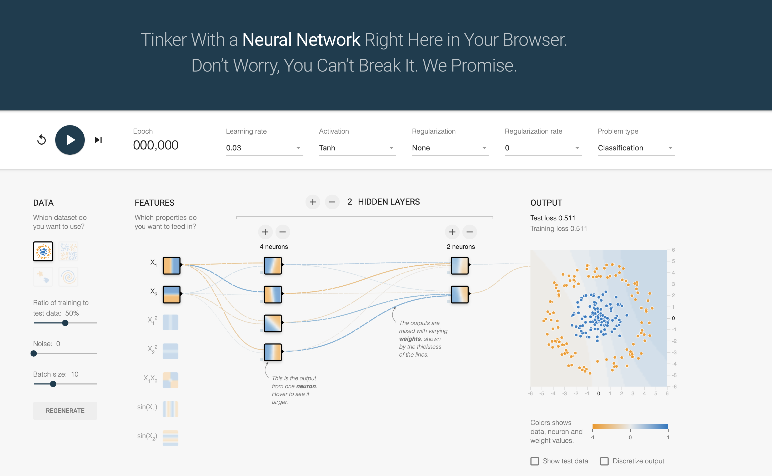
Visualizing Neural Networks
https://playground.tensorflow.org/

Slide 26
Lots of AI therefore depends on transforming your data into a more useful form
The layers in a neural network are each some form of transformation.
Let’s look at an example:

Slide 27
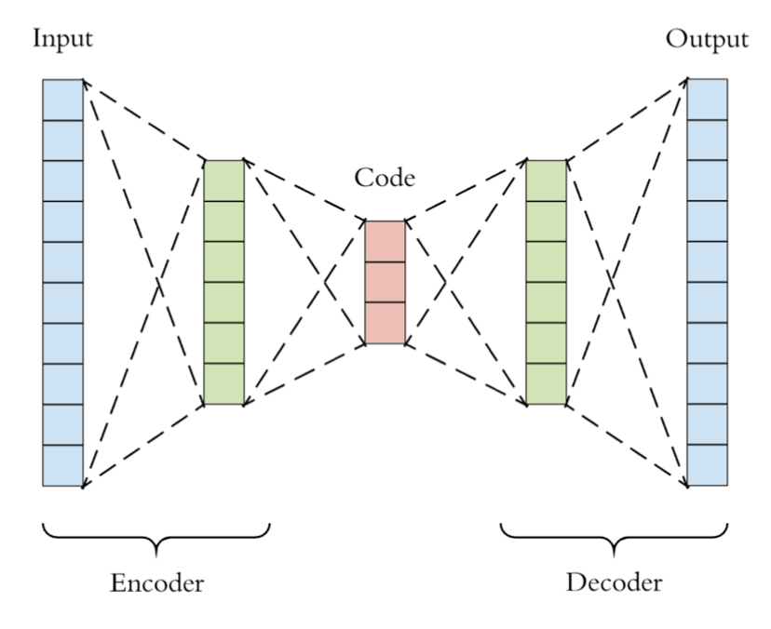
Autoencoder: unsupervised dimensionality reduction
Let’s train an encoder-decoder to reconstruct the input.
Loss function: try to make the output look like the input.
What might we use this for?

Slide 28
Autoencoder: unsupervised dimensionality reduction
We can use this for transfer learning!
(more on that later)
Helpful to think of this as a learned compression algorithm:
Learning some low dimension representation of high dimensional data.
That low dimensional representation can be used for lots of things, often in a transfer learning setting.

Slide 29
Autoencoder: unsupervised dimensionality reduction
We can use this for transfer learning!
(more on that later)
Helpful to think of this as a learned compression algorithm:
Learning some low dimension representation of high dimensional data.
That low dimensional representation can be used for lots of things, often in a transfer learning setting.
Key takeaways: (1) we can learn to make big data smaller and (2) we can learn to make small data bigger. This will come up again later!

Slide 30
Autoencoder: unsupervised dimensionality reduction
Conceptual question: What happens if I use the autoencoder to encode/decode (compress/decompress) data that’s very different?

Slide 31
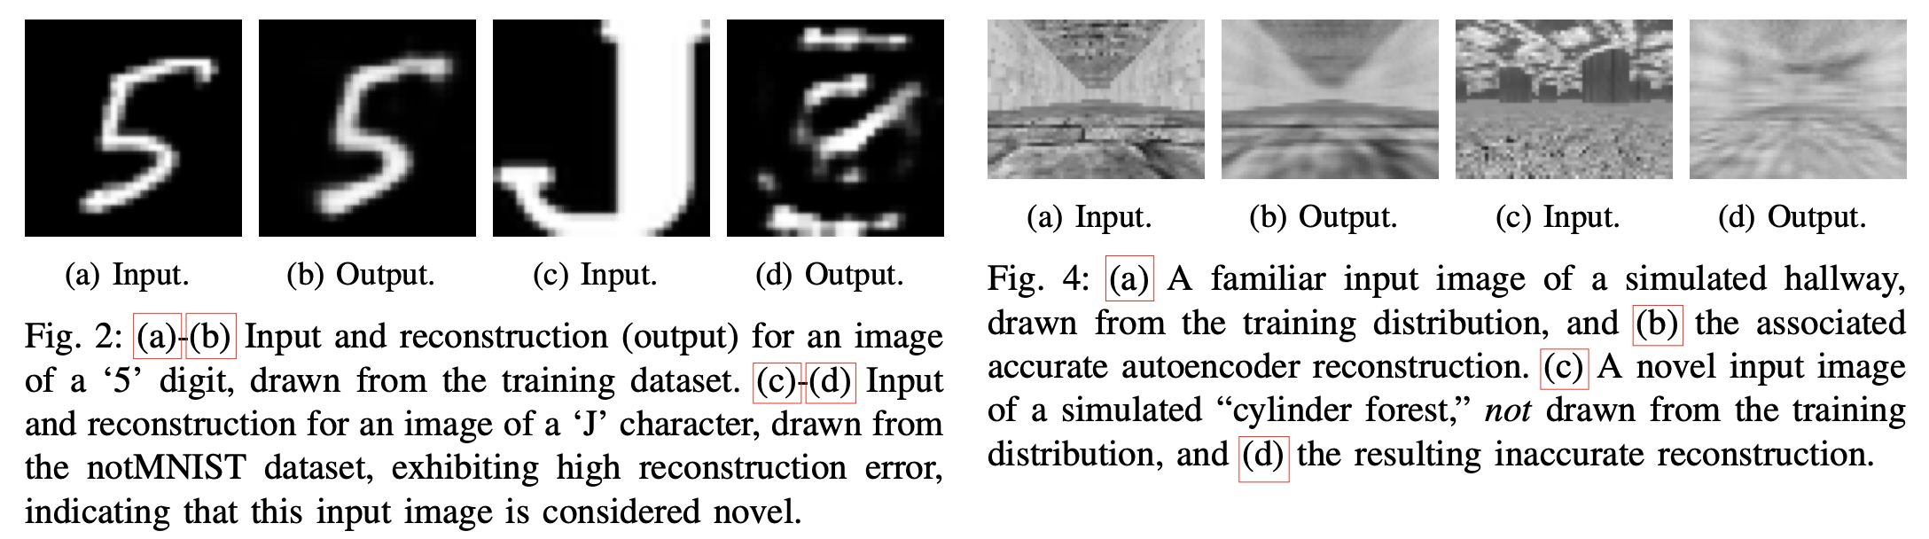
Autoencoder: unsupervised dimensionality reduction
Conceptual question: What happens if I use the autoencoder to encode/decode (compress/decompress) data that’s very different?
Answer: the reconstruction will be poor; compression throws away stuff that’s unlike the input:
Think of this like a projection operation in some high-dimensional space.
Safe Visual Navigation via Deep Learning and Novelty Detection, Richter & Roy, RSS 2017

Slide 32
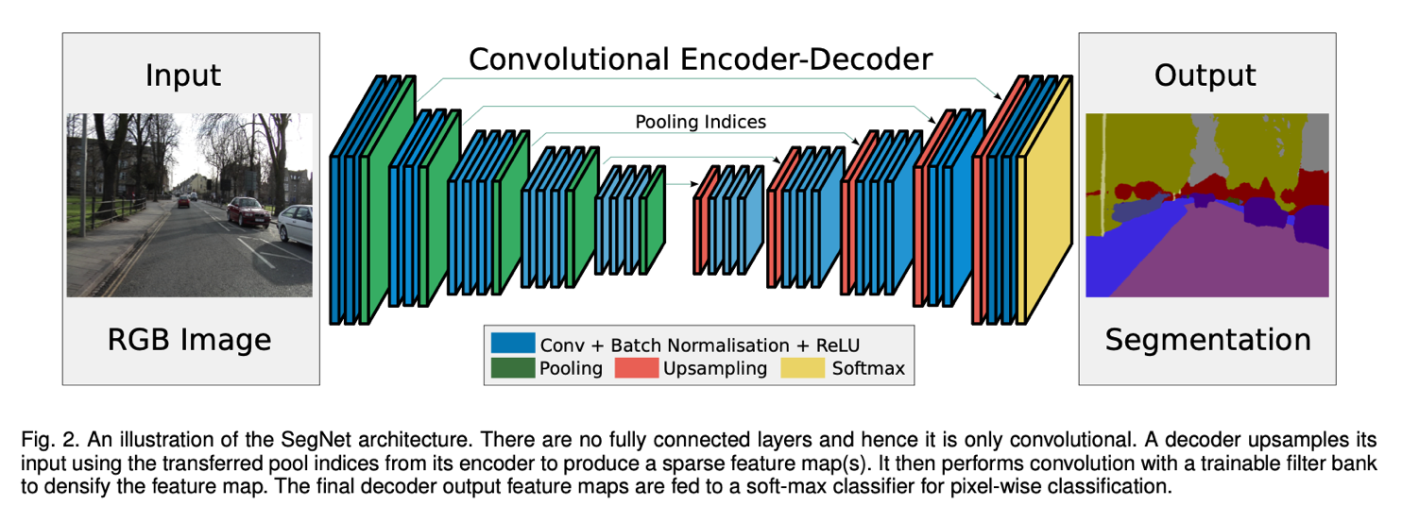
Use Cases of Encoder/decoders
Here’s an application for semantic segmentation
SegNet: https://arxiv.org/pdf/1511.00561.pdf

Slide 33
Also, we can use that “low dimensional embedding” of the data for other tasks
Take an auto-encoder and chop off the end
That compressed version of your data should contain much of the same information, but smaller, which makes is well-suited to serve as an input to other processes

Slide 34
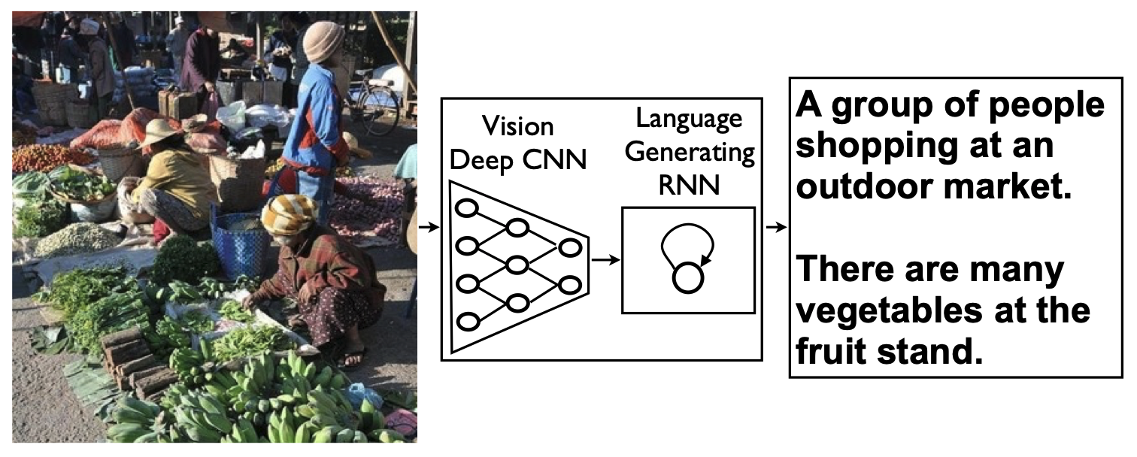

We can also “translate” between data types
Image In => Language Out

Slide 35
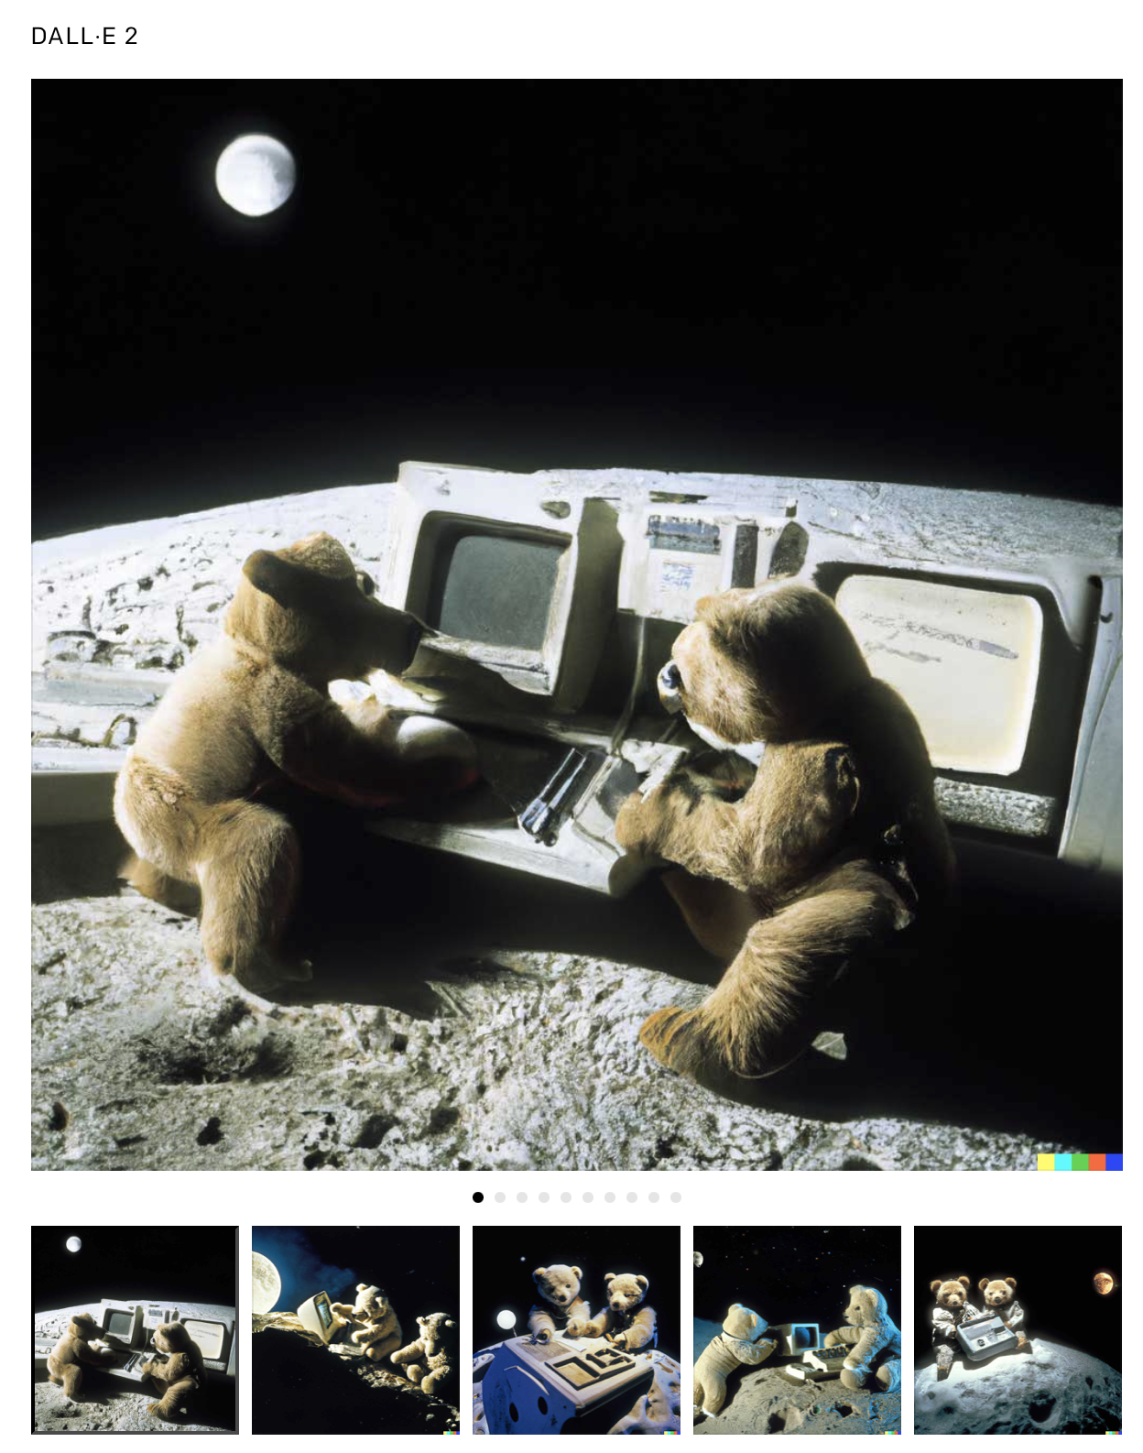
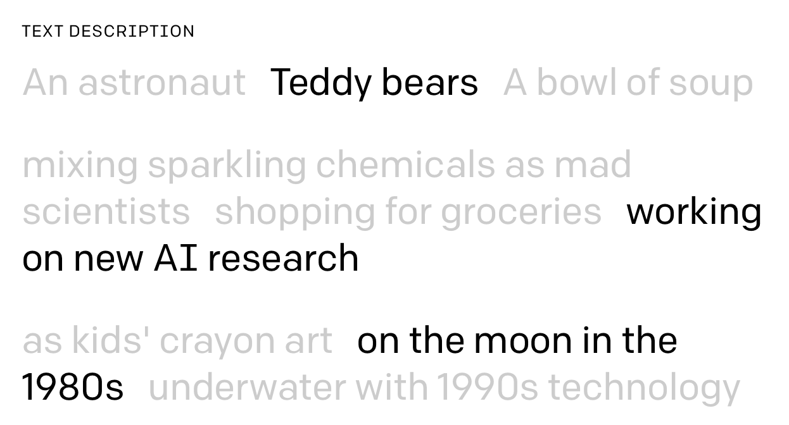
We can also “translate” between data types
Language In => Image Out [DALL-E 2]

Slide 36
Transfer Learning
Training on one dataset to help performance on another

Slide 37
What if you don’t have an ImageNet-sized dataset? How do you even get started?
You could just train on your smaller dataset, but it may not work!
Let’s think about how the neural net layers process data.

Slide 38
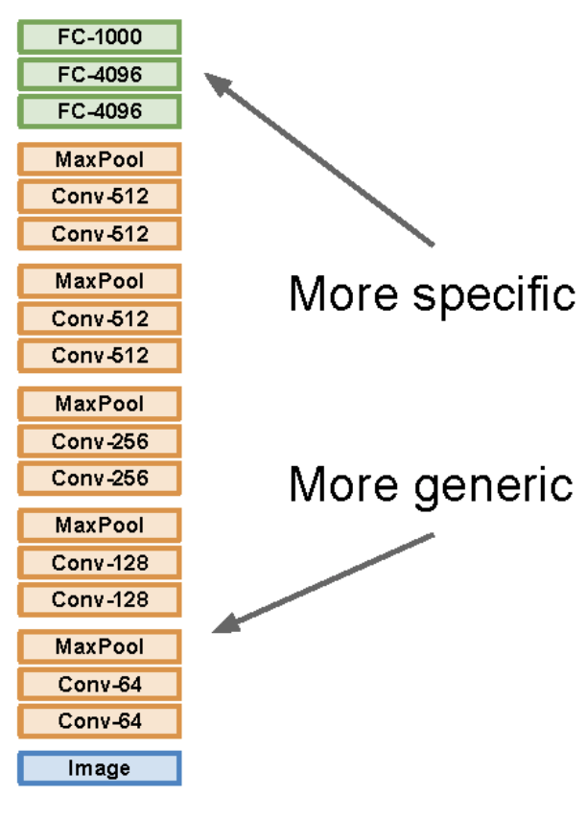
What if you don’t have an ImageNet-sized dataset? How do you even get started?
You could just train on your smaller dataset, but it may not work!
Let’s think about how the neural net layers process data.
The “earlier layers” are processing more “general” features (things like edges and small features), while the later layers will be looking at more macroscopic features (like wheels, legs, etc.)

Slide 39
Let’s train first on ImageNet to get the “general features” and then “fine tune”

Slide 40
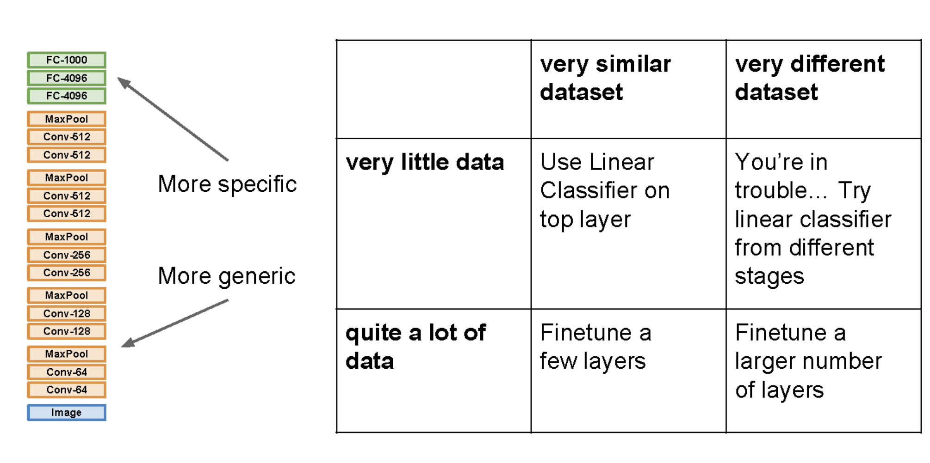
Let’s train first on ImageNet to get the “general features” and then “fine tune”

Slide 41
Transfer Learning is a key enabler of progress in the AI community

Slide 42
Transfer Learning is a key enabler of progress in the AI community

Slide 43
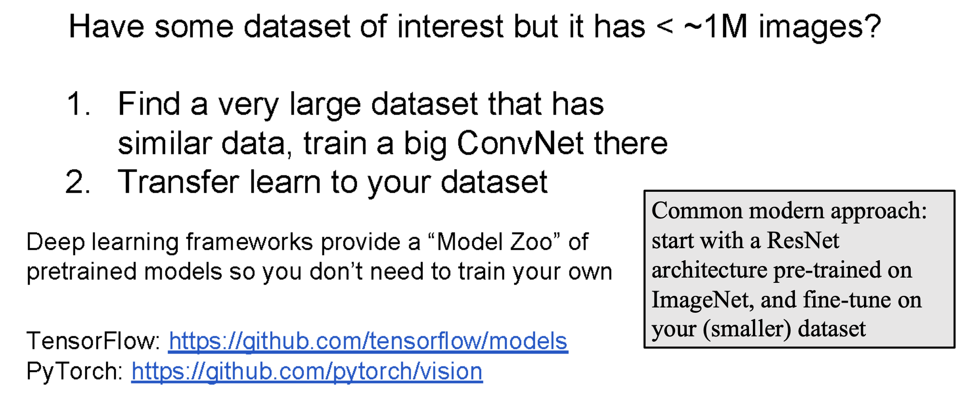
Transfer Learning is a key enabler of progress in the AI community

Slide 44
Learning for Action
Starting with Reinforcement Learning

Slide 45
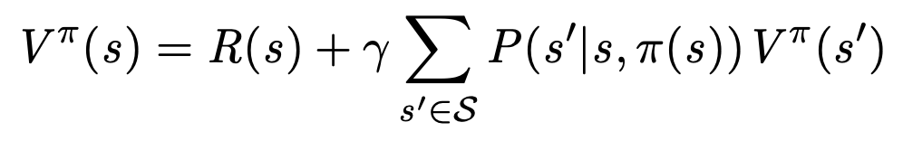
Given an MDP, how do we compute V* and the optimal policy?
This is the core question we’re looking to solve in the 2nd half of today. Computing the optimal value function is what it means to “solve an MDP”
So how do we do that?
Let’s revisit the Bellman Equation from CS580:

Slide 46
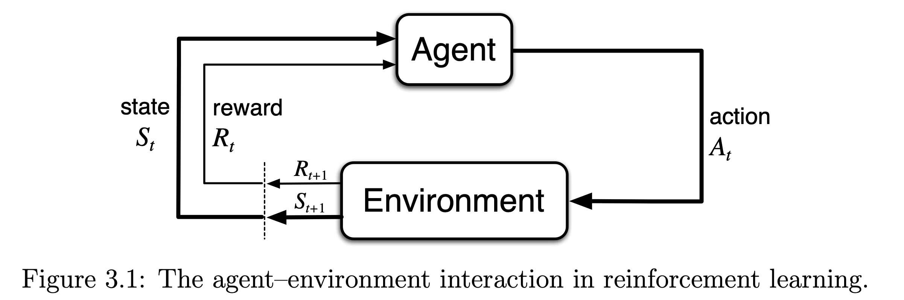
There are many different “flavors” of reinforcement learning
All are characterized by an agent that learns about the environment through interaction with it:
From: Sutton & Barto

Slide 47
In RL, we are looking to learn to act well (optimally?) by trial-and-error
The robot has many “episodes” to try different actions, observe what happened, and update its behavior for next time.
From: Sutton & Barto

Slide 48
In many situations, we don’t have access to the model of the world
Some or all of the model might be missing:
We may not know what transition probabilities define how an action will impact what state we’re in
We may not know the rewards we’ll get.
Often, we don’t know either of these things.
When our agent is in the world, it can take actions to discover (1) how its actions will change the state and (2) what the reward of taking those actions will be.

Slide 49
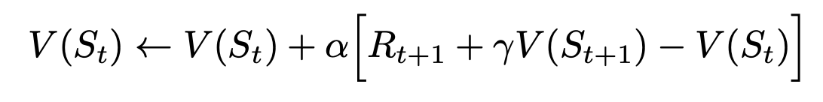
Temporal Difference Methods: a family of techniques for RL
We take an action (according to a policy), the state is updated and we get an instantaneous reward.
We can use this information to update what we think the value of the current state is:

Slide 50
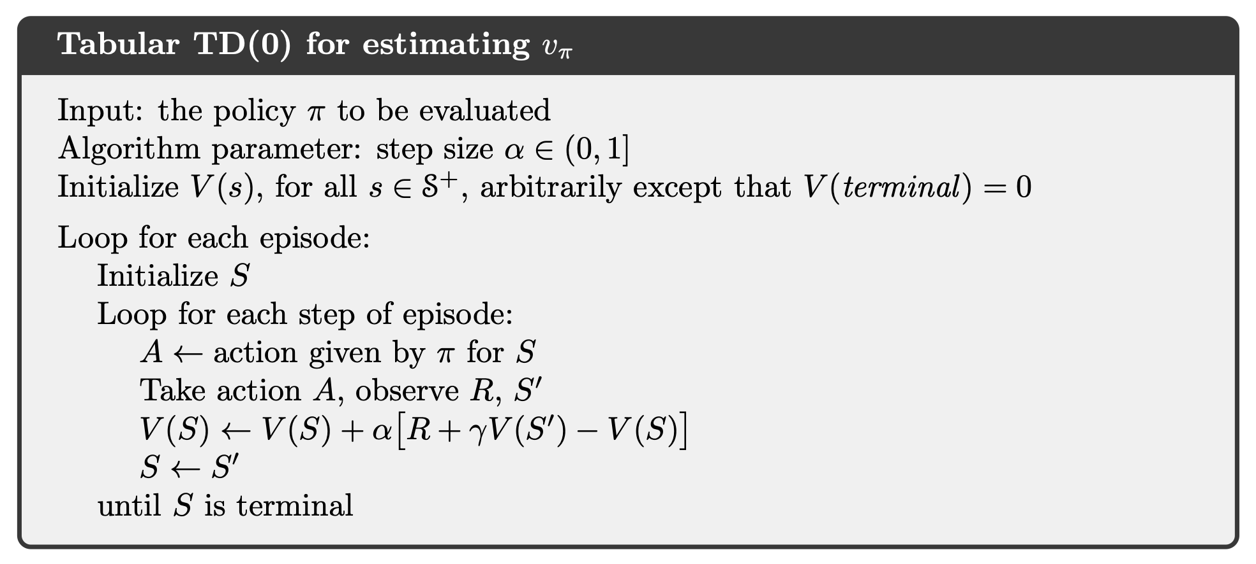
This update rule, called one-step TD, or TD(0), uses the current estimate of V
This process is only for estimating V for a policy:

Slide 51
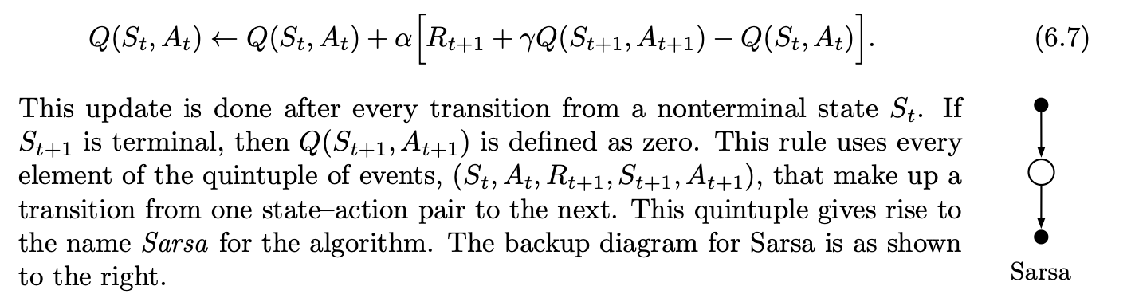
Next we want to use TD approaches to estimate the best policy.
An “episode” for a policy consists of an alternating sequence of state-action pairs
We can update as follows:

Slide 52
Next we want to use TD approaches to estimate the best policy.
An “episode” for a policy consists of an alternating sequence of state-action pairs
We can update as follows:

Slide 53
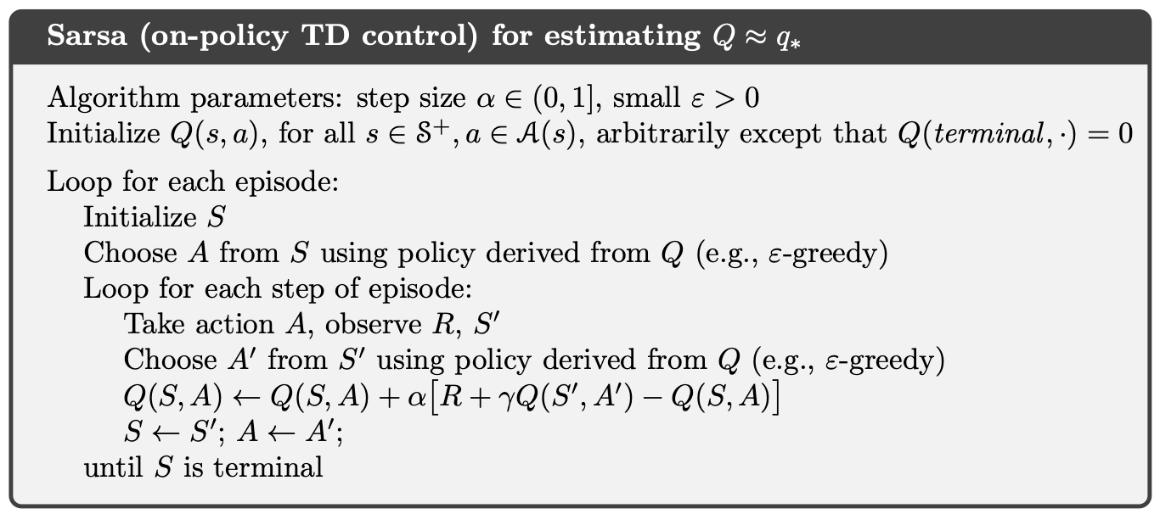
SARSA: updating a policy using (S, A, R, S, A) tuples from episode experiences
The agent still needs to use some way of picking non-deterministic actions to explore the entire state space.

Slide 54
One of the different “flavor distinctions” for RL is on- vs. off-policy learning
As we learn how the world works, we might want to ask “how well could I have done, if I had done something else?”
In on-policy methods, improving the policy is done with the policy itself: the MC method we saw earlier and “SARSA” were “on-policy” since they used the data collected using a particular policy to improve that policy.
Off-policy methods will be a bit different: we’ll instead use our estimate of how well the agent would have done if it had taken a different action. Why?

Slide 55
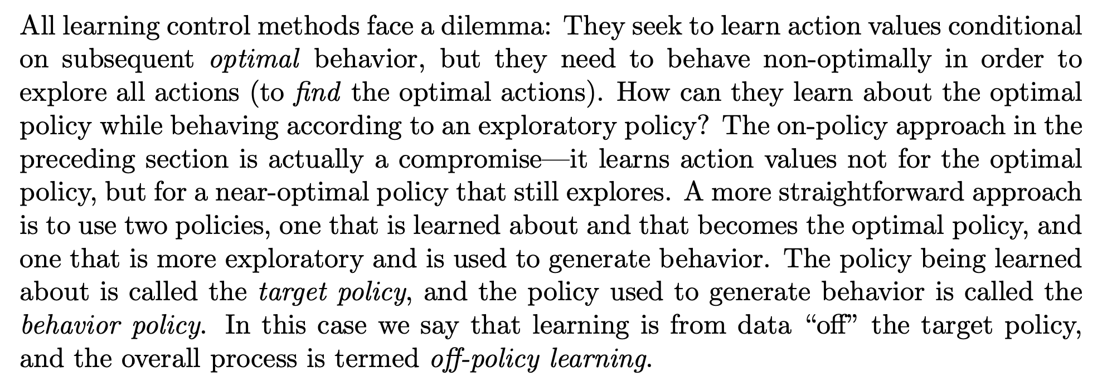
One of the different “flavor distinctions” for RL is on- vs. off-policy learning

Slide 56
What does off-policy learning look like?
Remember, the optimal value function is evaluated with respect to the optimal policy.
When we compute the best value function and policy, we might sometimes want to ask ourselves: “how would I have done if I picked the ‘best’ action at time t+1?”

Slide 57
What does off-policy learning look like?
Remember, the optimal value function is evaluated with respect to the optimal policy.
When we compute the best value function and policy, we might sometimes want to ask ourselves: “how would I have done if I picked the ‘best’ action at time t+1?”
We have an estimate of Q(s, a), so we can present an answer to this question using this estimate:

Slide 58
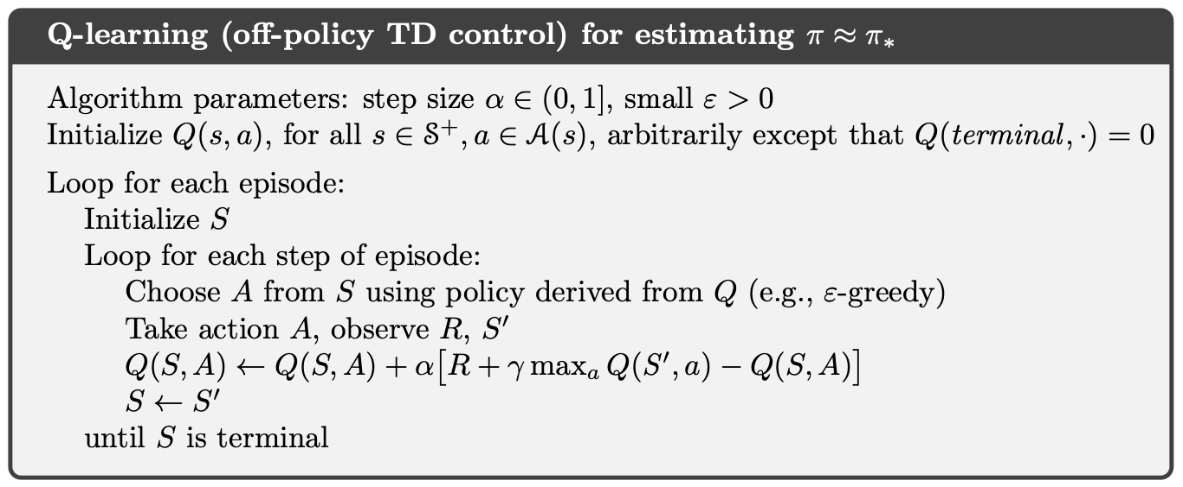
This approach is known as Q-learning
Q-learning is an off policy approach:

Slide 59
However: tabular RL methods don’t work when you have continuous states or actions
Tabular RL methods: states and actions are discrete and we could keep a “table” of Q, V, or π over the entire state/action space.

Slide 60
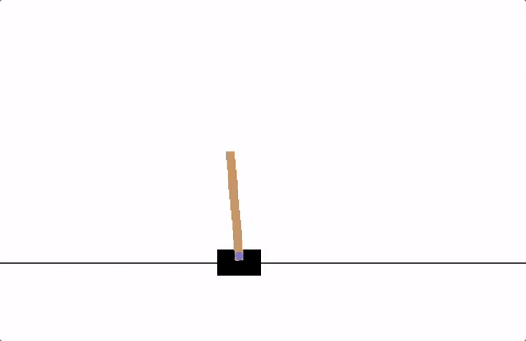
However: tabular RL methods don’t work when you have continuous states or actions
Tabular RL methods: states and actions are discrete and we could keep a “table” of Q, V, or π over the entire state/action space.
What about the “cartpole” setting?
Goal: balance a pole upright by controlling only the base.
The actions are discrete (left/right)
The states are continuous!
PyTorch Cartpole Tutorial

Slide 61
However: tabular RL methods don’t work when you have continuous states or actions
If we’re going to address this problem—and other problems more complex than those we just saw—we will need new approaches that allow us to approximate the functions we need to plan.
Hmm… we know a thing or two about function approximation...

Slide 62
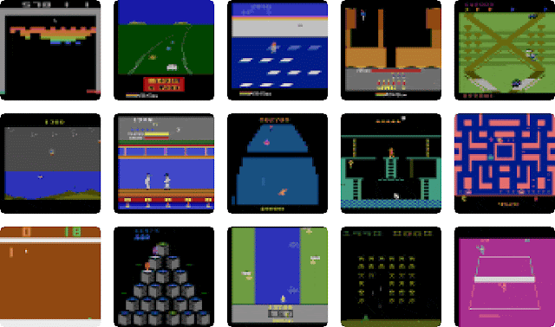
Let’s play Atari games!
We have some very high-dimensional input for some applications.

Slide 63
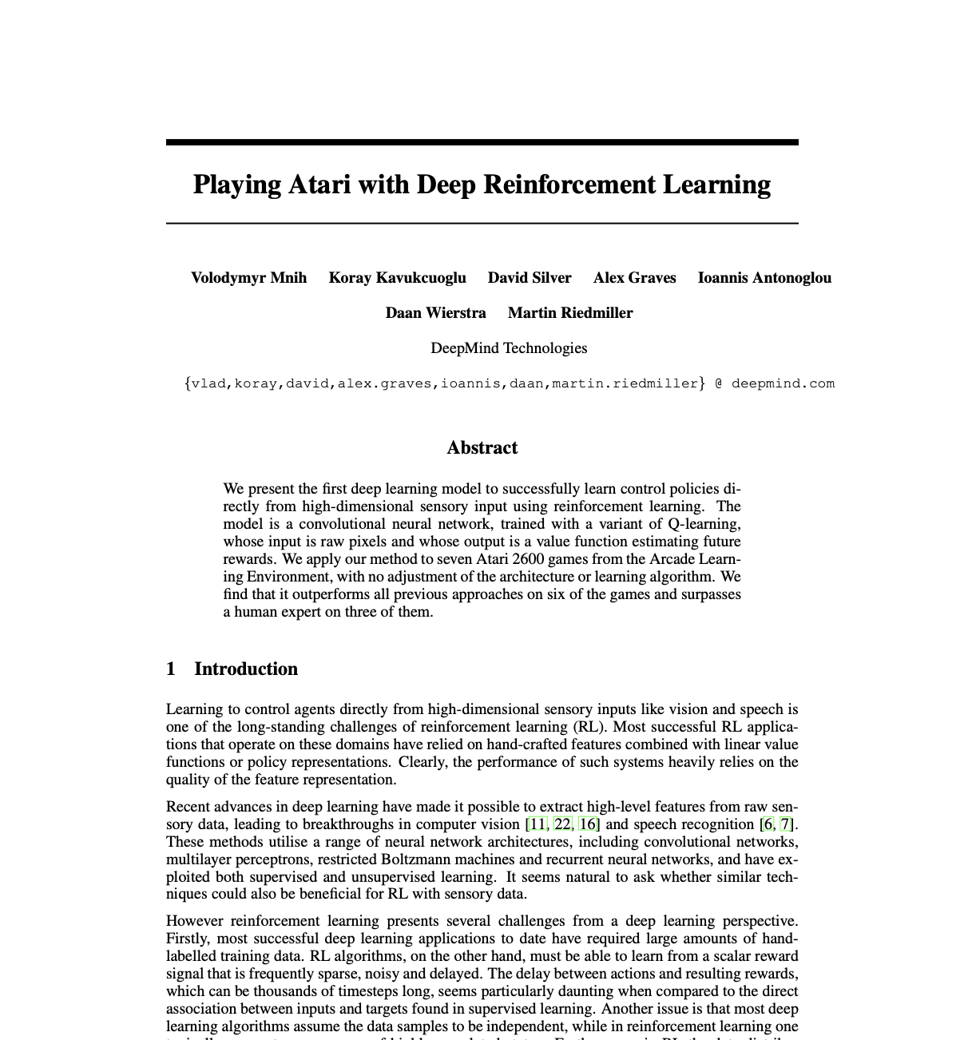
Deep Q Networks

Slide 64
This paper proposed the “Deep Q Networks” algorithm: “Deep” Q Learning
Based on our discussions from today and last week, that deep neural networks could be used for function approximation and support reinforcement learning shouldn’t surprise you very much.
…but this paper was a pretty big deal, because the application domain was incredibly difficult.
The target was Atari games, and the dimension of the input space was very high, though the impressive successes of CNN’s on ImageNet suggested that it could be possible (given “crazy” amounts of data).

Slide 65
One of the big insights was “experience replay”
The idea was to keep track of old experience and continue to loop through it, rather than just use the most recent example.
This helped to mitigate data-inefficiency.
Since Q learning is an “off policy” algorithm, old data doesn’t “becomes stale.” The reward given after taking a certain action is (mostly) consistent.
The only thing that might change is the data distribution: as you get better at selecting good actions, the likelihood of seeing “good” states will increase and “bad” states will decrease.

Slide 66
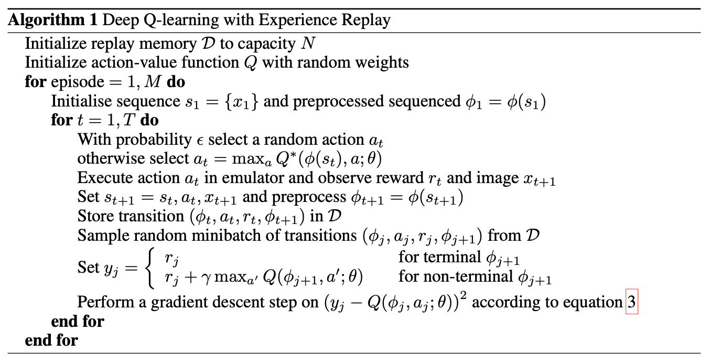
The Deep Q-learning Algorithm:

Slide 67
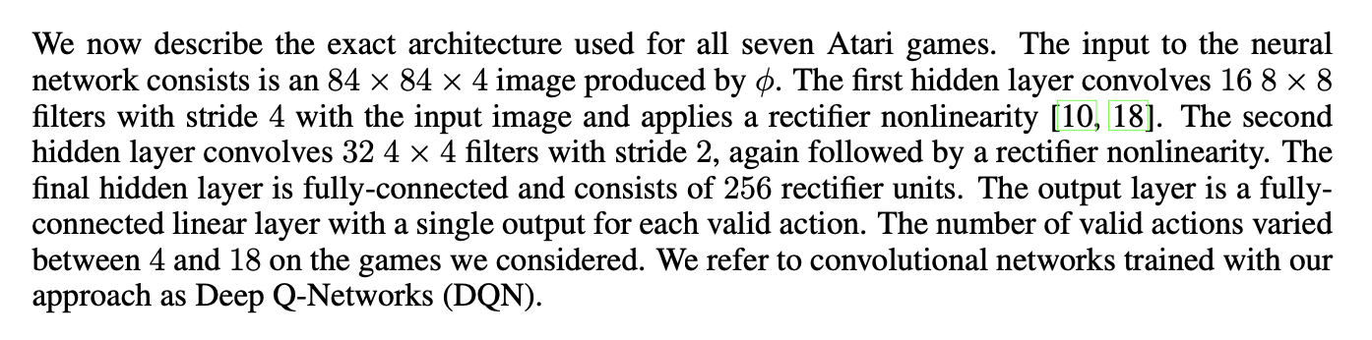
The model architecture wasn’t even particularly complex by “modern” standards

Slide 68
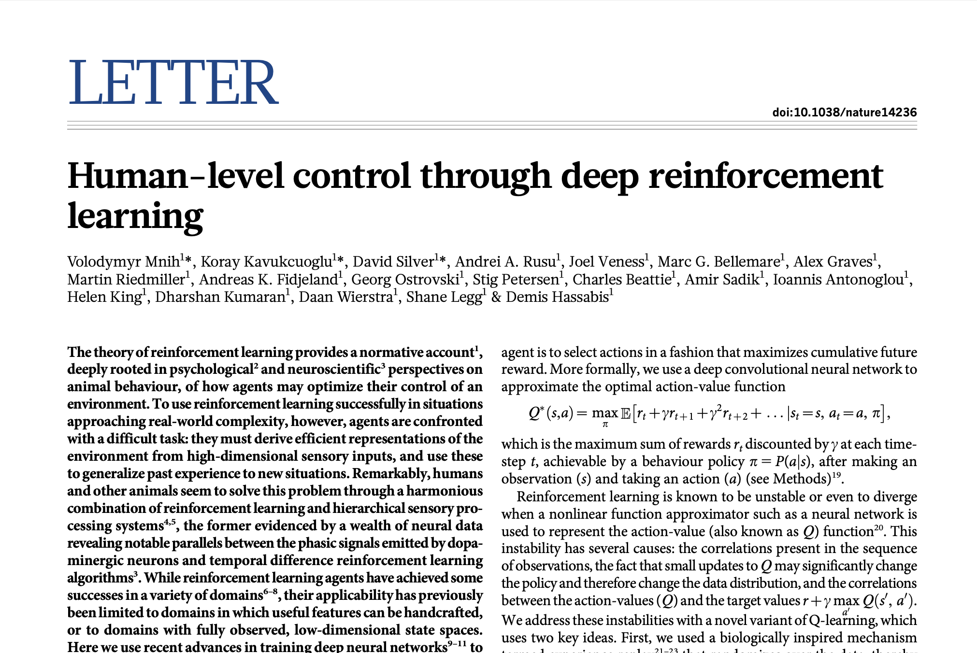
The follow up Nature paper was even more impressive

Slide 69
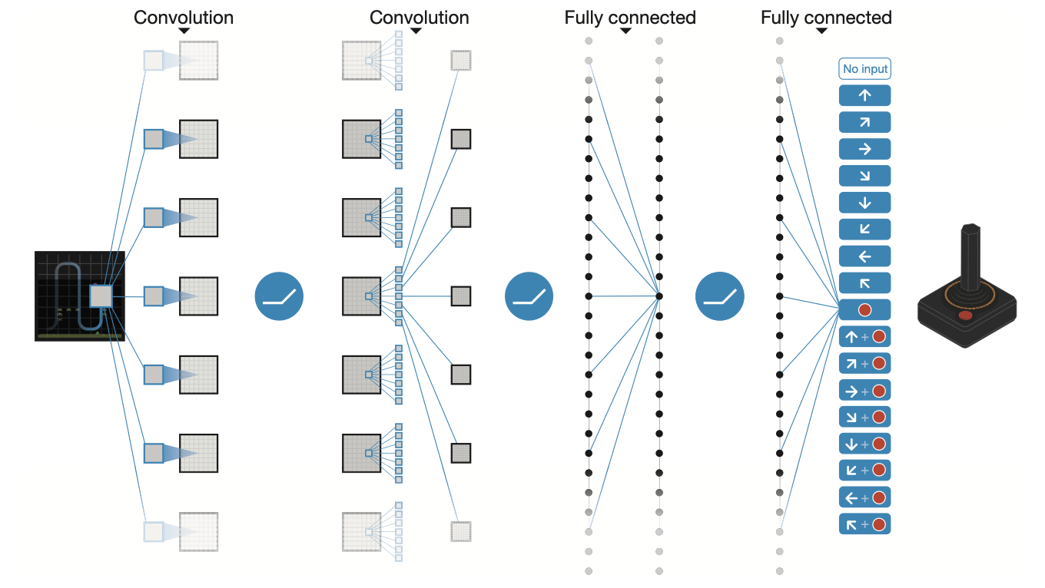
From pixels to action

Slide 70
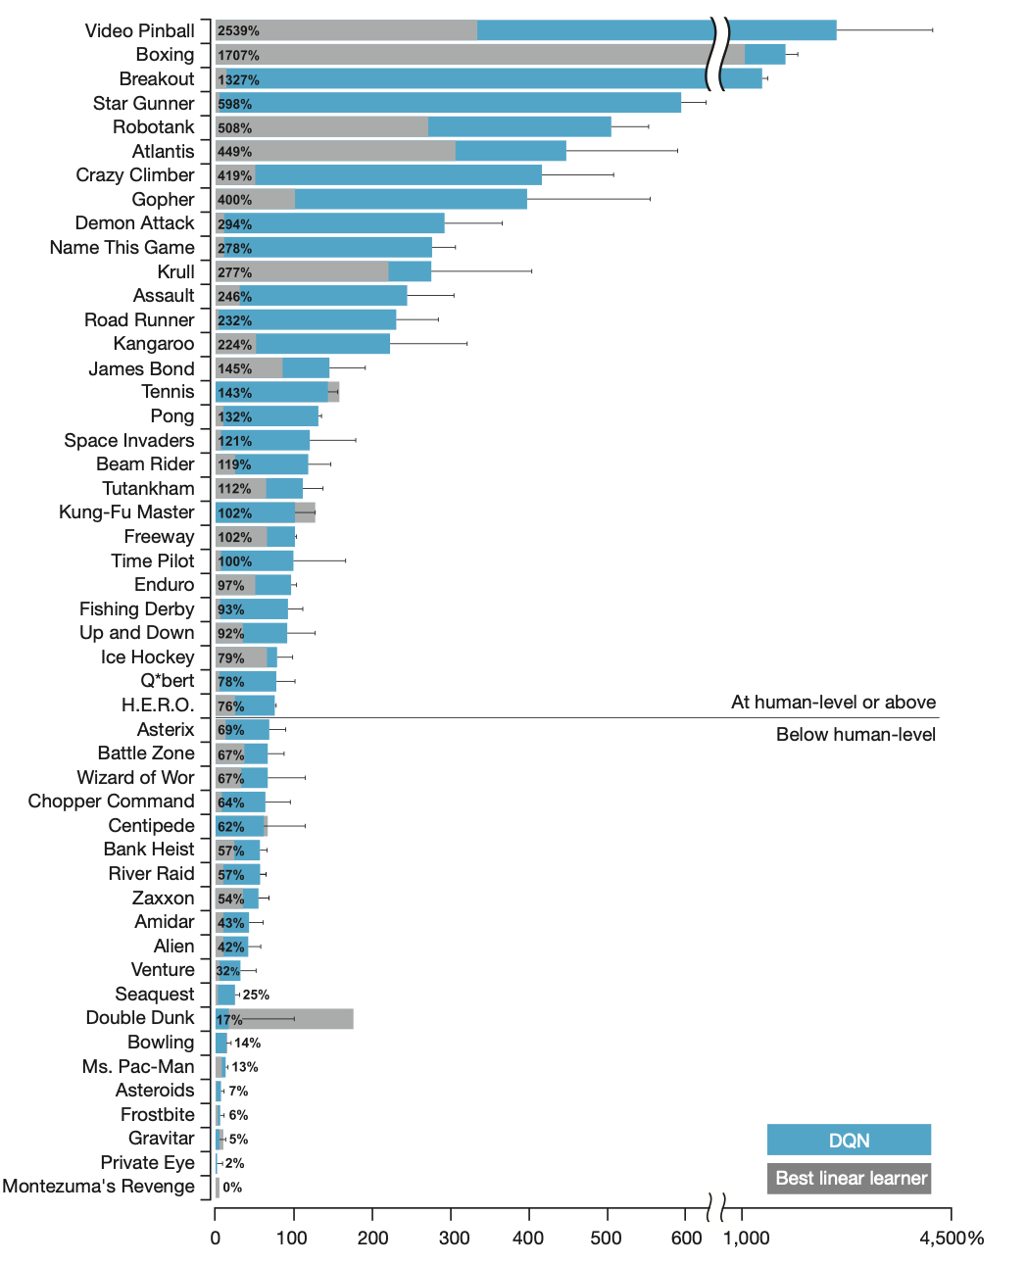
They outperformed humans on most games

Slide 71
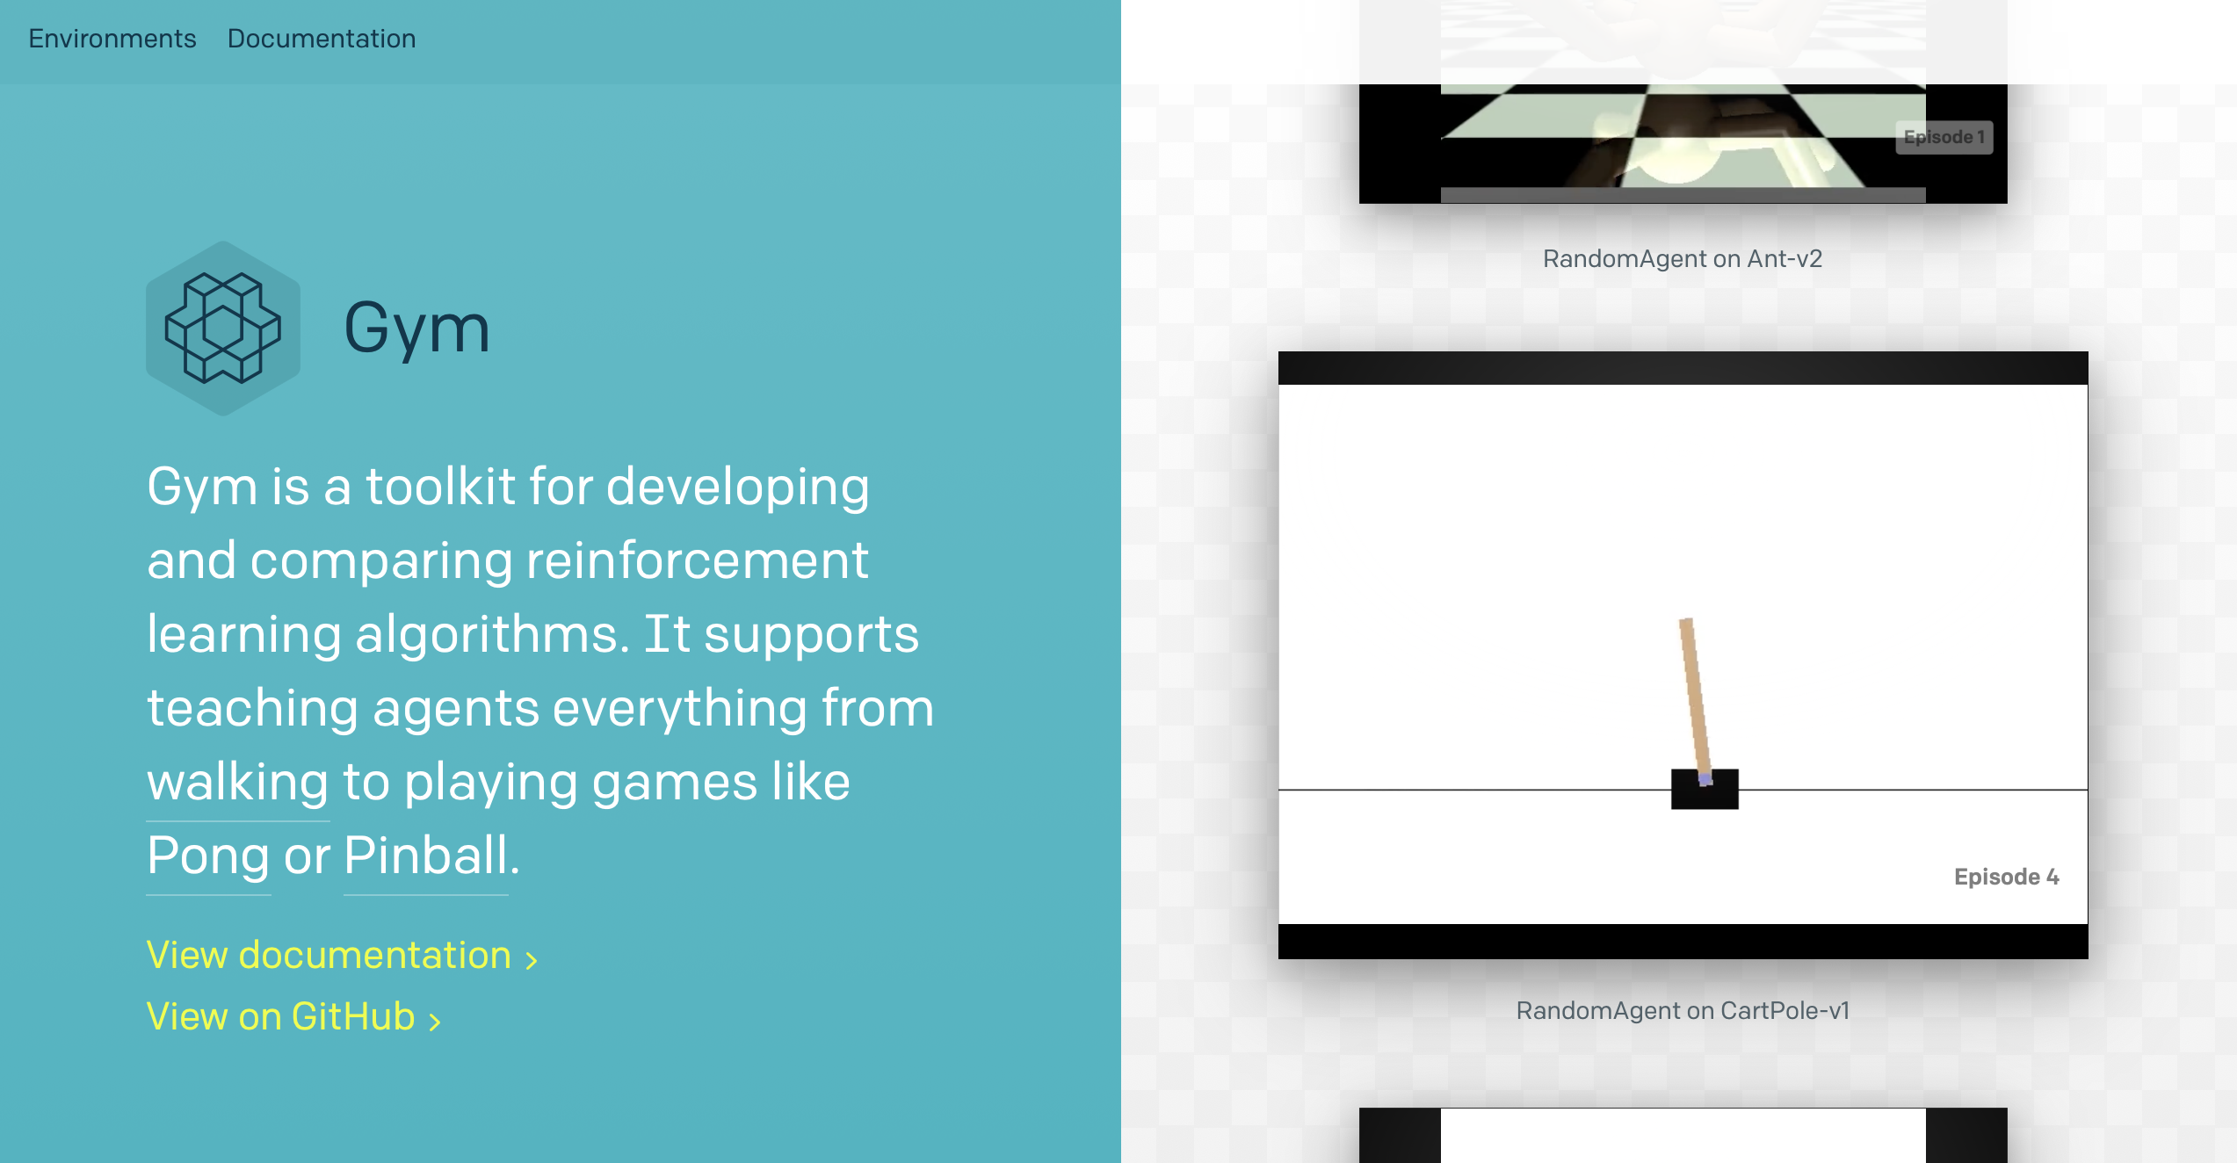
OpenAI Gym: a toolkit for running some RL benchmark environments
Gym is a great resource:

Slide 72
Model-based vs. Model-free Learning
There is another distinction we haven’t discussed yet: whether or not we have access to a model when we plan?
In model-based methods (e.g., value iteration), we had access to a model of the world: we could use it to think ahead, simulate actions in isolation, and get rewards.
Q learning is “model free” instead, where we don’t need access to a model of the world to plan. We simply learn Q directly and use that to compute the policy.

Slide 73
Learning for planning tends to work the best when the learning objective is well-scoped
There are many approaches to planning (e.g., for navigation) that eschew a model entirely and seek to learn everything “end-to-end” (from pixels to actions).
Look at Atari games: pixels in, actions out, magic in between.
Let’s see some examples.

Slide 74
Model-free Learning
Deciding what to do without a model of the world

Slide 75
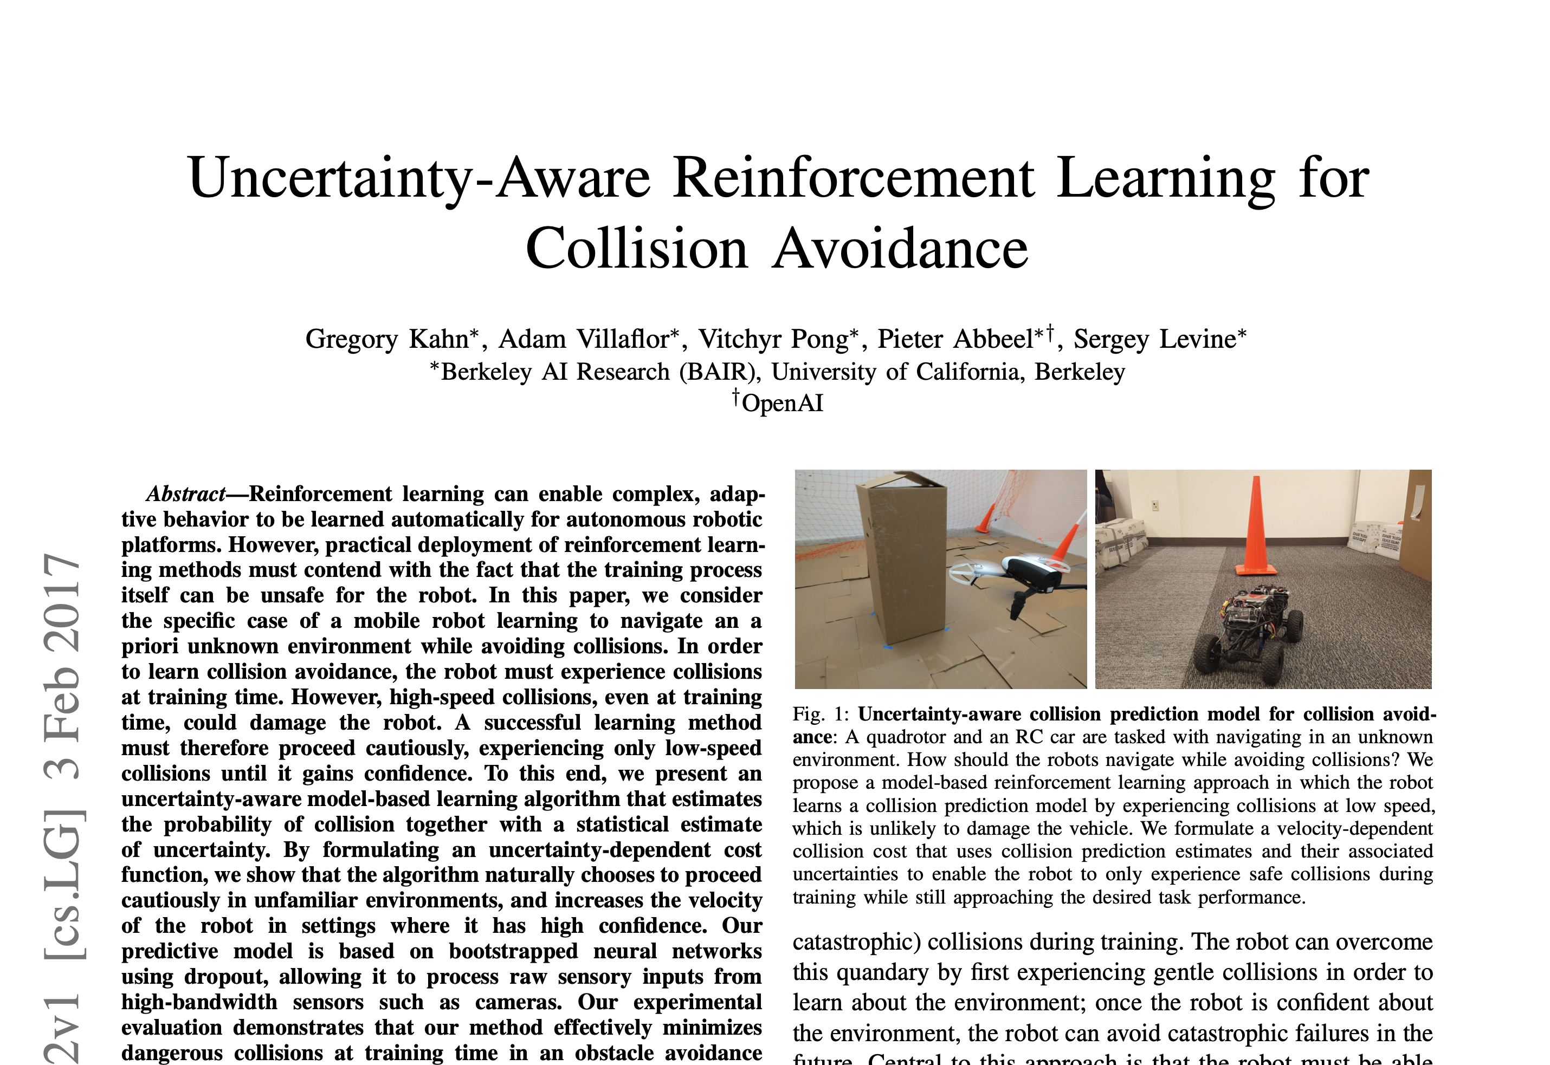
Let’s look at navigation (and related)
Obstacle avoidance is certainly possible!
Input: image. Output: action.

Slide 76
What about maze following?
Input: Image. Output: Action? Will that work?

Slide 77
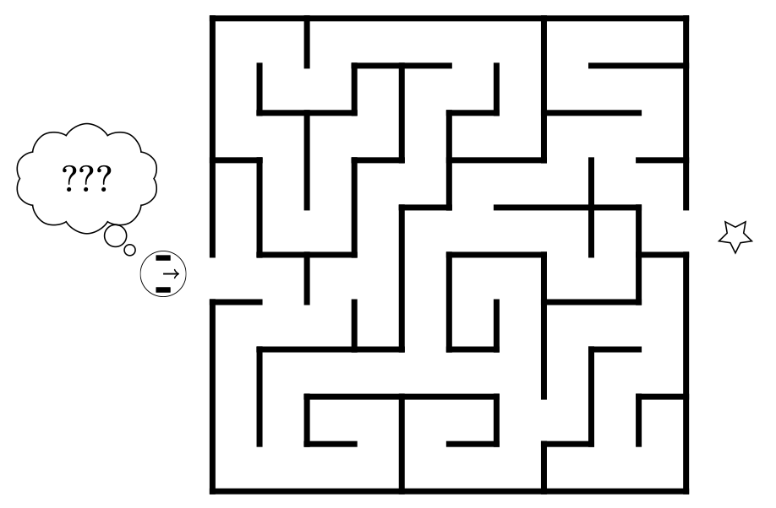
[Remember this]
So that’s control (in a nutshell)
What can’t we do with a controller?
What about this?
What do we need to solve a maze?
From: https://w3.cs.jmu.edu/molloykp/teaching/cs354/cs354_2021Fall/resources/pid.pdf

Slide 78
What about maze following?
Input: Image. Output: Action?
… but with some memory!!

Slide 79
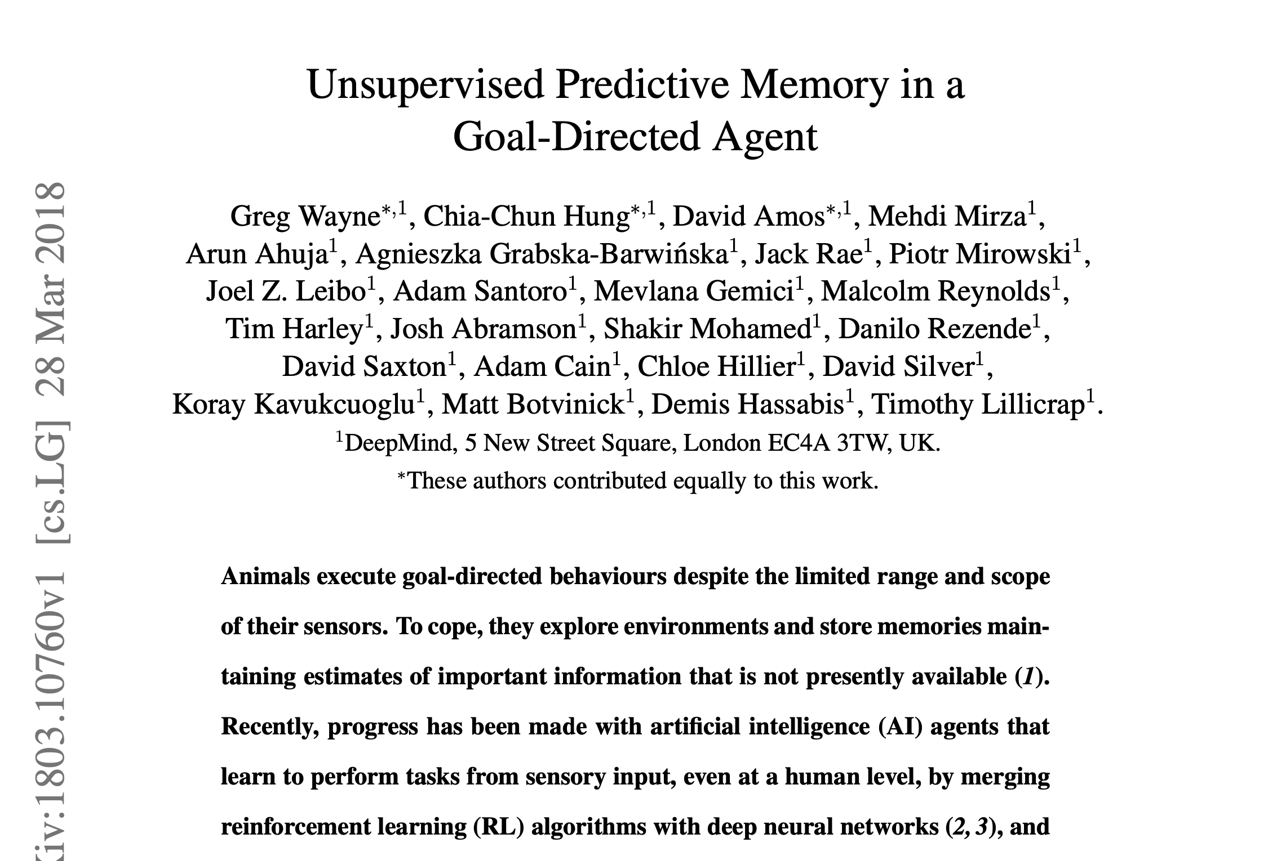
What about maze following?
Here’s an EXTREME example

Slide 80
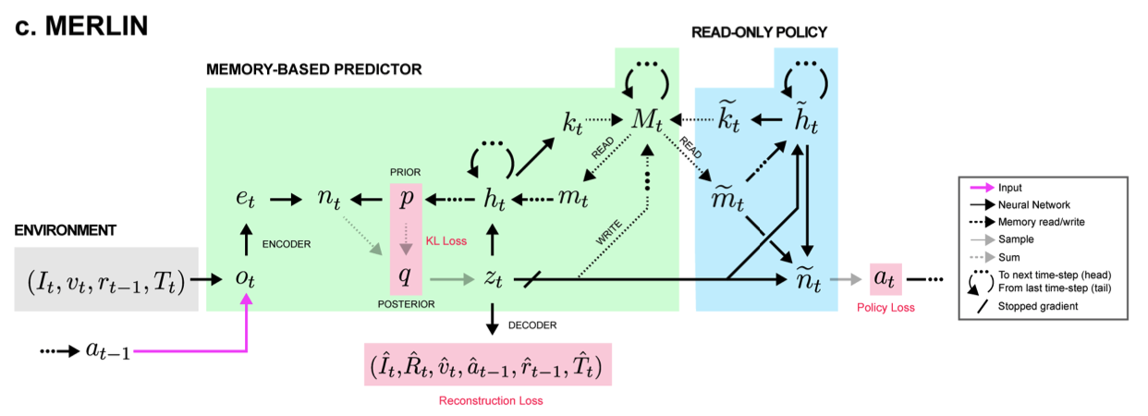
What about maze following?
Here’s an EXTREME example

Slide 81
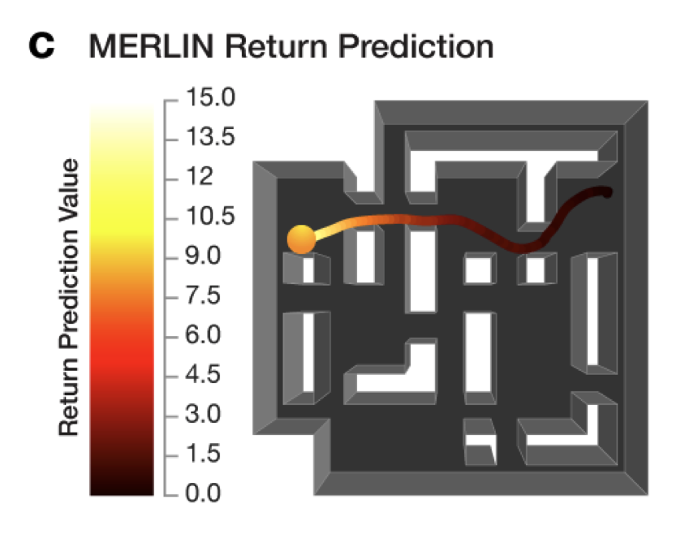
What about maze following?
Here’s an EXTREME example

Slide 82
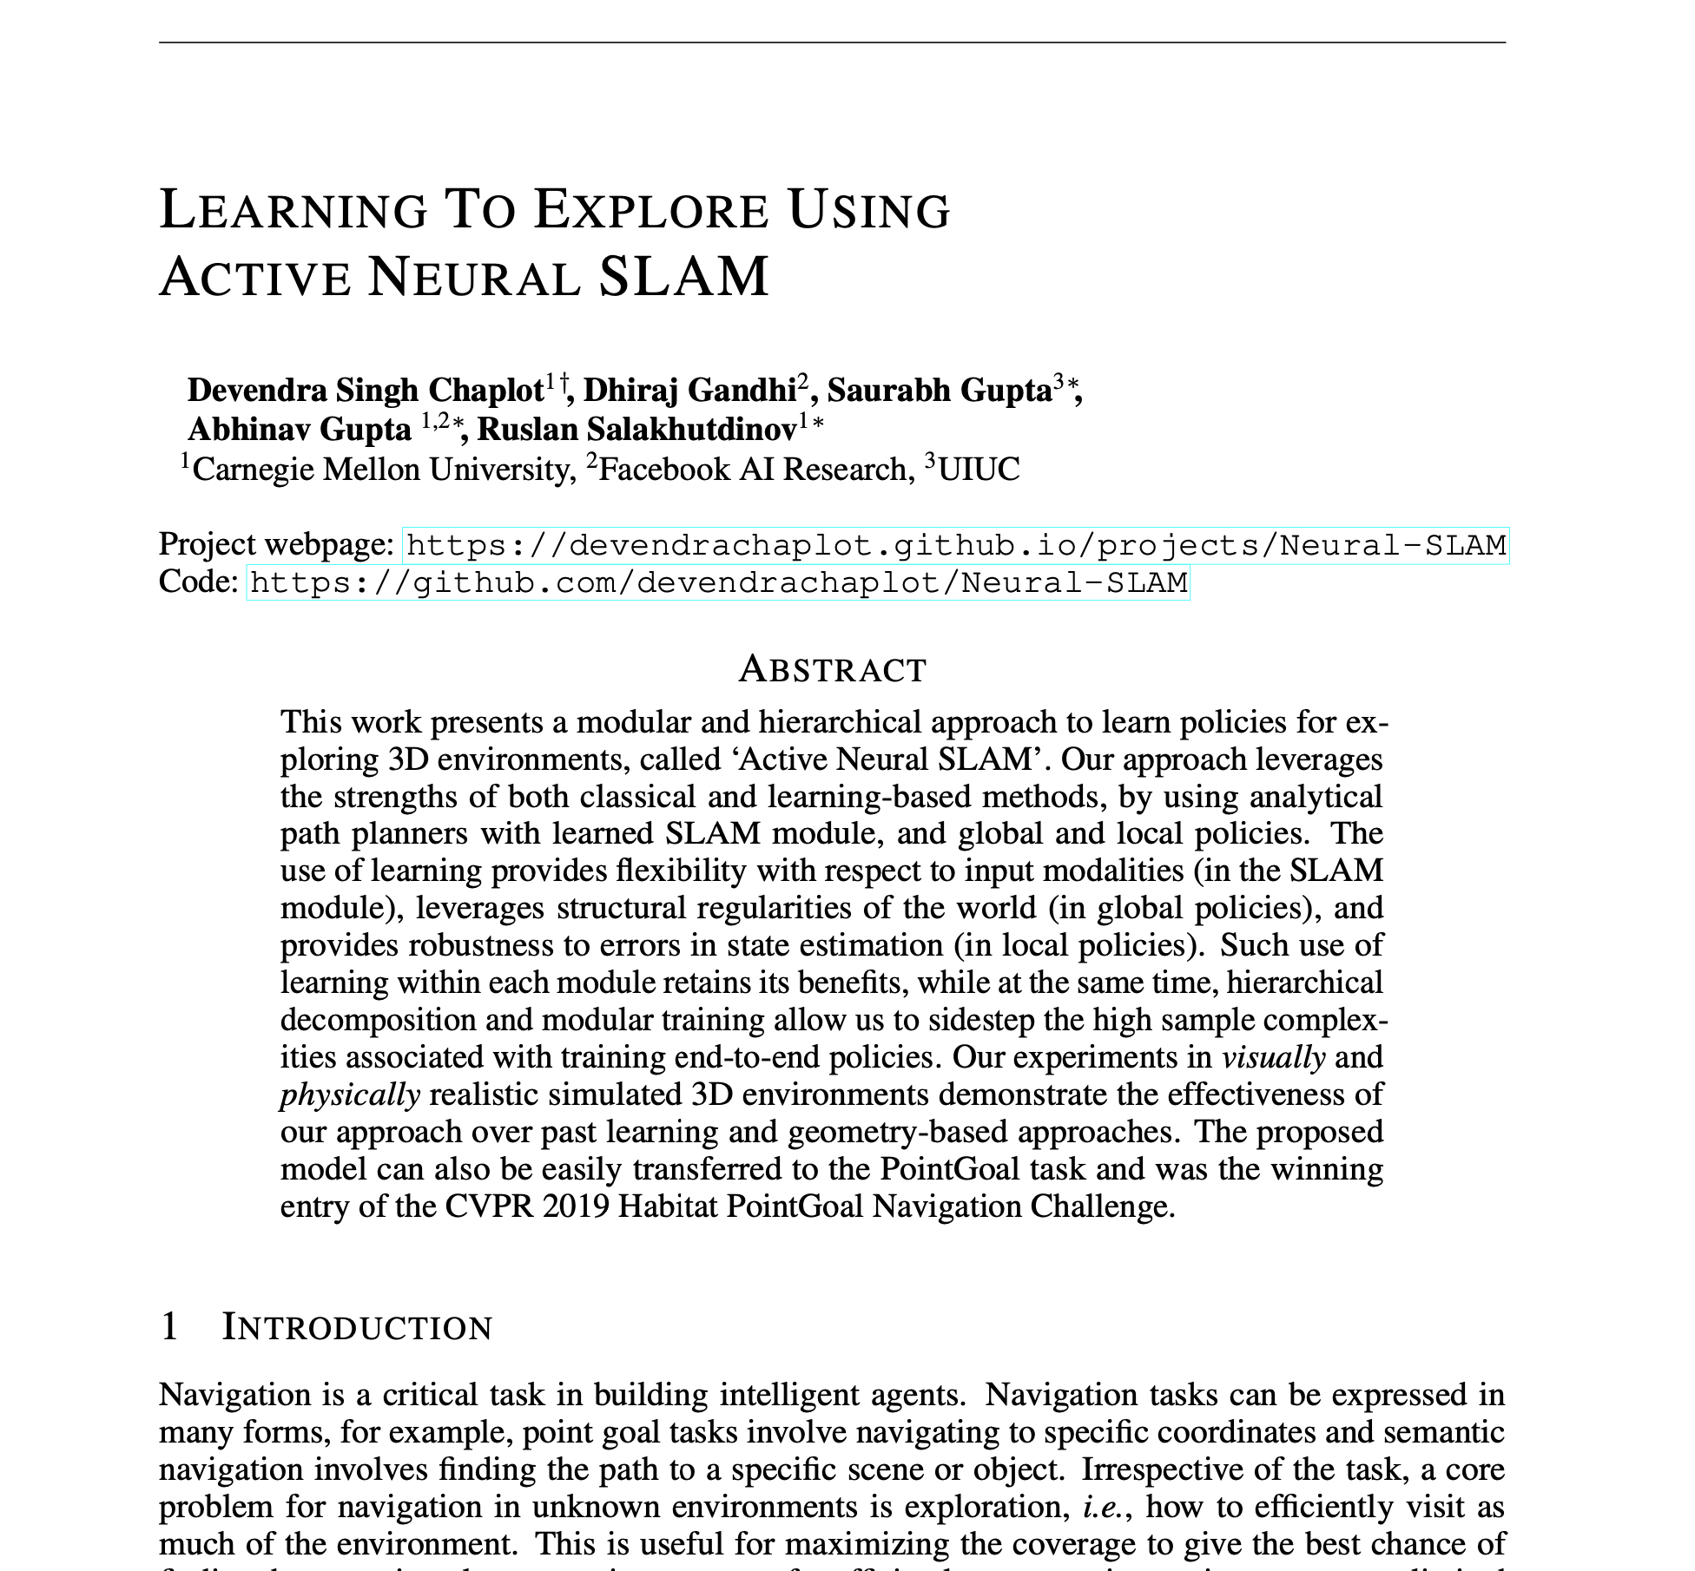

Also exploration via a
“learned map representation”

Slide 83
Learning-augmented
“classical” planning

Slide 84

Learning to avoid unseen obstacles

Slide 85

Learning to avoid unseen obstacles

Slide 86

There’s also plenty of learning to accelerate Task and Motion Planning

Slide 87


Learning over Subgoals Planning
Robot thinks with “high-level actions”
Robot learns to identify features that lead to dead ends and avoid them.
Start
Goal
Notes:
[SLIDE] (the results from my work show the effectiveness of this idea) “In my work, changing the way a robotic agent thinks about how it will interact with the world and (equally importantly) what the outcomes of its actions will be, allows us to make intelligent decisions (even when much of the world is not known to us).”

Slide 88

Outperform the optimistic planner MIT floorplan environments
Optimistic Planner
Distance: 175 meters
Learned Subgoal Planner
Distance: 115 meters

Slide 89
Learning for Grasping
We want to pick stuff up reliably. What’s hard about that?

Slide 90
Learning for Grasping
We want to pick stuff up reliably. What’s hard about that?
Motion planning? Well not really, we know how to do that.

Slide 91
Learning for Grasping
We want to pick stuff up reliably. What’s hard about that?
Motion planning? Well not really, we know how to do that.
Actually, it’s pretty challenging to know where to grasp an object to pick it up reliably.
What should we do about that?

Slide 92

Let’s try: Grasping
We want to pick stuff up reliably. What’s hard about that?
Motion planning? Well not really, we know how to do that.
Actually, it’s pretty challenging to know where to grasp an object to pick it up reliably.
What should we do about that?
LET’S GET A TON OF DATA

Slide 93

Let’s try: Grasping
We want to pick stuff up reliably. What’s hard about that?
Motion planning? Well not really, we know how to do that.
Actually, it’s pretty challenging to know where to grasp an object to pick it up reliably.
What should we do about that?
LET’S GET A TON OF DATA
LET’S USE A NEURAL NET

Slide 94

CLIP is a cool way of learning embeddings for both language and image
https://openai.com/blog/clip/

Slide 95

CLIP is a cool way of learning embeddings for both language and image
https://openai.com/blog/clip/

Slide 96

CLIPort
https://cliport.github.io

Slide 97
To wrap up: learning is not “the answer”
It’s a tool, to be used when appropriate
Deep RL (particularly model-free approaches) can be quite brittle and fail in unexpected ways.
Learning is a great strategy for overcoming limitations in our ability to write down relationships between quantities we care about (e.g., sensors and actions), but it may not always be wise to eliminate what we know about how the world works altogether.
Notes:
`

