Slide 1
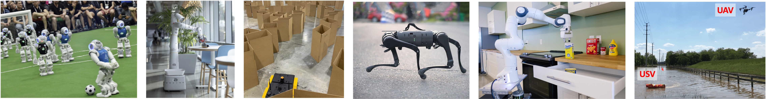
CS 685 Autonomous Robotics
Motion Planning II
Prof. Xuesu Xiao
George Mason University
Slides Credits: Gregory Stein

Slide 2
Roadmaps
What more can we do with state space search?
Where do these graphs come from in practice?

Slide 3
We know how to search a graph: how can we relate that to motion planning?
Roadmaps are graphical representations of the environment, and their relation to the physical world. (…or at least, toy examples that illustrate situations we will encounter in the real world.)
  Representation is important When studying combinatorial motion planning algorithms, it is important to carefully consider the definition of the input. What is the representation used for the robot and obstacles? What set of transformations may be applied to the robot? What is the dimension of the world? Are the robot and obstacles convex? Are they piecewise linear? The specification of possible inputs defines a set of problem instances on which the algorithm will operate. — S. M. LaValle
From: S. M. LaValle: Planning Algorithms

Slide 4
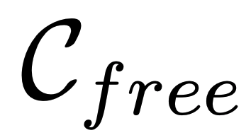
We know how to search a graph: how can we relate that to motion planning?
Roadmaps are graphical representations of the environment, and their relation to the physical world. (…or at least, toy examples that illustrate situations we will encounter in the real world.)
A roadmap is a topological graph corresponding to some free space: Nodes in the graph, the set S, correspond to points in free space.
From: S. M. LaValle: Planning Algorithms

Slide 5
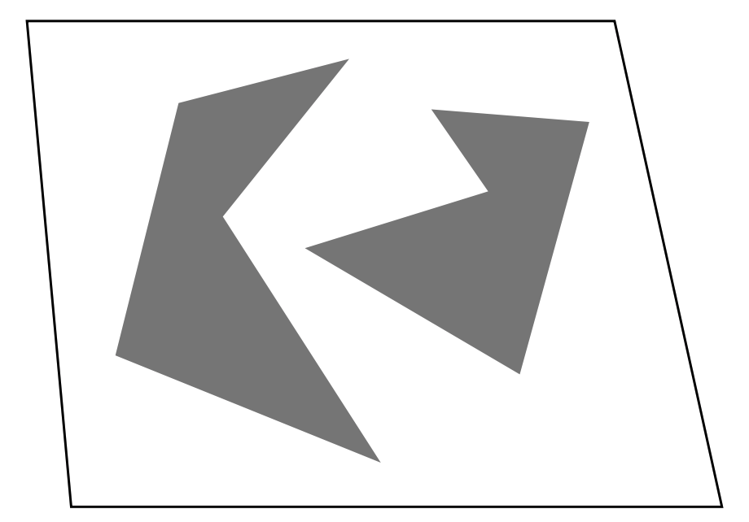
An example region, from which we will construct a roadmap
The space on the right defines our free space region.
A roadmap has two defining characteristics:
Accessibility: that we can (easily) compute a path from any point in free space to a node in the graph.
Connectivity: that the graph can be used to define a path between any two of its nodes.
From: S. M. LaValle: Planning Algorithms

Slide 6
An example region, from which we will construct a roadmap
The space on the right defines our free space region.
A roadmap has two defining characteristics:
Accessibility: that we can (easily) compute a path from any point in free space to a node in the graph.
Connectivity: that the graph can be used to define a path between any two of its nodes.
So how do we make a roadmap?
From: S. M. LaValle: Planning Algorithms

Slide 7
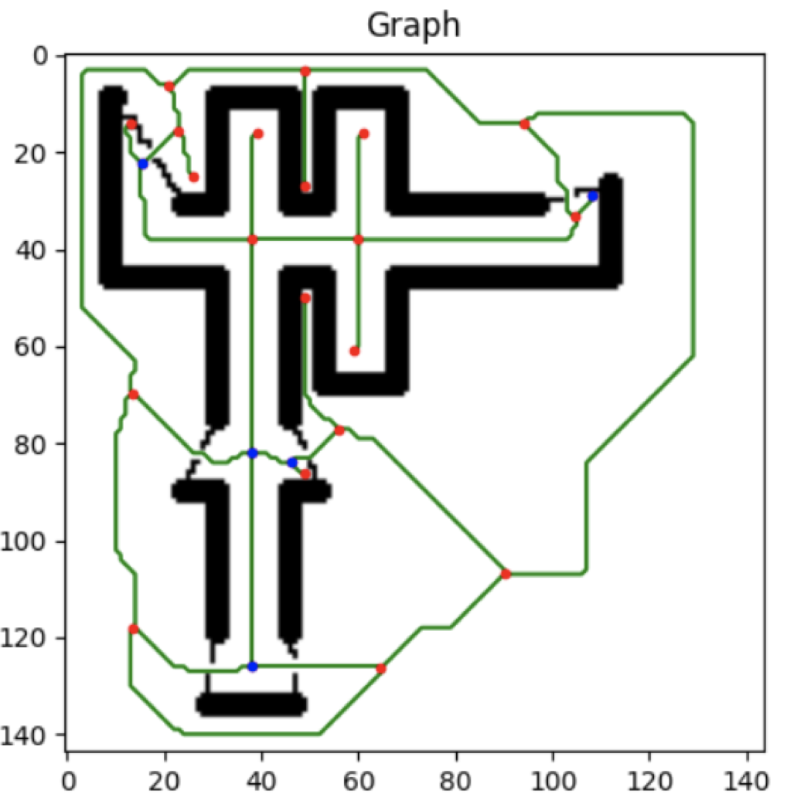
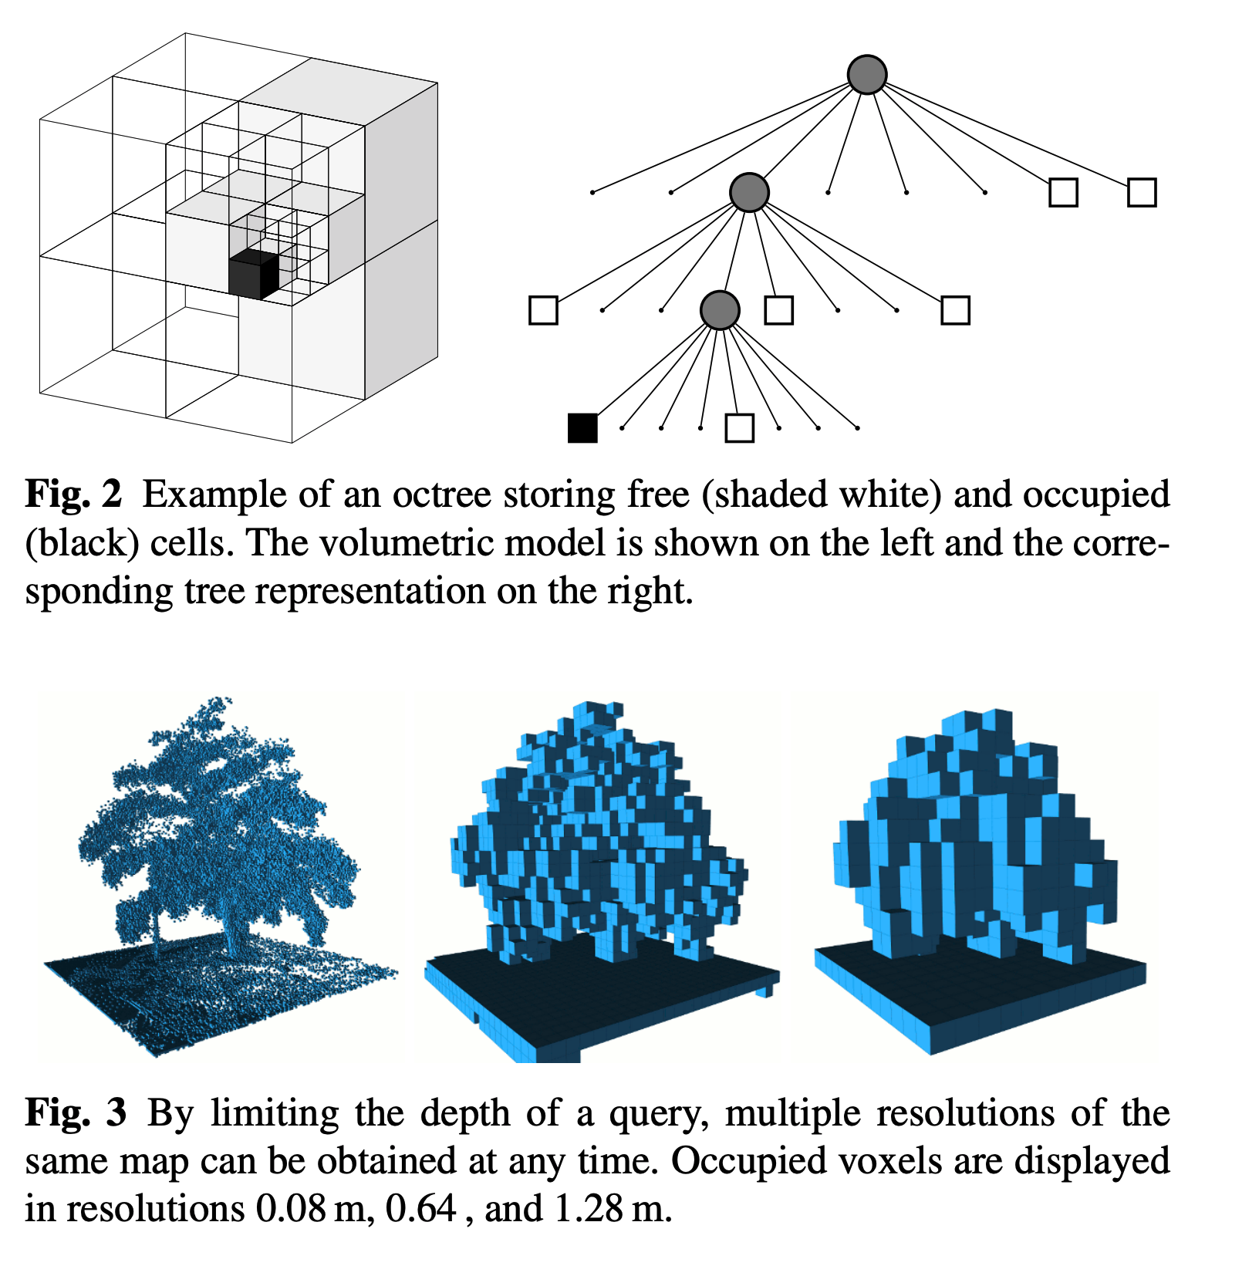
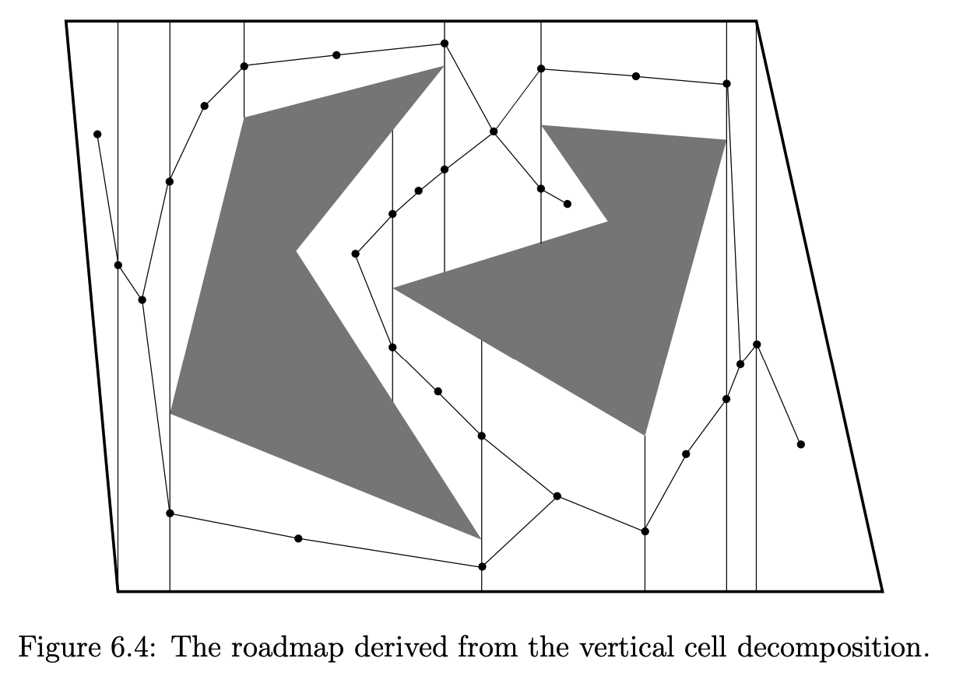
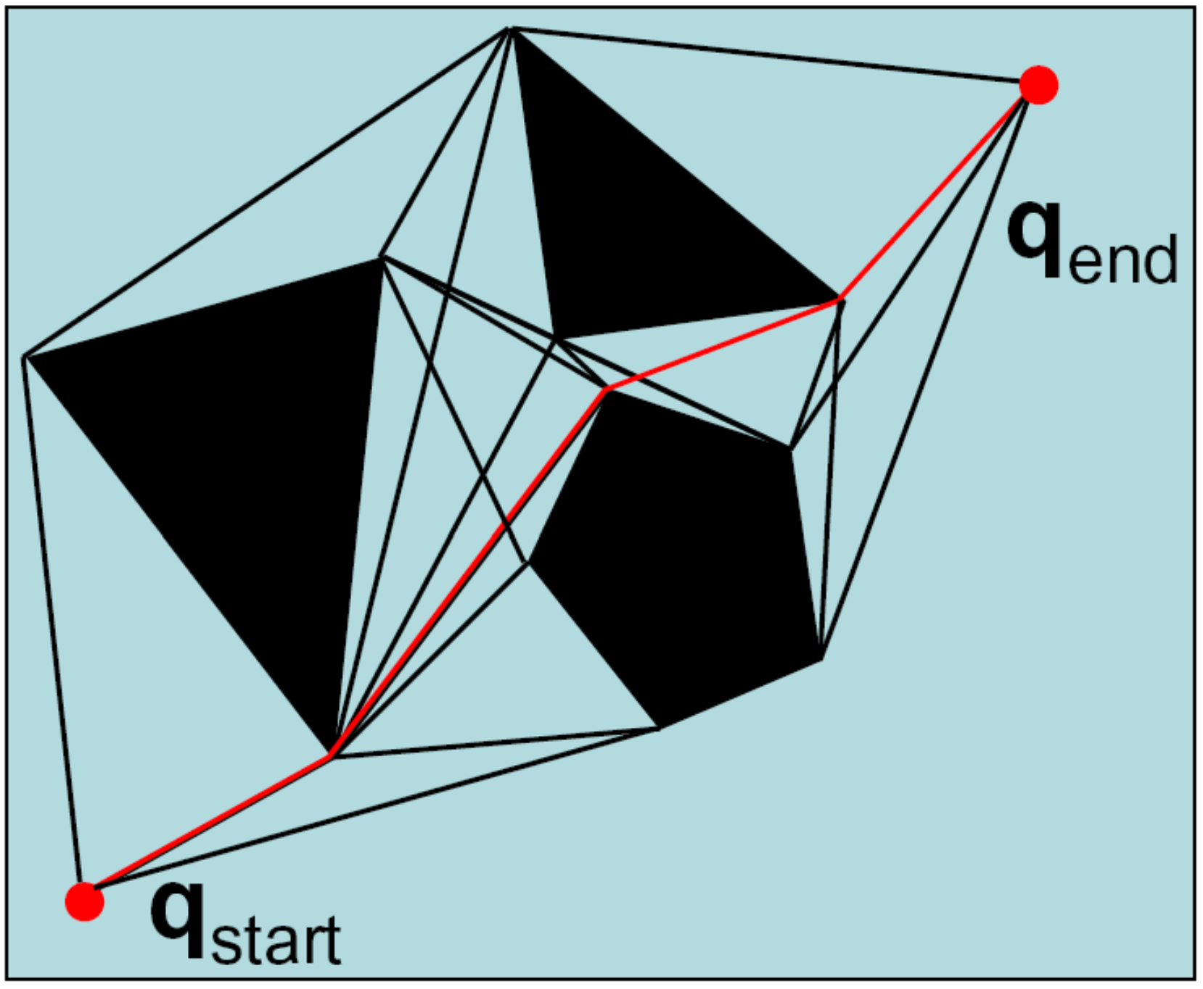
There are many ways to make a roadmap
Many of these involve partitioning or decomposing the space.

Slide 8
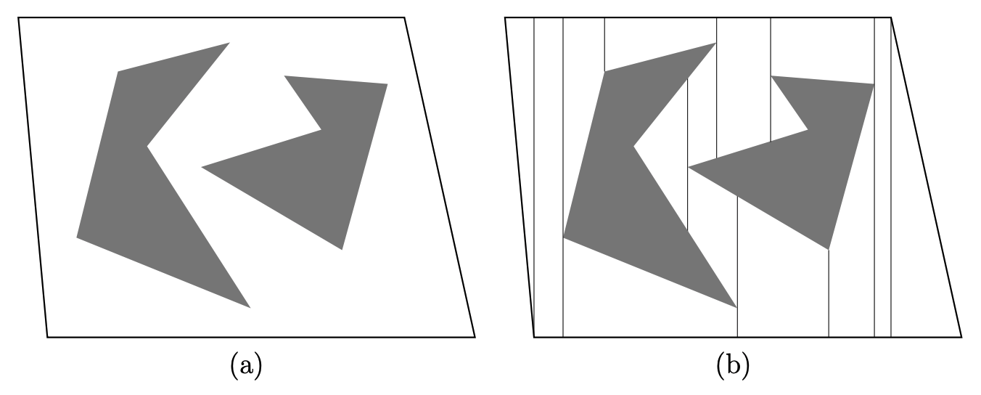
A simple way of decomposing the space is the “vertical cell decomposition”
…also known as a “Trapezoidal Decomposition”

Slide 9
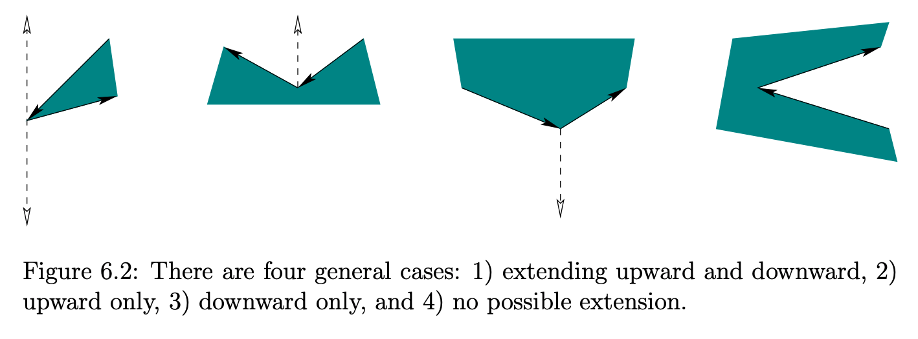
A simple way of decomposing the space is the “vertical cell decomposition”
If you have polygonal obstacles, defined by some set of nodes and edges, computing this representation is done with a type of “sweep algorithm.”
We travel from left-to-right and every time we encounter a node, we have to divide the space somehow:

Slide 10
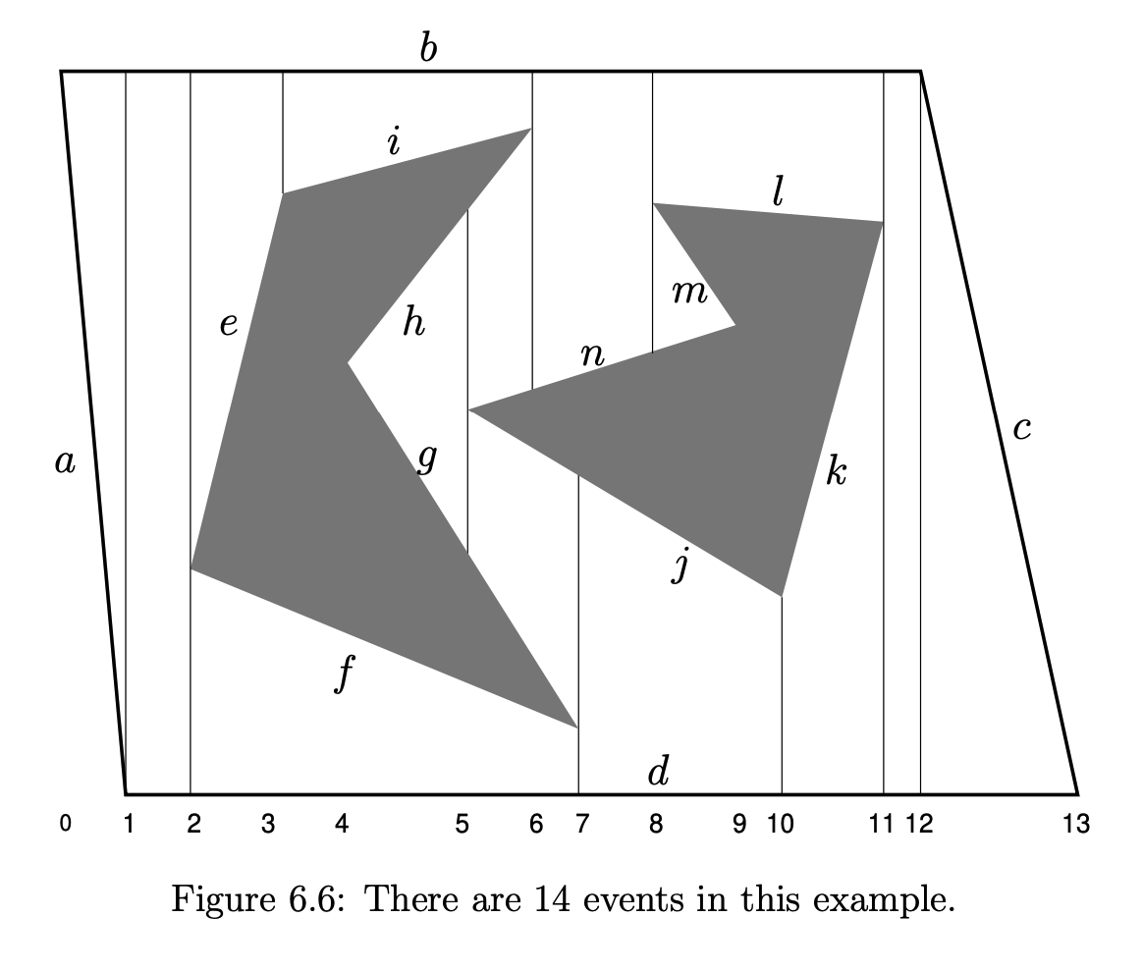
A simple way of decomposing the space is the “vertical cell decomposition”
This gives us some ”cells” and the boundaries between them:

Slide 11
A simple way of decomposing the space is the “vertical cell decomposition”
This gives us some ”cells” and the boundaries between them.
To get the roadmap, it is common to add points at the midpoint of all the vertical cell boundaries and at the center-of-mass for each trapezoid.
Connectivity comes “for free” if you remember which cells are touching.

Slide 12
Vertical Cell Decomposition: is it a roadmap?
There are two properties that define a roadmap:
Does it satisfy Connectivity?

Slide 13
Vertical Cell Decomposition: is it a roadmap?
There are two properties that define a roadmap:
Does it satisfy Connectivity? Yes: can get between all nodes.

Slide 14
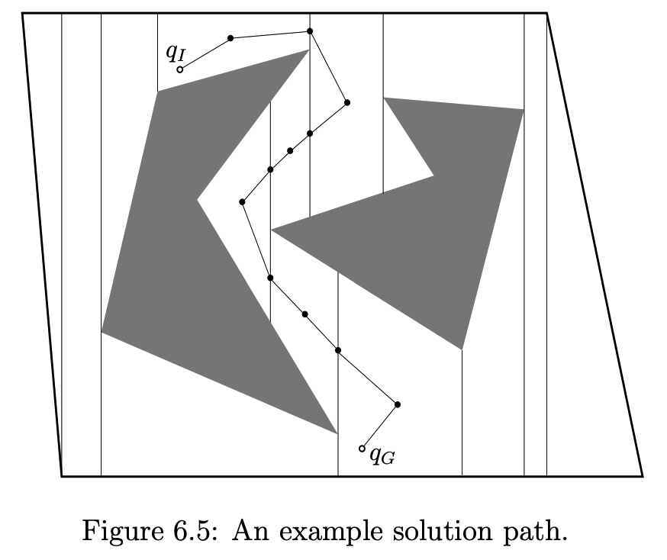
Vertical Cell Decomposition: is it a roadmap?
There are two properties that define a roadmap:
Does it satisfy Connectivity? Yes: can get between all nodes.
Does it satisfy Accessibility?

Slide 15
Vertical Cell Decomposition: is it a roadmap?
There are two properties that define a roadmap:
Does it satisfy Connectivity? Yes: can get between all nodes.
Does it satisfy Accessibility? Yes: can get from any point to a node

Slide 16
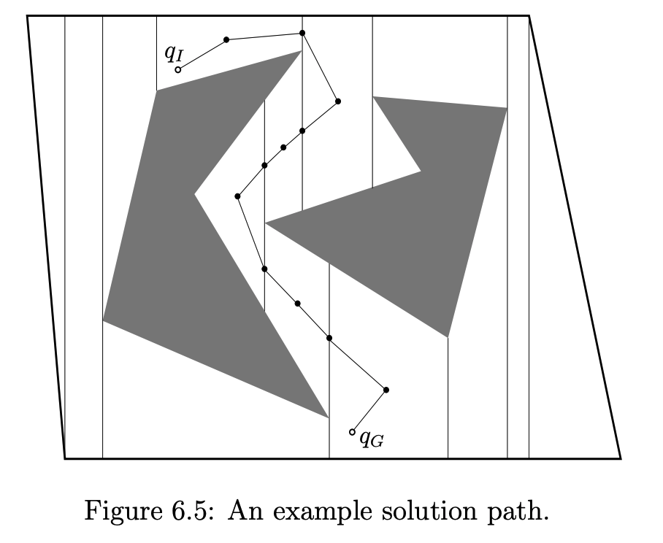
So are we done? No! Vertical Cell Decomposition yields suboptimal plans
These paths could be made shorter by moving the edges closer to the obstacles.
So we want a representation that allows us to get asymptotically close to the obstacles.

Slide 17
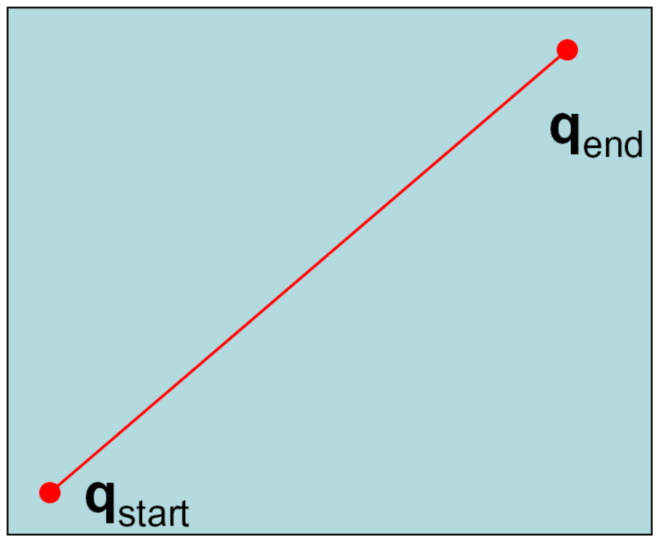
A visibility graph is a common way to build a roadmap in 2D polygonal environments
If there are no obstacles, the shortest path between two points is a straight line.
From: CMU 15.381

Slide 18
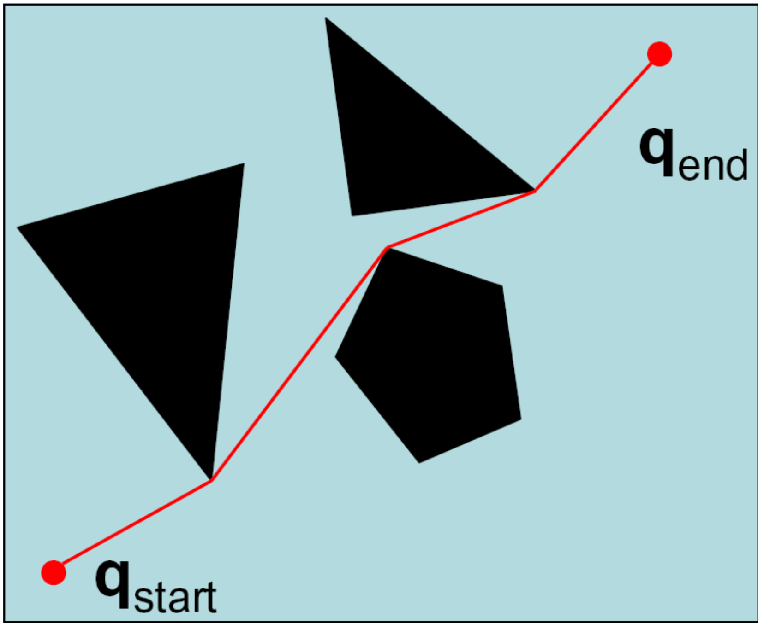
A visibility graph is a common way to build a roadmap in 2D polygonal environments
If there are no obstacles, the shortest path between two points is a straight line.
But what if we add obstacles (polygonal ones for now)?
From: CMU 15.381

Slide 19
A visibility graph is a common way to build a roadmap in 2D polygonal environments
If there are no obstacles, the shortest path between two points is a straight line.
But what if we add obstacles (polygonal ones for now)?
The shortest path seems to be a sequence of points joining object vertices.
Is this always true?
From: CMU 15.381

Slide 20
A visibility graph is a common way to build a roadmap in 2D polygonal environments
If there are no obstacles, the shortest path between two points is a straight line.
But what if we add obstacles (polygonal ones for now)?
The shortest path seems to be a sequence of points joining object vertices.
Is this always true?
Yes! (Proof by contradiction)
From: CMU 15.381

Slide 21
A visibility graph is a common way to build a roadmap in 2D polygonal environments
The visibility graph involves computing which vertices can see which other vertices (and the start and goal points).
Searching over this graph gives us the shortest path.
From: CMU 15.381

Slide 22
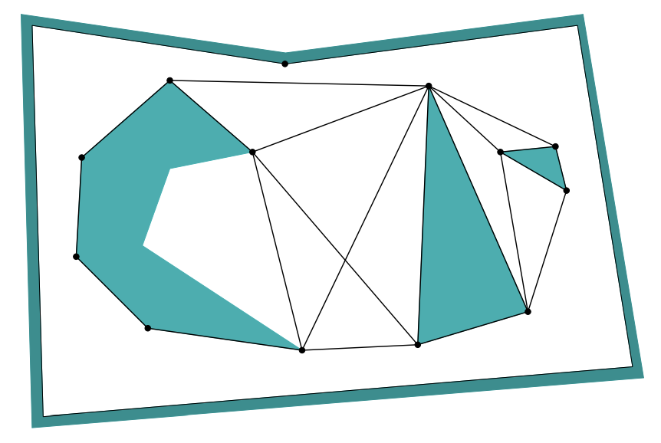
We can go even farther than visibility with the “Shortest Path” roadmap
Notice that not all visibility edges are included.

Slide 23
Why don’t we always use visibility graphs for planning?
First: they get quite complicated and unwieldly in higher than 2 dimension.
Also, we don’t always want to be incredibly close to the obstacles. Sometimes it’s better to be safer
Other factors may play a role as well: it may be impossible for the robot (e.g., a self-driving car) to make sharp turns. Vehicle dynamics will play a big role for the next couple of weeks.

Slide 24
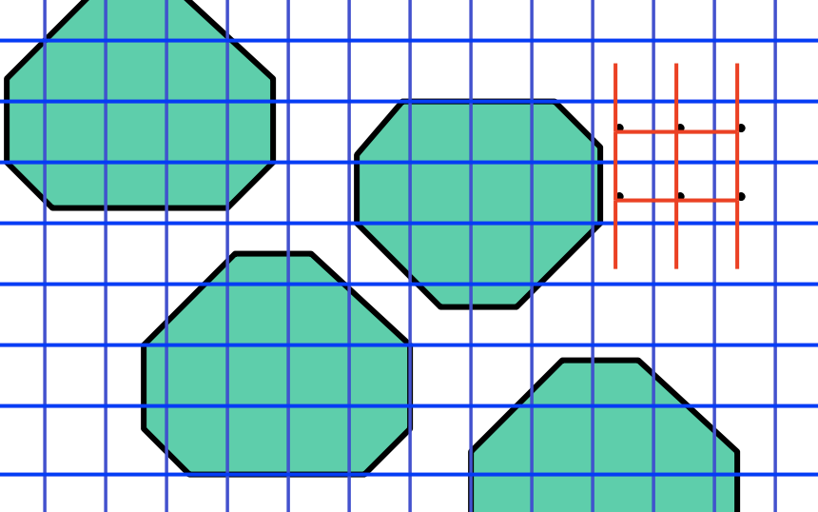
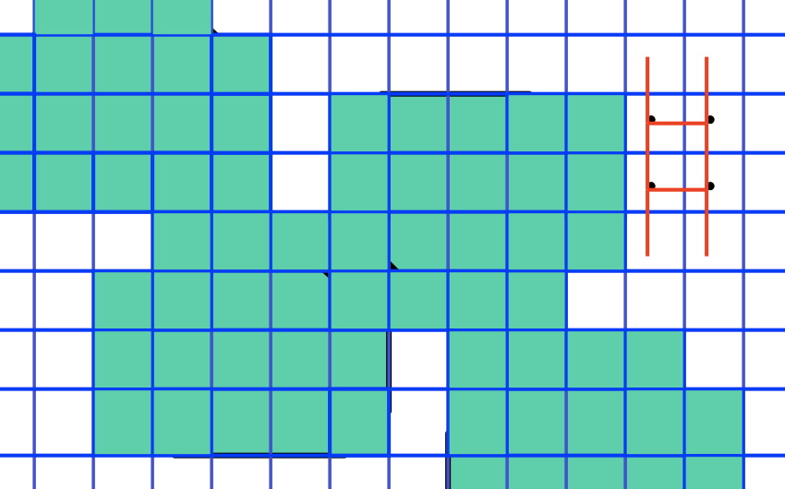
It is also common to create regular discrete grids out of otherwise continuous maps
But turning a continuous space into a grid, you must trade off between a very small resolution (and high computational cost) or a big resolution (and miss closing off paths):
This approach is therefore not complete in general!
Image from: MIT 16.410

Slide 25
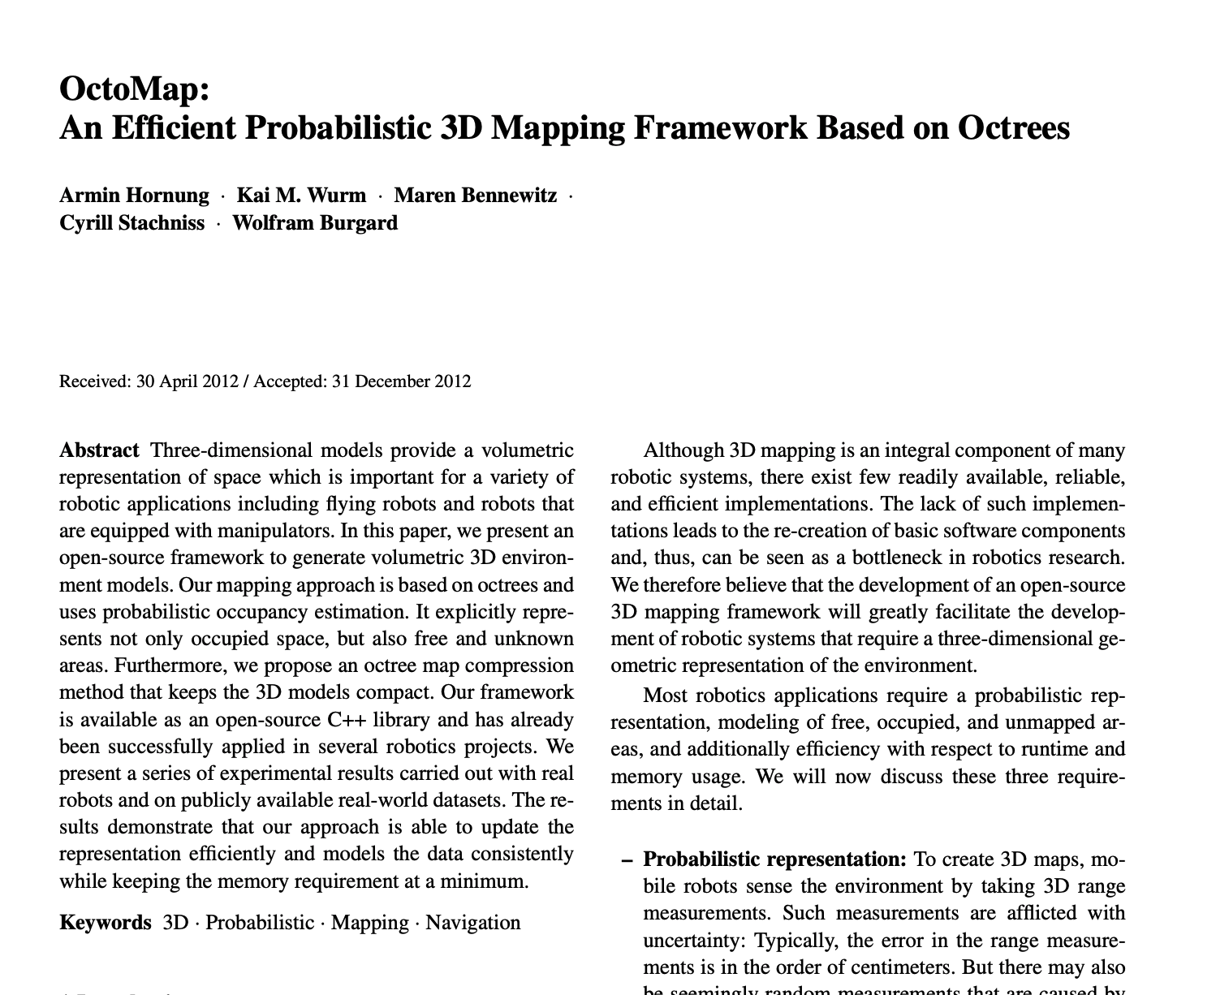
OctoMap (octrees) is a representation that allows for multi-resolution grid cells
Key idea: if you need higher resolution, split a cell in half (in all dimensions). If not: keep a single “big” cell. Great for both large free space regions and small obstacles between them.
https://octomap.github.io/

Slide 26

OctoMap Server is great for fusing laser scan data into a grid
https://www.youtube.com/watch?v=AodHUpuvJqs

Slide 27
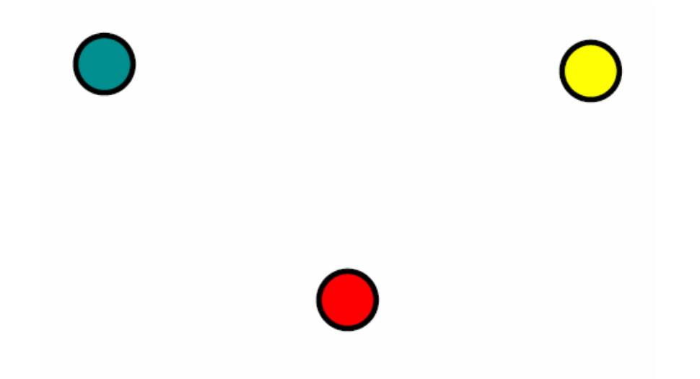
Voronoi Diagrams: let’s make a roadmap based on distance to obstacles
Given a set of points in the plane, a Voronoi Diagram partitions space into regions based on proximity to the points:
The line segments connecting these regions are equidistant to 2 points. The vertices are equidistant to 3.
From: CMU 15.381

Slide 28
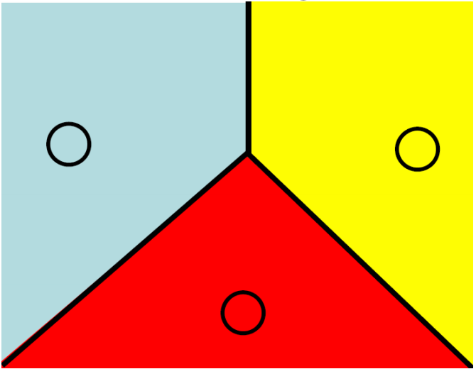
Voronoi Diagrams: let’s make a roadmap based on distance to obstacles
Given a set of points in the plane, a Voronoi Diagram partitions space into regions based on proximity to the points:
The line segments connecting these regions are equidistant to 2 points. The vertices are equidistant to 3.
From: CMU 15.381

Slide 29
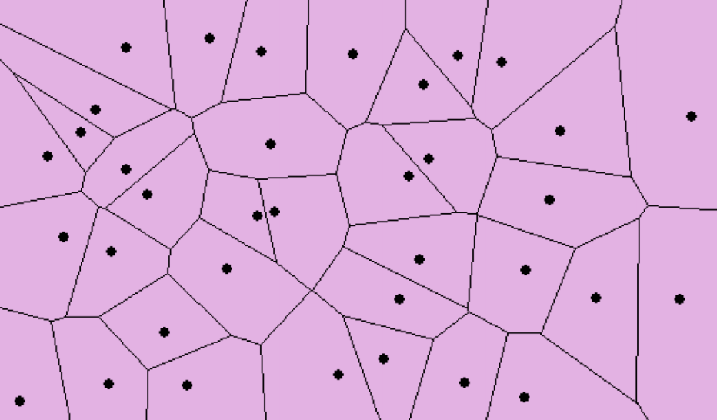
Voronoi Diagrams: let’s make a roadmap based on distance to obstacles
From: CMU 15.381

Slide 30
Can we make Voronoi Diagrams from obstacles?

Slide 31
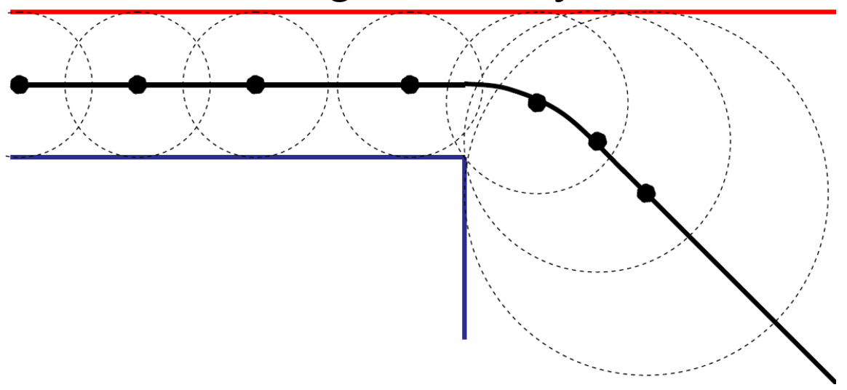
Can we make Voronoi Diagrams from obstacles? Yes: the Generalized Voronoi Diagram
Edges are piecewise, made up of straight lines and quadratic curves.
Straight: equidistant from 2 edges
Curved: equidistant from 1 corner and 1 edge

Slide 32
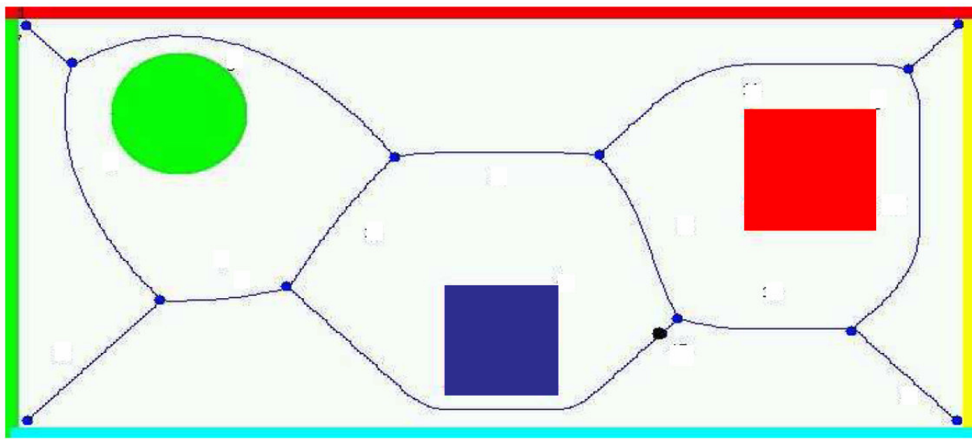
Can we make Voronoi Diagrams from obstacles? Yes: the Generalized Voronoi Diagram
Edges are piecewise, made up of straight lines and quadratic curves.
Straight: equidistant from 2 edges
Curved: equidistant from 1 corner and 1 edge

Slide 33
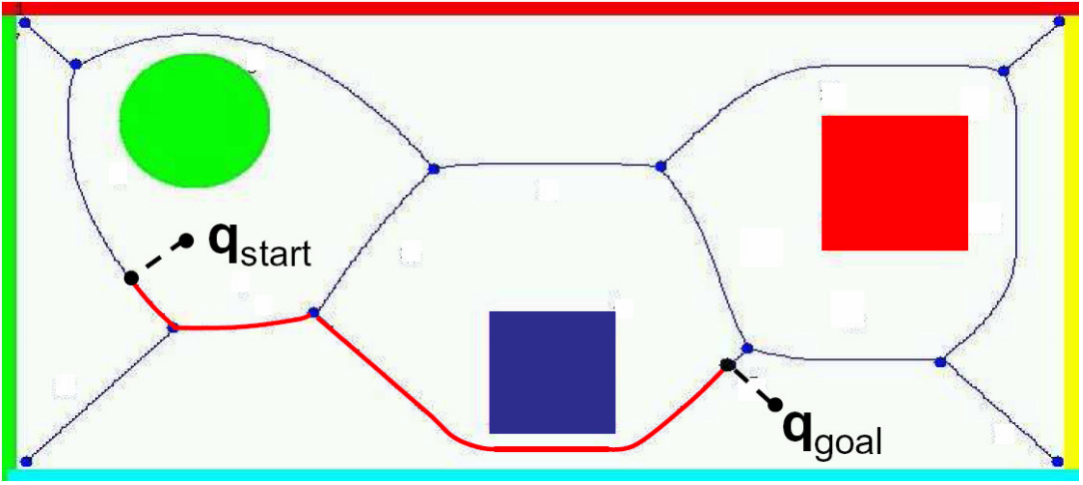
Planning in a GVD works about as you’d expect:
Find a route to the nearest edge and then follow the edges to travel between the points (as computed by a search algorithm).
Note: points on these lines are farthest from the nearest obstacles.
This can be good for safety, but strongly depends on the problem.

Slide 34
Weaknesses of the Voronoi Diagram
Like many of the other approaches we’ve discussed, it’s hard to compute them in higher dimensions.
Also, they can be brittle/unstable: small changes in the environment can significantly change the GVD.
Also, “stay as far away from obstacles as you can” isn’t always the best planning objective. In most problem settings we don’t need to be so conservative/cautious.

Slide 35
Summary of Roadmap Models
Vertical Cell Decomposition
Visibility Graph
Generalized Voronoi Graph

Slide 36
Planning with movement costs
Now we’ll talk about how to plan over roadmaps: the edges have cost (often in units of time or distance) that need to be included when searching for the “best” path.
In the coming weeks we’ll talk about how to plan in environments where computing the graph is hard! What do we do when we cannot easily compute a roadmap?
Planning with motion primitives
Incorporating vehicle size, shape, and dynamics
Sampling-based Planning

Slide 37
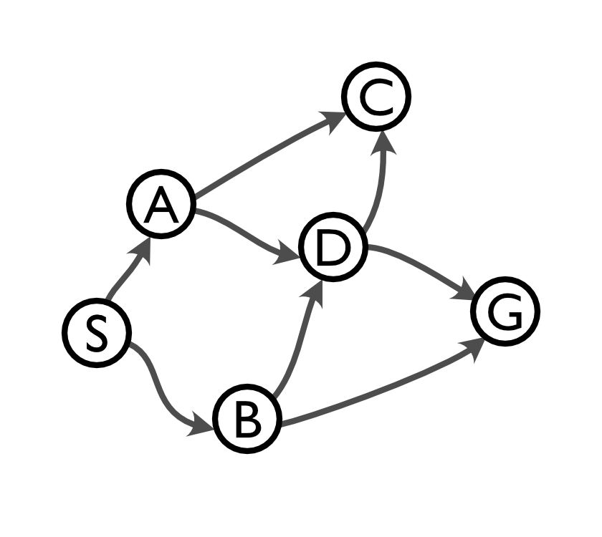
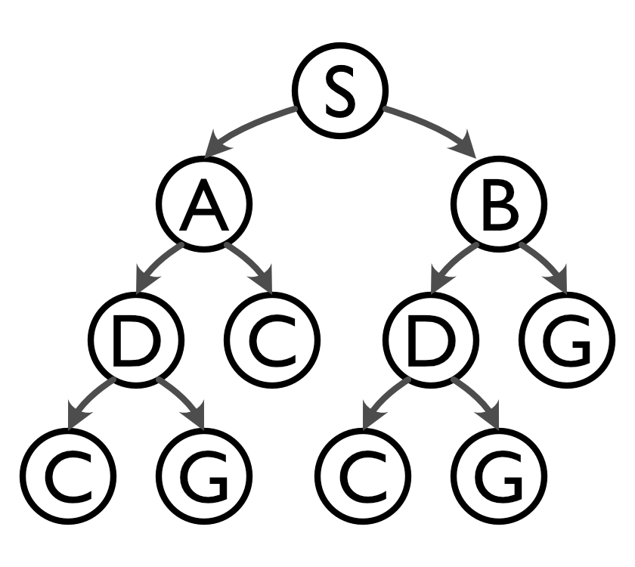
Add cost (path length) to the edges
This means that our roadmap graph will include edge costs.
These edge costs will also be added to our search tree and incorporated into the total path cost at each node.
0
2
3
4
2
2
2
1
6
5
5
8

Slide 38
Finding the shortest path: a problem statement
The input to our search problem now includes a weight function:
where
(a function that outputs a cost for pairs of vertices)
The output is now a simple path from S to G that (ideally) has the shortest path weight (and optionally also returns the weight of the path).
Notes:
\left< g, w, S, G \right>

Slide 39
What’s the simplest way to find the shortest path we can think of?

Slide 40
What’s the simplest way to find the shortest path we can think of?
How about we just “grow” outward from the starting node in order of cost: Uniform Cost Search

Slide 41
What’s the simplest way to find the shortest path we can think of?
How about we just “grow” outward from the starting node in order of cost: Uniform Cost Search
Similar to breadth-first search, except instead of using the length of the path to order Q, we use path length of the elements of Q.
Visually:
Grows outward from the start until the goal is reached.

Slide 42
Uniform-Cost Search: An Example
From: MIT 16.410

Slide 43
Uniform-Cost Search: An Example
From: MIT 16.410

Slide 44
Uniform-Cost Search: An Example
From: MIT 16.410

Slide 45
Uniform-Cost Search: An Example
From: MIT 16.410

Slide 46
Uniform-Cost Search: An Example
We reached the goal! …are we done?
From: MIT 16.410

Slide 47
Uniform-Cost Search: An Example
We reached the goal! …are we done?
Maybe not, so let’s keep going.
From: MIT 16.410

Slide 48
Uniform-Cost Search: An Example
We reached the goal! …are we done?
Maybe not, so let’s keep going.
Look: we found a new path to the goal that’s shorter!
From: MIT 16.410

Slide 49
Uniform-Cost Search: An Example
We reached the goal! …are we done?
Maybe not, so let’s keep going.
Look: we found a new path to the goal that’s shorter!
From: MIT 16.410

Slide 50
Notice: we did not keep a visited list!
What happens if we don’t allow ourselves to revisit nodes?
From: MIT 16.410

Slide 51
Notice: we did not keep a visited list!
What happens if we don’t allow ourselves to revisit nodes?
We would miss the best route to the goal!
From: MIT 16.410

Slide 52
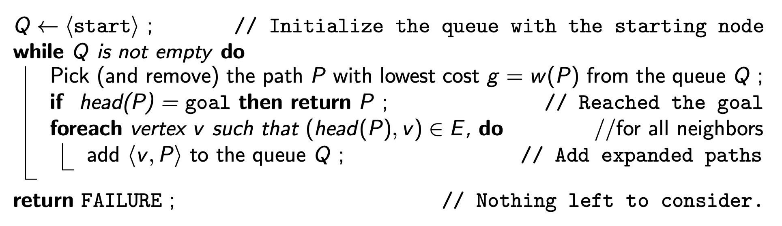
Uniform-Cost Search Algorithm
Observe: the algorithm only stops when the lowest cost path reaches the goal. If that’s not true, we could add a new node that reaches the goal in less time (visited or not).
If there are paths that don’t reach the goal that are already longer than the shortest path to the goal, we don’t need to explore them. Weights cannot be negative, so it will never be shorter again.
From: MIT 16.410

Slide 53
Uniform-Cost Search Algorithm
UCS generalizes BFS to handle the weighted graph. If all the edges have the same cost then they produce the same result.
It is both complete and optimal, though can struggle if there are some edges with very low cost. If W* is the optimal cost, and 𝝐 is the lowest cost edge, the time and space complexity is:
From: MIT 16.410

Slide 54
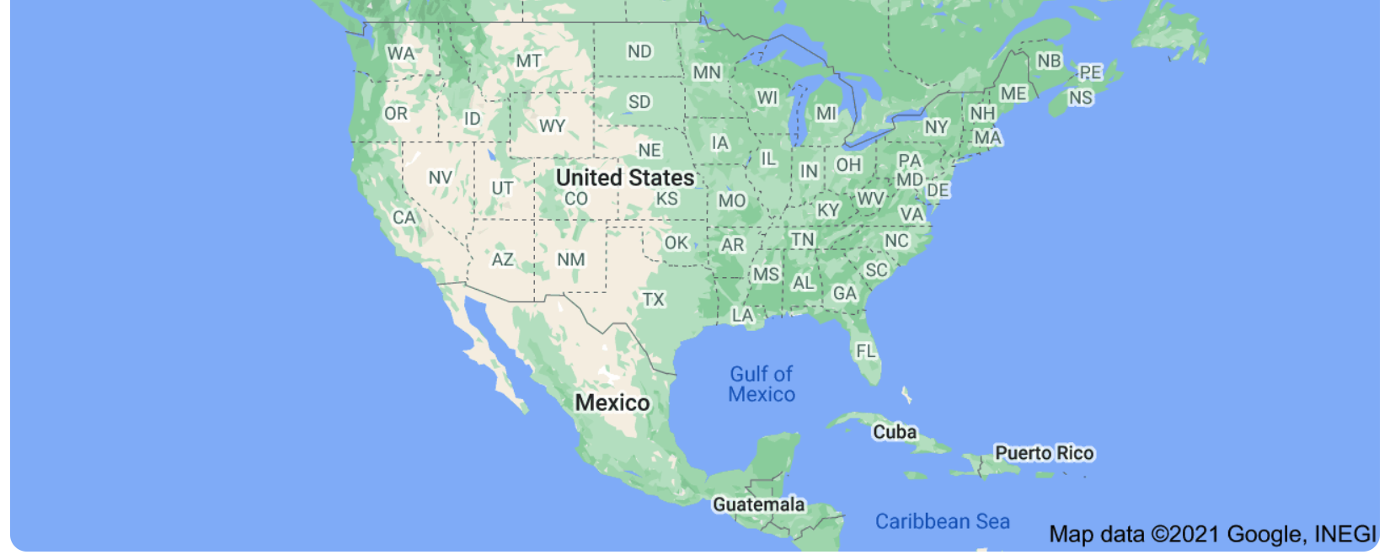
UCS is complete and yields the optimal path, but there’s often more we know, right?
My algorithm is searching outward from the start point, but I often know (at least) the general direction of the goal.
For example, if I want to plan a trip to D.C. from the middle of the United States, my search algorithm probably won’t need to expand much in the direction of California:

Slide 55
Greedy (Best First) Search
Greedy Search: try to bias search to get “closer” to the goal
We need a measure of distance to the goal. It would be ideal to use the length of the shortest path... but this is exactly what we are trying to compute!
Instead, we use a “heuristic function” h to estimate the remaining distance to the goal and try to move in a way to minimize the remaining distance.
For motion planning, using Euclidian distance from the goal is a common choice of heuristic function.
From: MIT 16.410

Slide 56
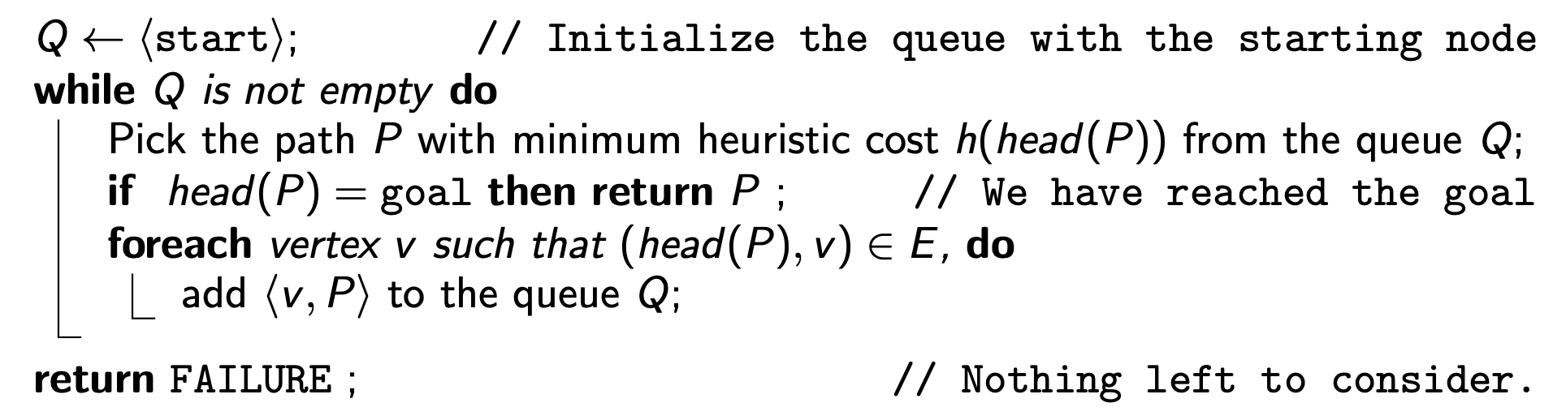
Greedy (Best First) Search
From: MIT 16.410

Slide 57
Greedy (Best First) Search: An Example
From: MIT 16.410

Slide 58
Greedy (Best First) Search: An Example
From: MIT 16.410

Slide 59
Greedy (Best First) Search: An Example
From: MIT 16.410

Slide 60
Greedy (Best First) Search: An Example
From: MIT 16.410

Slide 61
Greedy (Best First) Search: An Example
From: MIT 16.410

Slide 62
Greedy (Best First) Search
Greedy Search is similar to Depth-First Search: it keeps exploring until it needs to back up when it finds a dead end.
Greedy Search is not optimal and not complete (it may get stuck in loops, since it doesn’t accumulate path cost).
However, it can be quite fast and efficient depending on the choice of heuristic function and the nature of the problem.

Slide 63
More about motion planning next week!

