Slide 1
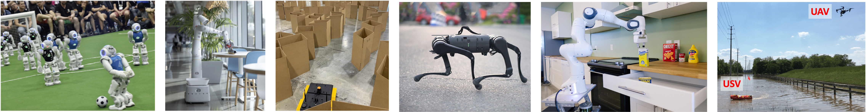
CS 685 Autonomous Robotics
Introduction to
Probabilistic Robotics II
Prof. Xuesu Xiao
George Mason University
Slides Credits: Gregory Stein

Slide 2
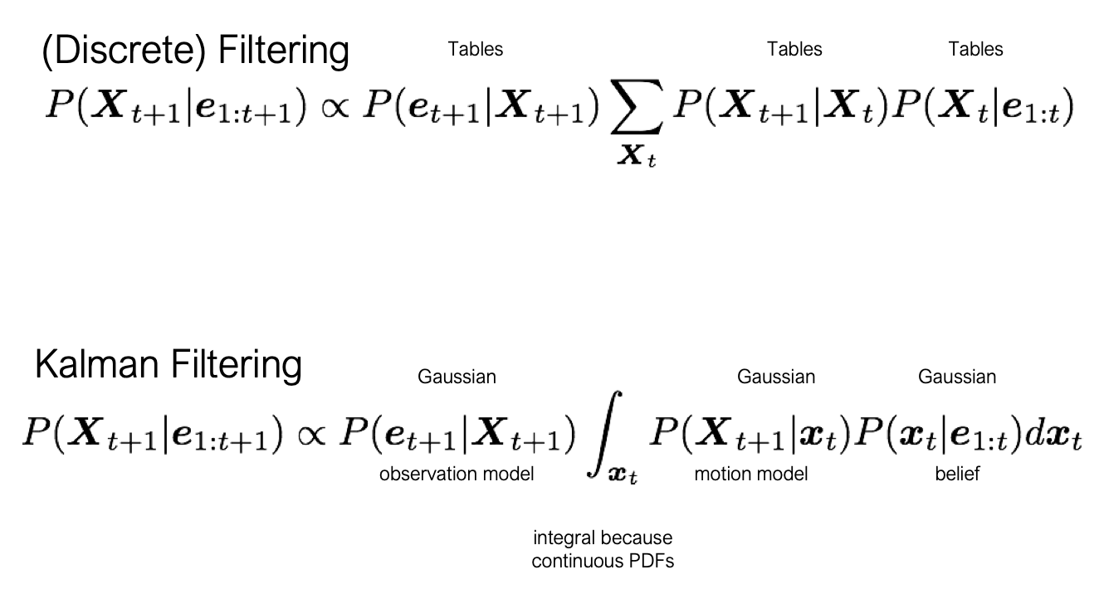
So far, everything has been discrete

Slide 3
So far, everything has been discrete
…but the math generalizes to continuous
The Kalman Filter: continuous (gaussian) filtering

Slide 4
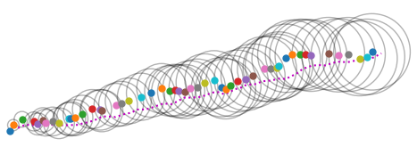
Think of our 2D Motion + GPS example from earlier
How do we compute the “uncertainty” on each?

Slide 5
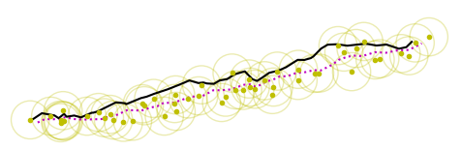
Think of our 2D Motion + GPS example from earlier
How do we compute the “uncertainty” on each?
How do we incorporate the GPS observations?

Slide 6
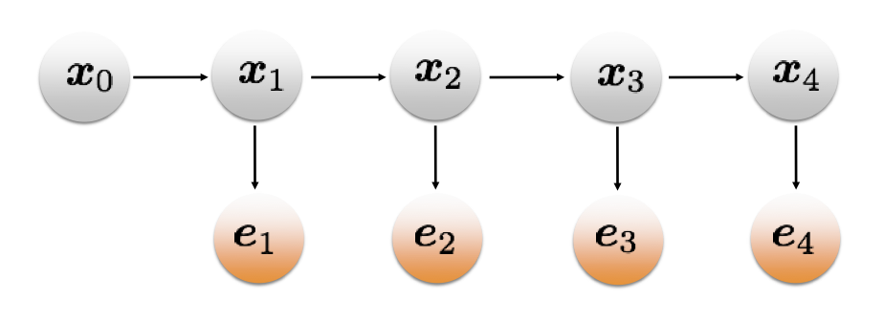
We’ll use a very similar model as in the discrete HMM case
The graphical representation will look pretty much the same:

Slide 7

Let’s start with an example in 1D
My robot moves along the x-axis:

Slide 8
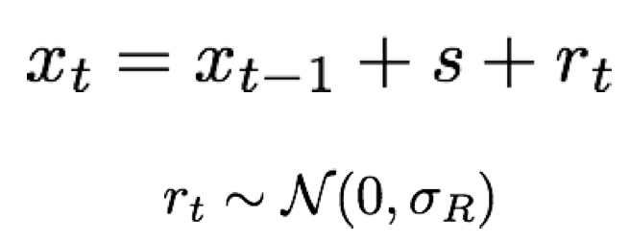
Let’s start with an example in 1D
My robot moves along the x-axis:
It moves by some distance “s” with an added noise “r_{t}”
The noise is gaussian with known covariance.

Slide 9
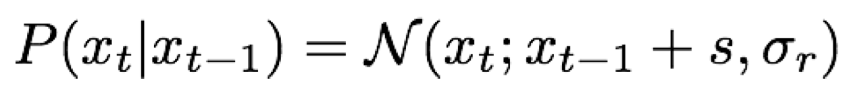
Let’s start with an example in 1D
My robot moves along the x-axis:
The motion model is therefore as follows:

Slide 10
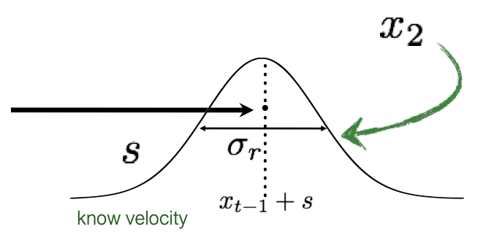
Let’s start with an example in 1D
My robot moves along the x-axis:
The motion model is therefore as follows:

Slide 11
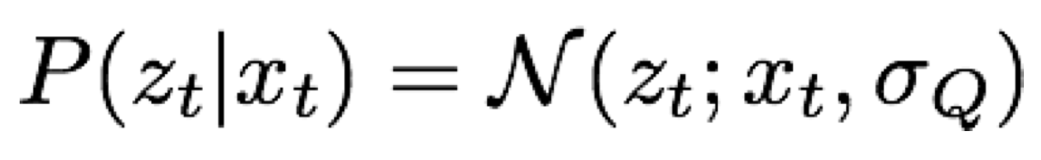
GPS gives us a noisy estimate of the “true” state.
Similar to the previous, its assumed to be gaussian:

Slide 12
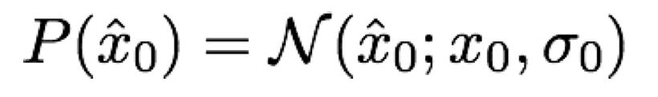
We also need a prior
We also assume that to be Gaussian:

Slide 13
Combining all these is pretty straightforward, using our model from before

Slide 14
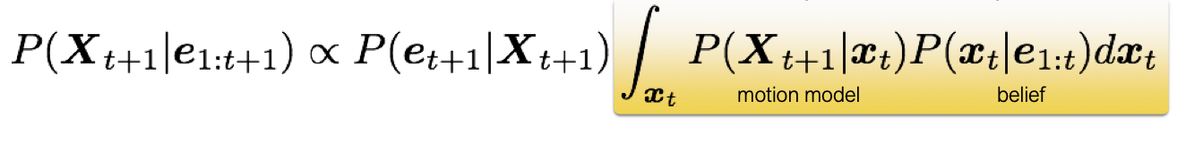
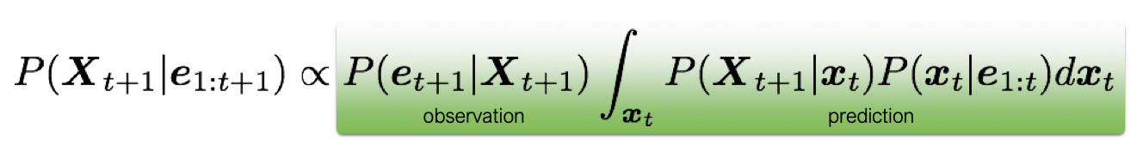
Combining all these is pretty straightforward, using our model from before
Prediction Step
Update Step

Slide 15
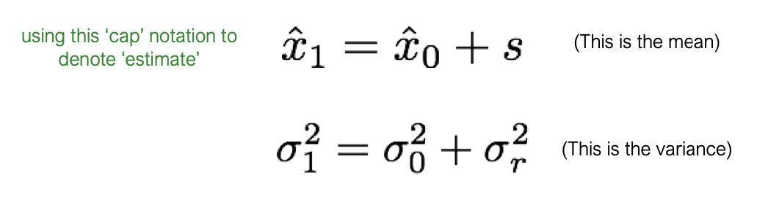
Gaussians in; Gaussians out
First, is the prediction step.
It’s pretty easy to update the state: the mean moves and the noise grows:

Slide 16
Gaussians in; Gaussians out
What about the update step?
It’s slightly more complicated, but still gives us a Gaussian

Slide 17
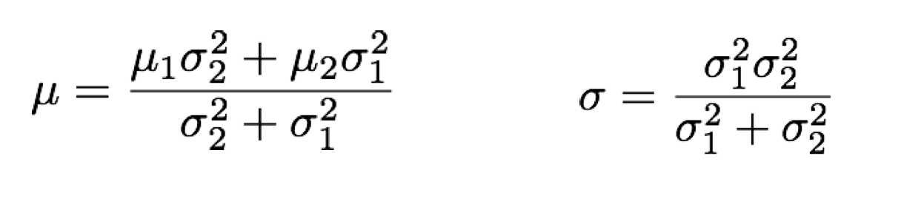
Gaussians in; Gaussians out
Don’t forget, the product of two Gaussians yields another Gaussian.
The mean and covariance of the new Gaussian:

Slide 18
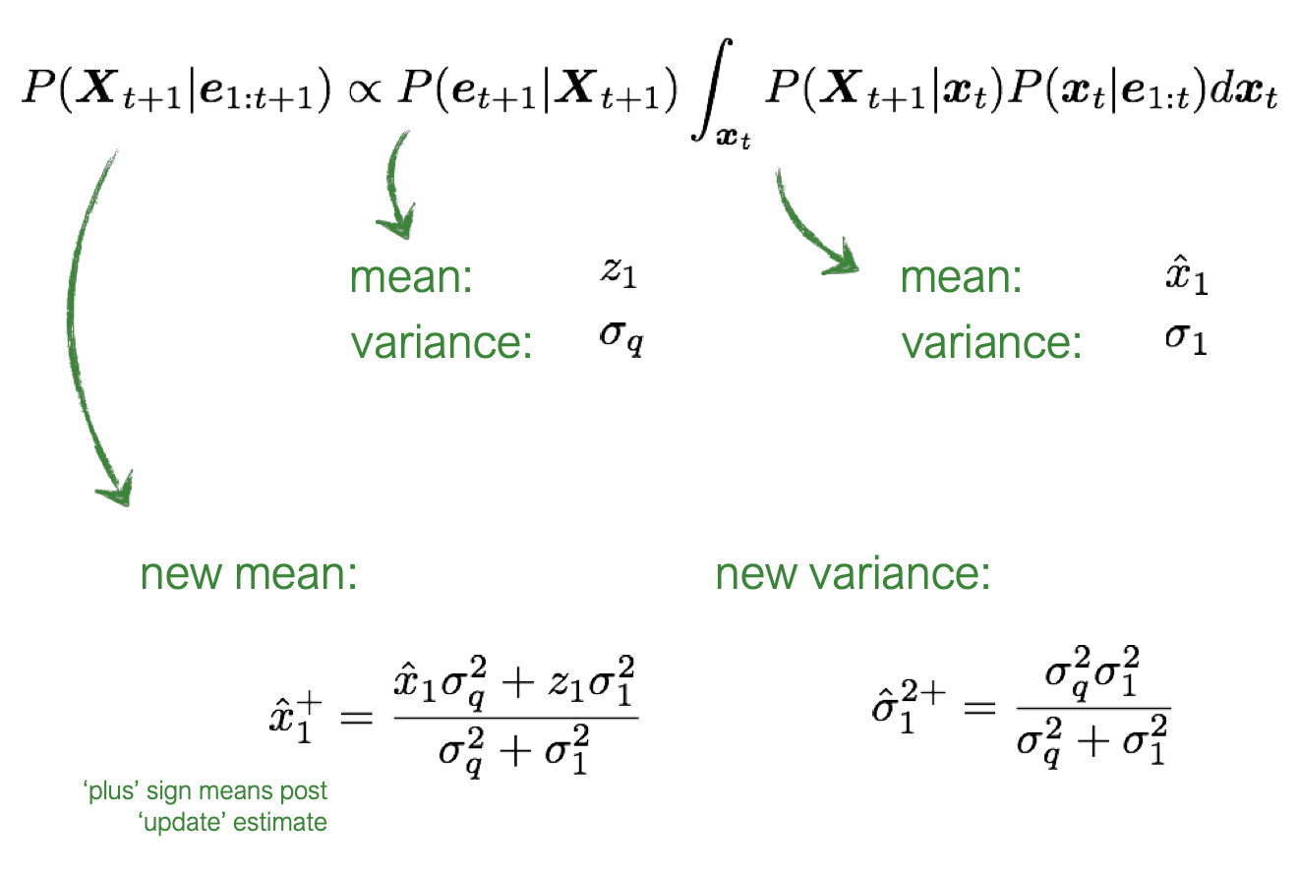
Applying that Gaussian rule to the Filtering equation gives us the following:

Slide 19
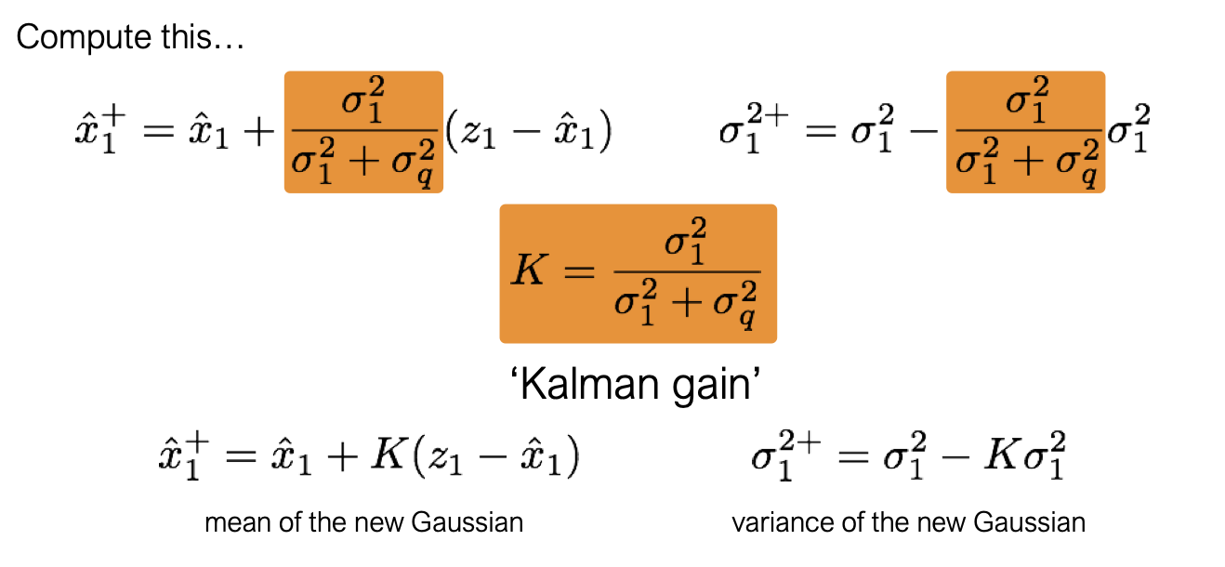
Applying that Gaussian rule to the Filtering equation gives us the following:

Slide 20
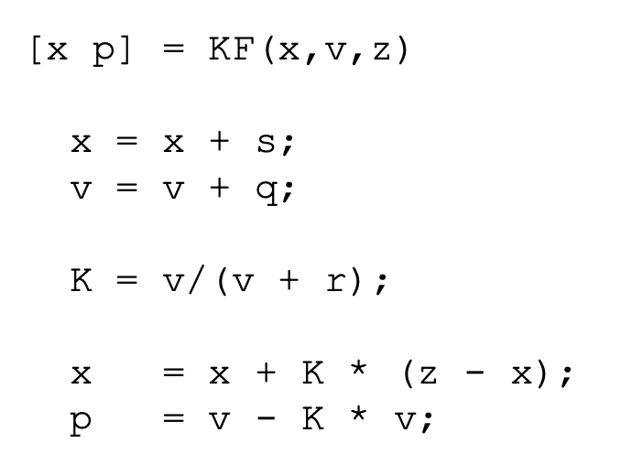
The Kalman Filter
Gaussian update equations
It’s just a handful of lines of code

Slide 21
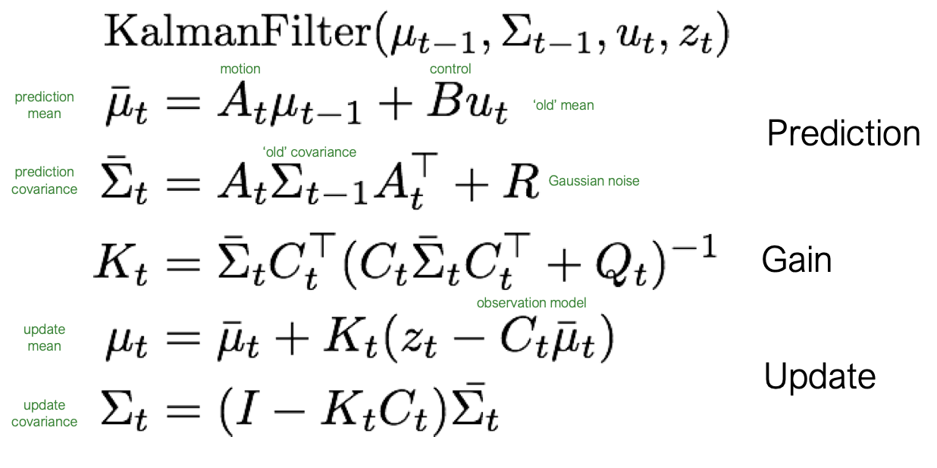
The Kalman Filter
Gaussian update equations
Linear Algebra helps us to generalize these concepts:
(Also just a few lines of code)

Slide 22
Let’s revisit our 2D GPS model
Does all the behavior make sense?
What are the equations the govern the motion?
Motion Model:
We are given a measurement of the movement “s” at each time step: the dx_noisy and dy_noisy
The noise is known to us: a 0.3 diagonal matrix

Slide 23
Let’s revisit our 2D GPS model
Does all the behavior make sense?
What are the equations the govern the motion?
Motion Model:
We are given a measurement of the movement “s” at each time step: the dx_noisy and dy_noisy
The noise is known to us: a 0.3 diagonal matrix
If we only include motion (no GPS), the robot moves by “s” and the noise grows according to the earlier equations

Slide 24
Let’s revisit our 2D GPS model
Does all the behavior make sense?
What are the equations the govern the motion?
We also understand the GPS measurements:
We know that it’s related to the true state by a noise matrix that’s a 1.0 diagonal matrix.

Slide 25
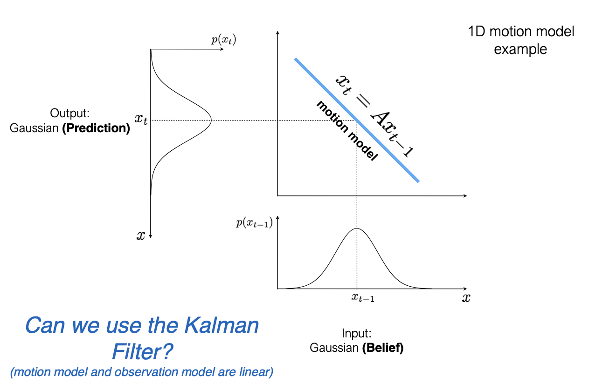
When can’t we use a Kalman Filter?
Well…most of the time…
We assumed everything was Gaussian and linear

Slide 26
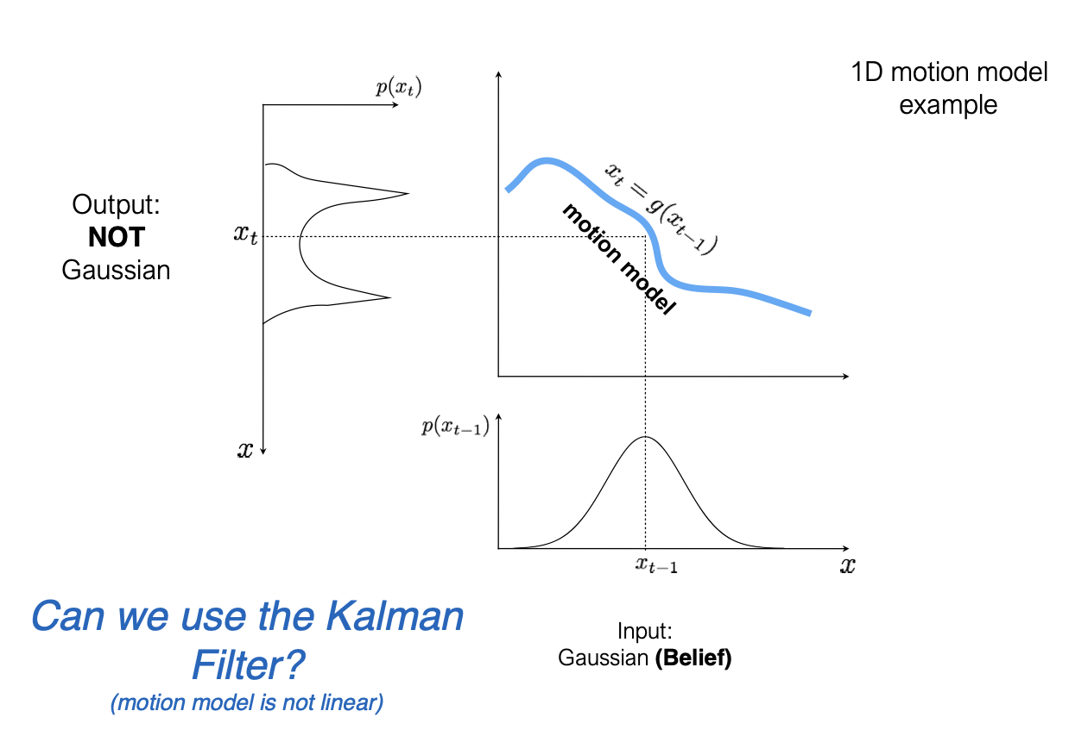
When can’t we use a Kalman Filter?
Here’s a non-linear model:

Slide 27
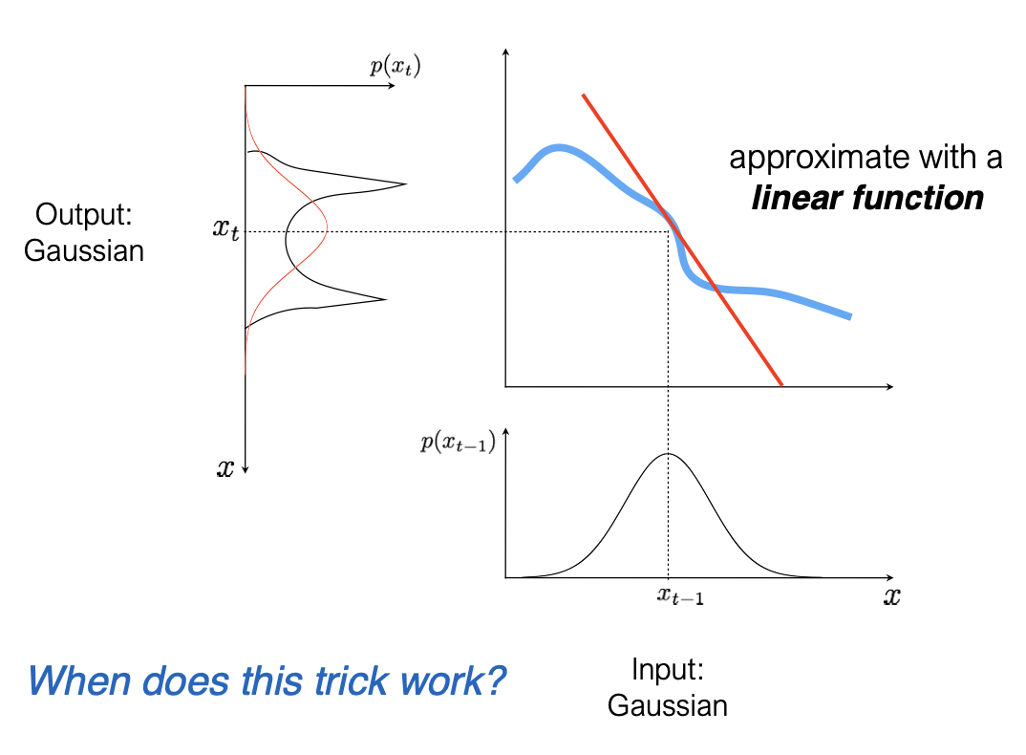
Instead, let’s “linearize” the model

Slide 28
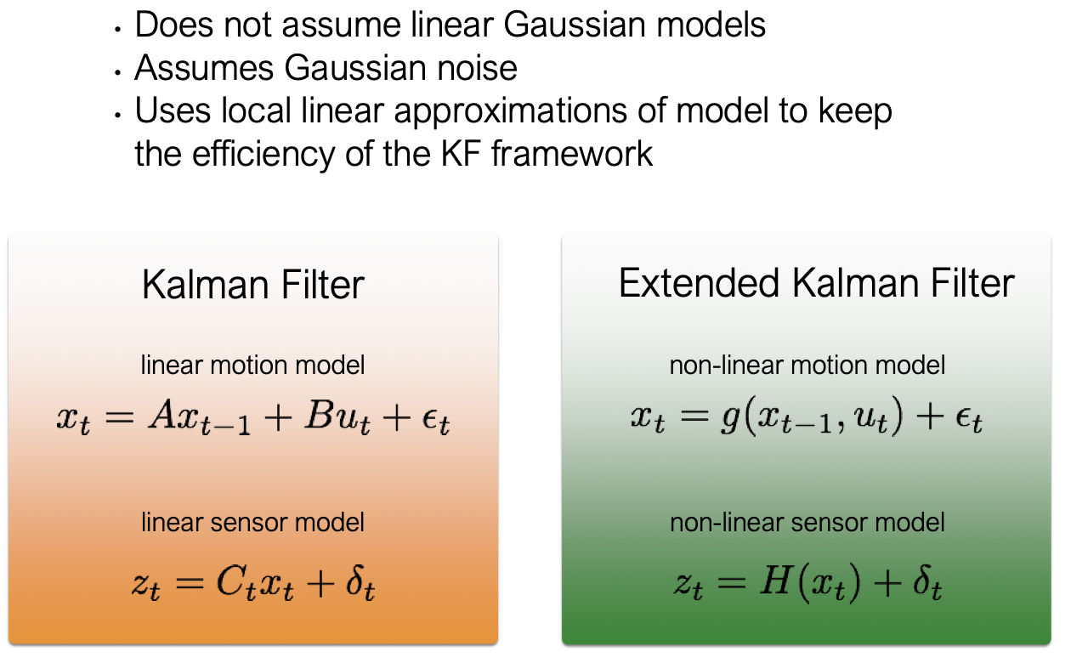
The “Extended” Kalman Filter

Slide 29
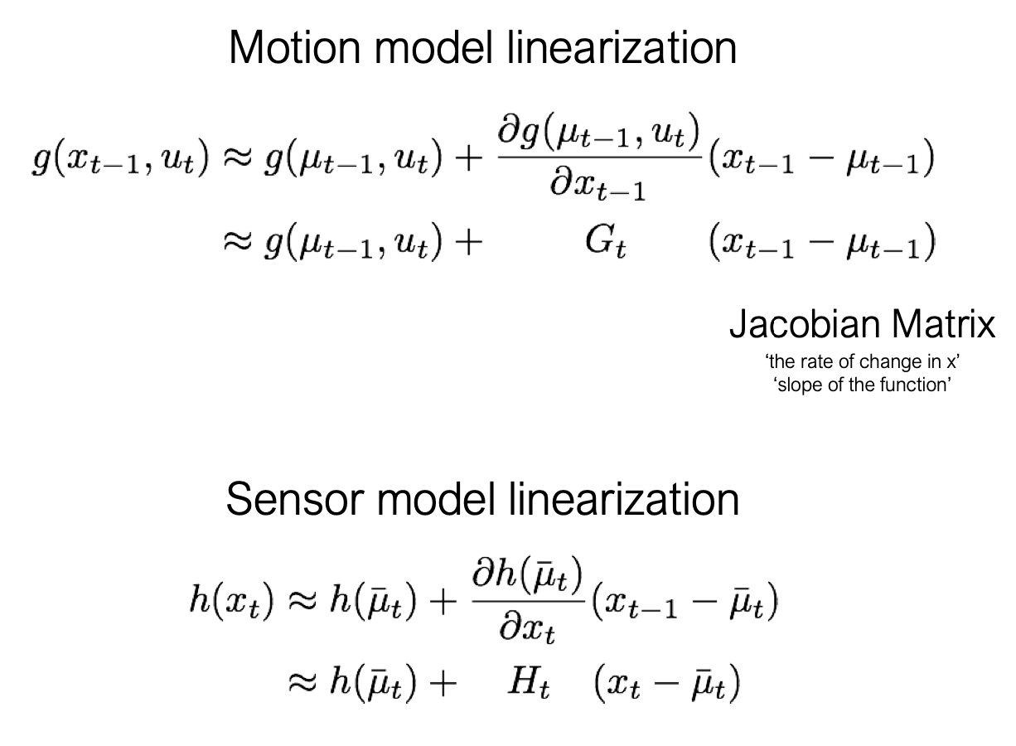
We “linearize” using a Taylor series expansion

Slide 30
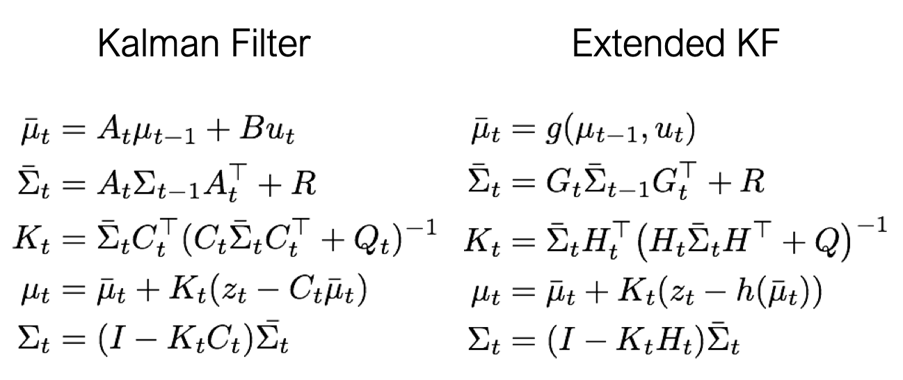
The “EKF” algorithm is pretty much the same

Slide 31
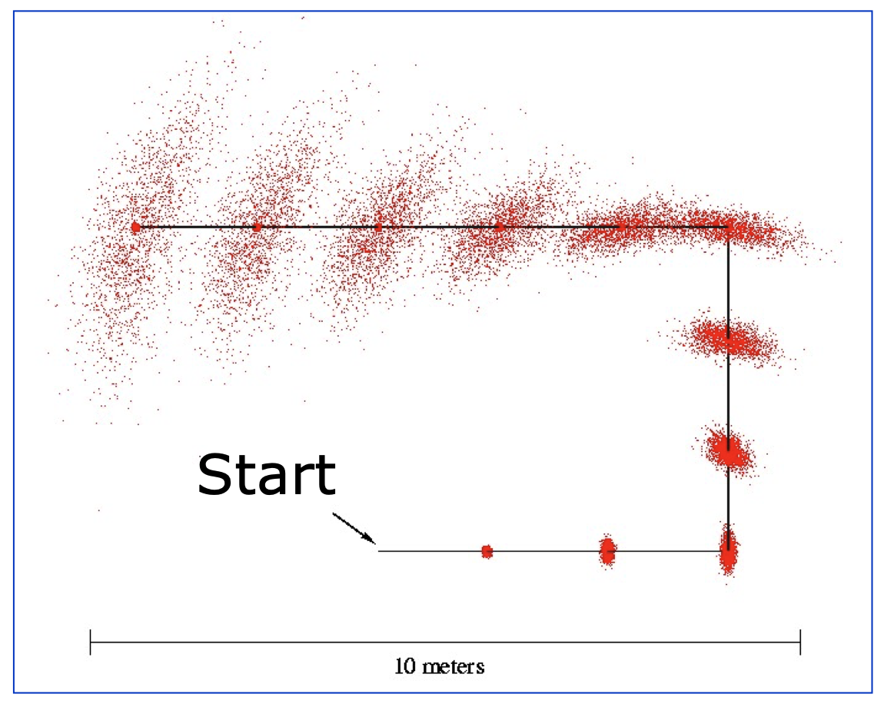
The EKF is necessary when we have a robot with orientation
If we have uncertainty in yaw, the motion model becomes nonlinear:
From: https://cs.gmu.edu/%7Ekosecka/cs685/cs685-11-sensor-motion-models.pdf

Slide 32
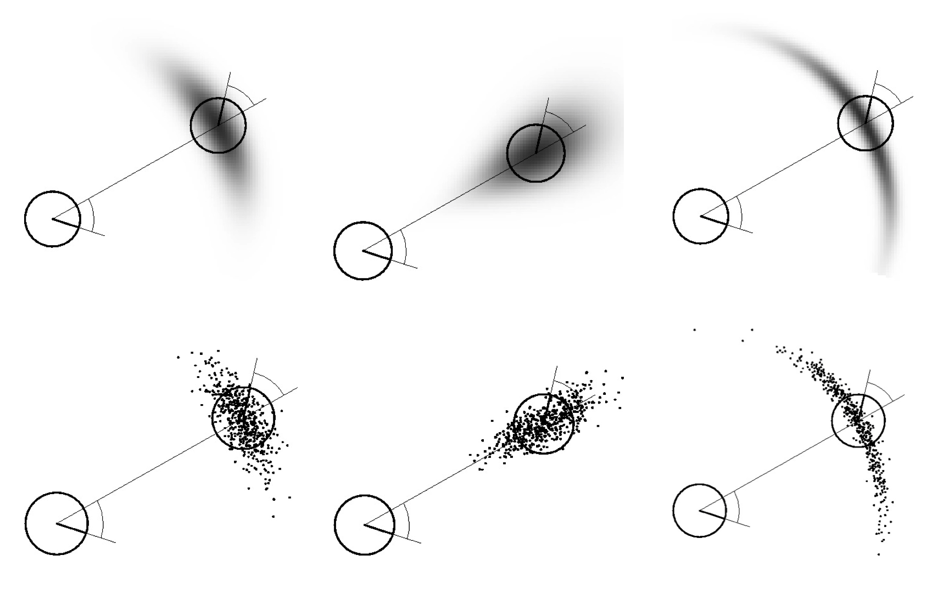
The EKF is necessary when we have a robot with orientation
If we have uncertainty in yaw, the motion model becomes nonlinear:
From: https://cs.gmu.edu/%7Ekosecka/cs685/cs685-11-sensor-motion-models.pdf

Slide 33

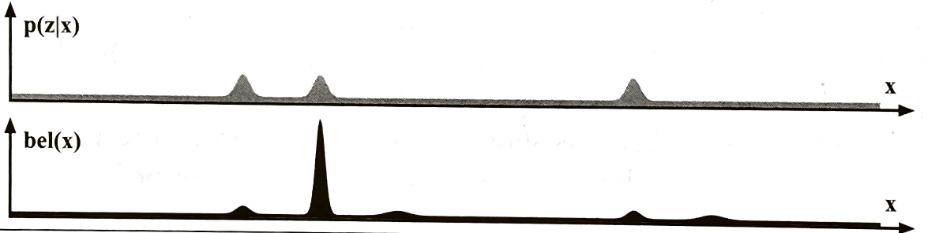
Will the EKF help us with the “Doors” example from earlier?

Slide 34
Will the EKF help us with the “Doors” example from earlier?
Hmm, probably not. We approximate the distribution as being Gaussian, so we’d lose the multi-peaked structure.
We’ll talk more about how to handle more complex probability distributions like these.

Slide 35
Let’s revisit the idea of probability distributions being represented as graphs
The graph is a convenient visual tool, but an incredibly powerful way to think about these problems more generally:
What if I removed an observation?
What if I added additional observations and sensors?

Slide 36
Let’s revisit the idea of probability distributions being represented as graphs
The graph is a convenient visual tool, but an incredibly powerful way to think about these problems more generally:
What if I removed an observation?
What if I added additional observations and sensors?
The probability distribution starts to get quite complicated, but the graph helps us manage that complexity.

Slide 37
Modern SLAM: everything is a graph
SLAM: Simultaneous Localization and Mapping
Square Root SAM paper

Slide 38
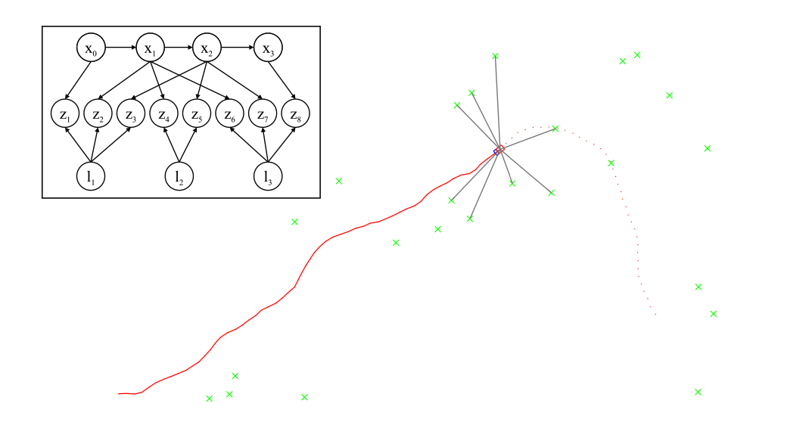
Modern SLAM: everything is a graph
Square Root SAM paper

Slide 39
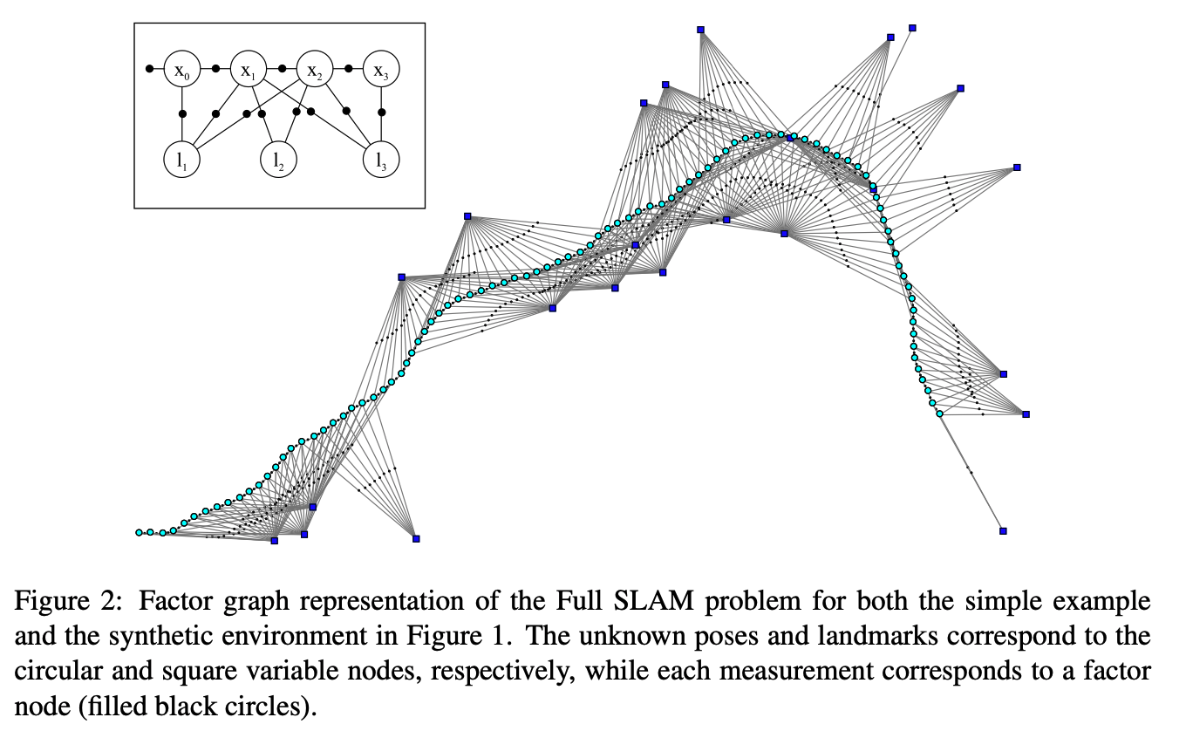
Modern SLAM: everything is a graph
Square Root SAM paper

