Slide 1
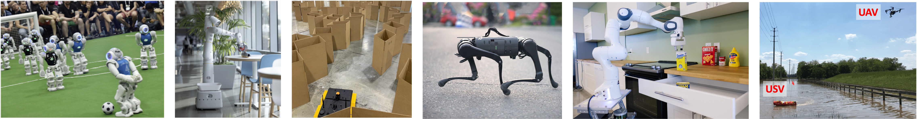
CS 685 Autonomous Robotics
Robot Vision II
Prof. Xuesu Xiao
George Mason University
Slides Credits: Gregory Stein

Slide 2
Mid-Project Presentation next week!
Each team prepares a 5-10 min presentation on
  Reminder of what your project is about?
  What you have done?
  If you have any intermediate results, show it!
  Any difficulties? Is everything on track?
  What you plan to do in the coming 3 weeks?
Remember the open-ended project is 40% of your final grade!
  Start early!
  Devote 40% of the effort necessary for a 3-credit graduate-level course!

Slide 3
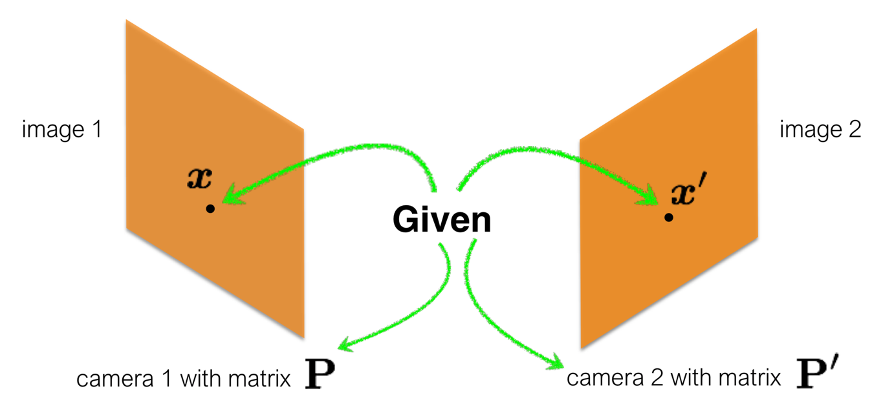
What happens when we detect the same point from two locations?

Slide 4
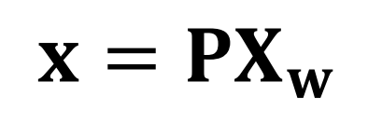
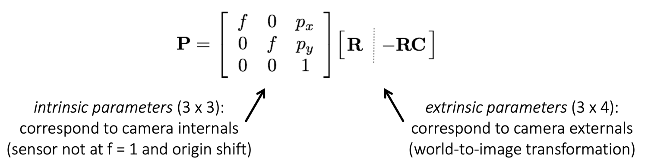
Reminder: Camera Matrix / Geometry
Projecting a point from 3D to 2D (homogeneous):
where:

Slide 5
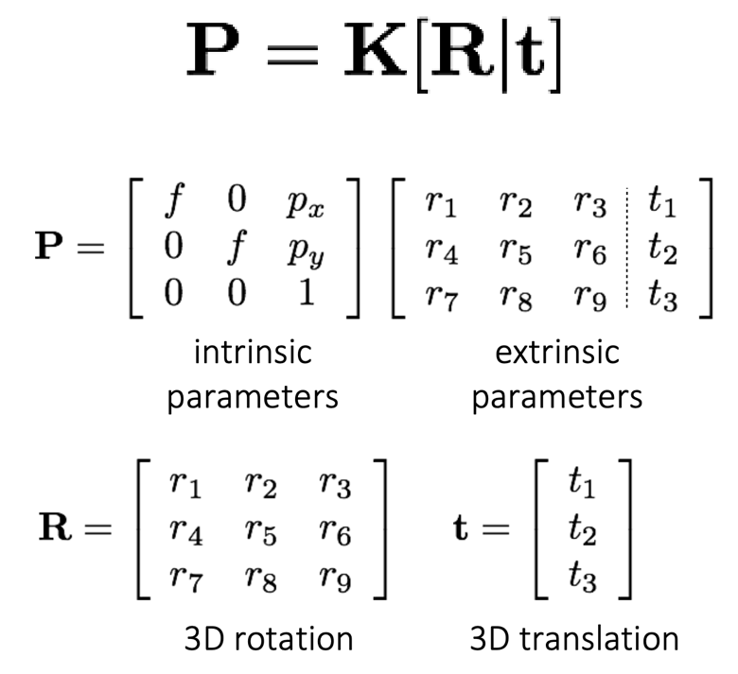
Reminder: Camera Matrix / Geometry

Slide 6
What happens when we detect the same point from two locations?
Which 3D points project to this 2D point?

Slide 7
What happens when we detect the same point from two locations?
Which 3D points project to this 2D point?

Slide 8
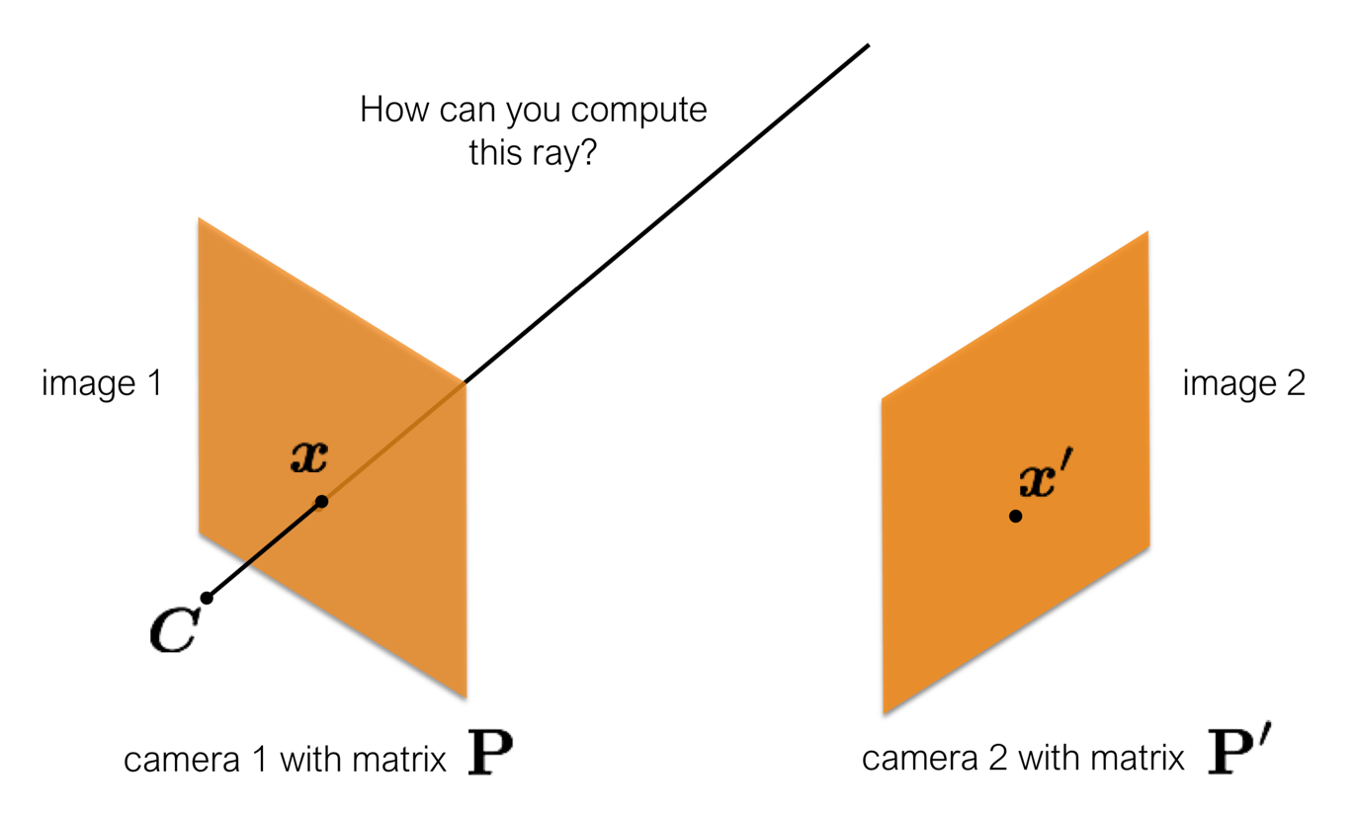
What happens when we detect the same point from two locations?

Slide 9
What happens when we detect the same point from two locations?
The ray intersects both x and C.

Slide 10
What happens when we detect the same point from two locations?

Slide 11
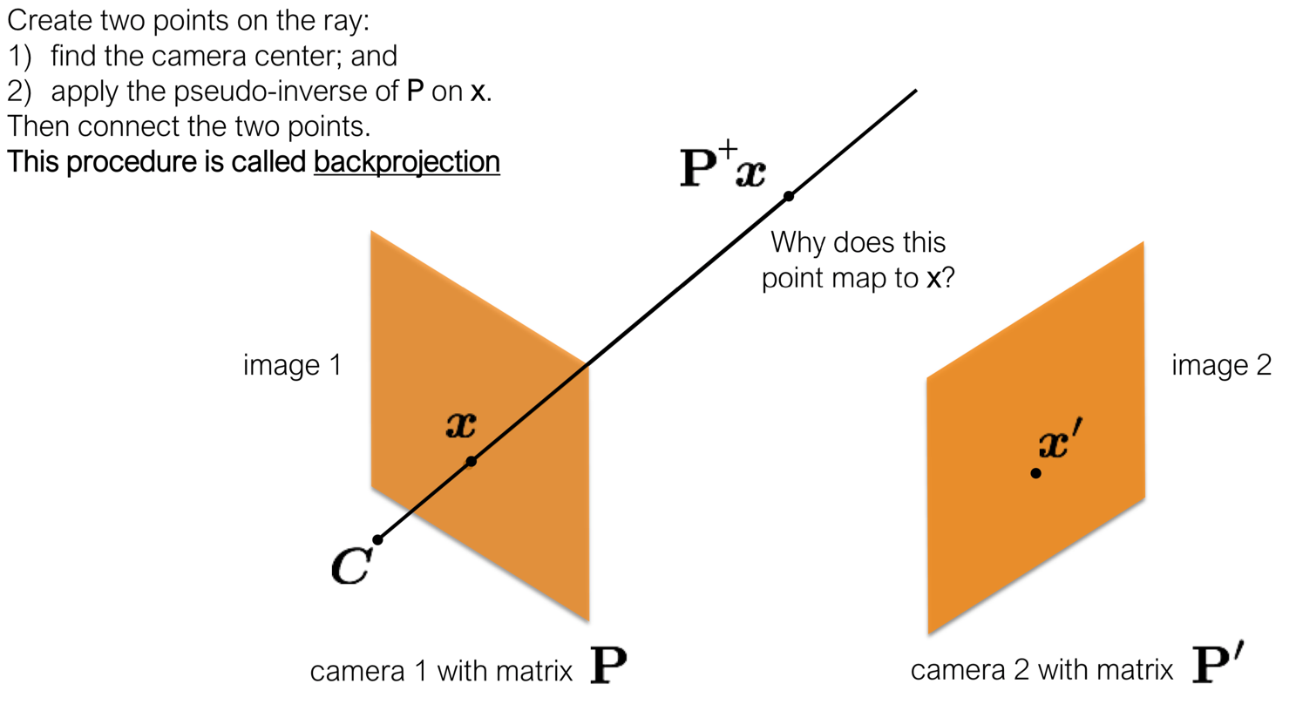
What happens when we detect the same point from two locations?

Slide 12
How do we find the exact point on this ray?

Slide 13
How do we find the exact point on this ray?
Let’s use the other camera

Slide 14
Triangulation: computing the location of a 3D point using two 2D observations

Slide 15
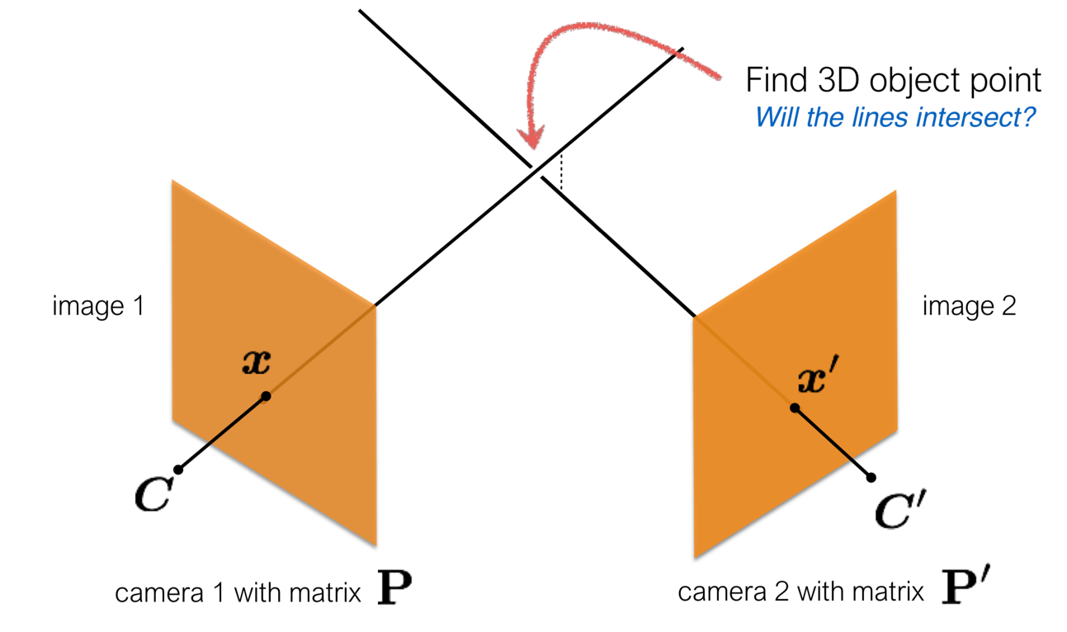
Triangulation: computing the location of a 3D point using two 2D observations
Will the lines exactly intersect?

Slide 16
Triangulation: computing the location of a 3D point using two 2D observations
Because of noise, might not exactly overlap.
Find the best fit instead.

Slide 17
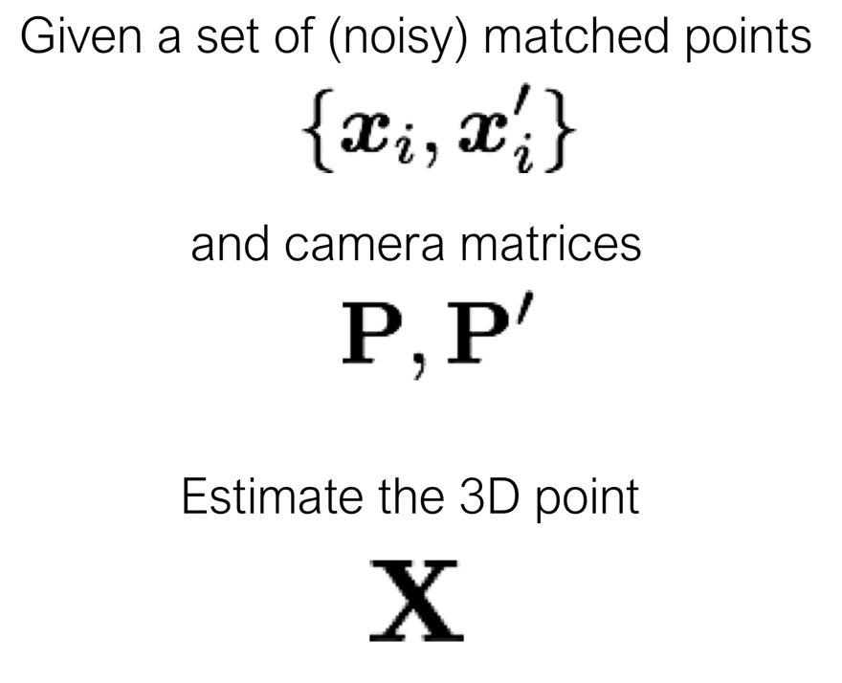
Triangulation (mathematically)

Slide 18
Triangulation (mathematically)
Can we compute the 3D point X from a single point x?
A single correspondence?
known
known

Slide 19
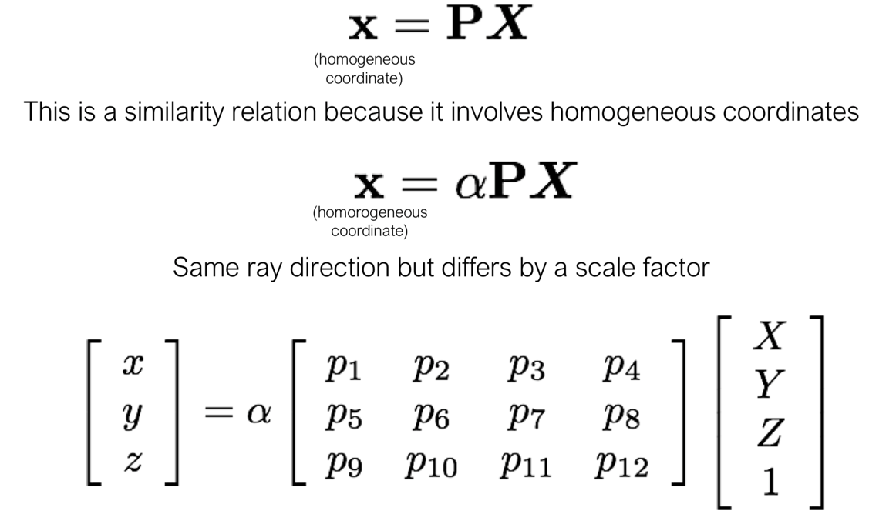
Triangulation (mathematically)
Can we compute the 3D point X from a single point x?
A single correspondence?
Can we solve for X?

Slide 20
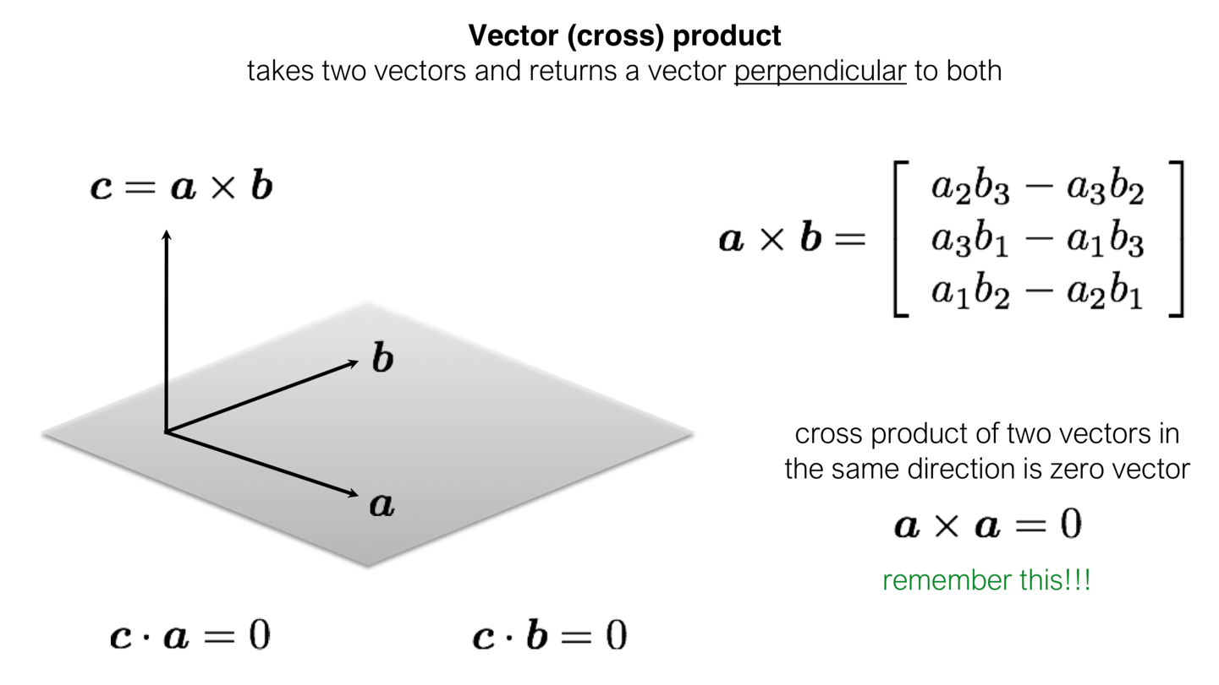
First, a linear algebra review: the cross product

Slide 21
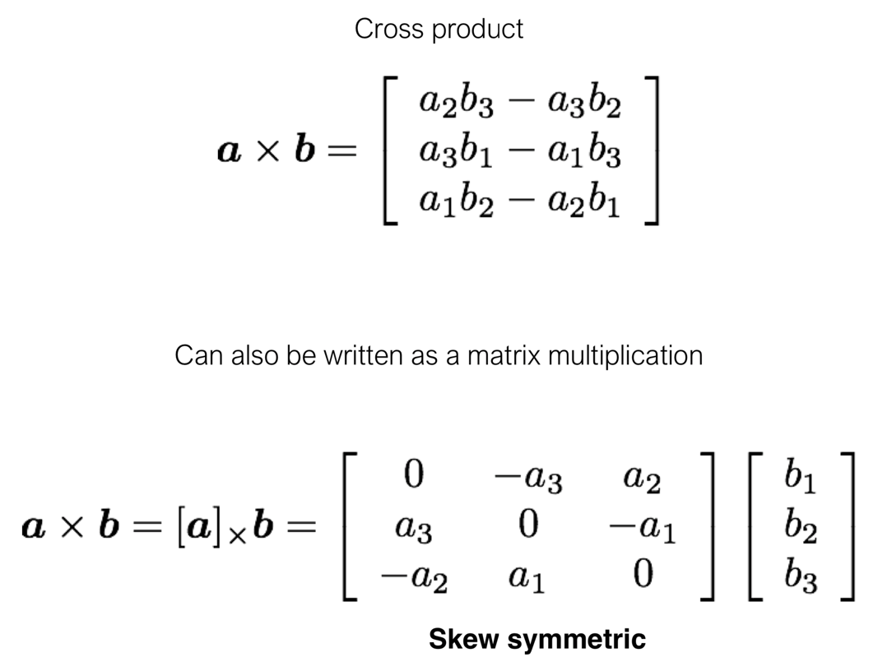
First, a linear algebra review: the cross product

Slide 22
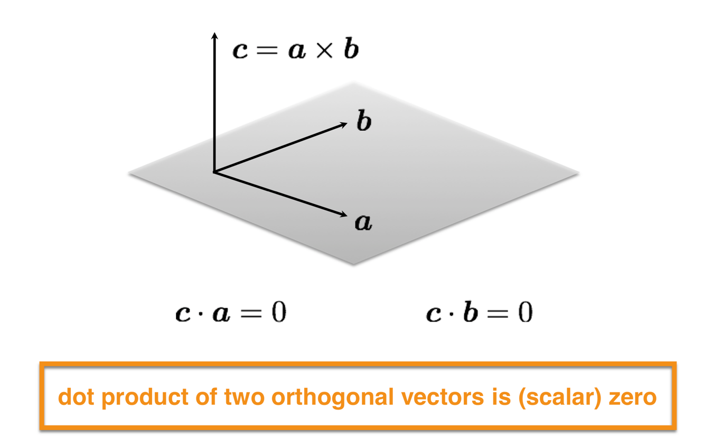
First, a linear algebra review: the cross product

Slide 23
Now back to triangulation
One observation is not enough to uniquely compute a 3D point X, but let’s press on anyway using the cross product!

Slide 24
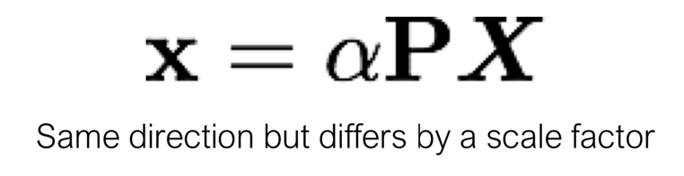
Now back to triangulation
One observation is not enough to uniquely compute a 3D point X, but let’s press on anyway using the cross product!
What if we take the cross product of both sides with x?

Slide 25
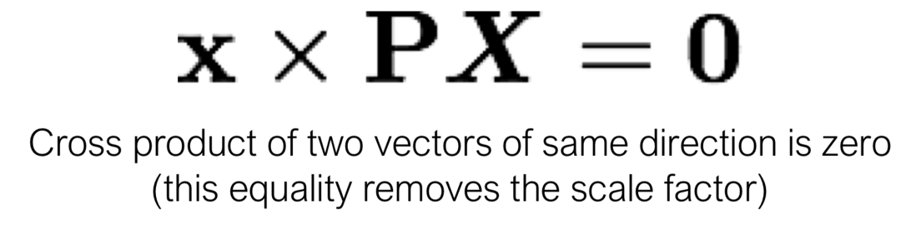
Now back to triangulation
One observation is not enough to uniquely compute a 3D point X, but let’s press on anyway using the cross product!
What if we take the cross product of both sides with x?

Slide 26
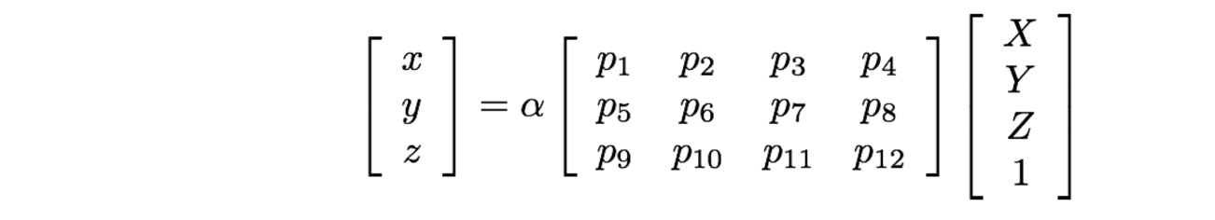
Let’s write out / expand these cross product equations
Our equation from before

Slide 27
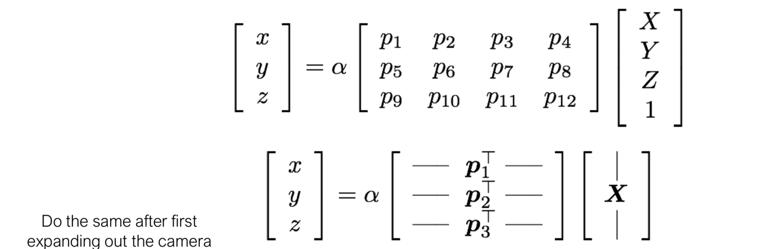
Let’s write out / expand these cross product equations
Our equation from before
Writing in “vector form”

Slide 28
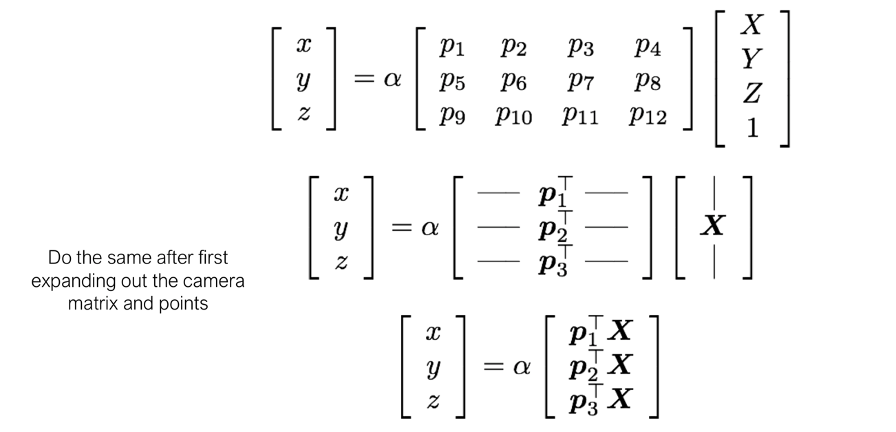
Let’s write out / expand these cross product equations
Our equation from before
Writing in “vector form”
Rewriting the right hand side after multiplication

Slide 29
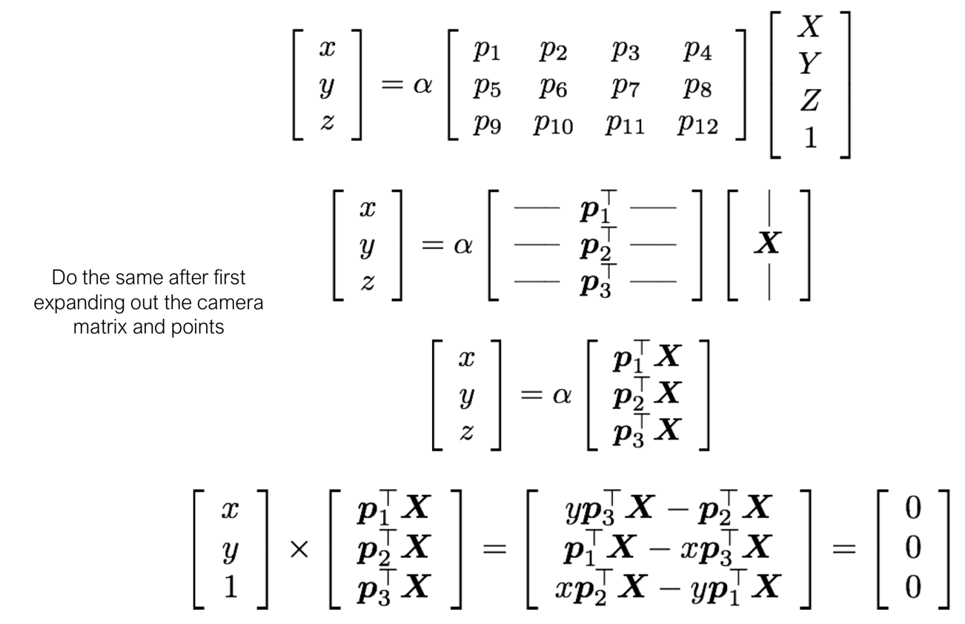
Let’s write out / expand these cross product equations
Our equation from before
Writing in “vector form”
Rewriting the right hand side after multiplication
Applying the cross product.

Slide 30
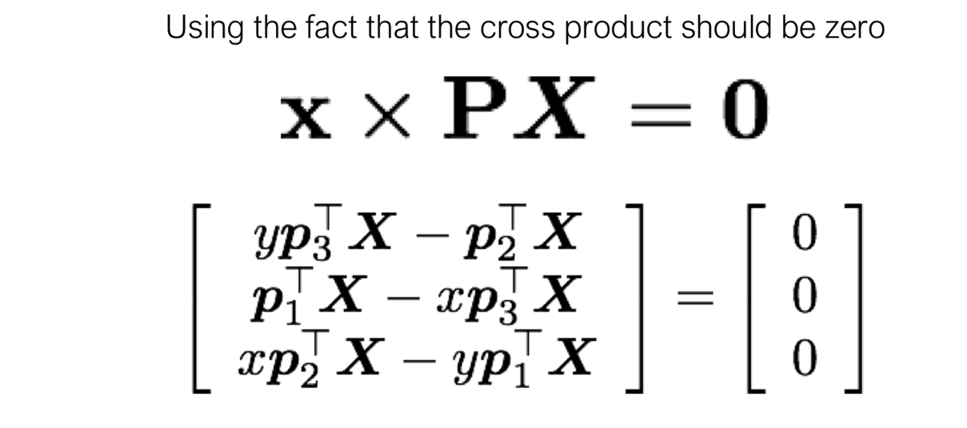
This expansion results in a system of equations
How many equations does this yield?

Slide 31
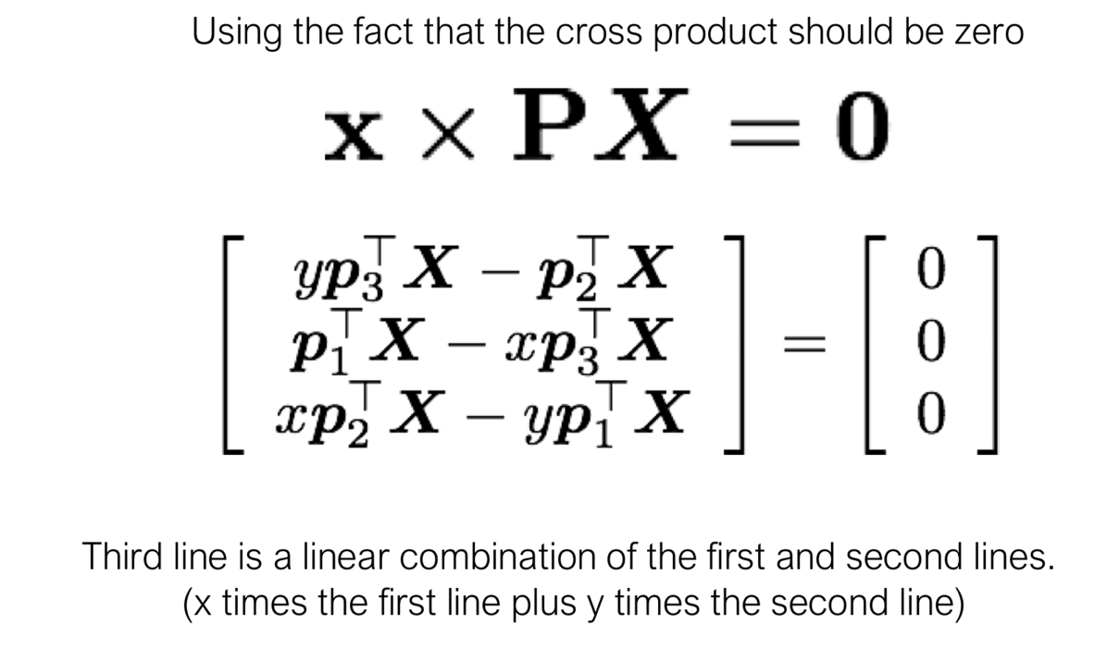
This expansion results in a system of equations
How many equations does this yield? 2

Slide 32
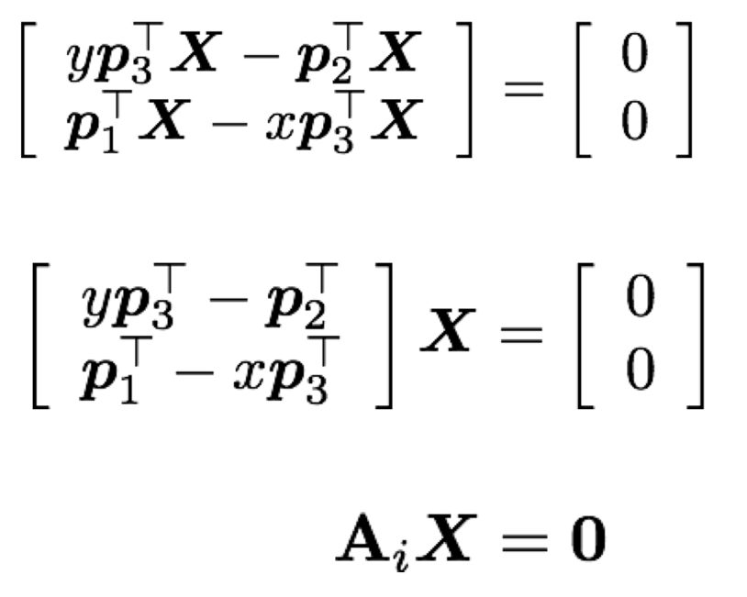
This expansion results in a system of equations
Remove the third row from the previous matrix, and rearrange into a system of unknowns:
Each correspondence gives us two equations that we can add to A.

Slide 33
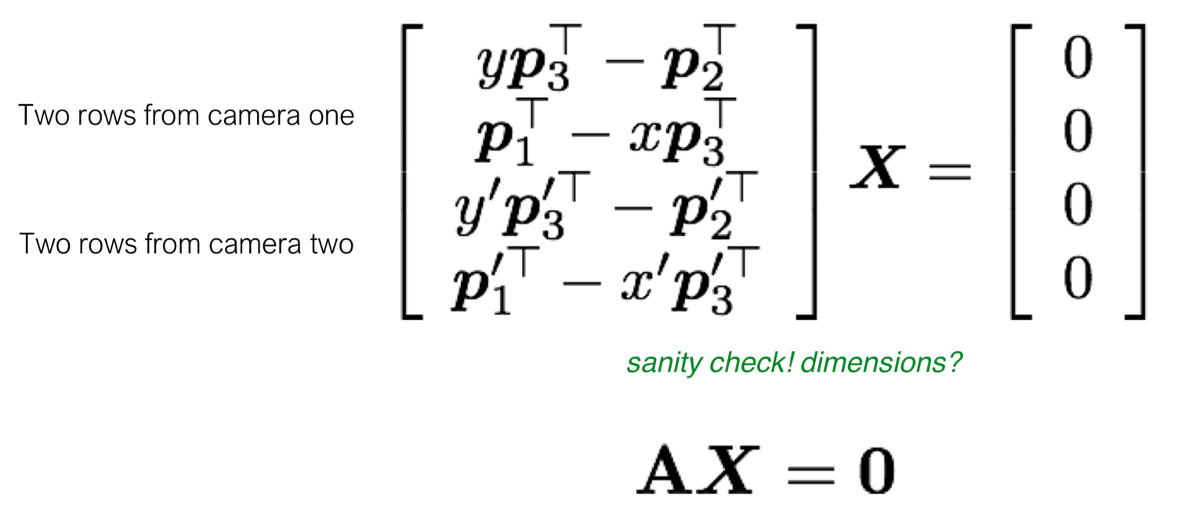
This expansion results in a system of equations
Now let’s combine the equations from each camera:
How do we pick the “best” X? SVD (Singular Value Decomposition)

Slide 34
Linear Algebra
A brief review of SVD

Slide 35
Eigenvalues and Eigenvectors

Slide 36
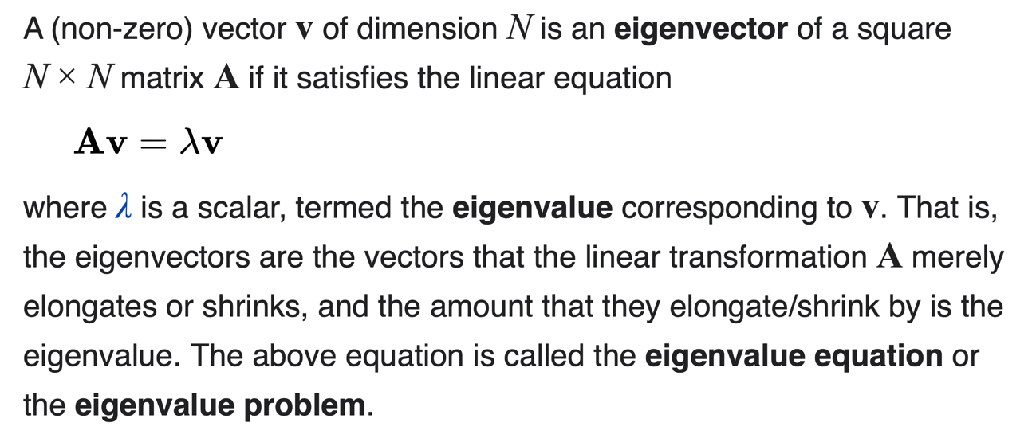
What is are eigenvalues and eigenvectors?
Source: Wikipedia

Slide 37
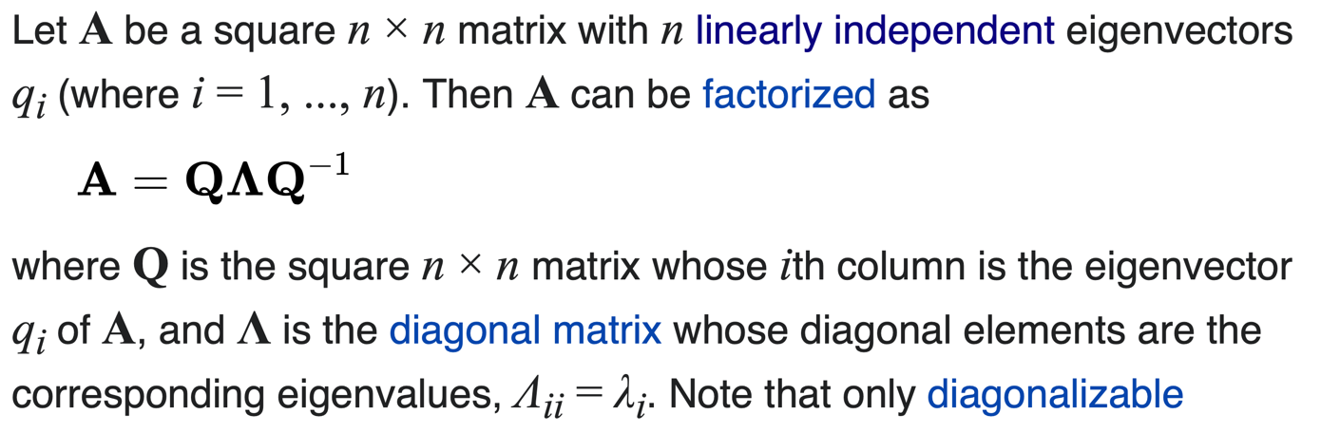
We can also rewrite a matrix using its eigenvalues and eigenvectors
Source: Wikipedia

Slide 38
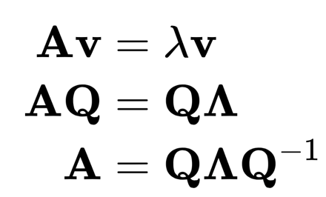
We can also rewrite a matrix using its eigenvalues and eigenvectors
Source: Wikipedia

Slide 39
Matrix Factorization

Slide 40
There are many different ways of “factorizing” matrices
Source: Wikipedia

Slide 41
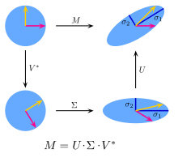
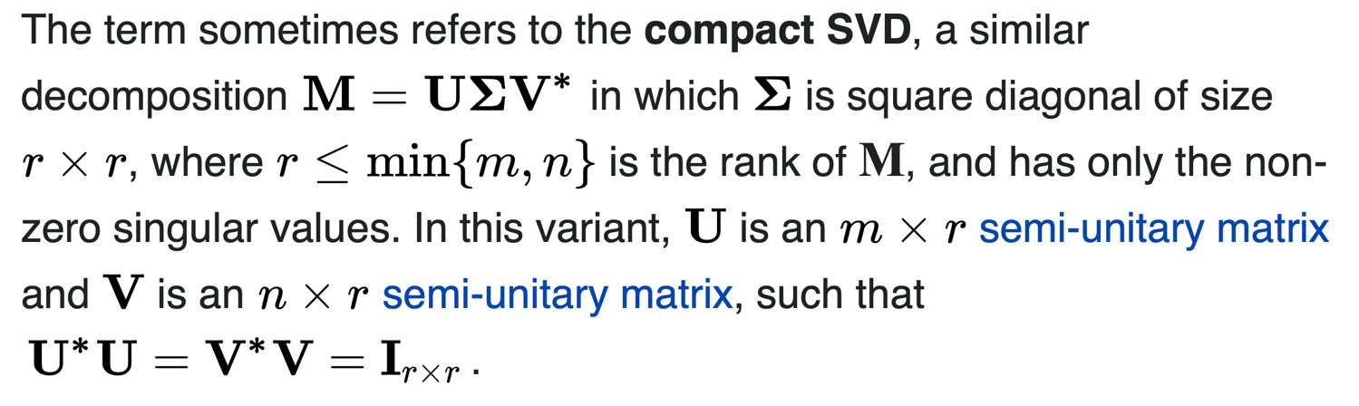
Singular Value Decomposition is similar but for non-square matrices

Slide 42
We would like to solve X
Now let’s combine the equations from each camera:
How do we pick the “best” X? SVD (Singular Value Decomposition)

Slide 43
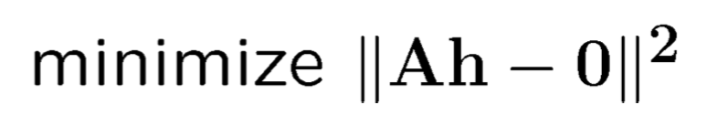
We would like to solve X
X
We can solve this by either finding the smallest eigenvector of A^{T}A or using Singular Value Decomposition (SVD).

Slide 44
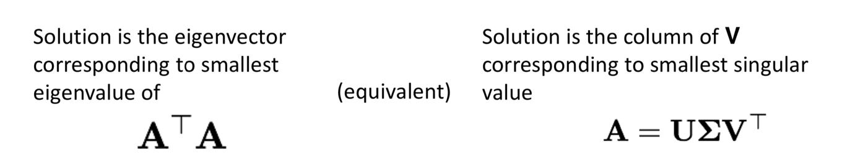
We would like to solve X
X
We can solve this by either finding the smallest eigenvector of A^{T}A or using Singular Value Decomposition (SVD).

Slide 45
Geometric Camera Calibration

Slide 46
Motivation: Geometric Camera Calibration
Until last week, we assumed that we were handed an image and did not need to care about how it was collected.
Last week, we discussed how to start thinking about the camera itself, and how a camera (with known intrinsic and extrinsic parameters) maps the 3D world into a 2D image.
What if we’re handed a camera and expected to use it?

Slide 47
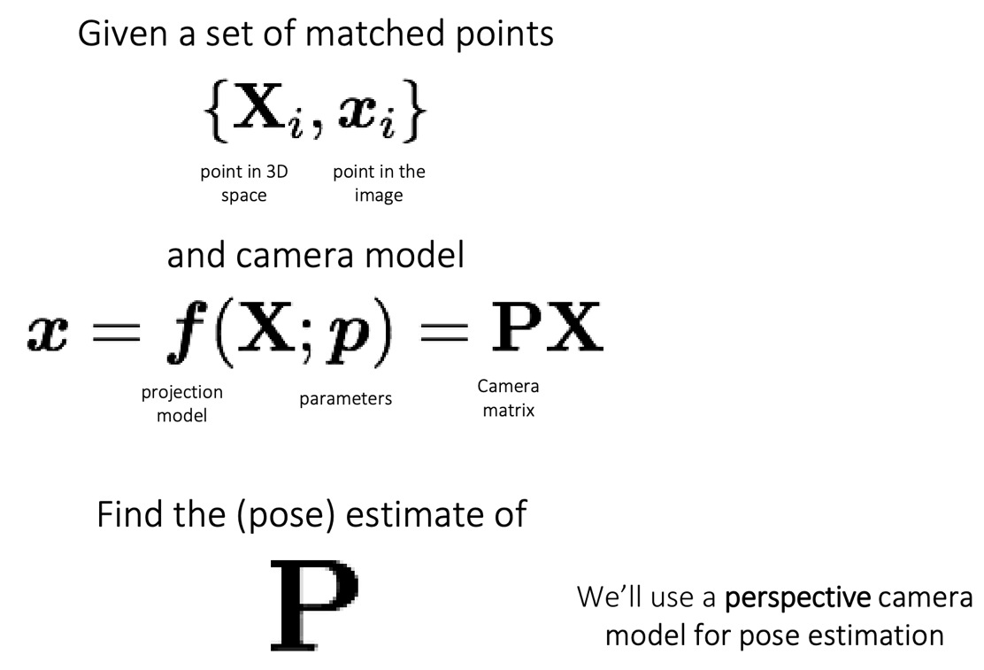
Geometric Camera Calibration

Slide 48
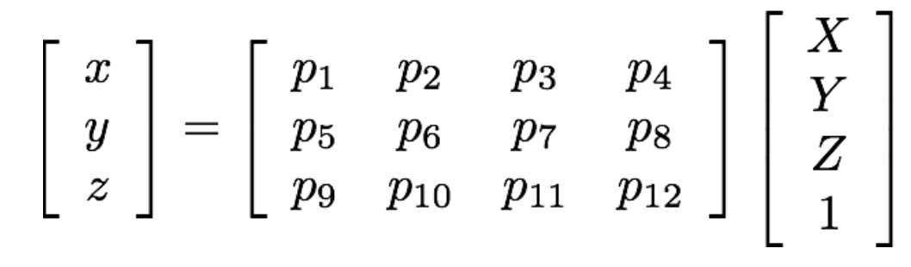
Geometric Camera Calibration
The process is similar to how we previously performed triangulation. We start with the mapping we want to estimate:

Slide 49
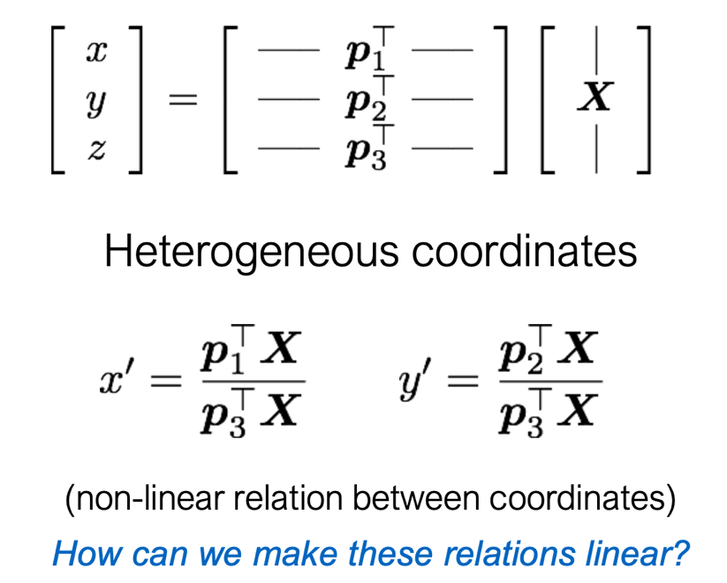
Geometric Camera Calibration
The process is similar to how we previously performed triangulation. We start with the mapping we want to estimate:

Slide 50
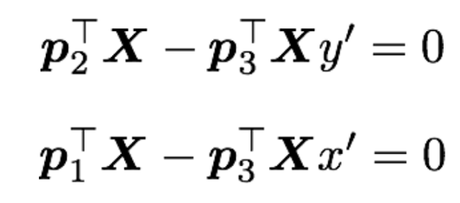
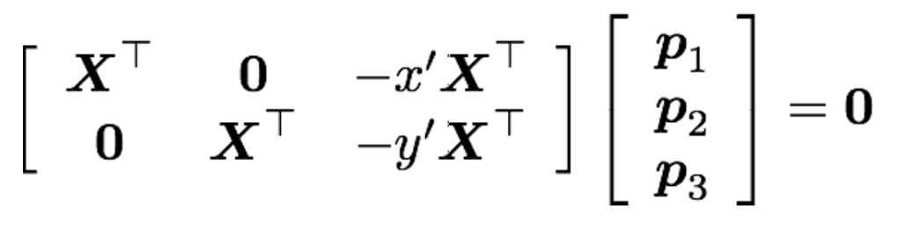
Geometric Camera Calibration
We can linearize these equations:
and put them in matrix form

Slide 51
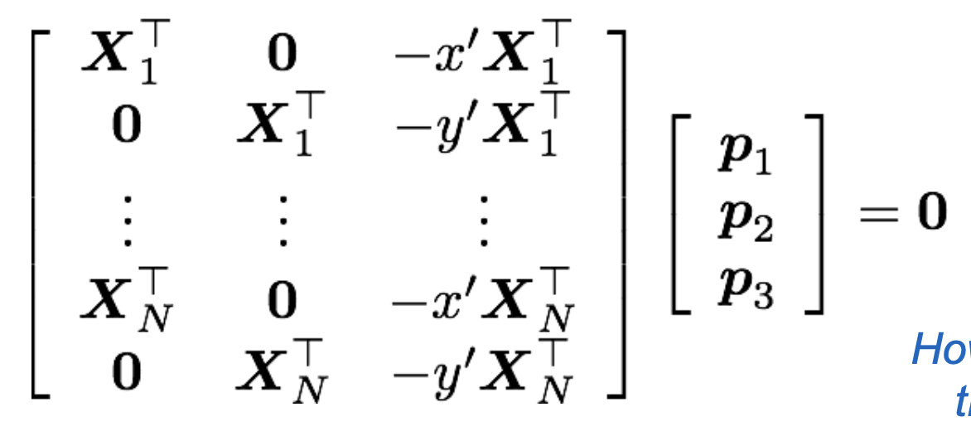
Geometric Camera Calibration
We can collect many of these correspondences and combine them:

Slide 52
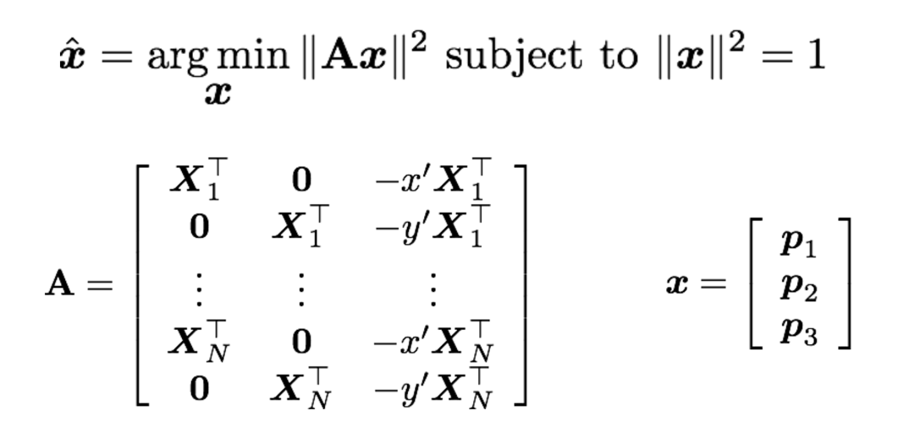
Geometric Camera Calibration
The solution procedure also uses SVD:

Slide 53


Geometric Camera Calibration
The solution procedure also uses SVD:
We seek the eigenvector corresponding to the minimal eigenvalue of

Slide 54

Geometric Camera Calibration
The solution procedure also uses SVD:
Equivalently, we seek the vector x that’s the column of V corresponding to the smallest singular value of

Slide 55
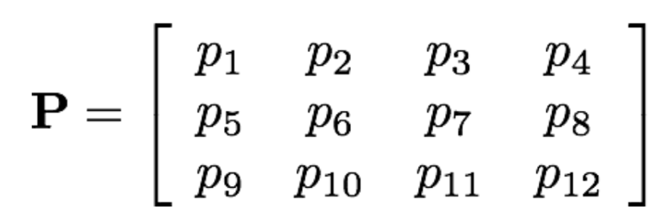
Geometric Camera Calibration
We’ve computed the projection matrix:
Are we done?

Slide 56
Splitting up the camera matrix
We’ve computed the projection matrix:
Are we done?
No! We want to compute the camera intrinsics, so we need to separate the intrinsics from the extrinsics.

Slide 57
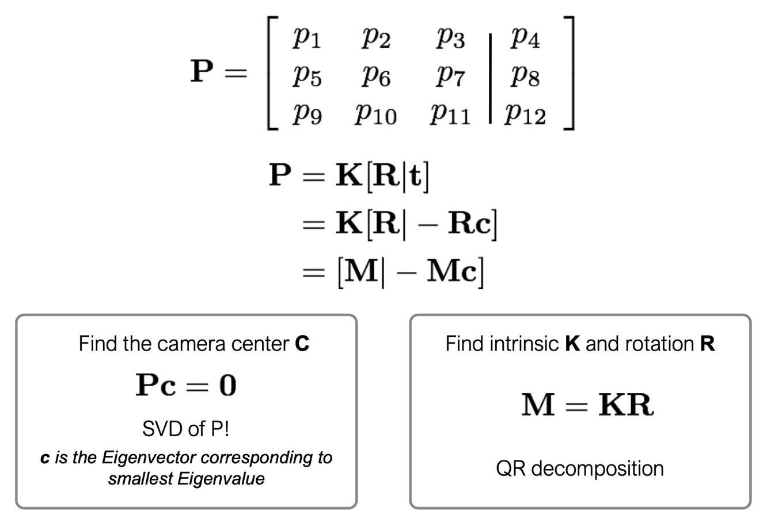
Splitting up the camera matrix
We can split the camera matrix into components, based on our earlier derivation.

Slide 58
Splitting up the camera matrix
We can split the camera matrix into components, based on our earlier derivation.

Slide 59
Splitting up the camera matrix
We can split the camera matrix into components, based on our earlier derivation.
How do we compute c, the camera center?

Slide 60
Splitting up the camera matrix
The camera center is the point where the projection is zero.

Slide 61
Splitting up the camera matrix
The camera center is the point where the projection is zero.

Slide 62
Splitting up the camera matrix

Slide 63
Splitting up the camera matrix
What do we know about K and R?

Slide 64
Splitting up the camera matrix
K: upper triangular
R: orthogonal

Slide 65
Splitting up the camera matrix

Slide 66
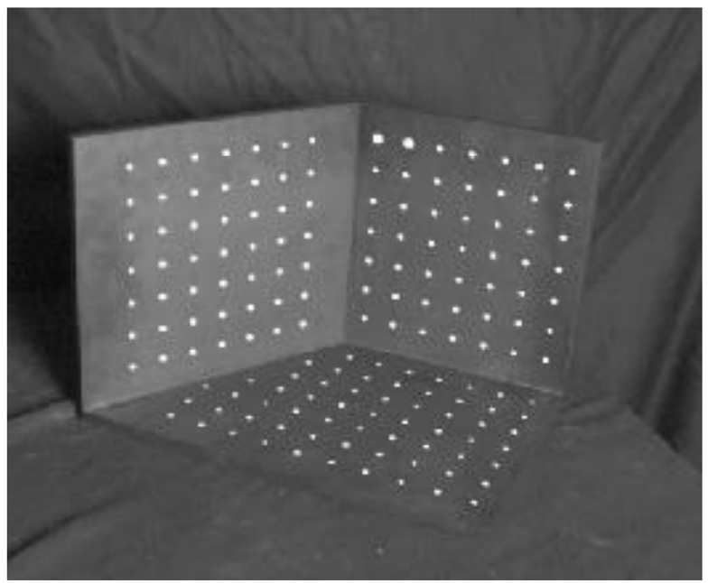
Where do these matches come from?
We might use a reference object, an object with well-known geometric properties, and place it in the scene.

Slide 67
Geometric Camera Calibration
Advantages:
  Simple to formulate
  Analytical solution.

Slide 68
Geometric Camera Calibration
Advantages:
  Simple to formulate
  Analytical solution.
Disadvantages:
  Hard to impose constraints (e.g., known f).
  Doesn’t model radial distortion.
  Doesn’t minimize the correct error function.

Slide 69
Geometric Camera Calibration
Advantages:
  Simple to formulate
  Analytical solution.
Disadvantages:
  Hard to impose constraints (e.g., known f).
  Doesn’t model radial distortion.
  Doesn’t minimize the correct error function.
Nonlinear methods are often preferred so that we can can capture more general effects (like distortion). Idea is the same: we define error function E between projected 3D points and image positions

Slide 70
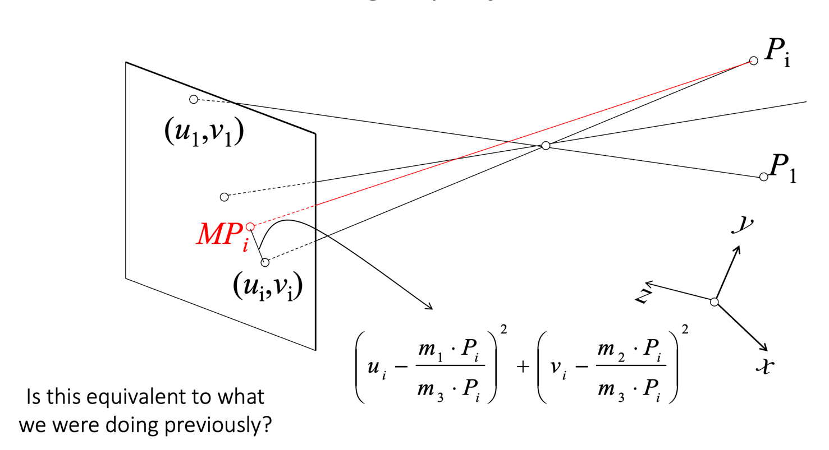
Geometric Camera Calibration
This is what we were doing before…

Slide 71
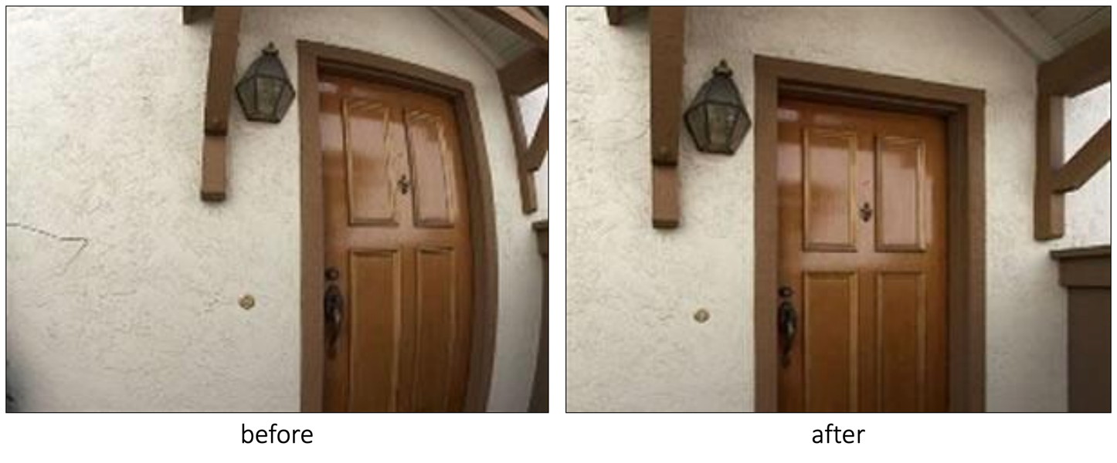
Geometric Camera Calibration:
Handling Radial Distortion

Slide 72
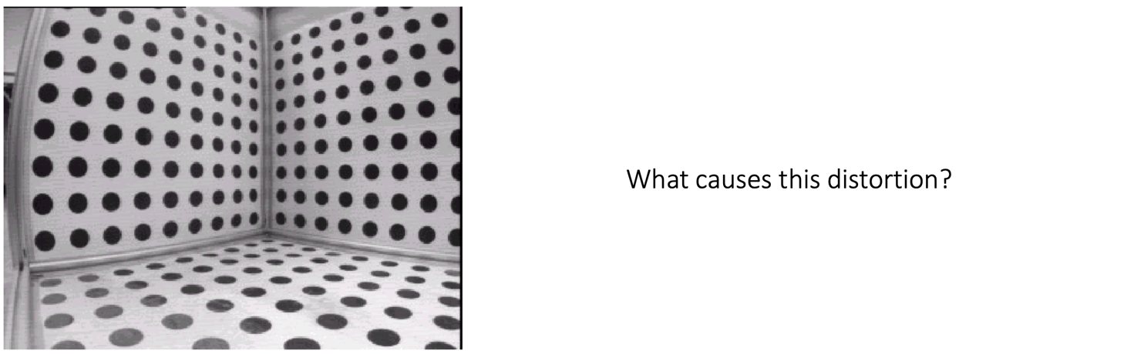
Geometric Camera Calibration:
Handling Radial Distortion
What causes this distortion?

Slide 73
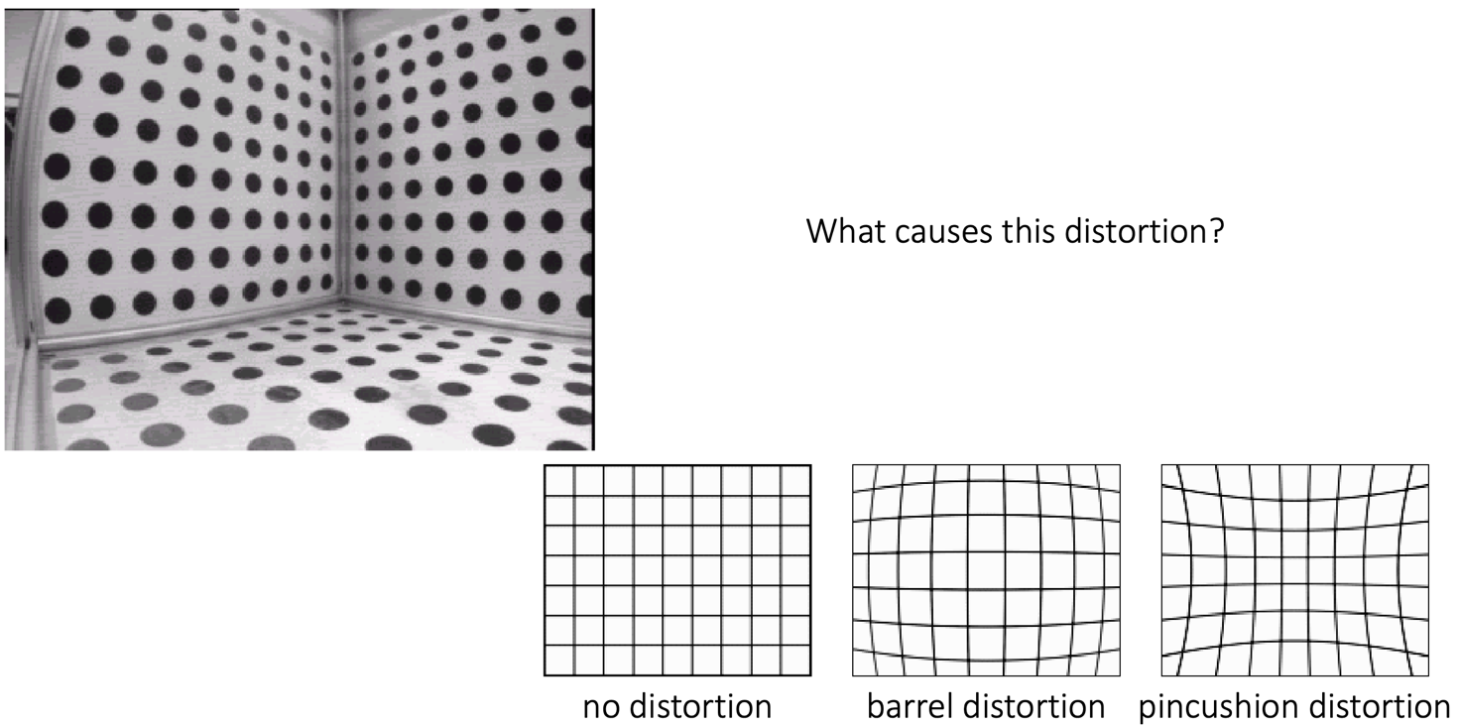
Geometric Camera Calibration:
Handling Radial Distortion
What causes this distortion?
Most lenses aren’t “perfect”
Wide field-of-view lenses will have barrel distortion:

Slide 74
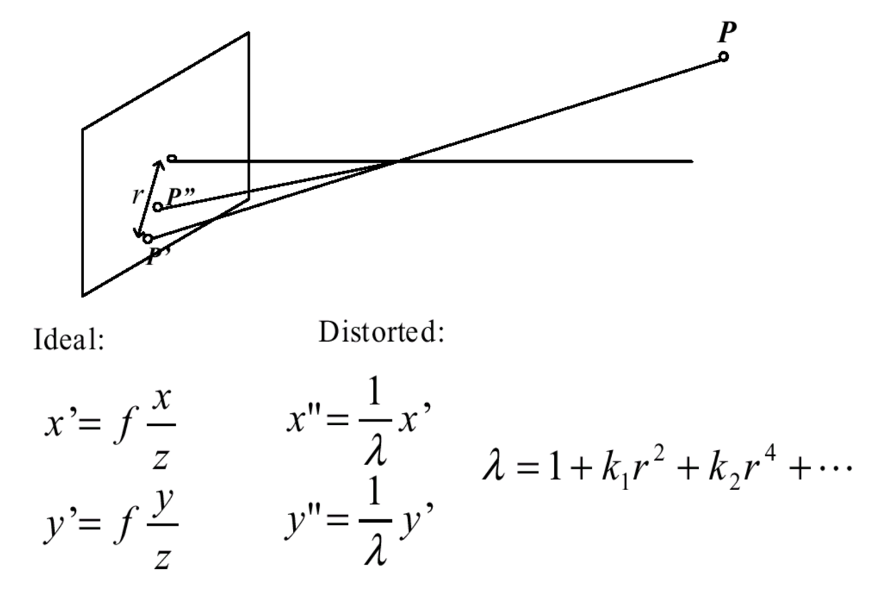
Geometric Camera Calibration:
Handling Radial Distortion
The common way to model radial distortion is to approximate it with a polynomial.

Slide 75
Geometric Camera Calibration:
Handling Radial Distortion
The common way to model radial distortion is to approximate it with a polynomial.
We can estimate the k’s during calibration.

Slide 76
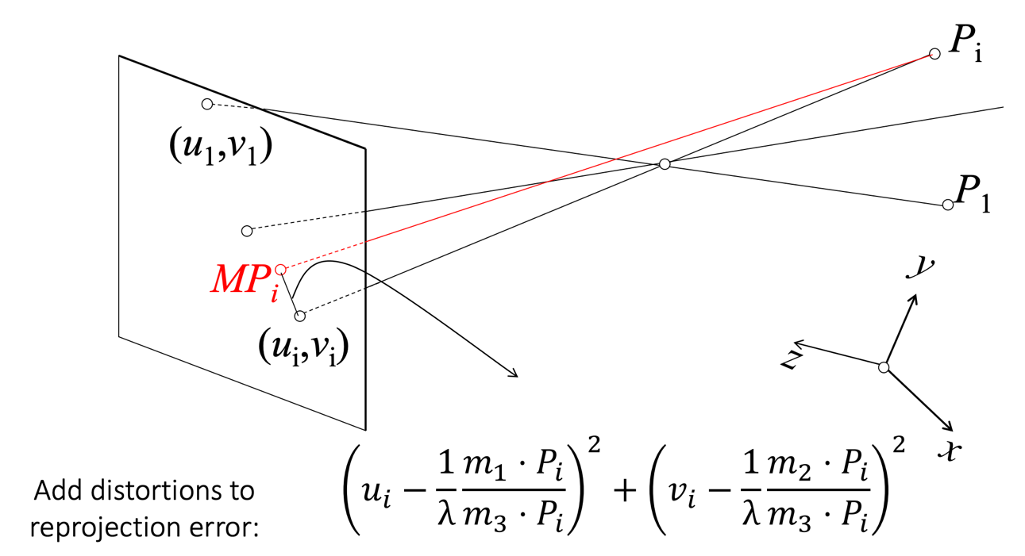
Geometric Camera Calibration:
Handling Radial Distortion

Slide 77
Geometric Camera Calibration:
Handling Radial Distortion

Slide 78
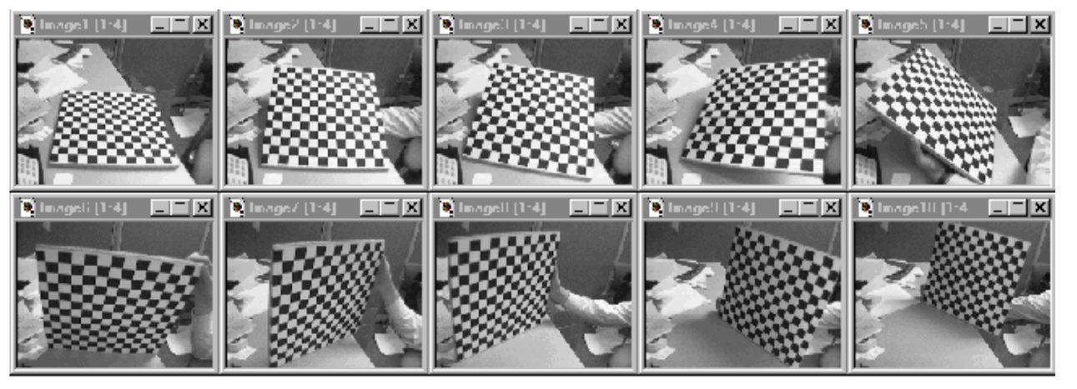
An alternative calibration involves taking multiple images of a known plane/image
Multi-plane calibration requires only that you have a plane with an image you know.
Positions and orientations are not needed, but we do need to solve a nonlinear optimization problem. (Lots of code available online to do this for you.)

Slide 79
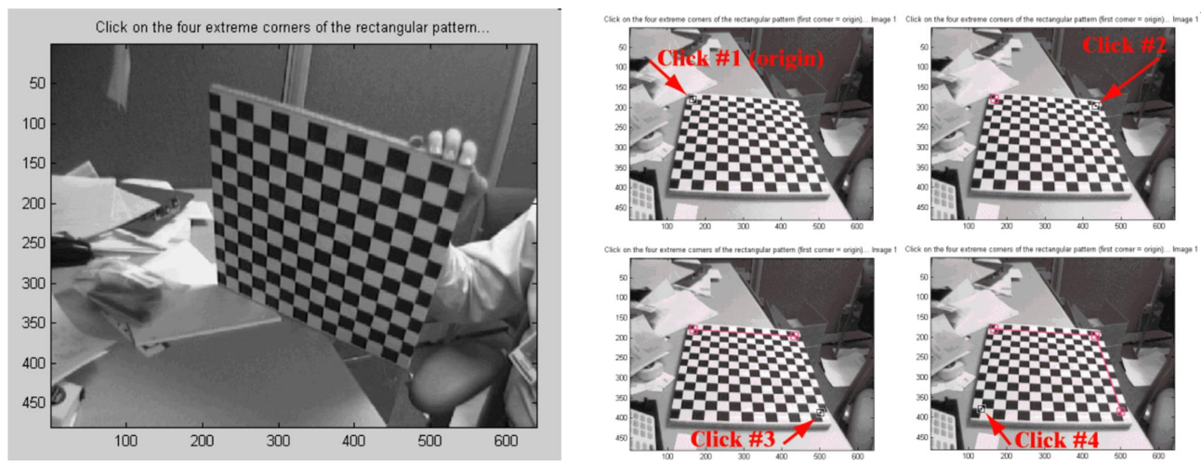
Multi-plane calibration

Slide 80
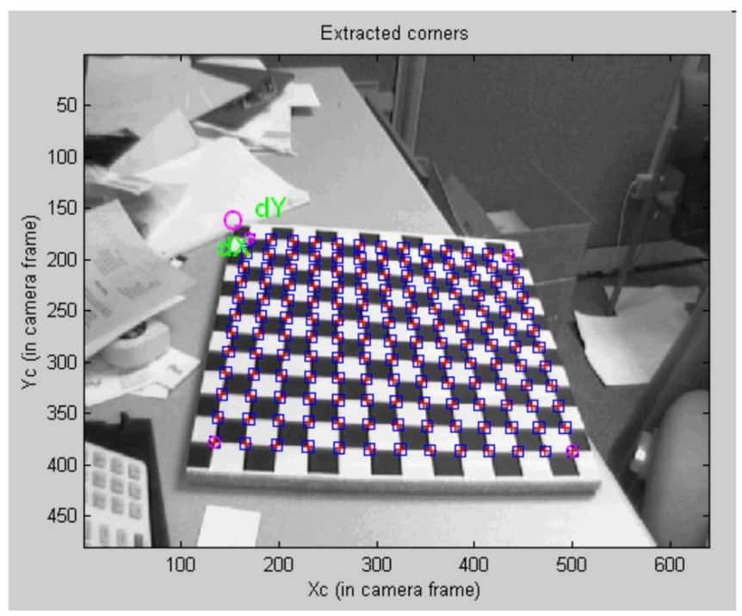
Multi-plane calibration

Slide 81
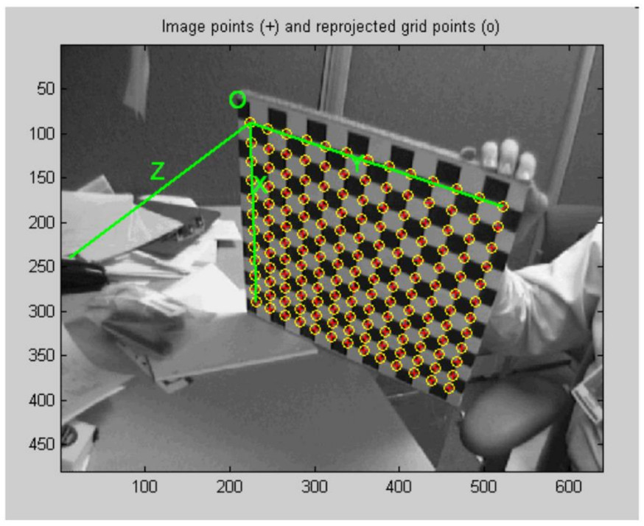
Multi-plane calibration

Slide 82

Multi-plane calibration

Slide 83
Could you calibrate your phone camera at home?

Slide 84
Could you calibrate your phone camera at home?
Well not really. Why?

Slide 85
Could you calibrate your phone camera at home?
Well not really. Why?
Autofocus! This changes your calibration
(Apple/Google/etc. control the phone hardware: they know the calibration as a function of the focus. Most augmented reality tools provide you a set of camera intrinsics per image)

