Slide 1

CS 480/580: Introduction to Artificial Intelligence
Introduction
Prof. Xuesu Xiao
George Mason University
[Based on slides created by Dan Klein and Pieter Abbeel for CS188 Intro to AI at UC Berkeley.
All original materials available at http://ai.berkeley.edu.]

Slide 2
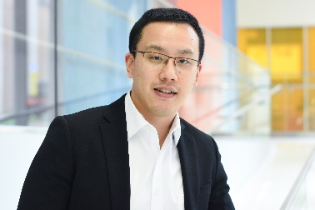


Course Staff
Instructor
GTA
UTA
Xuesu Xiao
Office: Fuse 3311 or Online
Office Hour: by Appointment
Email: xiao@gmu.edu
Website: https://people.cs.gmu.edu/~xiao/
Amirreza Payandeh
Office: Online
Office Hour: by Appointment
Email: apayande@gmu.edu
Sam O'Neill
Office: Online
Office Hour: by Appointment
Email: poneill3@gmu.edu

Slide 3
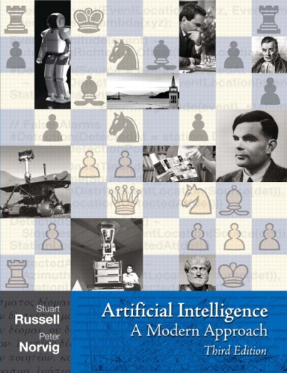
Course Information
This course is in-person (Fuse 1327)
Time: 4:30pm - 7:10pm, Wednesday
Announcements on webpage
  https://people.cs.gmu.edu/~xiao/Teaching/CS480_Spring2026/
Discussion on piazza
  https://piazza.com/class/mjxd0kvorxu15e
Assignments submission on Gradescope
  https://www.gradescope.com/courses/1208379
Course Textbook
  Artificial Intelligence: A Modern Approach

Slide 4
Course Information
Prerequisites:
  CS 310 (or INFS 519) and CS 330 (or CS 530)
  Computer science maturity
  There will be a lot of math (and programming)
Work and Grading:
  7 programming projects: Python, groups of no more than (1) 4 undergrad, (2) 2 grad, or (3) 2 undergrad and 1 grad students (50%)
  11 interactive homework assignments (35%, mostly due before next class)
  Participation in class is important (15%)
  Academic integrity policy

Slide 5
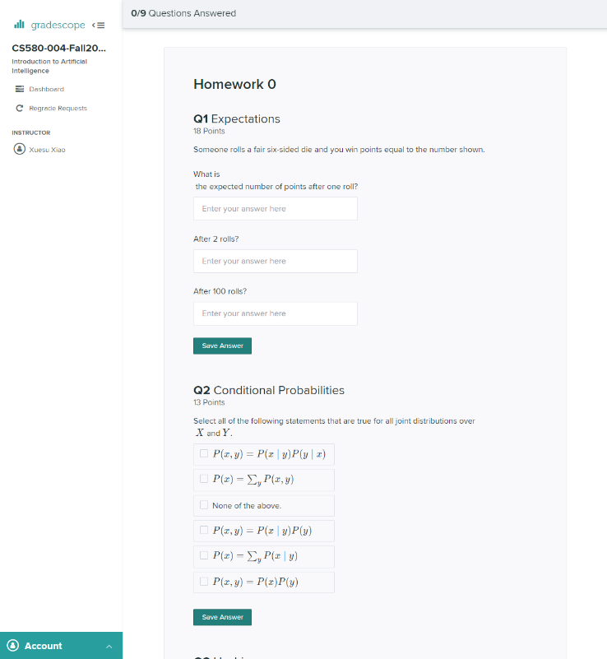
Course Information
Assignments submission on Gradescope
  https://www.gradescope.com/courses/1208379
  7 programming projects: Python
    Autograder will be provided
  11 interactive homework assignments
    Will be autograded

Slide 6
Course Information
Academic Integrity
  Students are encouraged to discuss and collaborate with classmates. But all homework and projects must be the student's or the student team's (as authorized) own work. Please strictly stick to the Department Honor Code and Mason Honor Code.
Accommodations
  If you need academic accommodations, please make sure you contact the instructor at the beginning of the semester or as soon as possible. Also make sure to contact GMU's Disability Services, by email (ods@gmu.edu) or by phone (703.993.2474), which coordinates all academic accommodations. After you have contacted Disability Services, you still need to contact the instructor so that appropriate arrangements can be made.

Slide 7
Important This Week
Important this week:
  Register for the class on Gradescope (you should already be added)
  Register for the class on piazza --- our main resource for discussion and communication
  HW0: Math self-diagnostic is out (due on Wednesday Jan 28 at 4:30pm)
  PJ0: Python tutorial is out (due on Wednesday Jan 28 at 4:30pm)

Slide 8
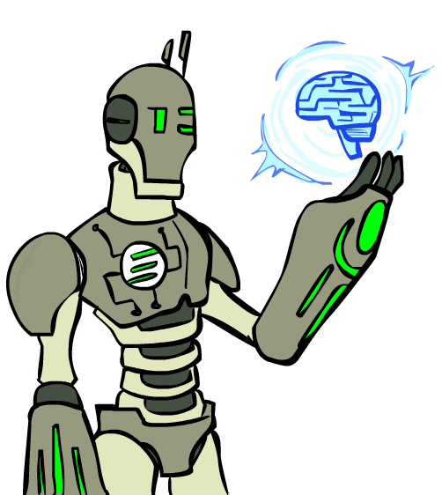
Today
What is artificial intelligence?
What can AI do?
What is this course?

Slide 9
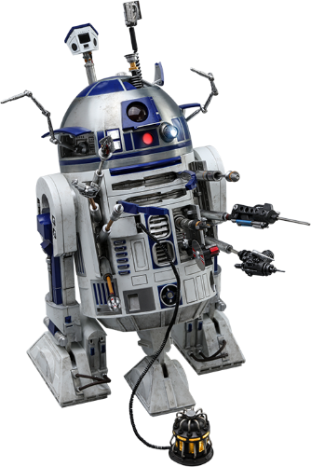
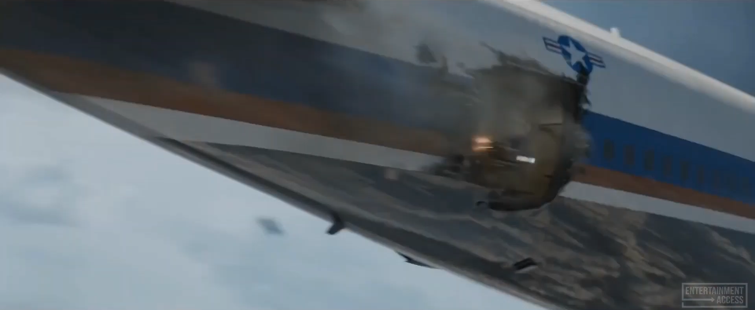

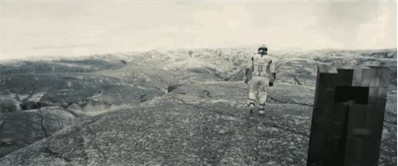
AI? Sci-Fi? Robots?
Iron Man [Iron Man 3]
R2D2 [Star Wars]
BayMax [Big Hero 6]
Tars [Interstellar]

Slide 10
Open Discussions (in the 2nd part today)
What do you think?
  What is artificial intelligence to you?
  Why do you want to study it?
  What would you like to do with AI?

Slide 11
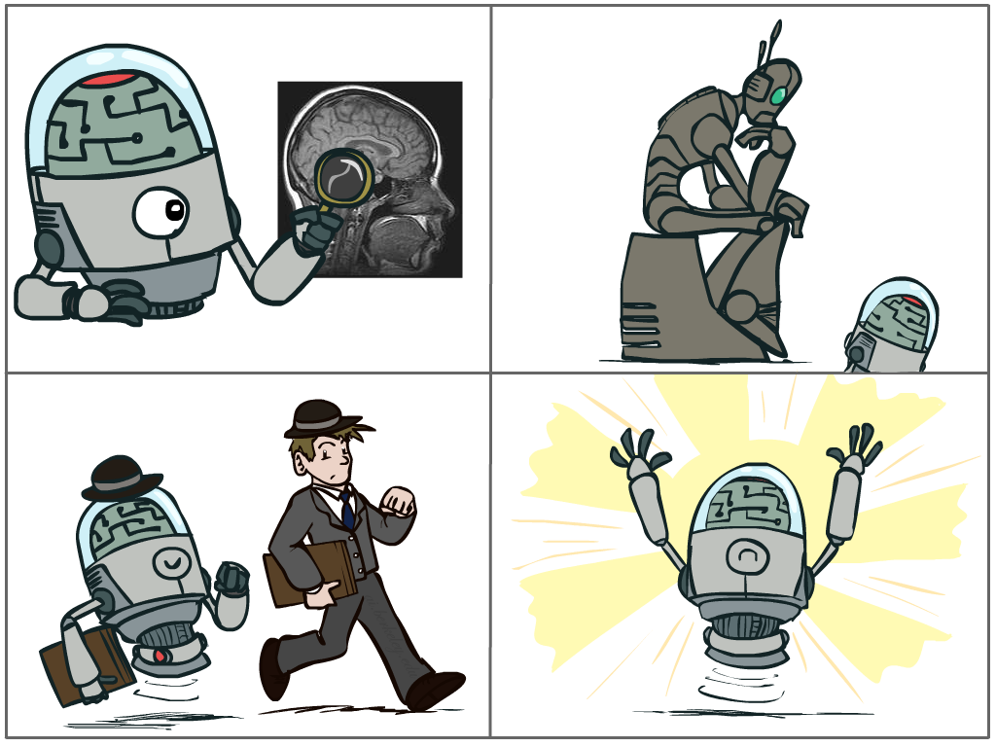
What is AI?
The science of making machines that:
Think like people
Think rationally
Act like people
Act rationally
Notes:
Top left: Think like people --- cognitive science, neuroscience
Bottom left: act like people --- actually very early definition, dating back to Alan Turing --- Turing test; problem to do really well you start focusing on things like don’t answer too quickly what the square root of 1412 is, don’t spell too well, and make sure you have a favorite movie etc. So it wasn’t really leading us to build intelligence
Think rationally – long tradition dating back to Aristotle --- but not a winner, because difficult to encode how to think, and in the end it’s not about how you think, it’s about how you end up acting

Slide 12
Rational Decisions
We’ll use the term rational in a very specific, technical way:
  Rational: maximally achieving pre-defined goals
  Rationality only concerns what decisions are made
  (not the thought process behind them)
  Goals are expressed in terms of the utility of outcomes
  Being rational means maximizing your expected utility
A better title for this course would be:
Computational Rationality
Notes:
Example of utilities. 10 for A, 1 for each Friday with friends

Slide 13
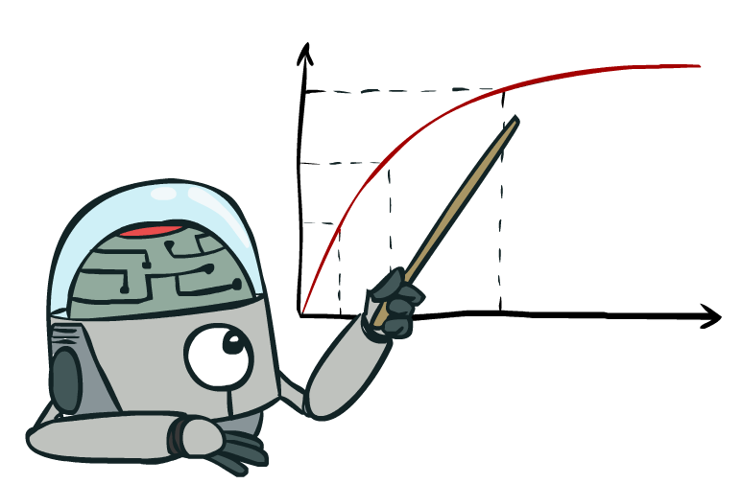
Maximize Your
Expected Utility

Slide 14
Maximize Your
Expected Utility

Slide 15
Maximize Your
Expected Utility

Slide 16
Maximize Your
Expected Utility

Slide 17
Maximize Your
Expected Utility

Slide 18
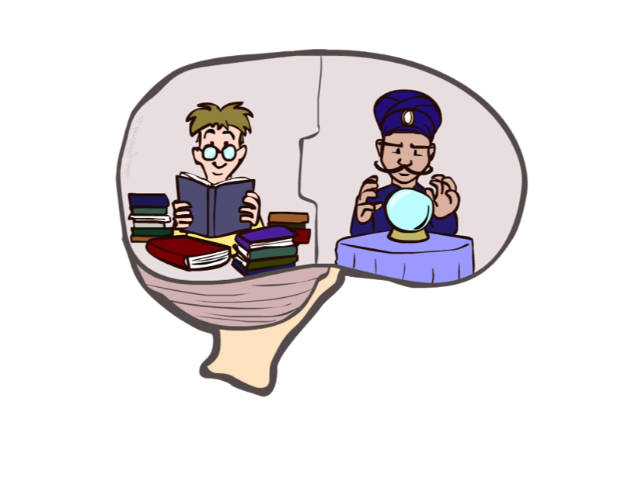
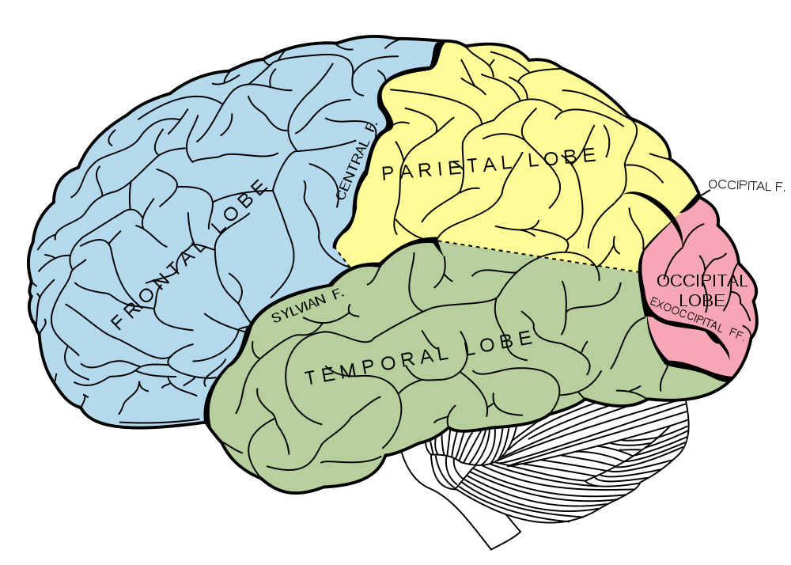
What About the Brain?
Brains (human minds) are very good at making rational decisions, but not perfect
Brains aren’t as modular as software, so hard to reverse engineer!
“Brains are to intelligence as wings are to flight”
Lessons learned from the brain: memory and simulation are key to decision making

Slide 19
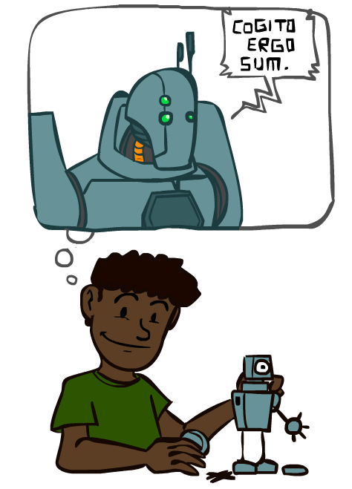
A (Short) History of AI

Slide 20

A (Short) History of AI

Slide 21

A (Short) History of AI
1940-1950: Early days
  1943: McCulloch & Pitts: Boolean circuit model of brain
  1950: Turing's “Computing Machinery and Intelligence”
1950—70: Excitement: Look, Ma, no hands!
  1950s: Early AI programs, including Samuel's checkers program, Newell & Simon's Logic Theorist, Gelernter's Geometry Engine
  1956: Dartmouth meeting: “Artificial Intelligence” adopted
  1965: Robinson's complete algorithm for logical reasoning
1970—90: Knowledge-based approaches
  1969—79: Early development of knowledge-based systems
  1980—88: Expert systems industry booms
  1988—93: Expert systems industry busts: “AI Winter”
1990—: Statistical approaches
  Resurgence of probability, focus on uncertainty
  General increase in technical depth
  Agents and learning systems… “AI Spring”?
2000—: Where are we now?
Notes:
Million dollar computer with less computation than your phone
MT was

Slide 22
A (Short) History of AI
2000—: Where are we now?
  Big data, big compute, neural networks
  Some re-unification of sub-fields
  AI used in many industries
  Chess engines running on ordinary laptops can defeat the world’s best chess players
  What can AI do now?
Notes:
Million dollar computer with less computation than your phone
MT was

Slide 23

What Can AI Do?
Quiz: Which of the following can be done at present?
Play a decent game of table tennis?

Slide 24
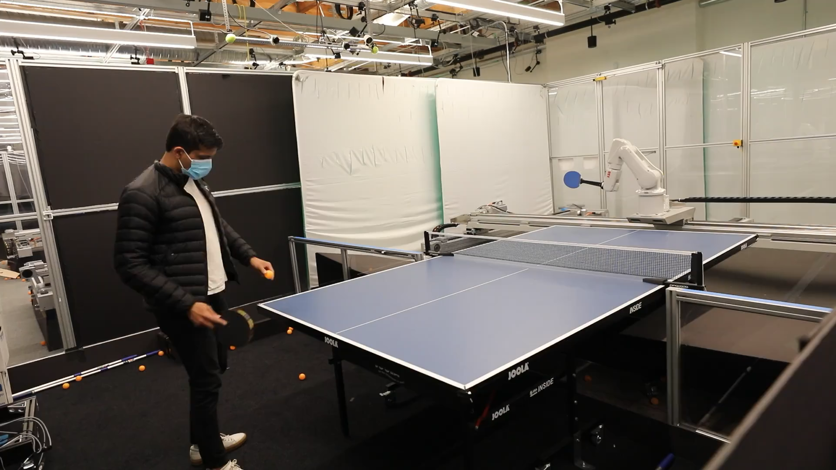
What Can AI Do?
Quiz: Which of the following can be done at present?
Play a decent game of table tennis?

Slide 25
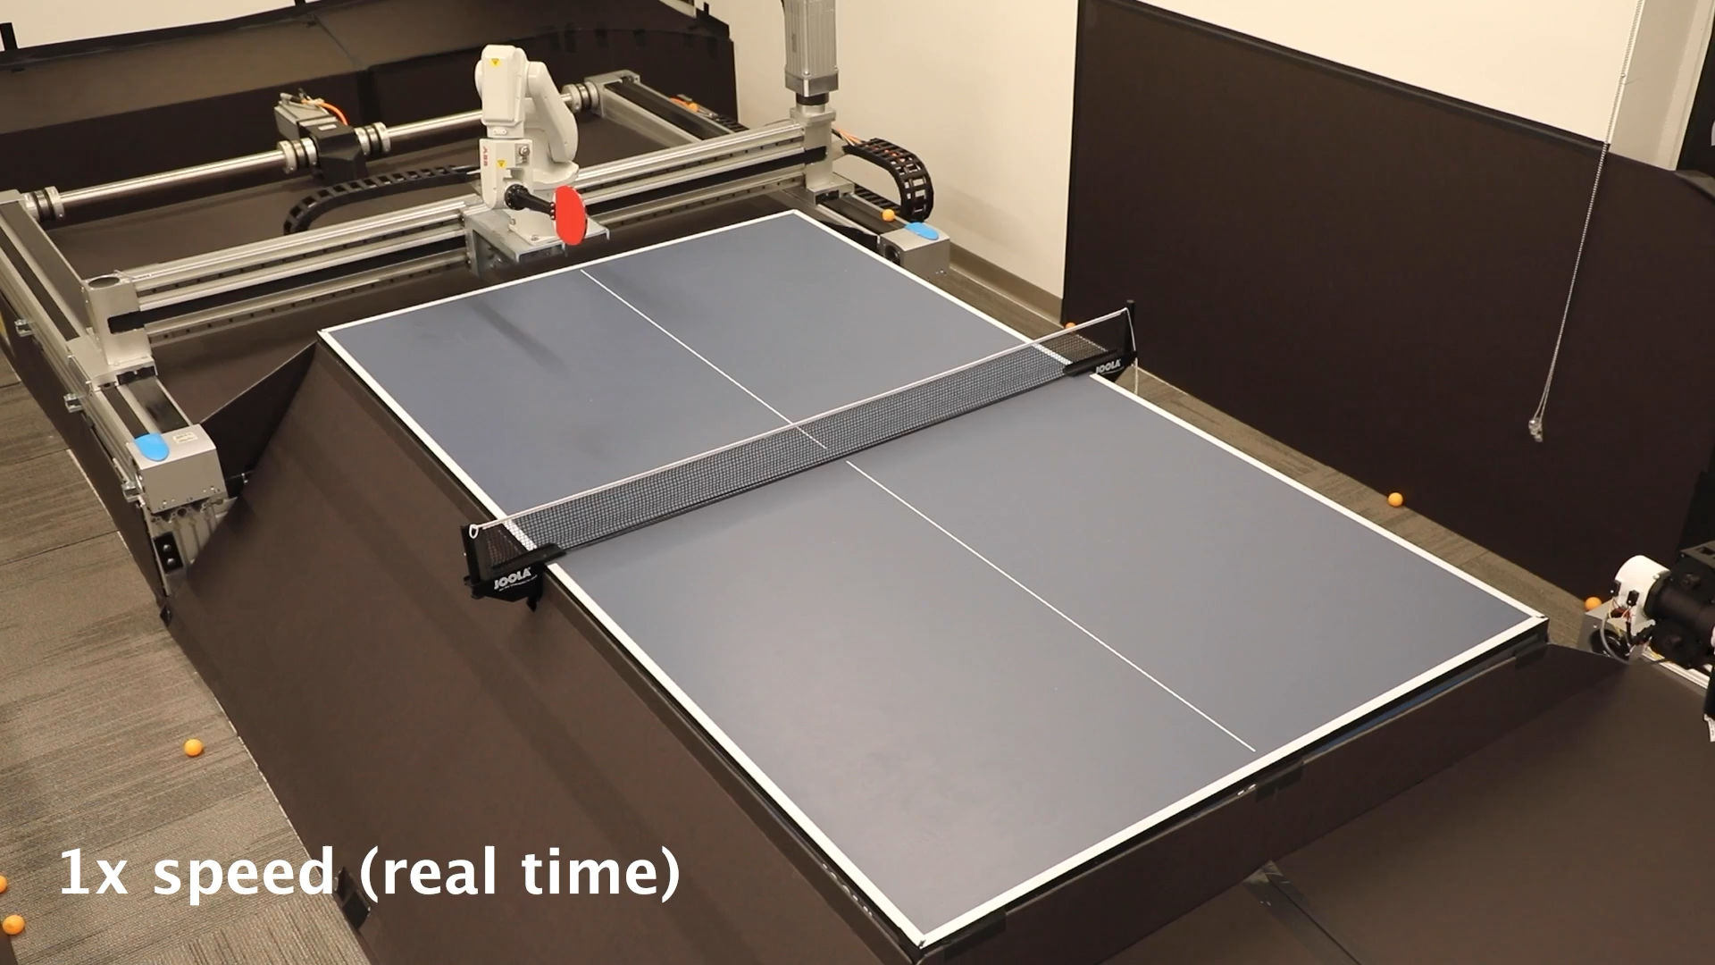
What Can AI Do?
Quiz: Which of the following can be done at present?
Play a decent game of table tennis?

Slide 26
What Can AI Do?
Quiz: Which of the following can be done at present?
Play a decent game of table tennis?
Play a decent game of Jeopardy?
Drive safely along a curving mountain road?
Drive safely in Washington D.C.?

Slide 27
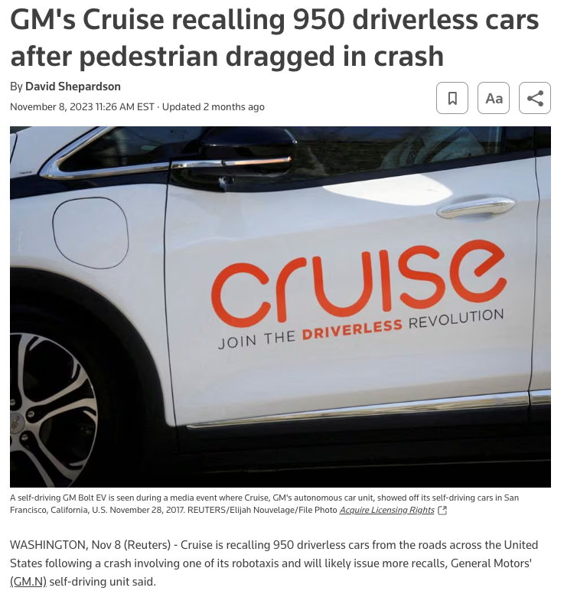
What Can AI Do?
Quiz: Which of the following can be done at present?
Play a decent game of table tennis?
Play a decent game of Jeopardy?
Drive safely along a curving mountain road?
Drive safely in Washington D.C.?

Slide 28
What Can AI Do?
Quiz: Which of the following can be done at present?
Play a decent game of table tennis?
Play a decent game of Jeopardy?
Drive safely along a curving mountain road?
Drive safely in Washington D.C.?
Buy a week's worth of groceries on the web?
Buy a week's worth of groceries from Safeway?
Discover and prove a new mathematical theorem?
Converse successfully with another person for an hour?
Perform a surgical operation?
Put away the dishes and fold the laundry?
Translate spoken Chinese into spoken English in real time?
Write an intentionally funny story?

Slide 29

What Can AI Do?
Quiz: Which of the following can be done at present?
Play a decent game of table tennis?
Play a decent game of Jeopardy?
Drive safely along a curving mountain road?
Drive safely in Washington D.C.?
Buy a week's worth of groceries on the web?
Buy a week's worth of groceries from Safeway?
Discover and prove a new mathematical theorem?
Converse successfully with another person for an hour?
Perform a surgical operation?
Put away the dishes and fold the laundry?
Translate spoken Chinese into spoken English in real time?
Write an intentionally funny story?

Slide 30
What Can AI Do?
Quiz: Which of the following can be done at present?
Play a decent game of table tennis?
Play a decent game of Jeopardy?
Drive safely along a curving mountain road?
Drive safely in Washington D.C.?
Buy a week's worth of groceries on the web?
Buy a week's worth of groceries from Safeway?
Discover and prove a new mathematical theorem?
Converse successfully with another person for an hour?
Perform a surgical operation?
Put away the dishes and fold the laundry?
Translate spoken Chinese into spoken English in real time?
Write an intentionally funny story?
Win an art competition?

Slide 31

What Can AI Do?
Quiz: Which of the following can be done at present?
Play a decent game of table tennis?
Play a decent game of Jeopardy?
Drive safely along a curving mountain road?
Drive safely in Washington D.C.?
Buy a week's worth of groceries on the web?
Buy a week's worth of groceries from Safeway?
Discover and prove a new mathematical theorem?
Converse successfully with another person for an hour?
Perform a surgical operation?
Put away the dishes and fold the laundry?
Translate spoken Chinese into spoken English in real time?
Write an intentionally funny story?
Win an art competition?

Slide 32
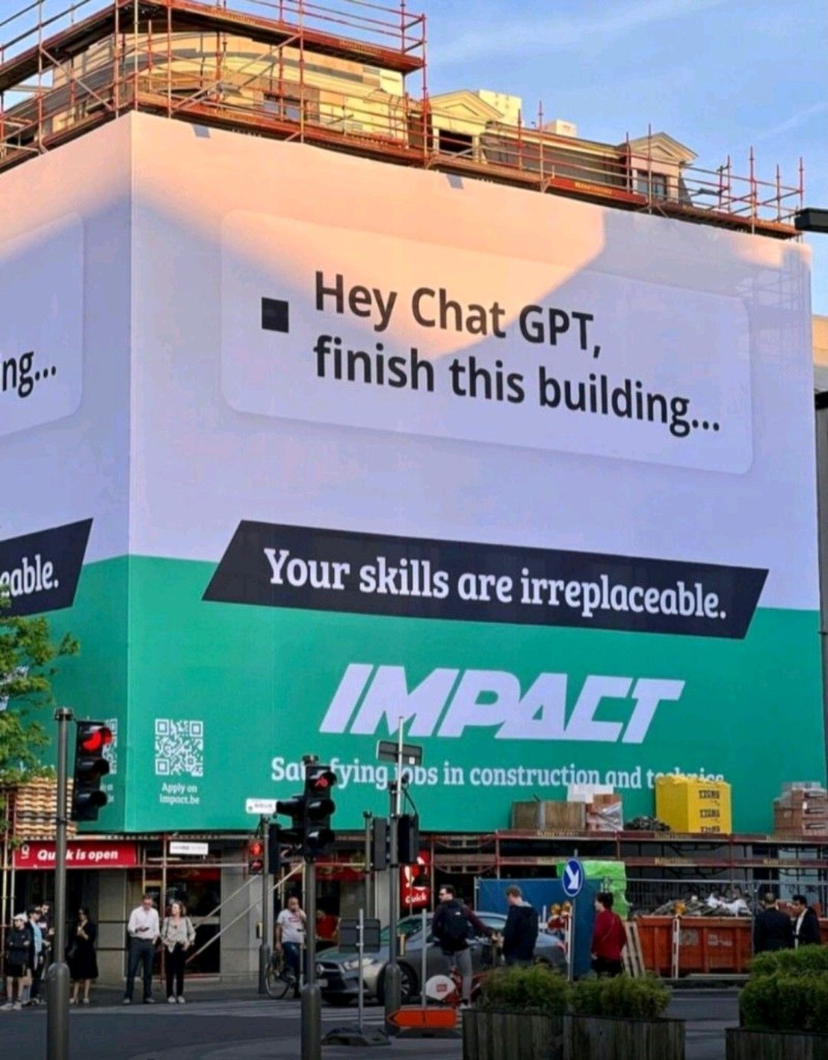
What Can AI Do?
Quiz: Which of the following can be done at present?
Play a decent game of table tennis?
Play a decent game of Jeopardy?
Drive safely along a curving mountain road?
Drive safely in Washington D.C.?
Buy a week's worth of groceries on the web?
Buy a week's worth of groceries from Safeway?
Discover and prove a new mathematical theorem?
Converse successfully with another person for an hour?
Perform a surgical operation?
Put away the dishes and fold the laundry?
Translate spoken Chinese into spoken English in real time?
Write an intentionally funny story?
Win an art competition?
Construct a building?

Slide 33
Natural Language
Speech technologies (e.g. Siri)
  Automatic speech recognition (ASR)
  Text-to-speech synthesis (TTS)
  Dialog systems
Language processing technologies
  Question answering
  Machine translation
  Web search
  Text classification, spam filtering, etc…
ChatGPT!

Slide 34


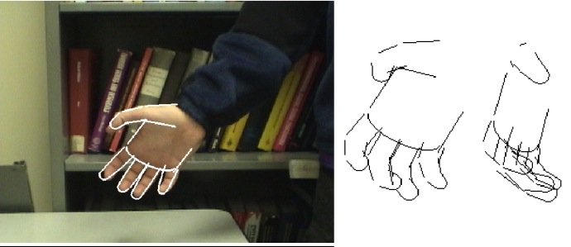

Vision (Perception)
Object and face recognition
Scene segmentation
Image classification
Images from Erik Sudderth (left), wikipedia (right)

Slide 35
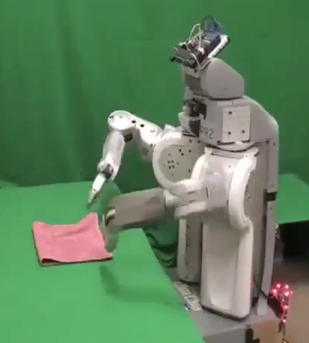
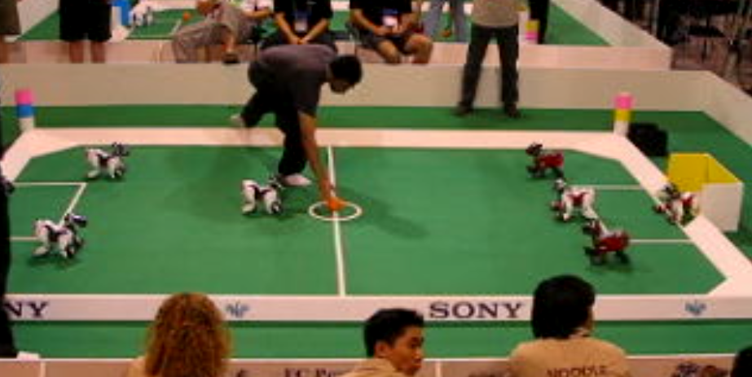
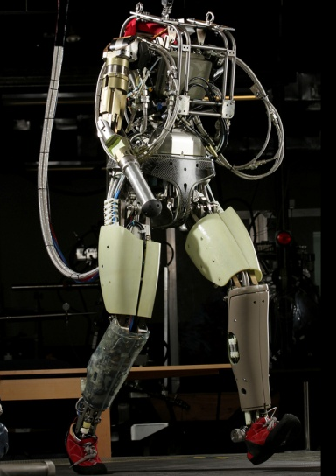
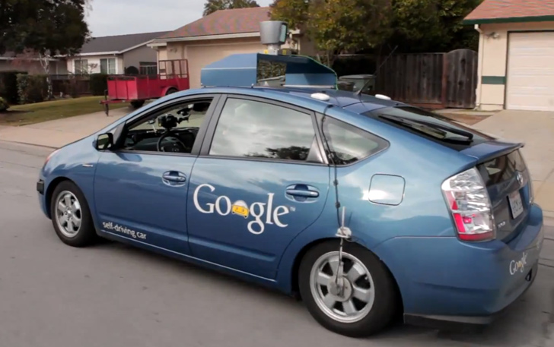
Robotics
Robotics
  Part mech. eng.
  Part AI
  Reality much
  harder than
  simulations!
Technologies
  Vehicles
  Rescue
  Soccer!
  Lots of automation…
In this class:
  We ignore mechanical aspects
  Methods for planning
  Methods for control
Images from UC Berkeley, Boston Dynamics, RoboCup, Google

Slide 36
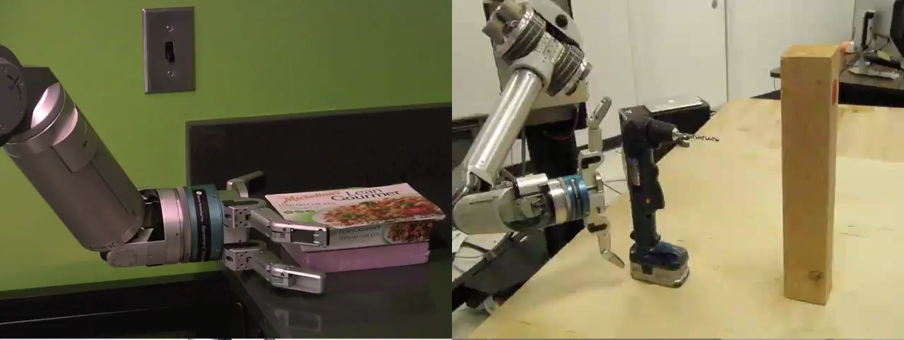
Robots

Slide 37

Robots
[Levine*, Finn*, Darrell, Abbeel, JMLR 2016]

Slide 38
Logic
Logical systems
  Theorem provers
  NASA fault diagnosis
  Question answering
Methods:
  Deduction systems
  Constraint satisfaction
  Satisfiability solvers
Image from Bart Selman

Slide 39
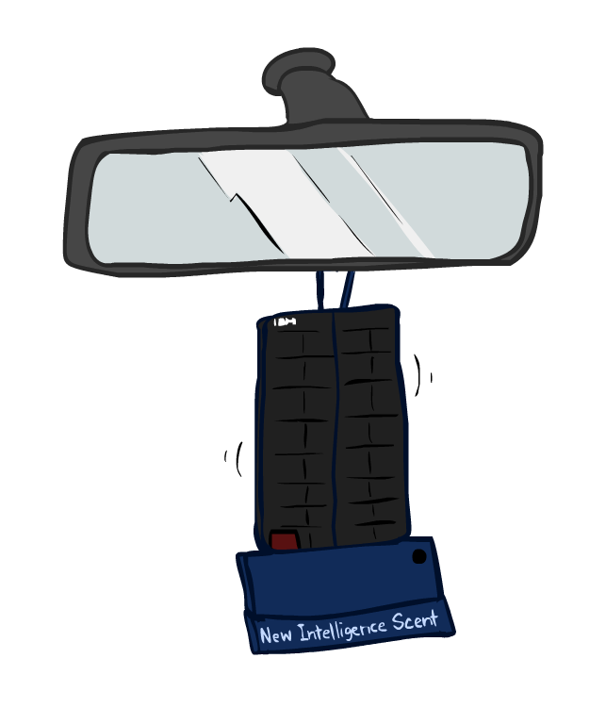
Game Playing
Classic Moment: May, '97: Deep Blue vs. Kasparov
  First match won against world champion
  “Intelligent creative” play
  200 million board positions per second
  Humans understood 99.9 of Deep Blue's moves
  Can do about the same now with a PC cluster
Open question:
  How does human cognition deal with the
  search space explosion of chess?
  Or: how can humans compete with computers at all??
1996: Kasparov Beats Deep Blue
“I could feel --- I could smell --- a new kind of intelligence across the table.”
1997: Deep Blue Beats Kasparov
“Deep Blue hasn't proven anything.”
Huge game-playing advances recently, e.g., in Go!
Notes:
Yeah, Kasparov comment probably says more about humans than about computers

Slide 40

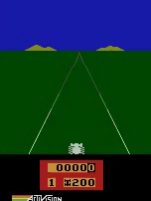
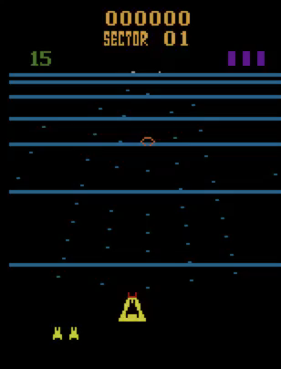
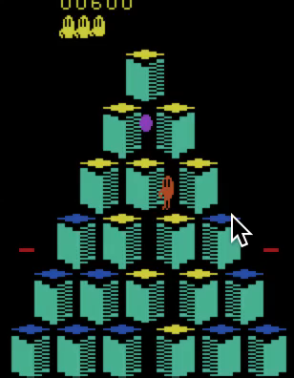
Game Agents
Reinforcement learning
Pong
Enduro
Beamrider
Q*bert

Slide 41


Decision Making
  Applied AI involves many kinds of automation
    Scheduling, e.g., airline routing, military
    Route planning, e.g., Google maps
    Medical diagnosis
    Web search engines
    Spam classifiers
    Automated help desks
    Fraud detection
    Product recommendations
    … Lots more!
Notes:
All applications can be thought of as decision making or useful sub-components of decision making

Slide 42
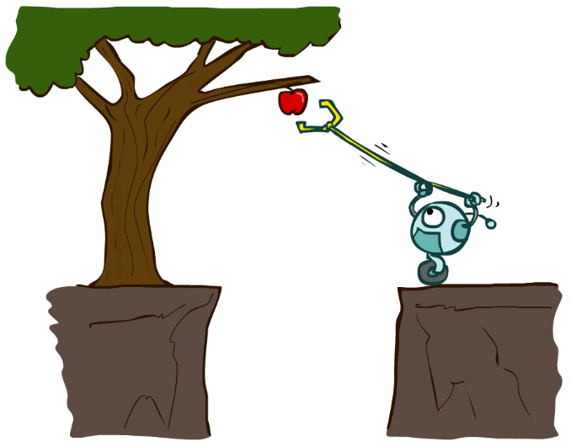
Designing Rational Agents
An agent is an entity that perceives and acts.
A rational agent selects actions that maximize its (expected) utility.
Characteristics of the percepts, environment, and action space dictate techniques for selecting rational actions
This course is about:
  General AI techniques for a variety of problem types
  Learning to recognize when and how a new problem can be solved with an existing technique
Sensors
Agent
Percepts
Environment
?
Actuators
Actions

Slide 43
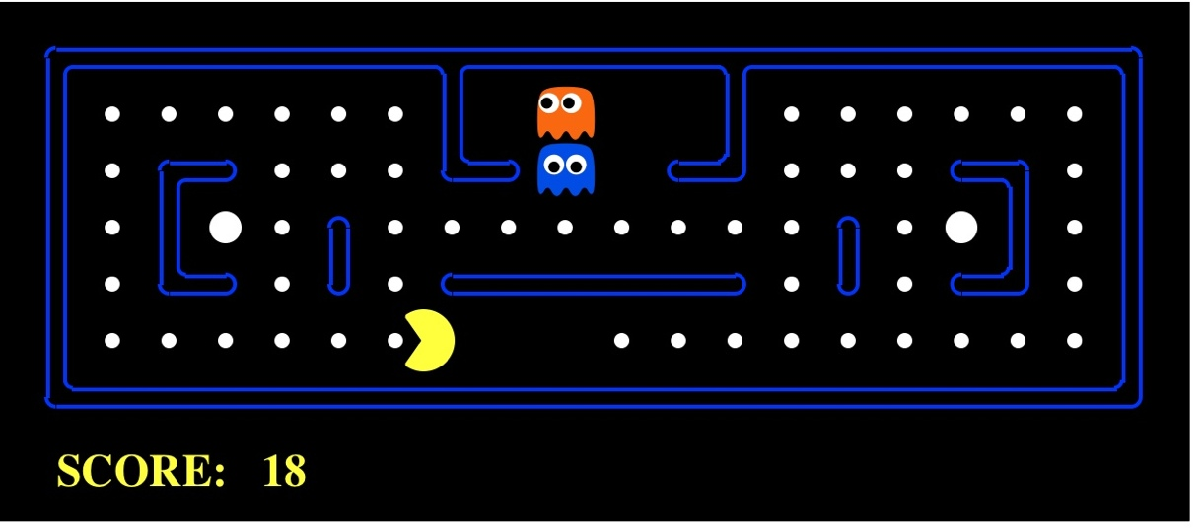
Pac-Man as an Agent
Agent
Environment
Sensors
Percepts
?
Actuators
Actions
Pac-Man is a registered trademark of Namco-Bandai Games, used here for educational purposes
Notes:
L1D2 =
python demos.py
Select Lecture 1 → select demo 2

Slide 44
Pac-Man as an Agent

Slide 45
Course Topics
Part I: Making Decisions
  Fast search / planning
  Constraint satisfaction
  Adversarial and uncertain search
Part II: Reasoning under Uncertainty
  Bayes’ nets
  Decision theory
  Machine learning
Throughout: Applications
  Natural language, vision, robotics, games, …

Slide 46
By the End of this Course you will
Build and understand the math of rational, learning agents
Select and apply the right AI methods for wide range of problems
Recognize how these methods are used in modern AI systems
Be prepared to make decisions on how AI is used in society

Slide 47
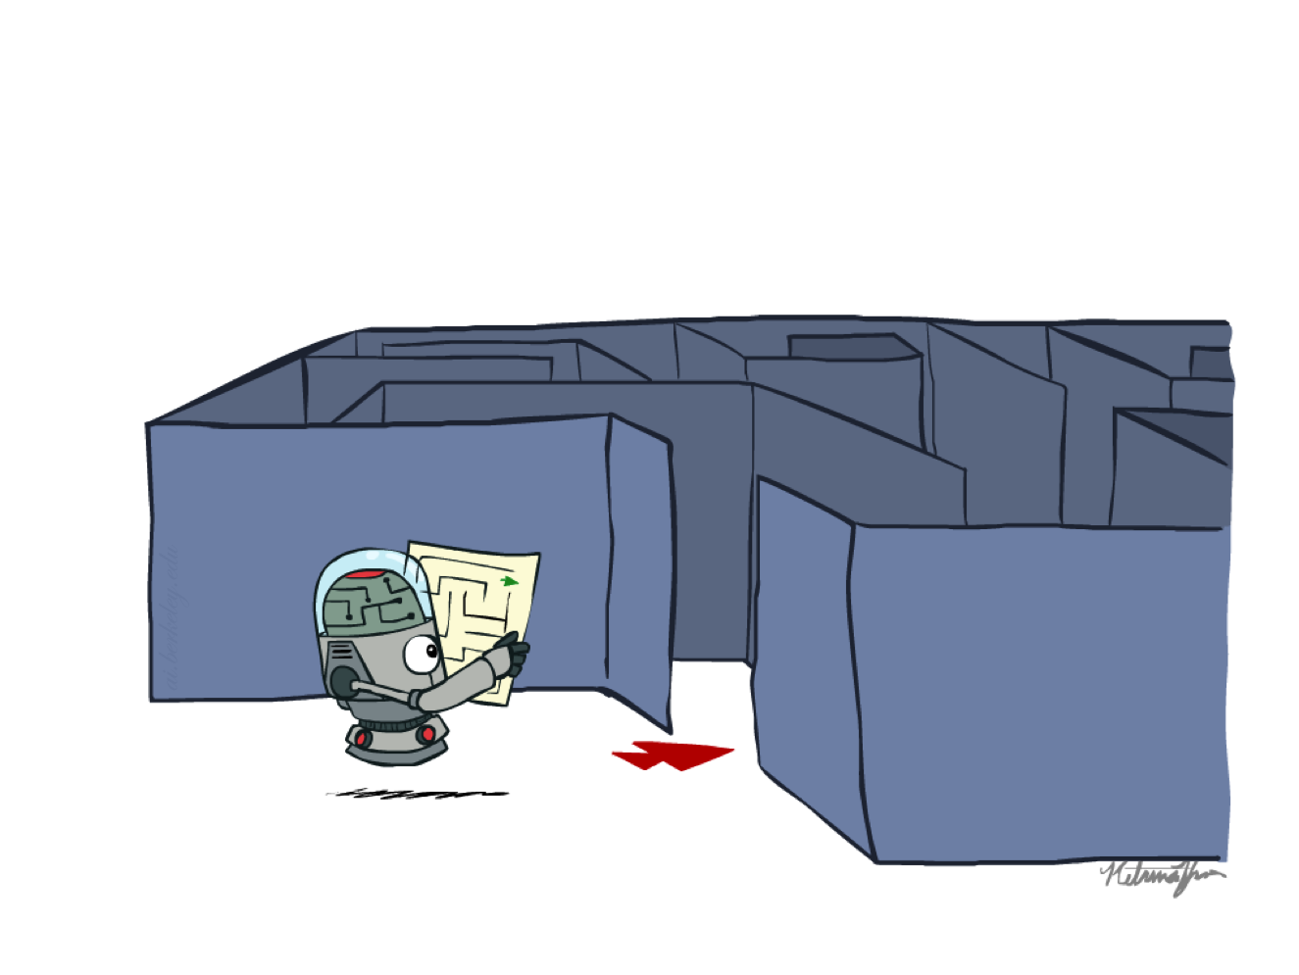
Next Week: Search

