Slide 1
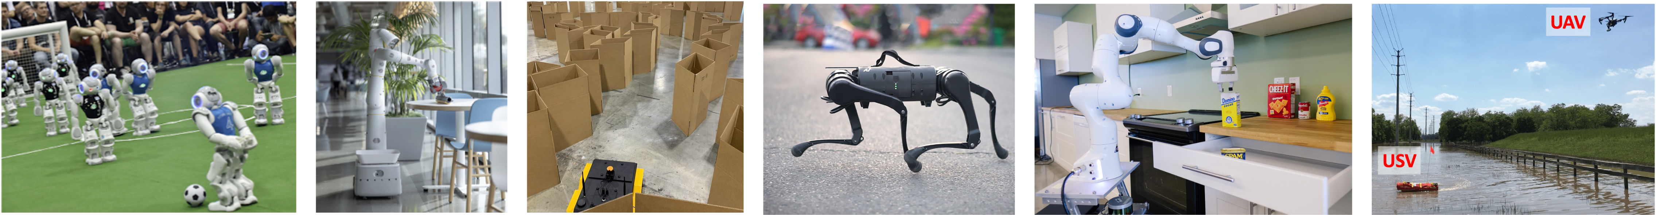
CS 485 Autonomous Robotics
Robot Learning
Prof. Xuesu Xiao
George Mason University
Slides Credits: Gregory Stein

Slide 2
Logistics
Course evaluation is out. Please provide feedback so we can improve the course for future offerings! ☺
  Send a proof of submission to get a 5-point extra credit!
Open-ended project is coming to the end!
  Final presentation on November 30 (demo your robots if possible).
  Final report due on December 3.

Slide 3
There are many things we want robots to do
In just one semester, we won’t be able to talk about all of those.
We will learn about the fundamentals:
The core mathematical tools used to represent robots and the world
How robots move and interact
How robots sense the world
How robots understand the world
How robots …

Slide 4
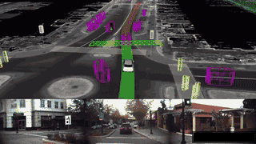
Waymo: let’s say you want to build a self-driving car… what might you need?

Slide 5
Motivation: the world is noisy and complicated
Let’s consider a self-driving vehicle:
How do I plan when there are other cars (or people or bikes) around?
How can I make good decisions when my sensors are noisy and I may not even be able to detect everyone or everything in my midst.

Slide 6
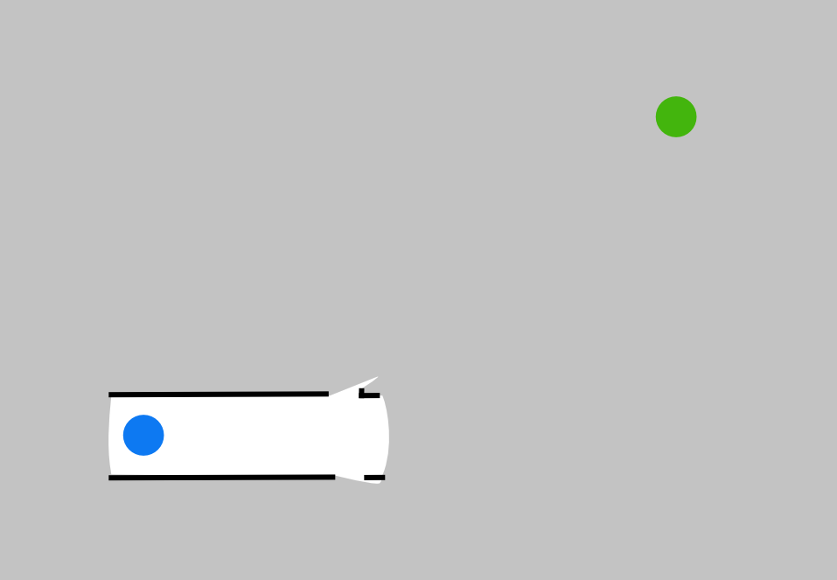
Motivation: we may not know the state of the world

Slide 7
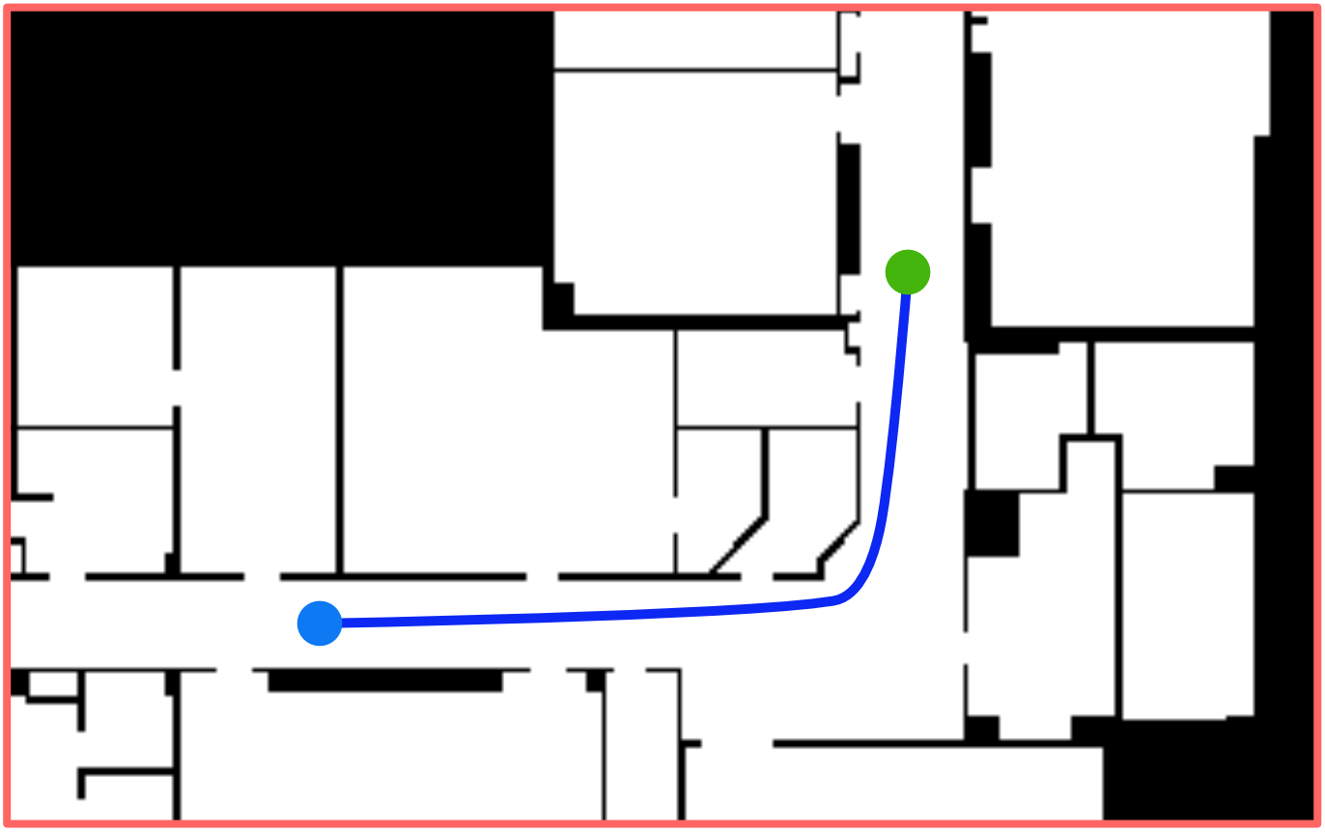
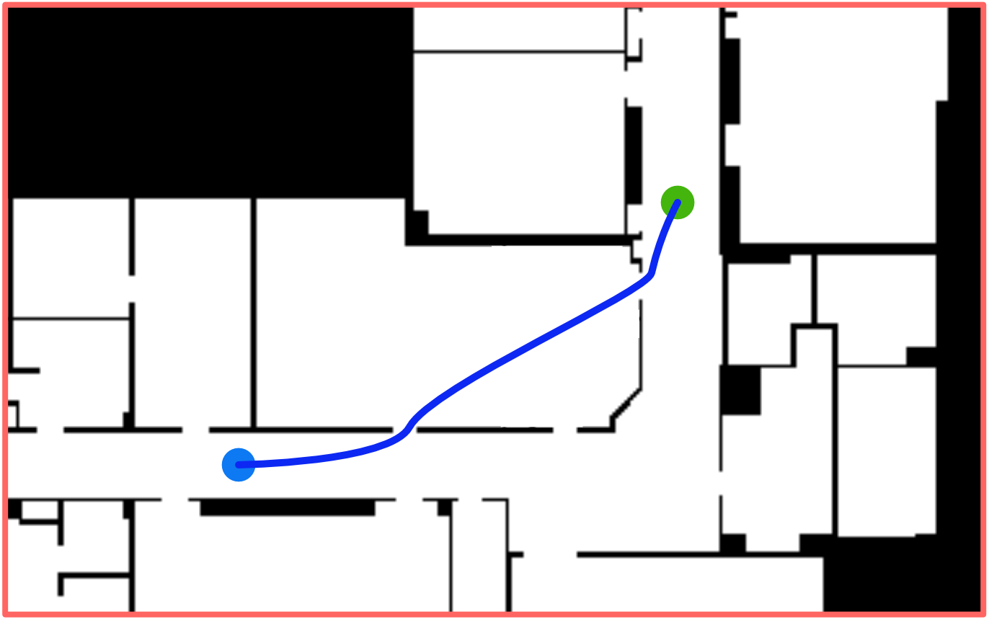
Motivation: we may not know the state of the world
Notes:
"...and this can be quite challenging, but making effective decisions requires considering what the unknown space will look like."

Slide 8
Motivation: we can use prior experience and data to inform what to do
Learning has become a key capability for robots
Today, we’ll discuss how machine learning—fueled by advancements in representation, data volume, and access to computation—has allowed for significant progress in robotics.

Slide 9
Plan for today
Deep Learning “Crash Course”
Learning for Robot Perception
Learning for Robot Action
Learning for Robot …

Slide 10
Curve Fitting Crash Course
Perhaps a review for many of you.

Slide 11
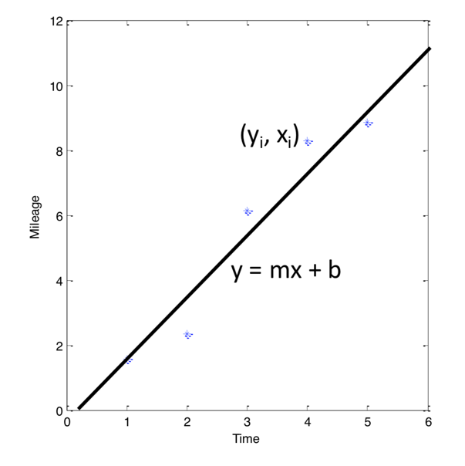
At it’s core, most of (supervised) machine learning is really just fitting lines to data.
We have a “bucket” of data with “labels”
Our aim is to find the parameters of the model (in this case ‘m’ and ‘b’)

Slide 12
At it’s core, most of (supervised) machine learning is really just fitting lines to data.
We have a “bucket” of data with “labels”
Our aim is to find the parameters of the model (in this case ‘m’ and ‘b’)
We are trying to solve a function approximation problem: we have a bunch of input/output pairs, and we want to estimate the parameters of a function that best relates the two.
This idea of function approximation will be very important for the rest of today. A question you should ask is what are we trying to approximate?

Slide 13
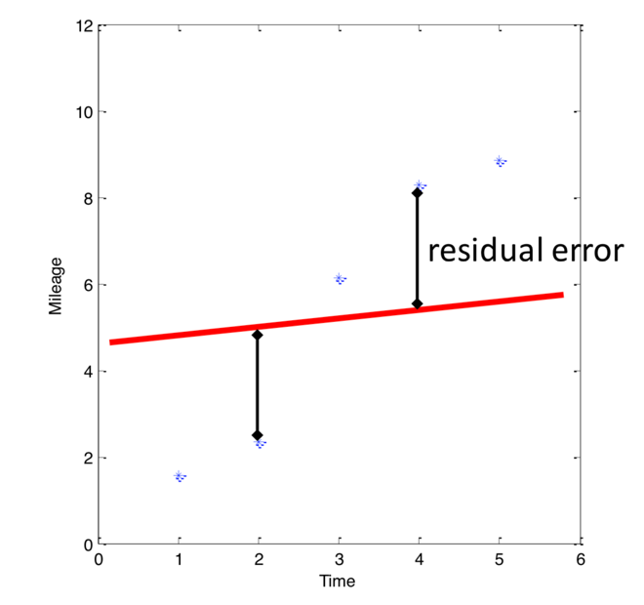
Least Squares is used to solve, for example, curve fitting problems
Linear regression:

Slide 14
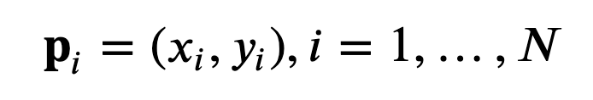
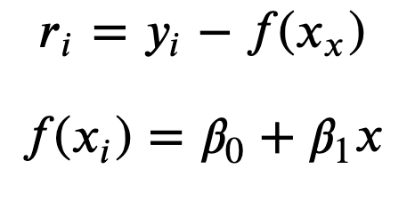
So how do we solve this problem?
Let’s look at this from a net cost perspective. I have
N points:
The residuals specify the “error”:
We want the beta’s that minimize
this error.

Slide 15
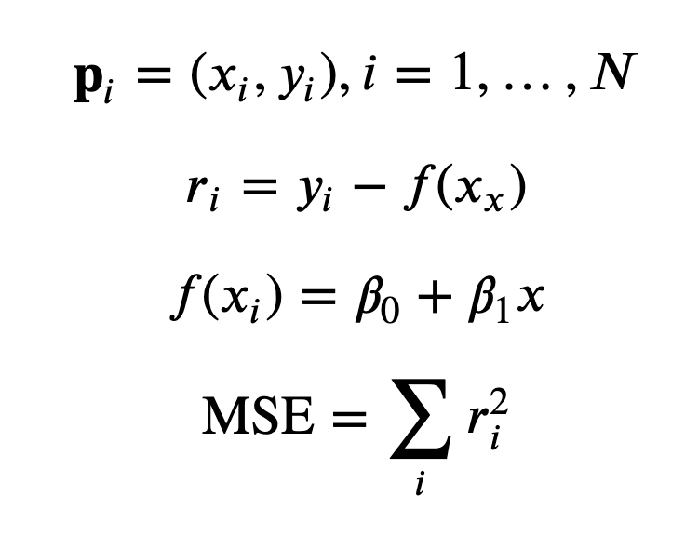
We want to minimize the Sum of Squared Error (or Mean Squared Error)

Slide 16
We want to minimize the Sum of Squared Error (or Mean Squared Error)
So how do we solve for this?

Slide 17
If we write this as a matrix equation, we can solve it using linear algebra.
From CMU Statistics Course

Slide 18
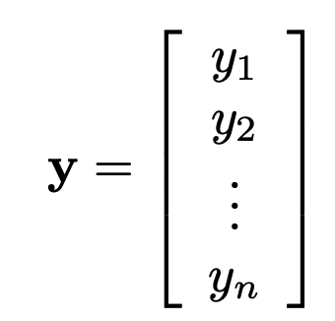
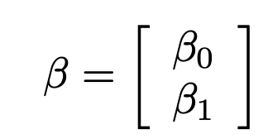
If we write this as a matrix equation, we can solve it using linear algebra.
From CMU Statistics Course

Slide 19
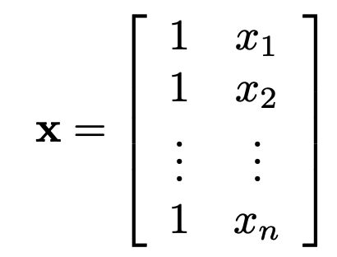
If we write this as a matrix equation, we can solve it using linear algebra.
From CMU Statistics Course

Slide 20
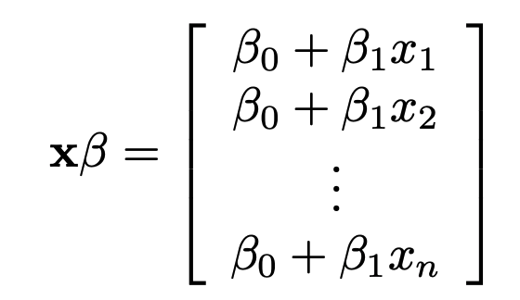
If we write this as a matrix equation, we can solve it using linear algebra.
From CMU Statistics Course

Slide 21
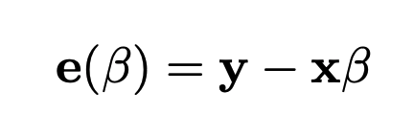
If we write this as a matrix equation, we can solve it using linear algebra.
From CMU Statistics Course

Slide 22
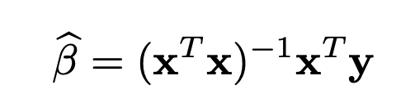
If we write this as a matrix equation, we can solve it using linear algebra.
From CMU Statistics Course

Slide 23
If we write this as a matrix equation, we can solve it using linear algebra.

Slide 24
If we write this as a matrix equation, we can solve it using linear algebra.
Also, this is the “Pseudo-inverse” of x:
It allows us to “invert” a matrix that isn’t square.
Note that if the matrix is square, this will allows us to solve for a line that exactly fits the parameters. No pseudo-inverse required.

Slide 25
However, most problems cannot be solved using linear algebra
Next, we’ll motivate gradient descent, a more generic (iterative) algorithm for learning from data.

Slide 26
So, what are these Neural Networks I’ve been hearing so much about lately?

Slide 27
So, what are these Neural Networks I’ve been hearing so much about lately?
First, some history…

Slide 28
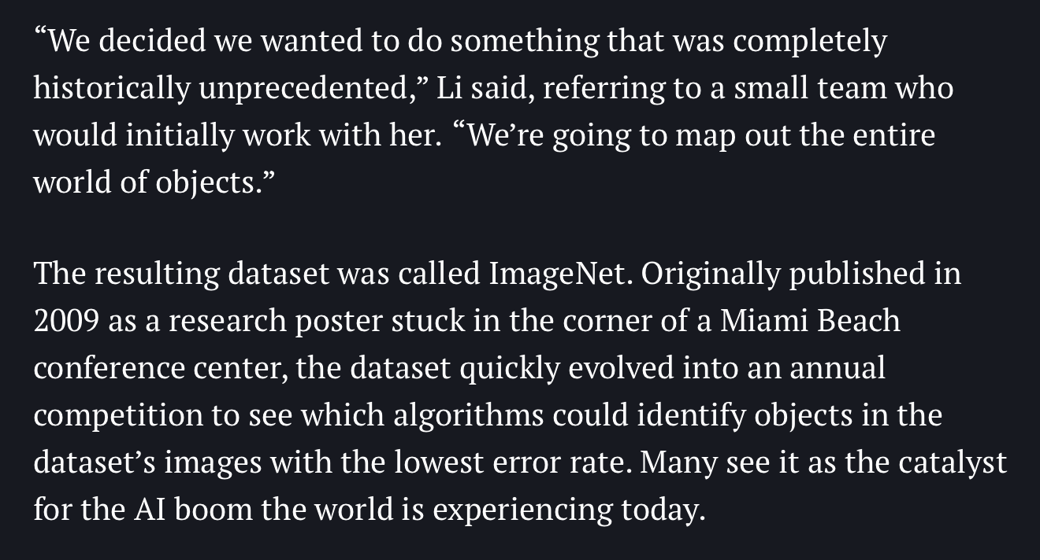

So, what are these Neural Networks I’ve been hearing so much about lately?
First, some history: 2010 marked the first year of the ImageNet image classification competition.
Fei-Fei Li
Sources: https://qz.com/1034972/the-data-that-changed-the-direction-of-ai-research-and-possibly-the-world/

Slide 29
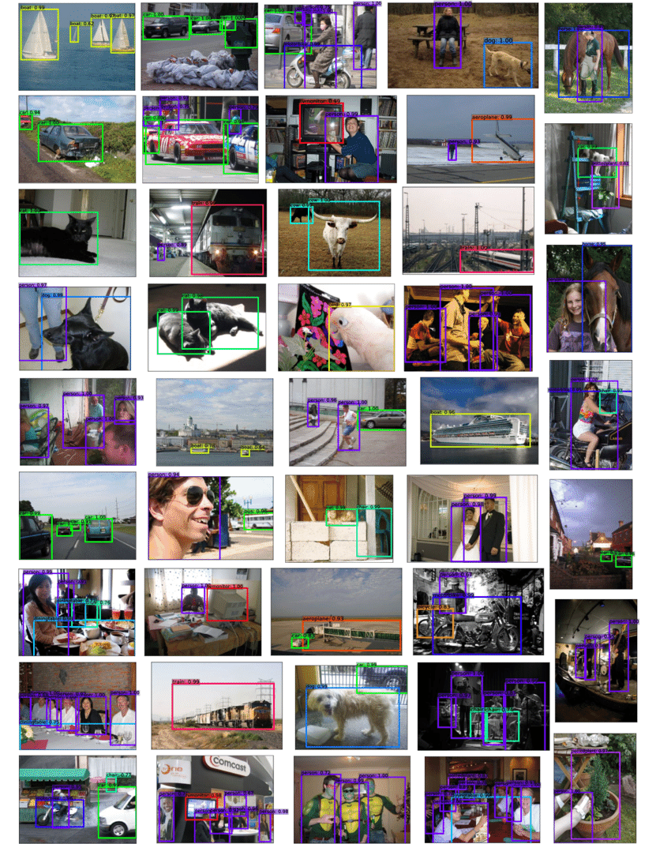
The ImageNet competition had more images/variety than other similar challenges
For context, PASCAL VOC 2012 had 10 object classes: bicycle, bus, car, cat, horse, motorbike, person, sheep.
Training set: 2618 images containing 4754 annotated objects

Slide 30

The ImageNet competition had more images/variety than other similar challenges
By contrast, ImageNet had 3.2 million images and 1,000 object classes (actually more like 5,000 grouped into 1,000 buckets)
Sources: https://qz.com/1034972/the-data-that-changed-the-direction-of-ai-research-and-possibly-the-world/

Slide 31
The ImageNet competition had more images/variety than other similar challenges
By contrast, ImageNet had 3.2 million images and 1,000 object classes (actually more like 5,000 grouped into 1,000 buckets)
This meant that the teams had an incredible amount of data to work with and performance on the challenge in its first year was 🤷‍♀️ … fine.
Sources: https://qz.com/1034972/the-data-that-changed-the-direction-of-ai-research-and-possibly-the-world/

Slide 32
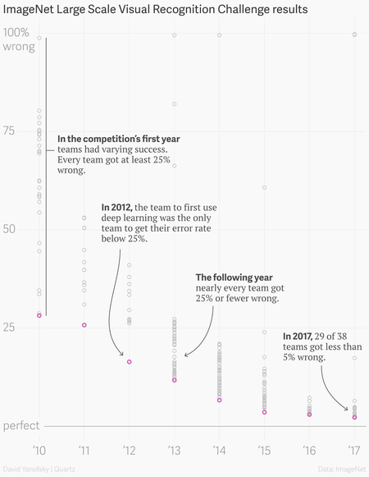
This graph shows Top-5 performance of the teams that entered the competition.
Performance was mediocre, although really impressive: teams were using techniques like bag-of-words on sparse features and training classifiers in descriptor space.
Sources: https://qz.com/1034972/the-data-that-changed-the-direction-of-ai-research-and-possibly-the-world/

Slide 33
This graph shows Top-5 performance of the teams that entered the competition.
Performance was mediocre, although really impressive: teams were using techniques like bag-of-words on sparse features and training classifiers in descriptor space.
Then 2012 happened…
Sources: https://qz.com/1034972/the-data-that-changed-the-direction-of-ai-research-and-possibly-the-world/

Slide 34
Other top performers are very close to each other
2012 is when AlexNet came on to the scene and, using a Convolutional Neural Network, outperformed all other teams by over 10% absolute accuracy.
Sources: https://qz.com/1034972/the-data-that-changed-the-direction-of-ai-research-and-possibly-the-world/

Slide 35
The Perceptron

Slide 36
Aside: inspiration from biological neurons

Slide 37
Here’s a simple “perceptron”
Many Inputs nonlinearly mapped to a single output

Slide 38
In code:

Slide 39
Neural Networks

Slide 40
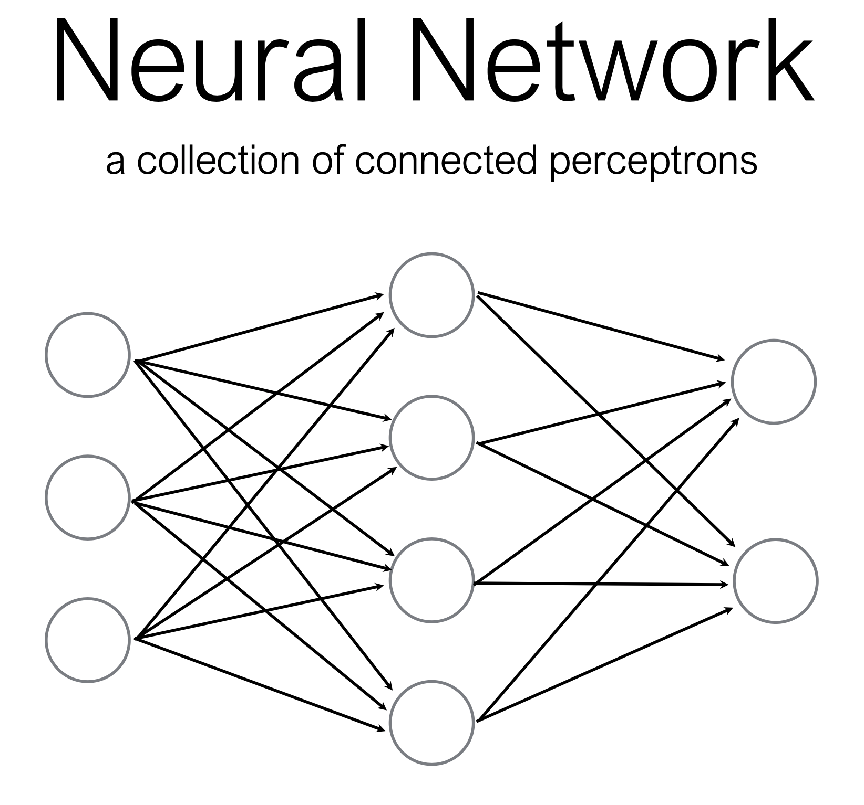
What if we just… connect a bunch of perceptrons together?

Slide 41
How many perceptrons are in this neural network?

Slide 42
How many perceptrons are in this neural network?

Slide 43
How many perceptrons are in this neural network?

Slide 44
How many perceptrons are in this neural network?

Slide 45
How many perceptrons are in this neural network?

Slide 46
How many perceptrons are in this neural network?

Slide 47
Some terminology

Slide 48
Some terminology

Slide 49
Some terminology

Slide 50
Some terminology

Slide 51
Some terminology

Slide 52
A Multi-Layer Perceptron is just a bunch of matrix multiplications + nonlinearity
MLP (multi-layer perceptron) is now more commonly known as a fully-connected neural network.
Each layer consists of:
a matrix multiplication (by a weight matrix W) to change the dimensionality of the data (input size => output size) and
An element-wise nonlinear function.
That’s the core idea!
Where does the weight matrix come from?

Slide 53
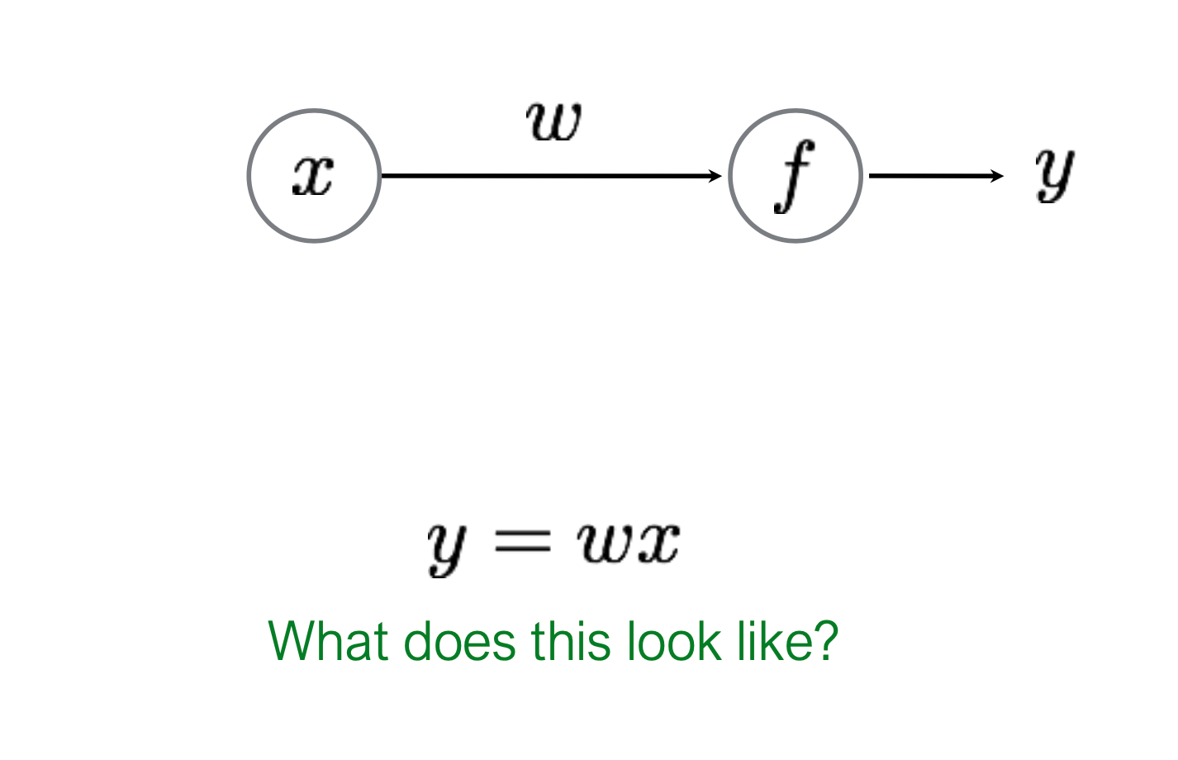
So how do we train these neural networks?
Let’s start easy!

Slide 54
So how do we train these neural networks?
Let’s start easy!
Linear Regression! We’ve seen this scenario before.

Slide 55
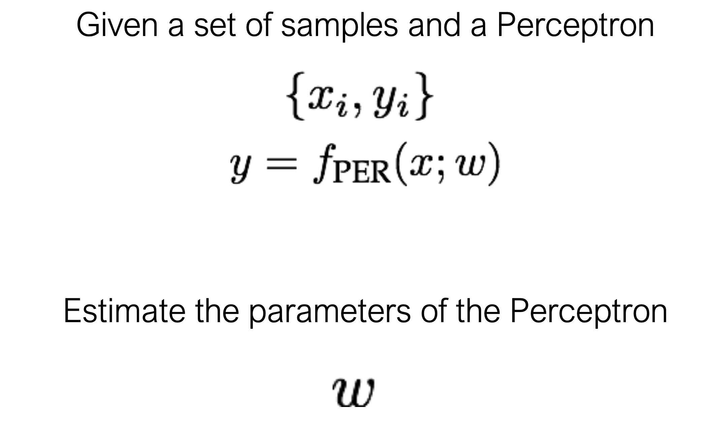
Learning (training) a perceptron

Slide 56
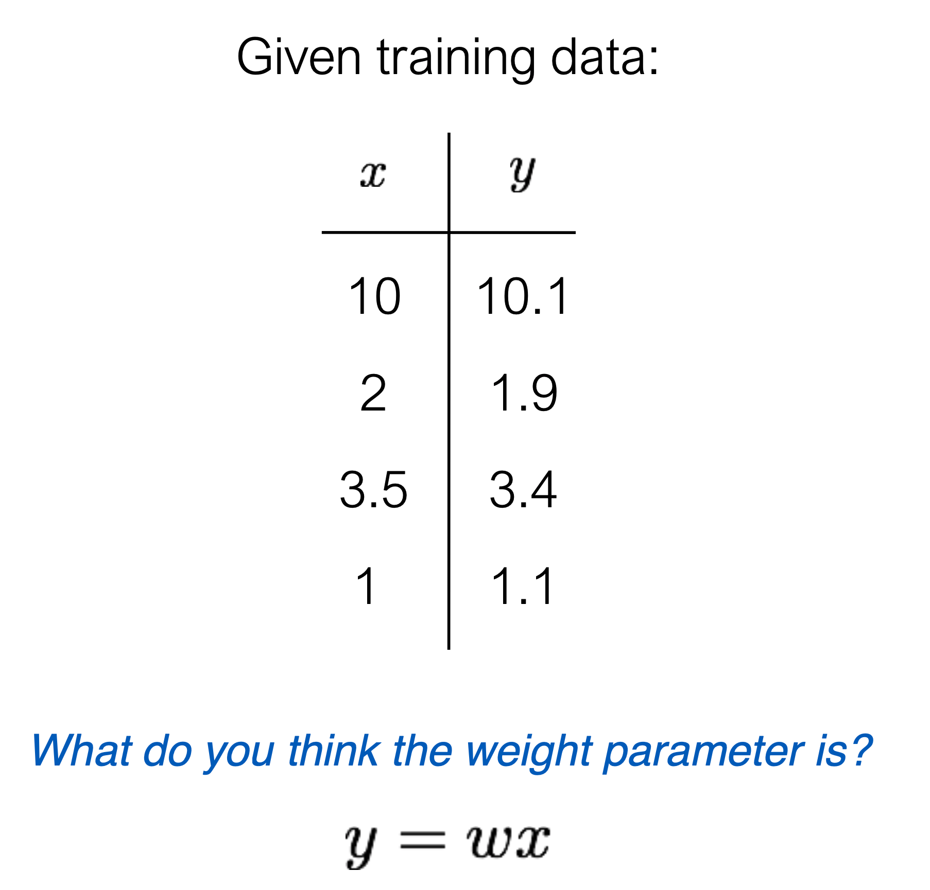
Learning (training) a perceptron

Slide 57
It is common to use an incremental learning strategy (often Gradient Descent)

Slide 58
It is common to use an incremental learning strategy (often Gradient Descent)

Slide 59
It is common to use an incremental learning strategy (often Gradient Descent)

Slide 60
It is common to use an incremental learning strategy (often Gradient Descent)

Slide 61
It is common to use an incremental learning strategy (often Gradient Descent)

Slide 62
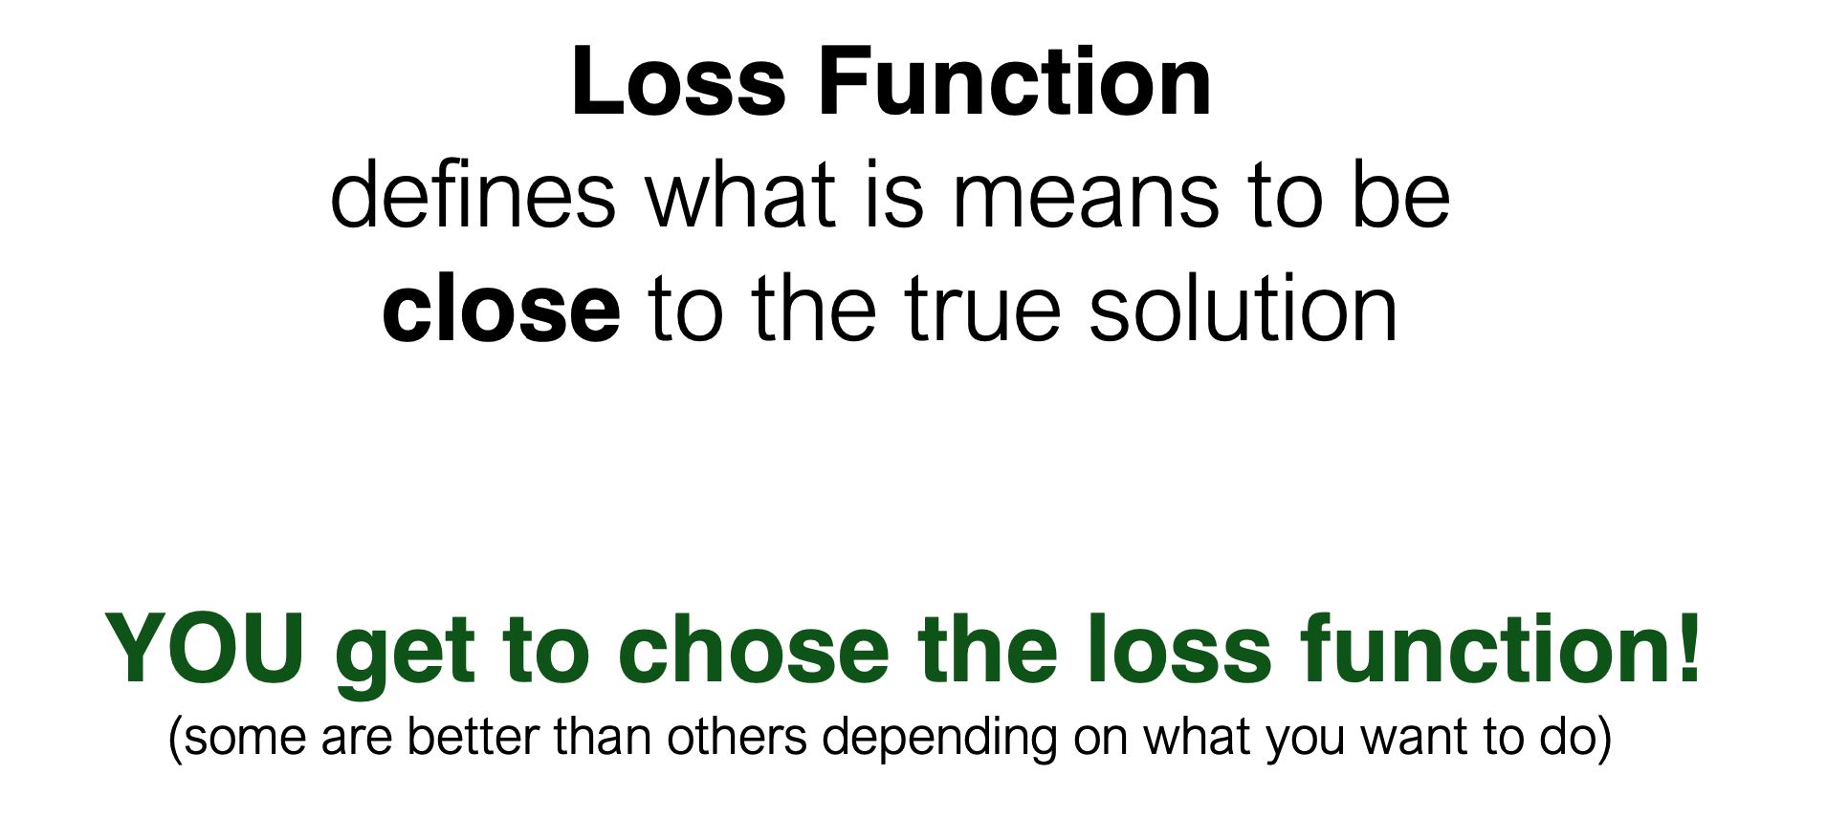
It is common to use an incremental learning strategy (often Gradient Descent)
Before diving deeper, we need to understand how we define “closeness”

Slide 63
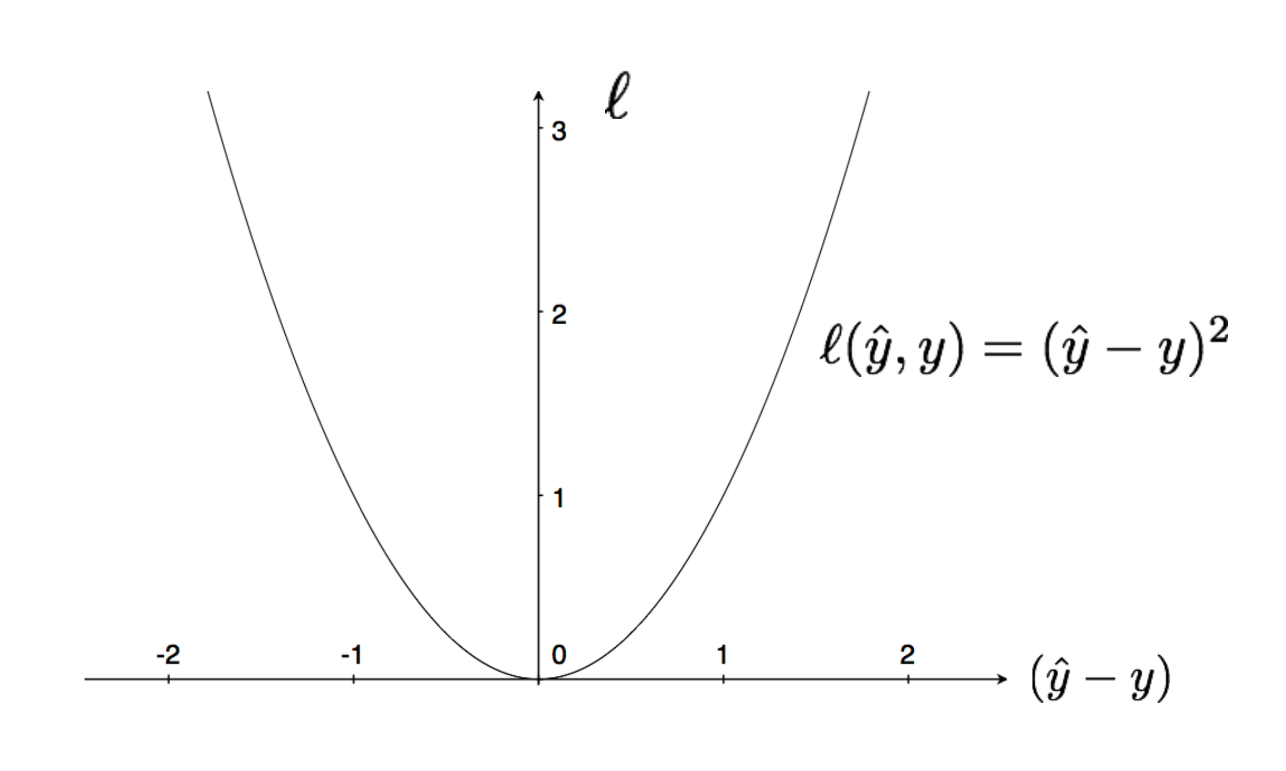
Squared Loss: very common loss function

Slide 64
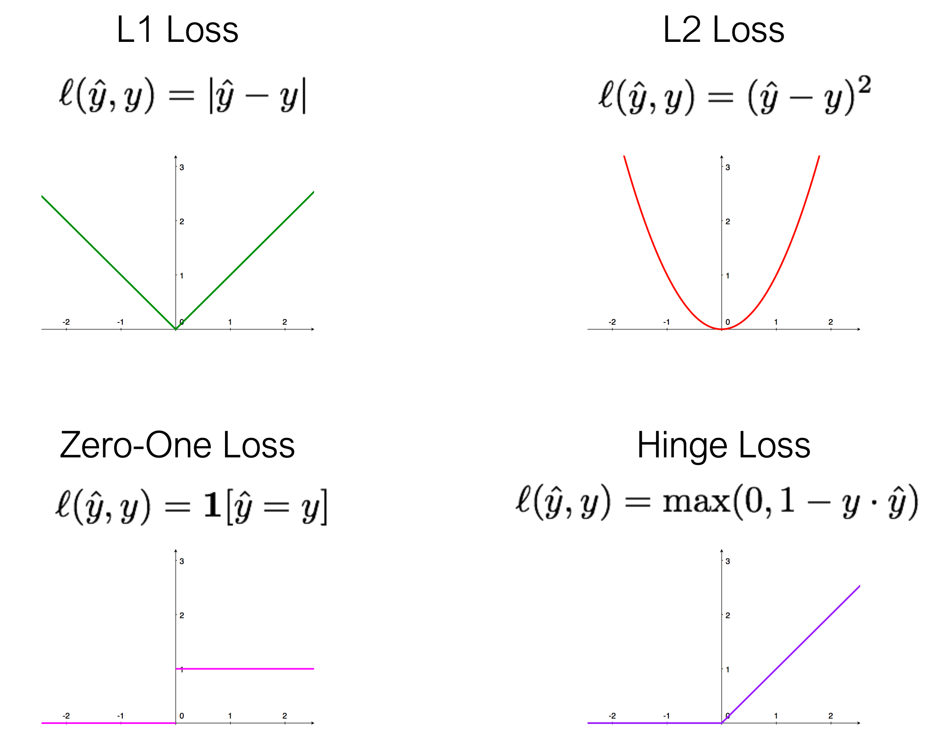
There are plenty of loss functions:

Slide 65
Back to our “world’s simplest perceptron” (which has only one parameter)
Linear Regression! We’ve seen this scenario before.

Slide 66
Back to our “world’s simplest perceptron” (which has only one parameter)

Slide 67
Back to our “world’s simplest perceptron” (which has only one parameter)

Slide 68
Back to our “world’s simplest perceptron” (which has only one parameter)

Slide 69
Gradient Descent
Training your model

Slide 70
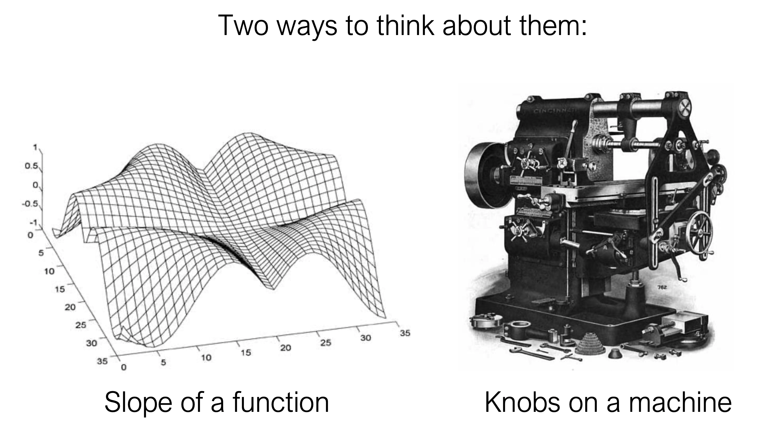
Partial derivatives tell us how much a change in one variable impacts another

Slide 71
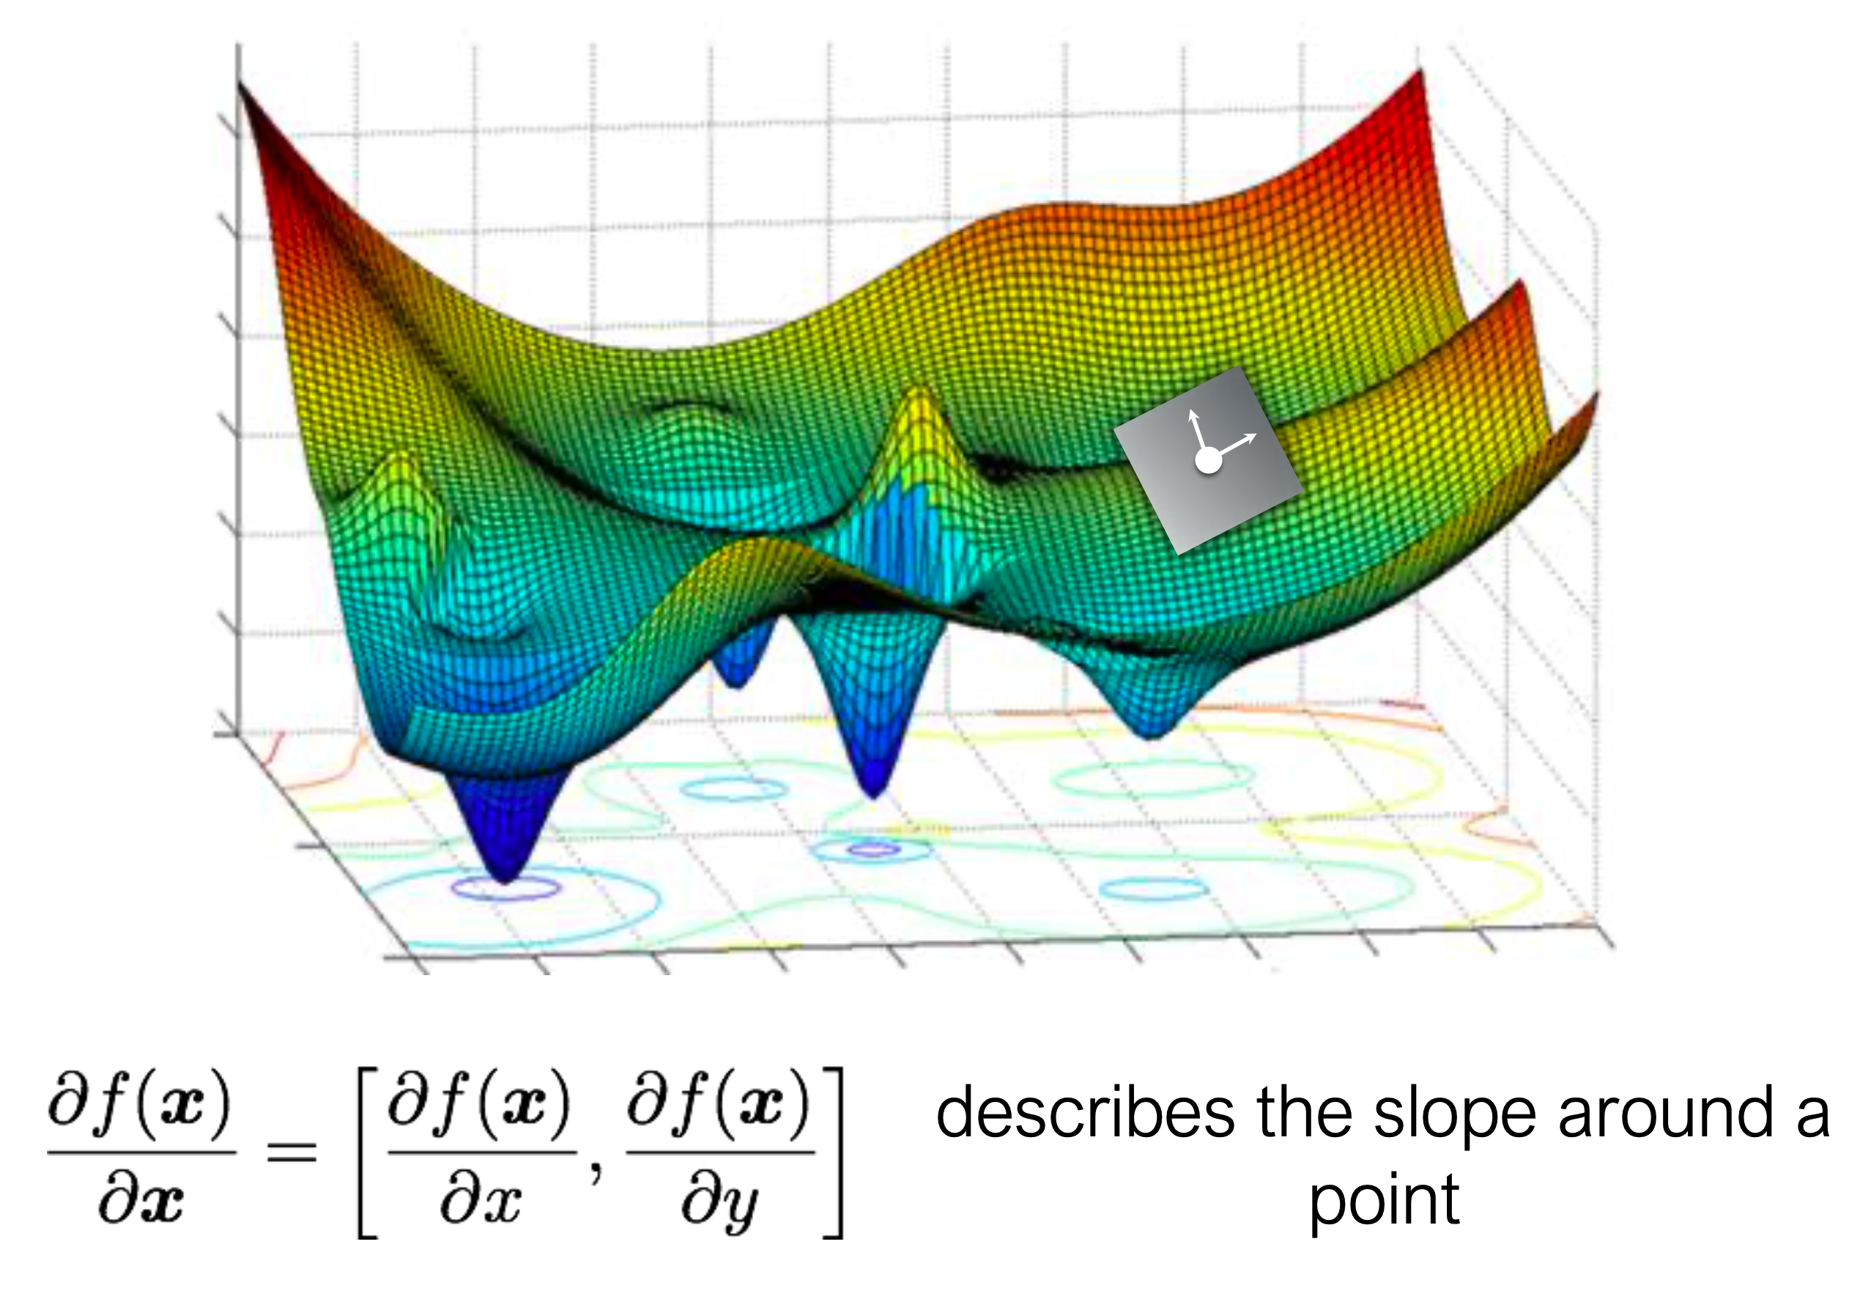
Slope of a function: the partial derivatives describe the slope around a point of interest

Slide 72
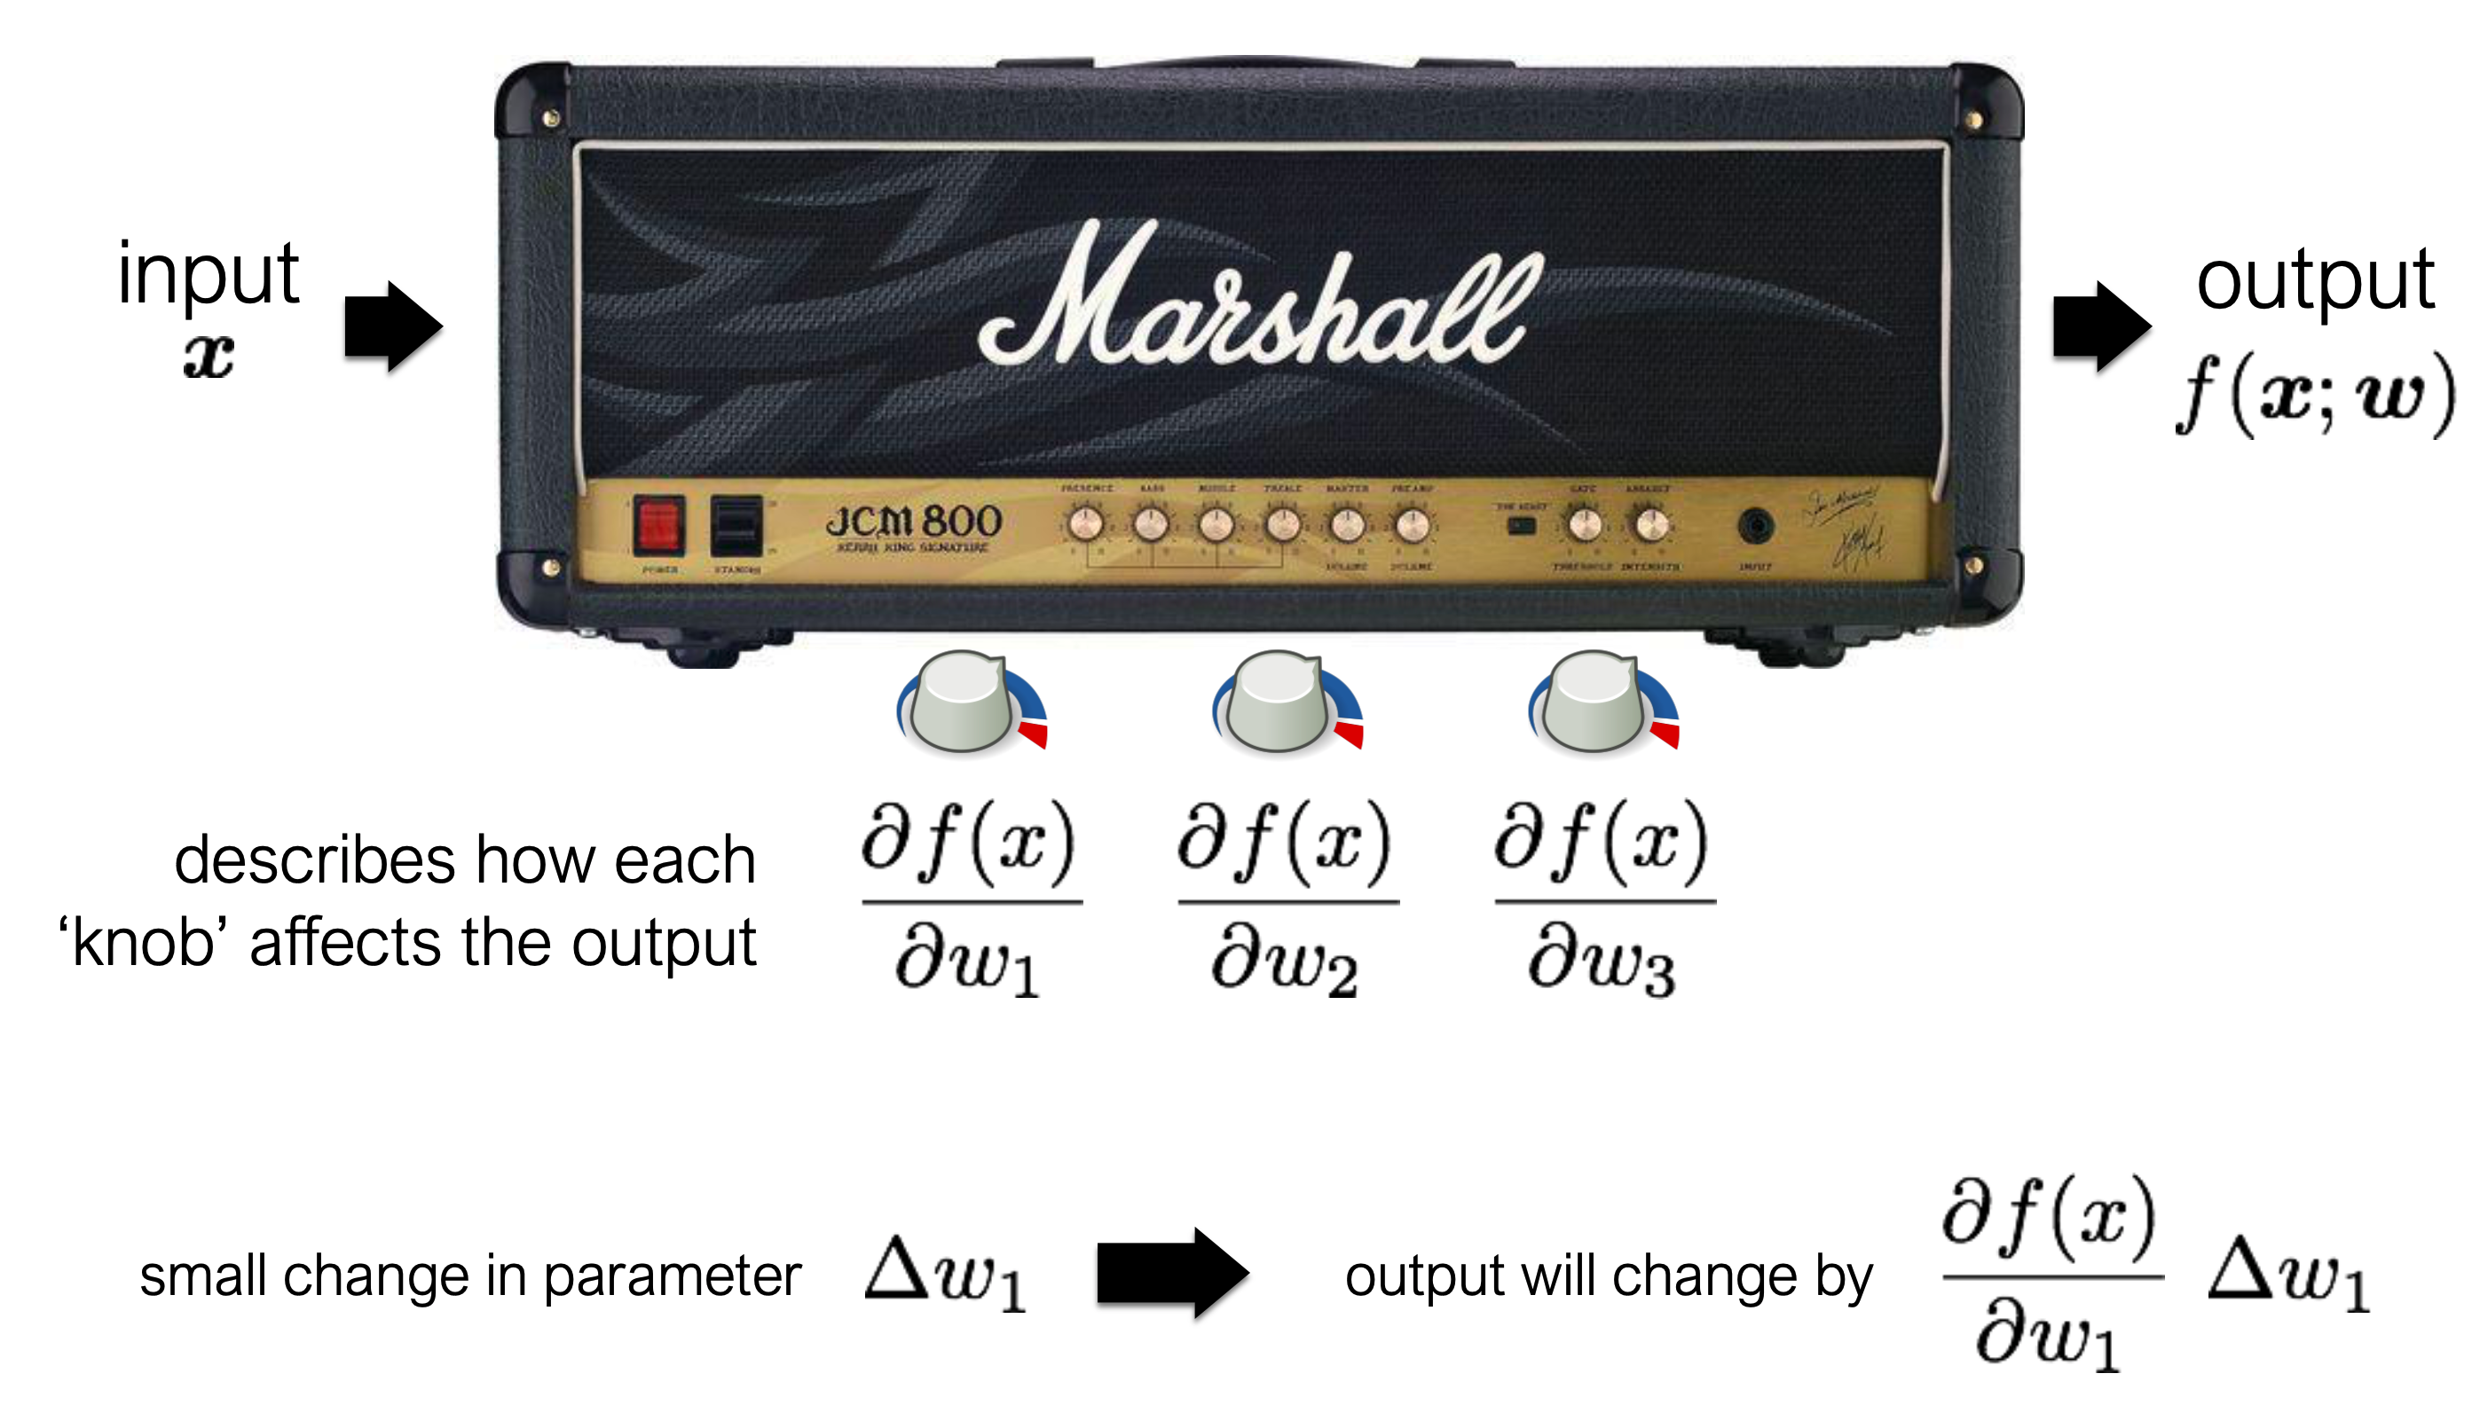
Knobs on a machine: tuning the knobs changing how the input becomes the output

Slide 73
Gradient Descent involves using the partial derivatives to tune the knobs:

Slide 74
Gradient Descent involves using the partial derivatives to tune the knobs:

Slide 75
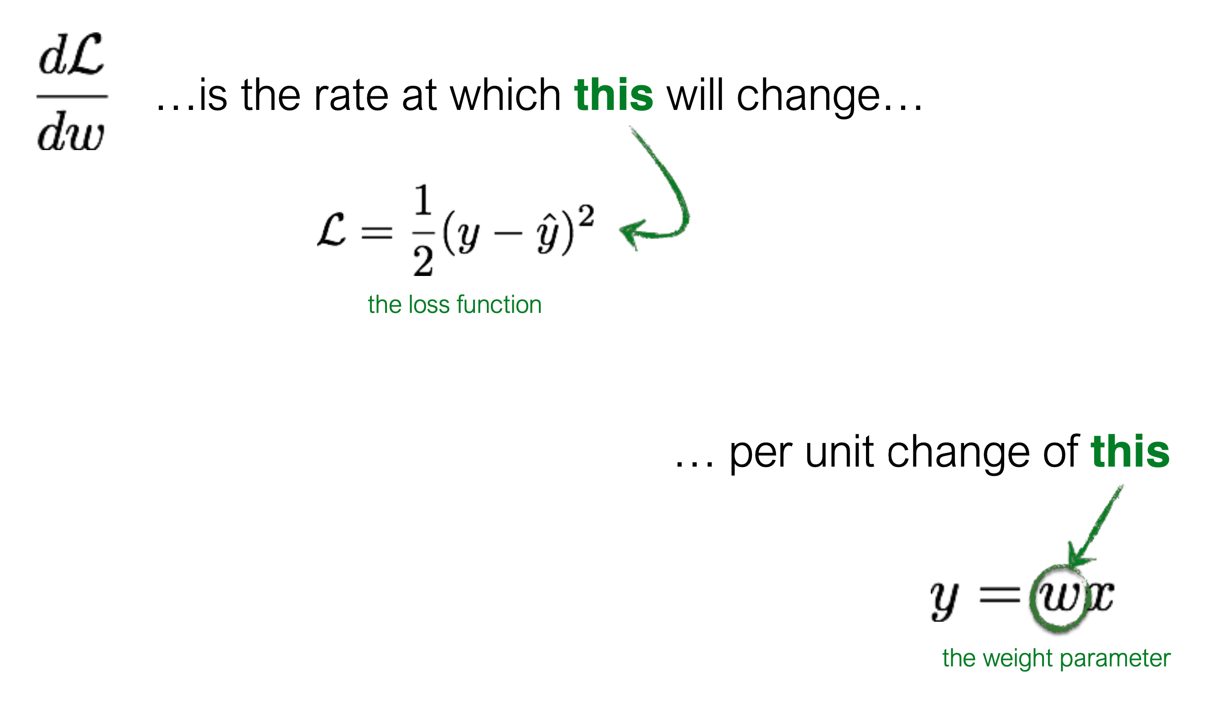
So what does gradient descent look like on our simple example?

Slide 76
So what does gradient descent look like on our simple example?

Slide 77
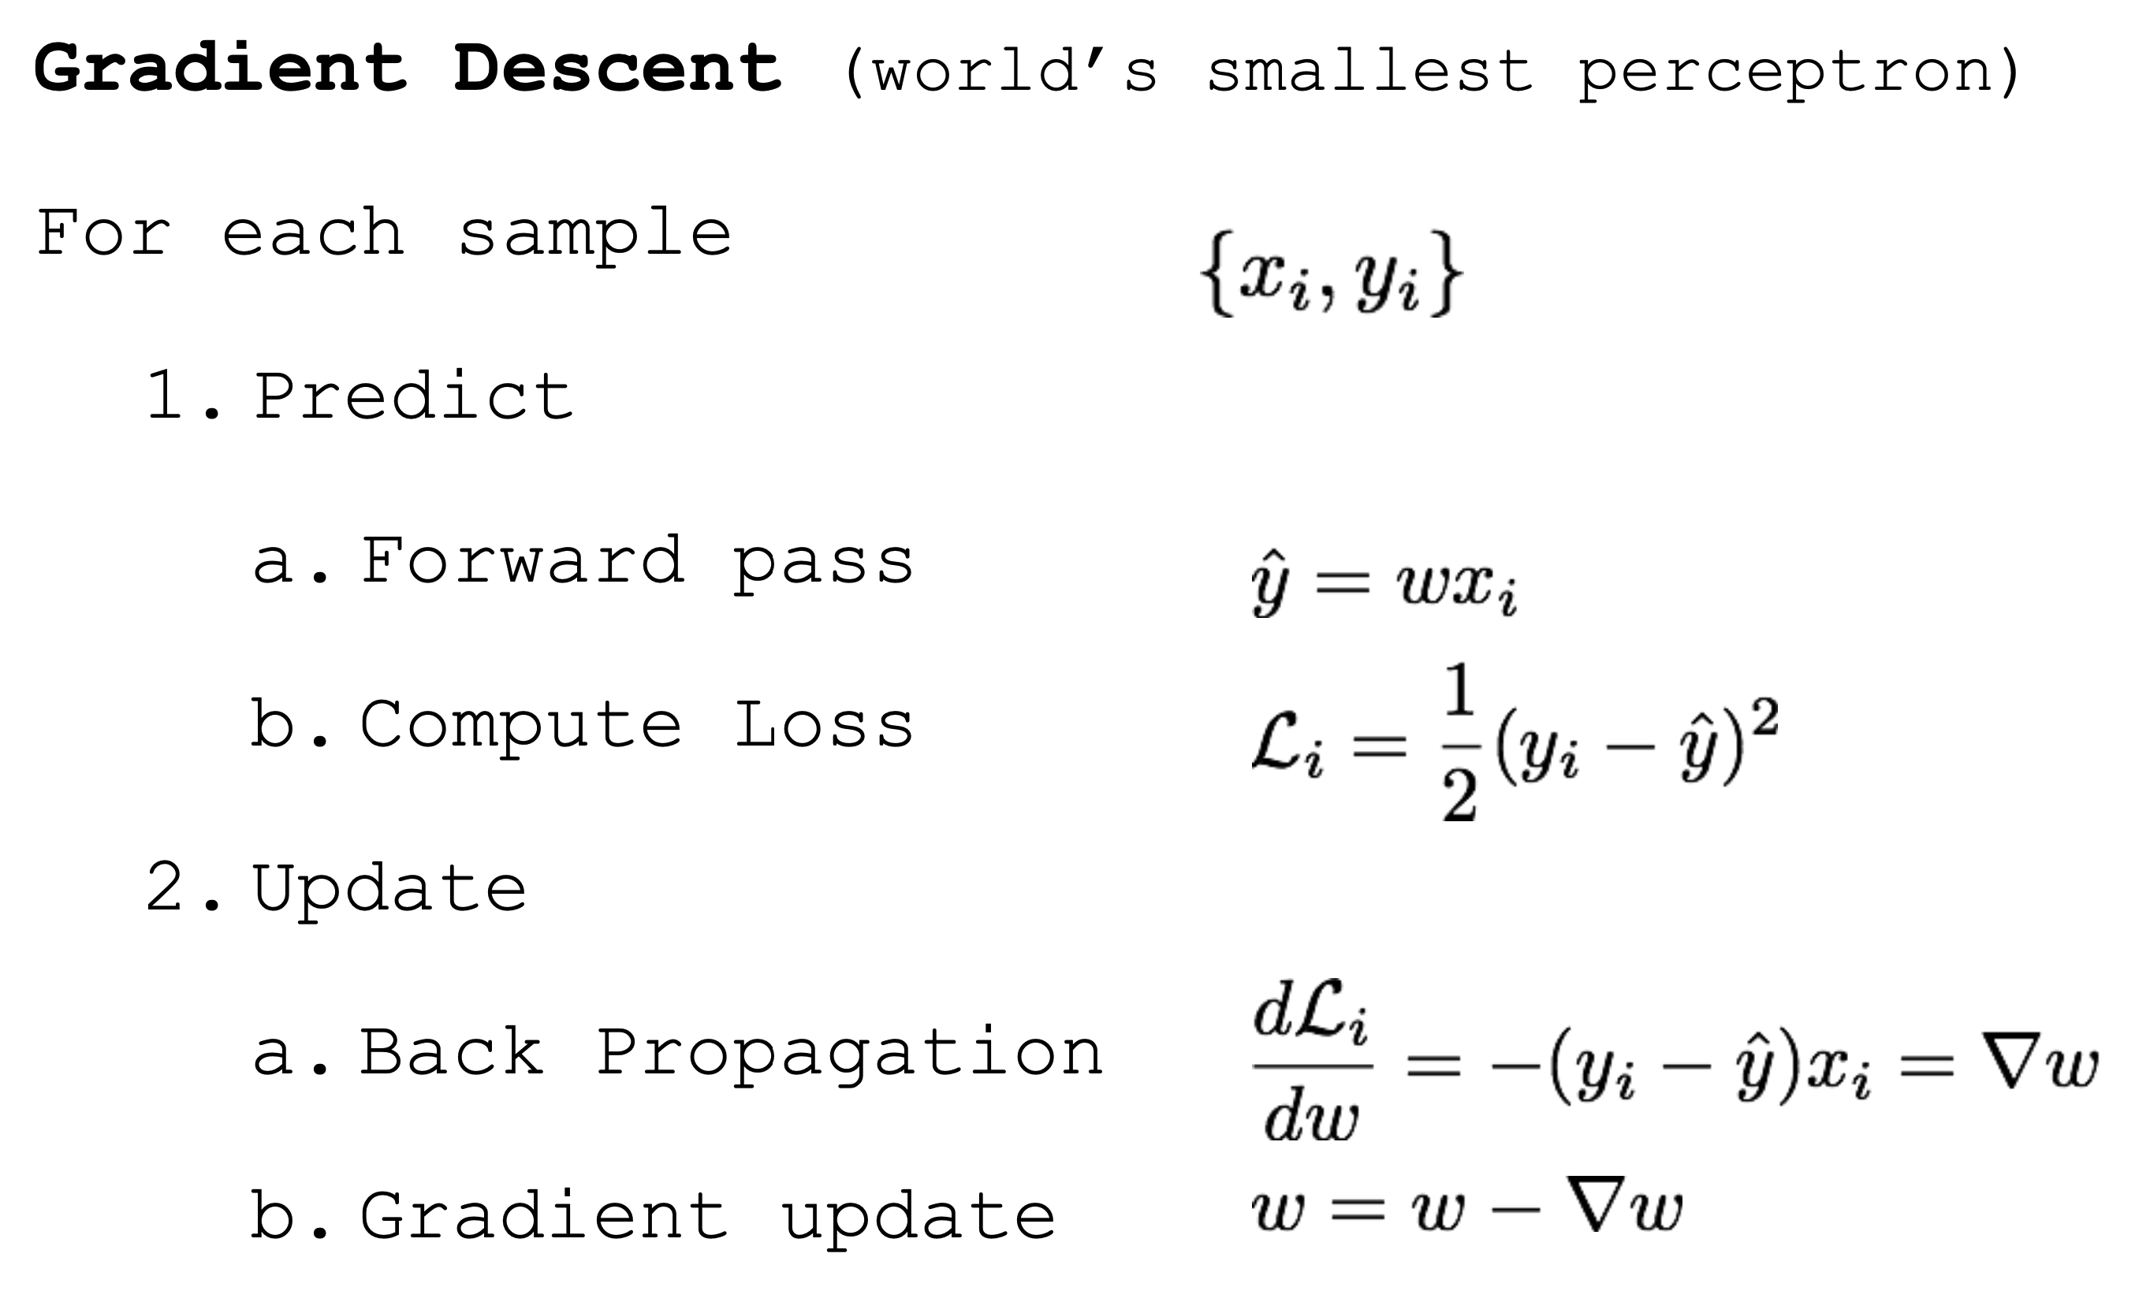
So what does gradient descent look like on our simple example?

Slide 78
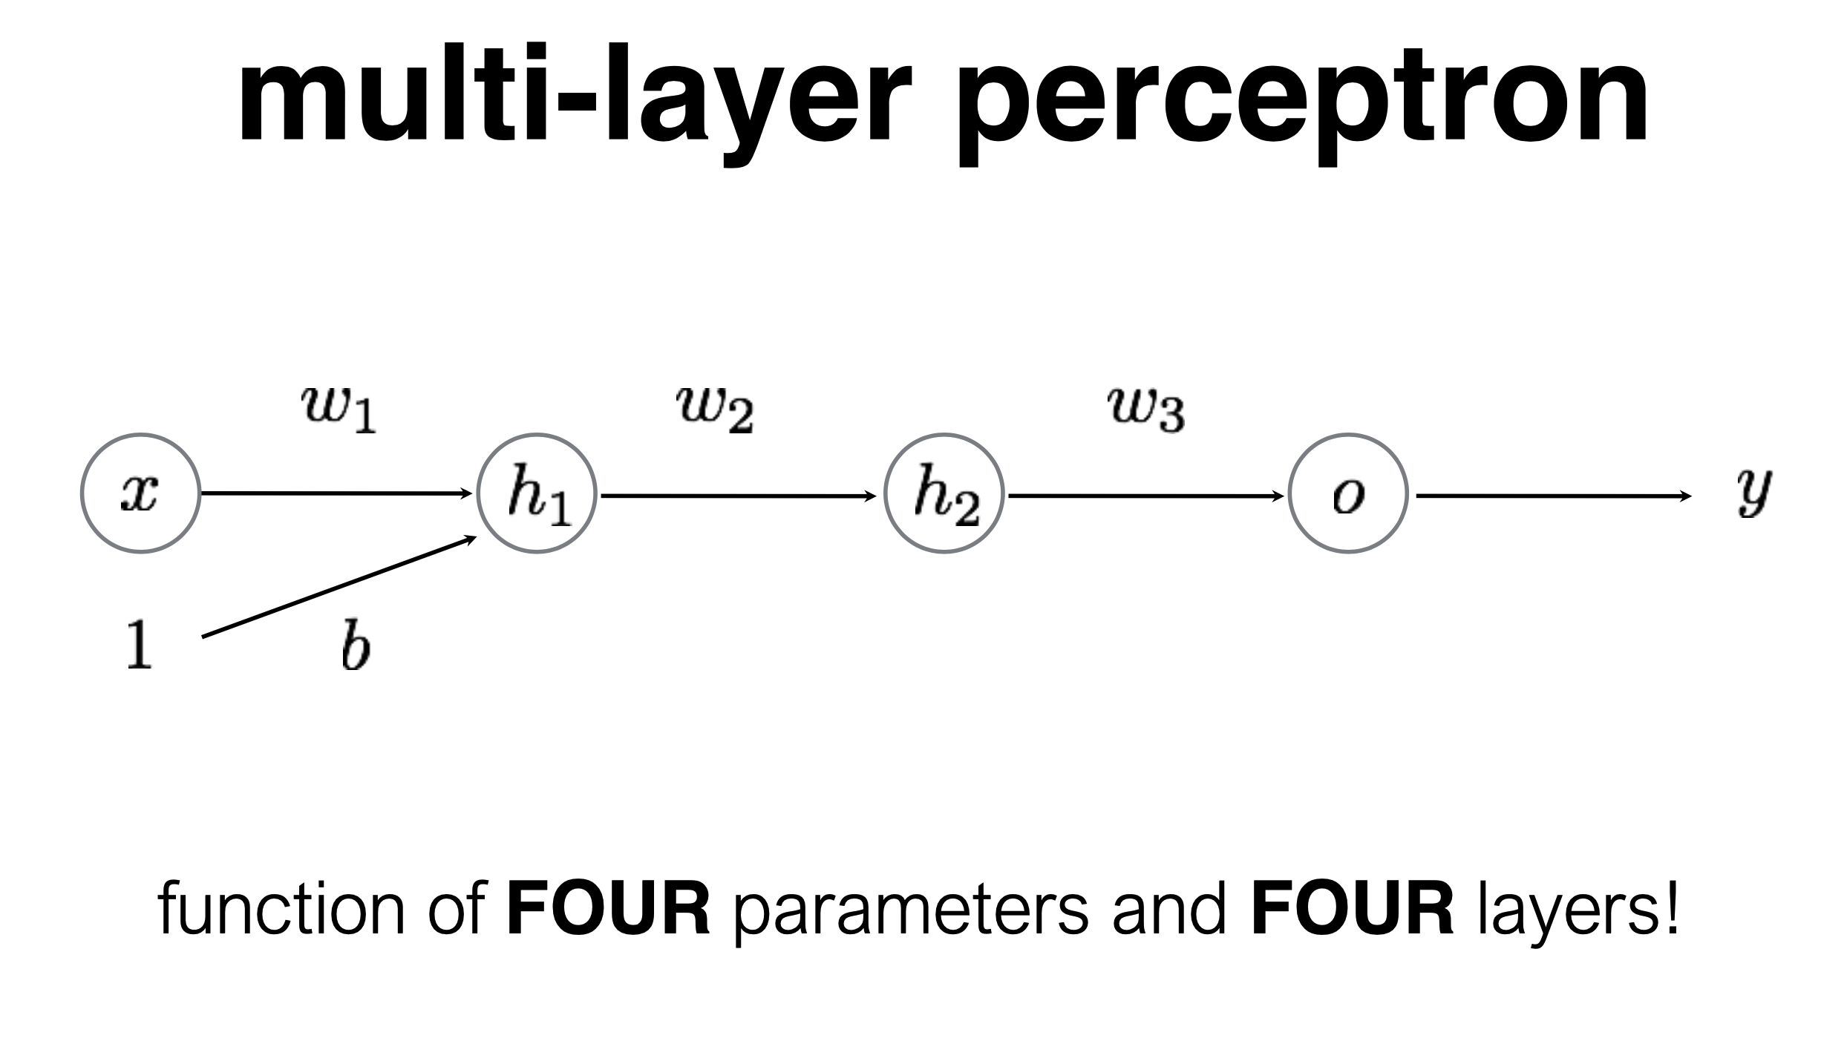
So far we’ve only had one layer.
Let’s add more!

Slide 88
We can write down the entire network as a single equation.

Slide 89
We can write down the entire network as a single equation.

Slide 90
We can write down the entire network as a single equation.

Slide 91
Using what we just learned, training an MLP isn’t terribly (theoretically) complicated

Slide 92
(Stochastic) Gradient Descent Procedure

Slide 93
Key Ideas: Deep Learning is about “hyperparametric function approximation”
We assume we have some model: y = f(x)
We have lots of examples of {y, x} and there are a TON of free parameters that define the function “f”
Given enough data and enough computation, we can approximate the function that represents that relationship knowing very little about that function in advance
That let’s us do a lot: think of object detection: we cannot write down the function that turns an image to a prediction about what object is in it, so we learn it instead.

Slide 94
When you see a learning problem, ask yourself…
What is the data? Where does it come from?
What is the loss function? How do we define error? (and is that the way we think we should actually measure error?)
What is the structure of the neural network? [Note: we’ll talk about this more later.]

Slide 95
Learning for Perception
Speaking of object detection…

Slide 96
Instead of “fully-connected layers” (matrix multiplies), CNN’s use convolutions
CNN: Convolutional Neural Network
A CNN consists of stacks of convolution operations, each followed by a nonlinearity and a “downsampling operation”
Similar in spirit to Fully Connected Neural Networks, but only to local pixels

Slide 98
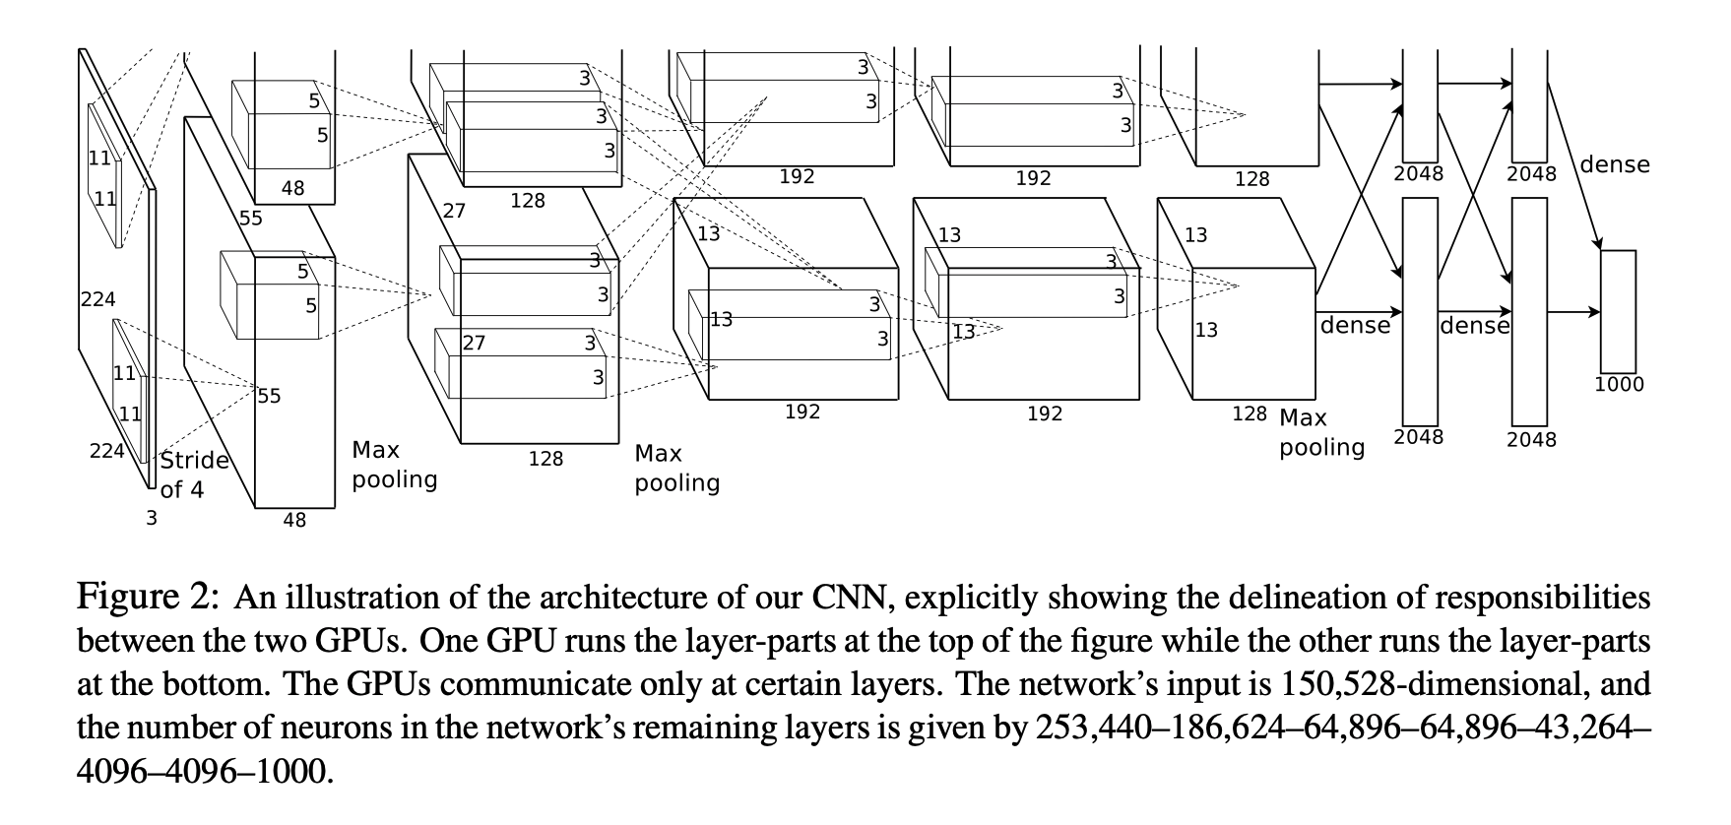
AlexNet
The CNN that started the revolution
https://papers.nips.cc/paper/2012/file/c399862d3b9d6b76c8436e924a68c45b-Paper.pdf

Slide 99
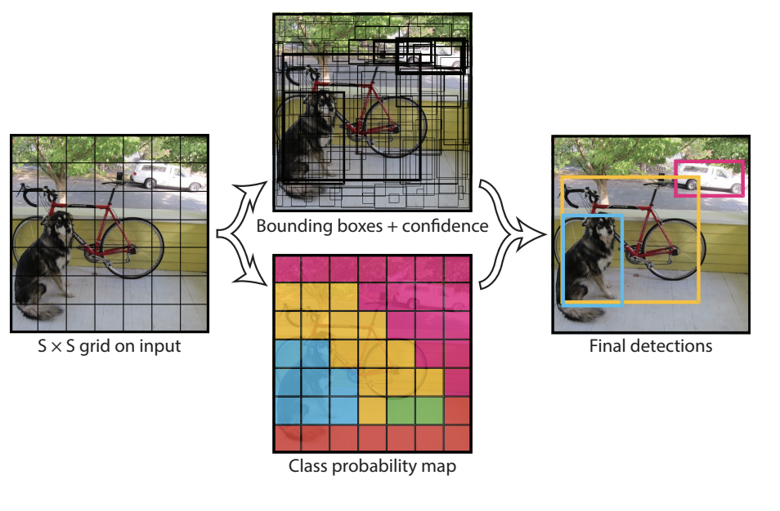
YOLO: You Only Look Once
An order of magnitude faster…

Slide 100
Learning for Action
Starting with Reinforcement Learning

Slide 101
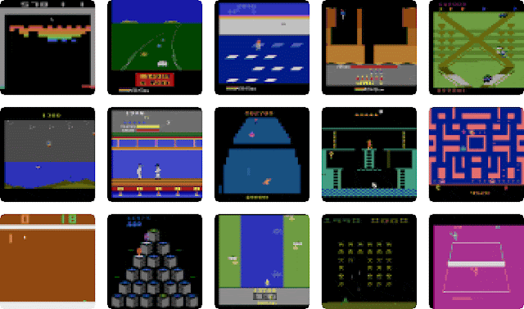
Let’s play Atari games!
We have some very high-dimensional input for some applications.

Slide 102
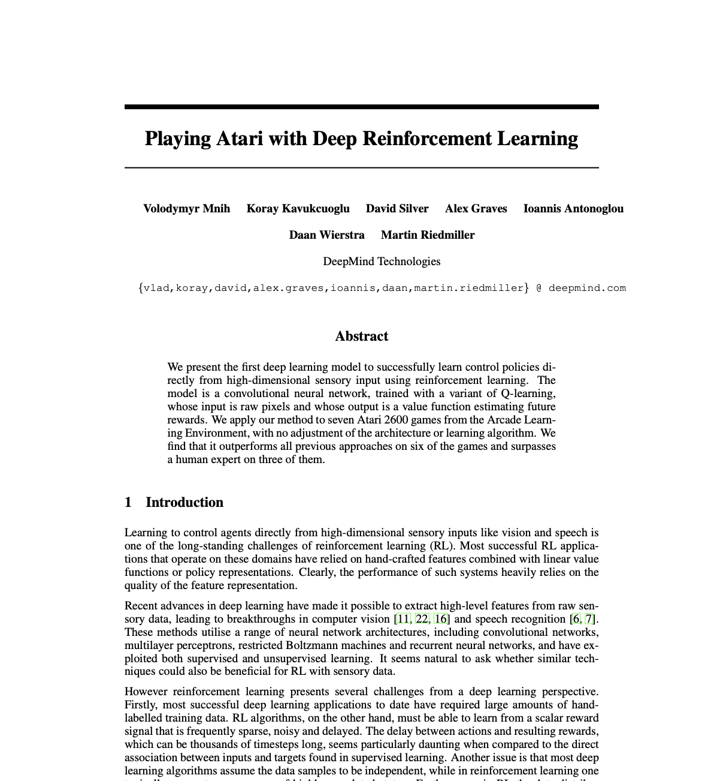
Deep Q Networks

Slide 103
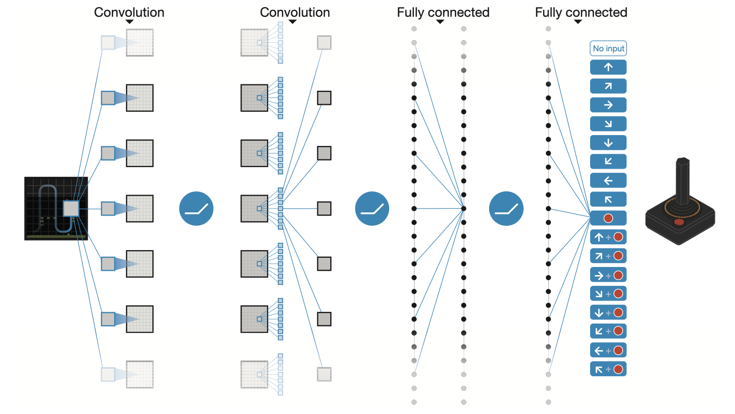
From pixels to action

Slide 104
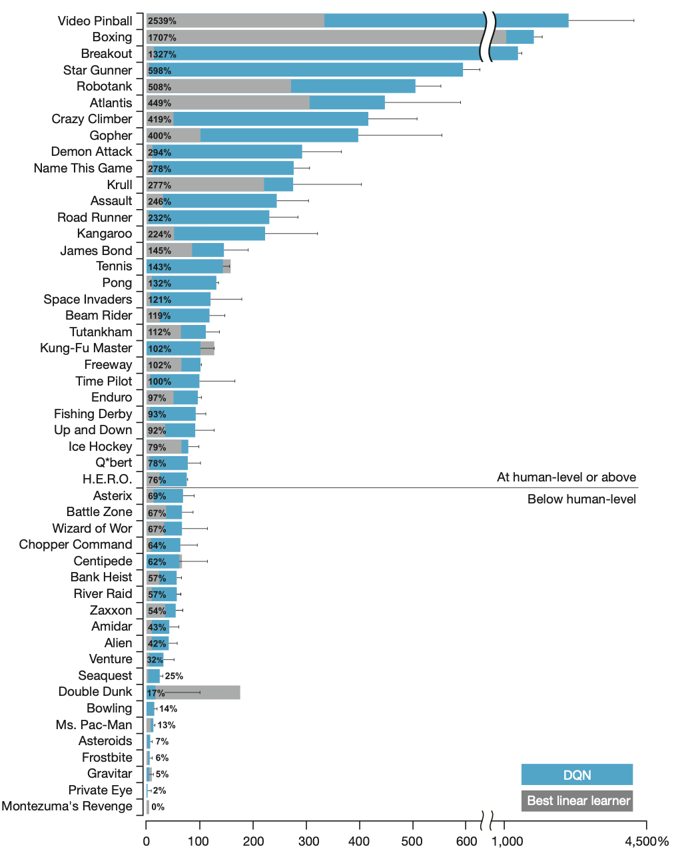
They outperformed humans on most games

Slide 105
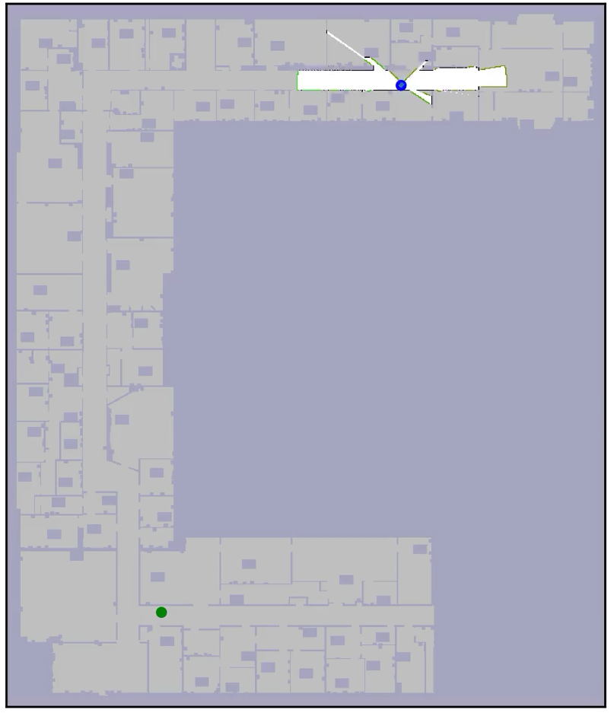
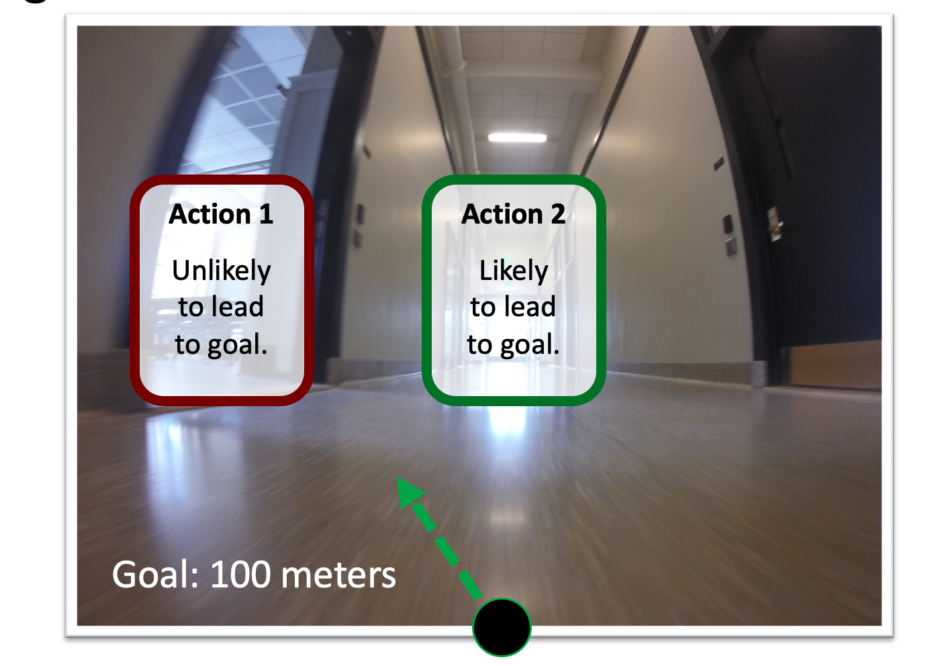
Learning over Subgoals Planning
Robot thinks with “high-level actions”
Robot learns to identify features that lead to dead ends and avoid them.
Start
Goal
Notes:
[SLIDE] (the results from my work show the effectiveness of this idea) “In my work, changing the way a robotic agent thinks about how it will interact with the world and (equally importantly) what the outcomes of its actions will be, allows us to make intelligent decisions (even when much of the world is not known to us).”

Slide 106
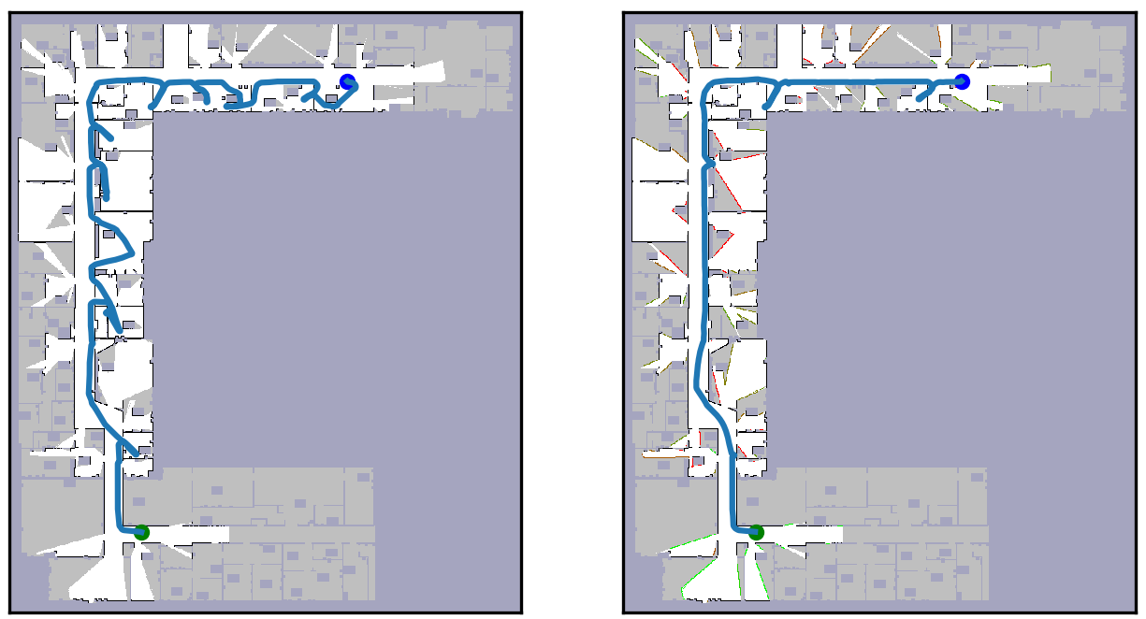
Outperform the optimistic planner MIT floorplan environments
Optimistic Planner
Distance: 175 meters
Learned Subgoal Planner
Distance: 115 meters

Slide 107
Learning for Grasping
We want to pick stuff up reliably. What’s hard about that?

Slide 108
Learning for Grasping
We want to pick stuff up reliably. What’s hard about that?
Motion planning? Well not really, we know how to do that.

Slide 109
Learning for Grasping
We want to pick stuff up reliably. What’s hard about that?
Motion planning? Well not really, we know how to do that.
Actually, it’s pretty challenging to know where to grasp an object to pick it up reliably.
What should we do about that?

Slide 110
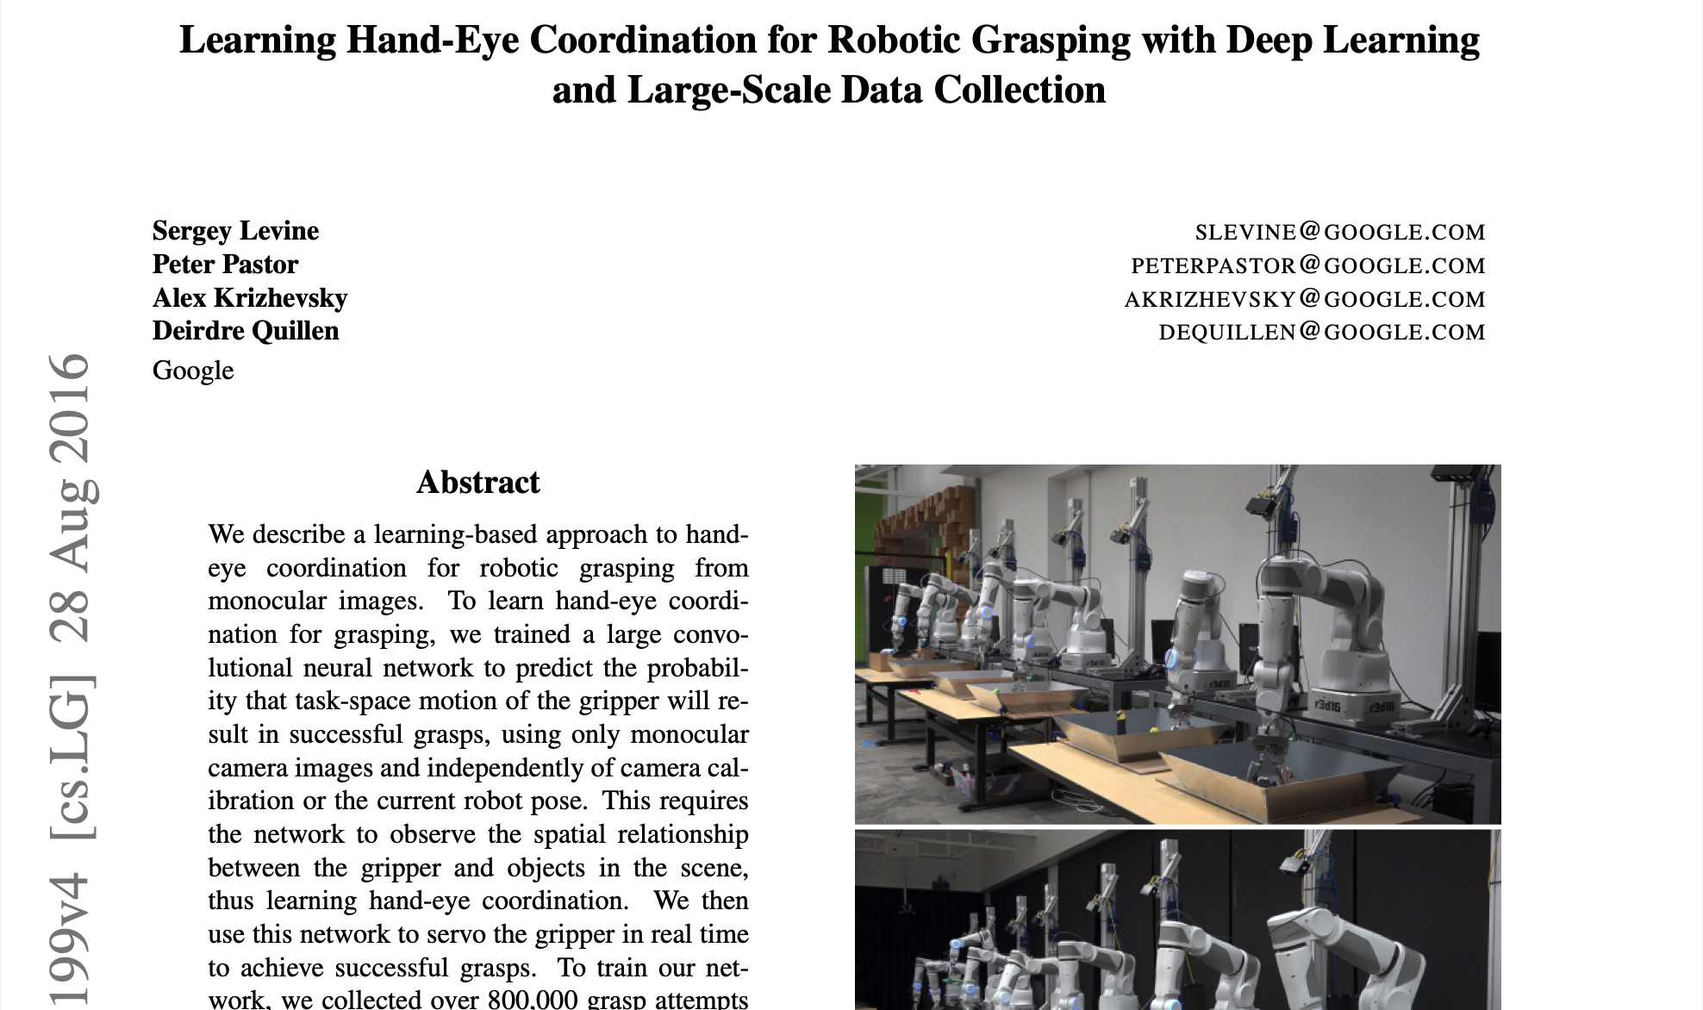
Let’s try: Grasping
We want to pick stuff up reliably. What’s hard about that?
Motion planning? Well not really, we know how to do that.
Actually, it’s pretty challenging to know where to grasp an object to pick it up reliably.
What should we do about that?
LET’S GET A TON OF DATA

Slide 111
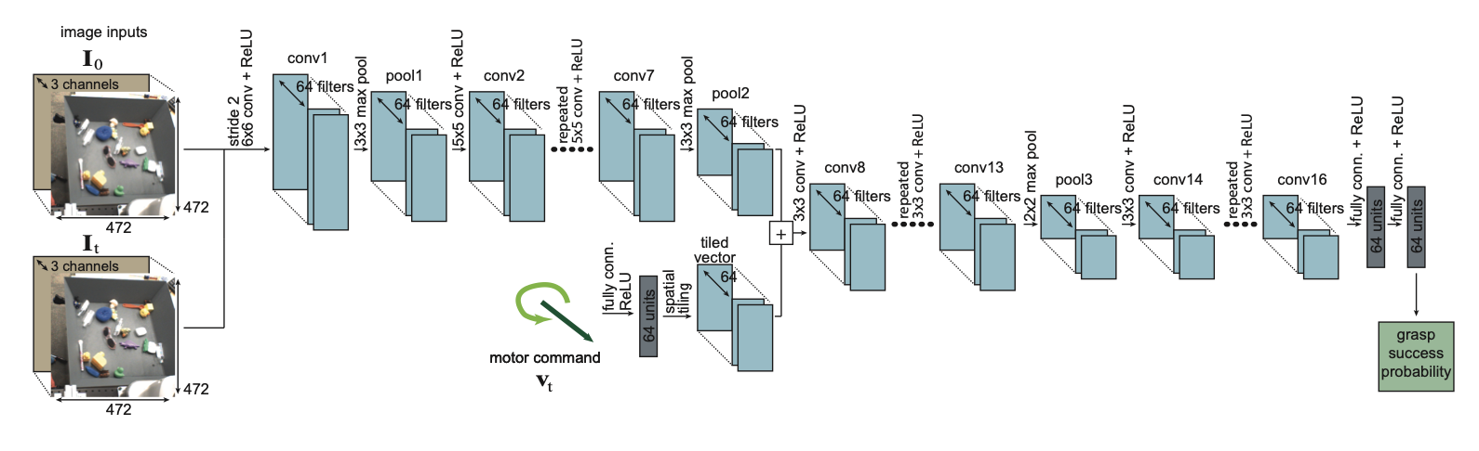
Let’s try: Grasping
We want to pick stuff up reliably. What’s hard about that?
Motion planning? Well not really, we know how to do that.
Actually, it’s pretty challenging to know where to grasp an object to pick it up reliably.
What should we do about that?
LET’S GET A TON OF DATA
LET’S USE A NEURAL NET

Slide 112
To wrap up: learning is not “the answer”
It’s a tool, to be used when appropriate
Deep RL can be quite brittle and fail in unexpected ways.
Learning is a great strategy for overcoming limitations in our ability to write down relationships between quantities we care about (e.g., sensors and actions), but it may not always be wise to eliminate what we know about how the world works altogether.
Notes:
`

