Slide 1
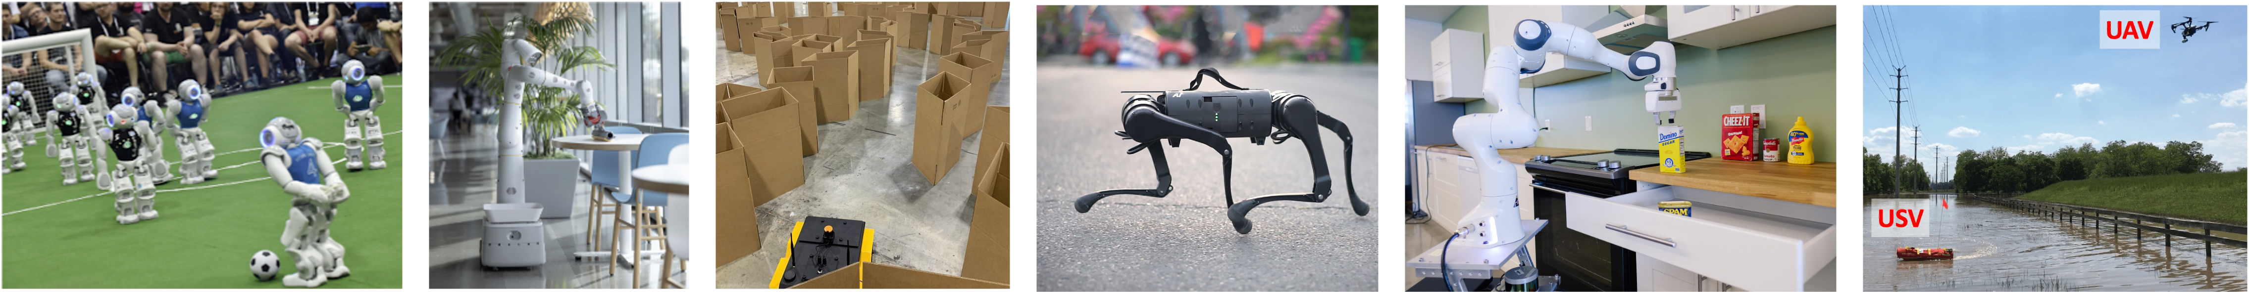
CS 485 Autonomous Robotics
Motion Planning IV
Prof. Xuesu Xiao
George Mason University
Slides Credits: Gregory Stein

Slide 2
Logistics
Assignment 2 is out, which is due in three weeks
Midterm in two weeks
  October 3 or October 6?
Fall break
  No class on October 10
The BARN Challenge
  Fully understand the default move_base stack
  Start implementing your own
Open-Ended Project
  Proposal Presentation in the week of October 9

Slide 3
Vehicle Dynamics &
Motion Primitives

Slide 4
We talked about how to build C-space.
How do we plan with it?

Slide 5
We talked about how to build C-space.
How do we plan with it?
There were a number of approaches we talked about that will still work here!
Discretization (into a grid)
Voronoi decomposition (not great in high-dimensions)
Visibility graph planning (also not great in High-D)

Slide 6
We talked about how to build C-space.
How do we plan with it?
We’ve been so focused on building configuration space that we haven’t really defined how planning will work yet…
We could discretize the space, but that’s non-ideal for a few reasons: what were the problems with discretizing continuous space (e.g., grid-based planning)?

Slide 7
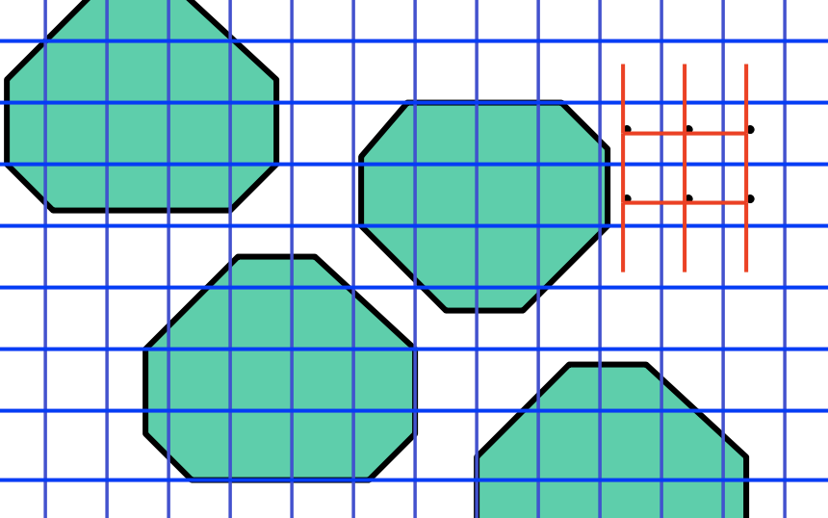
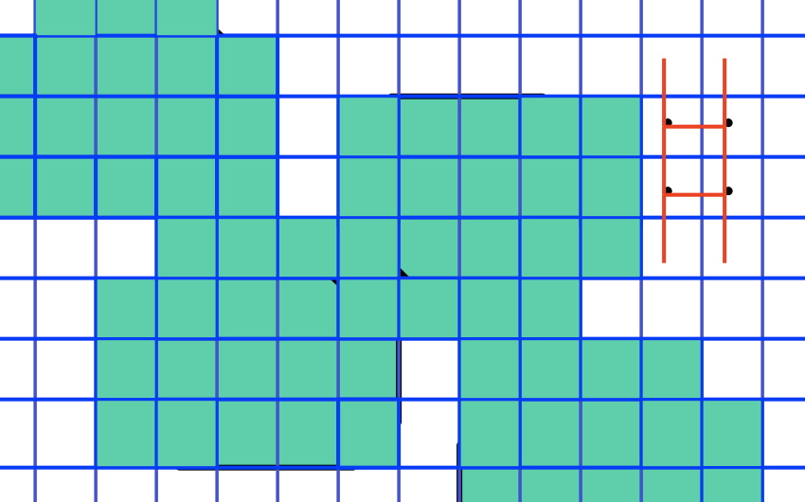
Remember this?
But turning a continuous space into a grid, you must trade off between a very small resolution (and high computational cost) or a big resolution (and miss closing off paths):
This approach is therefore not complete in general!
Image from: MIT 16.410

Slide 8
What were the problems with discretizing continuous space (e.g., grid-based planning)?
Not complete in general
Can be expensive if we make the grid cells very small to handle tight passages. Also expensive in high dimensions.

Slide 9
What were the problems with discretizing continuous space (e.g., grid-based planning)?
Not complete in general
Can be expensive if we make the grid cells very small to handle tight passages. Also expensive in high dimensions.
Also: what about vehicle dynamics (again)?
You can’t simply move along the x-direction.
The car is limited in how it can move through C-space.

Slide 10
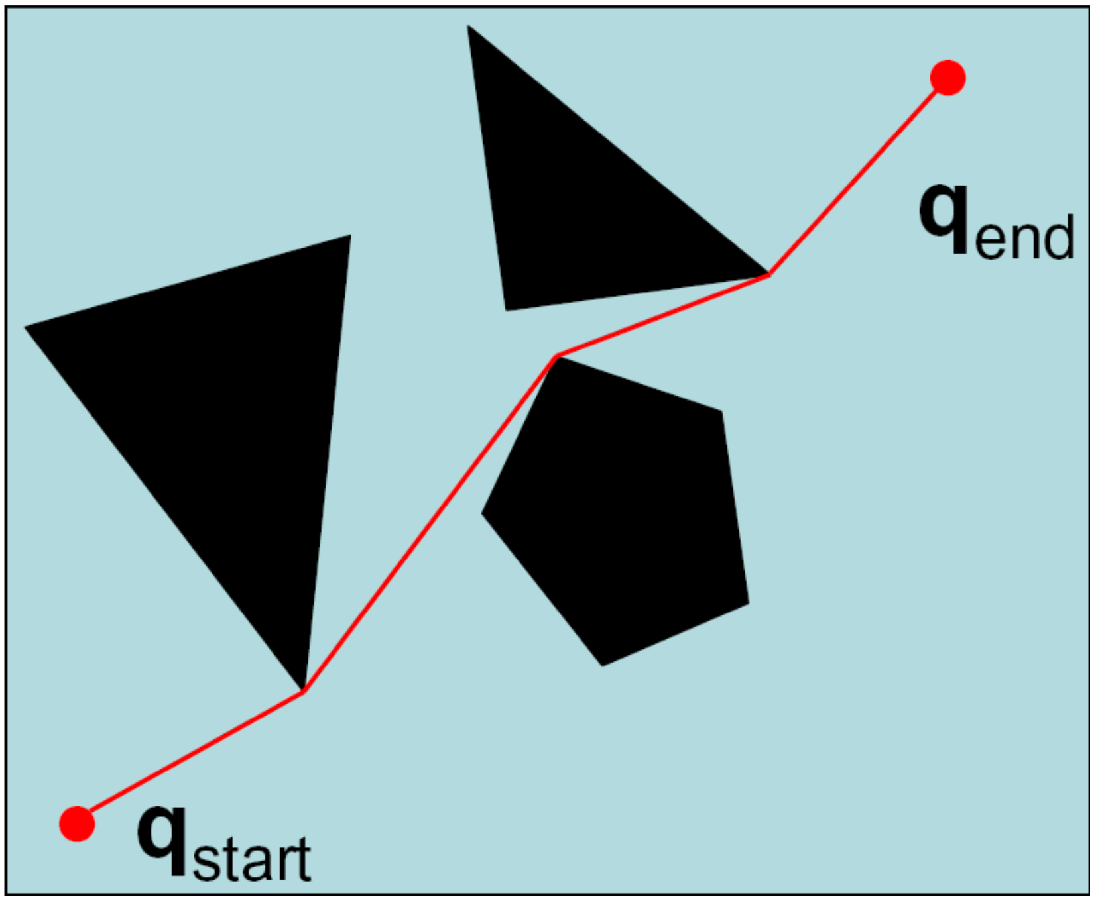
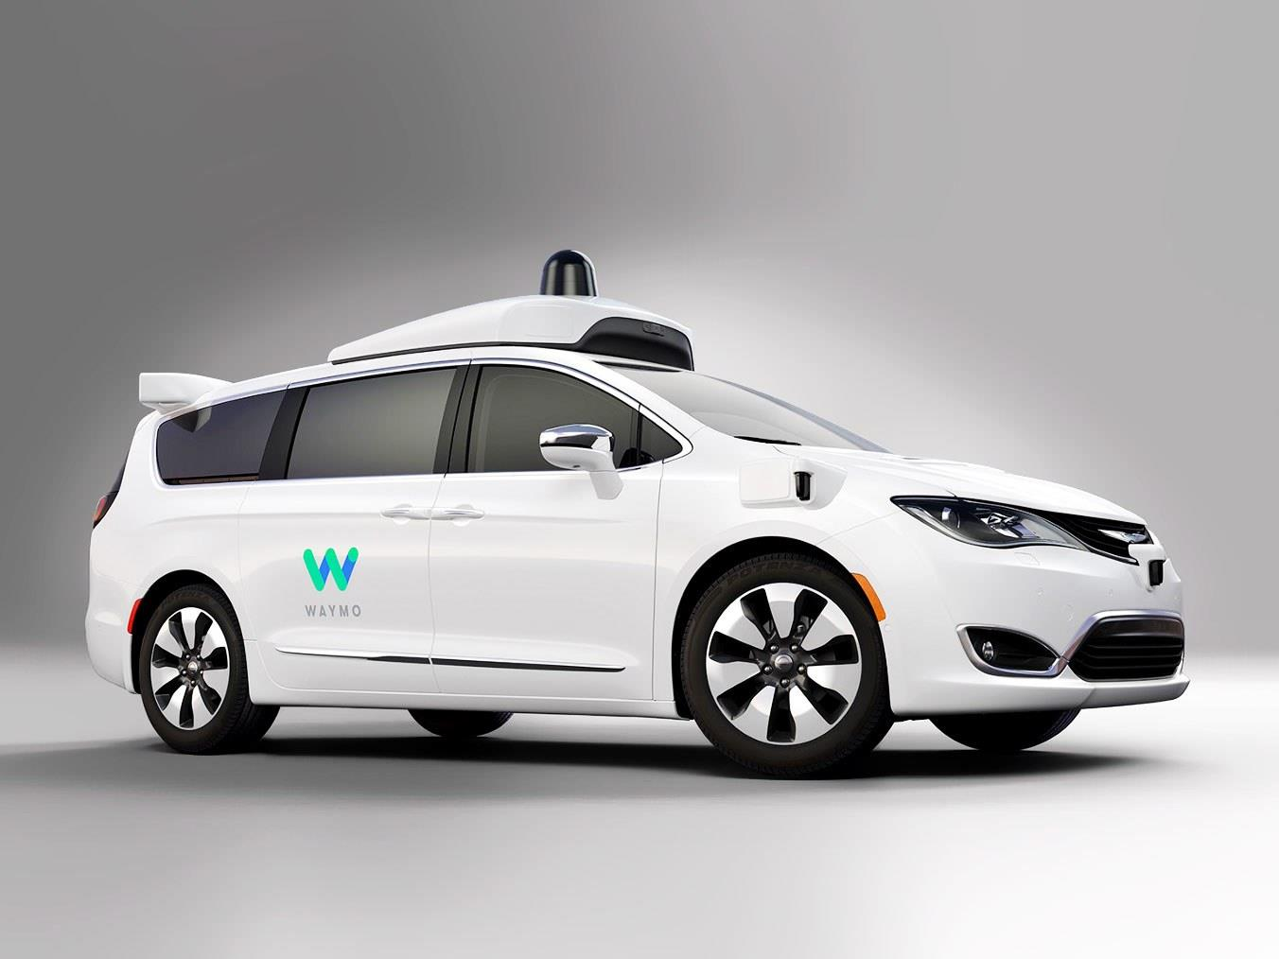
Recap: There are some limitations of our planning abstractions or representations thus far
If I’m a self-driving car, can I follow this path?
No! Why not?
Size: The vehicle cannot get infinitesimally close to objects.
Dynamics: The vehicle has a finite turning radius.

Slide 11
Recap: There are some limitations of our planning abstractions or representations thus far
If I’m a self-driving car, can I follow this path?
No! Why not?
Size: The vehicle cannot get infinitesimally close to objects.
Dynamics: The vehicle has a finite turning radius.

Slide 12
Recap: There are some limitations of our planning abstractions or representations thus far
If I’m a self-driving car, can I follow this path?
No! Why not?
Size: The vehicle cannot get infinitesimally close to objects.
Dynamics: The vehicle has a finite turning radius.
Planning Time: I might have a hard time planning in a reasonable amount of time

Slide 13
We have established that there are advantages of planning in continuous space
We can recover the optimal action, something that’s not possible when planning in discrete space.
However, planning in continuous space is incredibly difficult because we have an infinite number of possible trajectories…

Slide 14
Different planning modalities
Grid-based planning
  discrete states, discrete actions
“Continuous-space Planning” (we still haven’t really defined this)
  continuous states, continuous actions
Hypothesis: What if instead the robot could take discrete actions, but these actions still happened in continuous space?

Slide 15
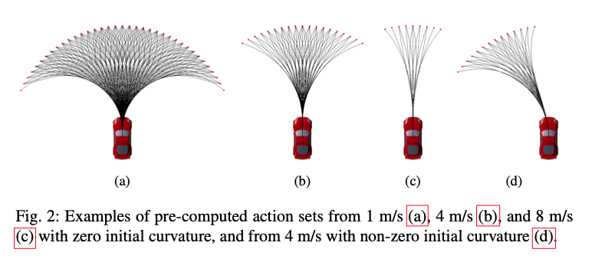
Motion Primitives: discrete actions that happen in continuous space
Let’s pretend that the actions available to the robot are discrete.

Slide 16
Where do motion primitives come from?
It very much depends on the scenario.
Some robots are pretty simple: e.g., a point robot that can move in every direction. Basically what we’ve been doing already.
Some are more complicated: e.g., a Dubins Car, a car, or a “snake-like robot” with multiple links.

Slide 17
Where do motion primitives come from?
Dubins Car: a car that can go forward, turn “all the way left” or ”all the way right” with some fixed turning radius.

Slide 18
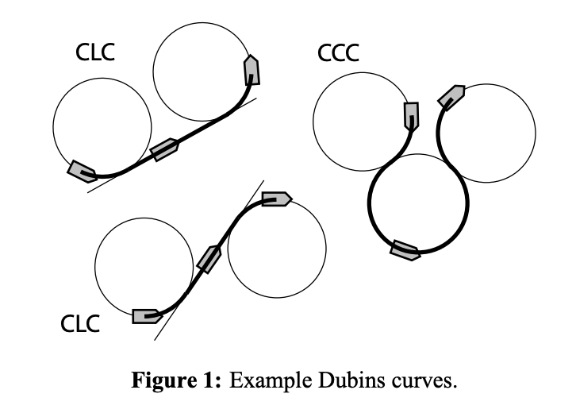
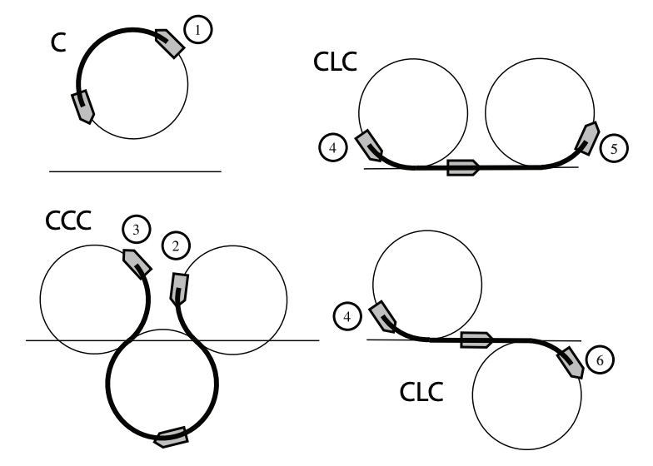
Where do motion primitives come from?
Dubins Car: a car that can go forward, turn “all the way left” or ”all the way right” with some fixed turning radius.
”Dubins curves are also the fastest trajectories for a simple model of a steered car that moves with unit velocity.”
From: https://rlab.cs.dartmouth.edu/publications/Furtuna2010.pdf

Slide 19
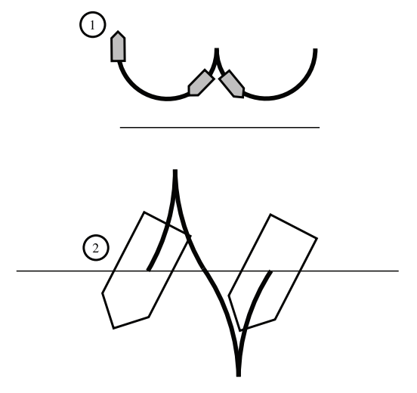
Where do motion primitives come from?
Reeds-Shepp Car: a Dubins car that can also go backwards.
From: https://rlab.cs.dartmouth.edu/publications/Furtuna2010.pdf

Slide 20
Other models may consider how max turning radius changes with speed.

Slide 21
Motion Primitives: discrete actions that happen in continuous space
Let’s pretend that the actions available to the robot are discrete. What can we do with these?

Slide 22
Monte-Carlo Methods

Slide 23
Let’s say you wanted to compute the area of a circle…
But you can’t use calculus or equations you know?
How might you do this?

Slide 24
Let’s say you wanted to compute the area of a circle…
But you can’t use calculus or equations you know?
How might you do this?
Polygonal approximation? Try to bound the area by drawing regular polygons inside and outside the circle?
Geometry? Draw some triangles over the surface

Slide 25

Let’s say you wanted to compute the area of a circle…
What if you printed out the shape and threw a dart at it?
If you aim is totally random, what’s the probability you’re inside the square, but not the circle?
Image Credit

Slide 26
Let’s say you wanted to compute the area of a circle…
What if you printed out the shape and threw a dart at it?
If you aim is totally random, what’s the probability you’re inside the square, but not the circle?
P = 1 - A_{circle} / A_{square}
Image Credit

Slide 27
Monte Carlo Sampling: throwing darts
Idea: we throw a lot of darts and the number that are inside the circle will tell us what its area is.

Slide 28
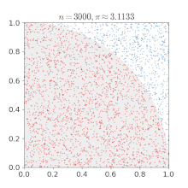
Monte Carlo Sampling: throwing darts
Idea: we throw a lot of darts and the number that are inside the circle will tell us what it’s area is.
As we get more samples, our approximation gets better.
In many cases, this can be way faster than trying to get an exact solution.
Image: Wikipedia

Slide 29
So-called “Monte Carlo Methods” or “Random Sampling” will come up again
It’s a very useful technique: often fast to get a “good enough” solution for a lot of problems where the “exact” solution is expensive and hard to derive.
Applications:
Numerical integration (very useful in high dimensions)
Sampling from probability distributions (Markov Chain Monte Carlo [MCMC] methods)
Game-playing (will come up again later on)
Motion Planning (today)

Slide 30
Sampling-Based Motion Planning
With multiple slides from P. Abbeel’s CS287 (Berkeley), papers, and S. LaValle’s textbook.

Slide 31
So if we don’t want to do search how are we going to plan (using randomness)?
Simply expanding the set of motion primitives was pretty inefficient.
For now, let’s ignore vehicle dynamics: they’ll come back later, but it will be helpful for the time being if we don’t have to “worry” about them.
We also still have full knowledge of the state of the world. This means we can easily tell when the vehicle collides with obstacles in the world.

Slide 32
Planning with random sampling
In MC sampling, we used randomness to our advantage to avoid needing to solve the problem exactly and exhaustively.
What are our options?
We could try just picking some random actions, but that’s not particularly intelligent.

Slide 33
Planning with random sampling
In MC sampling, we used randomness to our advantage to avoid needing to solve the problem exactly and exhaustively.
What are our options?
We could try just picking some random actions, but that’s not particularly intelligent.
What about using randomness to build a roadmap?

Slide 34
The Probabilistic Roadmap (PRM)
Let’s try that: use randomness to build a roadmap.
General procedure:
Pick a bunch of random points (e.g., uniformly across your domain)
Add visibility connections between those points: if we can travel directly between two of these, add an edge
The points and edges make up a roadmap, which we can then use for planning

Slide 35
The Probabilistic Roadmap (PRM)

Slide 36
The Probabilistic Roadmap (PRM)

Slide 37
The Probabilistic Roadmap (PRM)

Slide 38
The Probabilistic Roadmap (PRM)

Slide 39
The Probabilistic Roadmap (PRM)

Slide 40
The Probabilistic Roadmap (PRM)

Slide 41
The Probabilistic Roadmap (PRM)

Slide 42
The Probabilistic Roadmap (PRM)

Slide 43
The Probabilistic Roadmap (PRM)

Slide 44
The Probabilistic Roadmap (PRM)

Slide 45
Conceptual Question: is PRM…
Complete?
Optimal?

Slide 46
Conceptual Question: is PRM…
Complete?
Optimal?
It’s somewhat complicated: if we only have a finite number of points, it’s neither complete nor optimal.
What about if we had infinite points?

Slide 47
Conceptual Question: is PRM…
Complete?
Optimal?
It’s somewhat complicated: if we only have a finite number of points, it’s neither complete nor optimal.
What about if we had infinite points? We say that PRM is asymptotically optimal: as we approach infinite samples, the algorithm becomes complete and optimal.

Slide 48
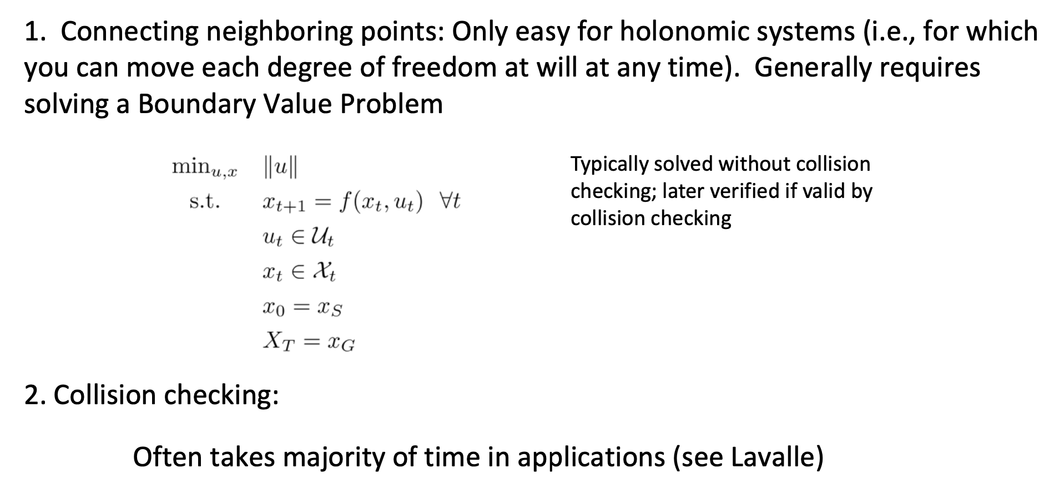
Limitations of the PRM: What if we were to add back dynamics? What about computation?

Slide 49
Plain PRM isn’t always a great choice, since you have to know too much in advance
The computation of the PRM happens in advance: we first pick all the points and compute the graph.
What if we don’t find a path between the start and goal?

Slide 50
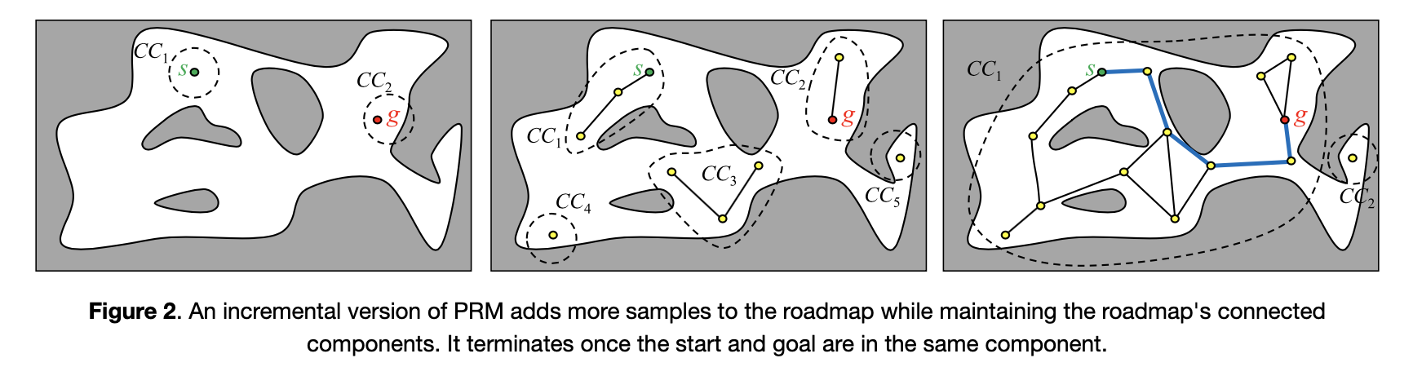
Plain PRM isn’t always a great choice, since you have to know too much in advance
The computation of the PRM happens in advance: we first pick all the points and compute the graph.
What if we don’t find a path between the start and goal? How about incremental PRM.
From: Kris Hauser’s Robotic Systems textbook

Slide 51
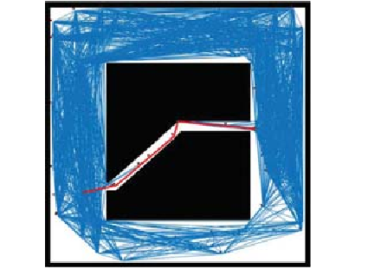
Also, there’s lots to consider when sampling!
How do we decide where to sample points? Uniform sampling may be pretty inefficient. Some places need more samples than others; how do we pick these?
Narrow passages are notoriously hard.

Slide 52
Also, there’s lots to consider when sampling!
Critically: many of the points we sample may not be useful to us.
They could be only connected in a small group and perhaps the robot can’t reach them (or will quickly realize that it doesn’t need to care about a region that’s very far away).

Slide 53
Also, there’s lots to consider when sampling!
Critically: many of the points we sample may not be useful to us.
They could be only connected in a small group and perhaps the robot can’t reach them (or will quickly realize that it doesn’t need to care about a region that’s very far away).
Instead, we can use Rapidly exploring Random Trees another foundational approach that addresses some of these issues.

Slide 54
Random Trees
Building a tree out from a start point
Rather than building an entire graph (as in the PRM), we can build a tree instead.
Why? Think about search: we built a tree and expanded it when we needed to in an effort to reach the goal.
Idea: we start from the start point and randomly add new actions to that tree. But wait, I thought we already agreed that wasn’t a great idea…

Slide 55
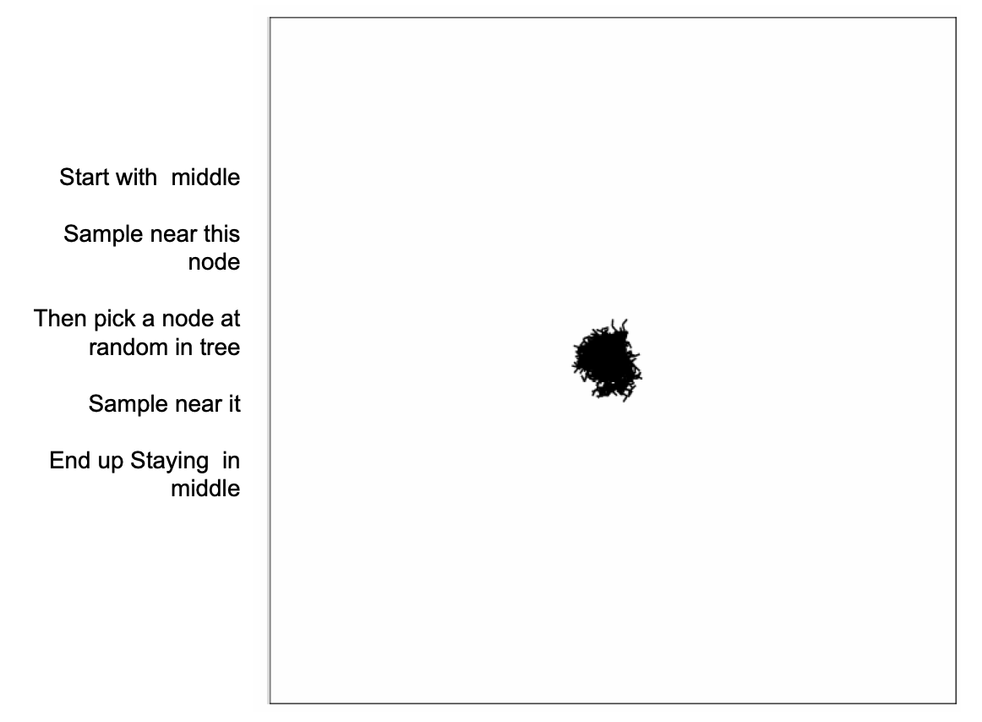
Random Trees
Building a tree out from a start point
Naïve approach:

Slide 56
Random Trees
Building a tree out from a start point
Rather than building an entire graph (as in the PRM), we can build a tree instead.
Why? Think about search: we built a tree and expanded it when we needed to in an effort to reach the goal.
Idea: we start from the start point and randomly add new actions to that tree in some clever way that avoids adding a ton of nodes we don’t need.
So what is this cleverness?

Slide 57
Rapidly exploring Random Trees (RRT)
Building a tree out from a start point
Idea:
We have a tree and want to add a new branch to the tree.
We pick a random point we’d like to navigate towards.
We find the point in the tree that’s closest to that point already and move “1 unit” towards that point.

Slide 58
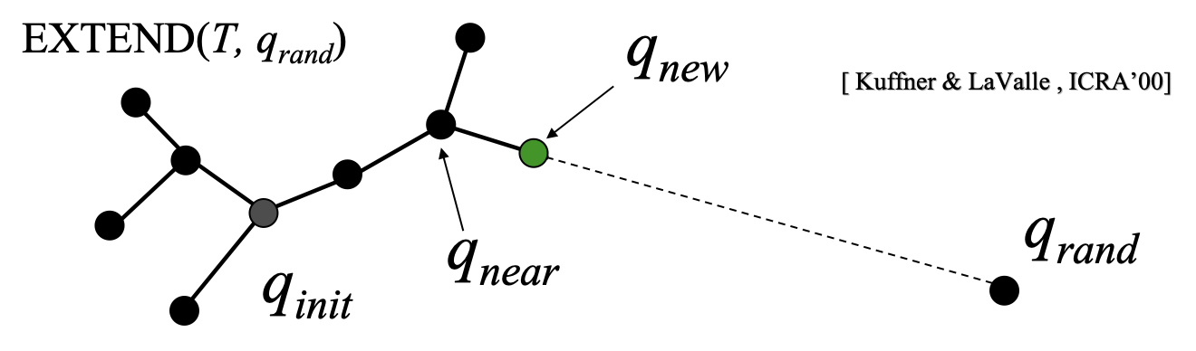
Rapidly exploring Random Trees (RRT)
Building a tree out from a start point
Idea:
We have a tree and want to add a new branch to the tree.
We pick a random point we’d like to navigate towards.
We find the point in the tree that’s closest to that point already and move “1 unit” towards that point. [Computed via the “EXTEND” function (also, more recently, known as the “steer” function)]

Slide 59
What is the significance of “EXTEND/steer”?
First, we don’t want to get too far away with a single jump. Having a finite step size means we more slowly build the tree out from the center, rather than having edges jumping across the map, which can be difficult to deal with.
Second, it naturally supports the idea of having vehicle dynamics: we simply compute the control input that best moves the vehicle in the direction of our randomly sampled point. That means that every branch of the tree is automatically dynamically feasible!

Slide 60
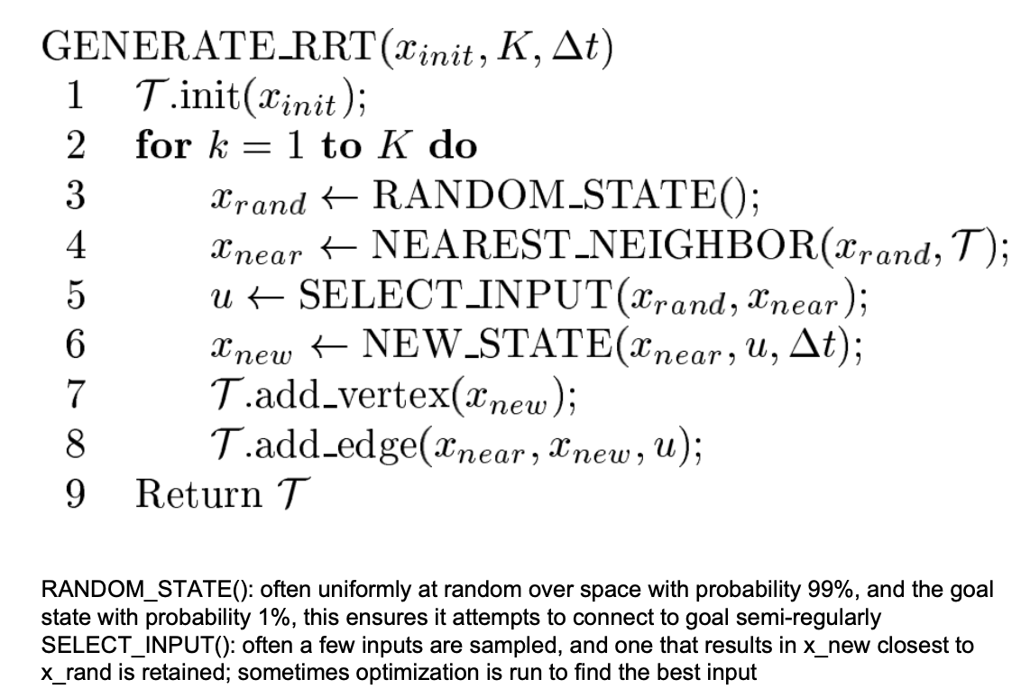
Rapidly exploring Random Trees (RRT)
Algorithm
Together, these lines “steer towards” the random point from the nearest neighbor point.

Slide 61

RRT Visualization [filling all the space]

Slide 62
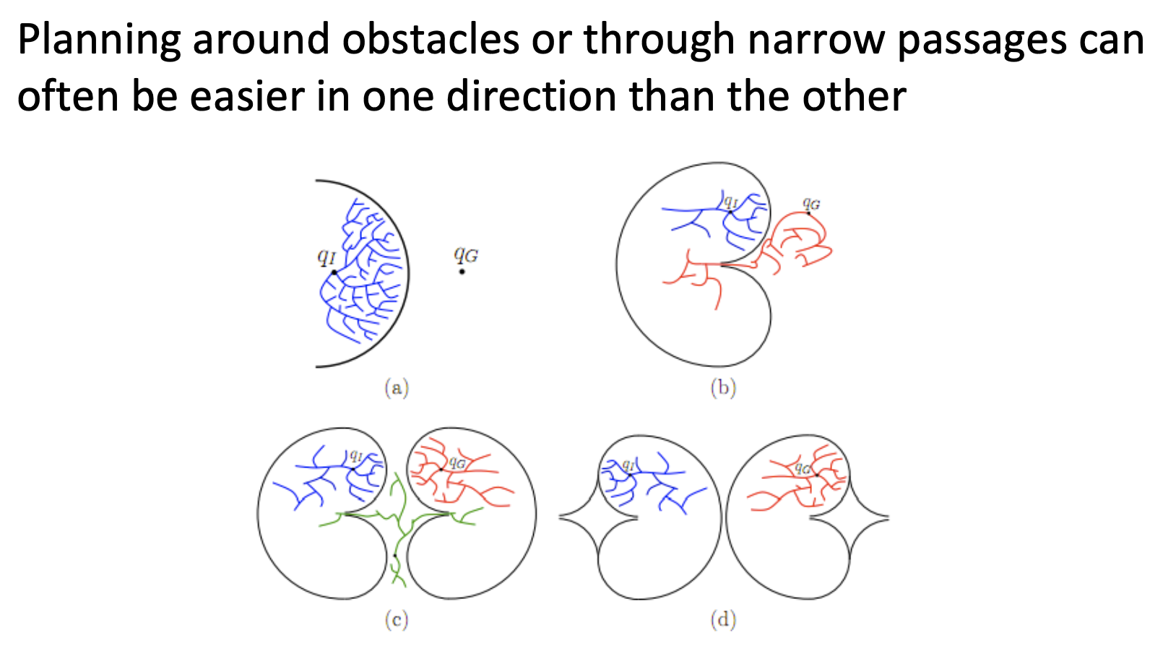
Multi-Directional RRT: build multiple RRTs simultaneously & connect to save cost

Slide 63
RRT Properties
Is it complete?

Slide 64
RRT Properties
Is it complete? Yes!

Slide 65
RRT Properties
Is it complete? Yes!
Is it optimal?

Slide 66
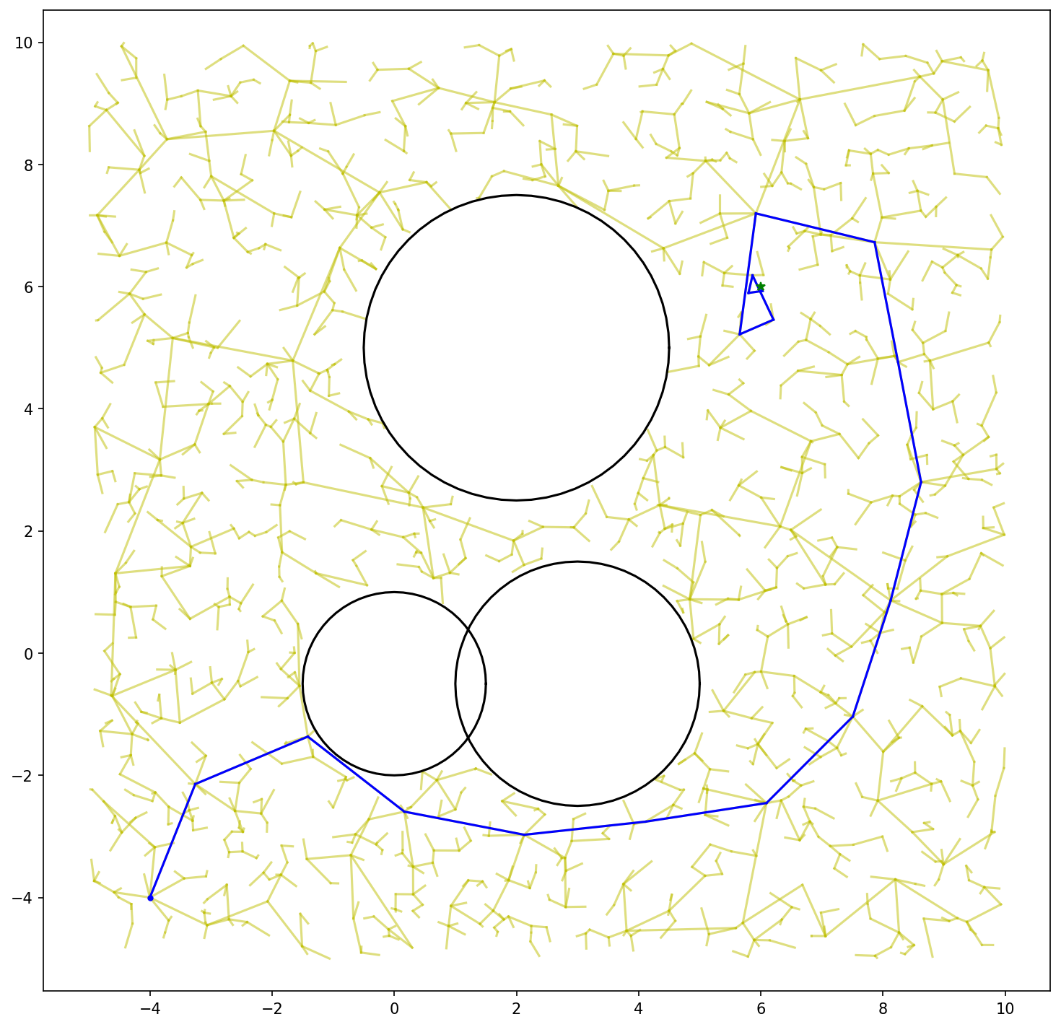
RRT Properties
Is it complete? Yes!
Is it optimal? No

Slide 67
RRT is provably not asymptotically optimal
So what happened…?
Whenever we add new points, we extend old branches but we never look for new ways to reach the same point that might have been shorter!
Think of when we tried to add a visited list to A*, if we add points too early, we risk missing out on shorter paths.

Slide 68
RRT is provably not asymptotically optimal
So what happened…?
Whenever we add new points, we extend old branches but we never look for new ways to reach the same point that might have been shorter!
Think of when we tried to add a visited list to A*, if we add points too early, we risk missing out on shorter paths.
This gap will never be closed

Slide 69
How do we “fix” RRT
We need some way of looking for shortcuts.
Whenever we add new points, we should check if that new point allows us to reach other points sooner.

Slide 70
How do we “fix” RRT
We need some way of looking for shortcuts.
Whenever we add new points, we should check if that new point allows us to reach other points sooner.
We add a new point: look at each nearby point. If the route through the new point to the nearby point is shorter than the old path, change the “root” of the nearby point to the new point and update cost

Slide 71
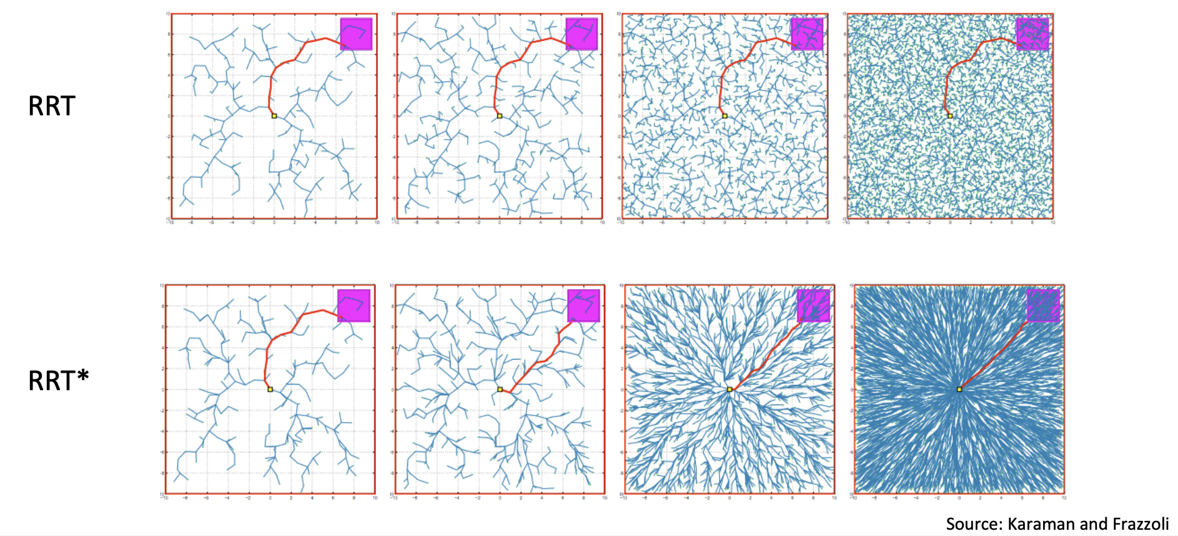
RRT* : RRT + Path Improvements
[It’s asymptotically optimal!]

Slide 72
RRT* : RRT + Path Improvements
[It’s asymptotically optimal!]

Slide 73
RRT* : RRT + Path Improvements
[It’s asymptotically optimal!]

Slide 74
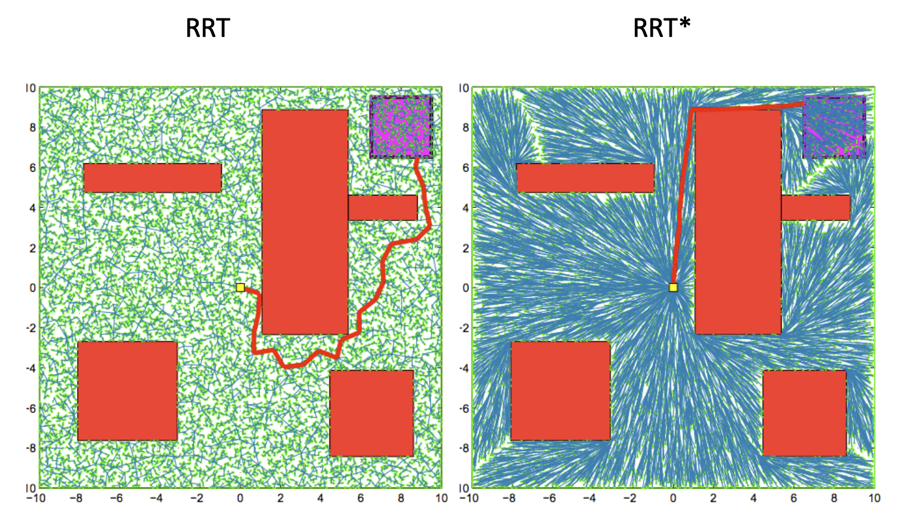
RRT* : RRT + Path Improvements
[It’s asymptotically optimal!]

Slide 75
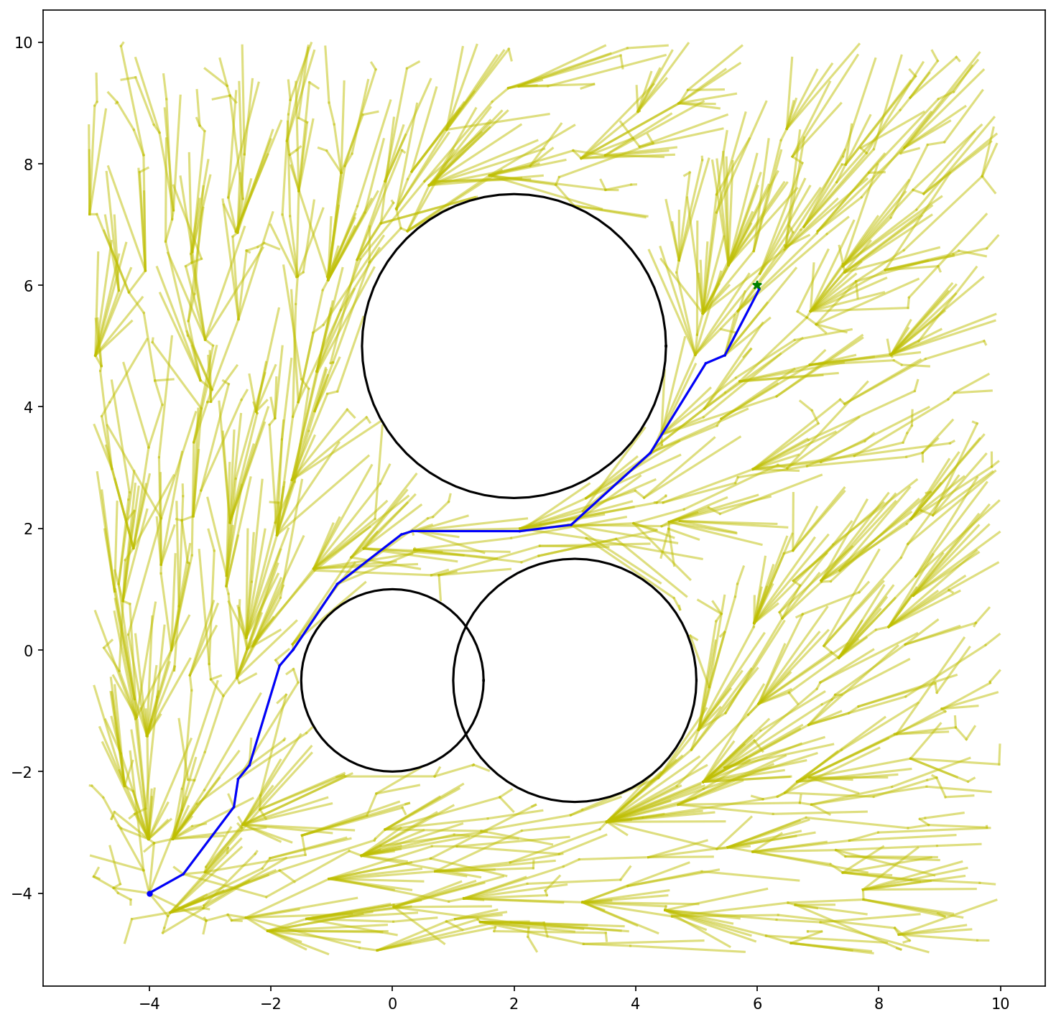
RRT* : RRT + Path Improvements

Slide 76
There are still some other considerations when using RRT* to plan
First, what about dynamics? How do we make sure our plans are still dynamically feasible if we are constantly changing the graph?

Slide 77
There are still some other considerations when using RRT* to plan
First, what about dynamics? How do we make sure our plans are still dynamically feasible if we are constantly changing the graph?
Second, how should we sample? There is interesting work in strategies to get out of “traps” and through narrow passages.

Slide 78
There are still some other considerations when using RRT* to plan
First, what about dynamics? How do we make sure our plans are still dynamically feasible if we are constantly changing the graph?
Second, how should we sample? There is interesting work in strategies to get out of “traps” and through narrow passages.
Also: when should we stop sampling? Not a clear-cut answer…

Slide 79
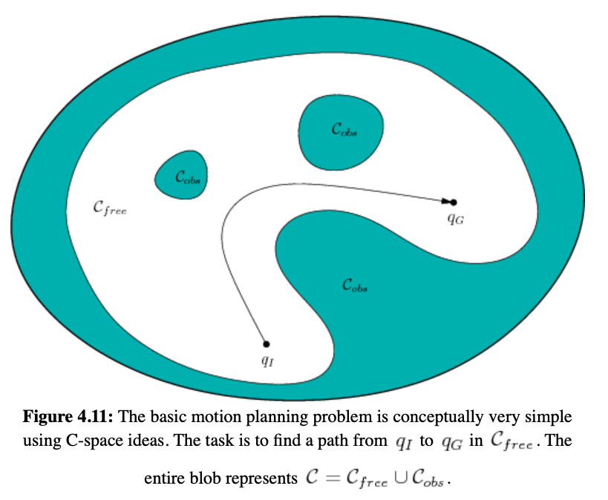
Optimization for (local) trajectory planning with constraints
Task: travel from a start region to a goal region while (1) satisfying differential constraints and (2) avoiding obstacles.
Remember: the start and goal are in C-space; may include orientation.
We can run this to decide whether it is possible to “travel” in C-space through two points after an RRT* update.

Slide 80
There are still some other considerations when using RRT* to plan
First, what about dynamics? How do we make sure our plans are still dynamically feasible if we are constantly changing the graph? Constraint-based optimization
Also, the trajectories we get are somewhat … jagged. Can we do anything about that?

Slide 81
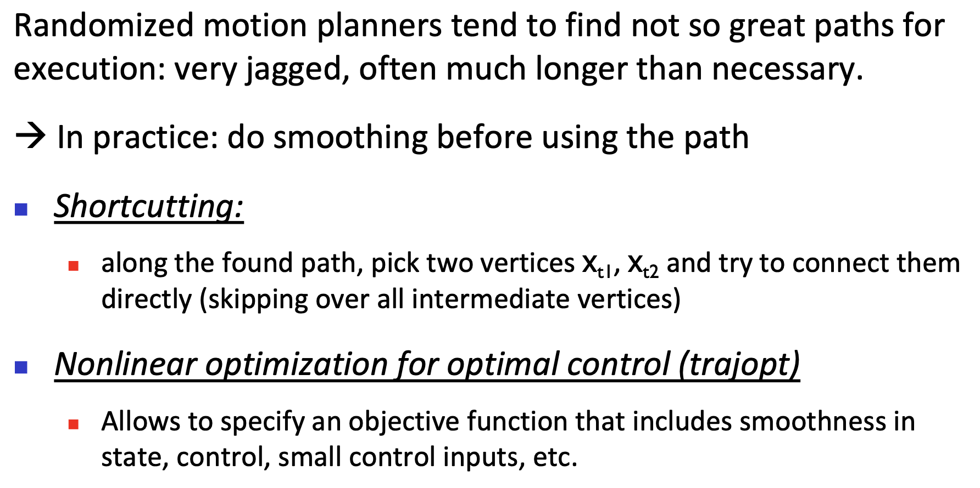
There are still some other considerations when using RRT* to plan

Slide 82
Different Classes of Motion Planners
Sampling-based Planner
  PRM (and its variants)
  RRT (and its variants)
  DWA (the base local planner of move_base used in The BARN Challenge!)
Trajectory Optimization
  E-BAND (and its variants)
  CHOMP
  STOMP
Artificial Potential Field

Slide 83
We have briefly addressed the 1st robot capability: motion control and planning
You already have everything you need for The BARN Challenge!
move_base
  Global Planner (Dijkstra’s, A*)
  Local Planner (DWA, E-BAND, TEB)
What do you want to do for your project?
  You can implement a new planner, e.g., PRM for global planning and RRT for local planning
  You can improve upon an existing motion planner
  You can develop your own motion planner (classical? Learning-based?)
We will move on to other robot capabilities next week!

