Slide 1
CS 485 Autonomous Robotics Introduction to Probabilistic Robotics II
Prof. Xuesu Xiao
George Mason University
Slides Credits: Gregory Stein

Slide 2
Logistics Notes
BARN Challenge submission due tonight at midnight
Submit your GitHub link via email
Follow the BARN Challenge Instructions for evaluation
BARN Challenge presentation next Tuesday
5 minutes each team
Show some simulation results of the Jackal navigating BARN environments
What you have done for the BARN Challenge?
What have you learned from the BARN Challege?

Slide 3
Logistic Notes
Open-Ended project proposal presentation next Thursday
(Talk to me if you are interested in the Raytheon competition)
5-10 minutes each team
Please cover the following information:
What problem are you trying to solve?
Why it is worth solving?
What are the possible approaches?
What approach are you taking and why it is appropriate?
What is your deliverables?
What is your timeline?

Slide 4
So far, everything has been discrete

Slide 5
So far, everything has been discrete …but the math generalizes to continuous
The Kalman Filter: continuous (gaussian) filtering

Slide 6
Think of our 2D Motion + GPS example from earlier
How do we compute the “uncertainty” on each?

Slide 7
Think of our 2D Motion + GPS example from earlier
How do we compute the “uncertainty” on each?
How do we incorporate the GPS observations?

Slide 8
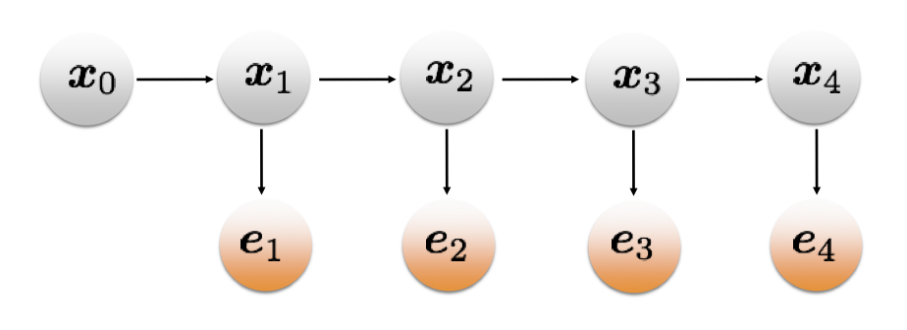
We’ll use a very similar model as in the discrete HMM case
The graphical representation will look pretty much the same:

Slide 9
Let’s start with an example in 1D
My robot moves along the x-axis:

Slide 10
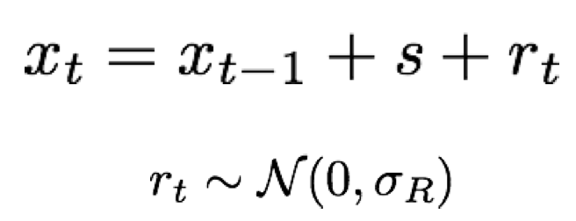
Let’s start with an example in 1D
My robot moves along the x-axis:
It moves by some distance “s” with an added noise “r_{t}”
The noise is gaussian with known covariance.

Slide 11
Let’s start with an example in 1D
My robot moves along the x-axis:
The motion model is therefore as follows:

Slide 12
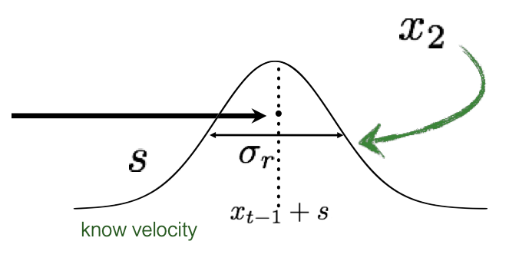
Let’s start with an example in 1D
My robot moves along the x-axis:
The motion model is therefore as follows:

Slide 13
GPS gives us a noisy estimate of the “true” state.
Similar to the previous, its assumed to be gaussian:

Slide 14
We also need a prior
We also assume that to be Gaussian:

Slide 15
Combining all these is pretty straightforward, using our model from before

Slide 16
Combining all these is pretty straightforward, using our model from before
Prediction Step
Update Step

Slide 17
Gaussians in; Gaussians out
First, is the prediction step.
It’s pretty easy to update the state: the mean moves and the noise grows:

Slide 18
Gaussians in; Gaussians out
What about the update step?
It’s slightly more complicated, but still gives us a Gaussian

Slide 19
Gaussians in; Gaussians out
Don’t forget, the product of two Gaussians yields another Gaussian.
The mean and covariance of the new Gaussian:

Slide 20
Applying that Gaussian rule to the Filtering equation gives us the following:

Slide 21
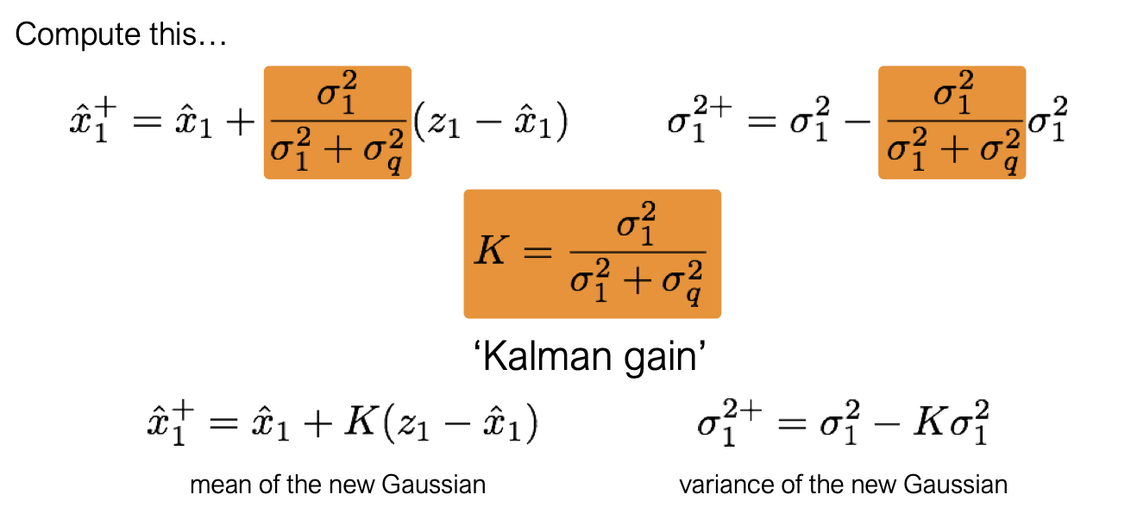
Applying that Gaussian rule to the Filtering equation gives us the following:

Slide 22
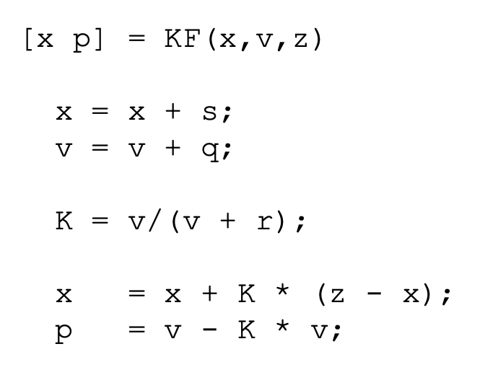
The Kalman Filter Gaussian update equations
It’s just a handful of lines of code

Slide 23
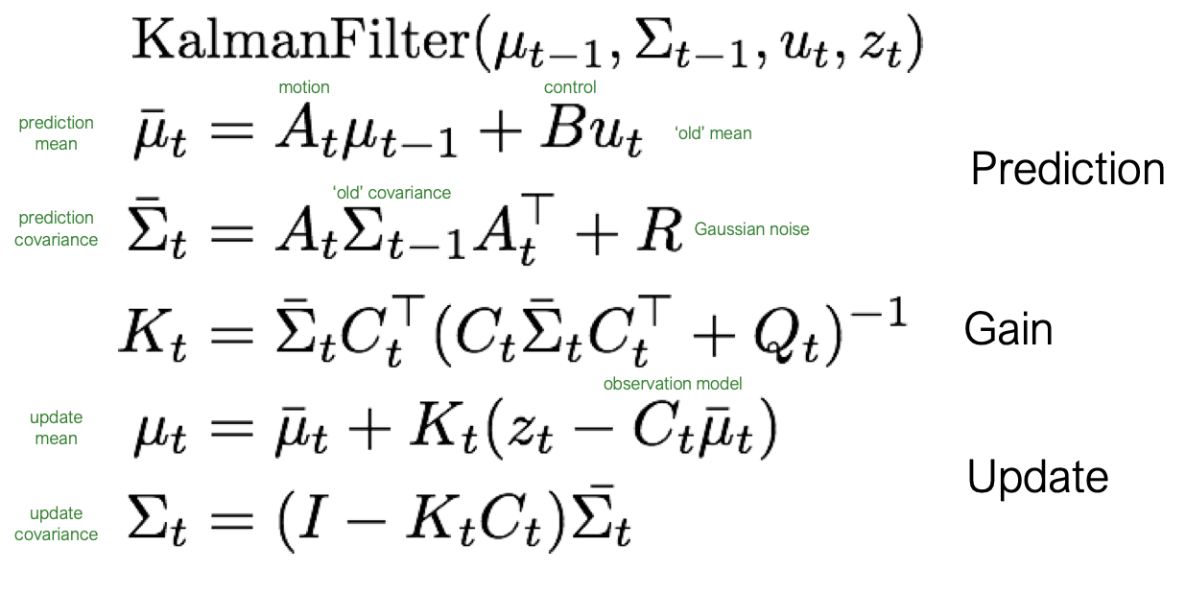
The Kalman Filter Gaussian update equations
Linear Algebra helps us to generalize these concepts:
(Also just a few lines of code)

Slide 24
Let’s revisit our 2D GPS model Does all the behavior make sense?
What are the equations that govern the motion?
Motion Model:
We are given a measurement of the movement “s” at each time step: the dx_noisy and dy_noisy
The noise is known to us: a 0.3 diagonal matrix

Slide 25
Let’s revisit our 2D GPS model Does all the behavior make sense?
What are the equations the govern the motion?
Motion Model:
We are given a measurement of the movement “s” at each time step: the dx_noisy and dy_noisy
The noise is known to us: a 0.3 diagonal matrix
If we only include motion (no GPS), the robot moves by “s” and the noise grows according to the earlier equations

Slide 26
Let’s revisit our 2D GPS model Does all the behavior make sense?
What are the equations that govern the motion?
We also understand the GPS measurements:
We know that it’s related to the true state by a noise matrix that’s a 1.0 diagonal matrix.

Slide 27
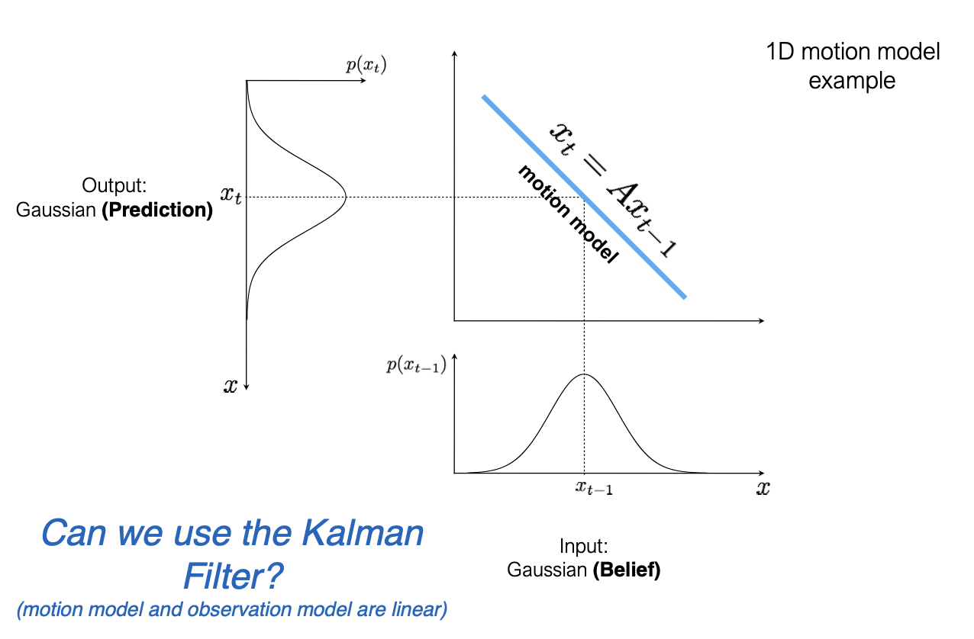
When can’t we use a Kalman Filter?
Well…most of the time…
We assumed everything was Gaussian and linear

Slide 28
When can’t we use a Kalman Filter?
Here’s a non-linear model:

Slide 29
Instead, let’s “linearize” the model

Slide 30
The “Extended” Kalman Filter

Slide 31
We “linearize” using a Taylor series expansion

Slide 32
The “EKF” algorithm is pretty much the same

Slide 33
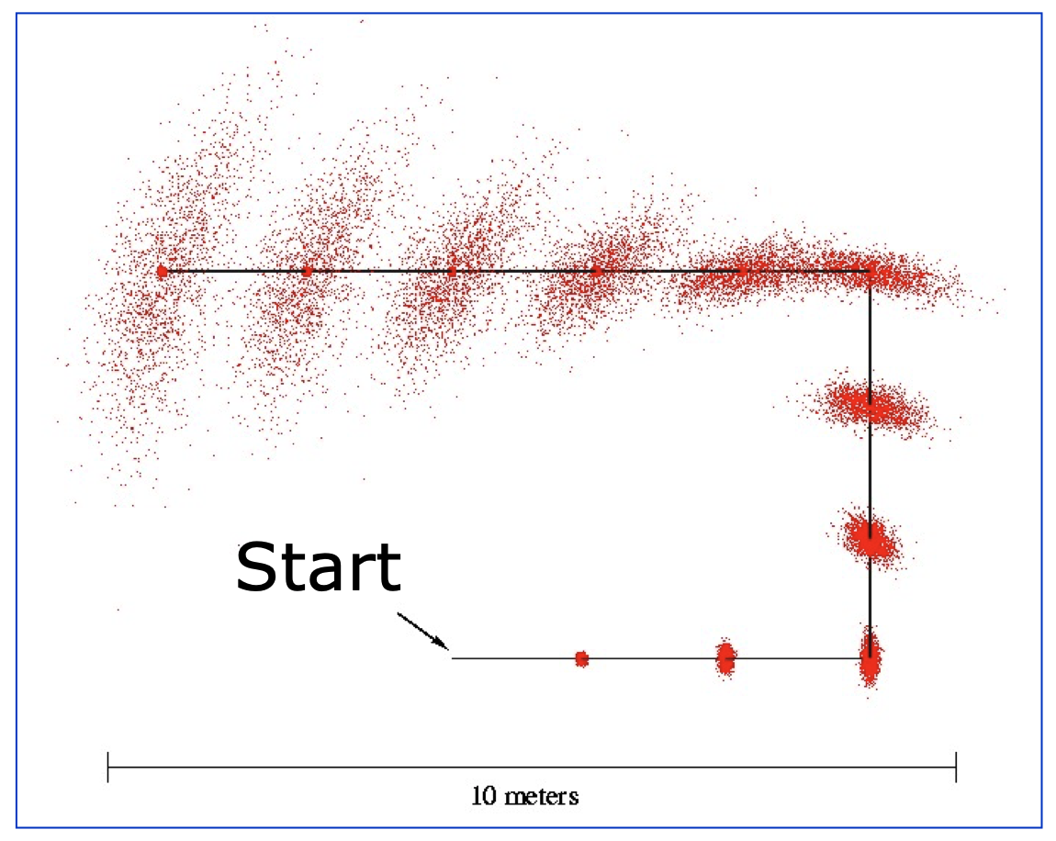
The EKF is necessary when we have a robot with orientation
If we have uncertainty in yaw, the motion model becomes nonlinear:
From: https://cs.gmu.edu/%7Ekosecka/cs685/cs685-11-sensor-motion-models.pdf

Slide 34
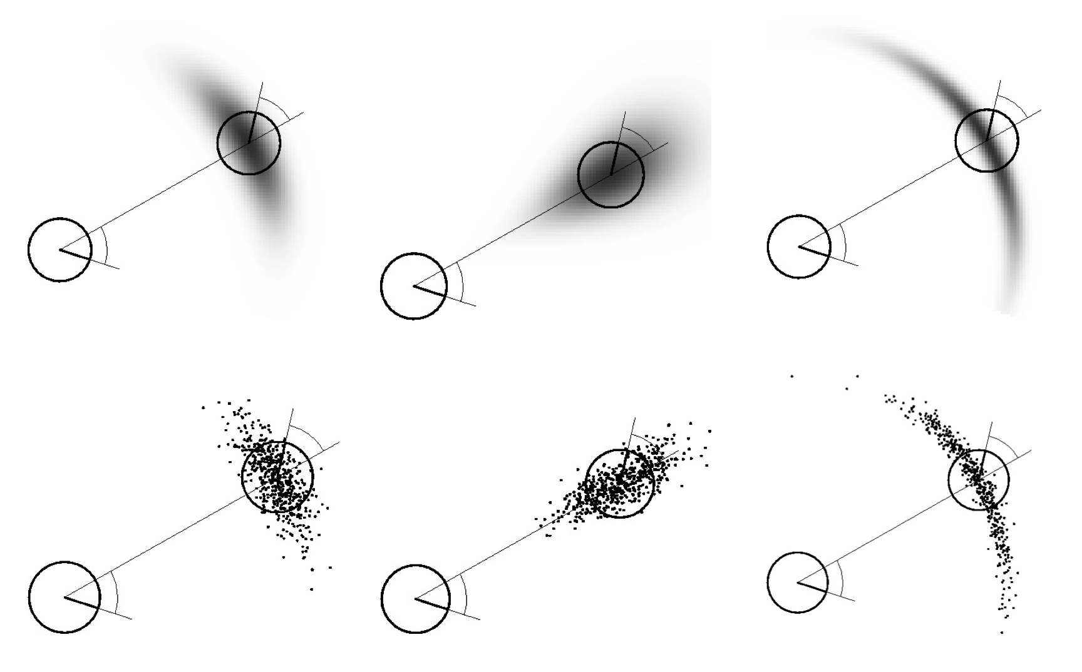
The EKF is necessary when we have a robot with orientation
If we have uncertainty in yaw, the motion model becomes nonlinear:
From: https://cs.gmu.edu/%7Ekosecka/cs685/cs685-11-sensor-motion-models.pdf

Slide 35
Will the EKF help us with the “Doors” example from earlier?

Slide 36
Will the EKF help us with the “Doors” example from earlier?
Hmm, probably not. We approximate the distribution as being Gaussian, so we’d lose the multi-peaked structure.
We’ll talk more about how to handle more complex probability distributions like these.

Slide 37
Let’s revisit the idea of probability distributions being represented as graphs
The graph is a convenient visual tool, but an incredibly powerful way to think about these problems more generally:
What if I removed an observation?
What if I added additional observations and sensors?

Slide 38
Let’s revisit the idea of probability distributions being represented as graphs
The graph is a convenient visual tool, but an incredibly powerful way to think about these problems more generally:
What if I removed an observation?
What if I added additional observations and sensors?
The probability distribution starts to get quite complicated, but the graph helps us manage that complexity.

Slide 39
Modern SLAM: everything is a graph
SLAM: Simultaneous Localization and Mapping
Square Root SAM paper

Slide 40
Modern SLAM: everything is a graph
Square Root SAM paper

Slide 41
Modern SLAM: everything is a graph
Square Root SAM paper

