Slide 1
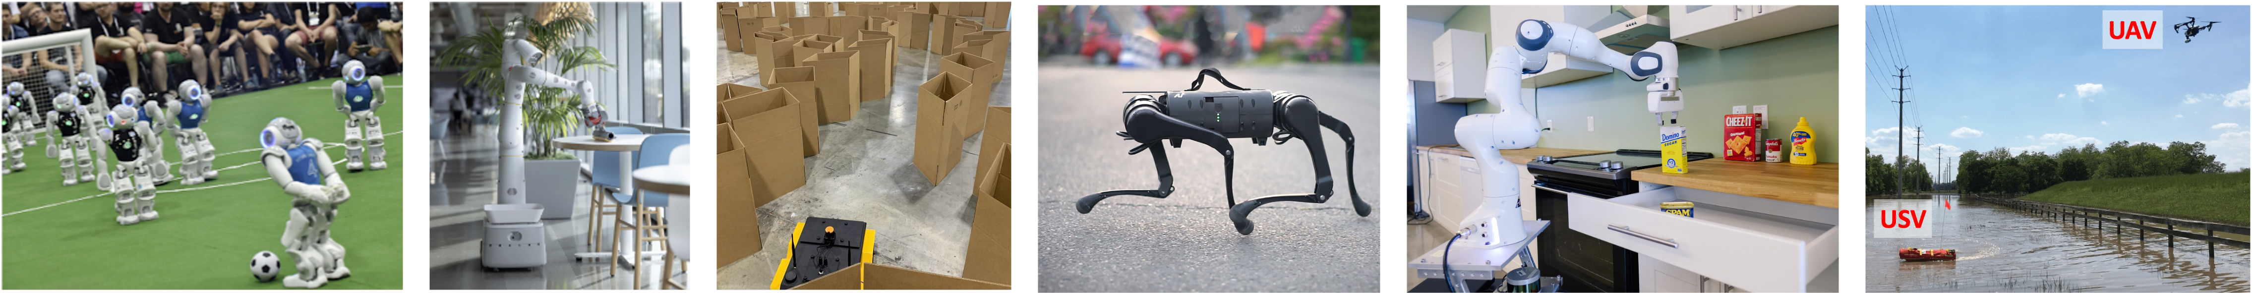
CS 485 Autonomous Robotics
Robot Vision III
Prof. Xuesu Xiao
George Mason University
Slides Credits: Gregory Stein

Slide 2
Logistics
Mid-project presentation this Thursday (in two days).
  8 minutes presentation + 2 minutes Q&A per team
Homework 4 due next Tuesday (before Thanksgiving).
Thanksgiving break next Thursday.

Slide 3
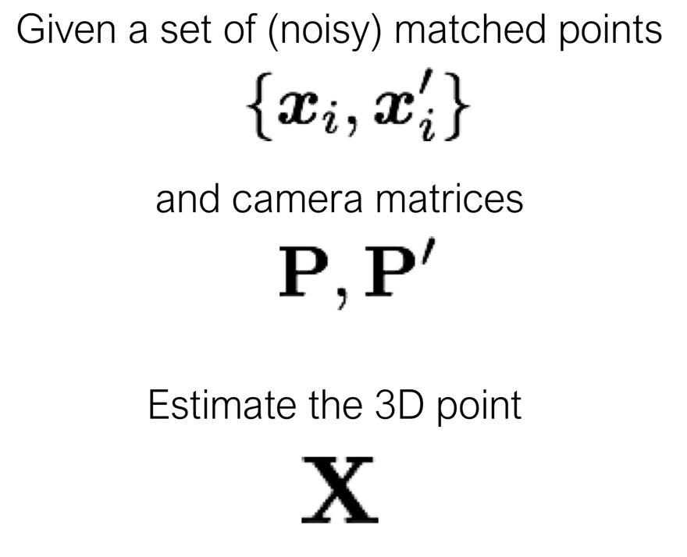
Triangulation

Slide 4
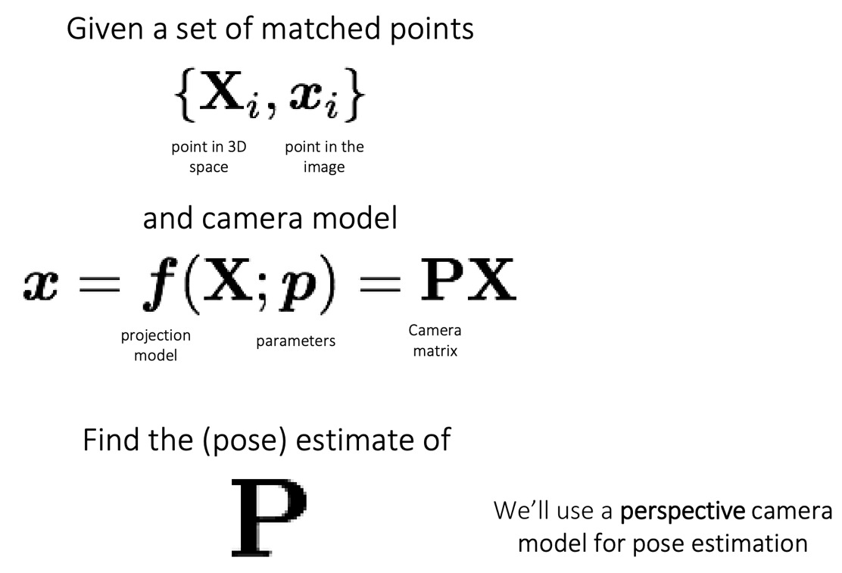
Geometric Camera Calibration

Slide 5
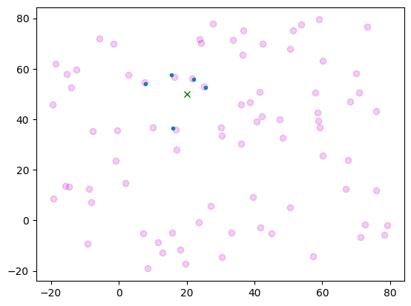
Motivation: the robot is given noisy observations of nearby landmarks

Slide 6
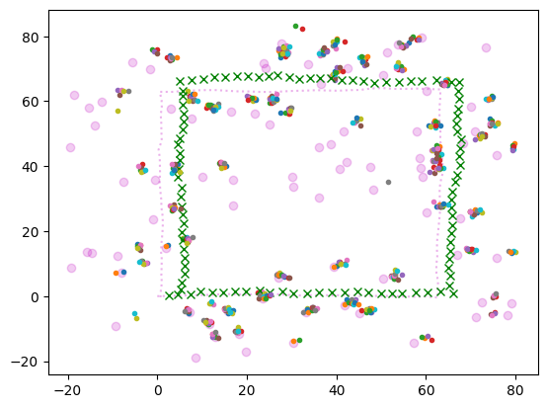
Motivation: here’s what the observations look like without any optimization…

Slide 7
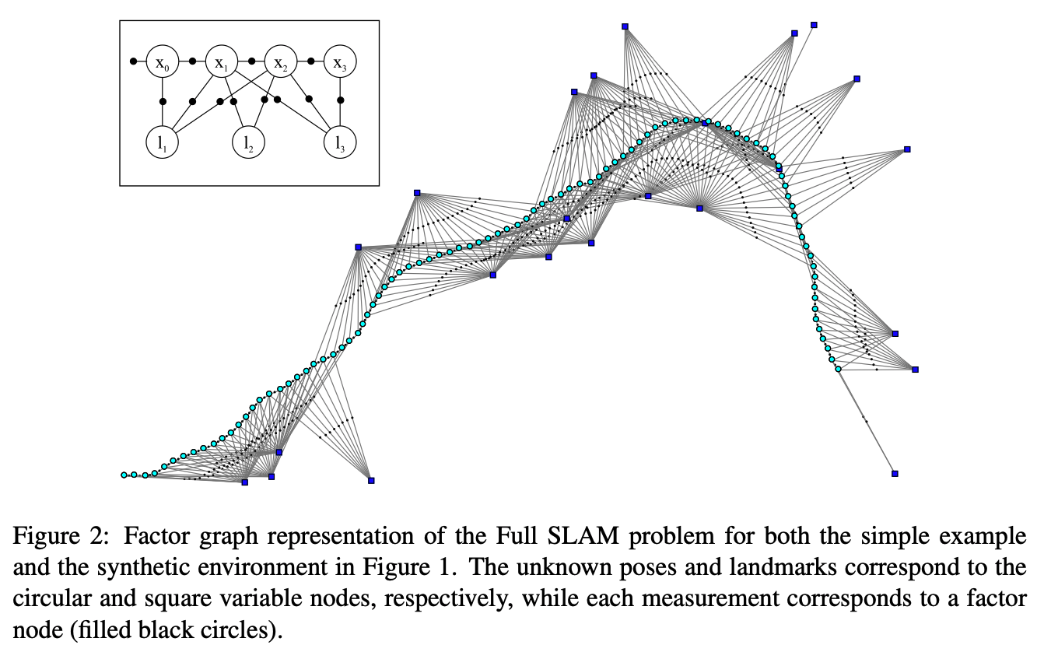
Motivation: we can combine our detections of each landmark to improve our estimates
Square Root SAM paper

Slide 8
Motivation: last week, you were told which observation was of which landmark
What if I was not told which landmark was which?

Slide 9
Motivation: last week, you were told which observation was of which landmark
What if I was not told which landmark was which?
I get a new detection.
Which landmark is this of?

Slide 10
Motivation: Data Association
Today we will study data association, the process of figuring out how new observations relate to previous observations.
This problem is very important and can be very challenging, and each application domain has its own tricks and approaches to get good performance.

Slide 11
Reading & Slide Credits
Slide Credits (from which many of the reference images have been taken or adapted):
Data Association Lecture: Robotics 2 (UNI Freiburg)
Introduction to Data Association CSE598C, Penn State

Slide 12
Outline for Today
Data Association
How do I decide whether ”this detection” is of the same landmark as “that detection”?
Sparse Features
How do I decide what parts of an image are good visual landmarks?
How can we “describe” these features to improve data association?

Slide 13
Data Association
How do I decide whether ”this detection” is of the same landmark as “that detection”?

Slide 14
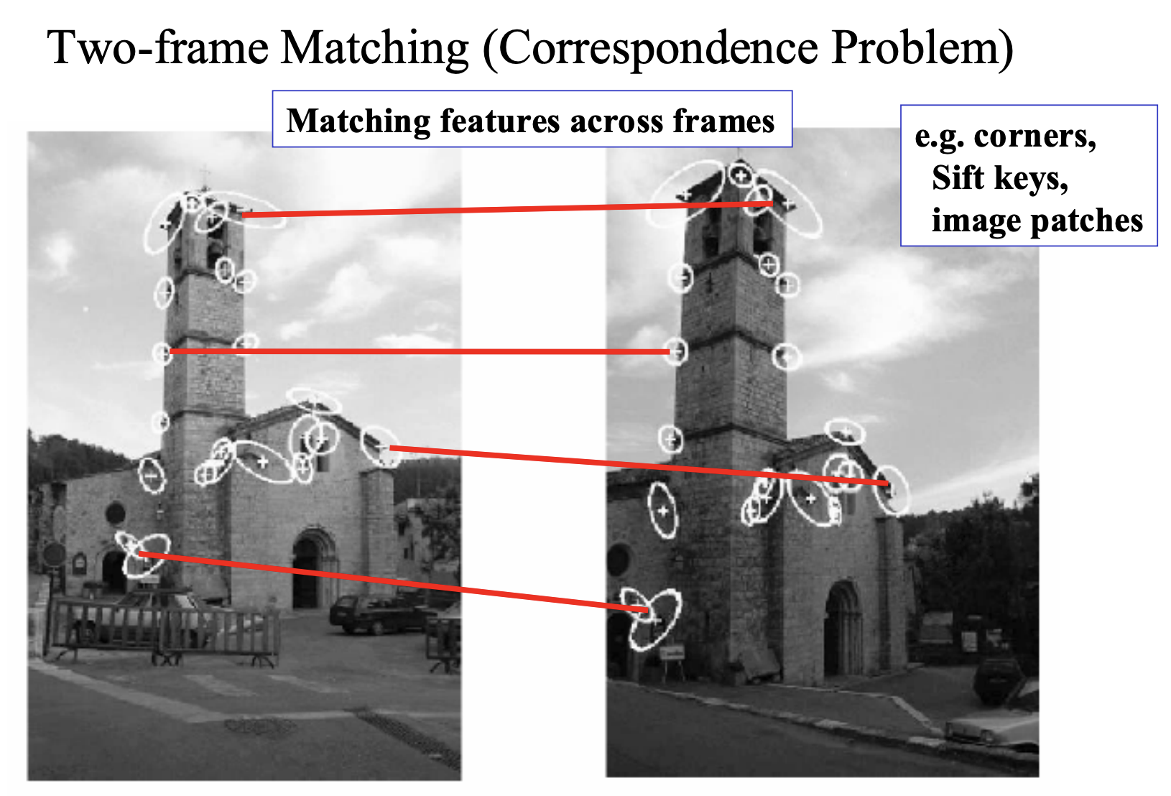
Data association applies to multiple application domains and sensor inputs

Slide 15
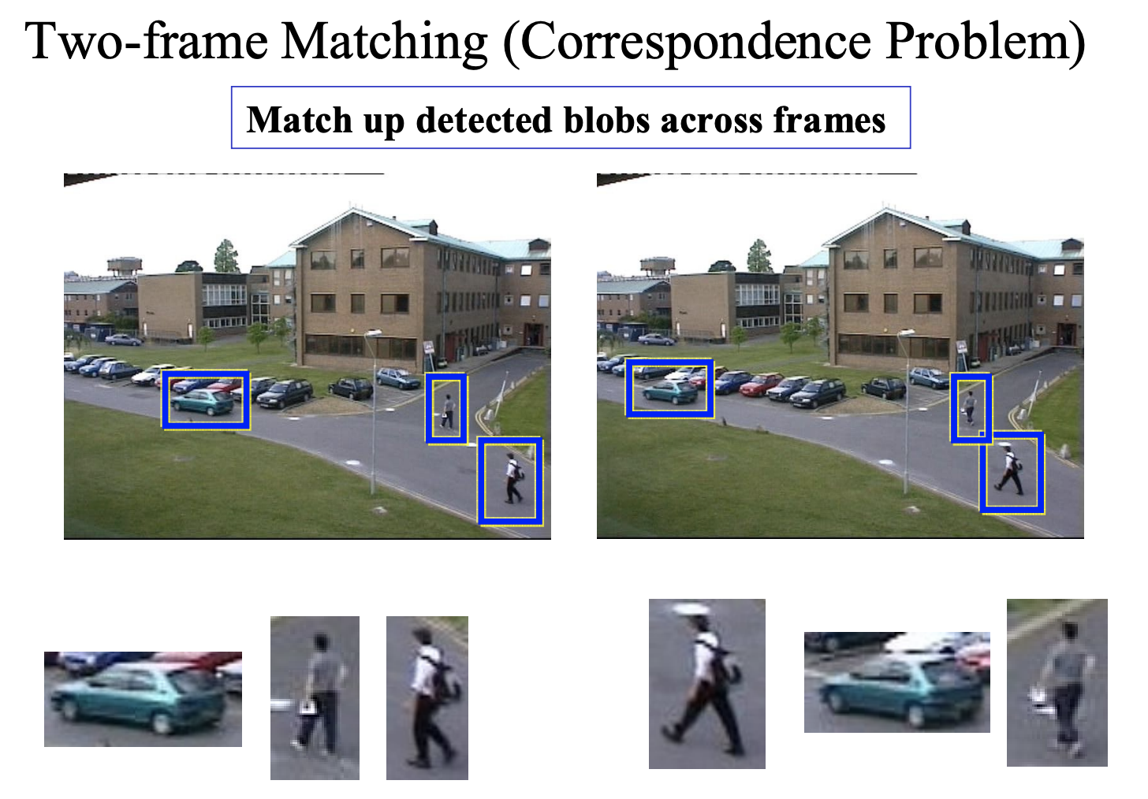
Data association applies to multiple application domains and sensor inputs

Slide 16
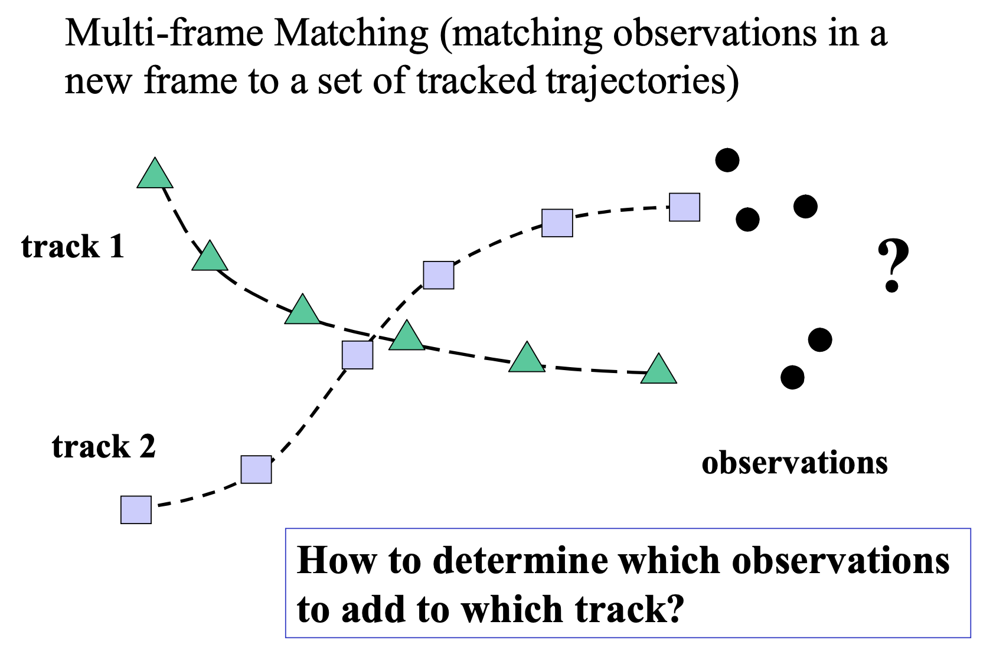
Data association applies to multiple application domains and sensor inputs

Slide 17
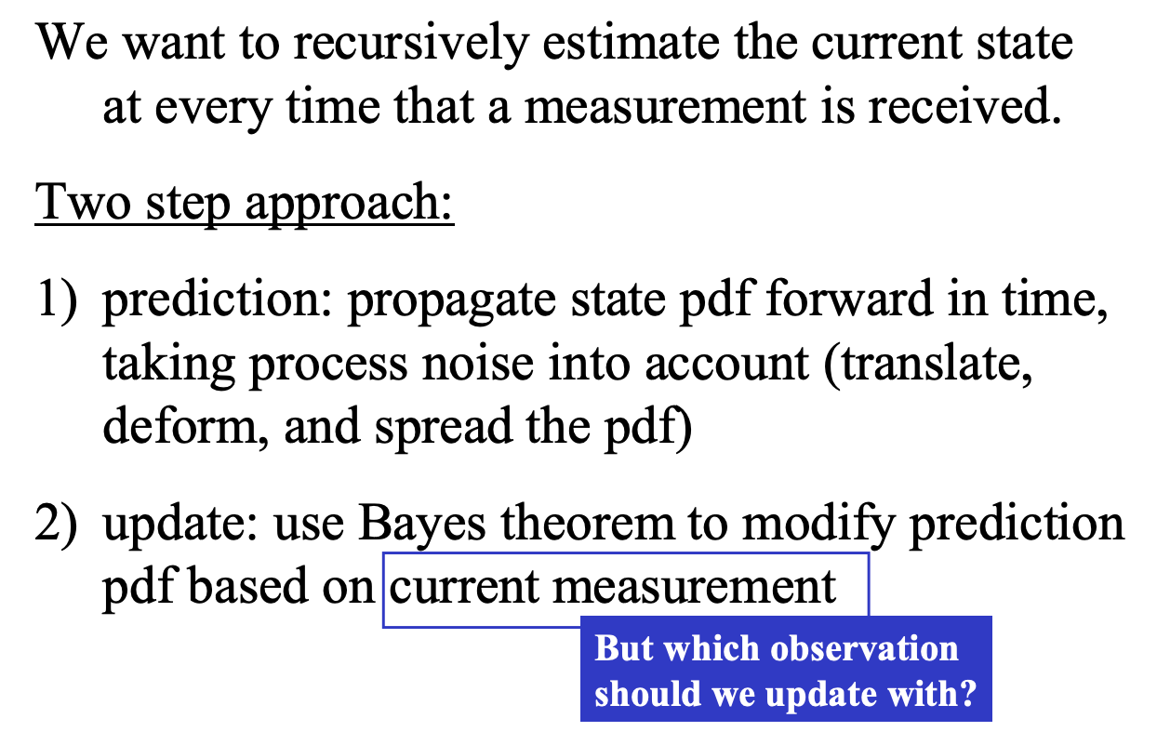
Data Association: at each step, we’ll perform state estimation (e.g., via a Kalman filter)

Slide 18
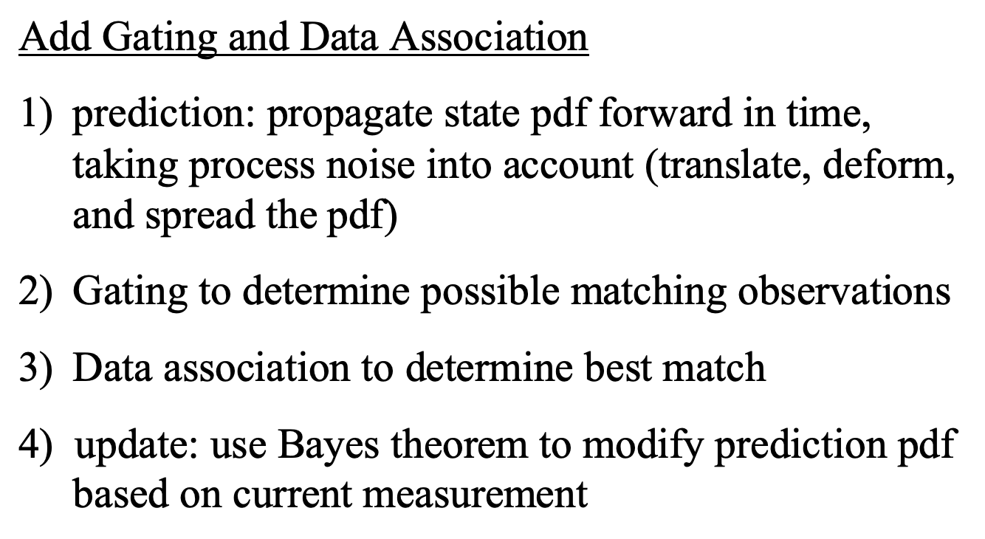
Data Association: the general idea

Slide 19
Let’s look at an example of object tracking

Slide 20
Let’s look at an example of object tracking

Slide 21
Let’s look at an example of object tracking

Slide 22
Let’s look at an example of object tracking

Slide 23
Scenario: we want to track multiple moving objects over time
We can assume some type of motion model for each object that constrains its motion.
We control the motion ourselves, which is corrupted by noise
We are not in control, but we have prior knowledge (e.g., a car cannot stop instantaneously and change direction)

Slide 24
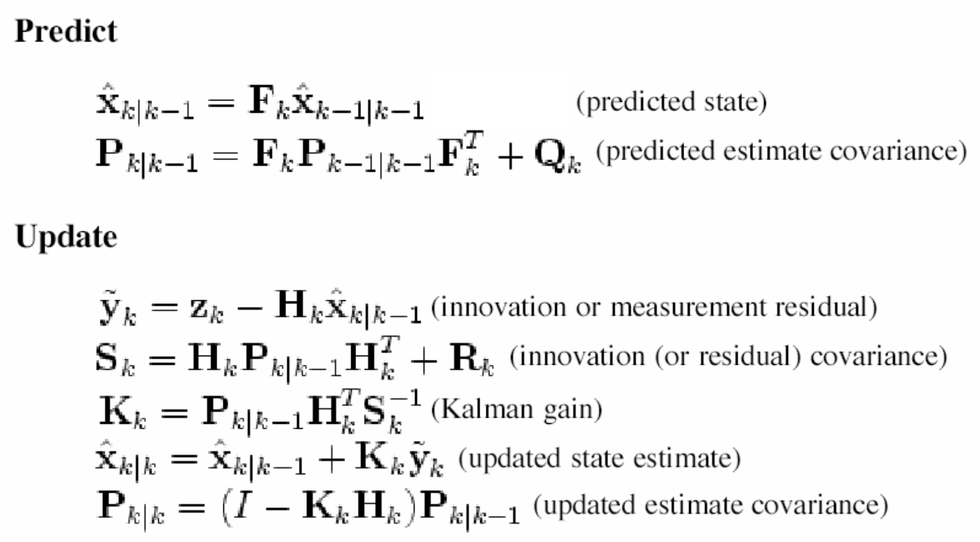
If the objects move, a Kalman filter may help us to predict where they are likely to be
Note: different notation, same idea. This should look familiar to you even though many of the notations have changed!

Slide 25
Before we perform matching, we will often “gate” possible matches to save computation

Slide 26
Before we perform matching, we will often “gate” possible matches to save computation

Slide 27
Simple data association via Global Nearest Neighbor
When we get multiple observations that may correspond to the point of interest, we pick the one closest to the predicted landmark position:
In this case, which observation will we associate with the landmark?

Slide 28
Simple data association via Global Nearest Neighbor
When we get multiple observations that may correspond to the point of interest, we pick the one closest to the predicted landmark position:
In this case, which observation will we associate with the landmark? O4! It’s the closest.

Slide 29
Aside: Relationship between “distance” and “Gaussian likelihood”
In the previous slide, we said the “best match” is the one that is closest.
Our model says that the location each point is represented as a gaussian distribution. As such, the likelihood of each point is proportional to the exponential of the negative squared distance (divided by the variance):
If the variances are all the same, picking the min distance point is the same as picking the max likelihood point

Slide 30
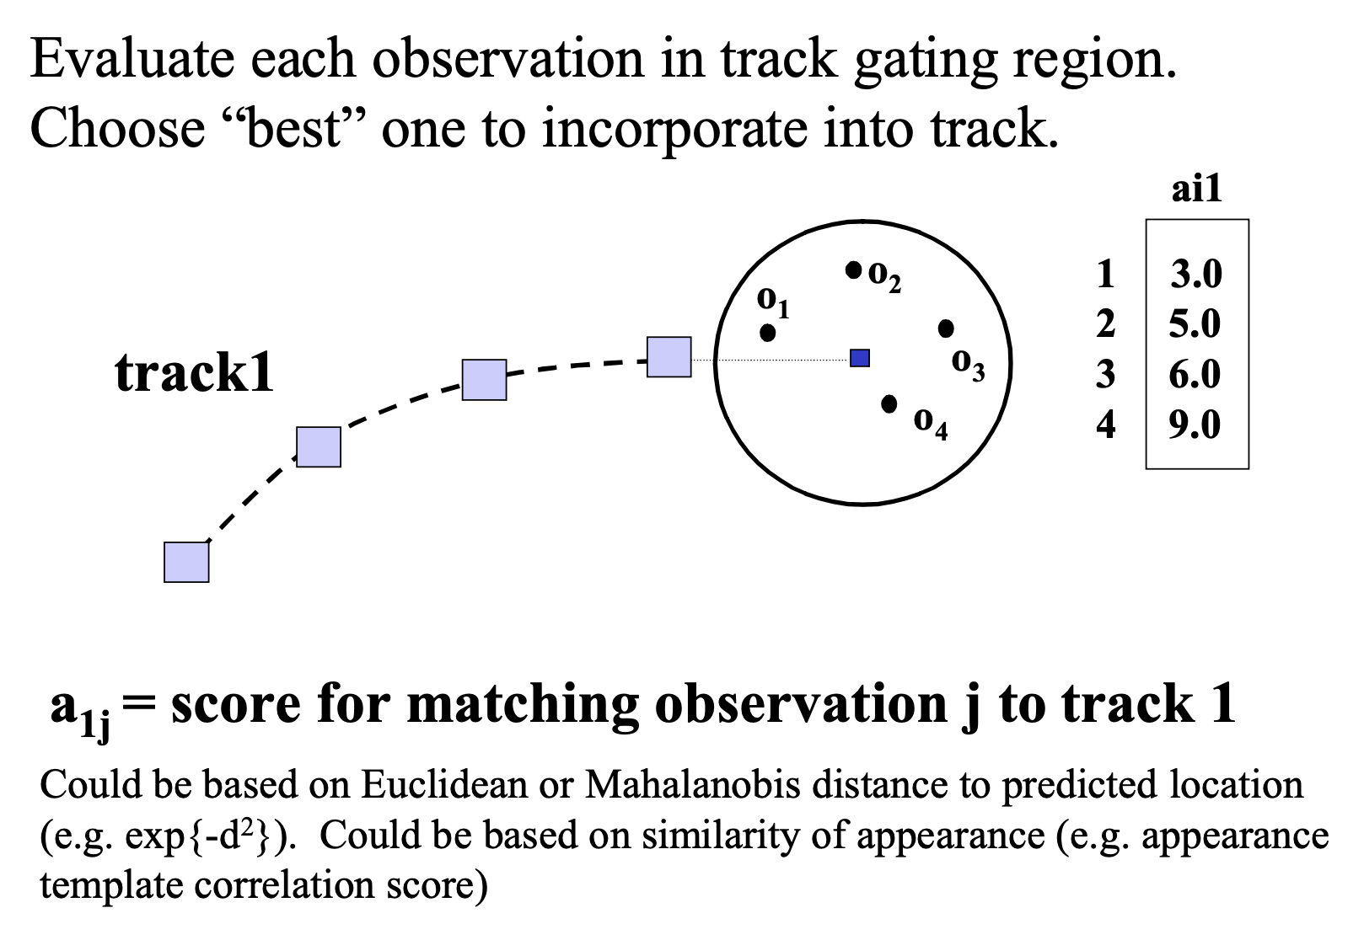
We can use “distance” to come up with a data association “score”, a more general idea

Slide 31
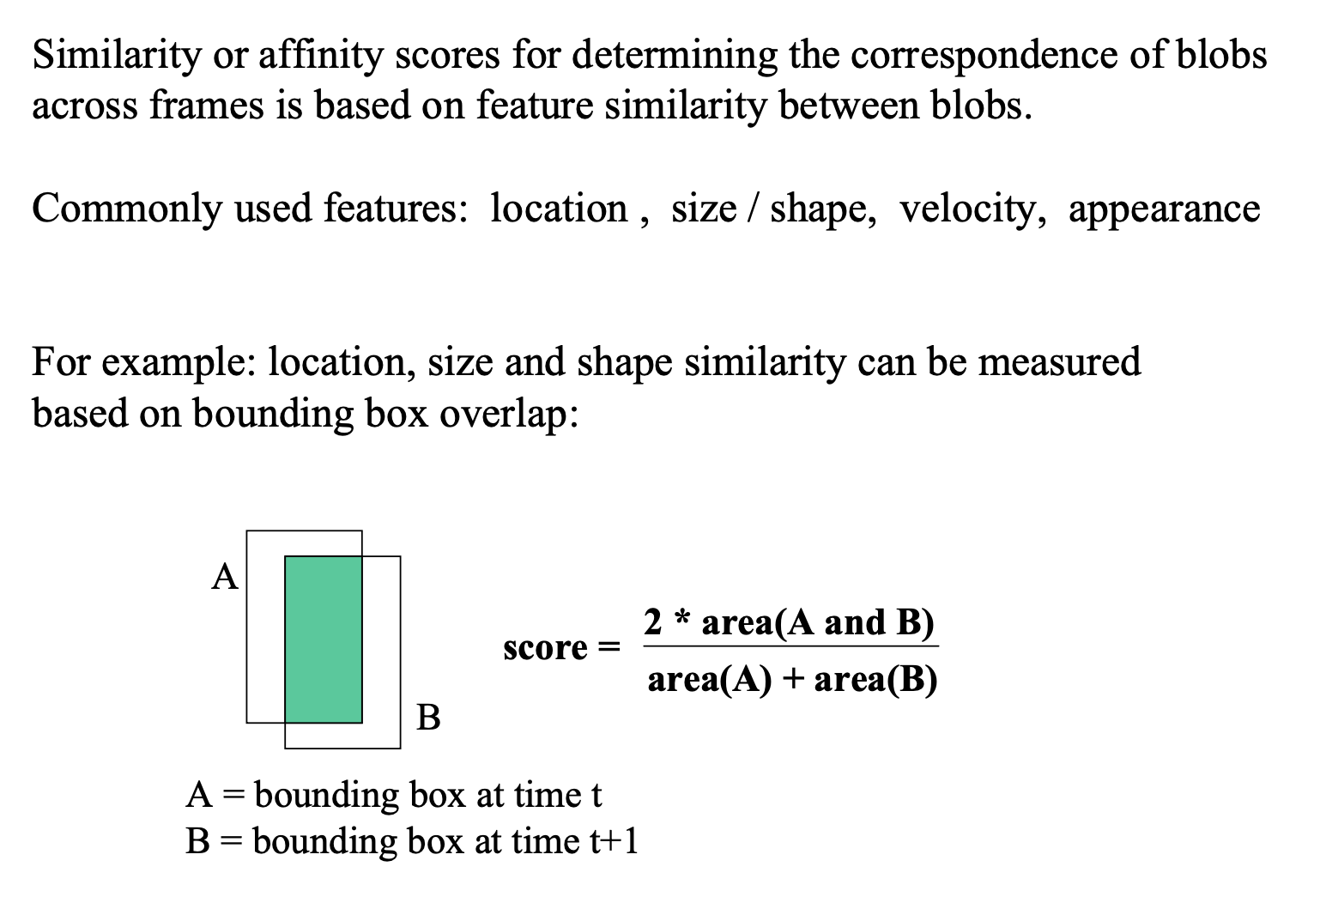
More generally, score can include distance, visual appearance, etc.

Slide 32
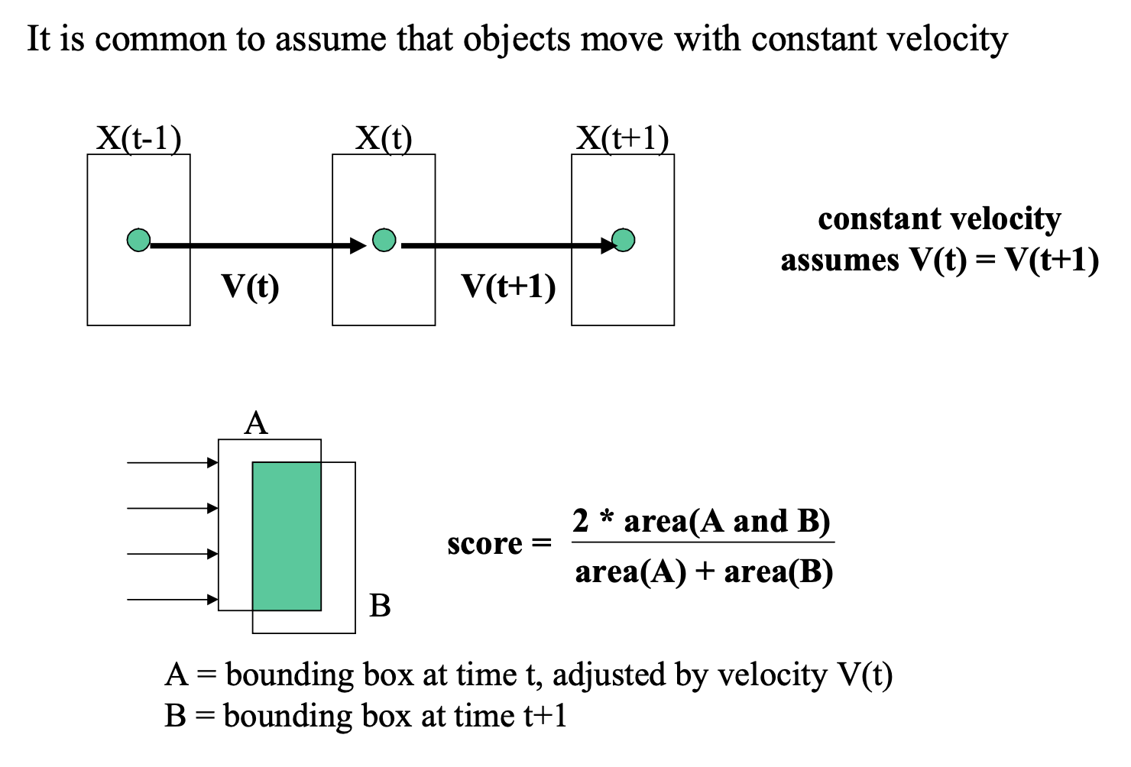
More generally, score can include distance, visual appearance, etc.

Slide 33
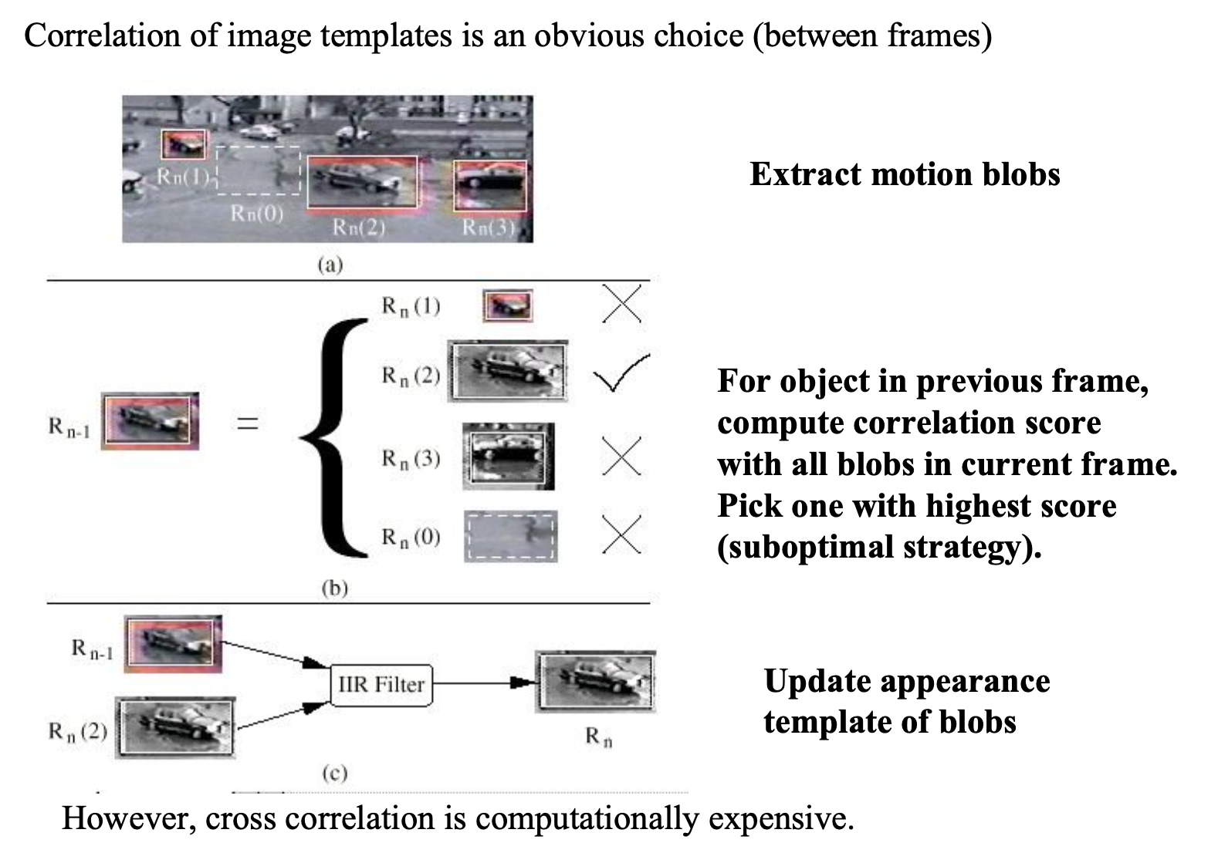
Appearance scores (which we will touch upon later) can help visual tracking/matching

Slide 34
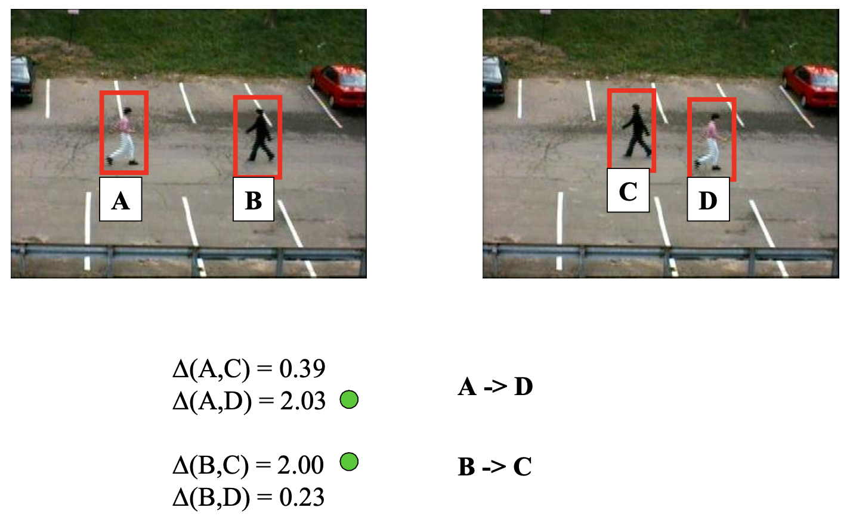
Appearance scores (which we will touch upon later) can help visual tracking/matching

Slide 35
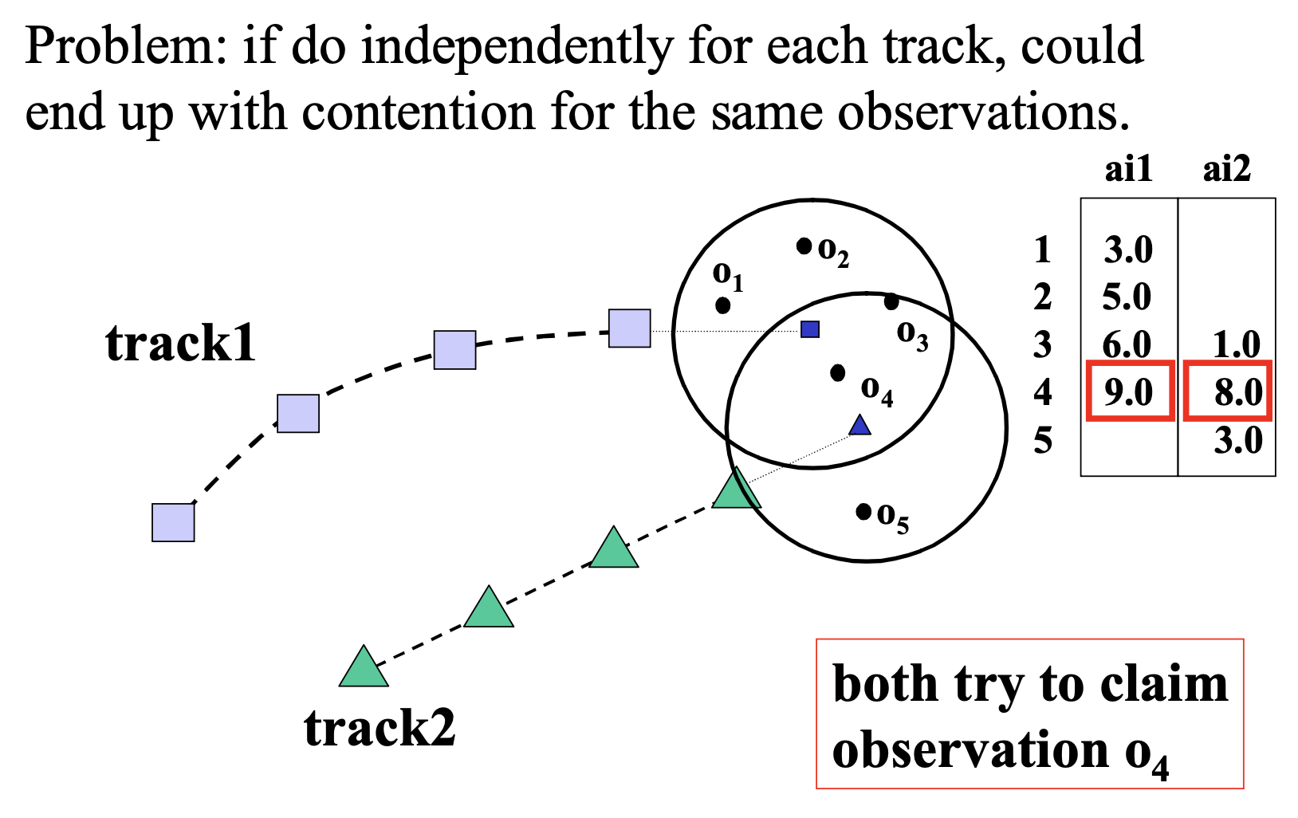
Nearest Neighbor is greedy and can have issues
We want to enforce an exclusion constraint

Slide 36
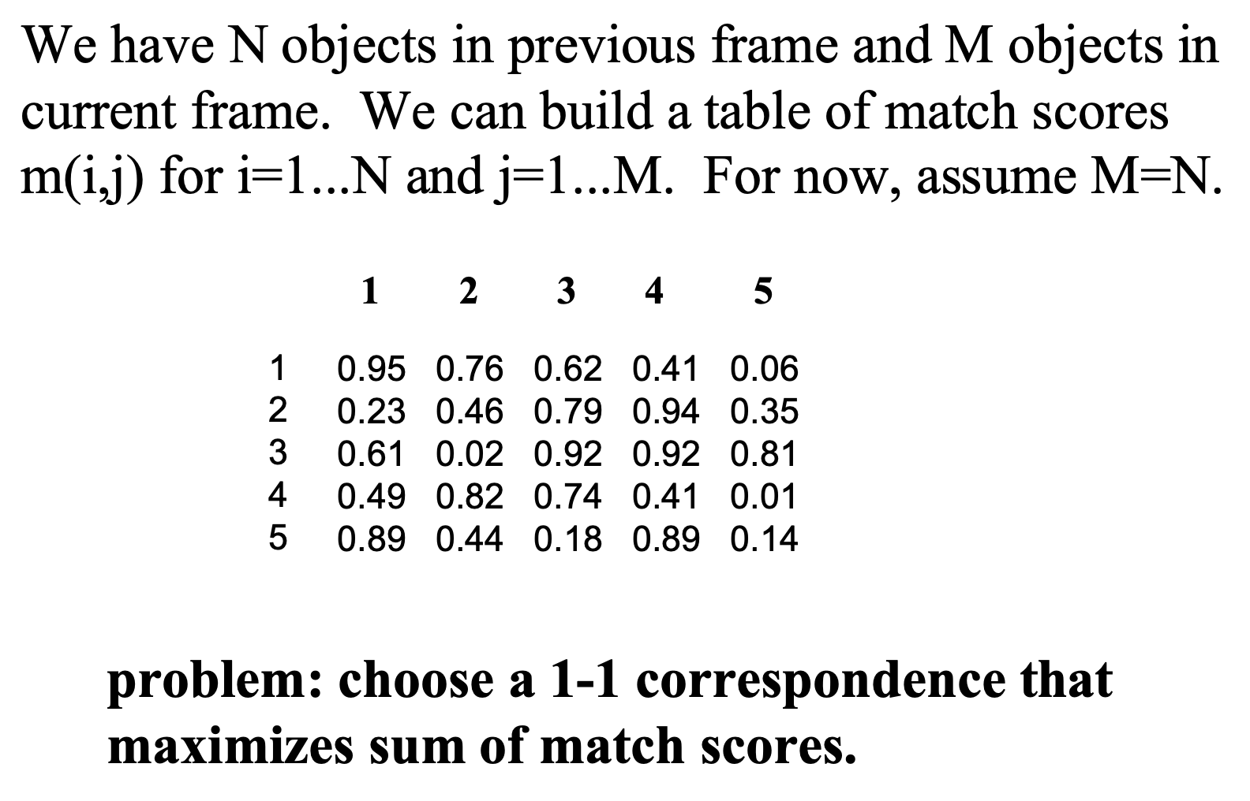
Linear Sum Assignment (a.k.a. Hungarian Matching Algorithm) solves this problem
Each element is the score relating detection to landmark

Slide 37
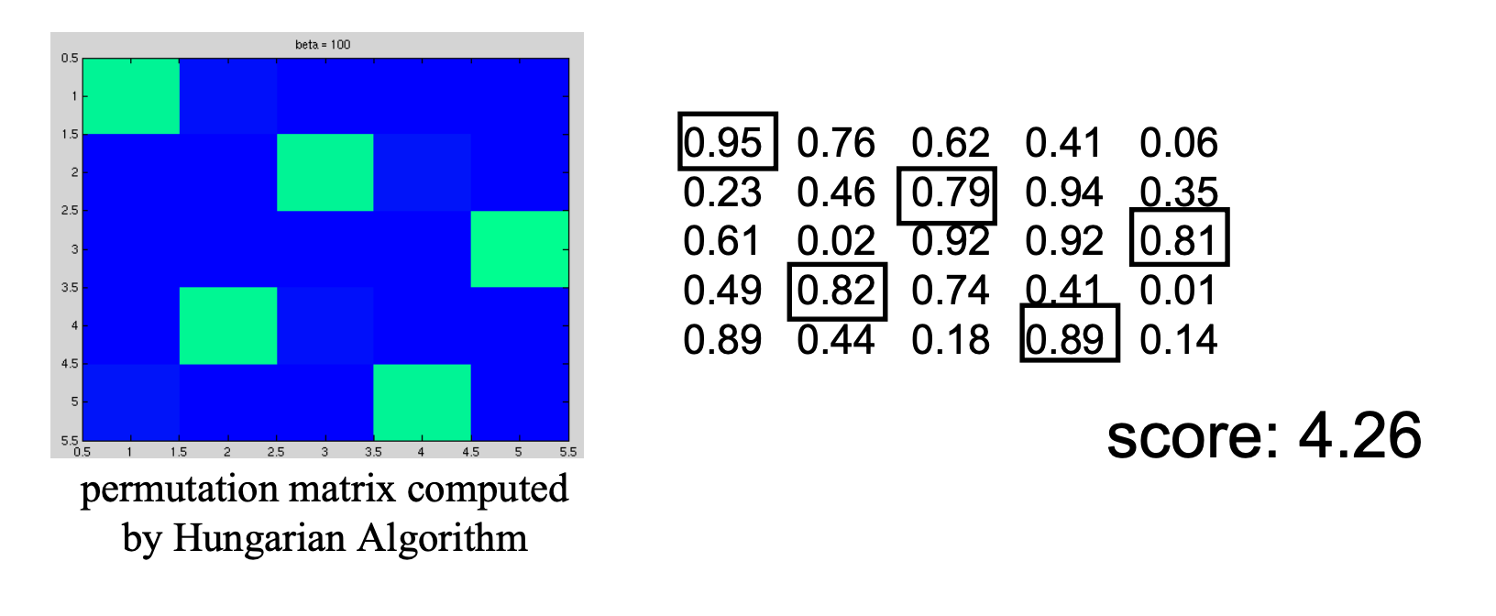
Linear Sum Assignment (a.k.a. Hungarian Matching Algorithm) solves this problem
This ensures that we will not try to associate a single detection with multiple landmarks (and vice versa):
Each element is the score relating detection to landmark

Slide 38
What score function should we use?
We are trying to find the data association that maximizes the likelihood of our observation.
We assume the detections are independent of one another, which means we want to maximize the product of a few Gaussians.
The Linear Sum Assignment maximizes a *sum* not a *product* of scores.
Anyone have any ideas how to handle this? Let’s take the logarithm!
If we take the log of a product, it becomes the sum of the log of the gaussians: which becomes the sum of the negative squared distances.

Slide 39
What score function should we use?
We are trying to find the data association that maximizes the likelihood of our observation.
We assume the detections are independent of one another, which means we want to maximize the product of a few Gaussians.
The Linear Sum Assignment maximizes a *sum* not a *product* of scores.
Anyone have any ideas how to handle this? Let’s take the logarithm!
If we take the log of a product, it becomes the sum of the log of the gaussians: which becomes the sum of the negative squared distances.

Slide 40
Negative Log Likelihood implies we should use the negative squared distances as scores
The product of gaussians:
Becomes a sum of the negative squared distances when you take the log.
Euclidian distance score: each element of the score matrix should be the negative squared distances.

Slide 41
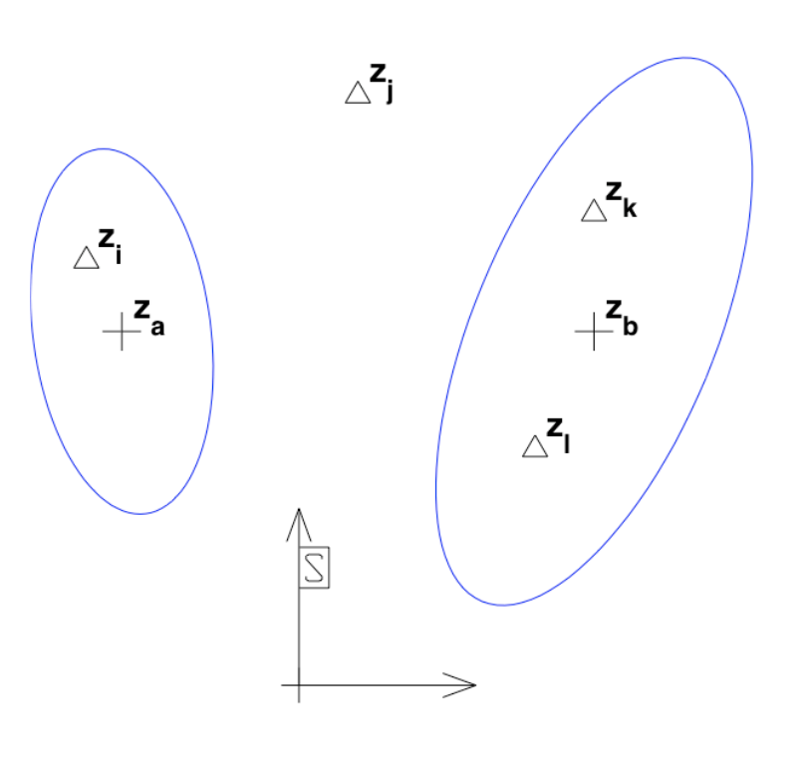
Euclidian distance is not an ideal score function for object tracking…
What if our variances are different?
What if our covariance results in a non-spherically-symmetric (ellipsoid) likelihood?

Slide 42
Mahalanobis Distance: a distance that takes into account our position uncertainty
Idea: If I have a huge uncertainty in the location of a landmark, it will be more likely that my faraway observation relates to it than to a closer but less uncertain landmark:
Despite being closer to the inner circle/uncertainty ellipse, the detection is more likely to be an observation of the landmark with greater uncertainty.
New Detection
Two Landmarks

Slide 43
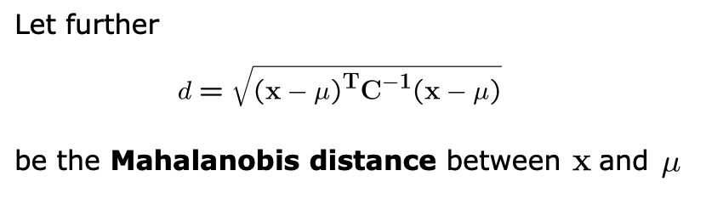
Mahalanobis Distance: a distance that takes into account our position uncertainty

Slide 44
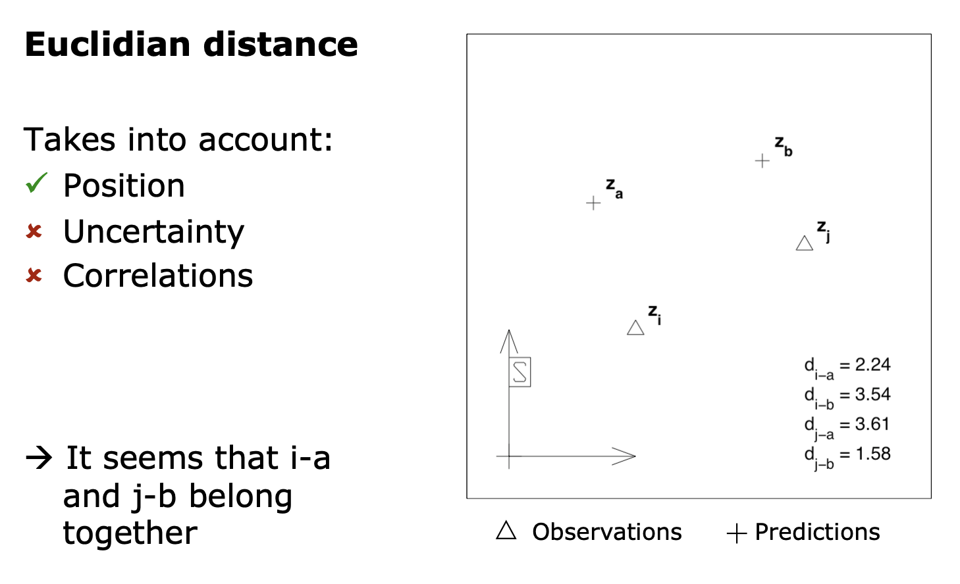
Different “distances” can yield different scores:

Slide 45
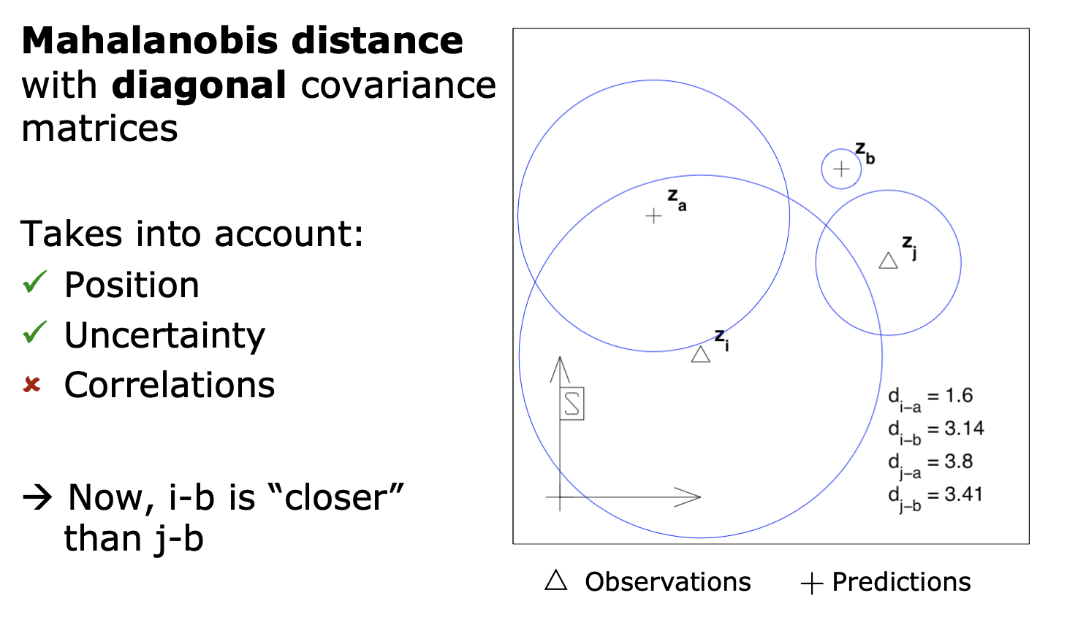
Different “distances” can yield different scores:

Slide 46
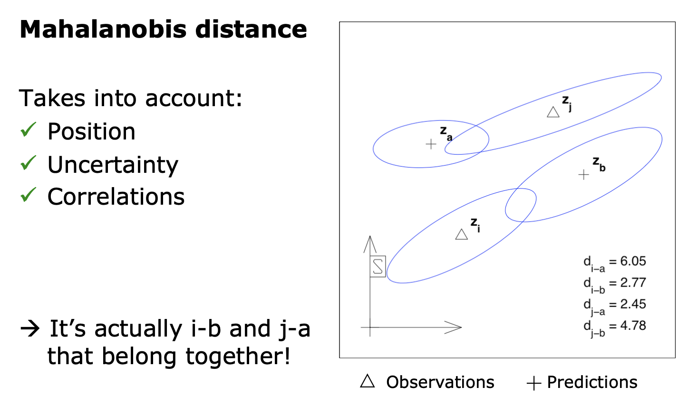
Different “distances” can yield different scores:

Slide 47
What if I have a point that’s far from all my previously detected landmarks?
We should add a new landmark sometimes!
If a detection is sufficiently unlikely (a.k.a. has too low a score) for any of the existing landmarks, we might want to create a new one.

Slide 48
Simple data association via Global Nearest Neighbor
When we get multiple observations that may correspond to the point of interest, we pick the one closest to the predicted landmark position:
What about the other observations?
What do we do with those?
Typically, we’ll make new landmarks for each. If we don’t see those landmarks ever again, we may remove them later, treating them as “false detections” or “false alarms”

Slide 49
Simple data association via Global Nearest Neighbor
When we get multiple observations that may correspond to the point of interest, we pick the one closest to the predicted landmark position:
What about the other observations?
What do we do with those?
Typically, we’ll make new landmarks for each. If we don’t see those landmarks ever again, we may remove them later, treating them as “false detections” or “false alarms”

Slide 50
In general, data association needs to be globally optimized
With a single frame, I may not be able to pick the maximum likelihood scenario:
Is this detection of a new landmark?
Is the detection a false alarm?
Is the detection of a landmark that I’ve seen already (and then which one)?
It may only be possible to tell which it is after more frames/observations. However keeping track of “multiple hypothesis” can be incredibly expensive.
We may need to perform multi-hypothesis data association

Slide 51
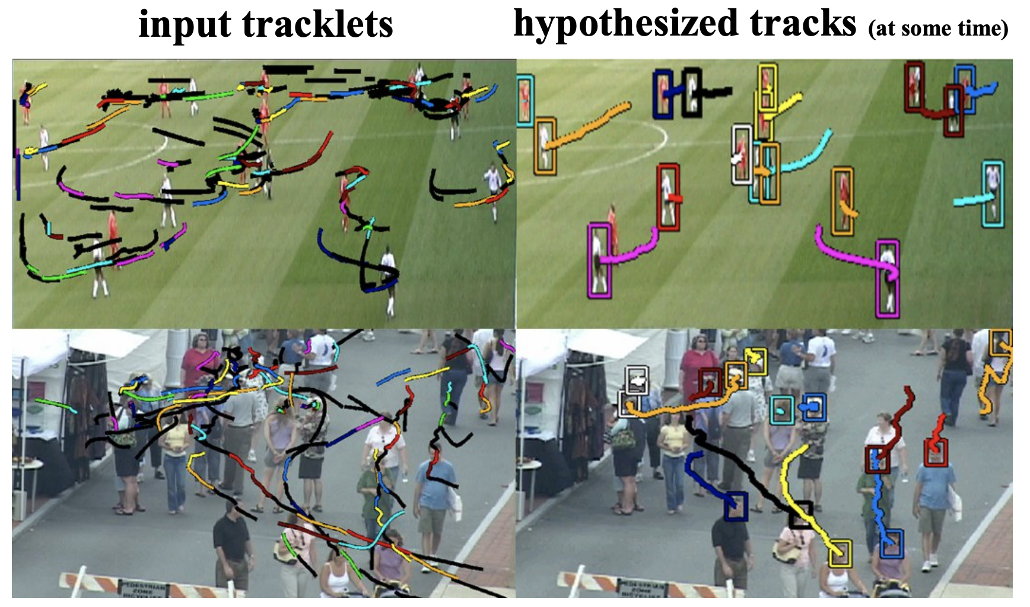
Example for multi-track data association

Slide 52
Sparse Features
How do I decide what parts of an image are good visual landmarks?
How can we “describe” these features to improve data association?

Slide 53
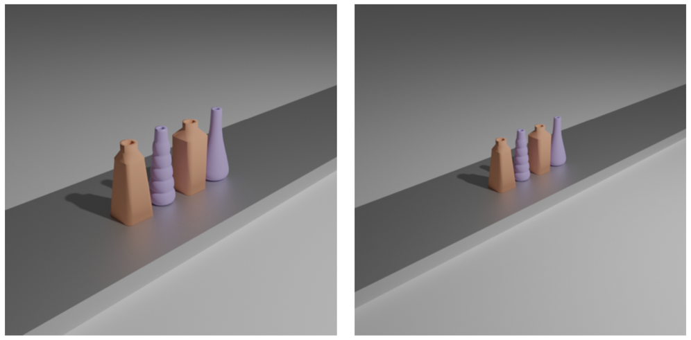
Motivation: finding visual landmarks in images
What if we want to find objects common to two images:
How might we “match” them computationally?

Slide 54
Motivation: finding visual landmarks in images
What if we want to find objects common to two images:
What if we take the derivative?
What if we use curvature?

Slide 55
Motivation: finding visual landmarks in images
What if we want to find objects common to two images:
What if we take the derivative?
What if we use curvature?
Neither of these properties are scale invariant.
More generally: we want to find “features” that we can identify in both images and match (like the landmarks from earlier)

Slide 56
Reading & Slide Credits
Slide Credits (from which many of these slides are either directly taken or adapted)
CMU Computer Vision Course (Yannis Gkioulekas)
Cornell Tech Computer Vision Course (Noah Snavely)
Toronto CV Course

Slide 57
A Simple Example: How might you “track” this object?
Pick some points on this image and look for them in another.

Slide 58
A Simple Example: How might you “track” this object?
Pick some points on this image and look for them in another.

Slide 59
A Simple Example: How might you “track” this object?
Pick some points on this image and look for them in another.
Is this a good feature?

Slide 60
A Simple Example: How might you “track” this object?
Pick some points on this image and look for them in another.
Is this a good feature?
No! This region is flat; not at all distinct.

Slide 61
A Simple Example: How might you “track” this object?
Pick some points on this image and look for them in another.
Is this edge a good feature?

Slide 62
A Simple Example: How might you “track” this object?
Pick some points on this image and look for them in another.
Is this edge a good feature?
Better, but still not great. Hard to distinguish between these. We can slide along the edge and not know the difference.

Slide 63
A Simple Example: How might you “track” this object?
Pick some points on this image and look for them in another.
Is this corner a good feature?
Much better. Corners are much easier to localize (and don’t “slide” like edges do).

Slide 64
A Simple Example: How might you “track” this object?
Pick some points on this image and look for them in another.

Slide 65
A Simple Example: How might you “track” this object?
Pick some points on this image and look for them in another.

Slide 66
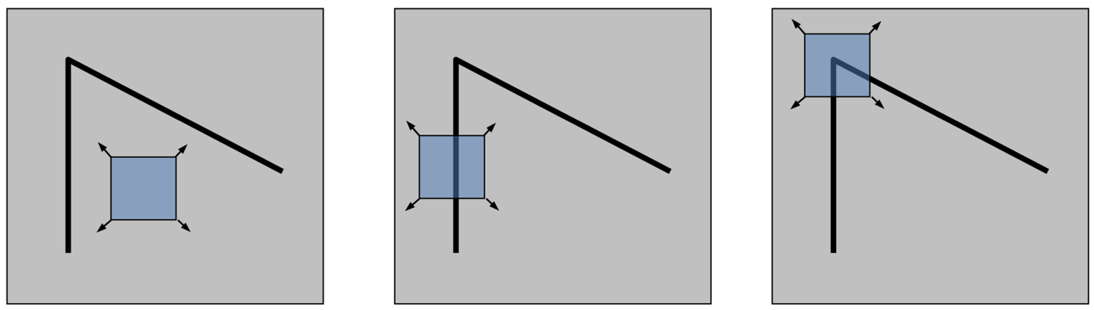
Features should be as unique as is reasonably achievable.
This will help us make less ambiguous matches between images.
Let’s consider looking at only a small window of pixels:
Corners are easier to localize, which will make them easier to match across images.

Slide 67
How can we detect where a corner exists?
Can we just detect regions in which the image derivative is high in both X and Y?

Slide 68
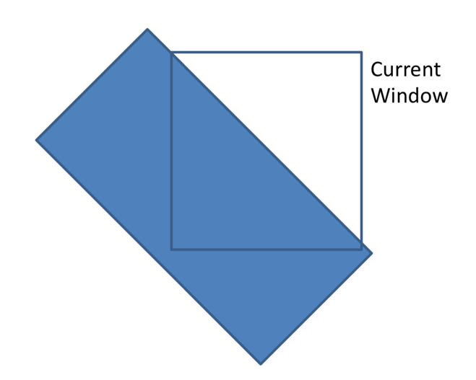
How can we detect where a corner exists?
Can we just detect regions in which the image derivative is high in both X and Y?
No! This would detect diagonal edges as well as corners:

Slide 69
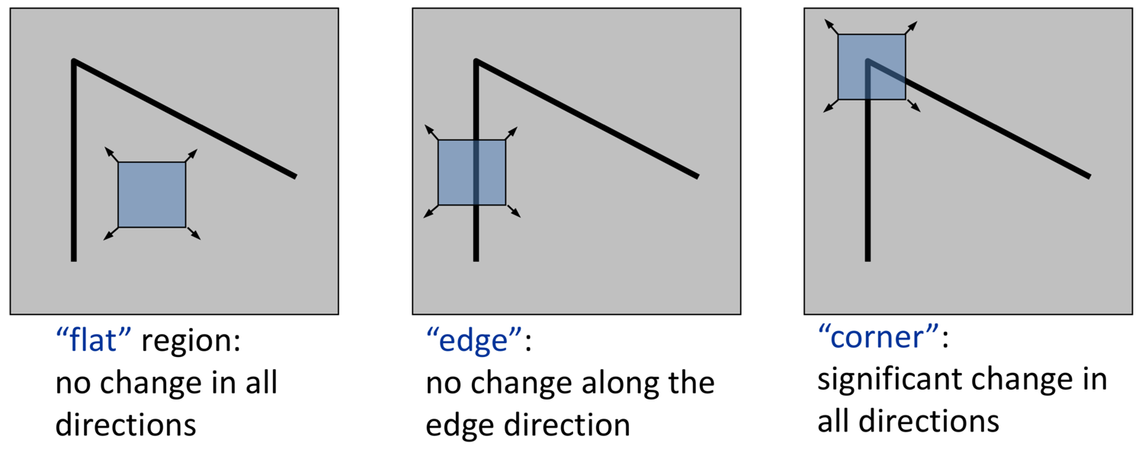
How can we detect where a corner exists?
Let’s consider the pixels in a small window: how much does this window change when you move it around the image.

Slide 70
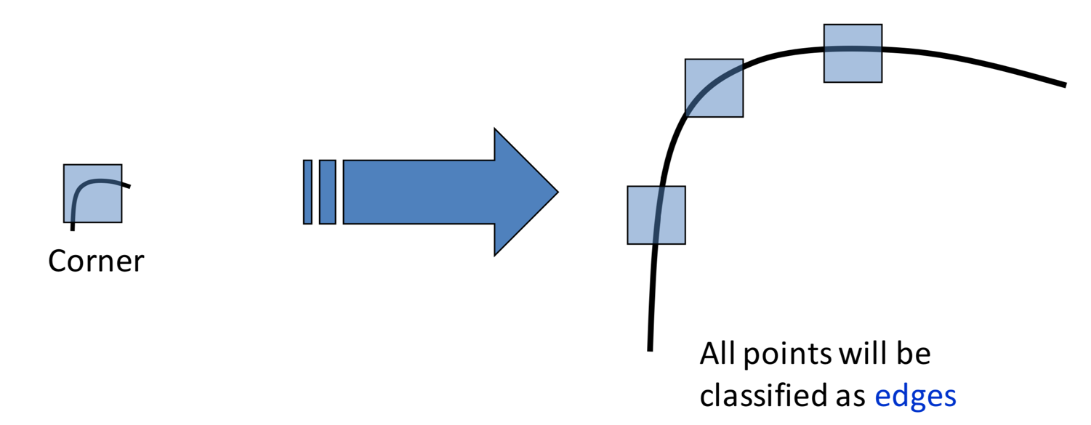
What about scale?

Slide 71
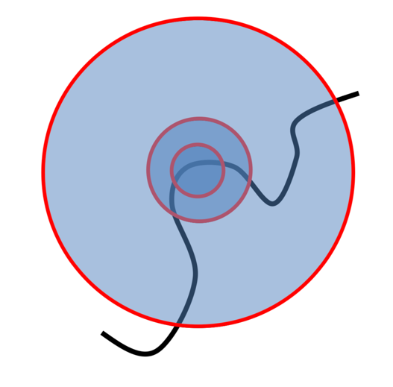
Let’s say we’re looking to detect corners in an image
What if we tried detecting features at multiple scales simultaneously:
Which of these scales is “best”

Slide 72
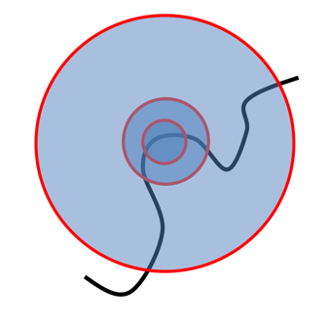
Let’s say we’re looking to detect corners in an image
Key idea for multi-scale detection: find a scale for which our measure of cornerness is maximized.
We can change:
- The size of the feature kernel
The size of the image
Usually, which we choose is a matter of implementation.

Slide 73
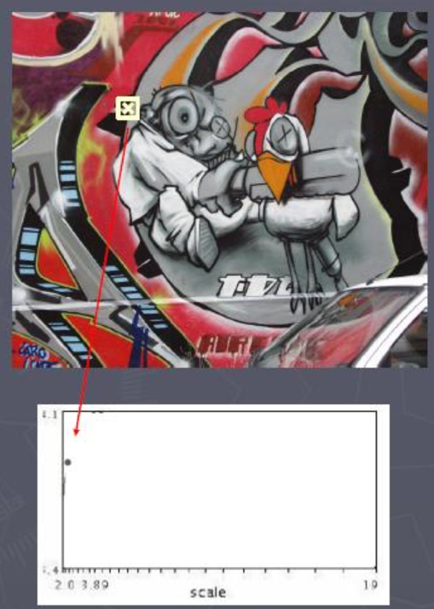
Example: Automatic Scale Selection
If we change the size of the kernel, its response will change.

Slide 74
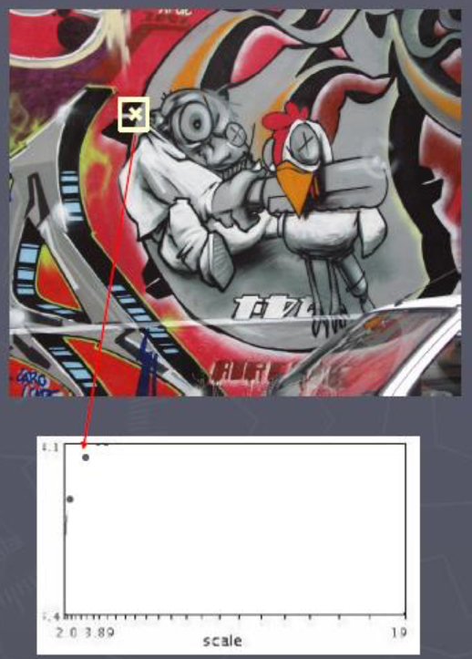
Example: Automatic Scale Selection
If we change the size of the kernel, its response will change.

Slide 75
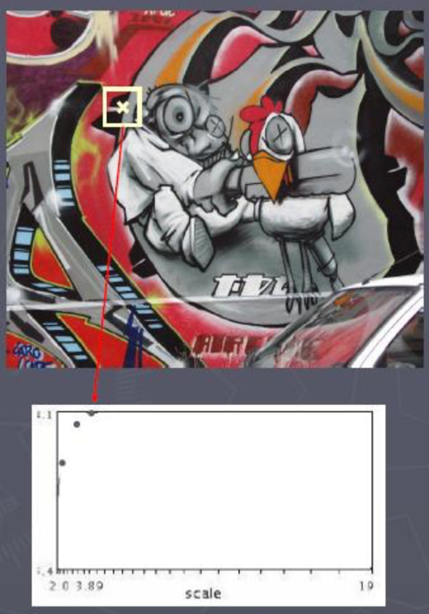
Example: Automatic Scale Selection
If we change the size of the kernel, its response will change.

Slide 76

Example: Automatic Scale Selection
If we change the size of the kernel, its response will change.

Slide 77
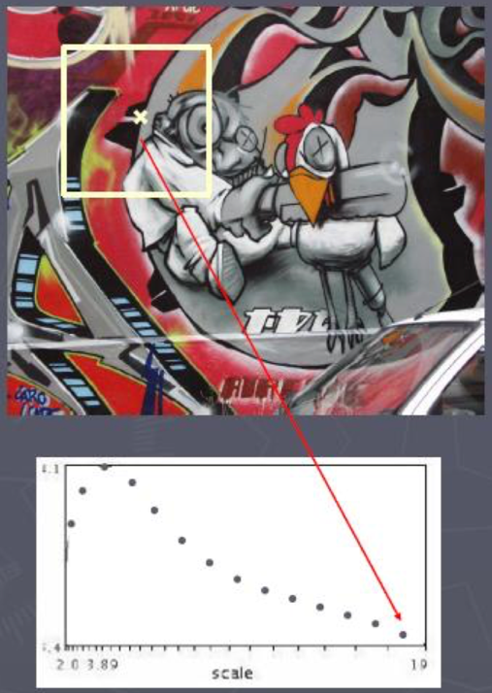
Example: Automatic Scale Selection
If we change the size of the kernel, its response will change.

Slide 78
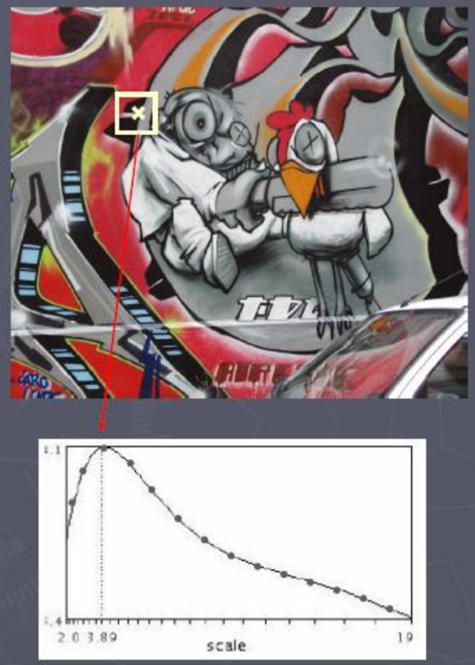
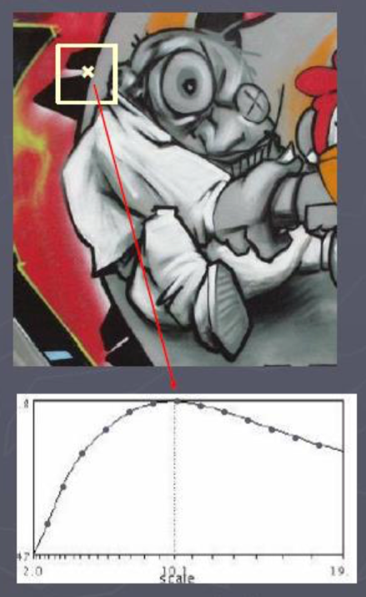
Example: Automatic Scale Selection
Matching features in images of different scales should have corresponding automatically-detected scales, which we can use to resize the features themselves.

Slide 79
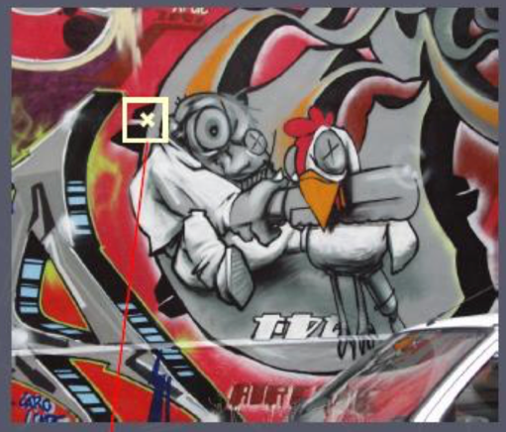
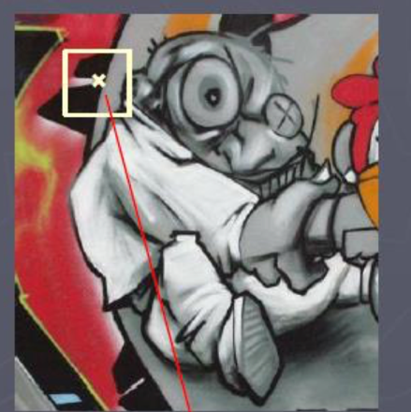
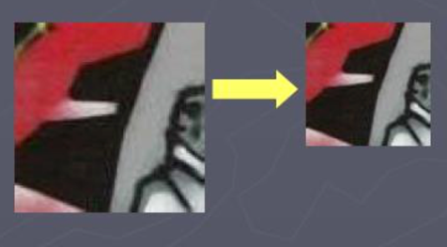
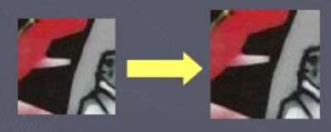
Example: Automatic Scale Selection
Matching features in images of different scales should have corresponding automatically-detected scales, which we can use to resize the features themselves.

Slide 80
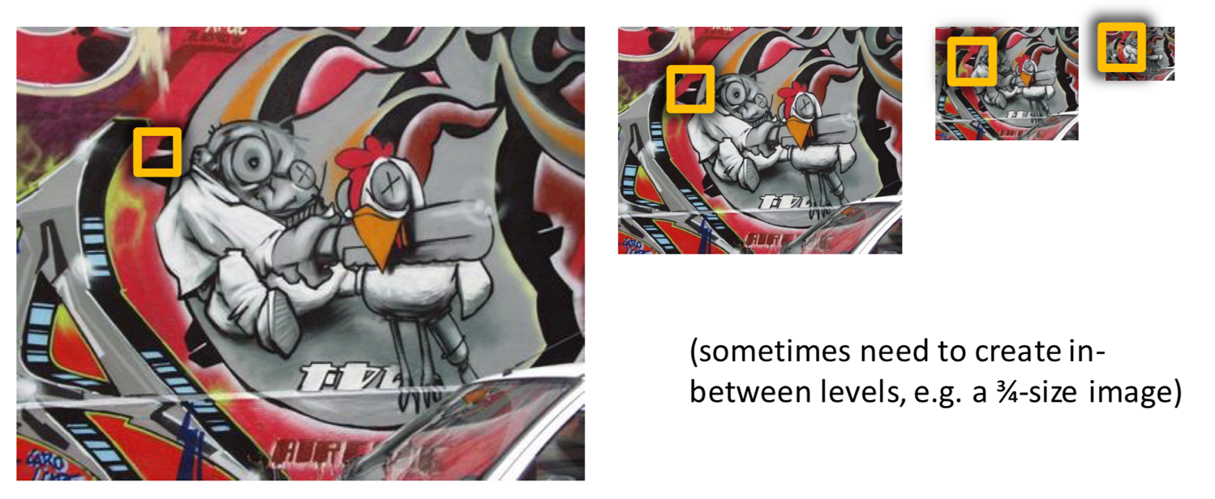
Relatedly: we’ve already talked about using image resizing to handle scale changes.
Instead of changing the filter size, we might change the size of the image and keep the filter size the same:

Slide 81
Now we can detect points of interest, but how do we compare them?
How do we decide that these two features correspond to the same “place” (at least in 3D space) or landmark?
What we need is the ability to describe the space around the feature and compare them.
If two descriptors are close enough, we say the features match.

Slide 82
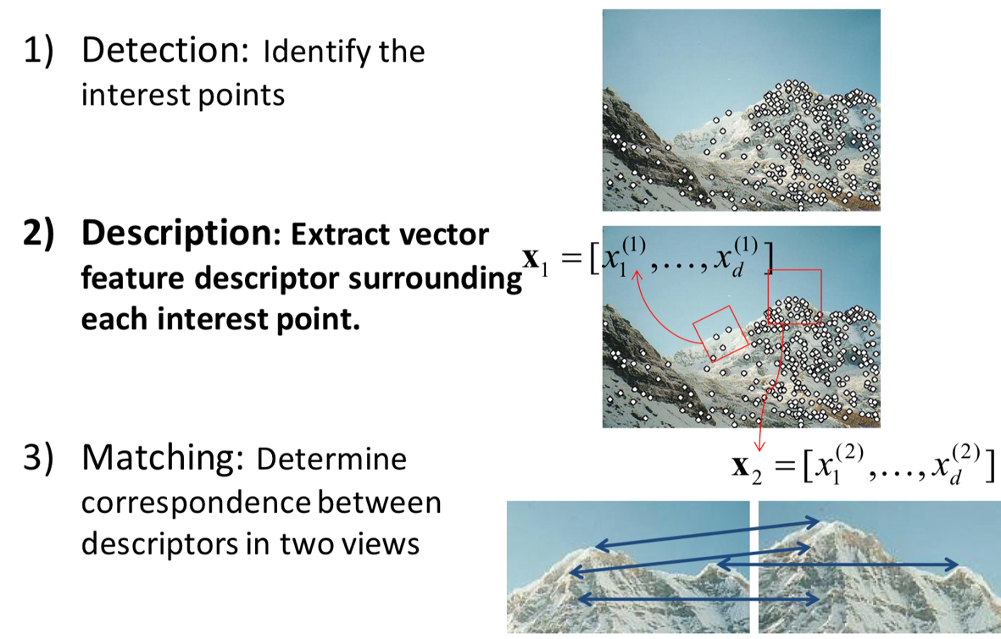
Feature matching (generally) follows a 3-step procedure:

Slide 83
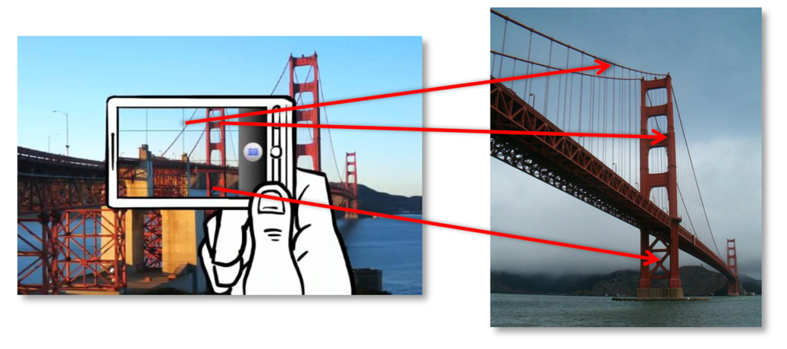
Today, we’ll talk about how to match these features across different images

Slide 84
Today, we’ll talk about how to match these features across different images
Plenty of challenges!
Rotations
Perspective changes
Changes in lighting

Slide 85
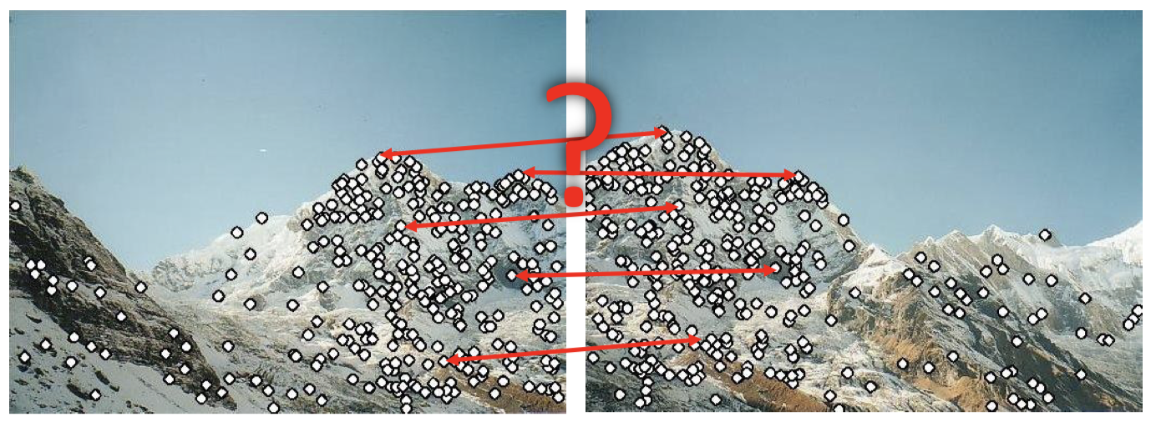
So how do we come up with ”good” descriptors for our detected features?

Slide 86
Properties of feature “descriptors”
Invariance: a feature is invariant if the image is changed and the feature (corner) do not change.
Equivariance: a feature is equivariant if it appears in corresponding locations before and after an image transformation is applied.

Slide 87
Properties of feature “descriptors”
Invariance: a feature is invariant if the image is changed and the feature (corner) do not change.
Equivariance: a feature is equivariant if it appears in corresponding locations before and after an image transformation is applied.
We want our descriptors to be both of these and also discriminative: that the descriptor is as unique as possible for different features. (Otherwise, they wouldn’t be terribly useful…)

Slide 88
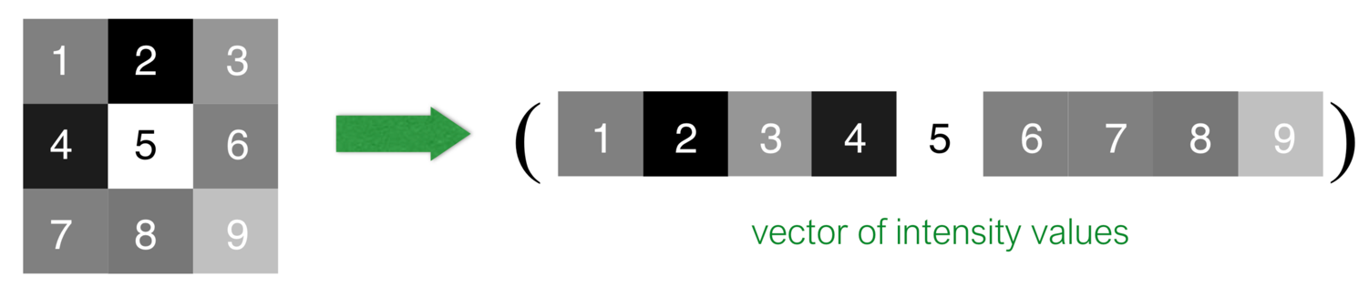
A simple (though not very general) feature is to use the “raw” pixel values

Slide 89
A simple (though not very general) feature is to use the “raw” pixel values
Properties:
Rotations? Not Invariant
Perspective changes? Not Invariant
Changes in lighting? Not Invariant
Discriminative? Very!

Slide 90
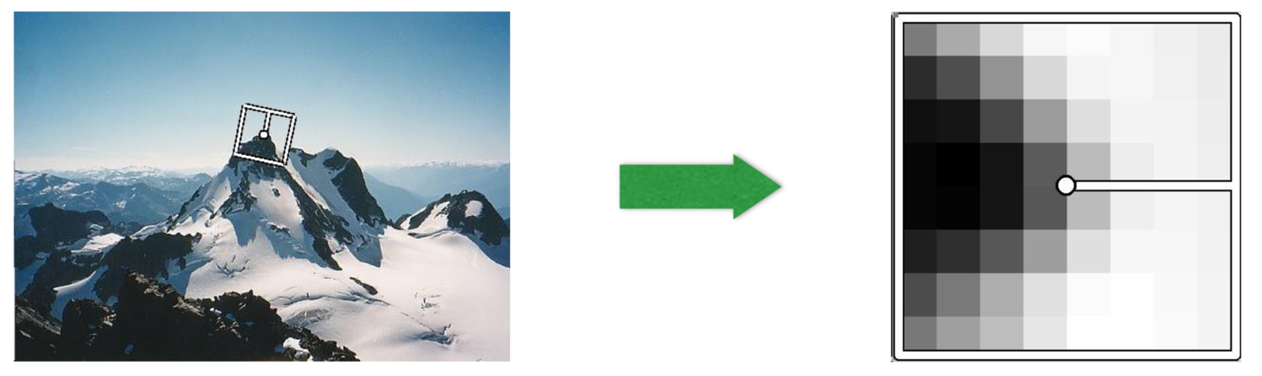
If orientation is a problem, let’s rotate the detected feature
In addition to computing the scale of a feature, we can also compute its orientation:
Feature orientation is frequently computed using the (blurred) image gradients at the feature location.

Slide 91
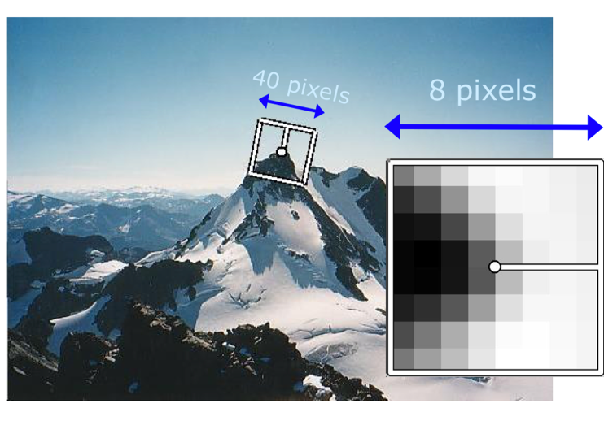
Multi-Scale Oriented Patches (MOPS)
Procedure:
Compute a 40x40 pixel region around feature
Orient the feature using the detected orientation
Downsample to an 8x8 window (often with some smoothing beforehand)
Normalize the window: subtract the mean and divide by the standard deviation (helps to compensate for bias/gain differences)

Slide 92

Multi-Scale Oriented Patches (MOPS)

Slide 93


Perhaps the most famous feature/descriptor is SIFT: Scale Invariant Feature Transform
Builds upon the idea of a spatial histogram but for orientation information:

Slide 94
Perhaps the most famous feature/descriptor is SIFT: Scale Invariant Feature Transform
SIFT takes a 16x16 pixel region, breaks it up into 4x4 cells, and computes a histogram of orientations of the image gradient:
Each cell is converted into an 8-dimensional representation. The dimension of the SIFT descriptor is 4*4*8 = 128

Slide 95
Perhaps the most famous feature/descriptor is SIFT: Scale Invariant Feature Transform
SIFT works astonishingly well!
Has been shown to handle viewpoint changes (of a 3D object) of ~60 degrees
Robust to significant illumination changes (even day-to-night changes sometimes)
In addition, it’s incredibly fast and can run in real time.
It has been a key enabler of progress in computer vision since it’s creation ~15 years ago.
Available in OpenCV

Slide 96

SIFT Example

Slide 97
Now that we’ve talked about how to compute descriptors, how do we compare them?
The general procedure is rather straightforward:
Define a distance function (matching function, scoring function) that compares two descriptors
Compare all features by their descriptors (the brute force method) and keep the minimum-distance matches.

Slide 98
Now that we’ve talked about how to compute descriptors, how do we compare them?
The general procedure is rather straightforward:
Define a distance function (matching function, scoring function) that compares two descriptors
Compare all features by their descriptors (the brute force method) and keep the minimum-distance matches.
The simplest approach is to simply compute the L2 norm between descriptors.

Slide 99
SIFT Matching Example
From the OpenCV matching tutorial:

Slide 100

L2-norm feature matching
Works quite well in general (and easy to compute), though can be ambiguous for similar patches and repeated textures:

Slide 101
L2-norm feature matching
Works quite well in general (and easy to compute), though can be ambiguous for similar patches and repeated textures:
Instead, we might use the ratio distance: the scoring function is the ratio of the distance to the closest feature divided by the distance to the next closest feature.

Slide 102

Building Rome in a Day
Building Rome in a Day
Sameer Agarwal, Noah Snavely, Ian Simon, Steven M. Seitz, Richard Szeliski

Slide 103

ORB: Oriented FAST and Rotated BRIEF
Uses an oriented version of FAST for detection
Uses an rotated version of BRIEF for matching
ORB-SLAM is spectacular…

Slide 104

Now there’s also LIFT:
Learned Invariant Feature Transform
https://arxiv.org/abs/1603.09114

Slide 105

There are also semi-supervised approaches to learning “dense descriptors”
https://arxiv.org/pdf/1806.08756.pdf

