Slide 1
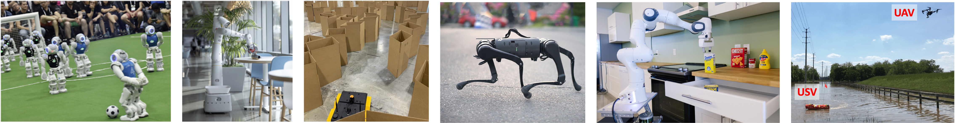
CS 485 Autonomous Robotics
Kinematics I
Prof. Xuesu Xiao
George Mason University
Slides Credits: Gregory Stein

Slide 2
Logistics
Team formation due next Wednesday (Feb 5)
Have you installed ROS yet?
Are you able to launch The BARN Challenge now?

Slide 3
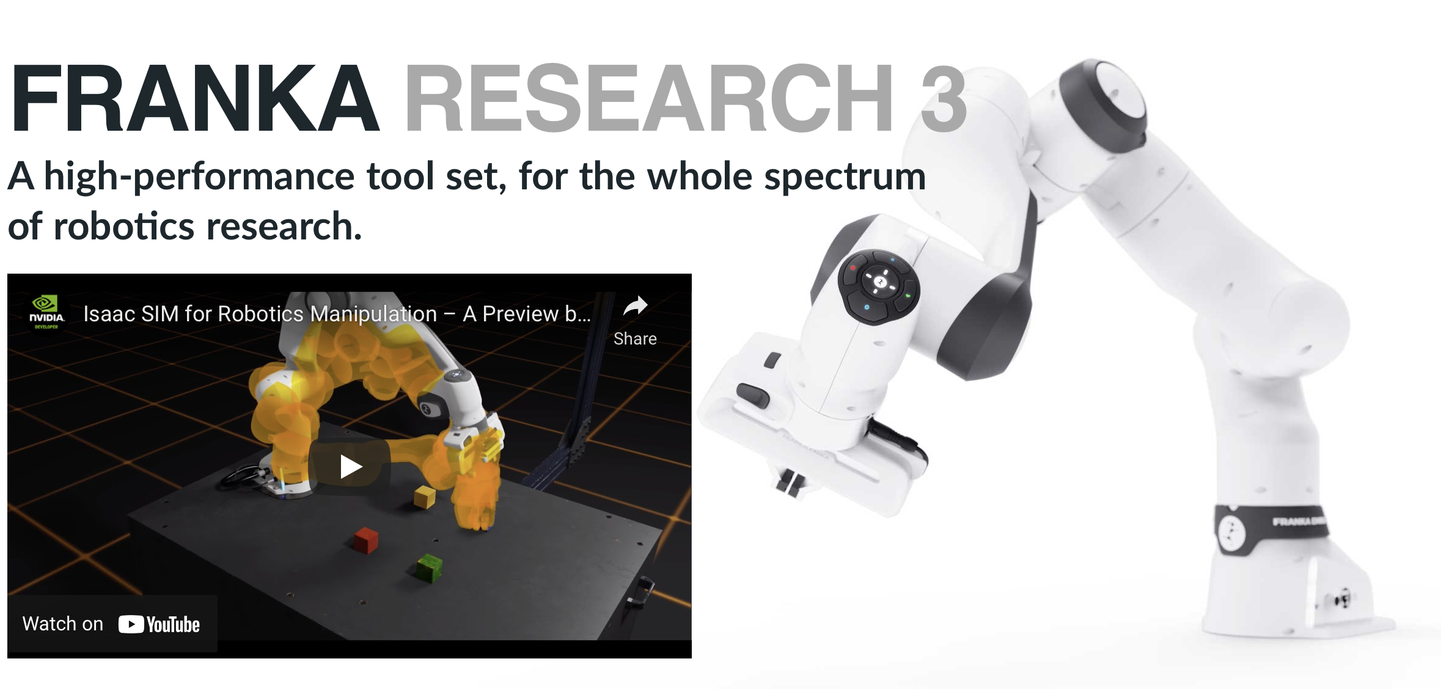
Motivation: before we can understand how robots act, we need to model their form

Slide 4
Reading & Slide Credits
Slide Credits (from which many of the reference images have been taken or adapted):
This reference from ETHZ has a lot of details about 3D transformations and kinematics.
Jana Kosecka, CS685 (FA21)
Kevin Lynch’s online course

Slide 5
Before talking about robots, we should discuss transformations

Slide 6



Before talking about robots, we should discuss transformations
Images make it fairly easy to visualize transformations in the plane: we want to relate the position of the same point between two images.
Scale
Rotation
Aspect
And, of course, translations.

Slide 7
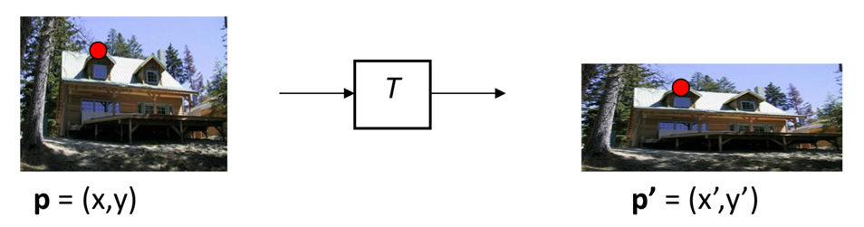
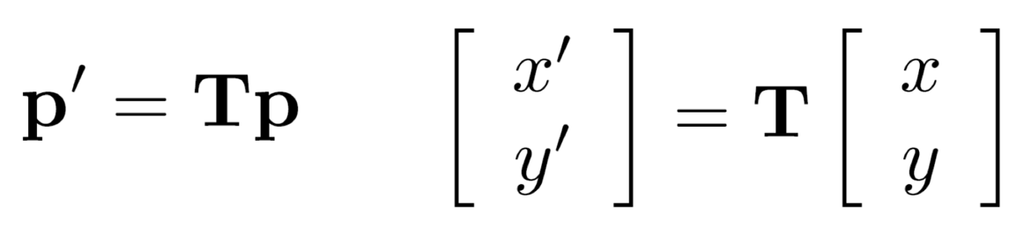
Global Warping: apply a function to every coordinate.
The transformation T applies some fixed operation to the coordinates:
A “global” transformation treats every point the same.
Commonly, these transformations are linear, i.e. they can be represented by matrix:

Slide 8


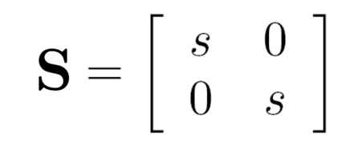
Linear Warping: what operations can we represent by a 2x2 matrix?
Scale is a linear warp:

Slide 9
Linear Warping: what operations can we represent by a 2x2 matrix?
Scale is a linear warp:
If s=2, does the image become larger or smaller?

Slide 10
Linear Warping: Scale
If s=2, does the image become larger or smaller?
Pixel [2, 2] in the transformed coordinates, correspond to [1, 1] in the original image: the image has become larger.

Slide 11
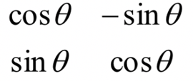
Linear Warping: what operations can we represent by a 2x2 matrix?
Rotation is also a linear warp:
R

Slide 12
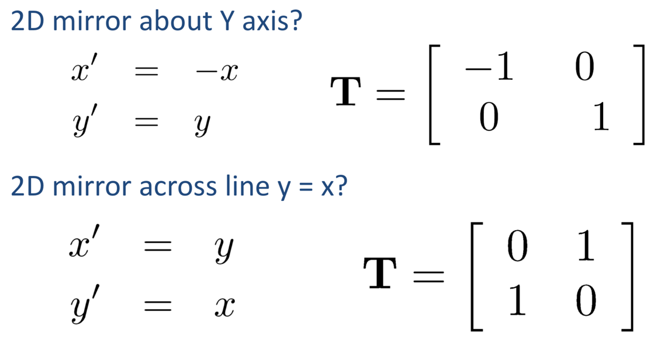
Linear Warping: what operations can we represent by a 2x2 matrix?
So are reflection operations:

Slide 13
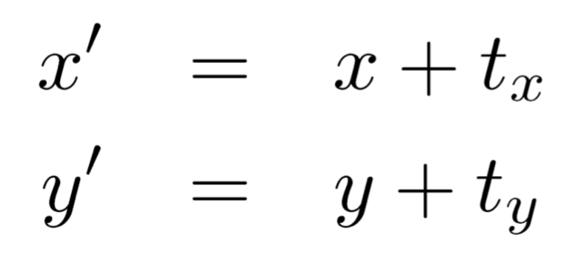
Linear Warping: what operations can we represent by a 2x2 matrix?
What about translation?

Slide 14
Linear Warping: what operations can we represent by a 2x2 matrix?
What about translation?
No! Transformation cannot be represented as a 2x2 matrix operation. [Think about what happens to the (0, 0) coordinate.]

Slide 15
Homogeneous Coordinates:

Slide 16
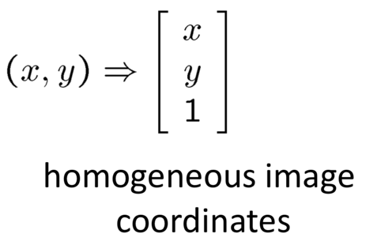
Homogeneous Coordinates:
How we add translation
The trick is to add a third coordinate:

Slide 17
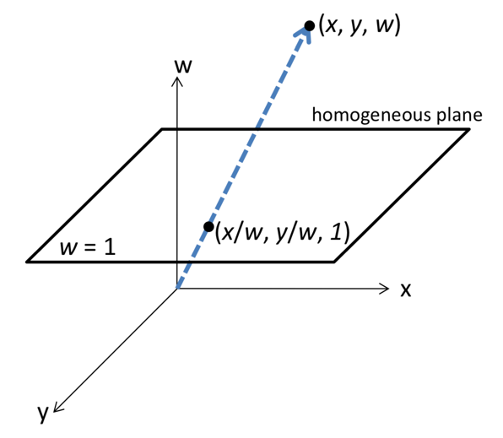
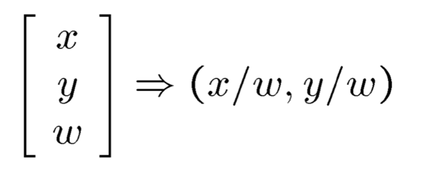
Homogeneous Coordinates:
How we add translation
The trick is to add a third coordinate:
After applying a transformation (now a 3x3 matrix), we can convert back to our “usual” 2D coordinates with:

Slide 18
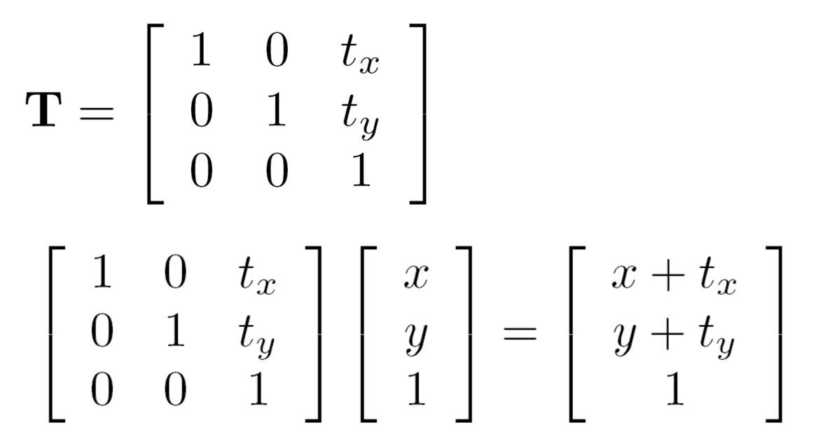
Homogeneous Coordinates:
How we add translation
The trick is to add a third coordinate:

Slide 19
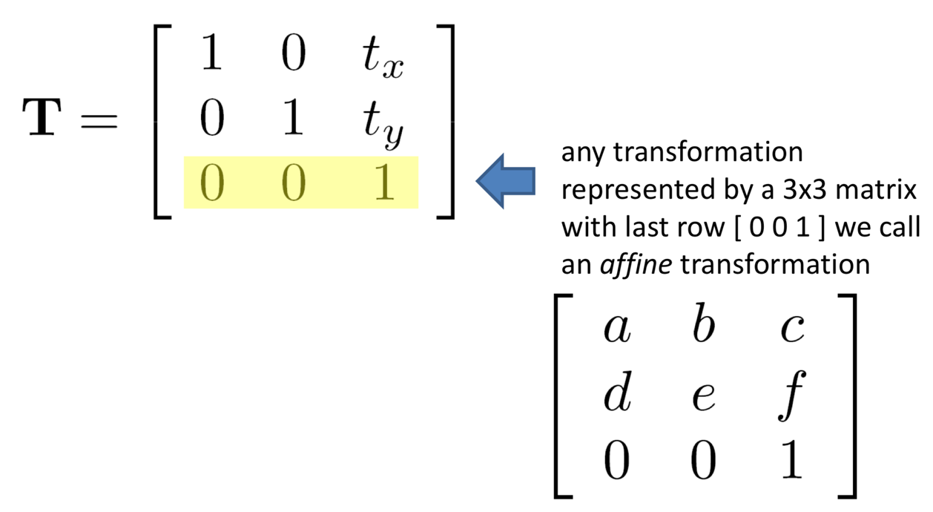
Homogeneous Coordinates:
Affine Transformations

Slide 20
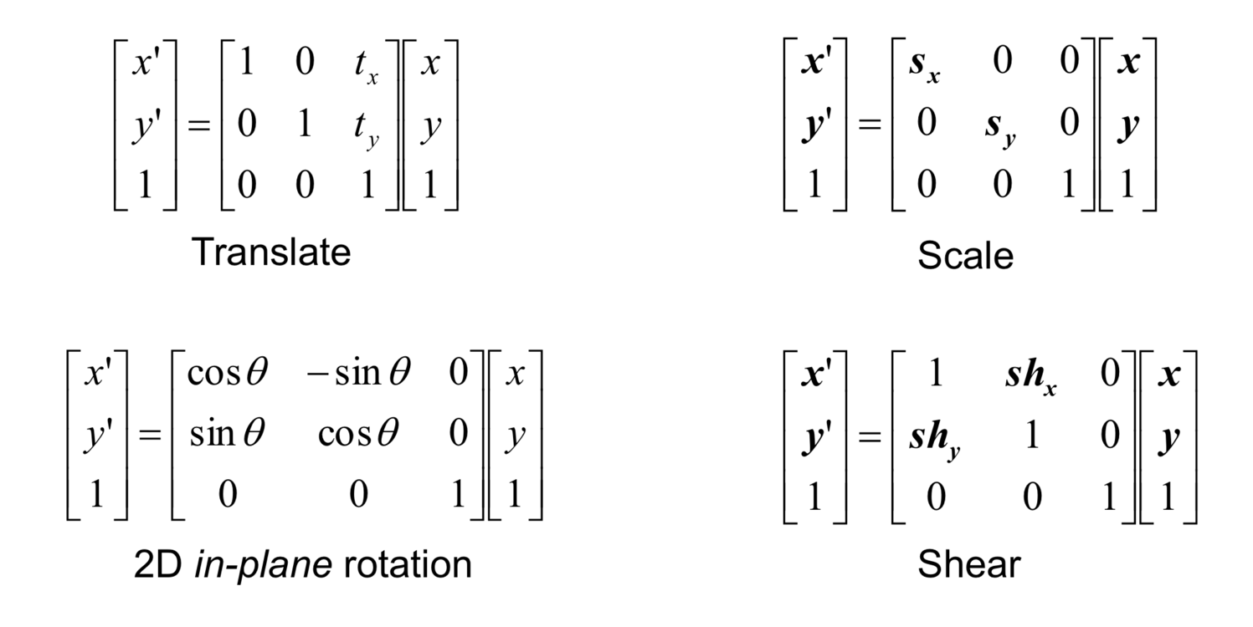
Homogeneous Coordinates:
Affine Transformations

Slide 21
Homogeneous Coordinates:
Affine Transformations
We’ll discuss out-of-plane transformations later.

Slide 22
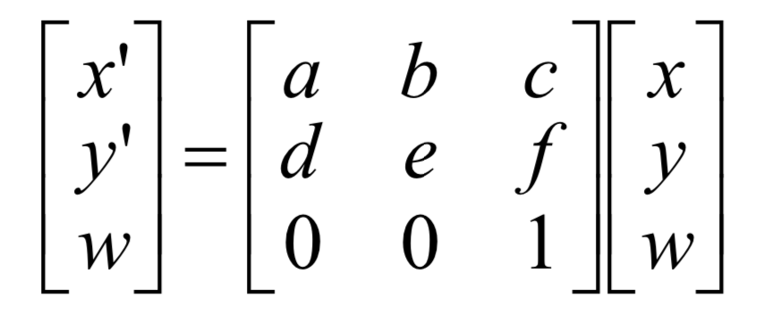
Homogeneous Coordinates:
Affine Transformations
Properties of Affine Transformations:
The origin of the input image does not map to the origin in the target image (in general)
Lines remain lines after transformations
Lines that are parallel remain parallel

Slide 23
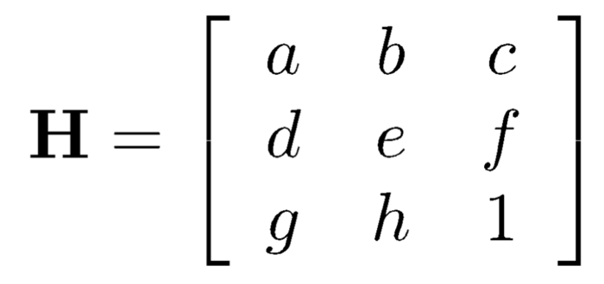
Homographies
(Also known as projective transforms or planar perspective maps)
We add elements to this bottom row, allowing the image to rotate out of the plane.

Slide 24


Homographies
(Also known as projective transforms or planar perspective maps)
We add elements to this bottom row, allowing the image to rotate out of the plane.

Slide 25
Homographies
(Also known as projective transforms or planar perspective maps)
We add elements to this bottom row, allowing the image to rotate out of the plane.

Slide 26
Transformations in the plane
Properties of Homographies:
The origin of the input image does not map to the origin in the target image (in general)
Lines remain lines after transformations
Lines that are parallel do not remain parallel

Slide 27
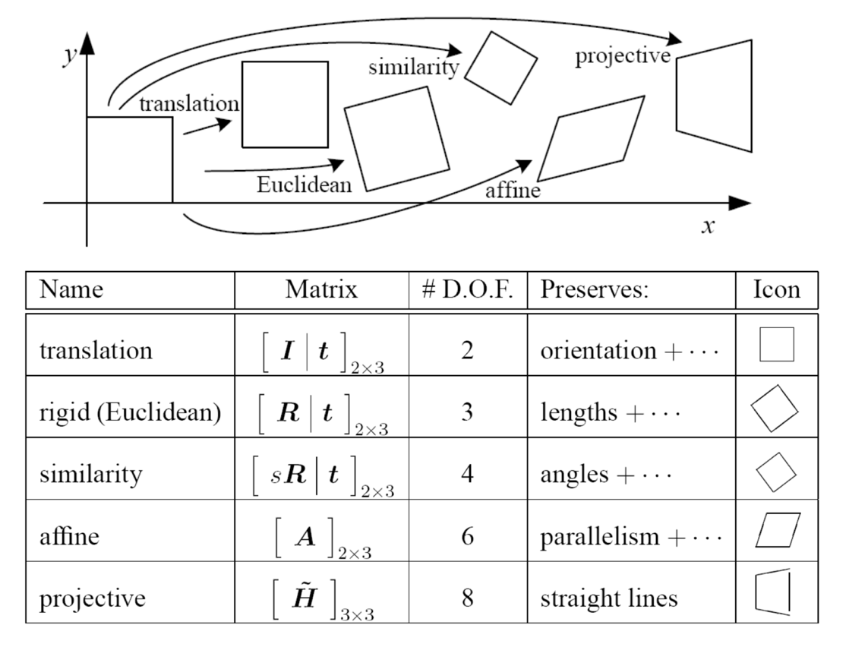
Transformations in the plane

Slide 28
Transformations in the plane

Slide 29
Rigid transformations for Robots
We can relate points in different coordinate frames as long as we know the (Euclidian) transformation between them.
The inverse of that transform (naturally) allows us to invert that transformation, to relate the coordinates in the opposite direction.

Slide 30
Rigid transformations for Robots
We can relate points in different coordinate frames as long as we know the (Euclidian) transformation between them.
The inverse of that transform (naturally) allows us to invert that transformation, to relate the coordinates in the opposite direction.
What about a two (or more) segment arm?

Slide 31
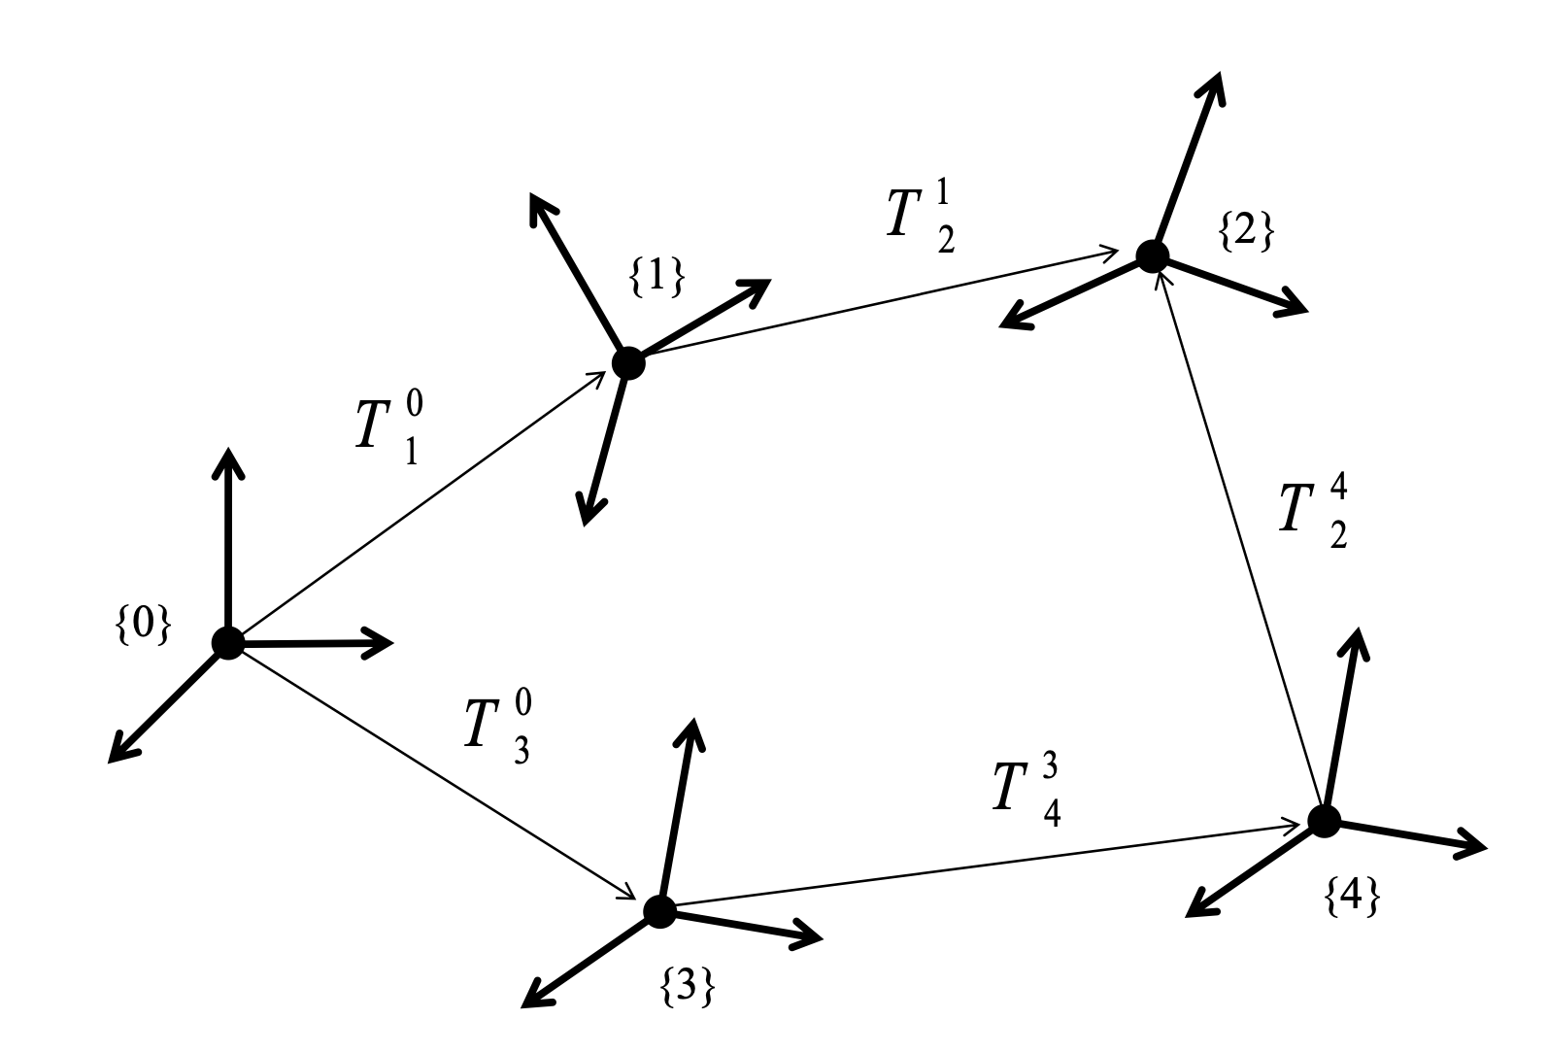
We can compose transformations to get the relative position between multiple frames
It just requires carefully keeping track of things…
From: https://www.eecs.yorku.ca/course_archive/2011-12/W/4421/lectures/Day%2006.pdf

Slide 32
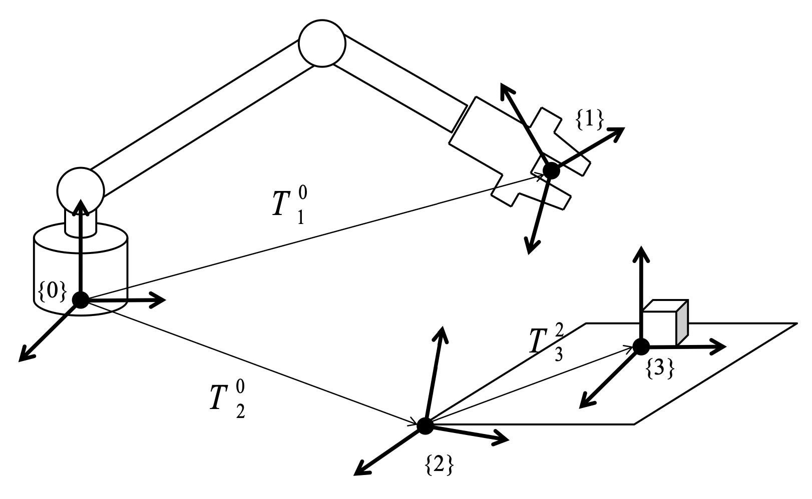
The same is true for a robot

Slide 33
Position and Pose are different
Position is just a point in 3D space.
We can represent it as a vector.
This is what we’ve been doing: we know the location of some point in a particular frame and we want its value in another frame.
From: Shivesh Kumar, Tutorial on Lie Algebras and Kinematics

Slide 34
Position and Pose are different
Position is just a point in 3D space.
We can represent it as a vector.
This is what we’ve been doing: we know the location of some point in a particular frame and we want its value in another frame.
Pose is a position and an orientation.
How should we represent it?
From: Shivesh Kumar, Tutorial on Lie Algebras and Kinematics

Slide 35
Position and Pose are different
Position is just a point in 3D space.
We can represent it as a vector.
This is what we’ve been doing: we know the location of some point in a particular frame and we want its value in another frame.
Pose is a position and an orientation.
How should we represent it?
Let’s use a SE(3) transformation! It has both position and orientation. It is common to represent pose as a 4x4 transformation matrix.
From: Shivesh Kumar, Tutorial on Lie Algebras and Kinematics

Slide 36
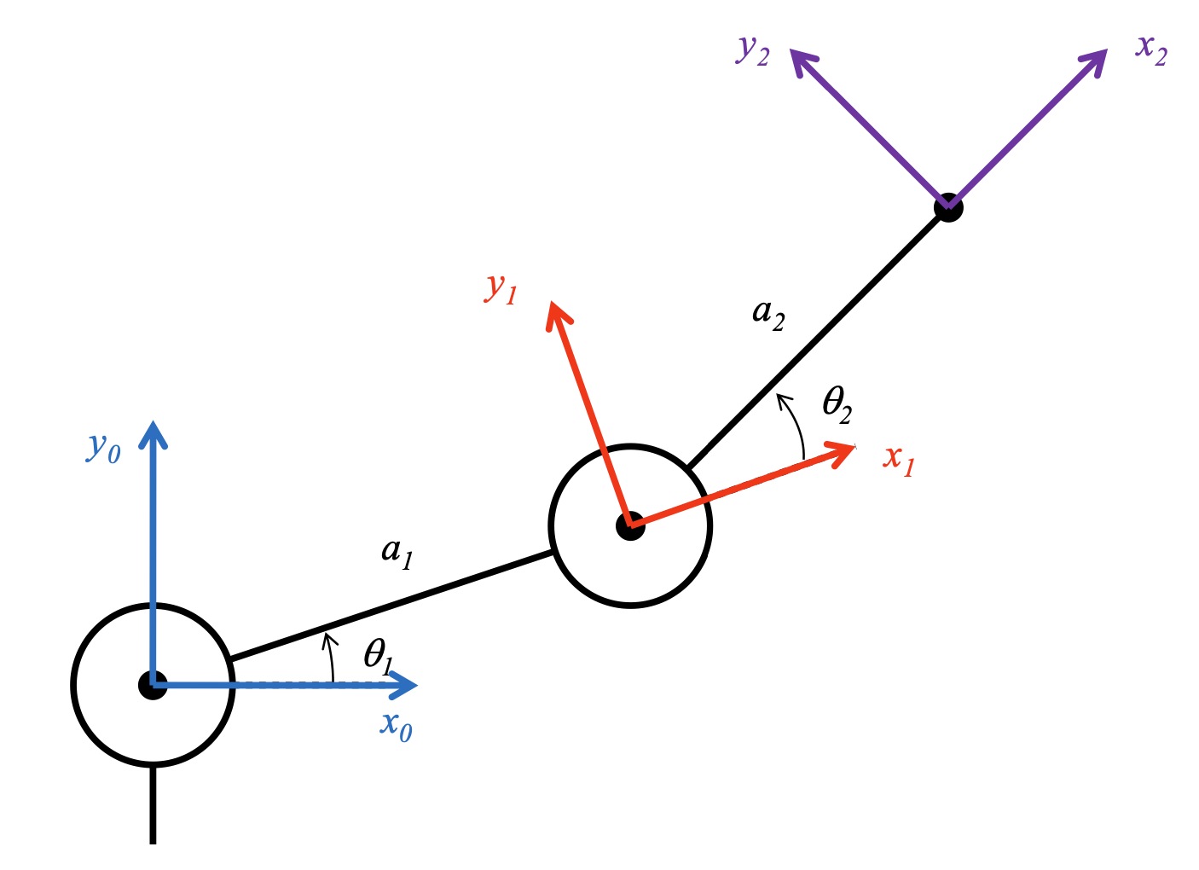
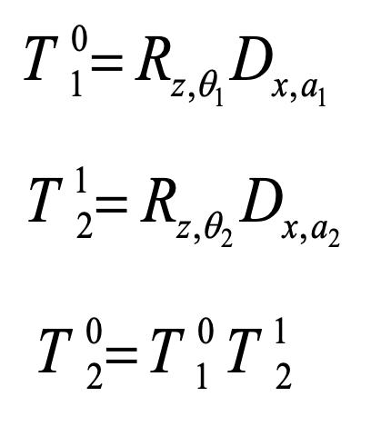
The end effector is the origin (0, 0) in the frame defined by the end effector
The transform between the endpoint of the arm and the global coordinate system is the transform we need.
That transform is then just:
(or its inverse, depending on what you want)

Slide 37
We recover the position of the end effector by passing the “origin” to the pose matrix
To compute the position, we passed the [0, 0, 1] vector in the endpoint coordinate frame, multiplying by the transformation matrix that represents the pose.
If you have a mechanism on the arm—say a point that’s 0.1 unit from the tip of the arm—the transformation will be able to tell you its point as well.

Slide 38
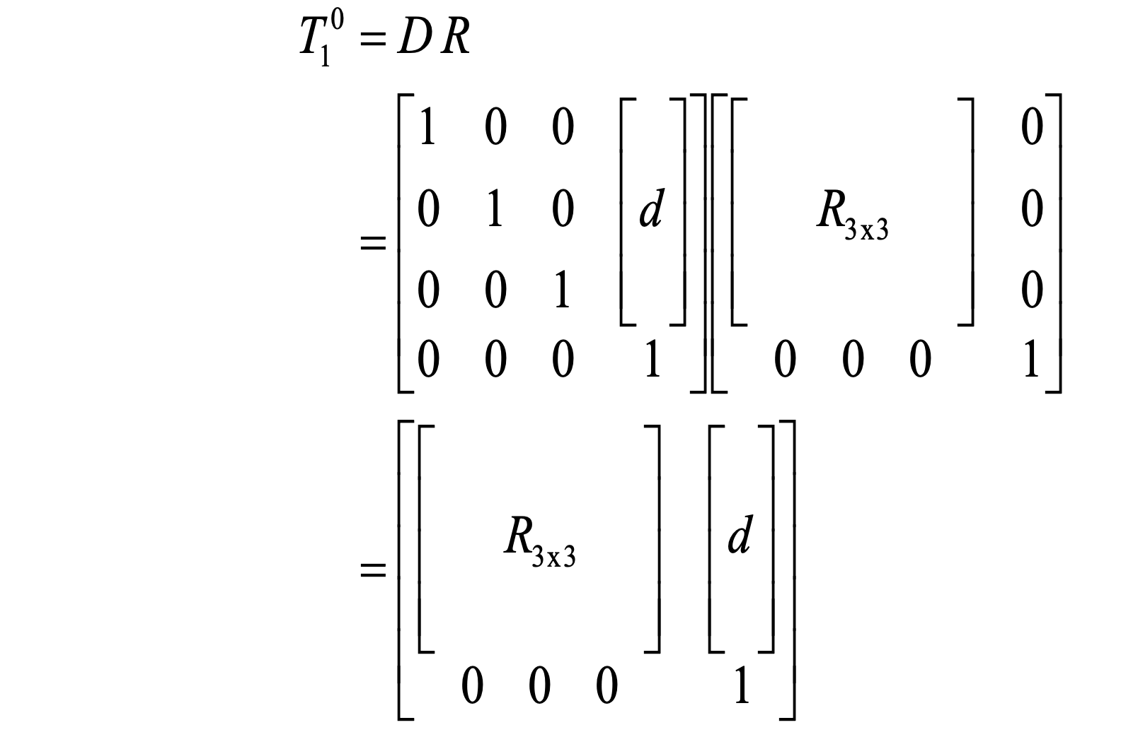
Are we done?
What about 3D coordinates?
So far, we’ve mostly only defined transformations in 2D.
The ideas are the same, but the rotations are a bit more complicated to deal with.

Slide 39
3D Rotations
Euler Angles and Quaternions

Slide 40
Like transformations, 3D rotations are tricky to get right
It’s not that they’re particularly complicated, but you have to be sure that the order of all the matrices is correct (and consistent with how you define the different coordinate systems, etc.) and it can sometimes be tricky to make sure that everything is accurate.
We’ll be going through some of the fundamentals now, but later today we’ll talk about some tools (in ROS) that keep track of the transforms for you.

Slide 41
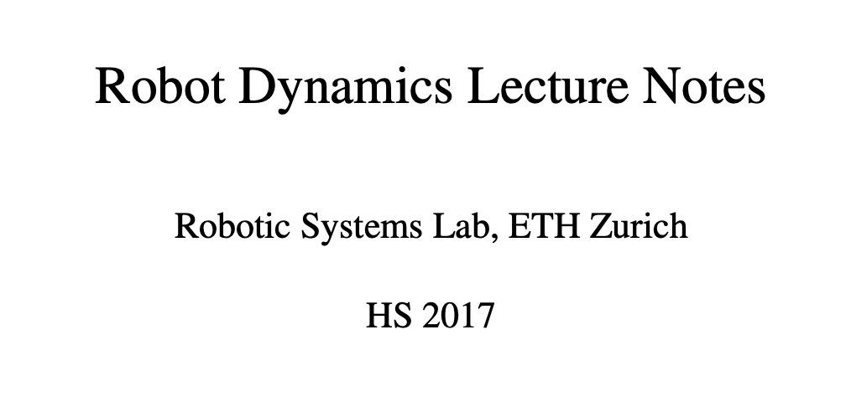
A reference you might appreciate
This reference from ETHZ has a lot of details about 3D transformations and kinematics. It’s where a handful of the next equations will come from and could be a useful guide to you.

Slide 42
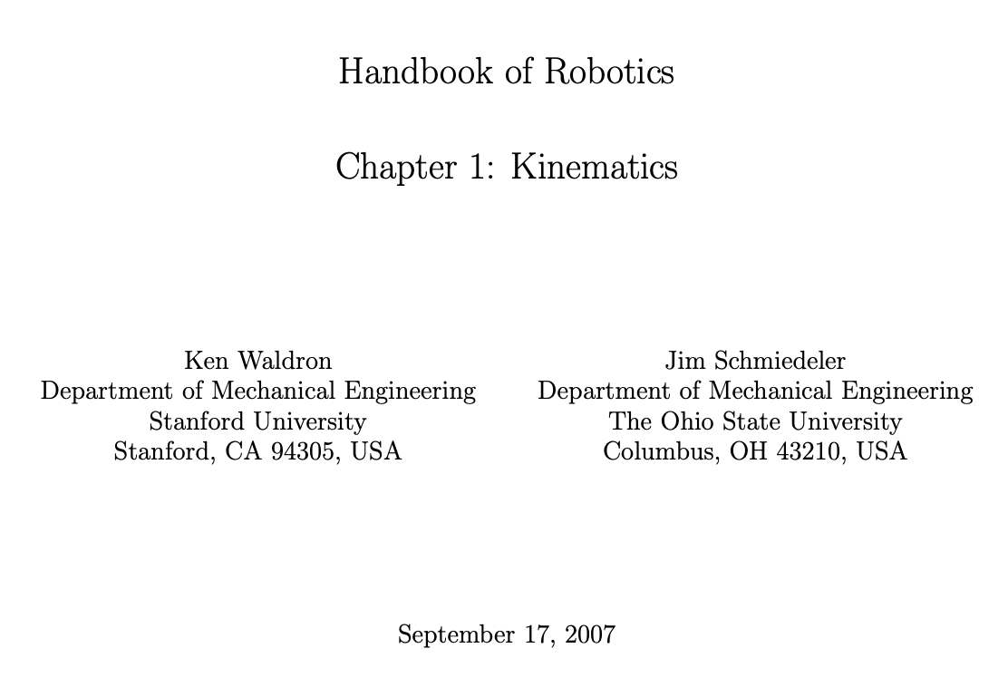
Another reference you might appreciate
This reference is also a very nice summary with some useful equations.

Slide 43
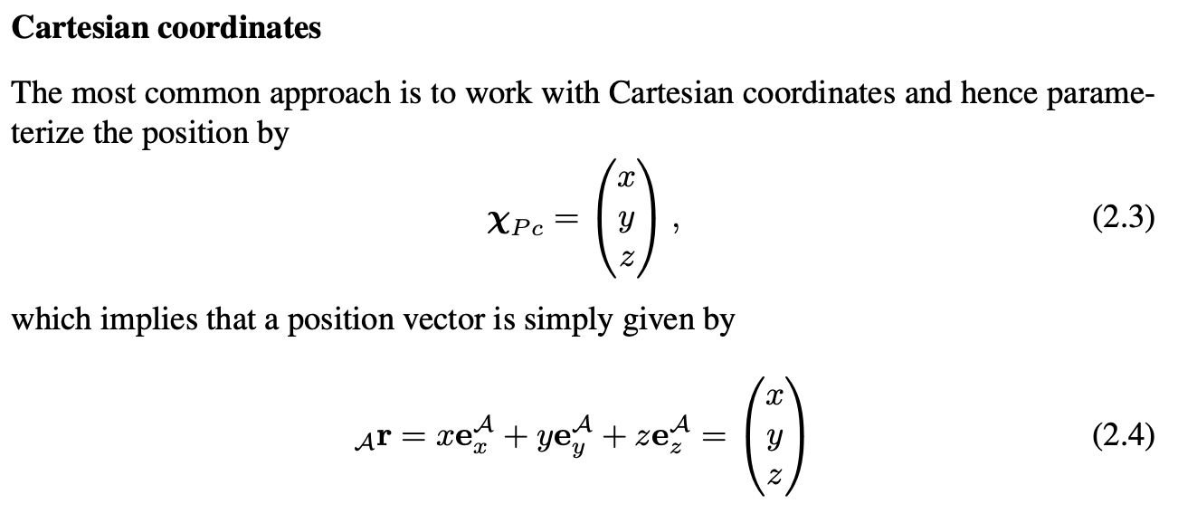
Representing a 3D position is straightforward
We simply need to add another coordinate to our homogeneous vector:

Slide 44
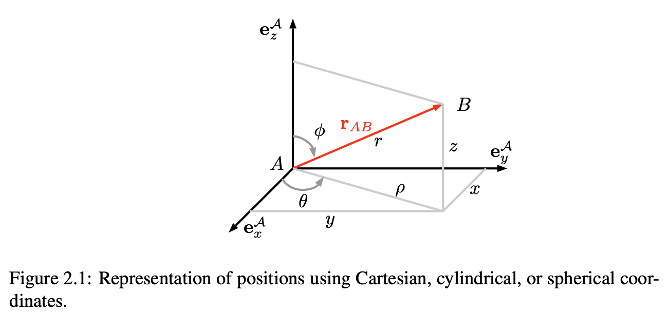
In 2D, we need only one rotation angle.
In 3D, we require three!
We need two angles to pick the direction of the arm (remember spherical coordinates?) and then a third to define the rotation of the arm itself (think of holding your arm out in a particular direction and then rotating your hand).

Slide 45
Rotations in 3D belong to the group “SO(3)”
SO(3) is the “Special Orthogonal Group” in 3D. It’s a notation that appears a lot to describe the degrees of freedom in the robot.

Slide 46
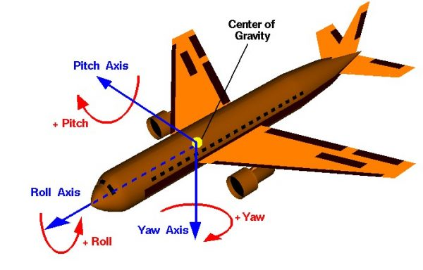
Some terminology from Aerospace
From: NASA

Slide 47
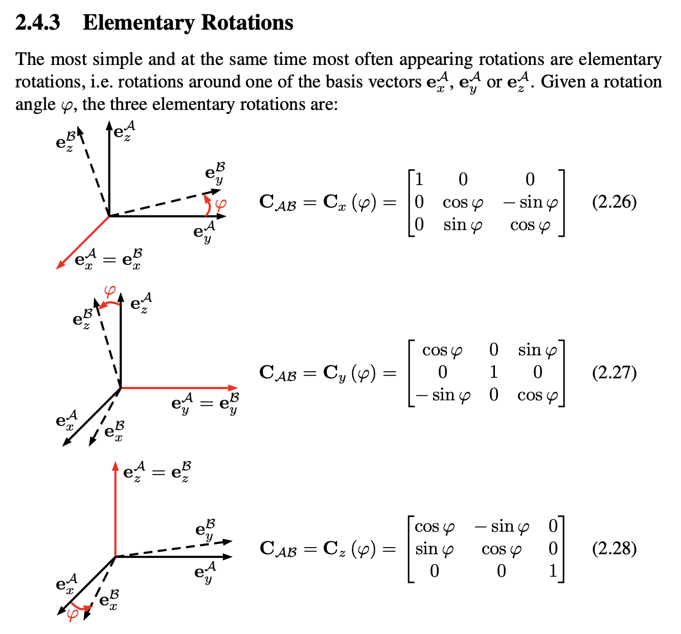

Slide 48
There are multiple ways to compose these transformations into a 3D rotation
We need three rotations to represent any 3D rotation (as mentioned before), but around which axes should they be performed? What order should we perform them?
Euler Angles: a 3D rotation is written as a sequence of 3 consecutive rotations about some axis.

Slide 49
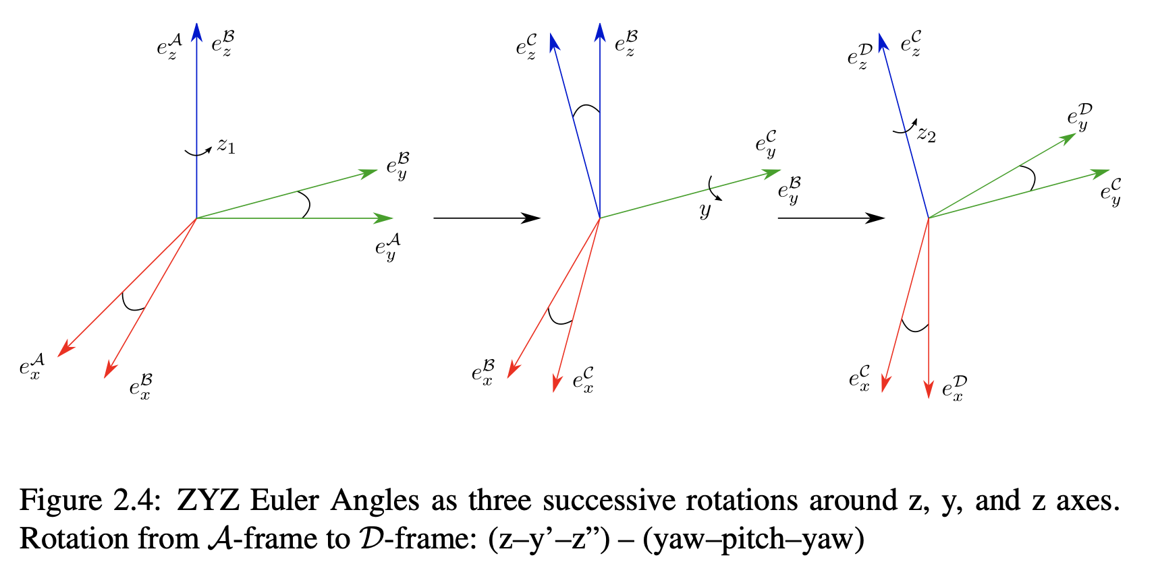
ZYZ Euler Angles

Slide 50
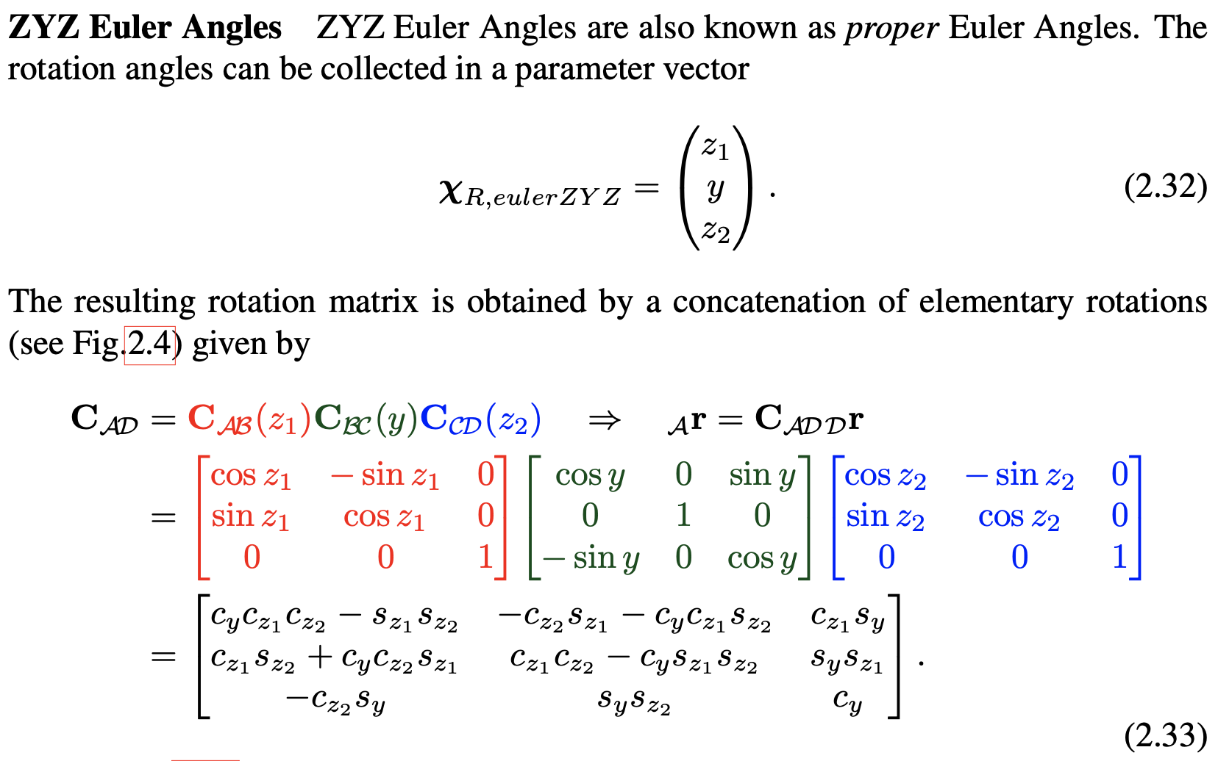
ZYZ Euler Angles

Slide 51
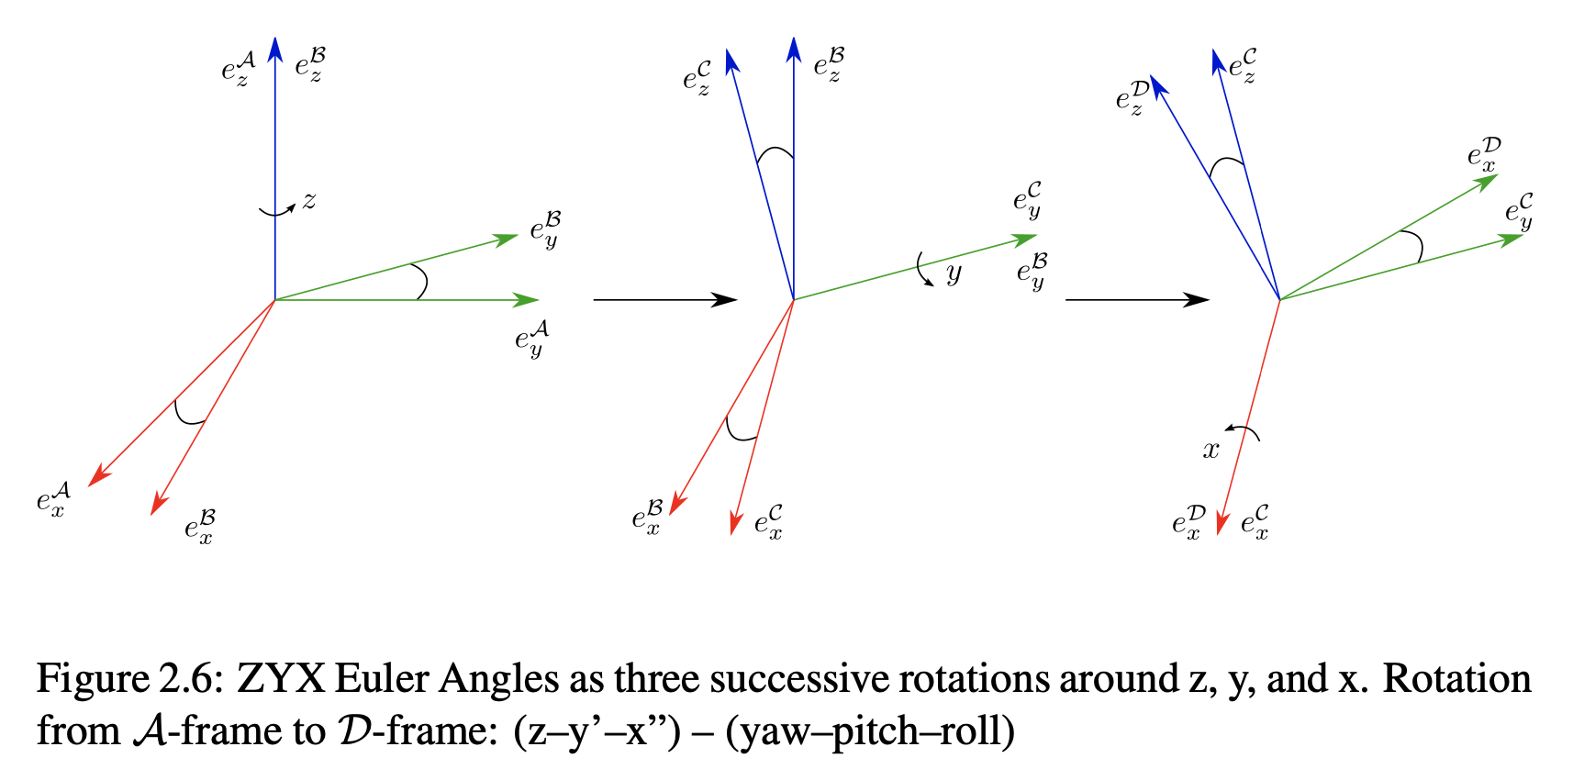
ZYX Euler Angles: “yaw, pitch, roll”

Slide 52
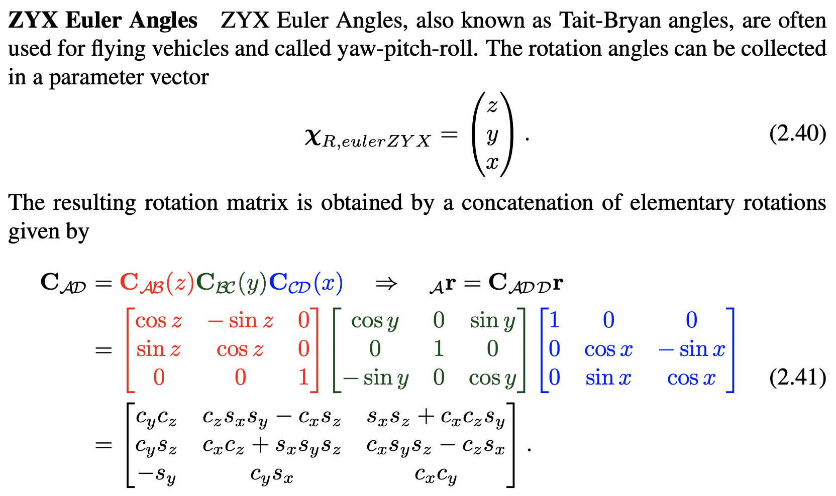
ZYX Euler Angles: “yaw, pitch, roll”

Slide 53
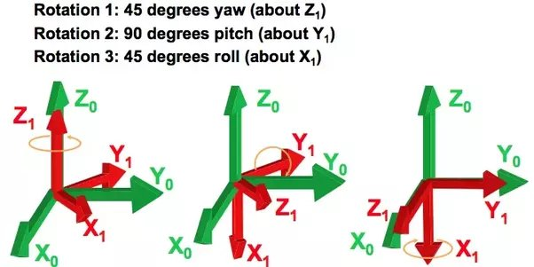
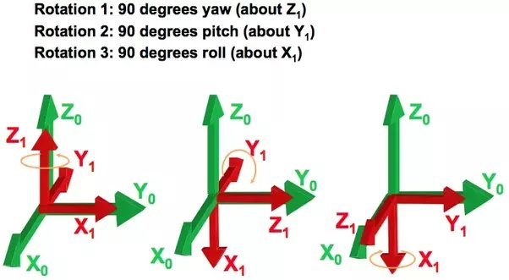
Euler angles have a “flaw”
For the 3-element representations, we can have configurations where the rotation matrix is singular and thus cannot be inverted.
Here’s an example: these two correspond to the same transform
From: https://www.quora.com/What-is-the-singularity-problem-while-representing-a-spacecraft-attitude-in-terms-of-Euler-angles

Slide 54
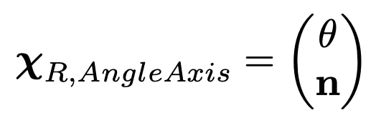
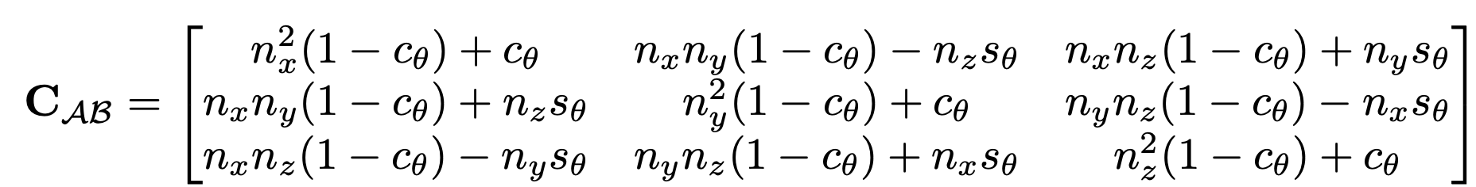
There is also the “angle axis” definition
We have an axis along which rotation occurs and the angle defining how much we rotate.
where c_theta = cos(theta) and s_theta = sin(theta)

Slide 55
You may also have heard of the Quaternion, another way of representing a 3D rotation
A “quaternion” is a 4-element vector and, as such, is “non-minimal”
So why do we use a 4-element vector when we only need 3-elements?
For the 3-element representations, we can have configurations where the rotation matrix is singular and thus cannot be inverted

Slide 56
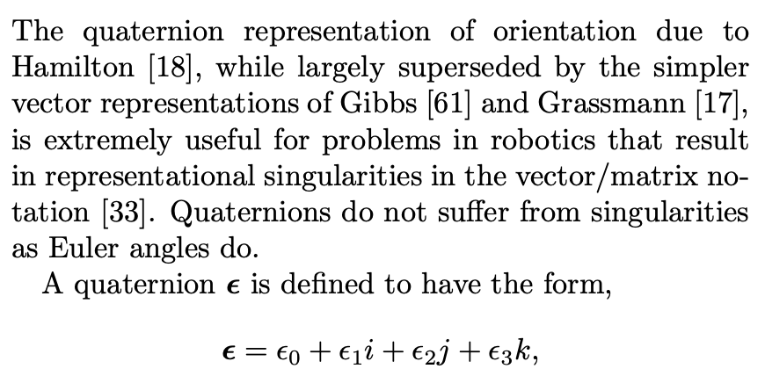
Quaternions are another way to represent 3D rotations (akin to 4D imaginary numbers)

Slide 57
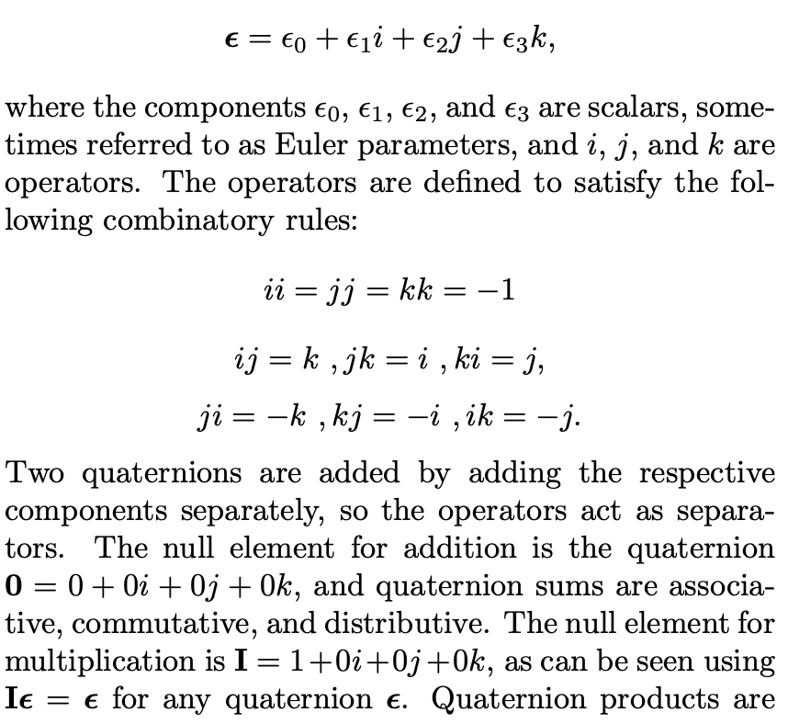
Quaternions are another way to represent 3D rotations (akin to 4D imaginary numbers)

Slide 58
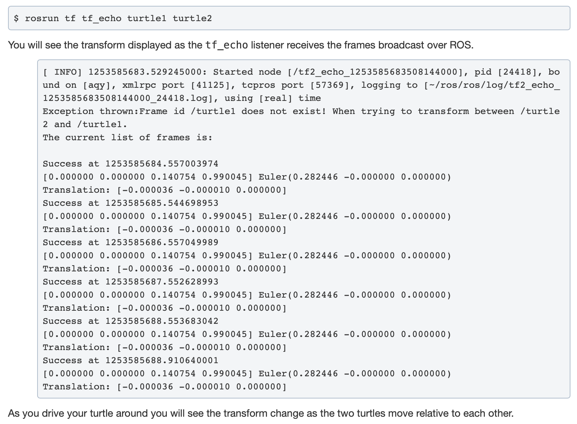
Most packages (including ROS’s tf) have support for both Euler Angles & Quaternions

Slide 59
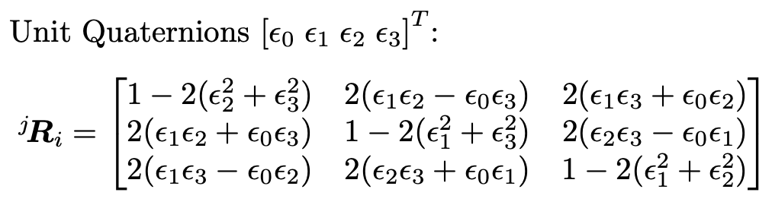
Most packages (including ROS’s tf2) have support for both Euler Angles & Quaternions
We can also convert between them:

