Slide 1
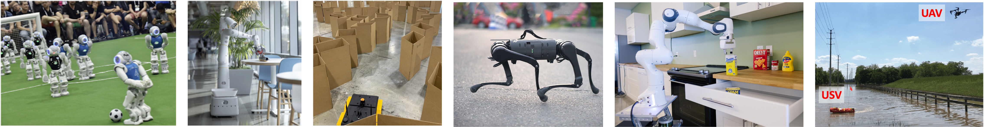
CS 485 Autonomous Robotics
Kinematics II
Prof. Xuesu Xiao
George Mason University
Slides Credits: Gregory Stein

Slide 2
Logistics
Send the instructor and TA your team formation via email before Wednesday's class
  Your team name
  Your team members’ name
  Your team members’ G#
  Your team members’ GMU email
Have you installed ROS yet?
Are you able to launch The BARN Challenge now?
Assignment 1 is out

Slide 3
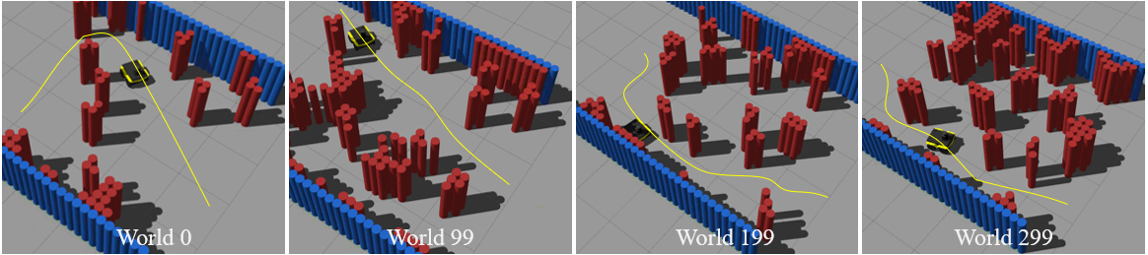
Why do we need all these transforms?
Global (Spatial) Frame
Robot (Body) Frame

Slide 4
Notes
https://citeseerx.ist.psu.edu/viewdoc/download?doi=10.1.1.126.2560&rep=rep1&type=pdf LIE GROUPS AND LIE ALGEBRAS IN ROBOTICS J.M. Selig
This is a great tutorial: http://www.stardust-network.eu/wp-content/uploads/2021/03/Shivesh_Kumar_Lie-group-based-modelling-of-robot-kinematics-dynamics.pdf

Slide 5
Forward and Inverse Kinematics
Joint angles to end effector pose, and vice versa…

Slide 6
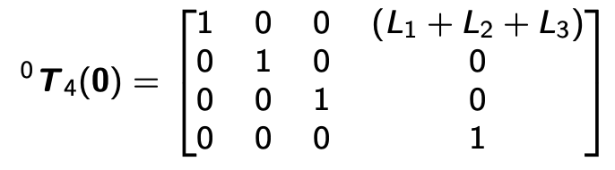
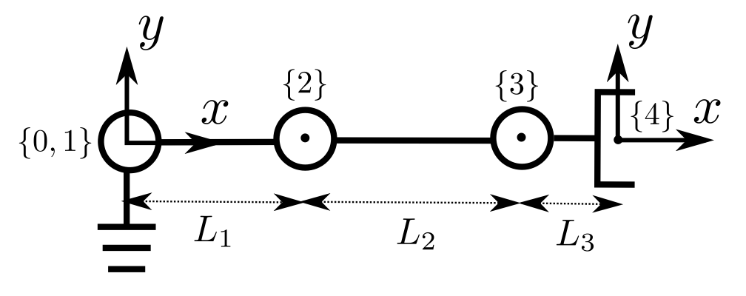
Let’s look at an example: the pose of a simple manipulator arm
The point is at x=L1+L2+L3.
The pose is as follows:
Notice the notation: ⁰T₄ implies transform from frame 0 to frame 4
From: Shivesh Kumar, Tutorial on Lie Algebras and Kinematics

Slide 7
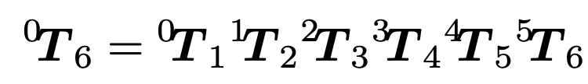
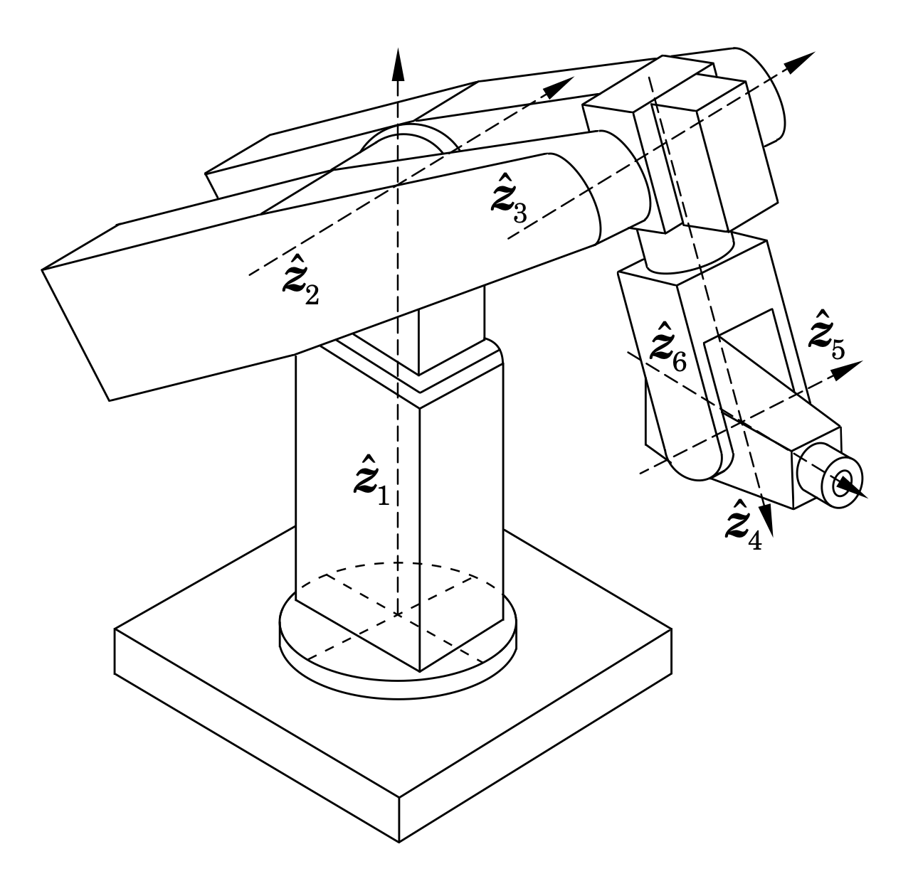
Forward Kinematics: taking a series of joint angles and computing the position of the end
The forward kinematics problem is no doubt important, but what if we wanted to go backwards?
Often we know where we want the robot to be, but we don’t know how to get it to that point.

Slide 8
Inverse Kinematics: computing joint angles from a target endpoint
For an inverse kinematics problem, we need to know a few things:
The model of the arm: the forward transformation as a function of the joint angles and such.
The coordinate of the point we want to reach.

Slide 9
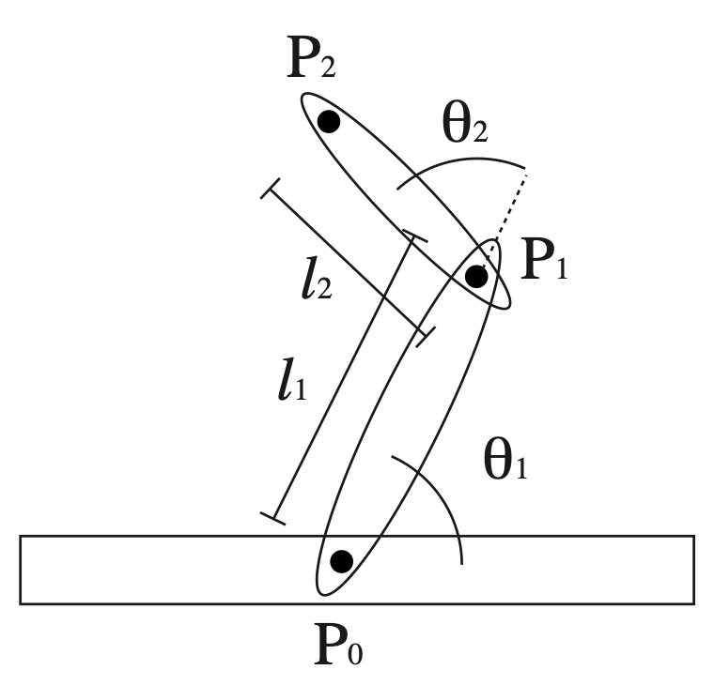
Let’s consider a simple example: a two-segment robot arm
We have a simple arm with two segments (at right).
Each joint can rotate freely.
What’s the forward transform?

Slide 10
Let’s consider a simple example: a two-segment robot arm
We have a simple arm with two segments (at right).
Each joint can rotate freely.
What’s the forward transform?

Slide 11
Let’s consider a simple example: a two-segment robot arm
Let’s consider some conceptual questions:
If the arm is “straight” (theta2 = 0), how far away is the end point?

Slide 12
Let’s consider a simple example: a two-segment robot arm
Let’s consider some conceptual questions:
If the arm is “straight” (theta2 = 0), how far away is the end point?
L1 + L2 units away.

Slide 13
Let’s consider a simple example: a two-segment robot arm
Let’s consider some conceptual questions:
If the arm is “straight” (theta2 = 0), how far away is the end point?
L1 + L2 units away.
What points can a straight arm reach?

Slide 14
Let’s consider a simple example: a two-segment robot arm
Let’s consider some conceptual questions:
If the arm is “straight” (theta2 = 0), how far away is the end point?
L1 + L2 units away.
What points can a straight arm reach?
A circle of that radius.

Slide 15
Let’s consider a simple example: a two-segment robot arm
Ok. Now let’s bend the arm. Let’s say we know theta2.
What points can the new “bent arm” reach?

Slide 16
Let’s consider a simple example: a two-segment robot arm
Ok. Now let’s bend the arm. Let’s say we know theta2.
What points can the new “bent arm” reach?
It’s still a circle, but a smaller one, with a radius given by the law of cosines

Slide 17
Let’s consider a simple example: a two-segment robot arm
Now we’re ready: If we have a point at coordinate (x, y), what angle values do we need to put the end of the arm at that point?

Slide 18
Let’s consider a simple example: a two-segment robot arm
Now we’re ready: If we have a point at coordinate (x, y), what angle values do we need to put the end of the arm at that point?
How might we approach this problem? Can we simplify it so that we don’t have to solve for two variables at once?

Slide 19
Let’s consider a simple example: a two-segment robot arm
Now we’re ready: If we have a point at coordinate (x, y), what angle values do we need to put the end of the arm at that point?
How might we approach this problem? Can we simplify it so that we don’t have to solve for two variables at once?
Sure! Let’s first figure out the value of theta2 that gives us the radius we need and then pick the value of theta1 that gets the orientation.

Slide 20
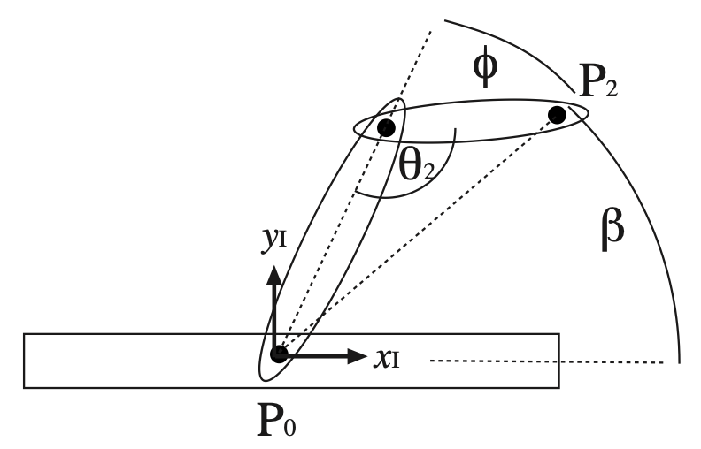
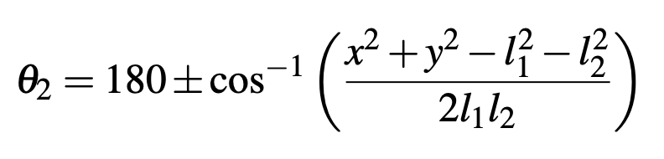
Let’s consider a simple example: a two-segment robot arm
Here’s the new coordinate system:
The math for theta2 isn’t too messy, and works out to be the following:

Slide 21
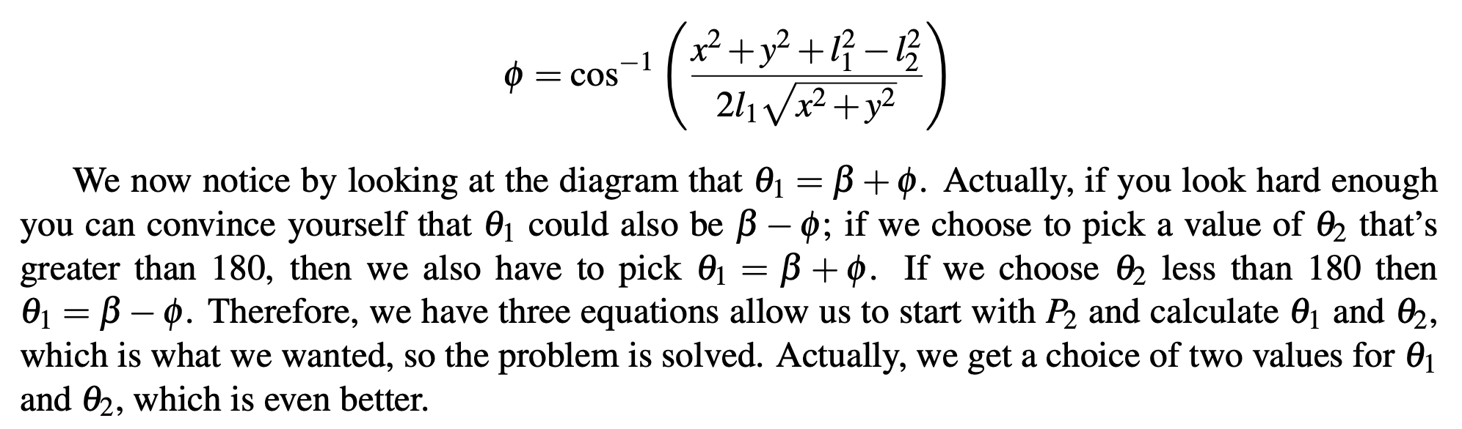
Let’s consider a simple example: a two-segment robot arm
Here’s the new coordinate system:
The math for theta2 isn’t too messy, and works out to be the following:

Slide 22
What might the Inverse Kinematics of this 6DoF arm look like?
It has 3 “arm segments” and a spherical end effector.
We can rotate the base and bend the arm to get the end effector to points within reach. The end effector can rotate around all three axes.
The IK solution uses both: we first figure out where the “base” of the end effector needs to be and then move the arm to get it there.

Slide 23
In general, inverse kinematics can be hard to solve exactly
If we do not have an exact formula, we can use numerical optimization techniques.
A simple procedure: iterate through the joint angles and increase or decrease the joint angle. If we’ve moved closer to the point we seek, keep the configuration, otherwise keep going. Repeat until we get to the goal.
Simple, but lacking in guarantees of convergence and can be very expensive.

Slide 24
In general, inverse kinematics can be hard to solve exactly
There are numerical (optimization) approaches as well.
There are some *excellent* details here:
https://motion.cs.illinois.edu/RoboticSystems/InverseKinematics.html
In short, we can take the higher-dimensional derivative (the “Jacobian”) and run Gradient Descent—an iterative procedure for moving “downhill” towards some satisfying configuration—until we reach the point we seek.

Slide 25
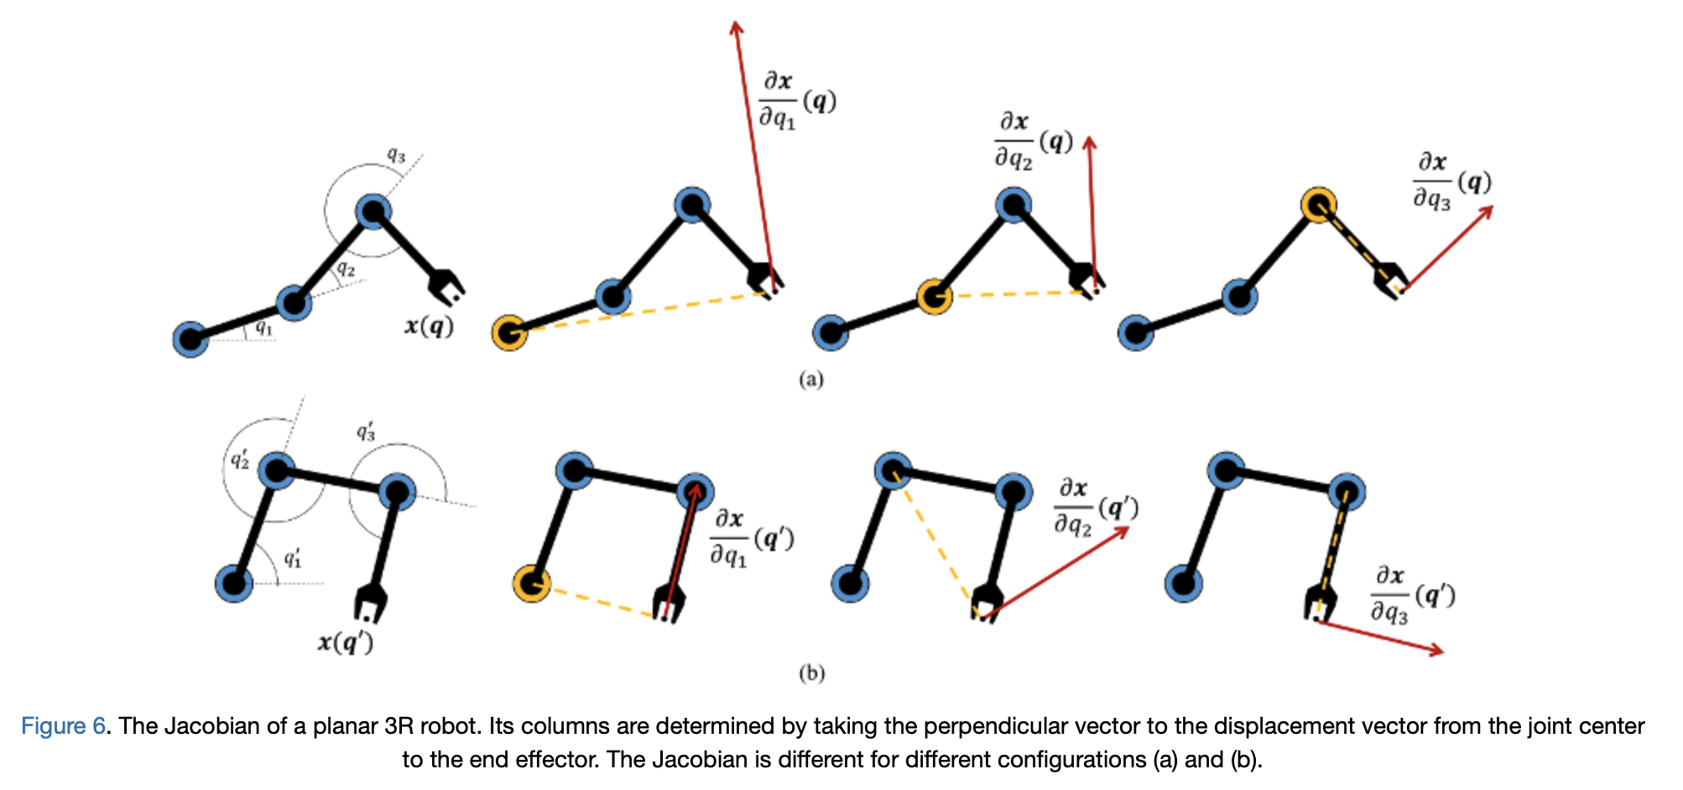

Slide 26

MoveIT

Slide 27
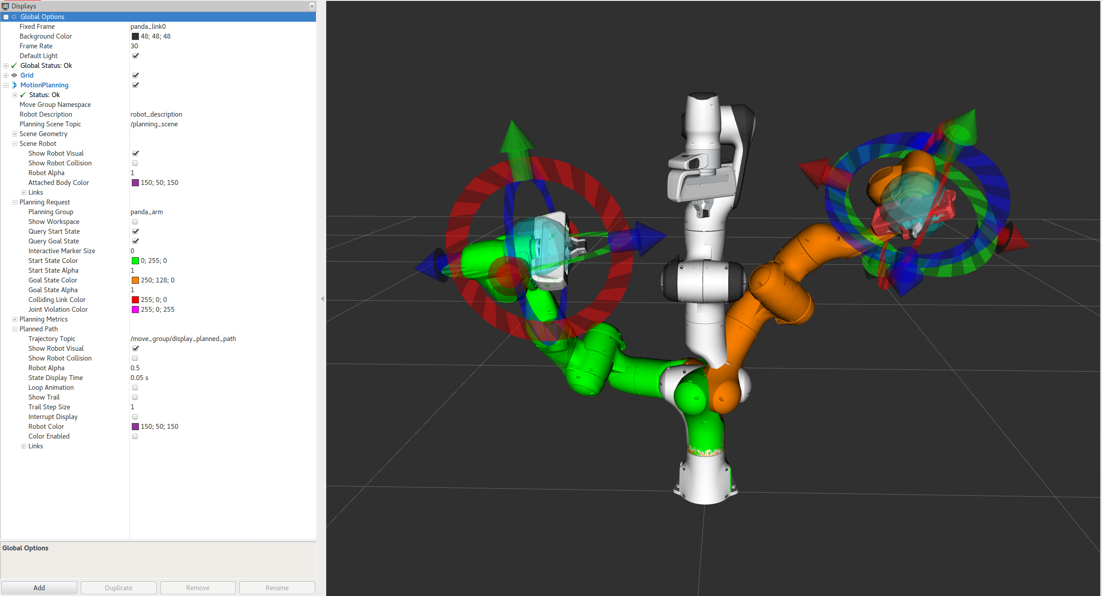
MoveIT
Tutorial Link: https://ros-planning.github.io/moveit_tutorials/doc/quickstart_in_rviz/quickstart_in_rviz_tutorial.html

Slide 28
ROS TF (or TF2)
Because doing this all by hand is a pain…

Slide 29
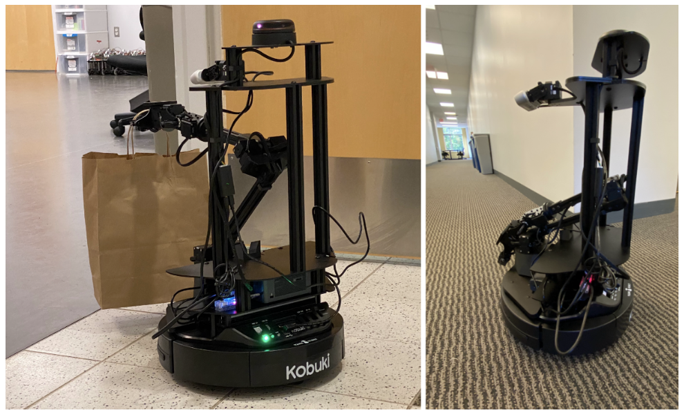
Motivation: managing all these relative transforms ourselves is tedious
Imagine I have a mobile manipulator. I know the joint angles for the arm and I know where the robot is. Thus, I know where the end of the arm is.
Now I move the robot. Where’s the end of the arm?
We need to recompute the transform: position of the robot base relative to the world and arm segments relative to the base.
Rather than do this yourself, ROS has a tool for this: TF

Slide 30
Motivation: managing all these relative transforms ourselves is tedious
Imagine I have a mobile manipulator. I know the joint angles for the arm and I know where the robot is. Thus, I know where the end of the arm is.
Now I move the robot. Where’s the end of the arm?
We need to recompute the transform: position of the robot base relative to the world and arm segments relative to the base.

Slide 31
Motivation: managing all these relative transforms ourselves is tedious
Imagine I have a mobile manipulator. I know the joint angles for the arm and I know where the robot is. Thus, I know where the end of the arm is.
Now I move the robot. Where’s the end of the arm?
We need to recompute the transform: position of the robot base relative to the world and arm segments relative to the base.
Rather than do this yourself, ROS has a tool for this: TF

Slide 32
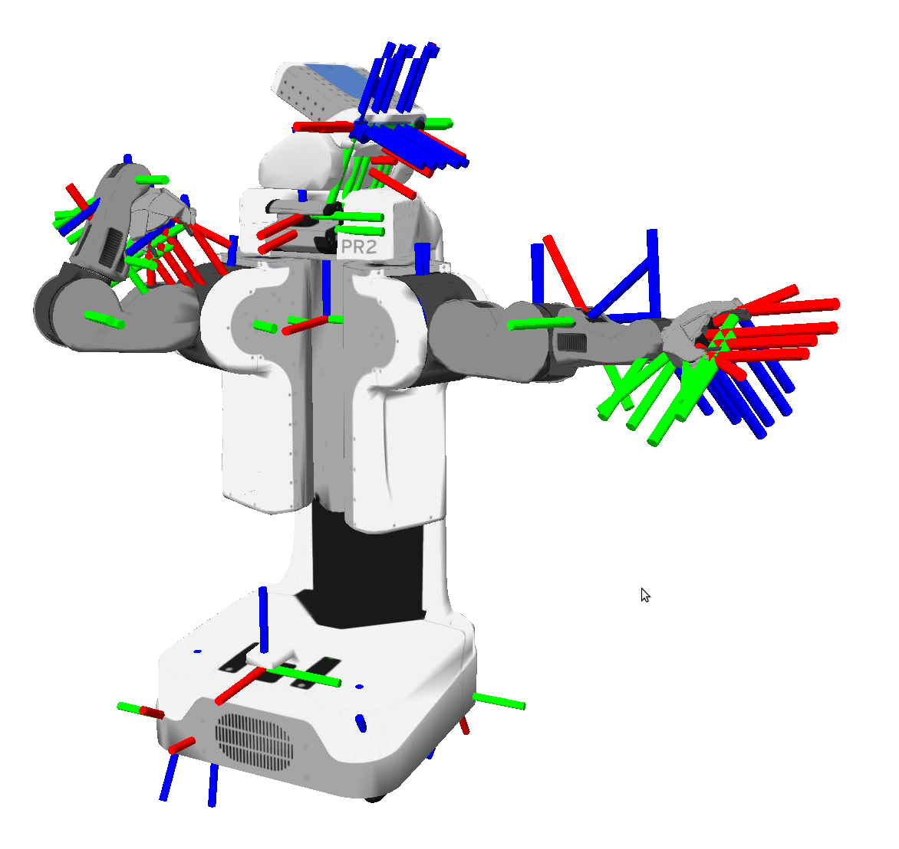
TF is ROS’s transform management library/system
Knowing where everything is with respect to everything else can be quite tedious.
That’s even more true for a whole robot system:
Joint angles can change at any time (and asynchronously)
Some transforms never change
We might add new objects or sensors or even robots (and therefore new reference frames) at any time. (Coding in advance won’t work!)
We need a system to keep track of these over time, even when new transforms are added.

Slide 33
So what’s tf?
tf Addresses all these challenges. In ROS, many messages (particularly sensor messages) will have a “frame”, which tells us the frame in which they are being reported.
Frames in tf only have a name—a string—rather than being given some number.
If you want the transform between two frames, all you need to know is their names.

Slide 34
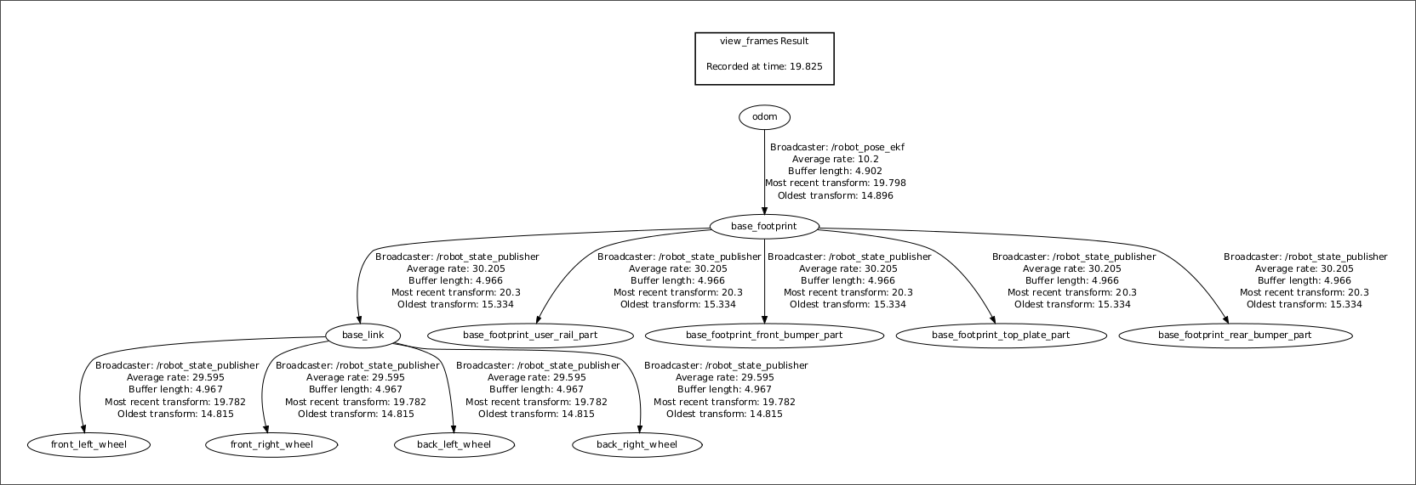

Here’s what a TF tree looks like for a Husky Robot
We see that the “base_footprint” frame is connected to ”odom” (the odometry) that says where it is in the world and also to many other elements, that say where the different pieces of the base are.
From: http://www.clearpathrobotics.com/assets/guides/kinetic/ros/Drive%20a%20Husky.html

Slide 35
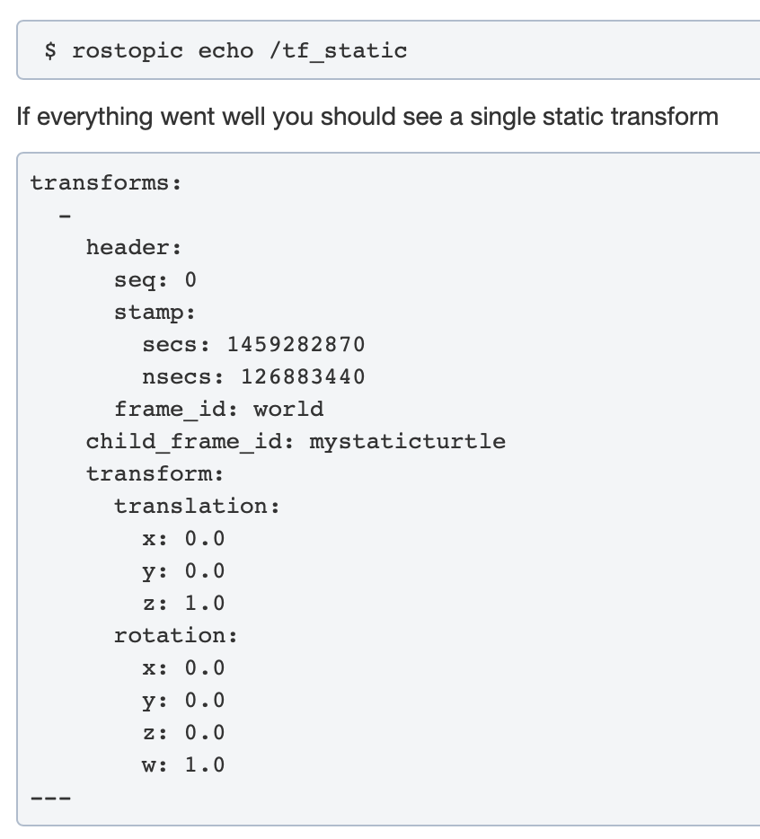
Let’s look at some examples from the tutorial: static frames
You may notice that many of the transformations on the Husky don’t change! These transformations are static, and are often used to represent the relative location of various pieces fixed to the robot: e.g., a sensor attached to a base or hand.

Slide 36
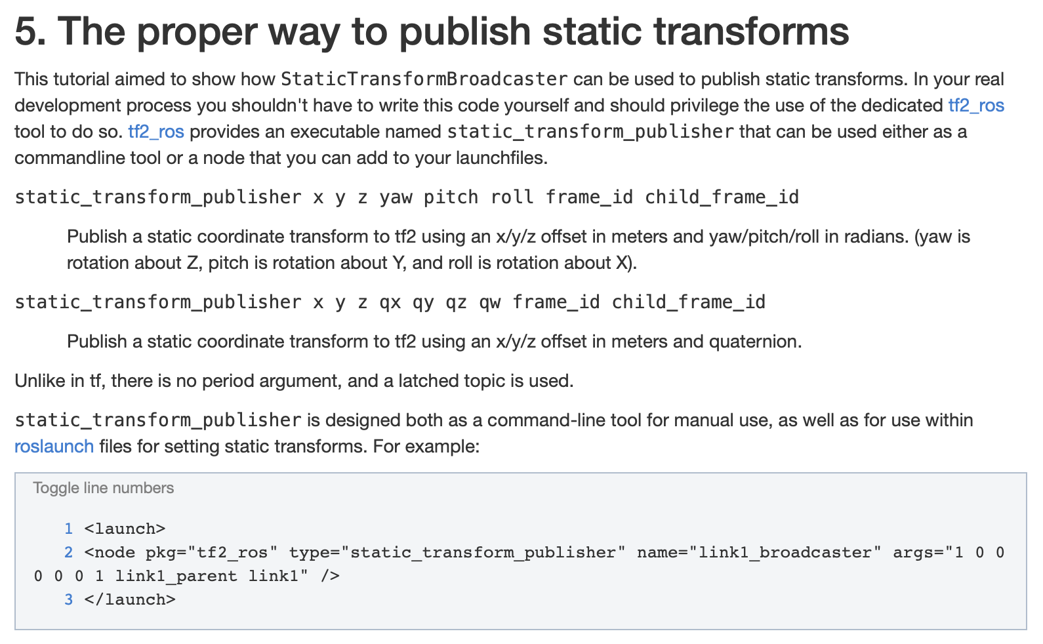
Let’s look at some examples from the tutorial: static frames
Launch files for a robot will often define a number of static transforms

Slide 37
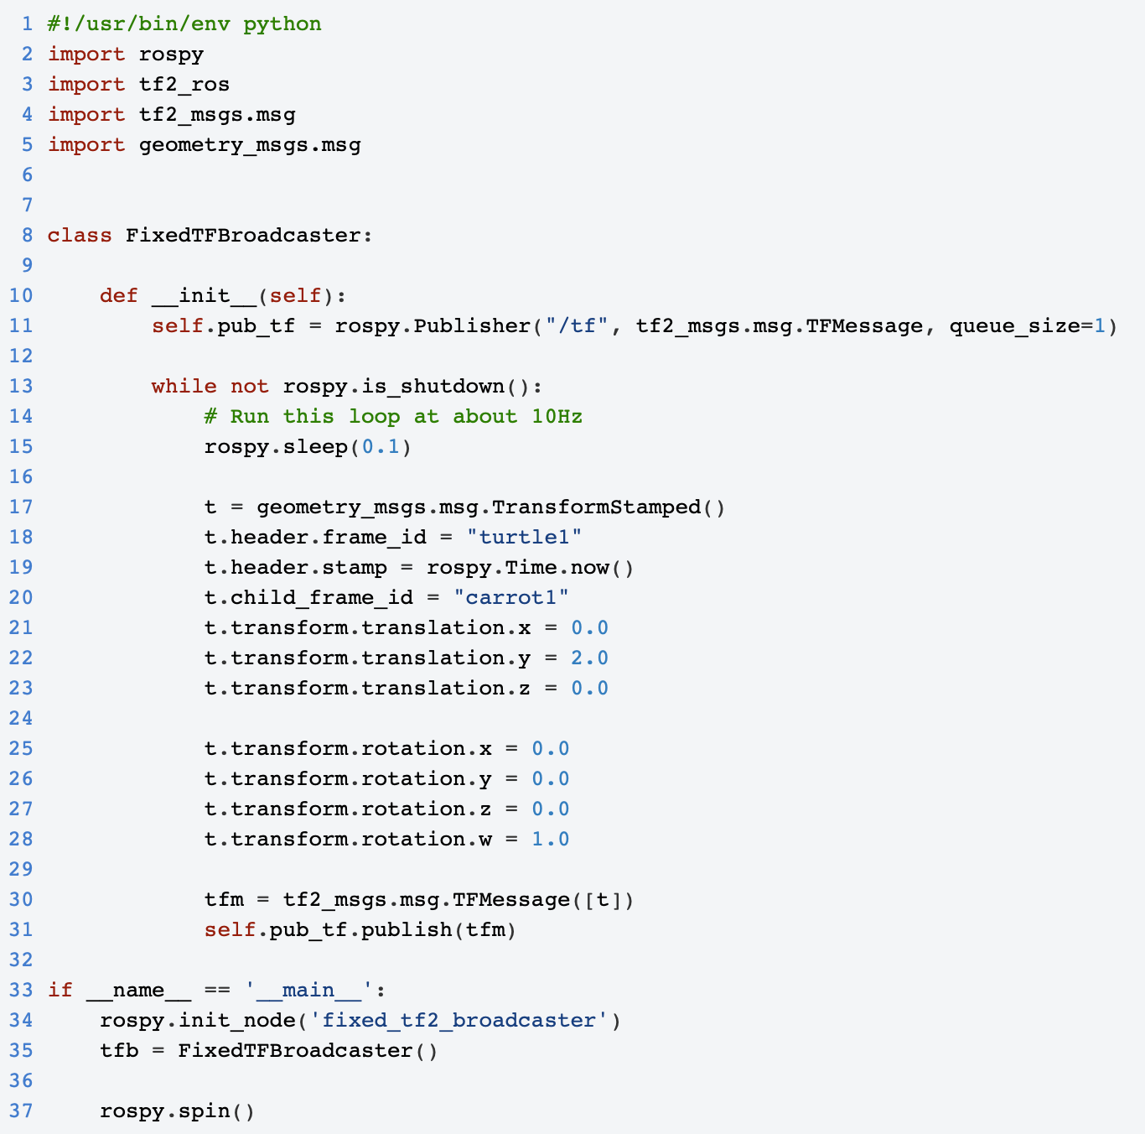
Let’s look at some examples from the tutorial: publishing a transform

Slide 38
Let’s look at some examples from the tutorial: publishing a transform

Slide 39
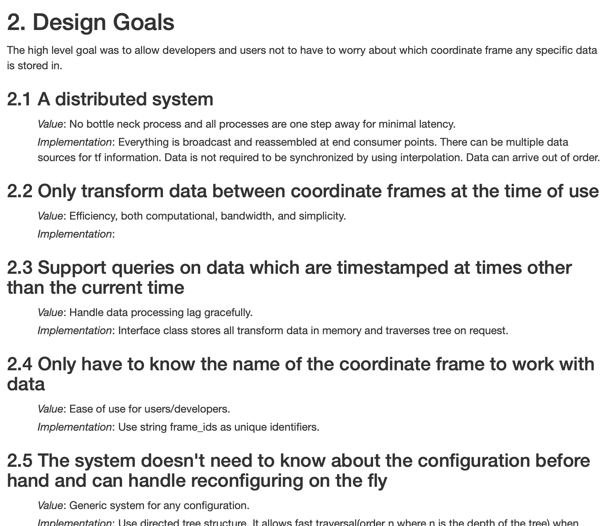
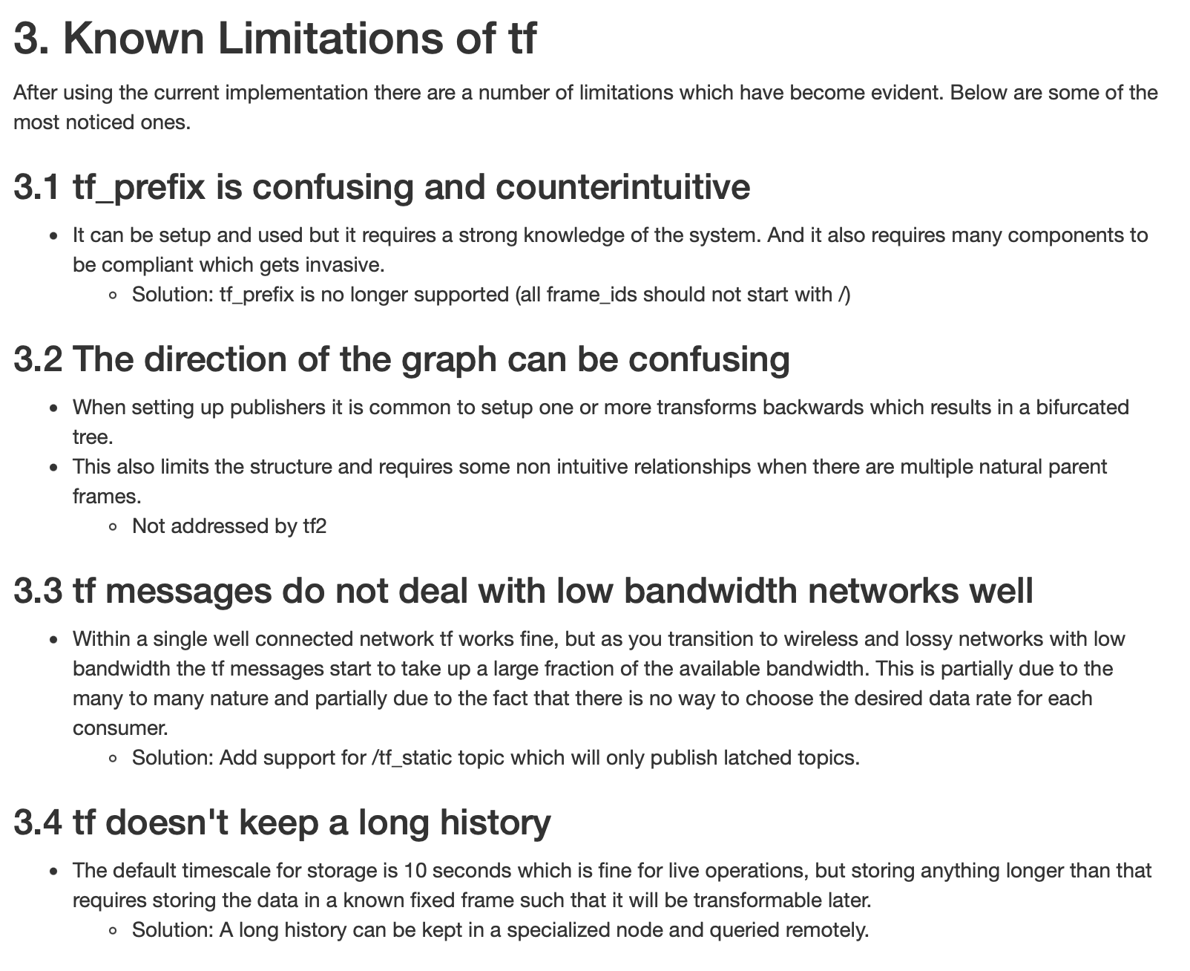
The TF design docs are fairly interesting
From: http://wiki.ros.org/tf2/Design

Slide 40
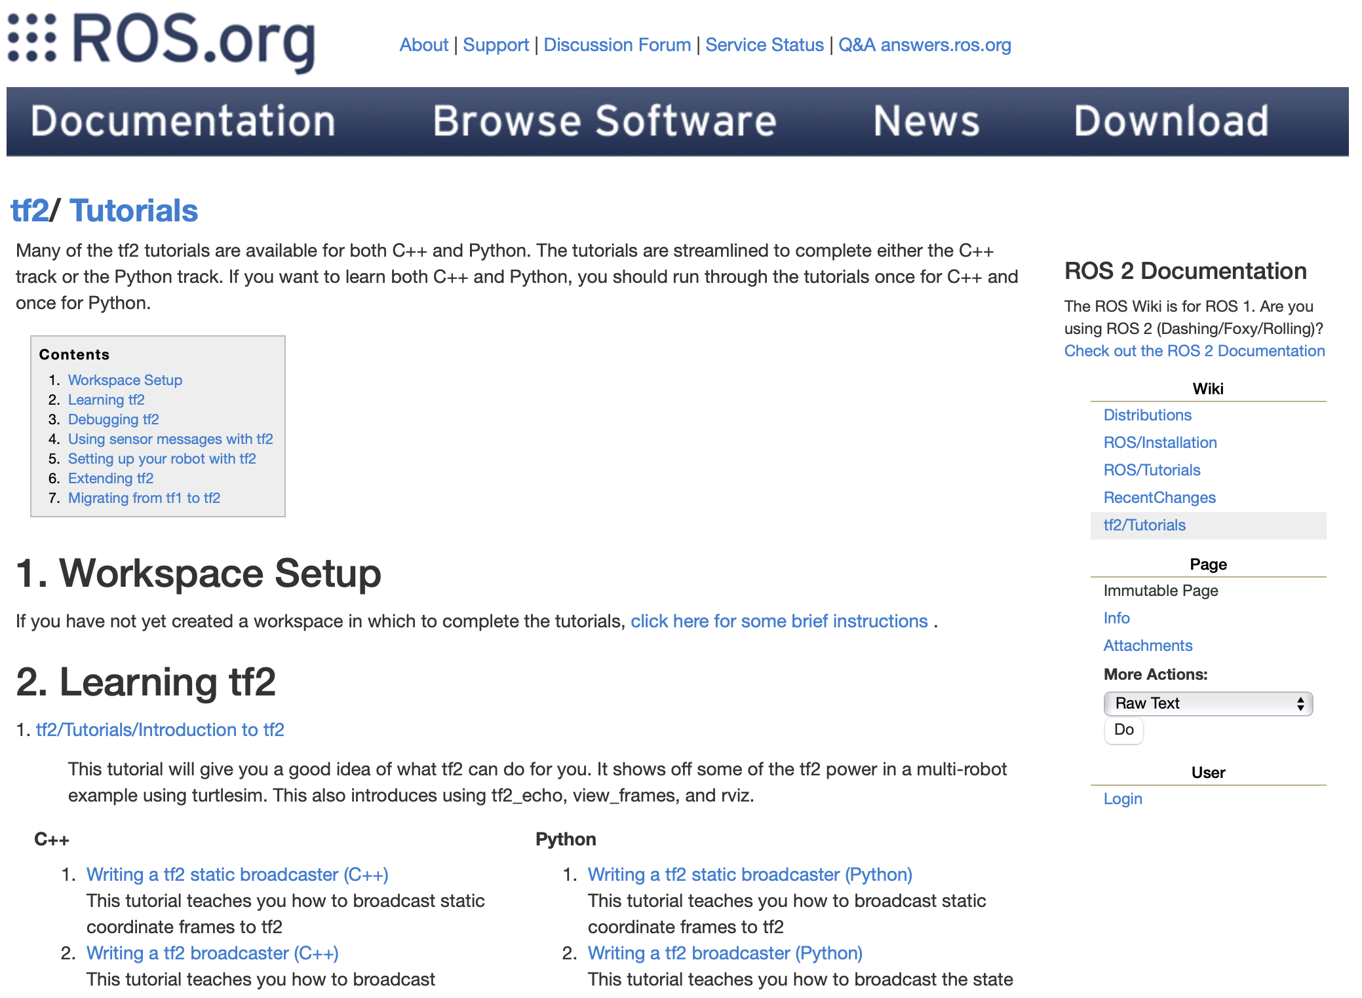
As you might expect, ROS provides some excellent tutorials on its use

Slide 41
In Rviz, you can often specify the
“global frame”
If you change the frame that Rviz treats as the ”global” coordinate frame, you can change your perspective.
If you change the Rviz frame to that of the robot, the robot will appear stationary while the world moves around it.
It’s all a matter of perspective…
You will need this in the BARN Challenge!

Slide 42
Transforms like these will appear through the remainder of the class
However, they will often be something we take for granted!
We won’t always think to ourselves “what about the transforms.”
Instead, they will be implicit in the problem formulation or addressed by some “lower level” process

