Slide 1
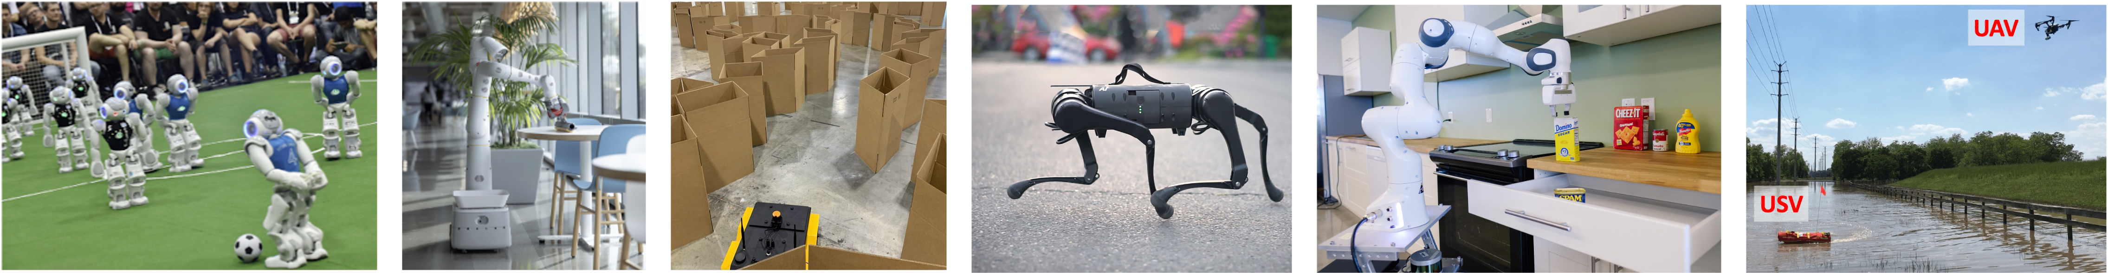
CS 485 Autonomous Robotics Localization I
Prof. Xuesu Xiao
George Mason University
Slides Credits: Gregory Stein

Slide 2
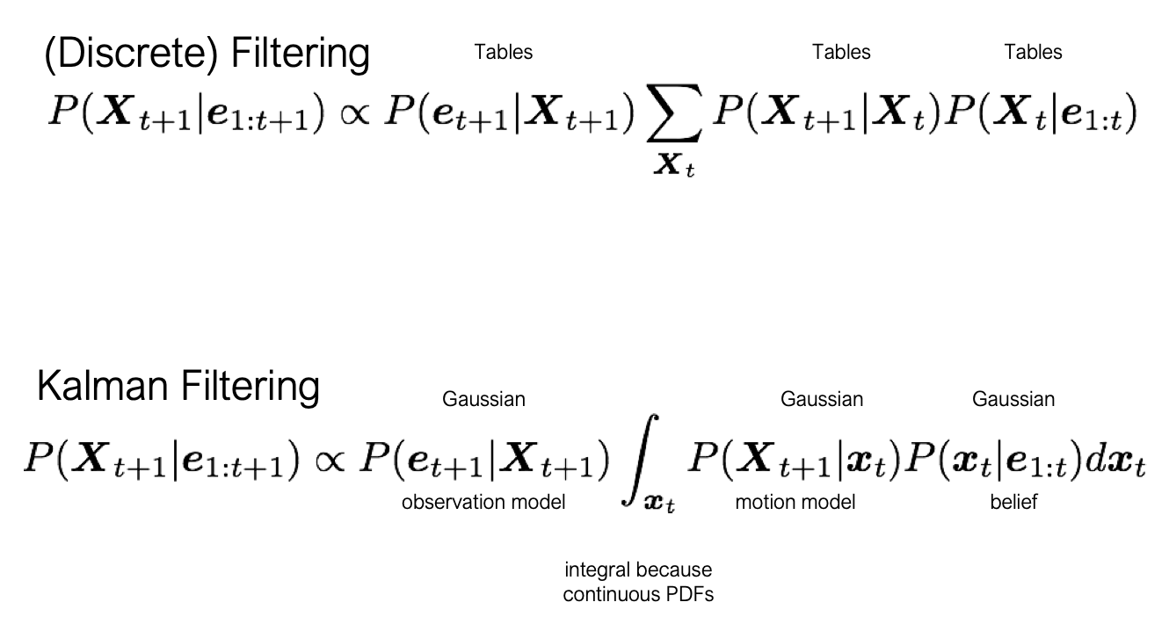
Reminder…
The Kalman Filter: continuous (gaussian) filtering

Slide 3
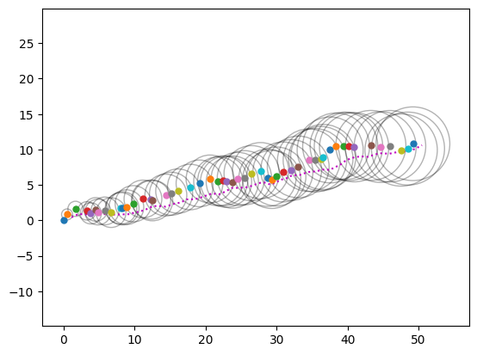
Last week, just about everything was Gaussian: Motion Model
How do we compute the “uncertainty” on each?

Slide 4
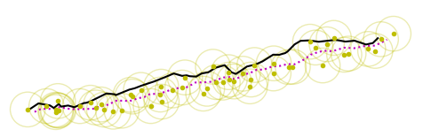
Last week, just about everything was Gaussian: Sensor Model
How do we compute the “uncertainty” on each?
How do we incorporate the GPS observations?

Slide 5
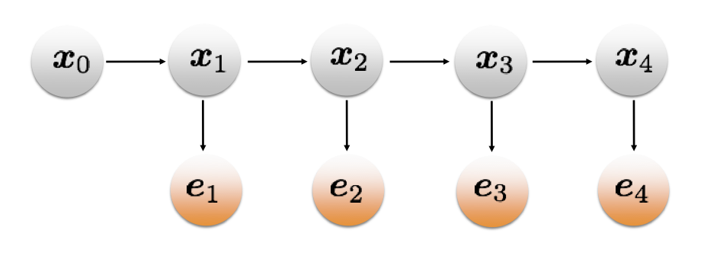
However, our graphical representation was more general
The graphical representation will look pretty much the same:

Slide 6
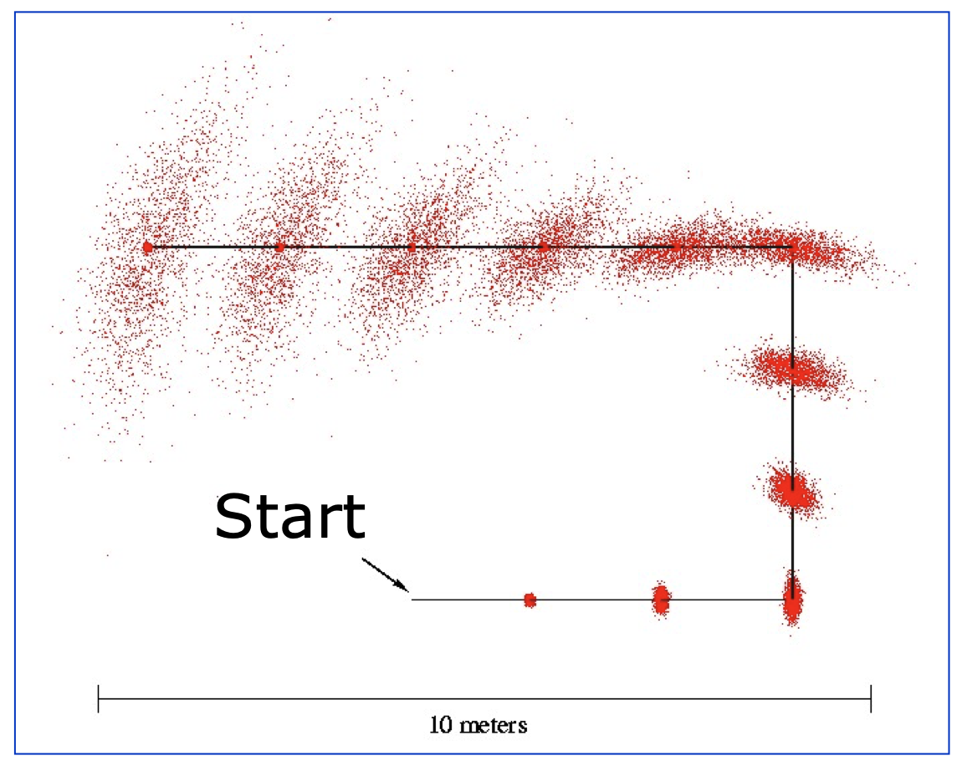
The EKF is necessary when we have a robot with orientation
If we have uncertainty in yaw, the motion model becomes nonlinear:
From: https://cs.gmu.edu/%7Ekosecka/cs685/cs685-11-sensor-motion-models.pdf

Slide 7
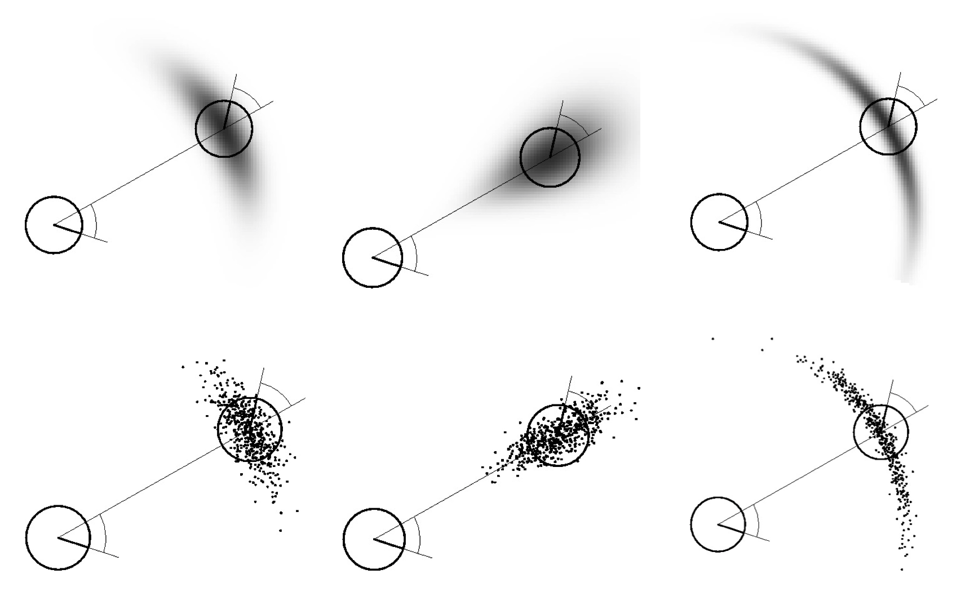
The EKF is necessary when we have a robot with orientation
If we have uncertainty in yaw, the motion model becomes nonlinear:
From: https://cs.gmu.edu/%7Ekosecka/cs685/cs685-11-sensor-motion-models.pdf

Slide 8

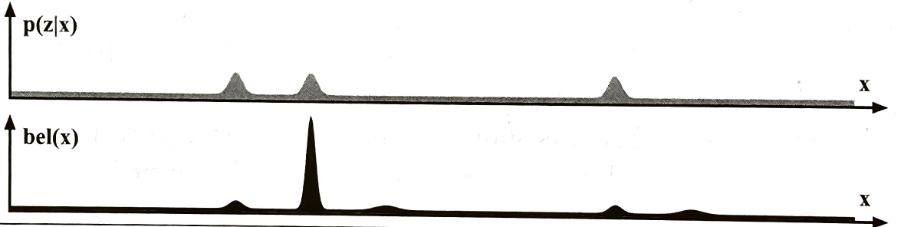
Will the EKF help us with the “Doors” example from earlier?

Slide 9
Will the EKF help us with the “Doors” example from earlier?
Hmm, probably not. We approximate the distribution as being Gaussian, so we’d lose the multi-peaked structure.
We’ll talk more about how to handle more complex probability distributions like these.

Slide 10
Motion and Sensor Models

Slide 11

Robot motion is inherently uncertain
Last week, we talked about both Gaussian Motion and Observations, but in general, neither will be. We need ways to represent non-Gaussian models.

Slide 12
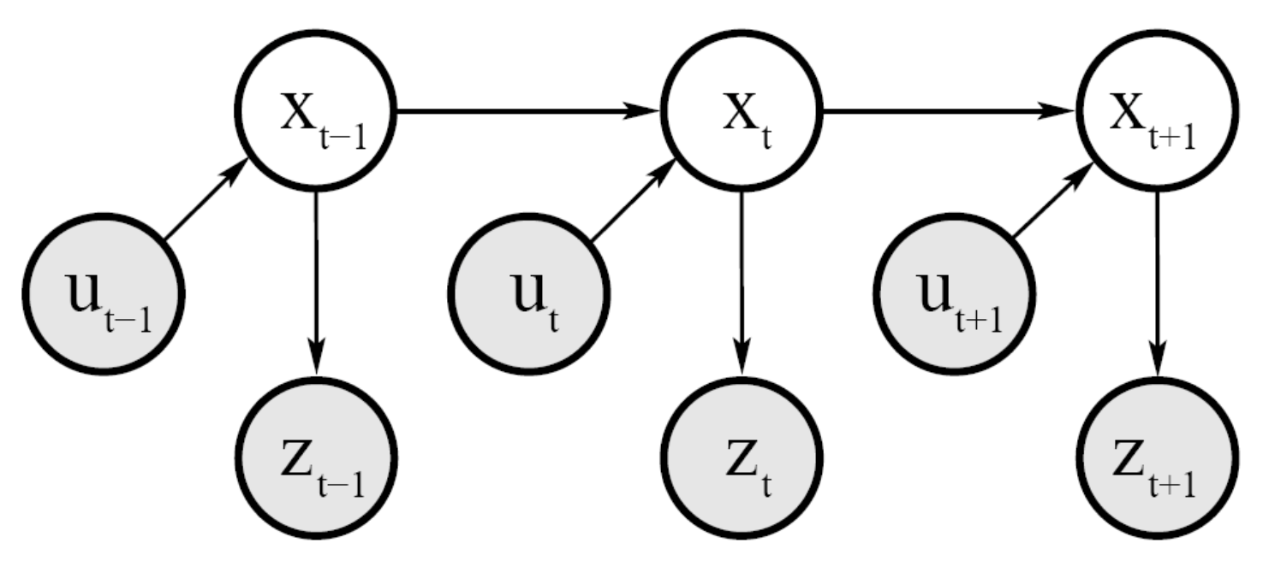
Reminder: graphical representations of joint probability distributions

Slide 13
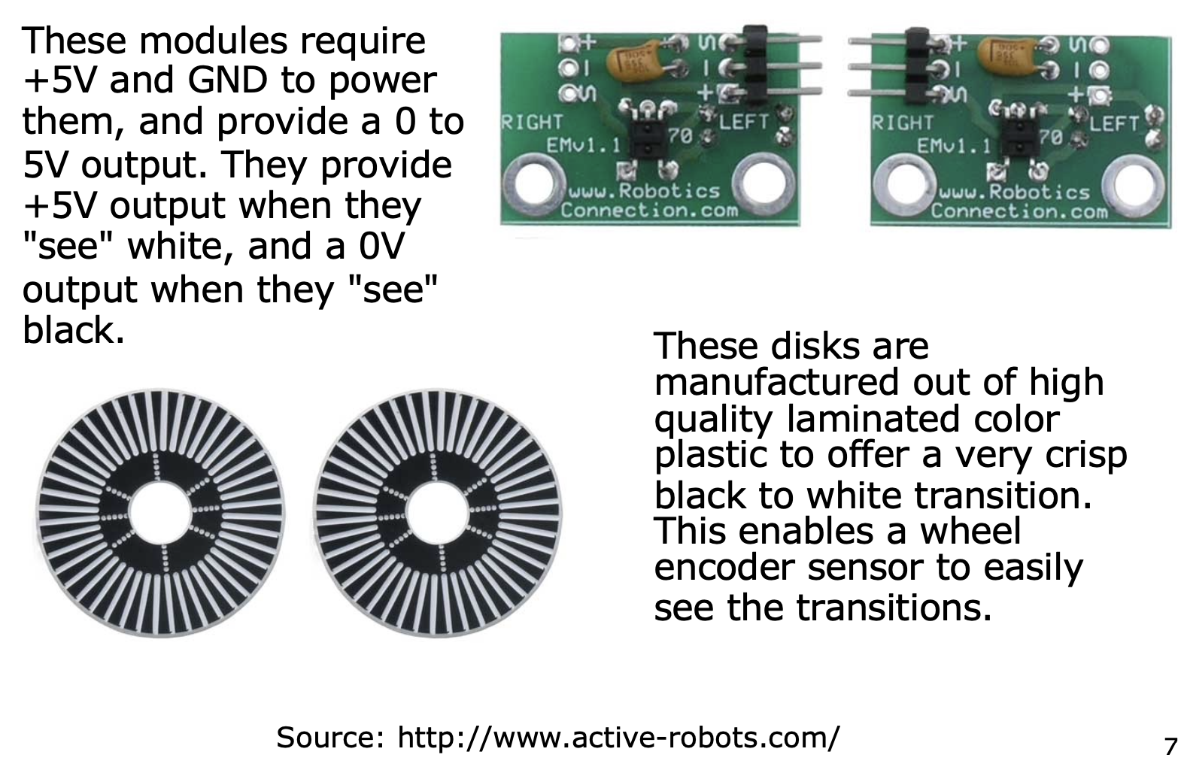
Consider a differential drive robot: Wheel encoders tell us the rotation

Slide 14
Dead Reckoning: integrating motion measurements to compute position
Mathematical procedure for determining the present location of a vehicle.
Achieved by calculating the current pose of the vehicle based on its velocities and the time elapsed.
Last week, we talked about this in the context of Gaussian Motion and the noisy motion estimates:

Slide 15
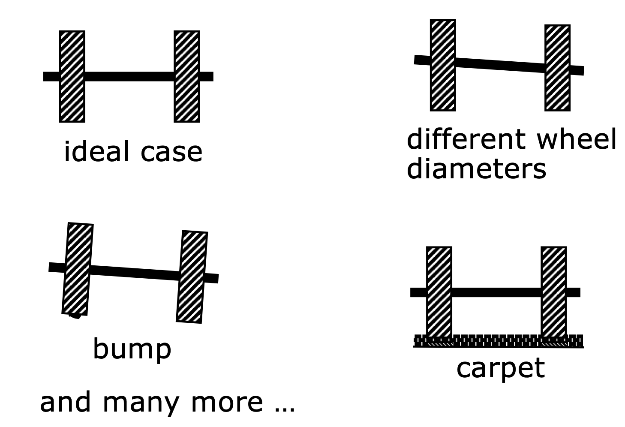
Even if we could perfectly integrate the wheel encoders, our measurements are noisy
Sources of motion error:

Slide 16
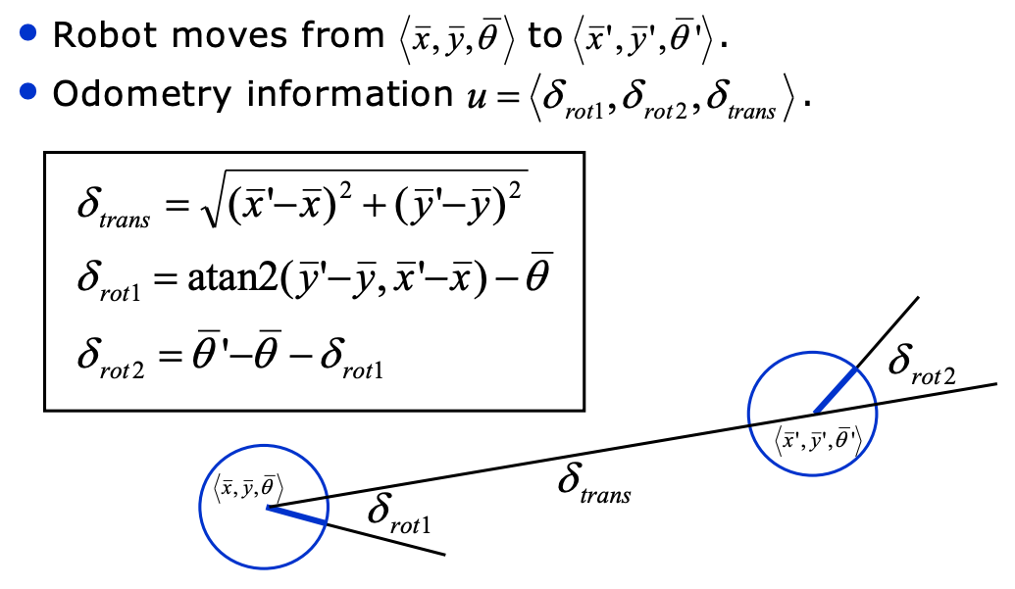
Odometry Model

Slide 17
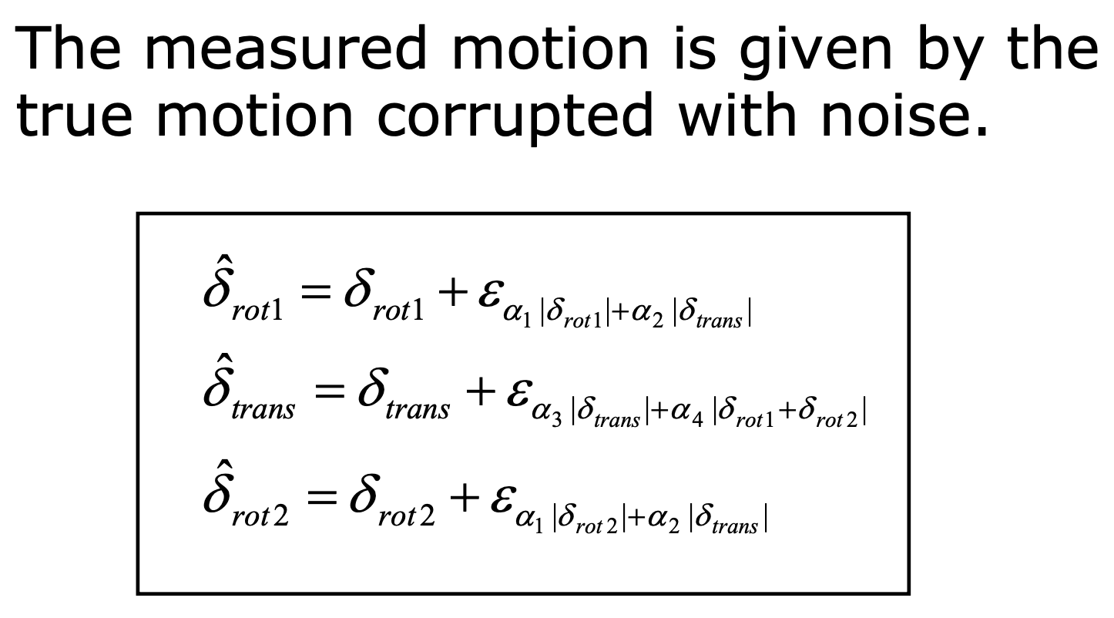
A noise model for odometry for a differential drive robot

Slide 18
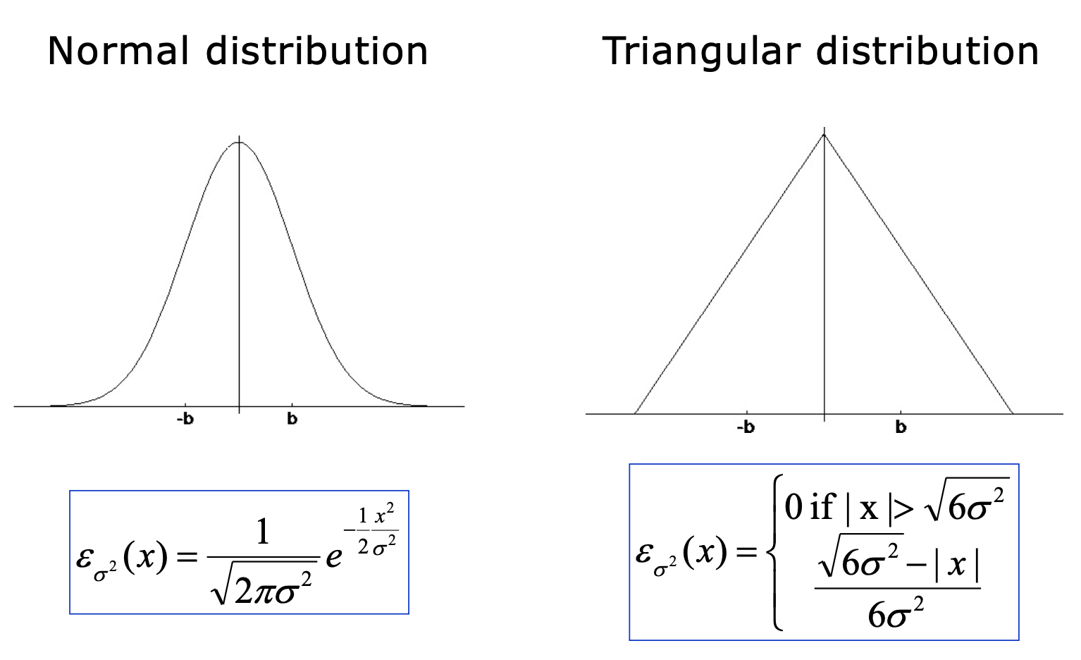
A noise model for odometry for a differential drive robot

Slide 19
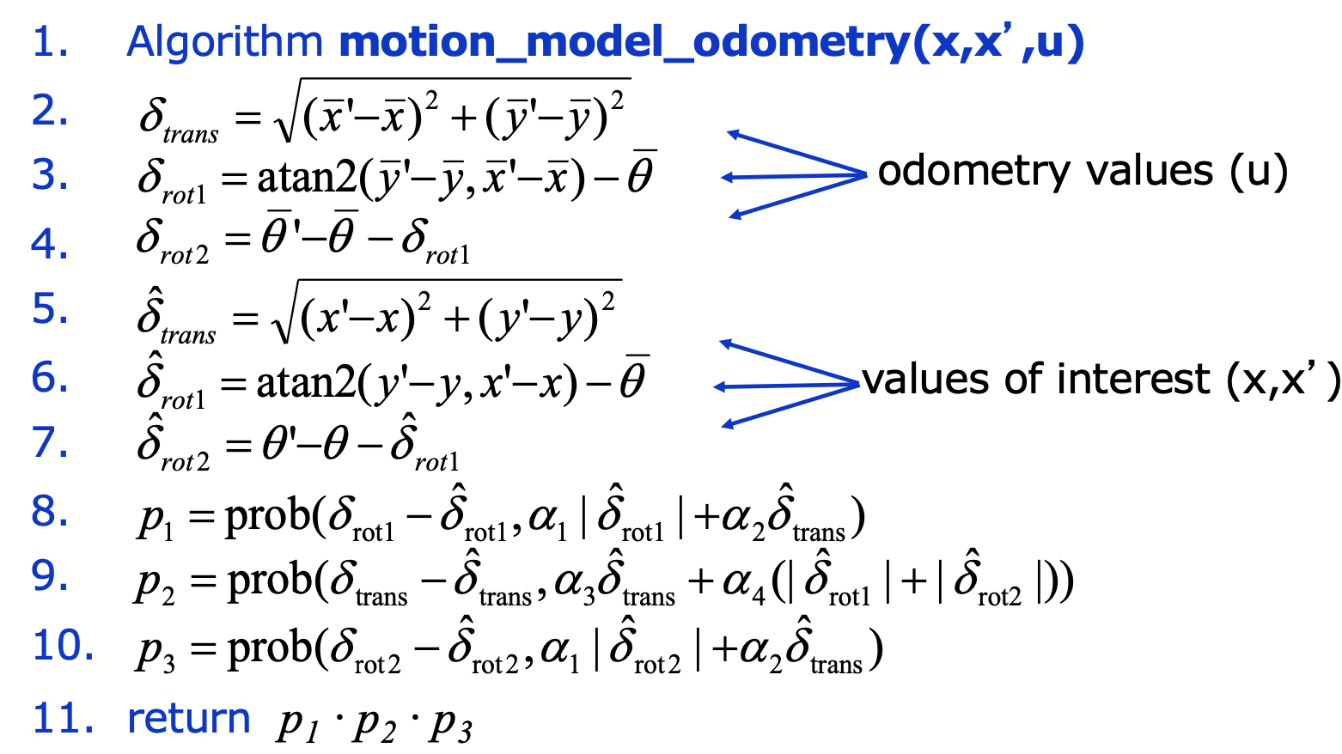
Calculating the posterior from our (noisy) motion model:
P(x’ | x, u)

Slide 20
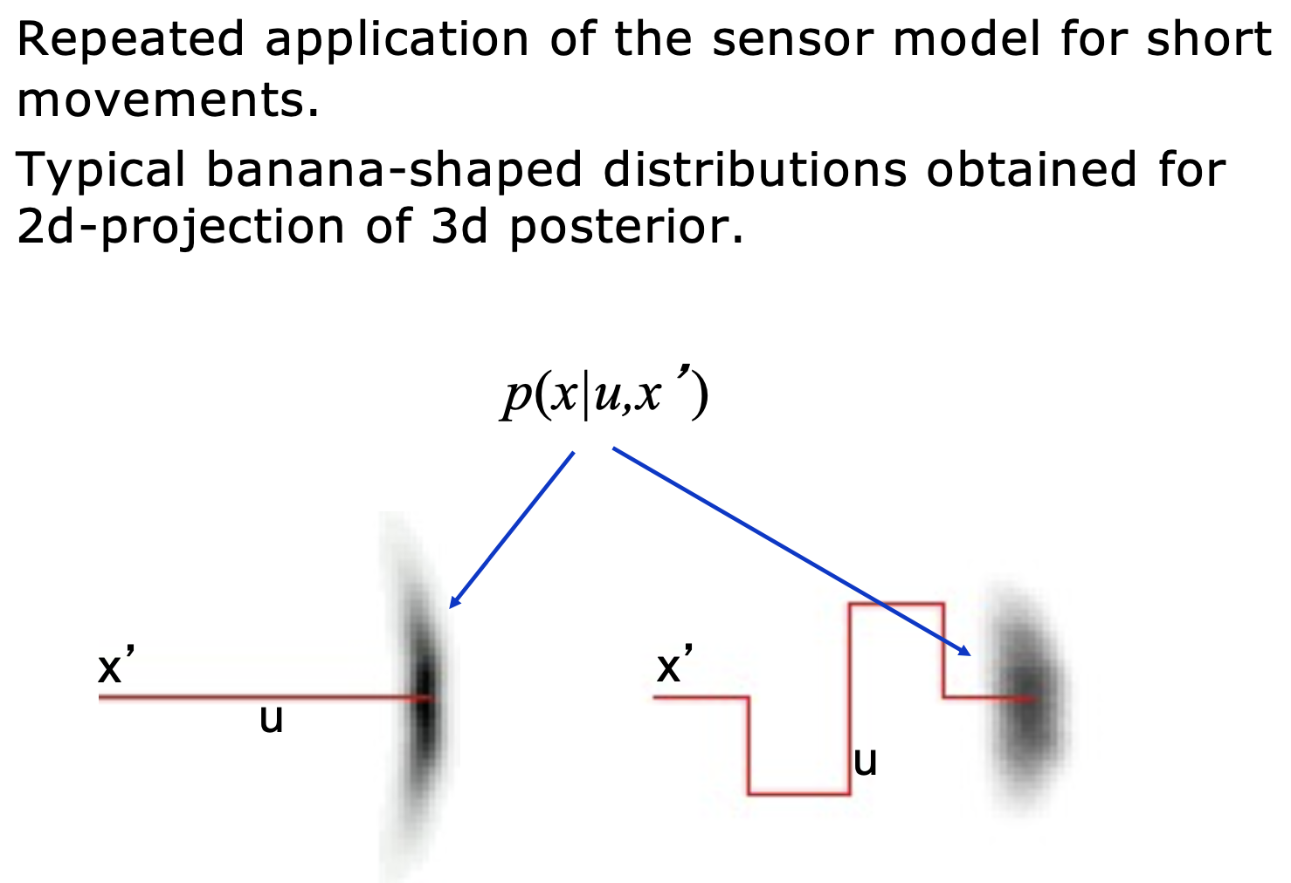
We repeatedly apply this motion model to get the posterior on the position

Slide 21
How do we use this motion model?
A Kalman Filter requires that everything be Gaussian.
The Extended Kalman Filter approximates the nonlinear system as being Gaussian, which works fairly well for a while, but over time—especially when dead reckoning, and there are no updates from other measurements—you start to lose accuracy.
What if we tried sampling again?

Slide 22

Reminder: Let’s say you wanted to compute the area of a circle…
What if you printed out the shape and threw a dart at it?
If you aim is totally random, what’s the probability you’re inside the square, but not the circle?
P = 1 - A_{circle} / A_{square}
Image Credit

Slide 23
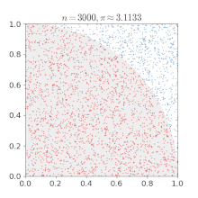
Reminder: Monte Carlo Sampling
Idea: we throw a lot of darts and the number that are inside the circle will tell us what it’s area is.
As we get more samples, our approximation gets better.
In many cases, this can be way faster than trying to get an exact solution.
Image: Wikipedia

Slide 24
Now, we have a probability distribution that we cannot easily write down…
We can sample values from the distribution and we’ll represent that distribution with points drawn from that distribution.
Idea: we have some random value x ~ P(X). If we can draw many values of x, we can use those as a stand in for the distribution. With enough samples, we can compute any value we would want that requires the distribution:

Slide 25
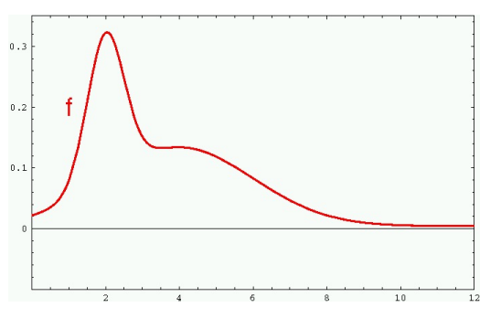
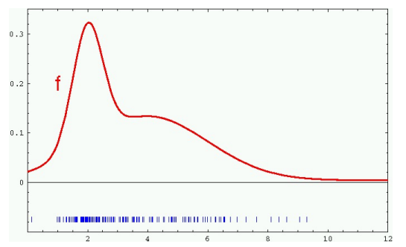
Sample-based Density Representation

Slide 26
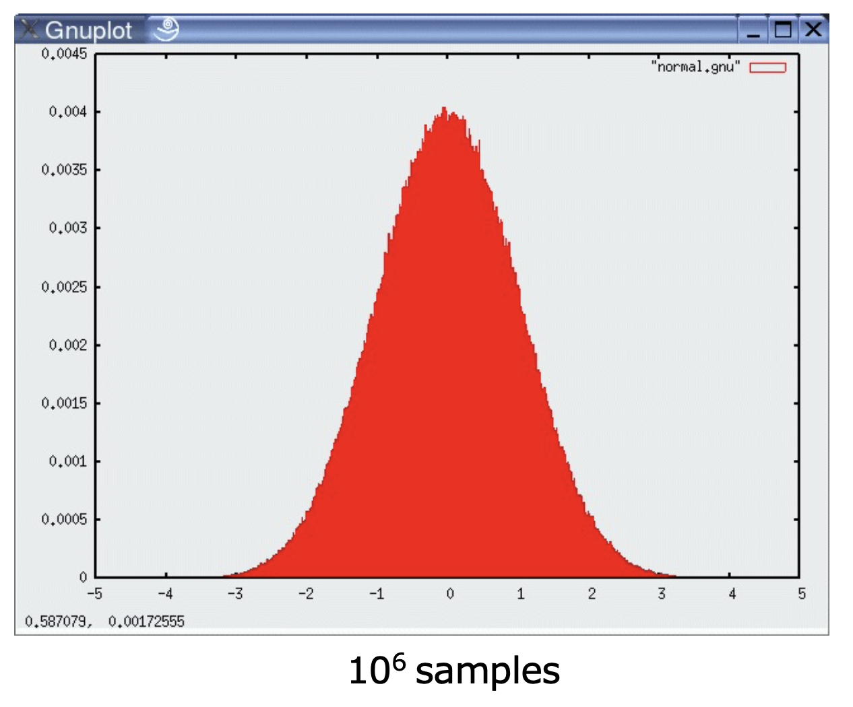
Sampled Normal Distribution

Slide 27
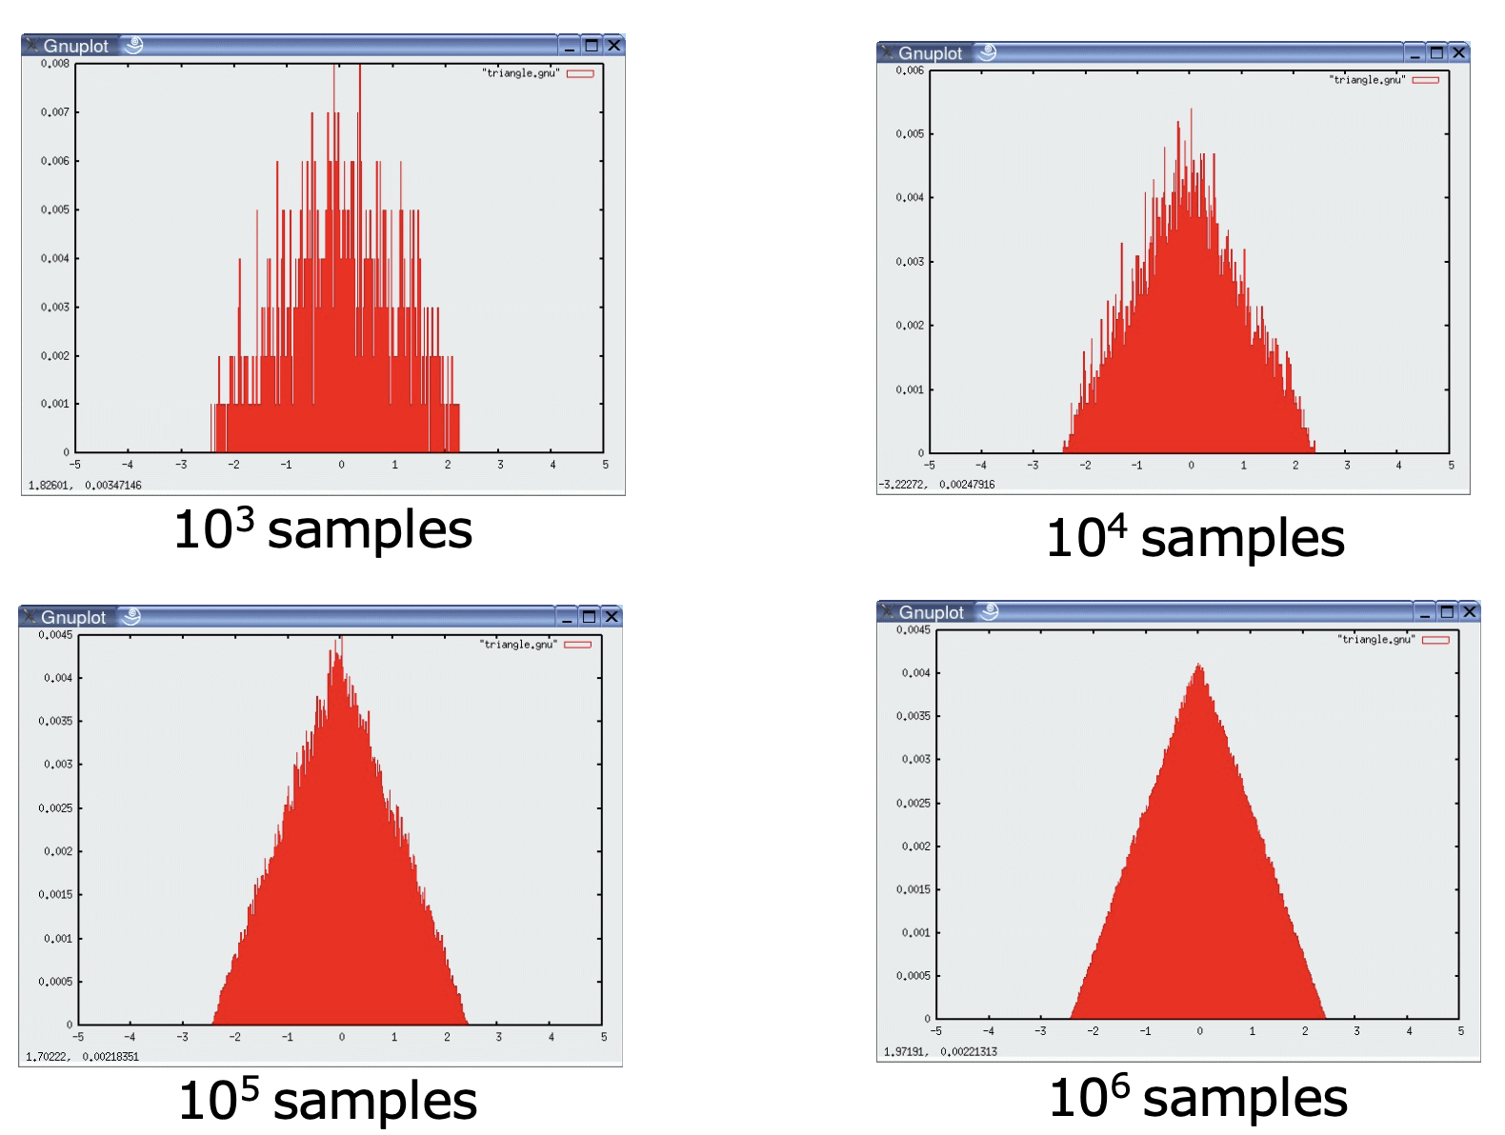
Sampled Triangular Distribution

Slide 28
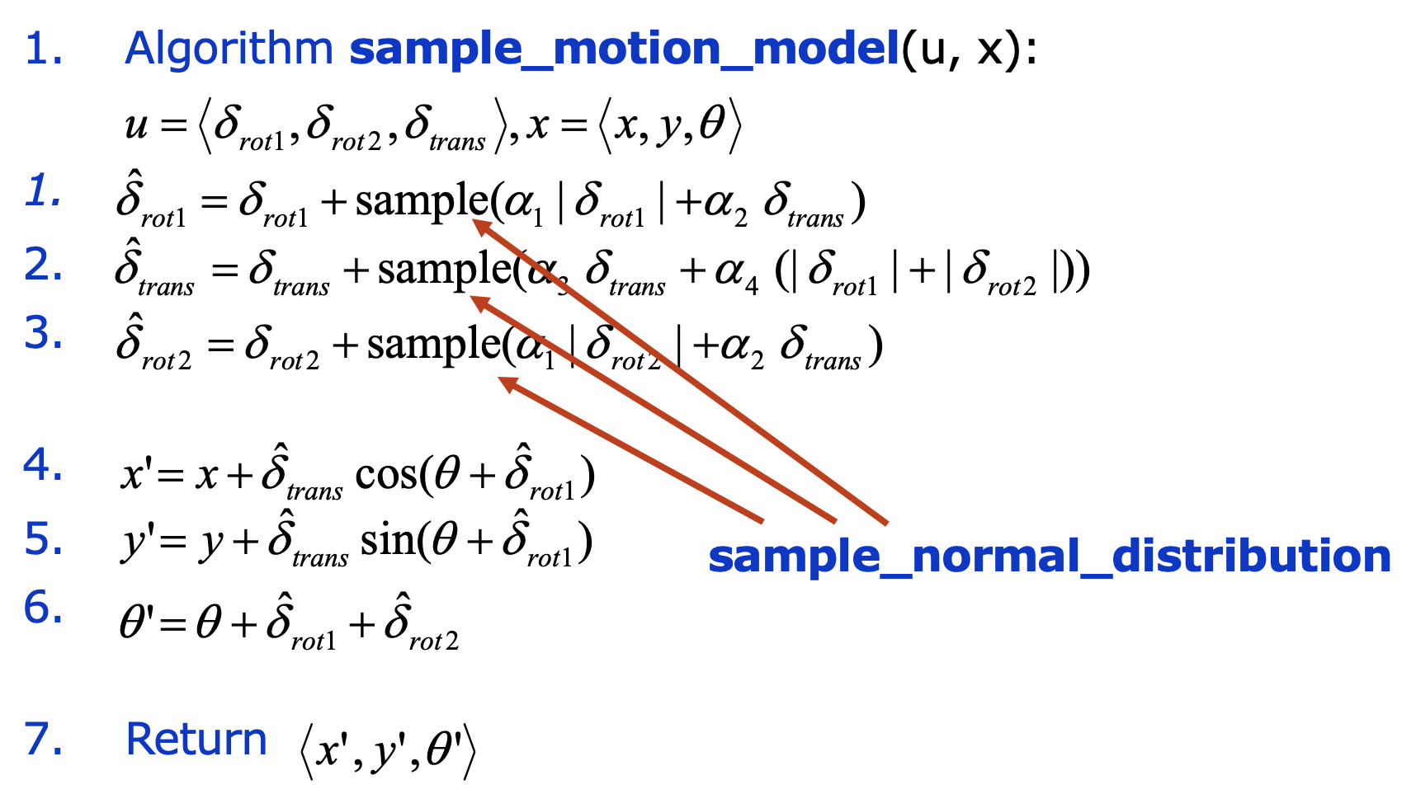
We can use this to sample from our noisy motion model

Slide 29
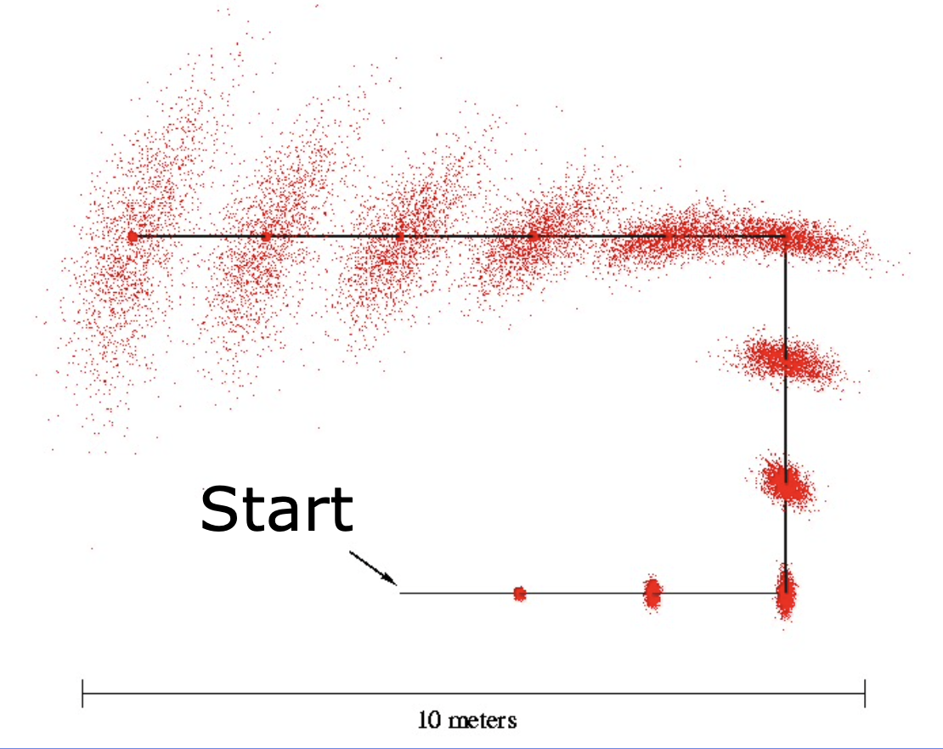
We can use this to sample from our noisy motion model

Slide 30
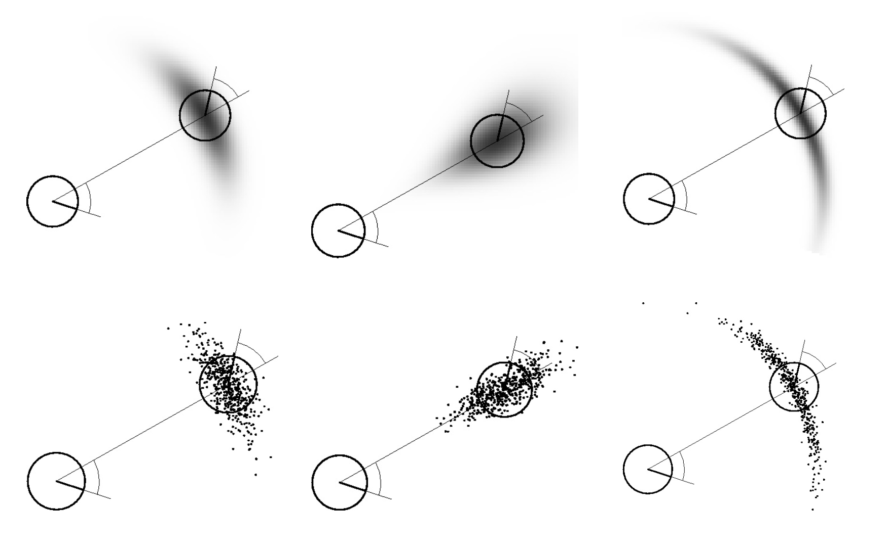
We can use this to sample from our noisy motion model

Slide 31
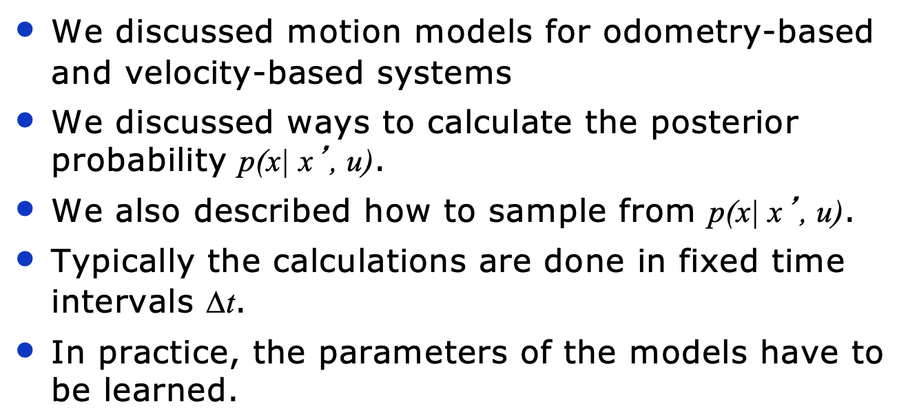
Overview: Non-Gaussian Motion Models

Slide 32
Sensor Models
How do we measure the world around us?

Slide 33
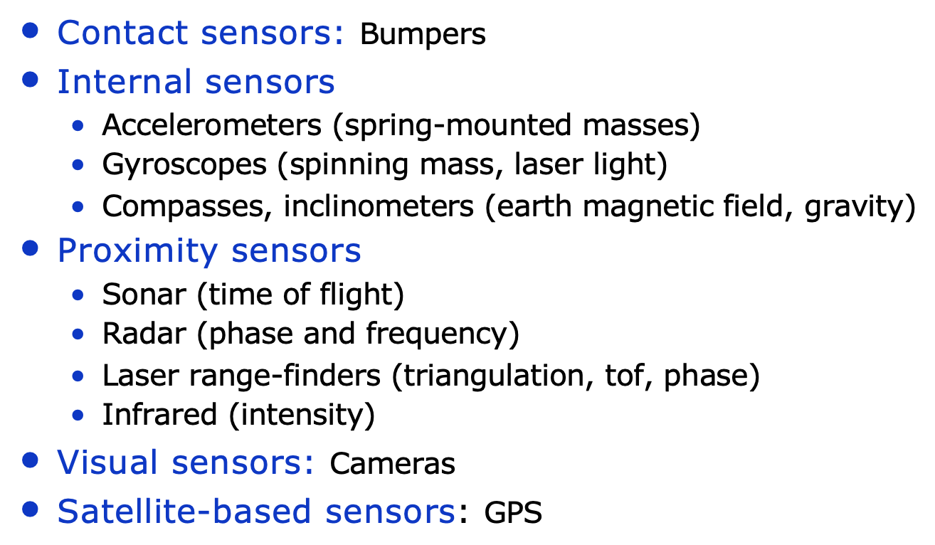
There are many ways robots sense the world

Slide 34
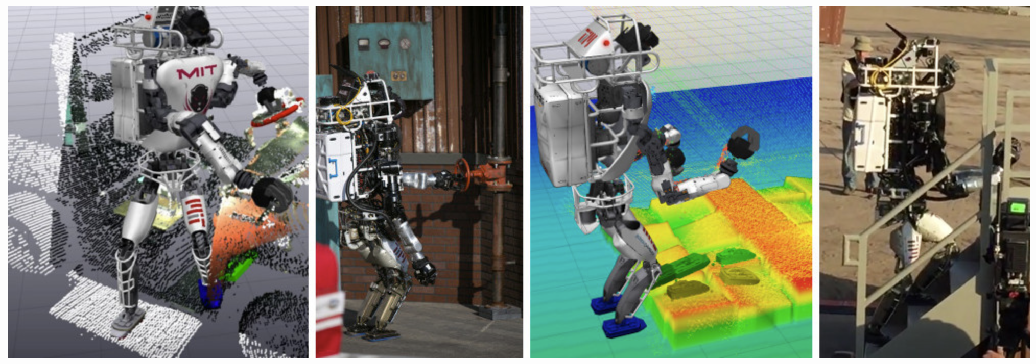
LiDAR: Light Detection and Ranging
Video from the MIT Team

Slide 35
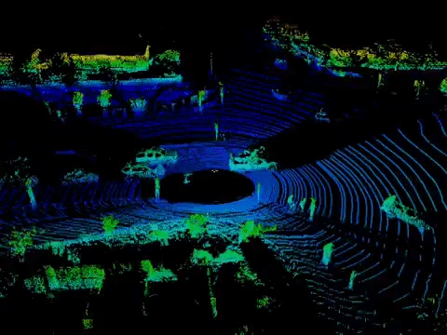
Velodyne makes great LiDARs
The Puck
Link: https://velodynelidar.com/products/puck/

Slide 36
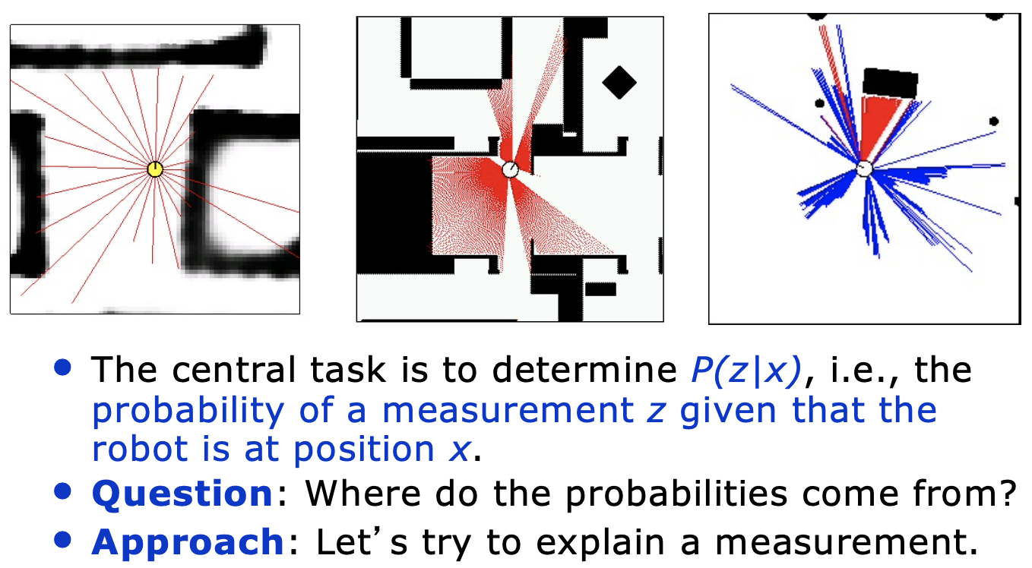
Proximity Sensors: lasers and sonars

Slide 37
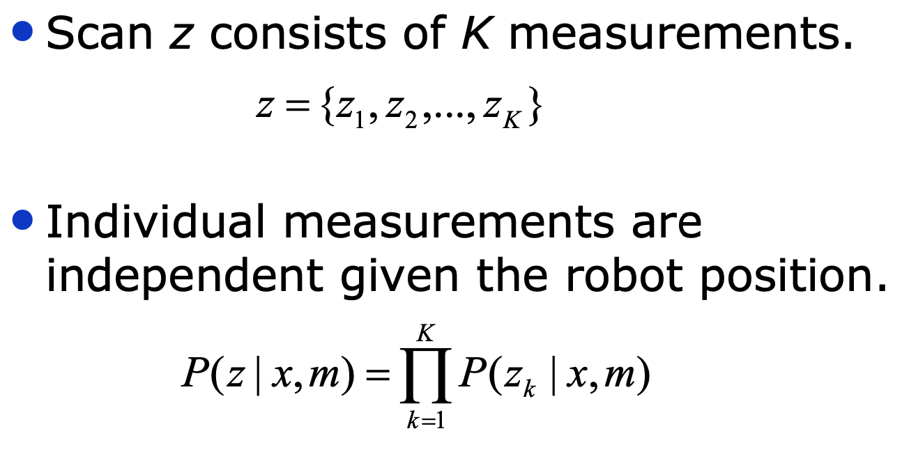
Beam-based (probabilistic) sensor model

Slide 38
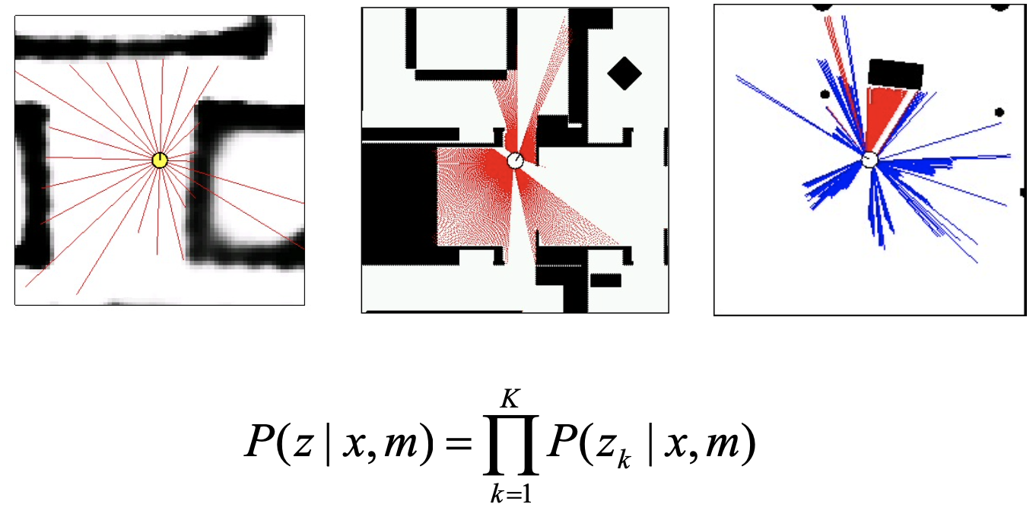
Beam-based (probabilistic) sensor model

Slide 39
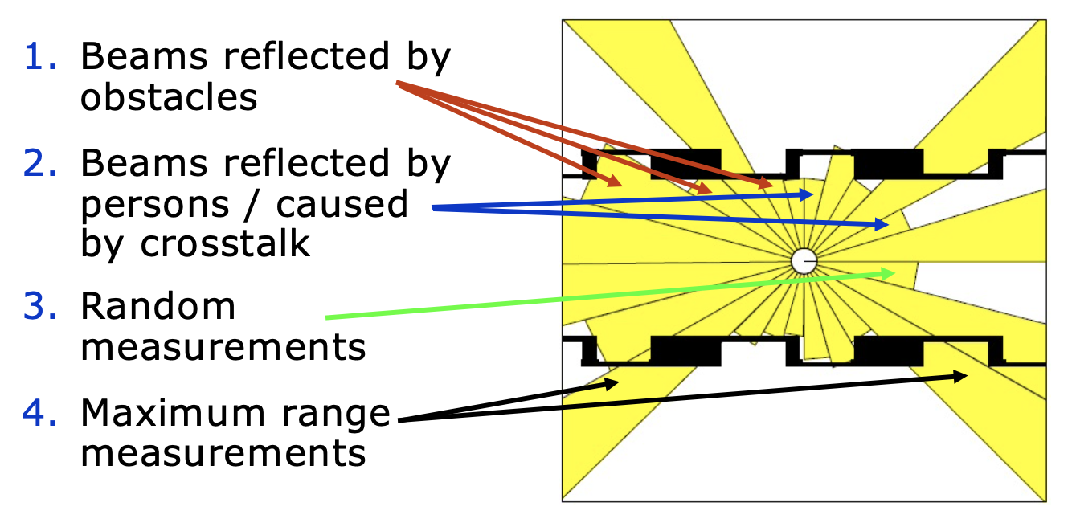
Typical types of errors for beam-like measurements

Slide 40
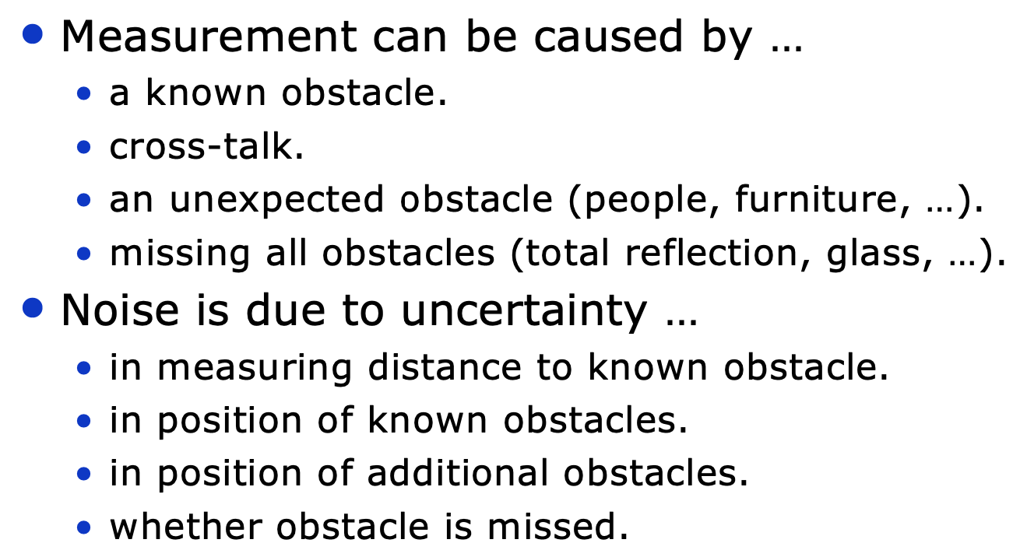
Proximity measurements and sources of noise and error

Slide 41
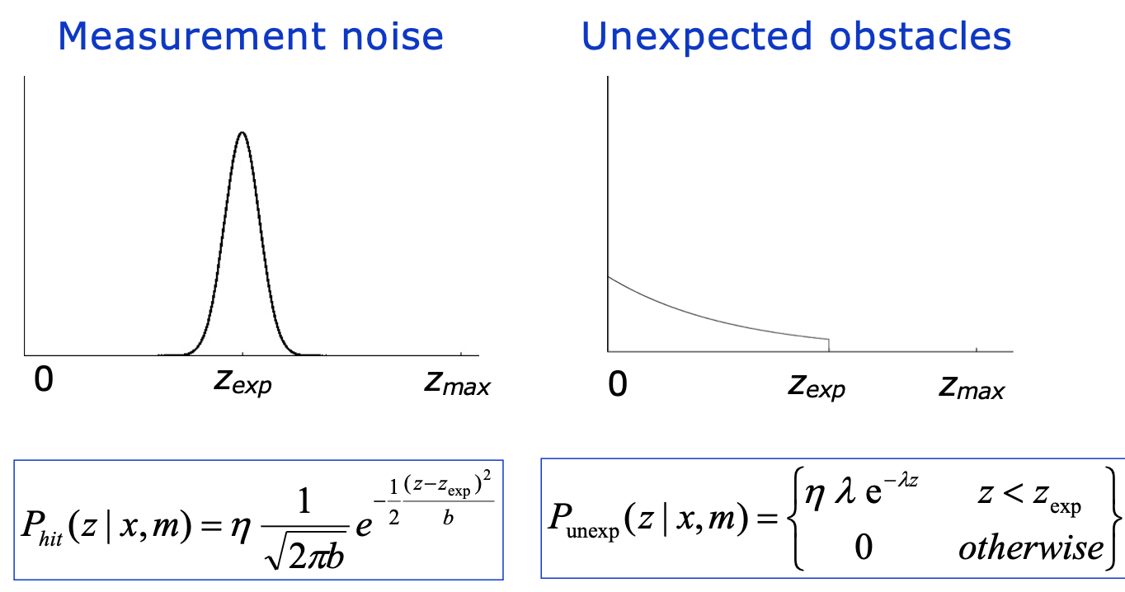
Beam-based proximity model

Slide 42
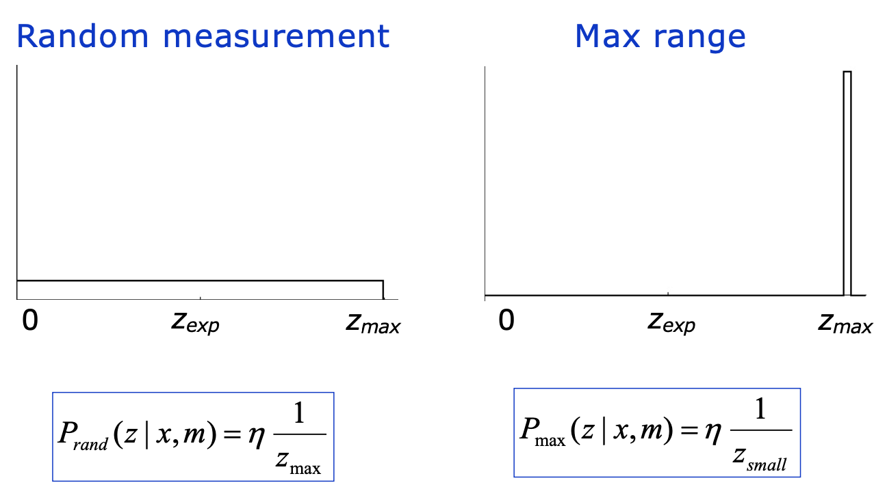
Beam-based proximity model

Slide 43
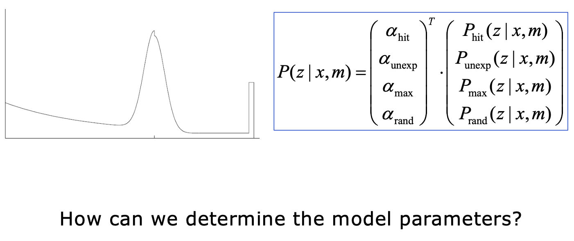
Beam-based proximity model

Slide 44
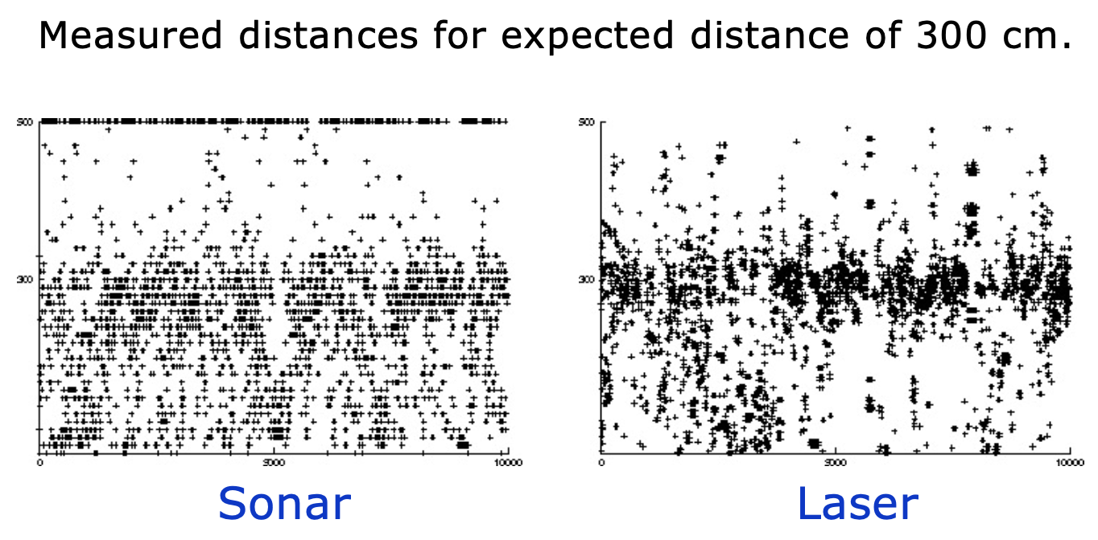
We can collect data for ranges of an object a known distance away

Slide 45
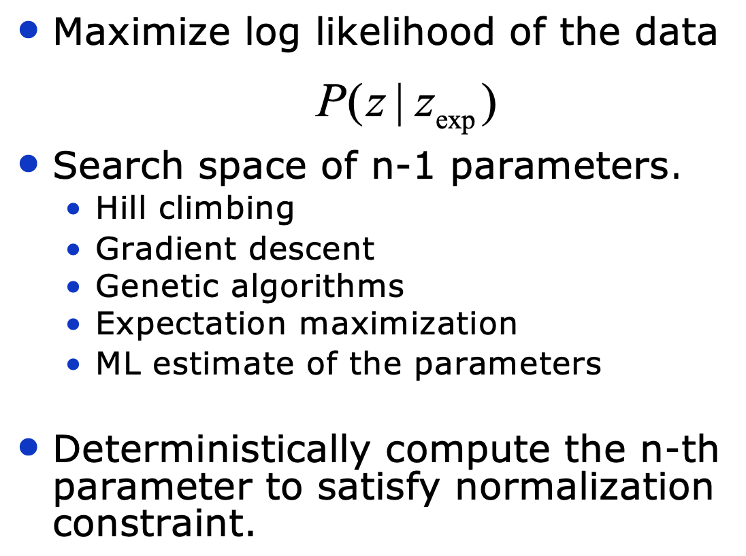
We can determine the model parameters by fitting to the data

Slide 46
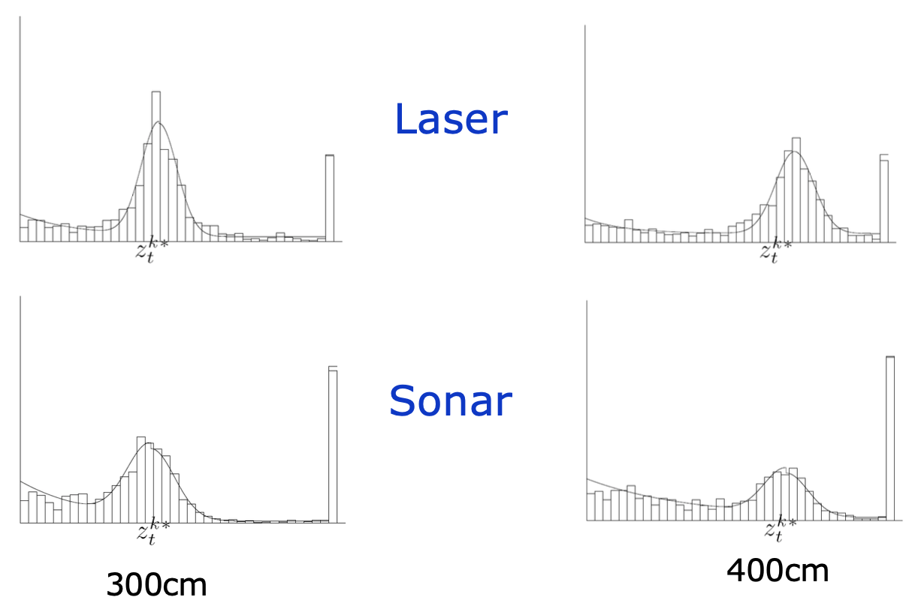
Here are how the model compares to the data:

Slide 47
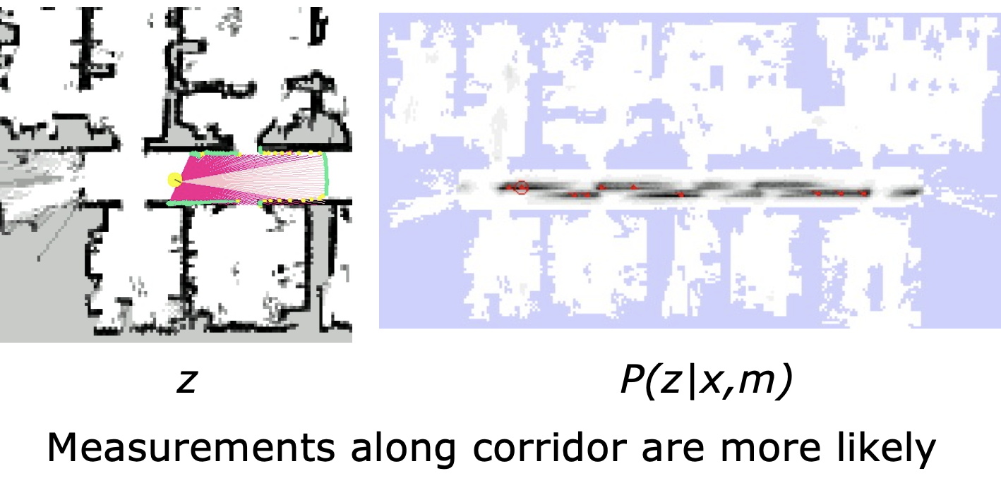
Here are some examples of laser scans in a physical environment

Slide 48
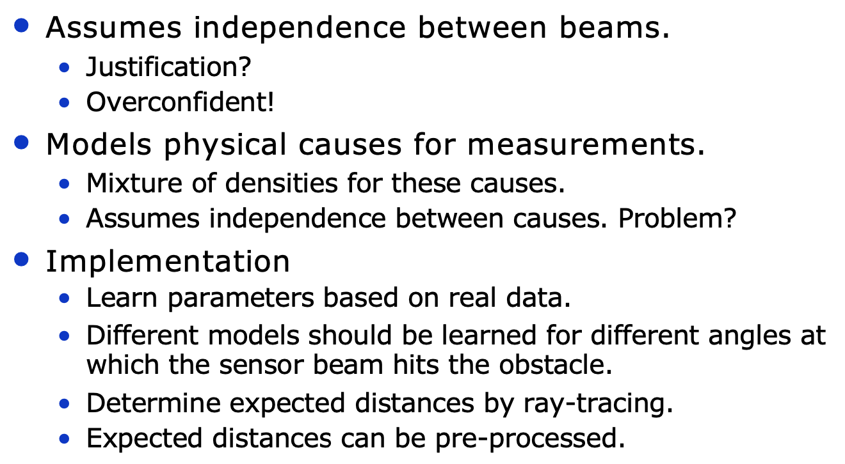
Summary of a beam-based sensor measurement model

Slide 49
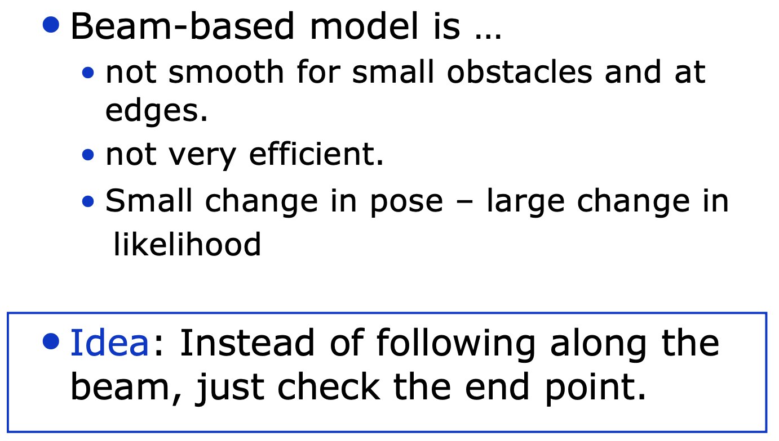
What about a “scan-based” measurement model?

Slide 50
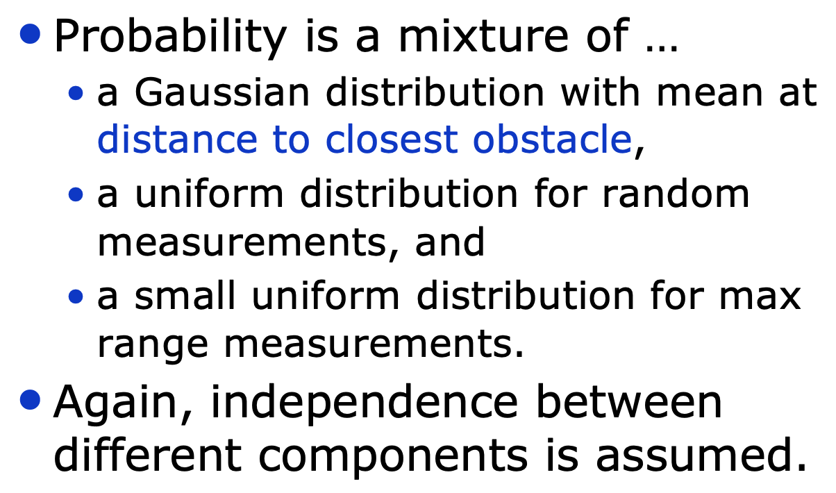
What about a “scan-based” measurement model?

Slide 51
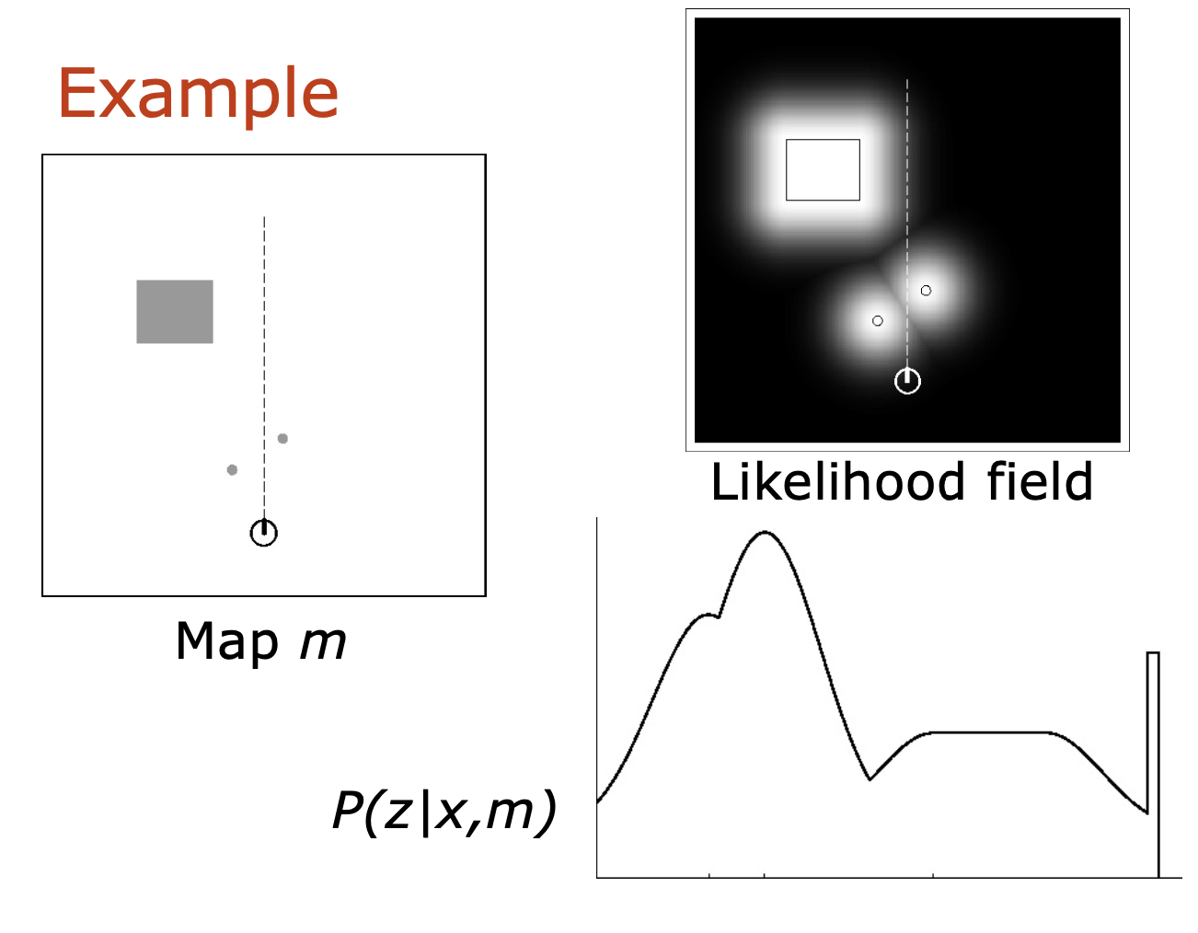
What about a “scan-based” measurement model?

Slide 52
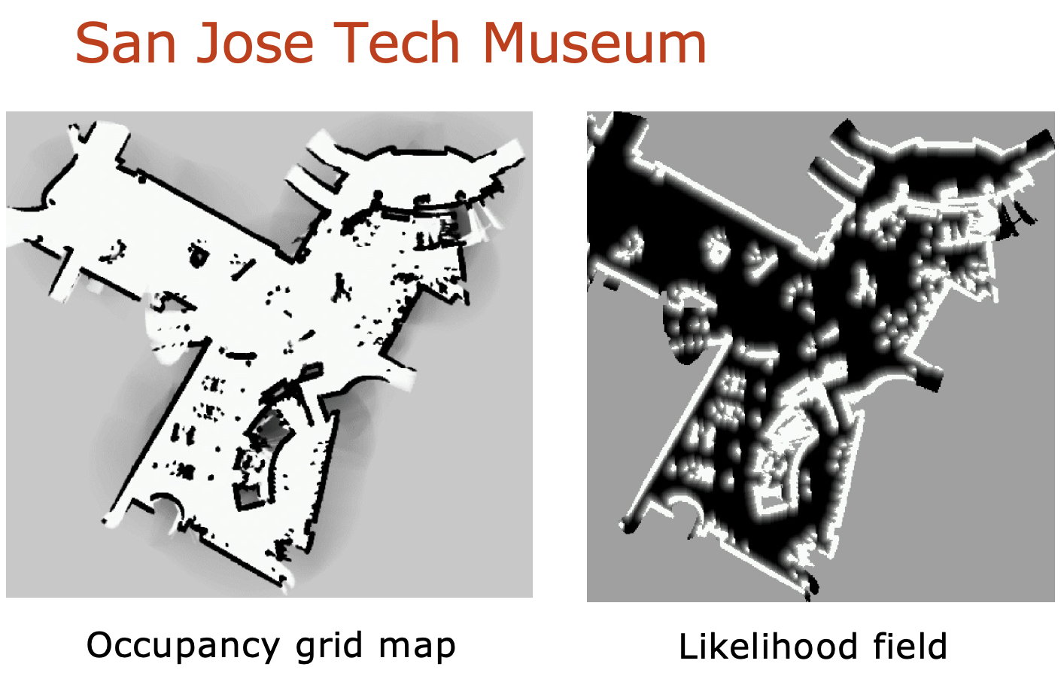
What about a “scan-based” measurement model?

Slide 53
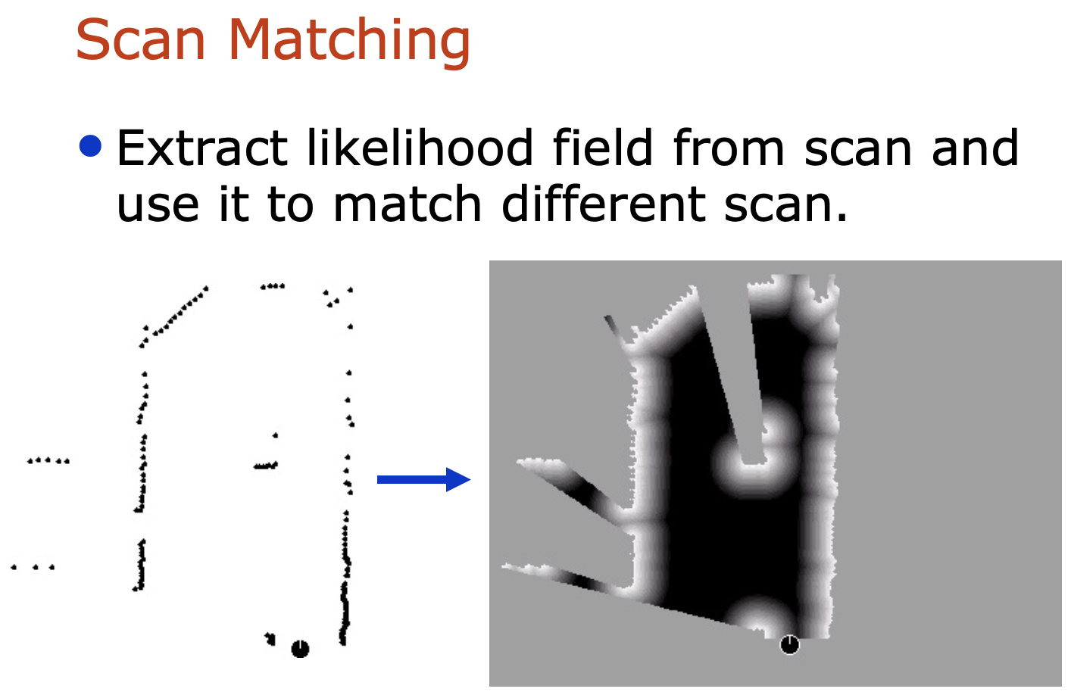
What about a “scan-based” measurement model?

Slide 54
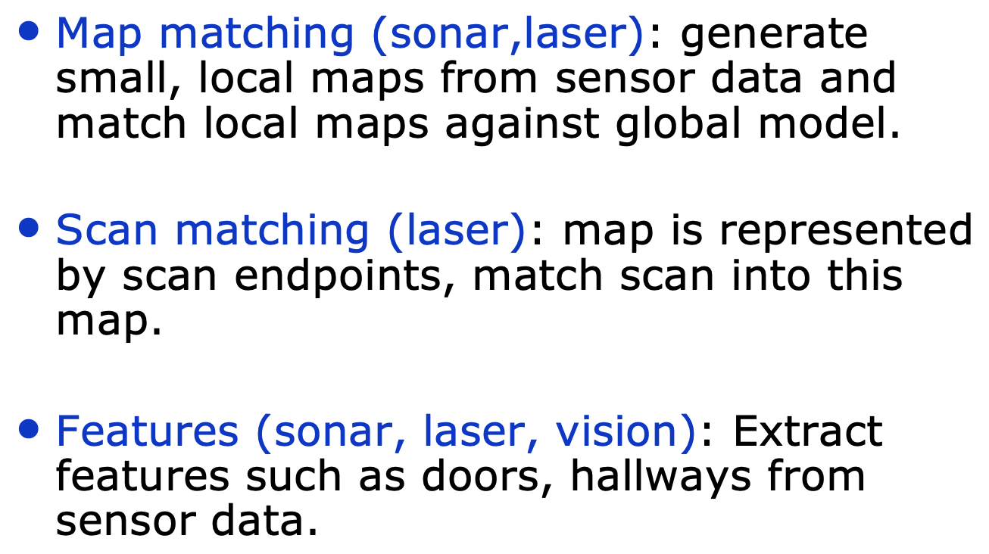
We can use probabilistic sensor models to perform multiple operations we may need:

Slide 55
Will the EKF help us with the “Doors” example from earlier?

Slide 56
Will the EKF help us with the “Doors” example from earlier?
Hmm, probably not. We approximate the distribution as being Gaussian, so we’d lose the multi-peaked structure.
Now, we’ll talk more about how to handle more complex probability distributions like these.

Slide 57
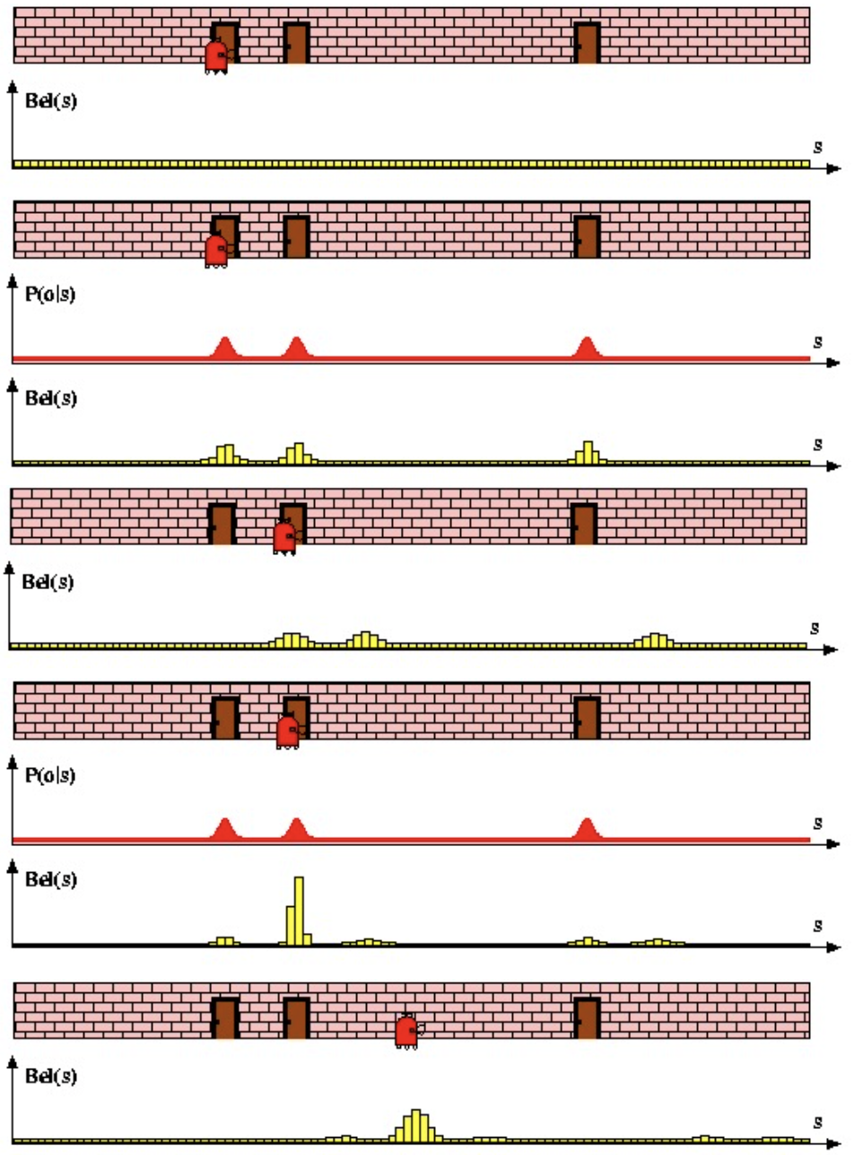
What if we discretize the space?
The Belief can be split into ”buckets” each with some “weight”
Motion “moves” the probability mass around
Measurements update the belief.
[Same as before, but no longer continuous.]

Slide 58
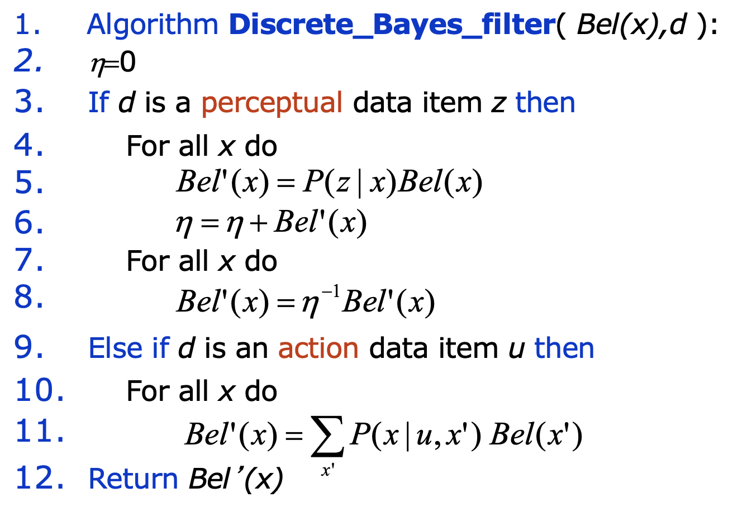
What if we discretize the space?
The Belief can be split into ”buckets” each with some “weight”
Motion “moves” the probability mass around
Measurements update the belief.
[Same as before, but no longer continuous.]

Slide 59
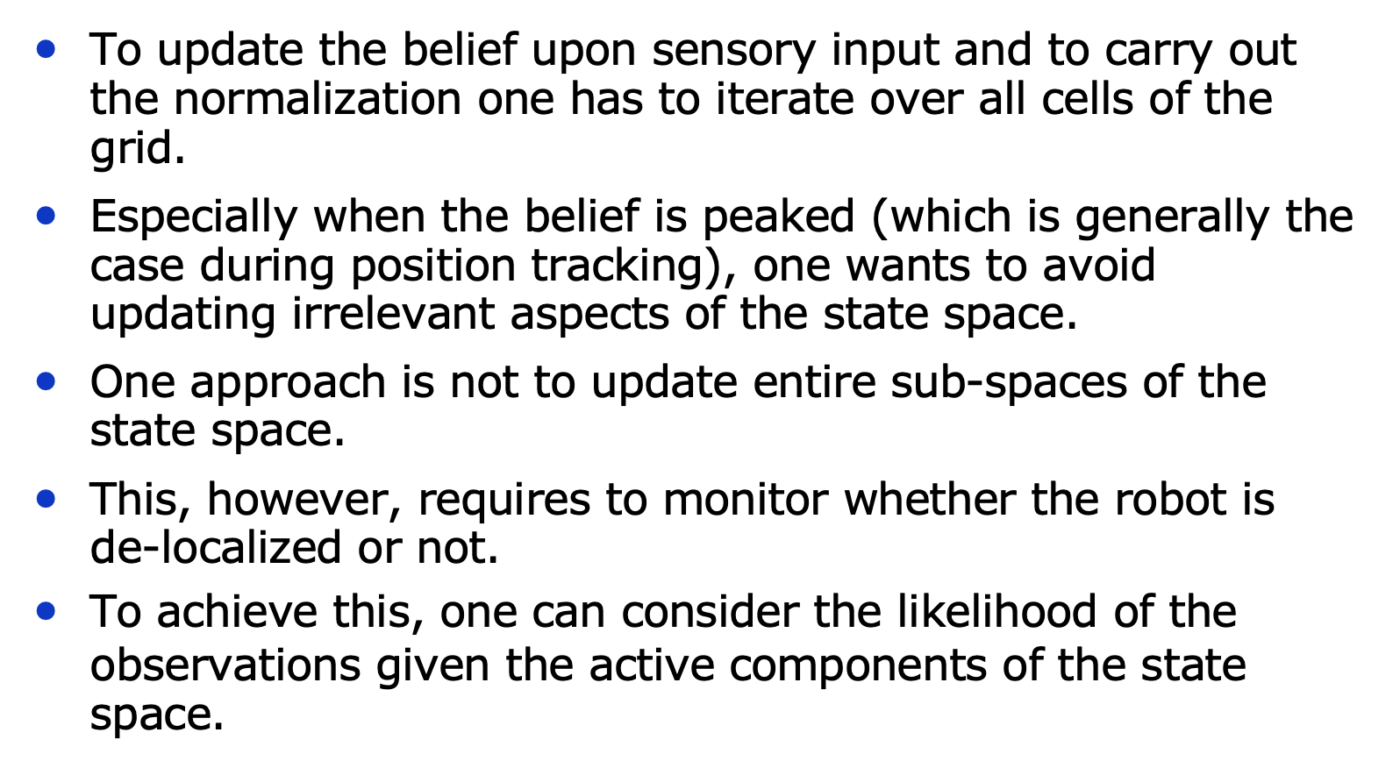
The Discrete Bayes Filter Implementation

Slide 60

Example application: grid-based localization Figure out where we are from scans

Slide 61

Sample-based localization
We get sensor observations and we know how much we move between observations

Slide 62

By getting sensor measurements and connecting them with motion, we can figure out the pose:

Slide 63

Introducing the “Particle Filter”

Slide 64

Particle filter: mathematical formalism

Slide 65

Function approximation using particles

Slide 66

Rejection Sampling

Slide 67

We don’t often want to sample everywhere, so we can use “Importance Sampling”

Slide 68

Particle Filtering Start with a uniform distribution of particles

Slide 69

Particle Filtering We next compute weights from an observation

Slide 70

Particle Filtering We move/update particles using the motion model and resample

Slide 71

Particle Filtering We next compute weights from an observation

Slide 72

Particle Filtering We move/update particles using the motion model and resample

Slide 73

Particle Filter Algorithm

Slide 74

Particle Filter Algorithm

Slide 75

Particle Filter Algorithm

Slide 76

How does resampling work?

Slide 77

Mobile Robot Localization

Slide 78


Mobile Robot Localization
Non-Gaussian Motion Model
Very non-Gaussian sensor model

Slide 79

Particle Filtering Example Start with a uniform particle distribution

Slide 80

Particle Filtering Example Get an observation

Slide 81

Particle Filtering Example Move and resample

Slide 82

Particle Filtering Example Get an observation

Slide 83

Particle Filtering Example Move and resample

Slide 84

Particle Filtering Example Get an observation

Slide 85

Particle Filtering Example Move and resample

Slide 86

We can do the same thing but with vision Vision-based localization

Slide 87

Vision-based localization Observation: Under a light

Slide 88

Vision-based localization Observation: Next to a light

Slide 89

Vision-based localization Observation: not near a light

Slide 90

Vision-based localization Combined we can figure out where we are

Slide 91

Limitations of particle filtering

Slide 92

Approaches to deal with limitations

Slide 93

Particle Filters

Slide 94

Particle Filter Localization

