Slide 1
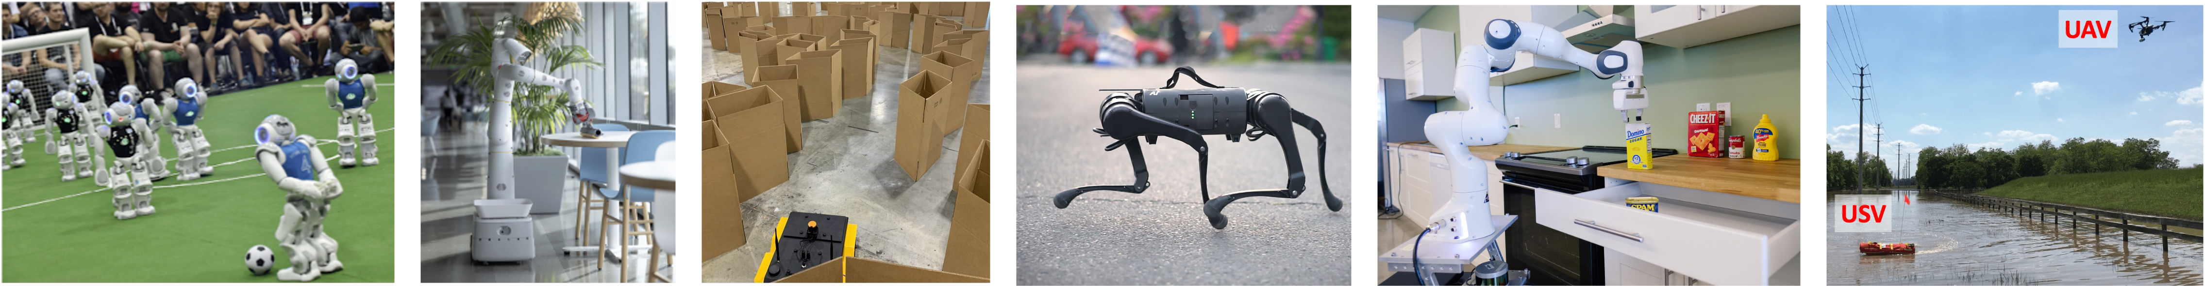
CS 485 Autonomous Robotics
Motion Control II
Prof. Xuesu Xiao
George Mason University
Slides Credits: Gregory Stein

Slide 2
Logistics
The BARN Challenge team formation has finished:
  Team 1
  Team 2
  Team 3 (Team Serpens)
  Team 4 (Junes)
  Team 5 (WALL-F)
  Team 6 (DeepSee)
  Team 7 (Go Robots)
  Team 8 (Autobots)
How many teams have successfully launched The BARN Challenge?

Slide 3
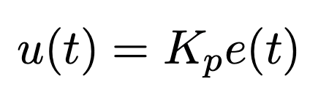
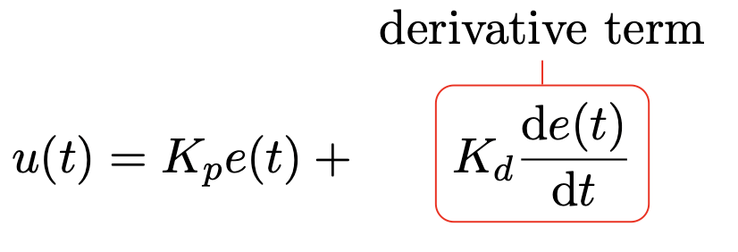
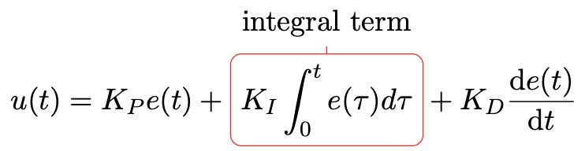
PID Controller

Slide 4
Now let’s look at some more complex systems

Slide 5
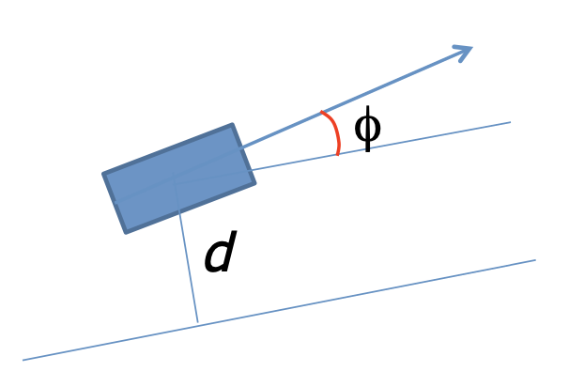
Let’s look at another example for a simple line-following robot
The robot with pose (x, y, θ) moves at a constant velocity v, and we can control the angular velocity ω (the “turnrate”)
From: https://www.cse.sc.edu/~yiannisr/574/2015/Lectures/14-Control.pdf

Slide 6
Let’s look at another example for a simple line-following robot
Consider two error measures
  d
  Φ
The orientation error is used to estimate when we are heading too much in the wrong direction
The distance error is what we feed to our controller
From: https://www.cse.sc.edu/~yiannisr/574/2015/Lectures/14-Control.pdf

Slide 7
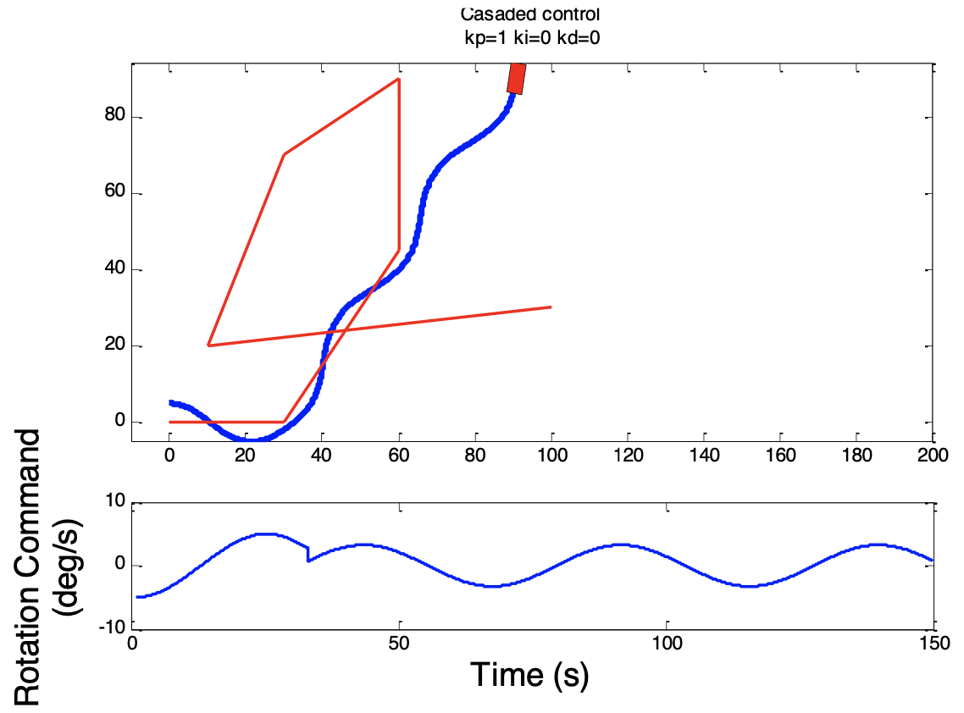
Let’s look at another example for a simple line-following robot: P control
Low proportional gain
From: https://www.cse.sc.edu/~yiannisr/574/2015/Lectures/14-Control.pdf

Slide 8
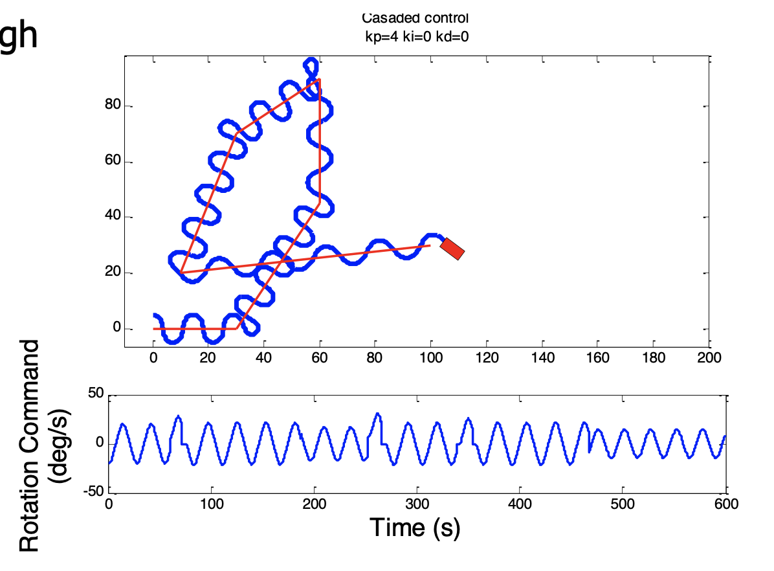
Let’s look at another example for a simple line-following robot: P control
Medium proportional gain
From: https://www.cse.sc.edu/~yiannisr/574/2015/Lectures/14-Control.pdf

Slide 9
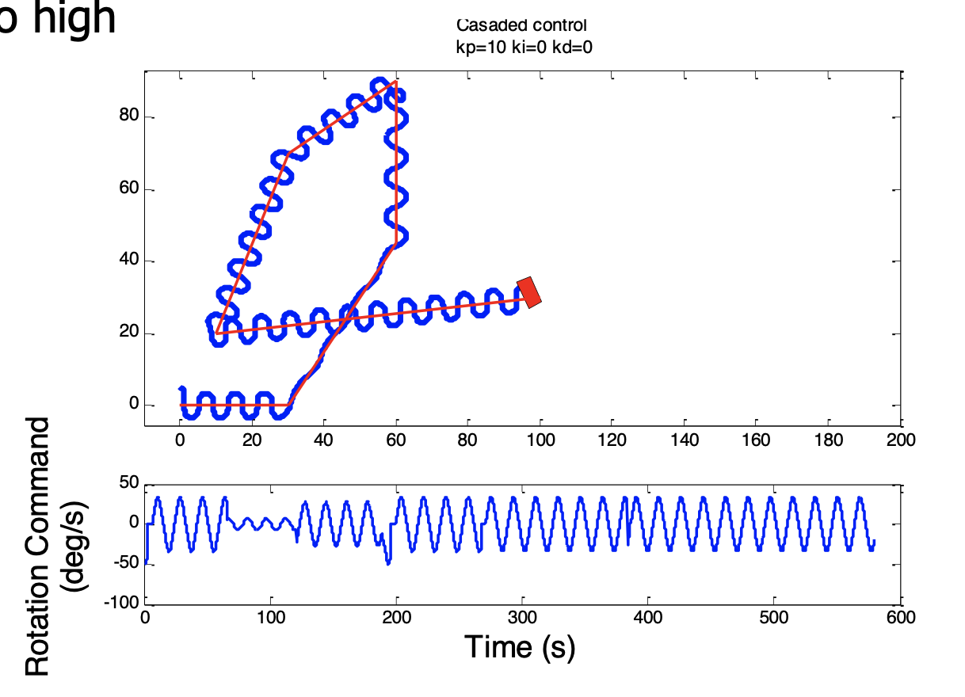
Let’s look at another example for a simple line-following robot: P control
High proportional gain
From: https://www.cse.sc.edu/~yiannisr/574/2015/Lectures/14-Control.pdf

Slide 10
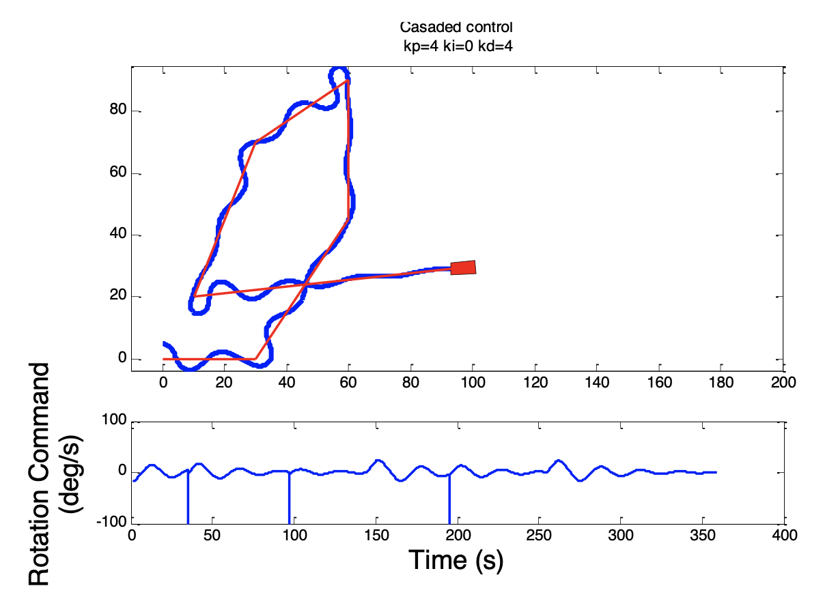
Let’s look at another example for a simple line-following robot: PD control
From: https://www.cse.sc.edu/~yiannisr/574/2015/Lectures/14-Control.pdf

Slide 11
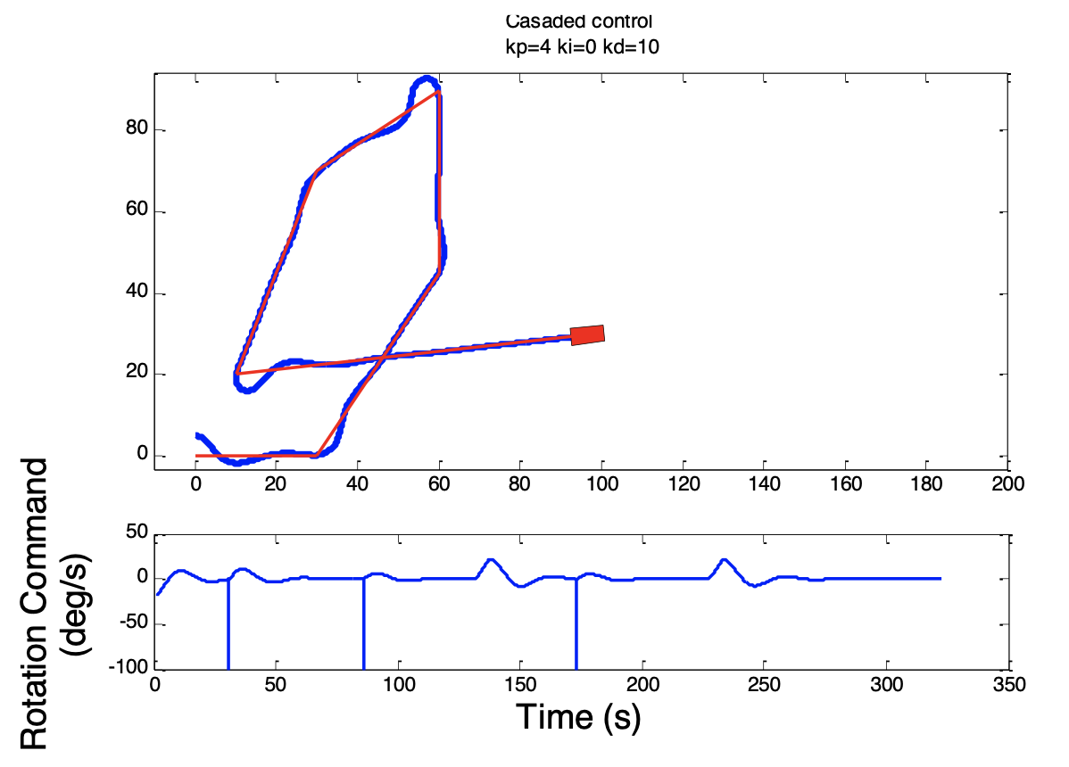
Let’s look at another example for a simple line-following robot: PD control
From: https://www.cse.sc.edu/~yiannisr/574/2015/Lectures/14-Control.pdf

Slide 12
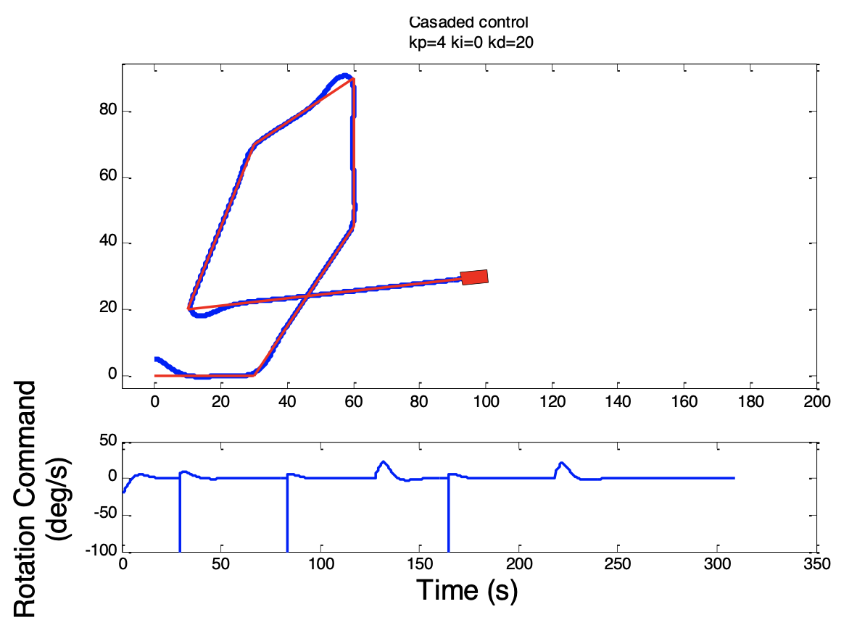
Let’s look at another example for a simple line-following robot: PD control
From: https://www.cse.sc.edu/~yiannisr/574/2015/Lectures/14-Control.pdf

Slide 13
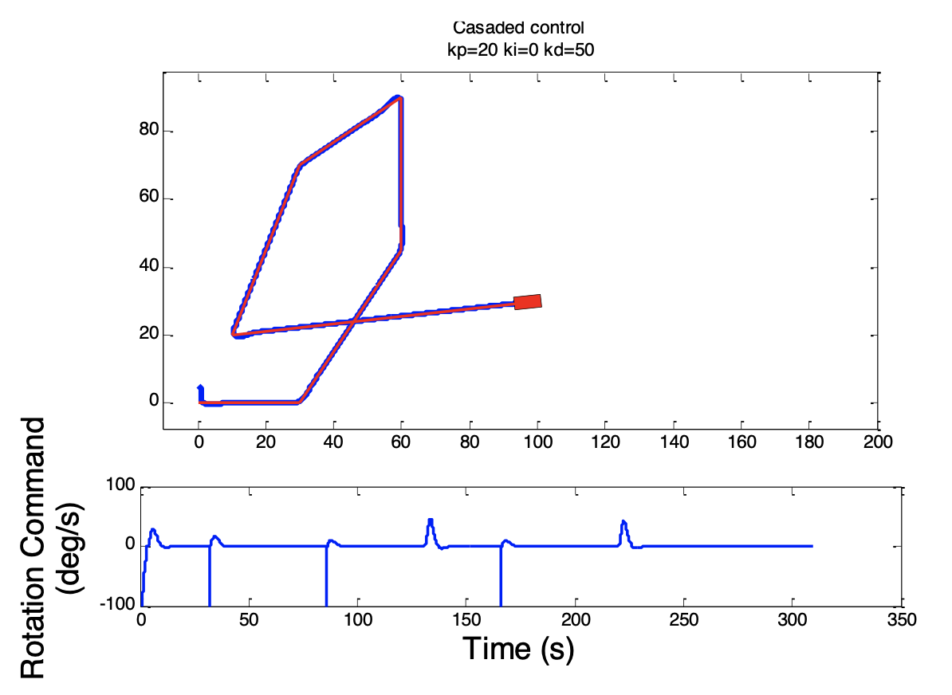
Let’s look at another example for a simple line-following robot: PD control
From: https://www.cse.sc.edu/~yiannisr/574/2015/Lectures/14-Control.pdf

Slide 14
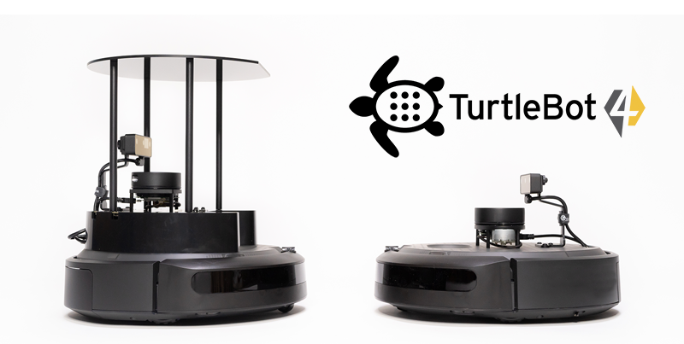
So far all our systems have been (effectively) 1 dimensional
Even for the two wheeled robot earlier, the controller was able to command only the one turnrate control.
Let’s consider that we can specify the turnrate and the speed of the robot or, framed another way, the rotation rate of each wheel of this differential drive robot.

Slide 15
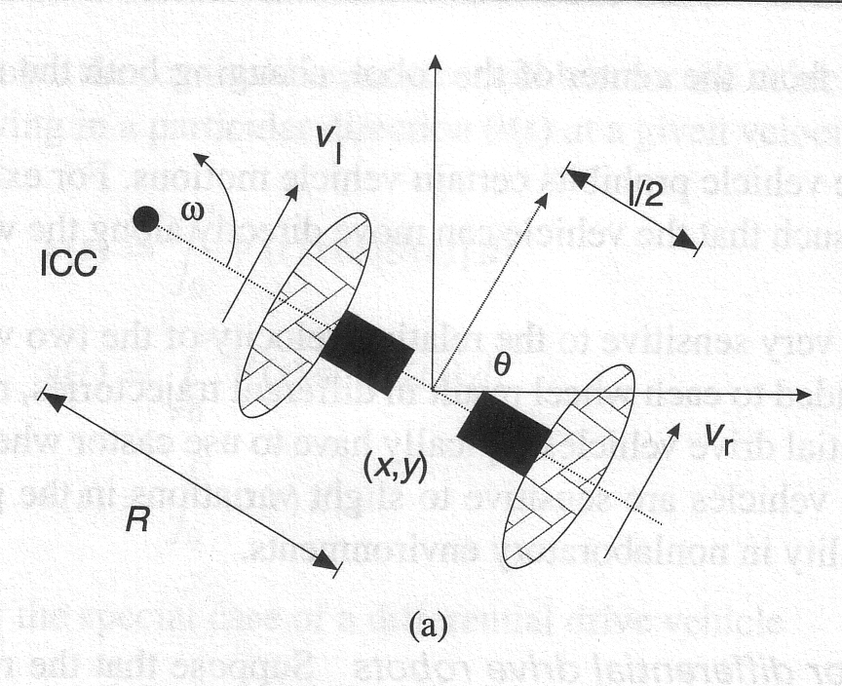
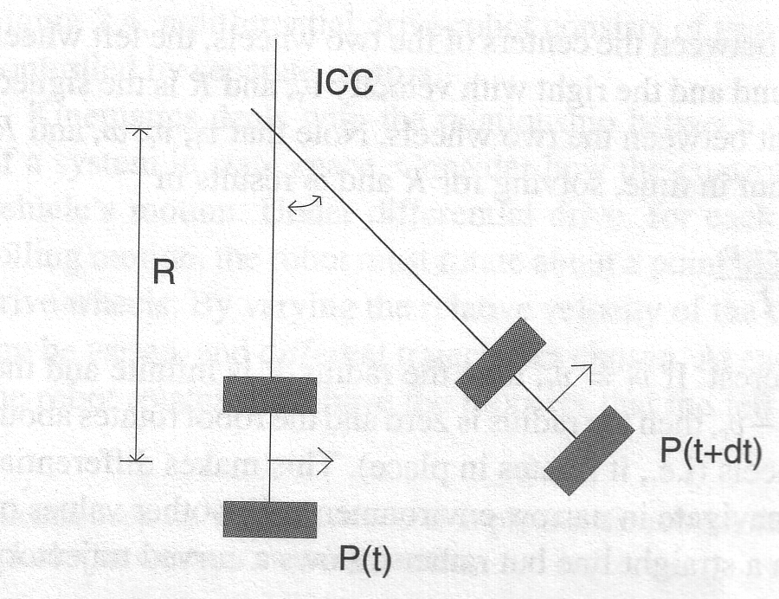
The Differential Drive Robot
A differential drive robot has two wheels separated by some length (l) about a center of mass.
As the wheels turn, the robot can both move and rotate.
If both wheels move at the same rate, the robot moves in a straight line.
If not, the robot orbits a point known as the “Instantaneous Center of Curvature” a distance R away along the axis of the wheels.
Differential Drive kinematics from Dudek and Jenkin, Computational Principles of Mobile Robotics.
From: https://www.cs.columbia.edu/~allen/F17/NOTES/icckinematics.pdf

Slide 16
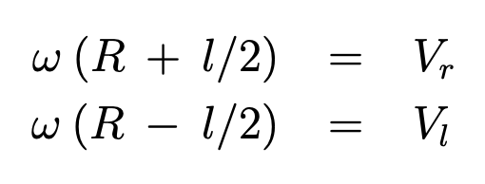
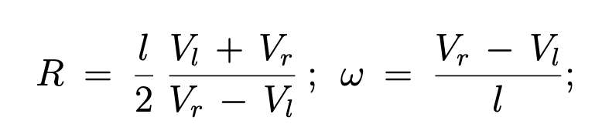
We can relate the rotation rate of the wheels to the movement of the robot
Both R and the rotation rate (about the ICC) are as follows:
So that:
The linear velocity of the robot is proportional to the sum of the wheel rotation rates. (In fact, is the average of the two.)
The rotational velocity of the robot is proportional to the difference of the rotation rates.
From: https://www.cs.columbia.edu/~allen/F17/NOTES/icckinematics.pdf

Slide 17
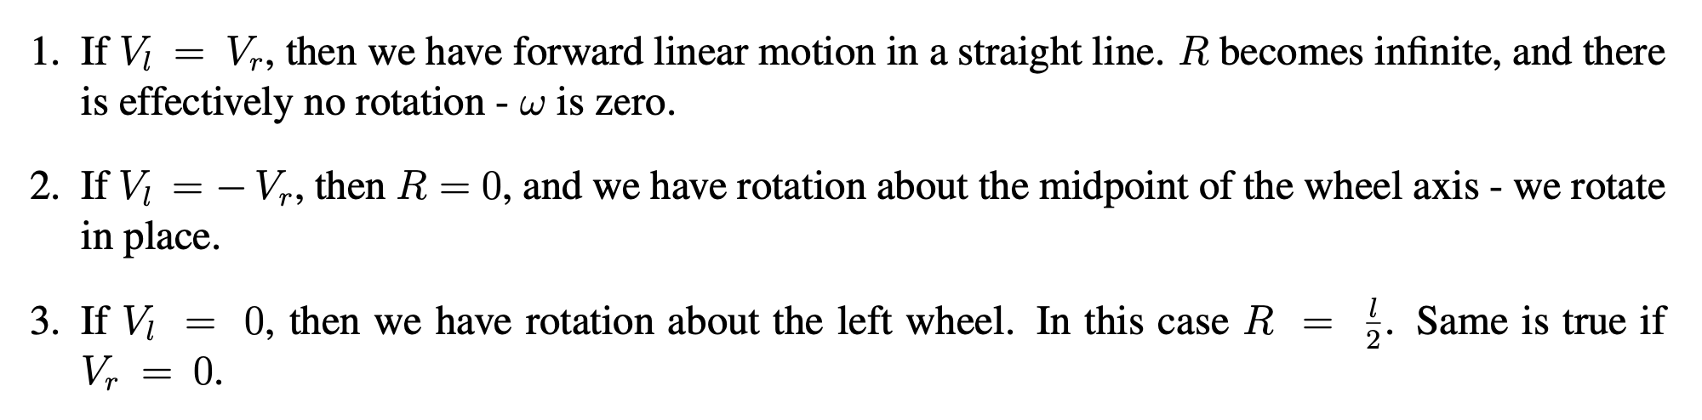
We can relate the rotation rate of the wheels to the movement of the robot
Both R and the rotation rate (about the ICC) are as follows:
So that:
The linear velocity of the robot is proportional to the sum of the wheel rotation rates. (In fact, is the average of the two.)
The rotational velocity of the robot is proportional to the difference of the rotation rates.
From: https://www.cs.columbia.edu/~allen/F17/NOTES/icckinematics.pdf

Slide 18
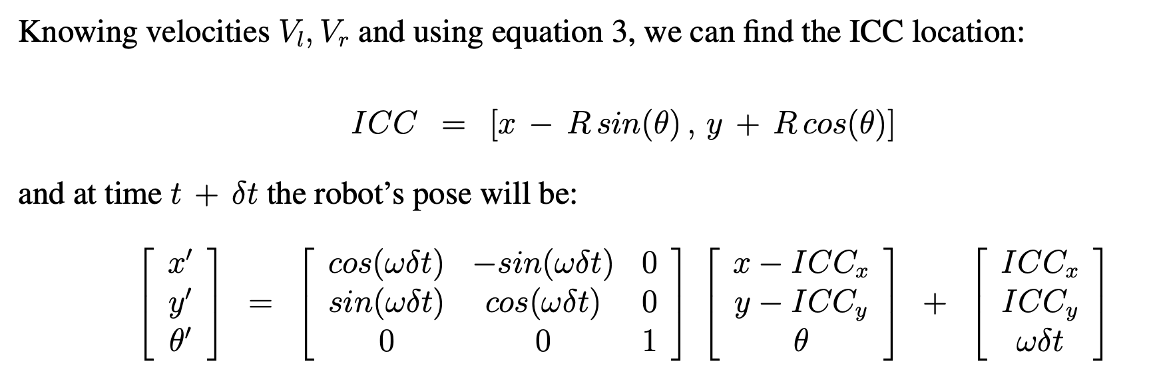
The position of the robot can be determined via some transformations
From: https://www.cs.columbia.edu/~allen/F17/NOTES/icckinematics.pdf

Slide 19
The controller of a differential drive robot must command both wheel velocities
Controlling the wheel velocities is inconvenient, so we’ll think instead about w and v the angular and linear velocities.
Similar to our previous 1D controller:
  The angular velocity should be proportional to the deviation from the direction the robot should be heading.
  The linear velocity should be proportional to the distance from that point.
From: https://w3.cs.jmu.edu/molloykp/teaching/cs354/cs354_2021Fall/resources/pid.pdf

Slide 20
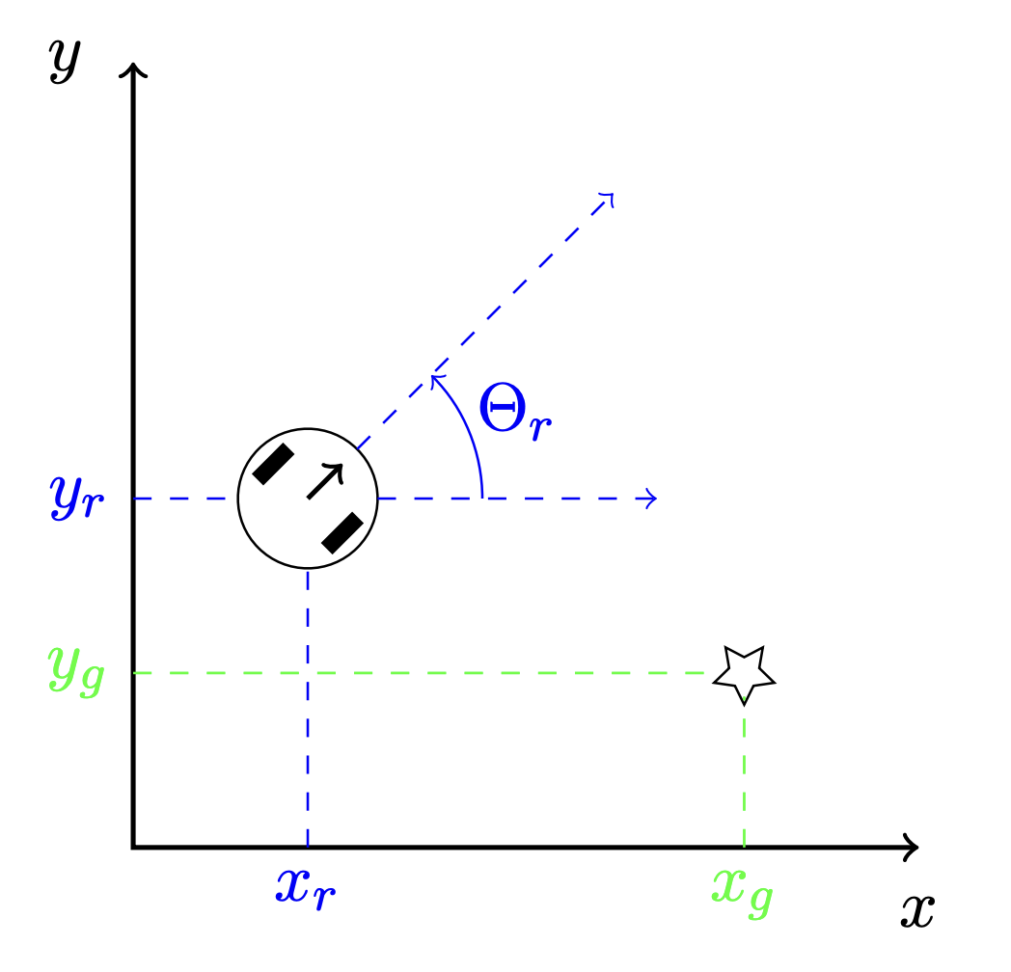
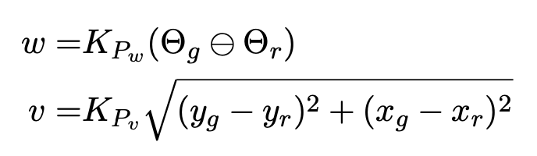
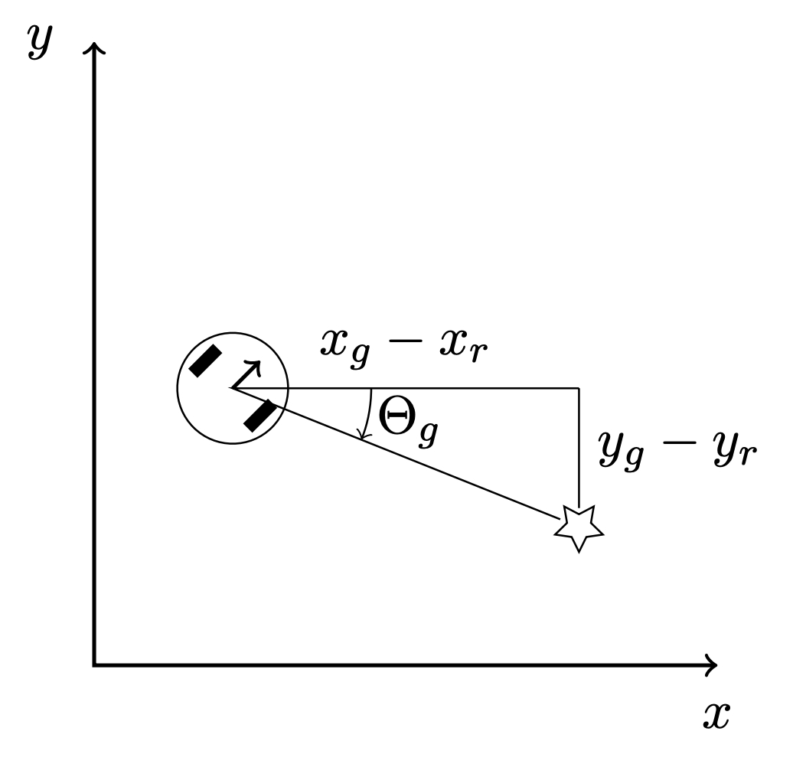
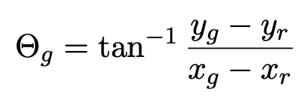
The controller of a differential drive robot must command both wheel velocities
From: https://w3.cs.jmu.edu/molloykp/teaching/cs354/cs354_2021Fall/resources/pid.pdf

Slide 21
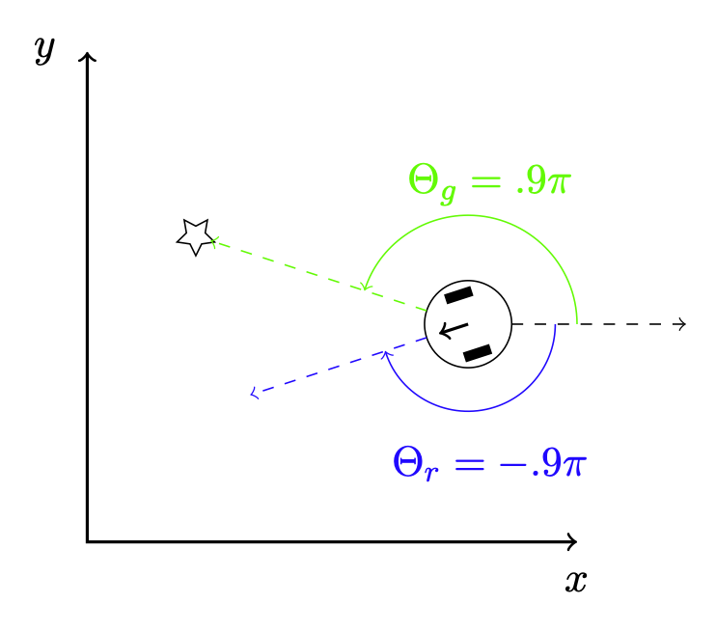
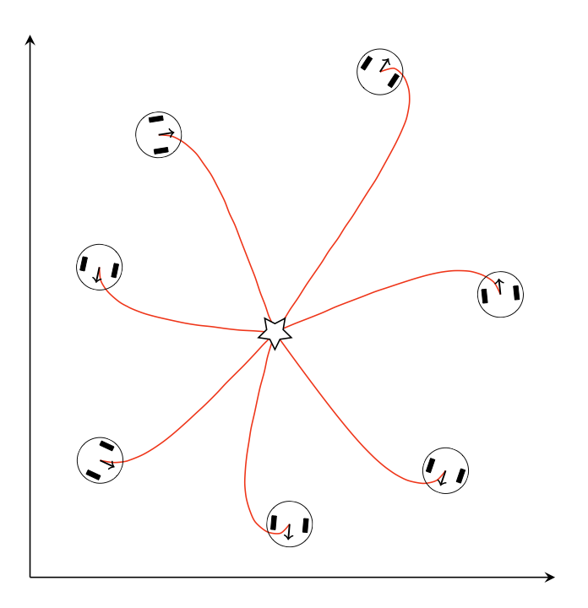
Note: be careful about commanding angles
You should be sure to keep in mind that angle “wraps around”. You don’t want to spin 350˚ just to turn what could have been a 10˚ turn.
Also, don’t forget to use arctan2 to get the sign right!
From: https://w3.cs.jmu.edu/molloykp/teaching/cs354/cs354_2021Fall/resources/pid.pdf

Slide 22
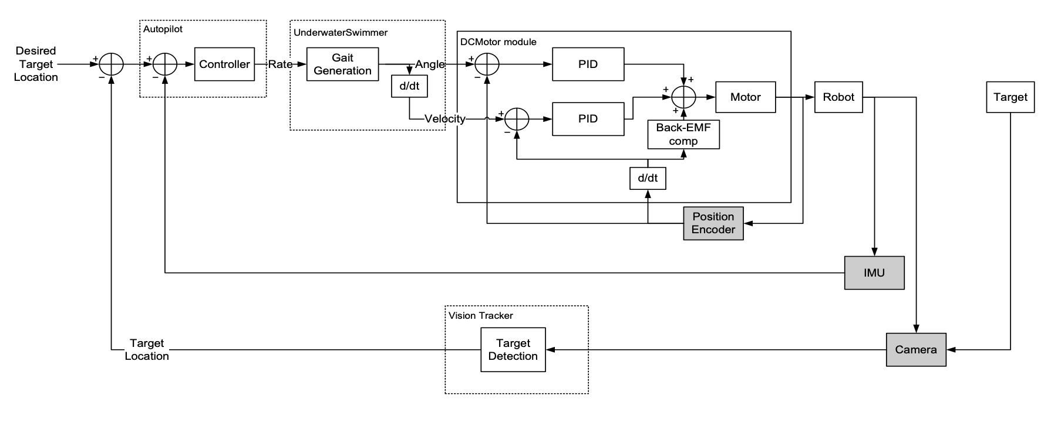
More complex systems will have multiple controllers, each a different “levels”
Inner control loops are typically faster than the outer ones
From: https://www.cse.sc.edu/~yiannisr/574/2015/Lectures/14-Control.pdf

Slide 23
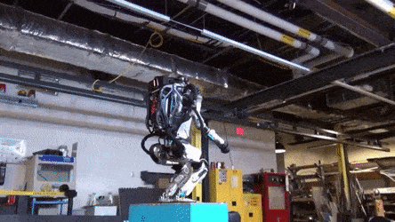
Boston Dynamics is known for their impressive robots and robot controllers
Atlas weighs 89kg / 190 lbs. (The old one seen at the DRC weighed nearly twice as much.)

Slide 24
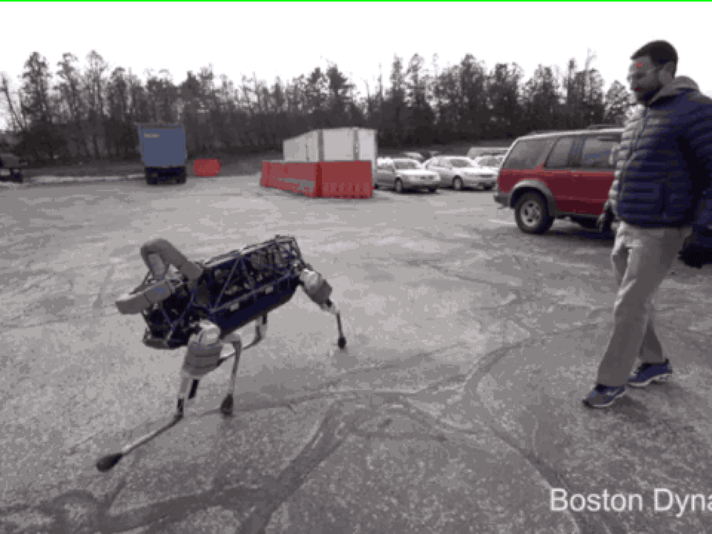
Boston Dynamics is known for their impressive robots and robot controllers
Atlas weighs 89kg / 190 lbs. (The old one seen at the DRC weighed nearly twice as much.)
From: https://www.theverge.com/2015/2/12/8028905/i-really-dont-think-we-should-be-kicking-the-robots

Slide 25
Things to think about…
Have we considered any specifics about the robot at all?
Other than the error e(t), what else have we considered?
Is this good or bad?

Slide 26
Finally, PID is not the only type of controller
If we knew more about our system, in principle we could do a better job at controlling it (and without the need to tune parameters through mere observation).
Enter: Linear Quadratic Regulation

Slide 27
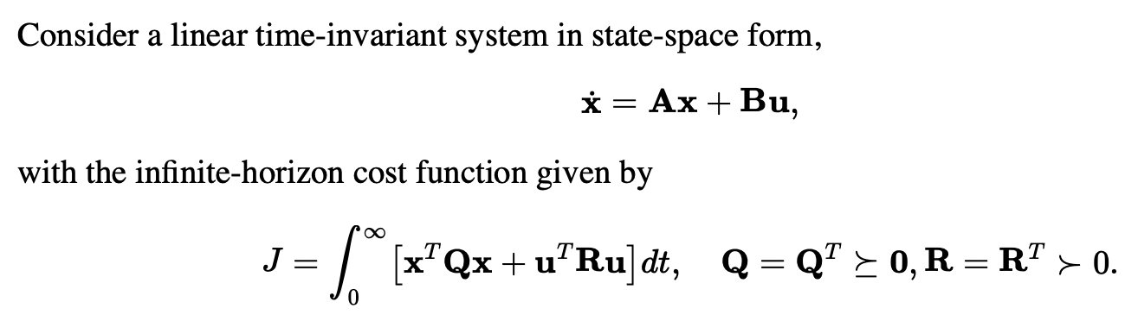
Linear Quadratic Regulation
Optimal Infinite-Horizon Control for Linear Systems
From: http://underactuated.mit.edu/lqr.html

Slide 28


What’s cool is that by taking a derivative of the cost, we can find an optimal policy
The derivation is beyond the scope of this course, but we can solve for the optimal policy for any x
Where we must solve the algebraic Riccati equation to get the value of the matrix S:
For a linear system, we need only solve this equation once and then we have an optimal control policy to reach the origin (in some coordinate frame), where u is proportional to x.
From: http://underactuated.mit.edu/lqr.html

Slide 29
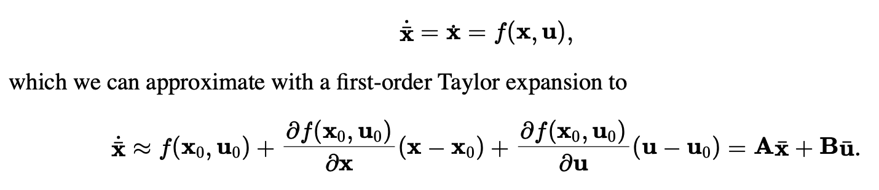
What about nonlinear systems?
We can locally control nonlinear systems by linearizing them.
This is something that will come up again later on in the class when we talk about Kalman Filtering.
The general idea is to use a Taylor series expansion to come up with a linear “best fit” line (tangent line) and approximate the nonlinear function with a line and then solve that:
However, we must now solve this at every step.
From: http://underactuated.mit.edu/lqr.html

Slide 30
What about time?
There are many extensions to LQR to support:
  Time-varying systems
  Discrete-time systems
  Finite-horizon control problems
  All of which seek to minimize the total cost for their respective problems.
LQR is a big deal! It’s been massively influential because of how general the concepts are and its use for approximately, locally controlling nonlinear systems as well.

Slide 31
Stability Analysis
Just for a bit, since it’s fascinating, but mostly out of scope for the class

Slide 32
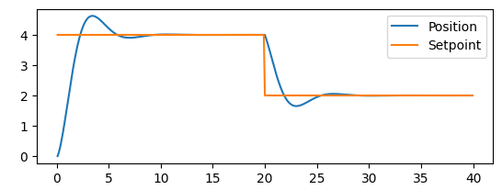
What does stability mean for a controller?
Let’s look at this example from before:
As time goes on, the oscillations are damped and the system converges to the set point.
Will this always be true? Stability analysis aims to understand.

Slide 33
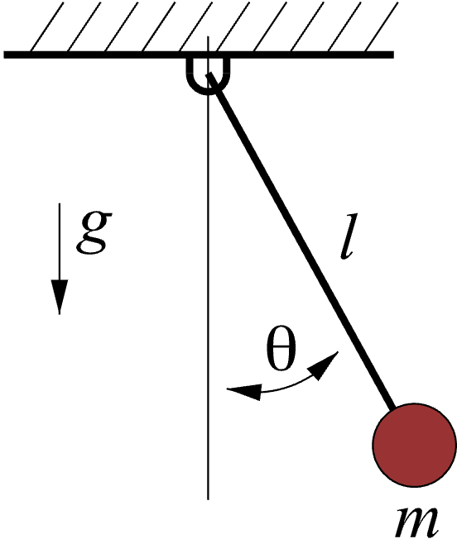
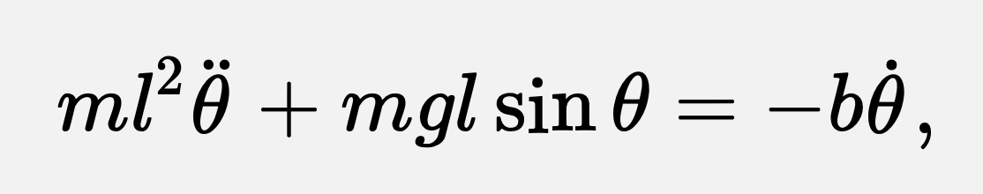
To understand this idea, we’ll look at a similar system: a damped pendulum
We have a pendulum with some small damping term. The equation of motion looks like this:
What will happen over time?
The pendulum will swing and the damping (e.g., some air resistance or friction in the joint at the top) will cause it to slow down.
Asymptotically, the pendulum will come to rest at the bottom.
From: https://underactuated.mit.edu/lyapunov.html

Slide 34
To understand this idea, we’ll look at a similar system: a damped pendulum
We have a pendulum with some small damping term. The equation of motion looks like this:
What will happen over time?
The pendulum will swing and the damping (e.g., some air resistance or friction in the joint at the top) will cause it to slow down.
Asymptotically, the pendulum will come to rest at the bottom.
The pendulum slowly loses energy and settles at a fixed (stable) point at the bottom.
We can apply a similar idea to test the stability of a controller.
From: https://underactuated.mit.edu/lyapunov.html

Slide 35
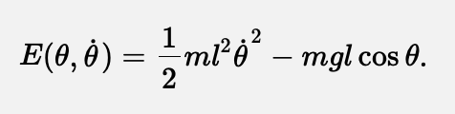
To understand this idea, we’ll look at a similar system: a damped pendulum
We cannot solve for the behavior of the pendulum analytically! But we can still understand it by analyzing its energy:
From: https://underactuated.mit.edu/lyapunov.html

Slide 36
To understand this idea, we’ll look at a similar system: a damped pendulum
Without any damping, the pendulum will always keep oscillating
When damped, the system will “decay” to the fixed (equilibrium) point at the bottom of the swing: the state of minimum energy.
From: https://underactuated.mit.edu/lyapunov.html

Slide 37
Note that we saw some similar behavior in our system
Without any damping term, we oscillated forever, but with damping we converted to the set point:
When we change the set point, the point around which we can claim stability changes, but the idea is the same.

Slide 38
Lyapunov Analysis: making claims about the system without explicitly modeling it
Idea: If we can come up with a function that behaves like our energy function and dissipates over time (called a “Lyapunov Function”, satisfying some specific criteria about decay over time), we can say the system is locally stable about that fixed point.
While outside the scope of this class, it’s a powerful idea that allows us to make claims about trajectories the system will follow without actually simulating the system.
This can let us (or someone else…) prove things about the asymptotic properties of a control policy.

Slide 39
For more details…
See Russ Tedrake’s amazing Underactuated Robotics textbook
He also discusses some other applications of Lyapunov analysis including how one can measure the region around a stable point to which a controller will stabilize the system to that point.
Russ has some pretty cool work on understanding how and when a controller will stabilize a system and the limits to which this works.

Slide 40
So that’s control (in a nutshell)
What can’t we do with a controller?

Slide 41
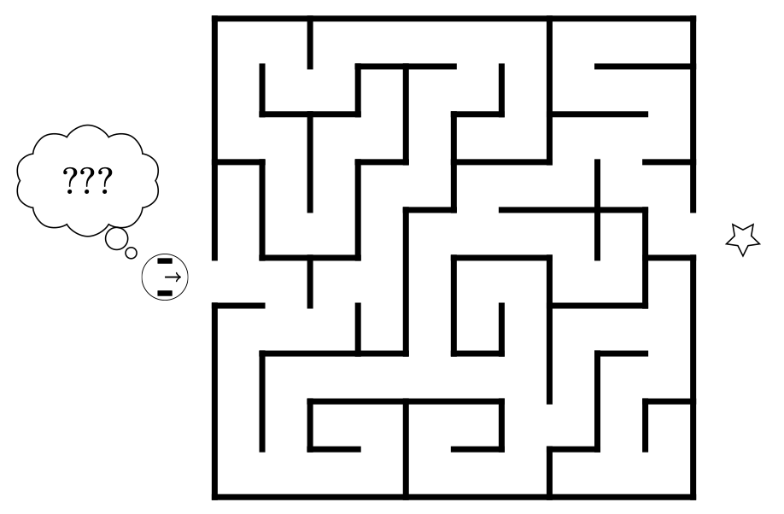
So that’s control (in a nutshell)
What can’t we do with a controller?
What about this?
For this we’ll need planning.
From: https://w3.cs.jmu.edu/molloykp/teaching/cs354/cs354_2021Fall/resources/pid.pdf

